Slide 1


Predictive maintenance of bearing shells
Univ.-Prof. Dr. Elmar Rueckert
M.Sc. Linus Nwankwo
January, 2026
Chair of Cyber-Physical-Systems

Slide 2
Motivation
Journal bearing failures cause high maintenance costs and downtime.
Friction behavior is a key indicator of bearing condition, but it is difficult to model due to noisy and interacting sensor signals.
Machine learning can help capture these relationships.

Slide 3
Research Question
Can machine learning models predict the coefficient of friction from sensor data, and which model performs better?

Slide 4
Data and Problem
Dataset - Journal Bearing Adapter experiments.
Measurements: torque, load, speed, temperature, and acoustic emission.
Task - regression problem with the coefficient of friction as the target variable.

Slide 5
Method
The data was preprocessed and normalized, and physically motivated features were engineered. Two regression models were trained and compared:
Random Forest
MLP
Model performance was evaluated using RMSE, MAE, and R².

Slide 6
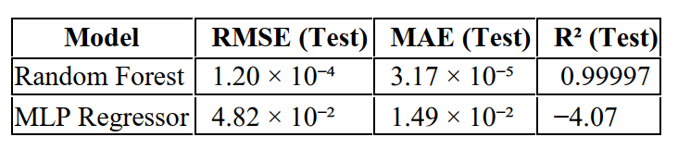
Results
Random Forest model - very high accuracy on the test set (R² ≈ 0.99997). MLP model - poor generalization with negative R². Feature importance analysis showed torque as the dominant predictor, which matches physical expectations.
Random Forest clearly outperforms MLP on all metrics.
Model performance on test dataset

Slide 7

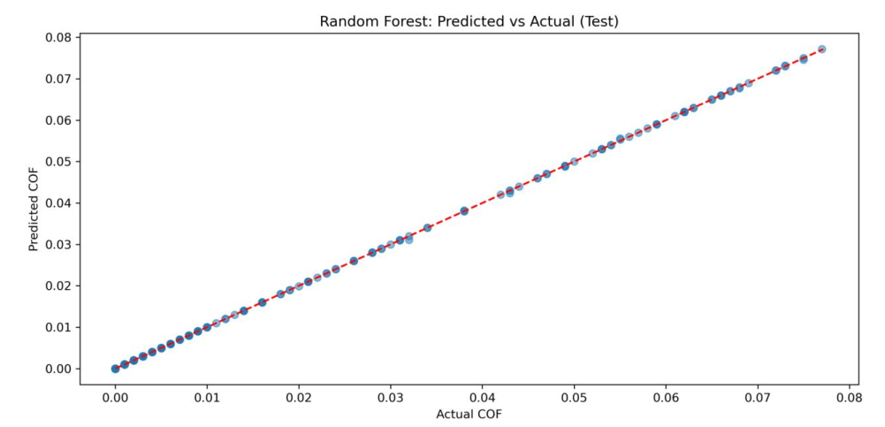
The predictions match the actual values, indicating very high accuracy.
Random Forest: Predicted vs Actual COF

Slide 8
Conclusion
Random Forest is well suited for friction prediction in this dataset. Direct bearing failure prediction was not possible due to limited wear variability, but accurate friction prediction is a meaningful step toward predictive maintenance.

Slide 9
Thank You for the Attention!
Student, Dipl.-Ing. Angela Dineva

