Slide 1
Prototype Long COVID model
Ângela Jornada Ben, Elizabeth Berghuis-Mutubuki, Johanna M. van Dongen, Idah Kinya, Welcome Wami, Gershim Asiki, Isaac Kisinagani, Menno D. de Jong, Judith E. Bosmans, Constance Schultsz, Anna Vassal

Slide 2

. . .
4 weeks
12 weeks
Acute
Long COVID
Mod
LCOVD
Survive
Mild
LCOVID
Severe
LCOVID
Asymp
Mild/
Mod
Severe
Critical
Recover
COVID-19 infection
PCR +
Die
Model adjustment
National statistics:
Vaccination coverage
Primary care coverage
HIV
Obesity
National life tables
Acute: Signs and symptoms of COVID‑19 for up to 4 weeks.
Long COVID: Signs and symptoms that continue or develop after acute COVID‑19. It includes both ongoing symptomatic COVID‑19 (from 4 to 12 weeks) and post‑COVID‑19 syndrome (12 weeks or more).
¹ COVID-19 rapid guideline: managing the long-term effects of COVID-19. NICE 2022

Slide 3
Transition probability matrix (mock data)
 | asymp | Mild/mod COVID-19 | Severe COVID-19 | Critical COVID-19 | Mild LCOVID | Mod LCOVID | Severe LCOVID | Recover | Dead*
asymp | 0 | 0 | 0 | 0 | 0.1 | 0.01 | 0.001 | 0.88 | 0.01
Mild/mod COVID-19 | 0 | 0 | 0.1 | 0 | 0.15 | 0.05 | 0.001 | 0.69 | 0.01
Severe COVID-19 | 0 | 0 | 0 | 0.03 | 0.1 | 0.2 | 0.15 | 0.50 | 0.02
Critical COVID-19 | 0 | 0 | 0 | 0 | 0.05 | 0.20 | 0.25 | 0.47 | 0.03
Mild LCOVID | 0 | 0 | 0 | 0 | 0.3 | 0.01 | 0.001 | 0.68 | 0.01
Mod LCOVID | 0 | 0 | 0 | 0 | 0.4 | 0.2 | 0.02 | 0.37 | 0.01
Sev LCOVID | 0 | 0 | 0 | 0 | 0.2 | 0.4 | 0.1 | 0.29 | 0.01
Recover | 0 | 0 | 0 | 0 | 0.1 | 0.01 | 0.001 | 0.88 | 0.01
Dead | 0 | 0 | 0 | 0 | 0 | 0 | 0 | 0 | 1
*The probability of dying will vary according to the age category described in slide 5
Transition probabilities will also be adjusted according to the ORs described in slide 6

Slide 4
Payoff (mock data)
health state | Lost productivity costs | QALY | Disability weights²
asymp | 10 | 0.95 | 0
mild.mod_COV | 800 | 0.65 | 0.051
sev_COV | 1500 | 0.45 | 0.133
crit_COV | 3000 | 0.1 | 0.655
mild_LCOV | 800 | 0.65 | 0.219
mod_LCOV | 1500 | 0.45
sev_LCOV | 3000 | 0.1
Recovery | 0 | 0.95
Death | 0 | 0
² European Burden of Disease Network

Slide 5
Probability of dying by age in Kenya (WHO 2019)
Indicator | Age category | Total | Male | Female
nqx - probability of dying between ages x and x+n | <1 year | 0.032815 | 0.036014 | 0.029515
nqx - probability of dying between ages x and x+n | 1-4 years | 0.011818 | 0.012449 | 0.011174
nqx - probability of dying between ages x and x+n | 5-9 years | 0.005325 | 0.005611 | 0.005034
nqx - probability of dying between ages x and x+n | 10-14 years | 0.004569 | 0.005323 | 0.003802
nqx - probability of dying between ages x and x+n | 15-19 years | 0.006581 | 0.007947 | 0.0052
nqx - probability of dying between ages x and x+n | 20-24 years | 0.008674 | 0.010232 | 0.007114
nqx - probability of dying between ages x and x+n | 25-29 years | 0.011237 | 0.011722 | 0.010758
nqx - probability of dying between ages x and x+n | 30-34 years | 0.01613 | 0.016371 | 0.015893
nqx - probability of dying between ages x and x+n | 35-39 years | 0.023913 | 0.025427 | 0.022429
nqx - probability of dying between ages x and x+n | 40-44 years | 0.034011 | 0.037654 | 0.030441
nqx - probability of dying between ages x and x+n | 45-49 years | 0.045804 | 0.052389 | 0.039376
nqx - probability of dying between ages x and x+n | 50-54 years | 0.059453 | 0.070931 | 0.048429
nqx - probability of dying between ages x and x+n | 55-59 years | 0.076052 | 0.094529 | 0.05893
nqx - probability of dying between ages x and x+n | 60-64 years | 0.10423 | 0.131324 | 0.080406
nqx - probability of dying between ages x and x+n | 65-69 years | 0.144191 | 0.179452 | 0.115219
nqx - probability of dying between ages x and x+n | 70-74 years | 0.212602 | 0.255346 | 0.179978
nqx - probability of dying between ages x and x+n | 75-79 years | 0.306535 | 0.353963 | 0.274077
nqx - probability of dying between ages x and x+n | 80-84 years | 0.439941 | 0.490045 | 0.40998
nqx - probability of dying between ages x and x+n | 85+ years | 1 | 1 | 1

Slide 6
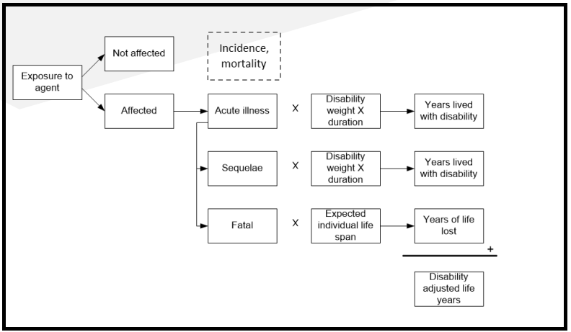
DALYs model

