Slide 1
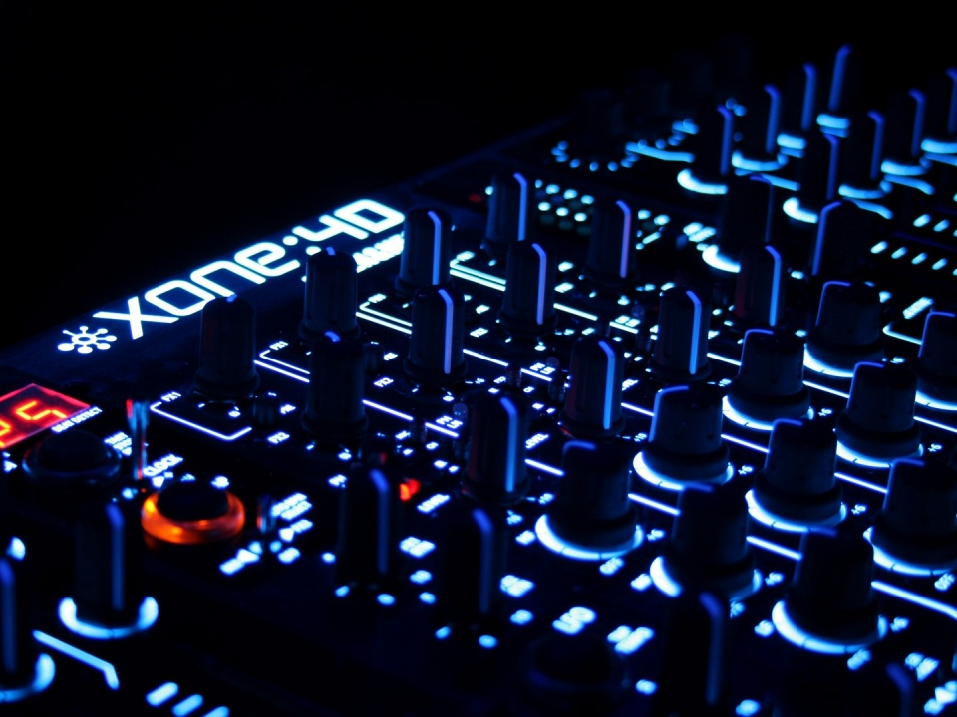
electronic music

Slide 2
electronic music
Has a long history dating back to late 1800’s-used in avant guard or new, edgy music at the time
Has crossed over into classical, pop and hip hop genres
Modern electronic music begins in the 1970’s
Electronic dance music has many subgenres including: dub step, techno, house, trance, and ambient

Slide 3
What makes an instrument solely electronic?

Slide 4
It doesn’t have any hammers, strings or reeds to help it vibrate. The music is made by the sound board inside the machine.

Slide 5
electronic music instruments
Keyboard Synthesizers: electronic keyboards. Used in multiple genres of music. Became popular in the 1970’s. Which rock song we listened to in class had this instrument featured at the beginning?
Computers: used in music starting in the 1950’s. Make music using built in instruments. For example, Apple computers have GarageBand, a program that makes music by using loops and software instruments. (8th graders start this unit next week)

Slide 6
History of electronic music
Link: https://youtu.be/daT0F0lfDBs (stop at 5:48)
What is a synthesizer?
What brand name of synthesizer does the video talk about?
What other types of music that we listened to have synthesizers?

Slide 7
synthesizer video #1
The man in the video shows us different ways to play the Microkorg synthesizer
While you’re watching think about:
What different ways can he create and change the sound?
https://youtu.be/fHtc67hDPLo?t=36s

Slide 8
synthesizer video #2
https://youtu.be/J9wzev494_k
Discussion Questions:

Slide 9

dubstep
Originated in South London in the 1990’s.
Roots in Jamaican music such as reggae
Lots of sub bass sounds (low bass)-bass makes a wub wub sound
Skrillex

Slide 10
techno
Started in mid-late 1980’s in Detroit, Michigan
Usually all instrumental: often use retro drum machines from the 1980’s to get an authentic sound
Mechanical machine like sound
4 steady beats in a measure: Bass drum plays a steady quarter note beat, snare drum on beats 2 and 4, high hat cymbals on eighth notes

Slide 11
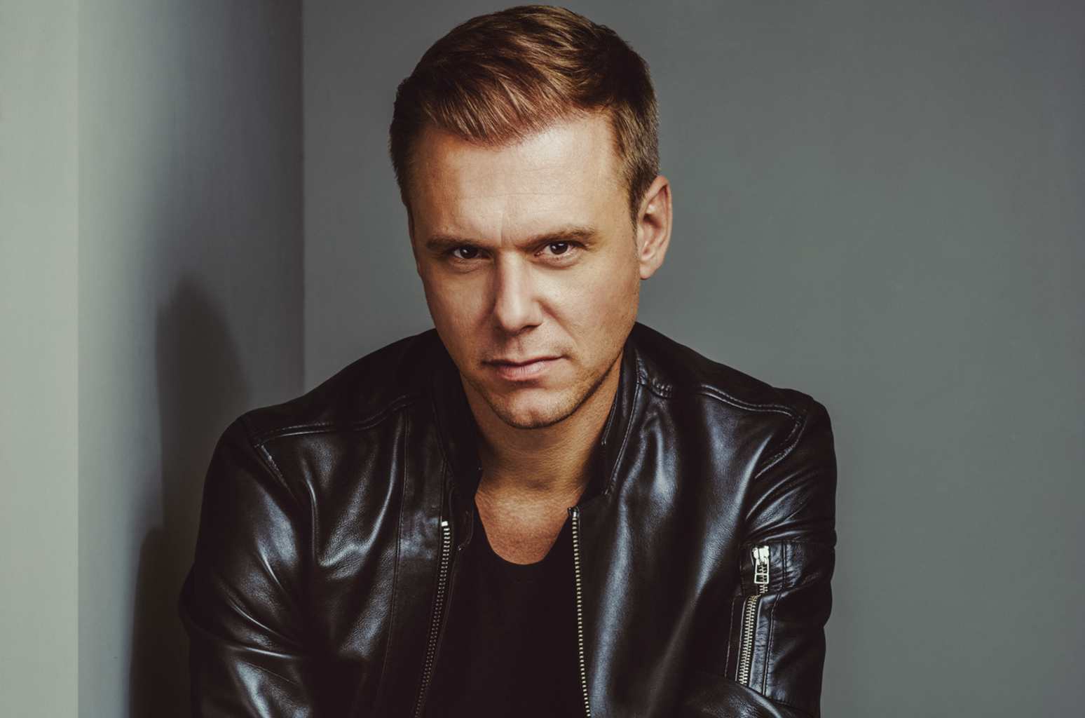
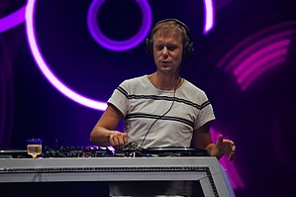
trance
Started in European countries such as Germany in the 1990’s
Has a more melodic sound than techno
Characterized by repeating melodic phrases and a build up and release throughout the song
Can be all instrumental or include vocals
Armin van Buuren

Slide 12
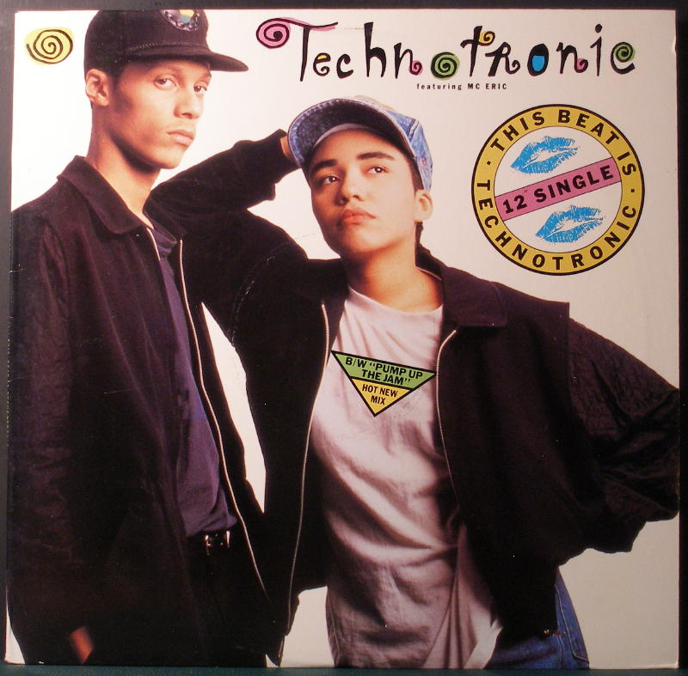
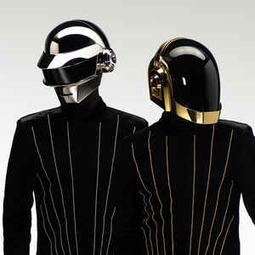
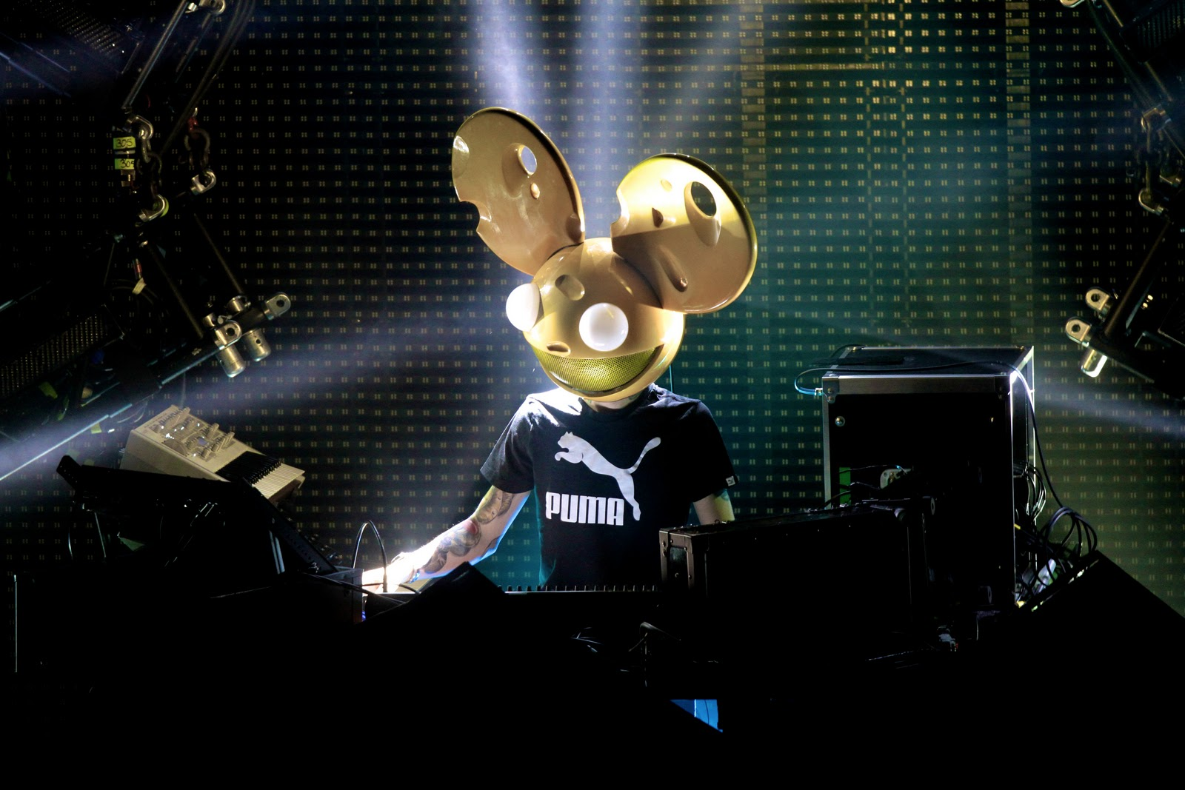
house music
Began in Chicago in the 1980’s-Created by club DJ’s and music producers
Roots in disco-changed to make beat sound more mechanical sounding and lower bass
Sounds: Electronic and minimalistic(short musical ideas that change slowly and gradually), off beat high hat, synthesized bass line
Daft Punk
deadmau5
Tecehnotronic (Jo Bogaert and vocals by Ya Kid K

Slide 13
Electronic music
https://youtu.be/Qm1edxnM8Xc
Stop at :26

Slide 14
which subgenre?
https://youtu.be/KzAEgL026a4
Funny video :)

