Slide 1
Cirrhosis
Survival Prediction
A Neural Network Classification Project
Angela
April 30, 2026
Notes:
For Project A I built a neural network that predicts patient survival for cirrhosis using the Mayo Clinic dataset from our textbook. This is a binary classification problem, and I'm going to walk you through how I cleaned the data, built the model in TensorFlow, and what I found out about whether a tool like this is actually useful.

Slide 2
Overview
Goal: predict patient survival from clinical features
Dataset: cirrhosis.csv — 418 patients, 20 columns
Binary classification: survived (1) vs. died (0)
Built a feed-forward neural network in TensorFlow / Keras
418
Patients
20
Features used
2
Output classes
Cirrhosis Survival Prediction
2 / 10
Notes:
The dataset comes from a real Mayo Clinic trial and contains 418 patient records with 20 columns covering demographics, lab values, and clinical signs. The goal is to predict survival as a binary outcome: did the patient die during the trial, or did they survive or get censored. I built this as a feed-forward neural network in TensorFlow and Keras, which is a good fit for tabular clinical data with mixed numerical and categorical features.

Slide 3
Data Prep
Cleaning & Encoding Steps
1
Drop missing rows
418 → 276 patients with complete data
2
Drop unused columns
ID, N_Days, Status, Drug
3
One-hot encode
Edema column (Y / N / S categories)
4
Map binary text
Sex F→1, M→0 | Y→1, N→0
5
Define target y
Status: 'D' → 0 (died), else → 1 (survived)
6
Convert all to float
ready for the neural network
Cirrhosis Survival Prediction
3 / 10
Notes:
Cleaning was actually a bigger part of this project than building the model. There were six steps: dropping rows with any missing values, removing the four columns that the project spec said to exclude, one-hot encoding the Edema column because it had three categories instead of two, mapping the binary text fields like Sex and Yes/No to ones and zeros, defining the target variable from the Status column, and converting everything to float. After all of that the data was ready to feed into the network.

Slide 4
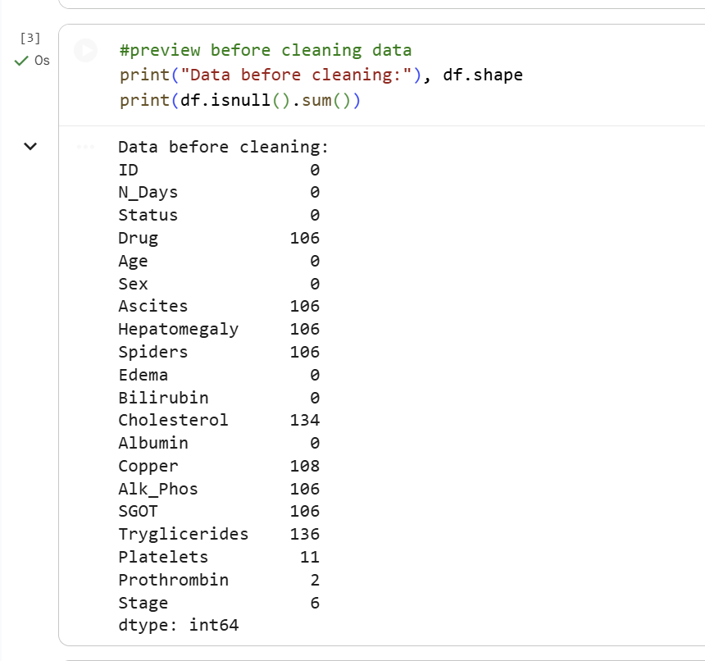
4 / 10
Notes:
Before I dropped anything I checked the missing-value counts to see what we were working with. You can see most columns had over 100 missing entries, mostly in the lab values like Cholesterol, Copper, and Triglycerides. I chose to drop rows rather than impute because the project spec asked us to, and because imputation on small clinical datasets can introduce bias. After dropping, the dataset went from 418 patients down to 276, which is something I want to flag again later.

Slide 5
Training the Model
Architecture
Input
n features
Sequential feed-forward neural network
Input layer matches feature count
2 hidden Dense layers (16 neurons, ReLU)
Output Dense(1) with sigmoid → probability
Dense(16)
ReLU
Dense(16)
ReLU
Training Setup
Optimizer: Adam | Loss: binary_crossentropy
80 / 20 train-test split (random_state = 42)
Features scaled with StandardScaler
Trained for 10 epochs
Dense(1)
Sigmoid
Cirrhosis Survival Prediction
5 / 10
Notes:
The architecture is intentionally simple. I have an input layer matching the feature count, two hidden Dense layers with 16 neurons each using ReLU activation, and a single sigmoid output that returns a probability between 0 and 1. ReLU is the standard choice for hidden layers because it handles nonlinear patterns without the gradient problems older activations have. For training I used the Adam optimizer, binary cross-entropy loss because this is a yes-or-no prediction, an 80/20 train-test split with a fixed random state for reproducibility, and StandardScaler so the features were all on the same scale.

Slide 6
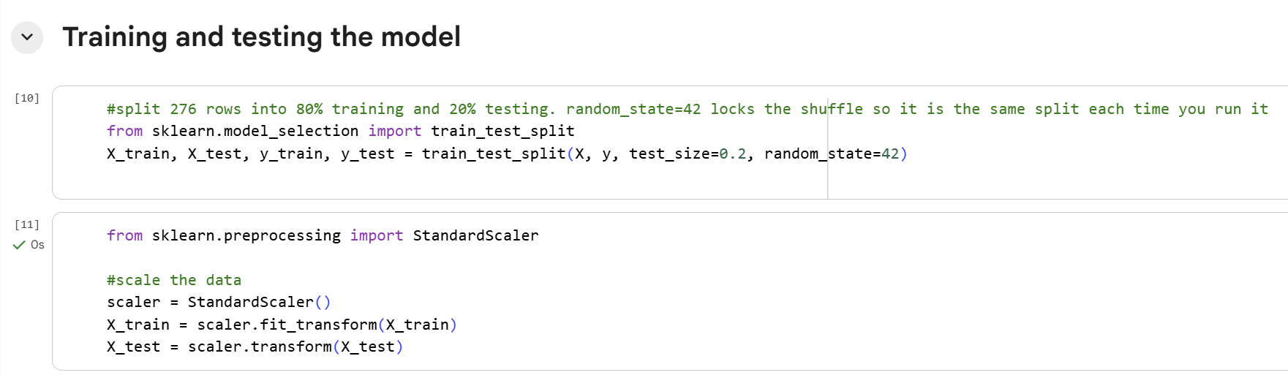
6 / 10
Notes:
Quick walk-through of the splitting and scaling. The 80/20 split gave me 220 patients to train on and 56 to test. I locked the random state to 42 so the split is the same every time I rerun, which made debugging much easier. The reason scaling matters here is that the features cover wildly different ranges. Age is in days, so it spans tens of thousands. Bilirubin is in milligrams per deciliter and rarely goes above 20. Without scaling, the bigger numbers would dominate the gradient updates and slow training down.

Slide 7
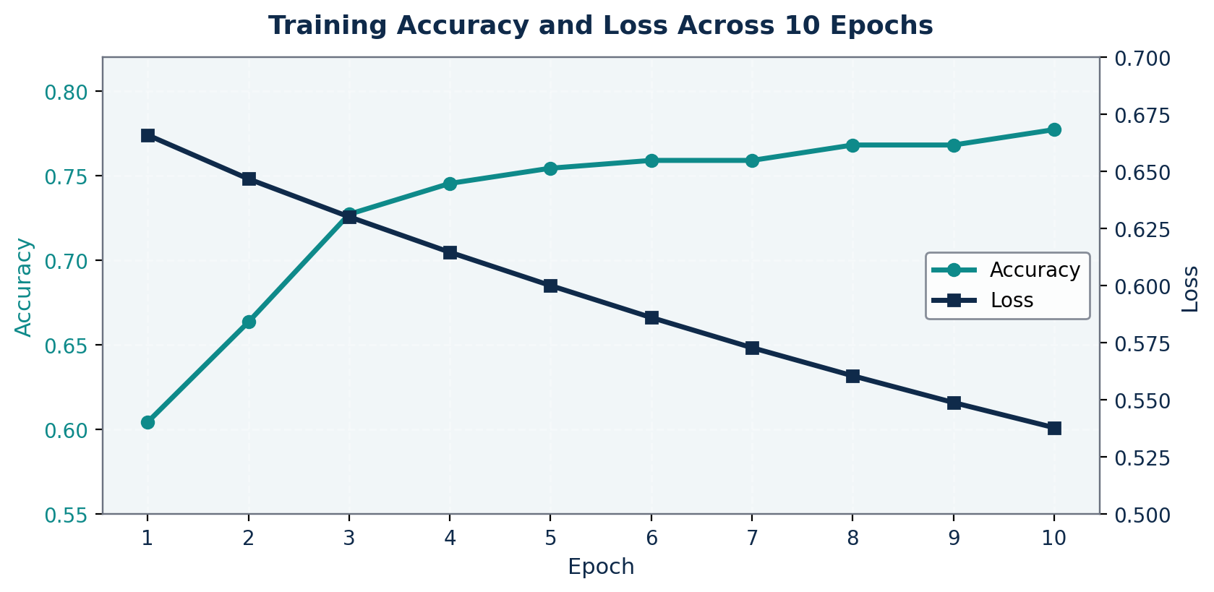
Training History
Accuracy and loss across 10 epochs
Takeaways
Accuracy climbed from 60% to 78%
Loss steadily decreased each epoch
Curves are smooth — no signs of overfitting
Cirrhosis Survival Prediction
7 / 10
Notes:
This chart shows what happened across the 10 training epochs. The teal line is accuracy on the left axis, and the navy line is loss on the right axis. Accuracy climbed steadily from about 60 percent in the first epoch to 78 percent by the end, and loss dropped from 0.67 down to 0.54. Both curves are still moving in the right direction at epoch 10, which suggests there's a little more to learn if I trained longer, but the gains had mostly leveled off. One caveat: these are only training curves. Without a validation curve I cannot actually see overfitting, so the takeaway about smooth curves is just about training behavior, not generalization.

Slide 8
Results
0.538
77.7%
80.4%
Final Training Loss
Training Accuracy
Testing Accuracy
Test accuracy slightly higher than training accuracy — the model generalized well to unseen patients.
Cirrhosis Survival Prediction
8 / 10
Notes:
This chart shows what happened across the 10 training epochs. The teal line is accuracy on the left axis, and the navy line is loss on the right axis. Accuracy climbed steadily from about 60 percent in the first epoch to 78 percent by the end, and loss dropped from 0.67 down to 0.54. Both curves are still moving in the right direction at epoch 10, which suggests there's a little more to learn if I trained longer, but the gains had mostly leveled off. One caveat: these are only training curves. Without a validation curve I cannot actually see overfitting, so the takeaway about smooth curves is just about training behavior, not generalization.

Slide 9
Limitations & Confidence
Would I trust this model to diagnose cirrhosis?
Dataset shrank from 418 to 276 patients after dropping rows with missing values
Only 10 epochs trained, with no validation split, dropout, or regularization
Drug column was excluded per the project spec, removing a clinically meaningful variable
80% accuracy is encouraging, but not high enough for actual clinical diagnosis
A real clinical tool would need higher sensitivity, calibrated probabilities, and external validation
Cirrhosis Survival Prediction
9 / 10
Notes:
This is the part of the rubric that asks how confident I would be using this to actually diagnose cirrhosis, and I want to be honest about it. The dataset shrank to 276 patients after cleaning. I only ran 10 epochs with no validation split, no dropout, and no regularization, so I cannot directly check for overfitting. The Drug column was excluded per the spec, which removes a clinically meaningful variable. So while 80 percent accuracy is encouraging for a class project, it is not high enough for real clinical use. A real diagnostic tool would need higher sensitivity, calibrated probabilities, and validation on outside patient data before anyone should trust it.

Slide 10
Conclusion
A simple neural network reached ~80% accuracy on cirrhosis survival prediction
Cleaning and encoding the clinical data was just as important as the model itself
Smooth training curves suggest the architecture was well matched to dataset size
Next steps: try cross-validation, more epochs, and class-weighted loss for the imbalanced classes
Thank you
Cirrhosis Survival Prediction
10 / 10
Notes:
To wrap up: a simple neural network with two hidden layers and 10 epochs reached around 80 percent accuracy on cirrhosis survival prediction. The biggest lesson for me was that cleaning and encoding the clinical data was just as important as the model architecture itself. The smooth training curves suggest the architecture matched the dataset size well. If I wanted to push this further, I would try cross-validation instead of a single split, train for more epochs with early stopping based on a validation set, and use class-weighted loss to better handle the class imbalance. Thanks for listening, and I'm happy to take questions.

