Slide 1
Table:User
user_id
User_name
Password
email
Table: Chat
Chat_id
posted_on
user_id
message
create table chat
...> (
...> chat_id int NOT NULL,
...> posted_on datetime NOT NULL,
...> userid int NOT NULL,
...> message text NOT NULL,
...> PRIMARY KEY (chat_id)
...> );

Slide 2
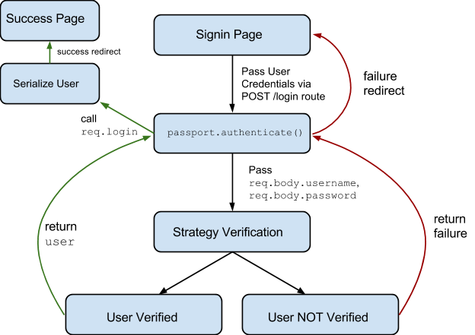

Slide 3
http://www.sitepoint.com/build-node-js-powered-chatroom-web-app-node-mongodb-socket/
http://www.chatib.com/

