Slide 1
XGBoost Community
The Impact Of Energy Distribution In India Per Region Before And During Lockdown

Slide 2
THE DATASET
The data analysed for this project was obtained from kaggle, titled Power Consumption in India (2019 - 2020). The data was collected over 17 months between 2nd Jan, 2019 to 23rd May, 2020.
The dataset was scraped from the weekly energy reports of Power System Operation Corporation Limited (POSOCO) and it is exhaustive in its demonstration of energy consumption state wise.
Notes:
https://www.kaggle.com/twinkle0705/state-wise-power-consumption-in-india

Slide 3
PROBLEM STATEMENT
India is the world's third-largest producer and third-largest consumer of electricity. The national electric grid in India has an installed capacity of 370.106 GW, while renewable power plants, which also include large hydroelectric plants, constitute 35.86% of India's total installed capacity
During the 2018-19 fiscal year, the gross electricity generated by utilities in India was 1,372 TWh and the total electricity generation (utilities and non-utilities) in the country was 1,547 TWh. The gross electricity consumption in 2018-19 was 1,181 kWh per capita.
However during the recent COVID-19 pandemic, everyone has been under lockdown for the months of April & May. The impacts of the lockdown on economic activities has been faced by every sector in a positive or a negative way and the goal of this project is to visualise the impact of lockdown on energy distribution per region before and during lockdown.

Slide 4
Questions
Which region consumes maximum & minimum power yearly?
State in each region which consume maximum & minimum power yearly?
Top 10 states that consume maximum power yearly.
Top 10 states that consume least power yearly.
In which months do you see a rise in consumption?
In which months do you see a decline in consumption?
Contrast between consumption during lockdown and without lockdown. (Compare the values in march-may 2019 and march-may 2020)
Percentage change in consumption during the lockdown(as compared to previous year).
What is the highest value reached by each state at any time of the year in 2019?
What is the lowest value reached by each state at any time of the year in 2019?

Slide 5
Data Wrangling
Data wrangling involves transforming raw data into data that can be analysed to generate valid actionable insights.
The first step carried out was exploratory analysis on the first data, which was done to have a better understanding of the dataset.
Then the variable named ‘Unnamed:0’ was renamed to ‘Date’, and converted from object to a datetime frame.
Next, the years were sorted and separated into 2019 and 2020.
The describe( ) function was used to show distribution, especially the minimum and maximum power consumption
For the second data, the other columns were dropped to give just the regions and state. The duplicated states was also dropped. Then the first and second data were merged on states

Slide 6
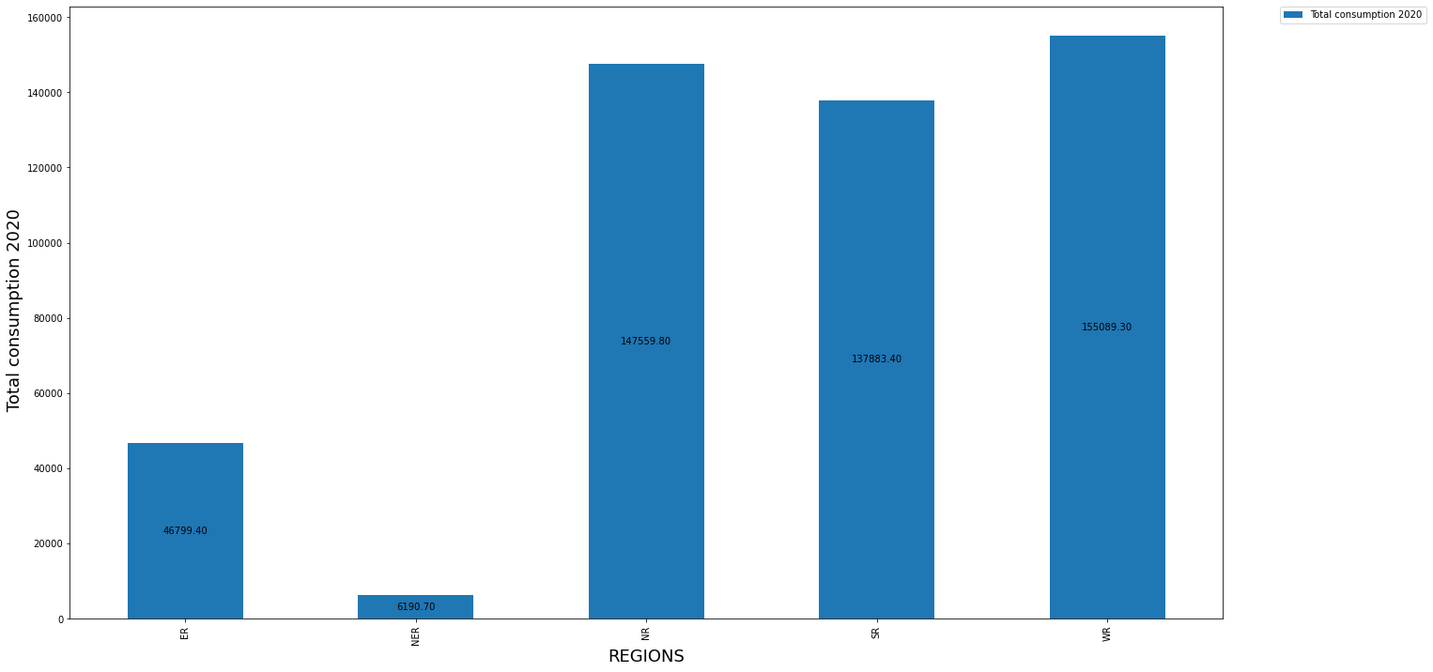
The Graph below shows the total power consumption by region.
East Region
North East Region
North Region
South Region
West Region

Slide 7
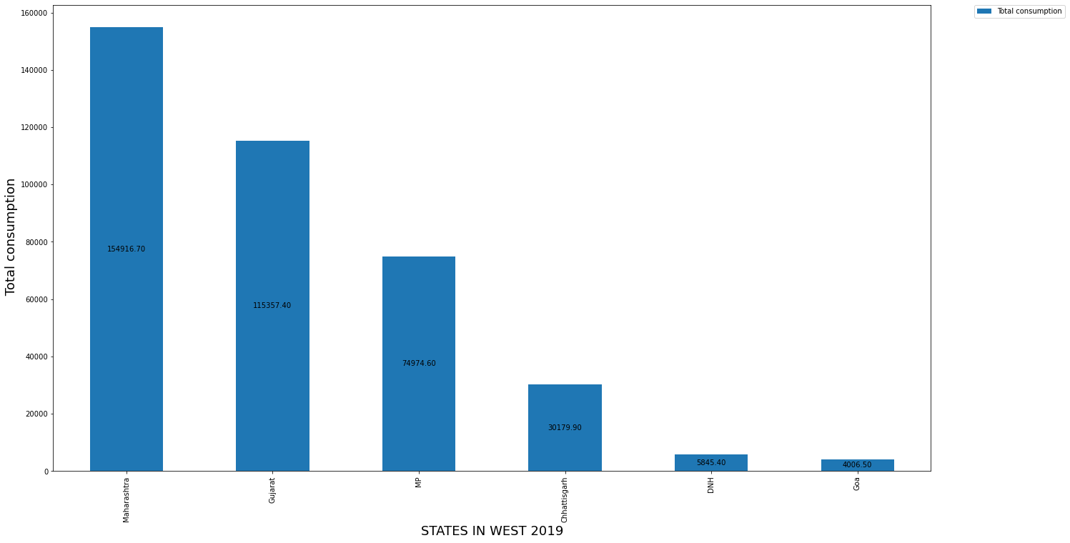
Power consumption by states 2019
For the West

Slide 8
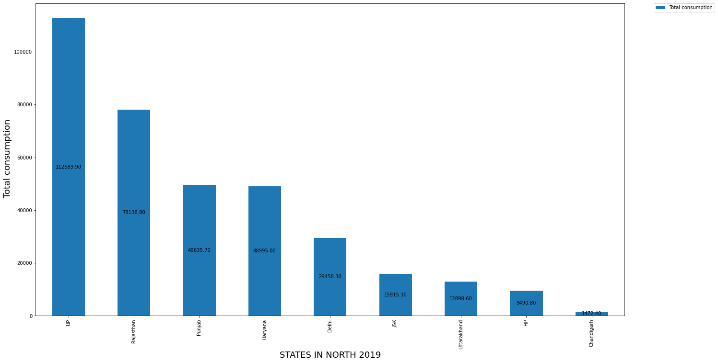
For the North

Slide 9
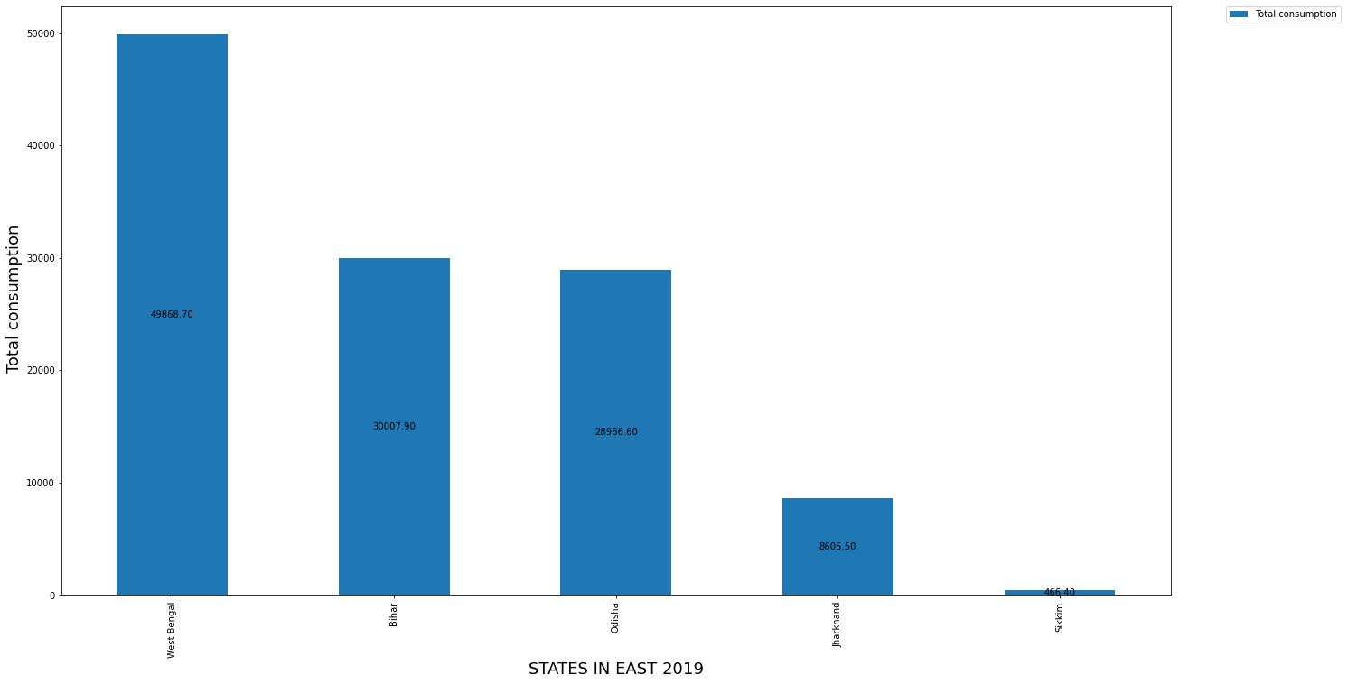
For the East

Slide 10
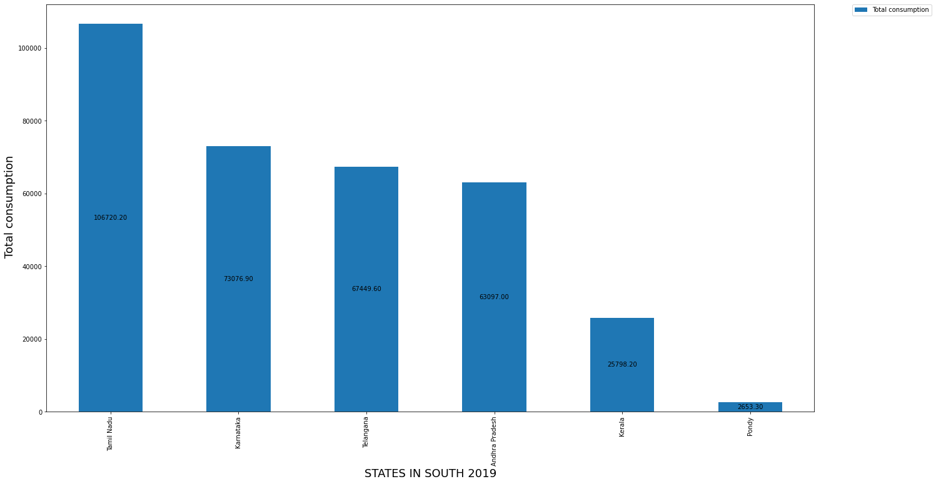
For the south:

Slide 11
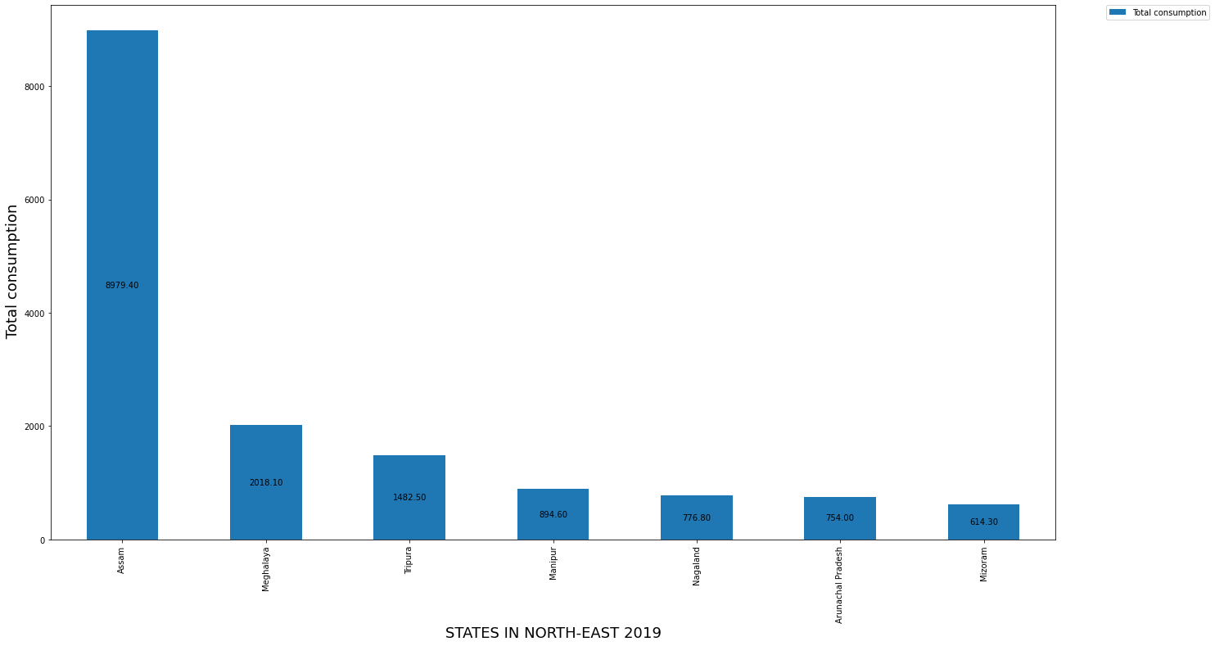
For North East:

Slide 12

Power consumption by states in 2020:
For the North

Slide 13
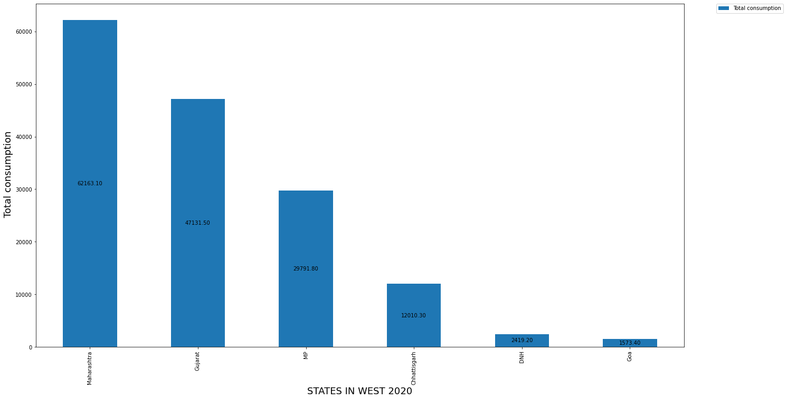
For West 2020:

Slide 14

For South 2020

Slide 15

For East 2020

Slide 16
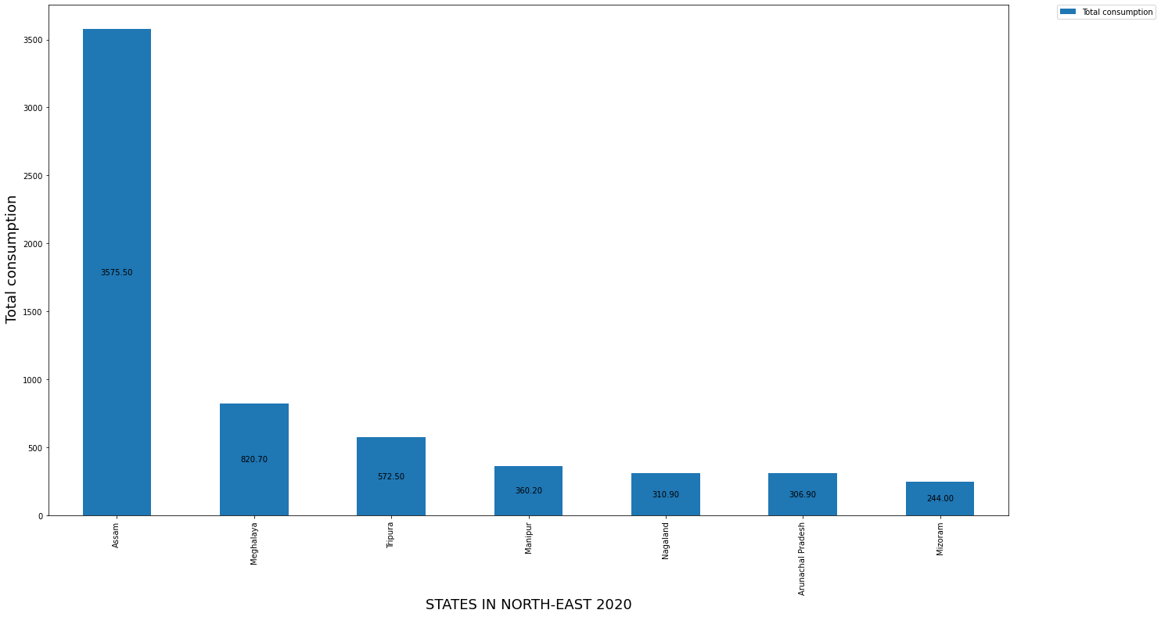
For NorthEast 2020:

Slide 17
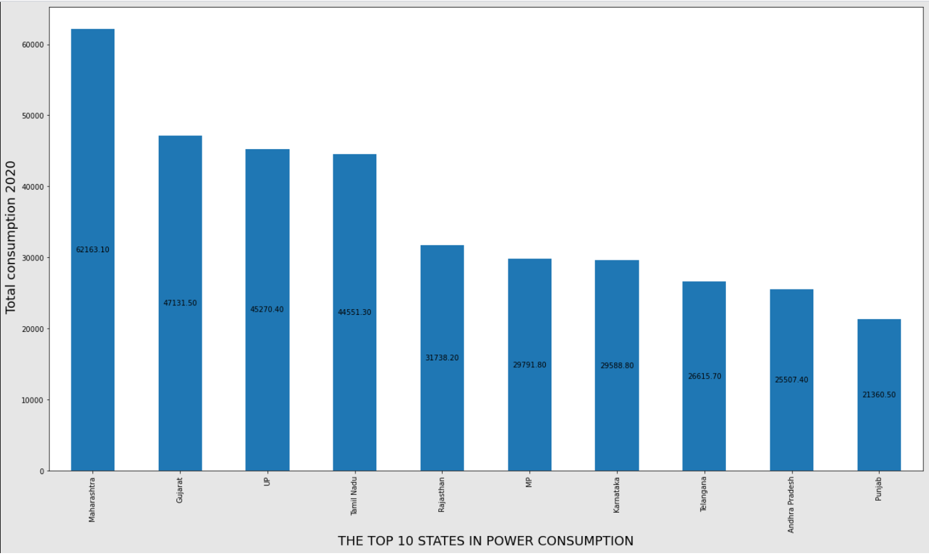
The top 10 highest consumption states in 2020

Slide 18
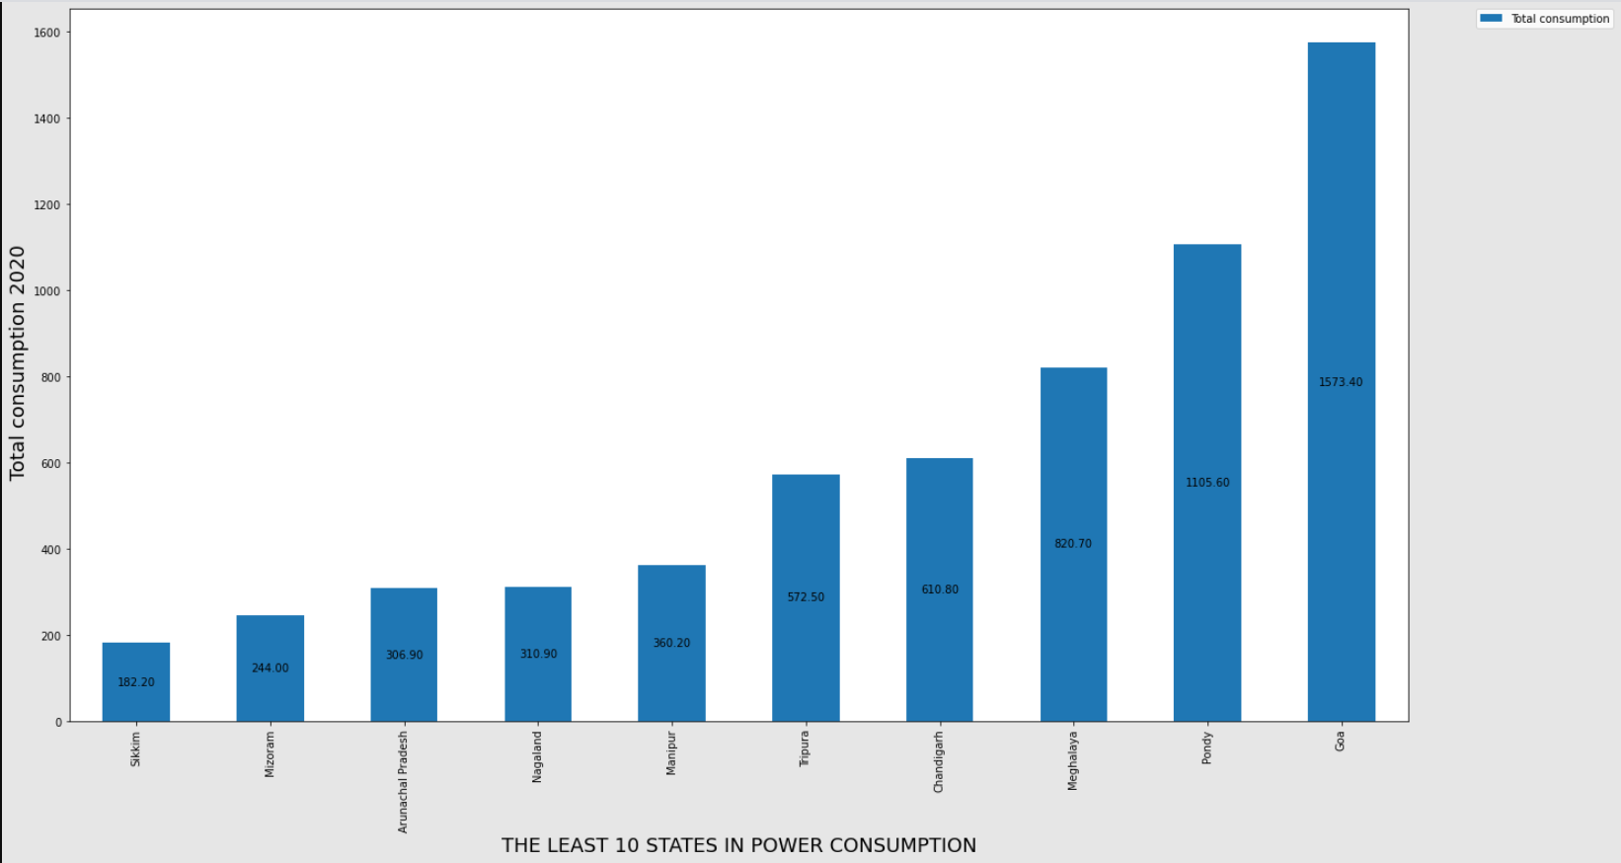
The least power consumption states in the year 2020.

Slide 19

The top 10 highest consumption states in 2019

Slide 20
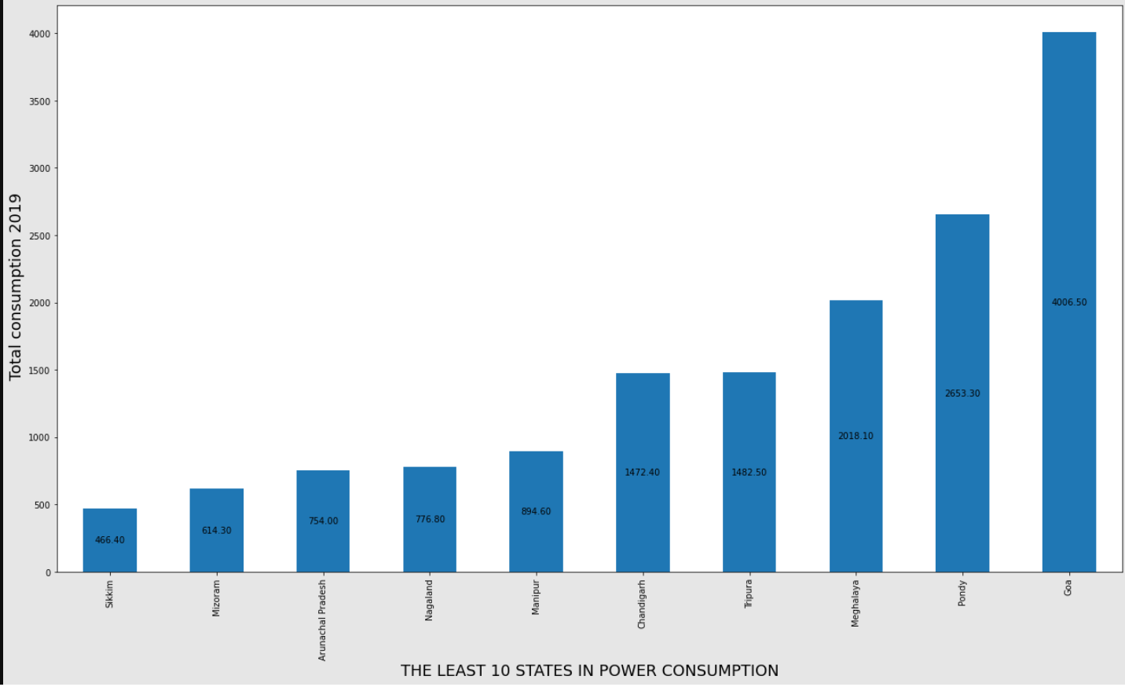
The 10 least power consumption state for 2019.

Slide 21
Power consumption contrast between during the lockdown and without lockdown (ref: march-may for the respective years)
Comparison
 | Without Lockdown total consumption | During the lockdown total consumption | % Change
MONTH
03 | 100800.2 | 101115.7 | 0.312019
04 | 105784.6 | 103707.8 | -2.002549
05 | 105696.8 | 77844.7 | -35.779058

Slide 22
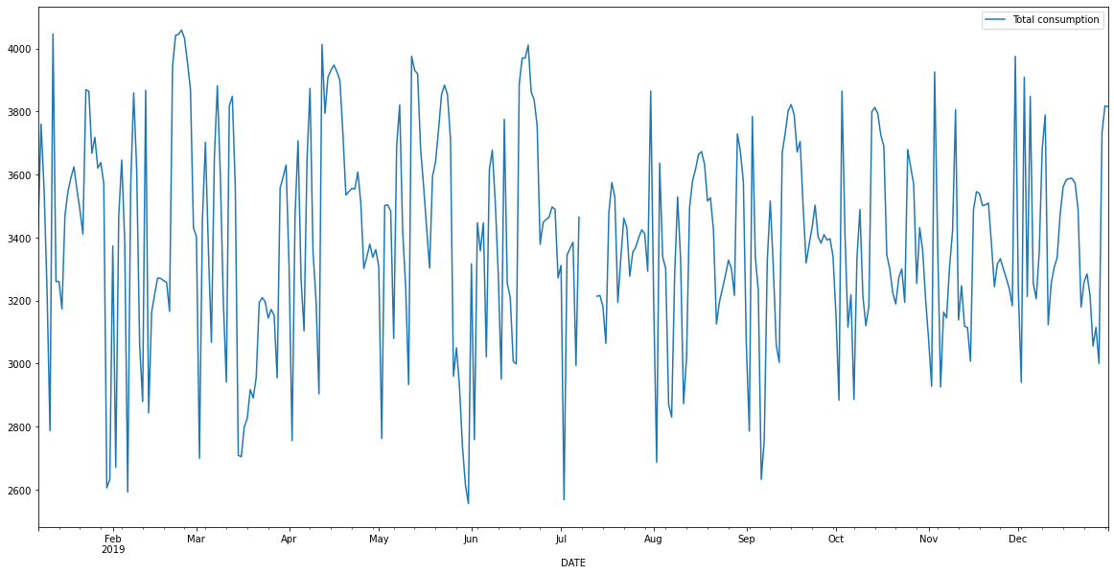
Graphs of daily and monthly consumptions at the respective years bringing out the periods of blackout in 2019.
Daily consumption rate.

Slide 23
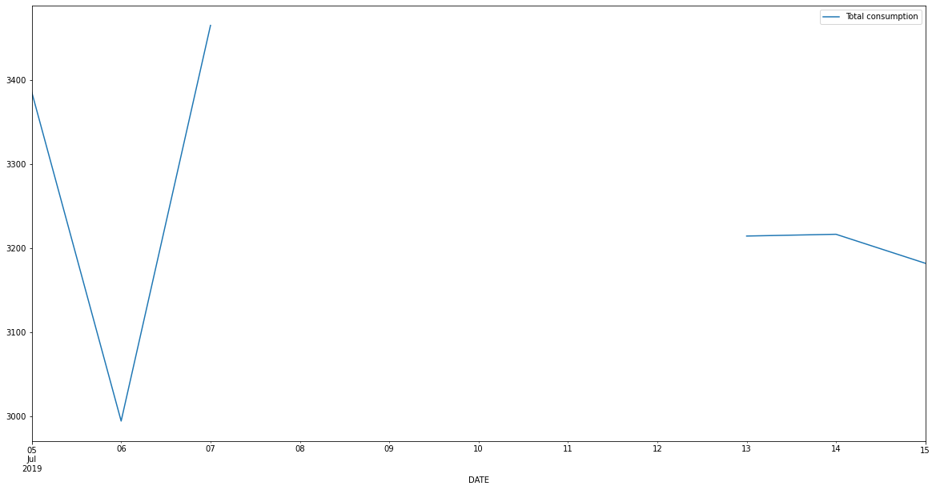
Daily Blackout in 2019

Slide 24
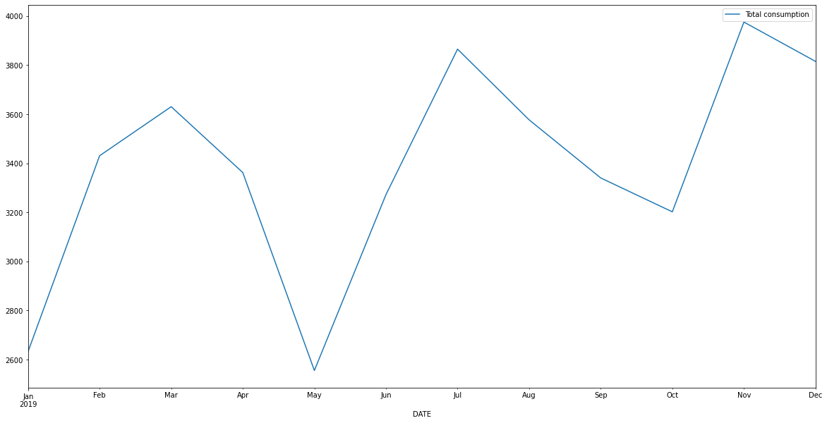
The monthly consumption rate 2019

Slide 25
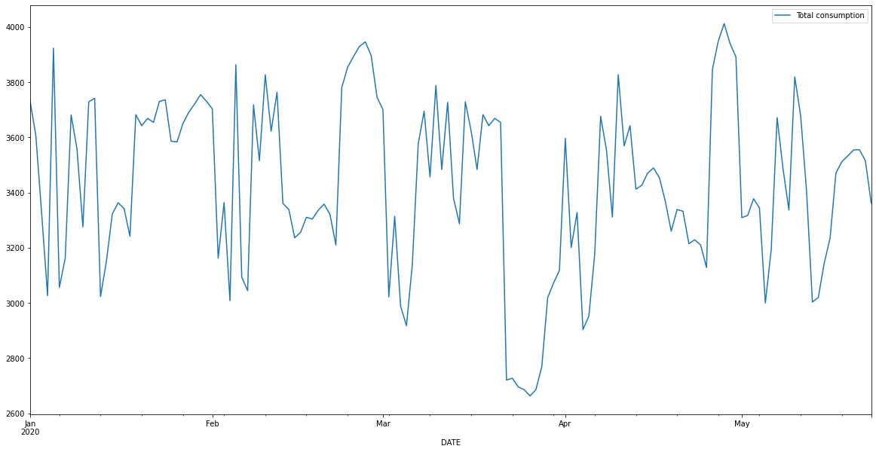
Daily consumption in 2020
Daily

Slide 26
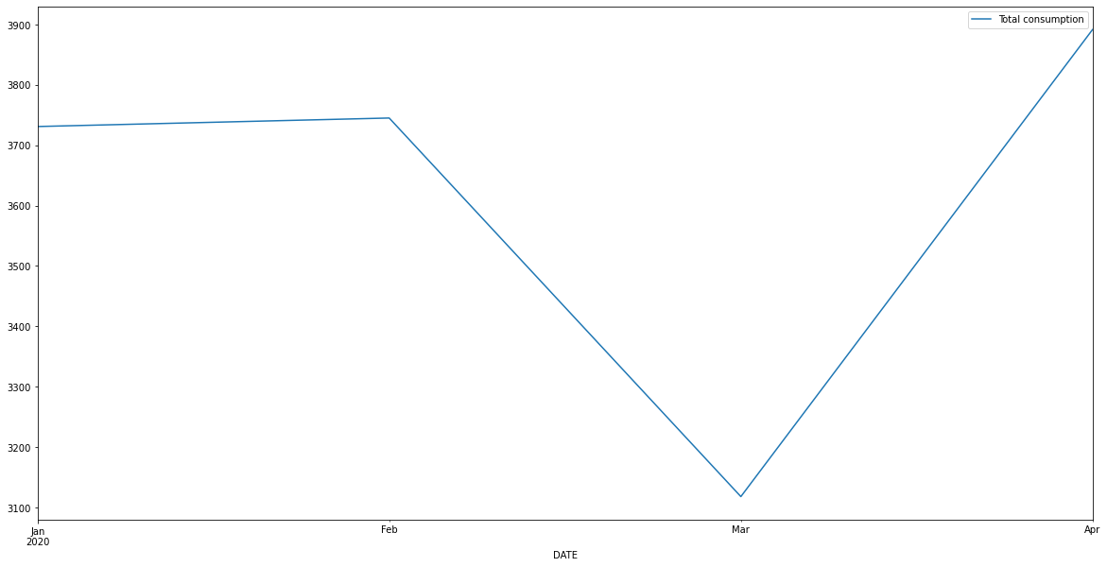
Monthly consumption in 2020
Monthly rate

