Slide 1
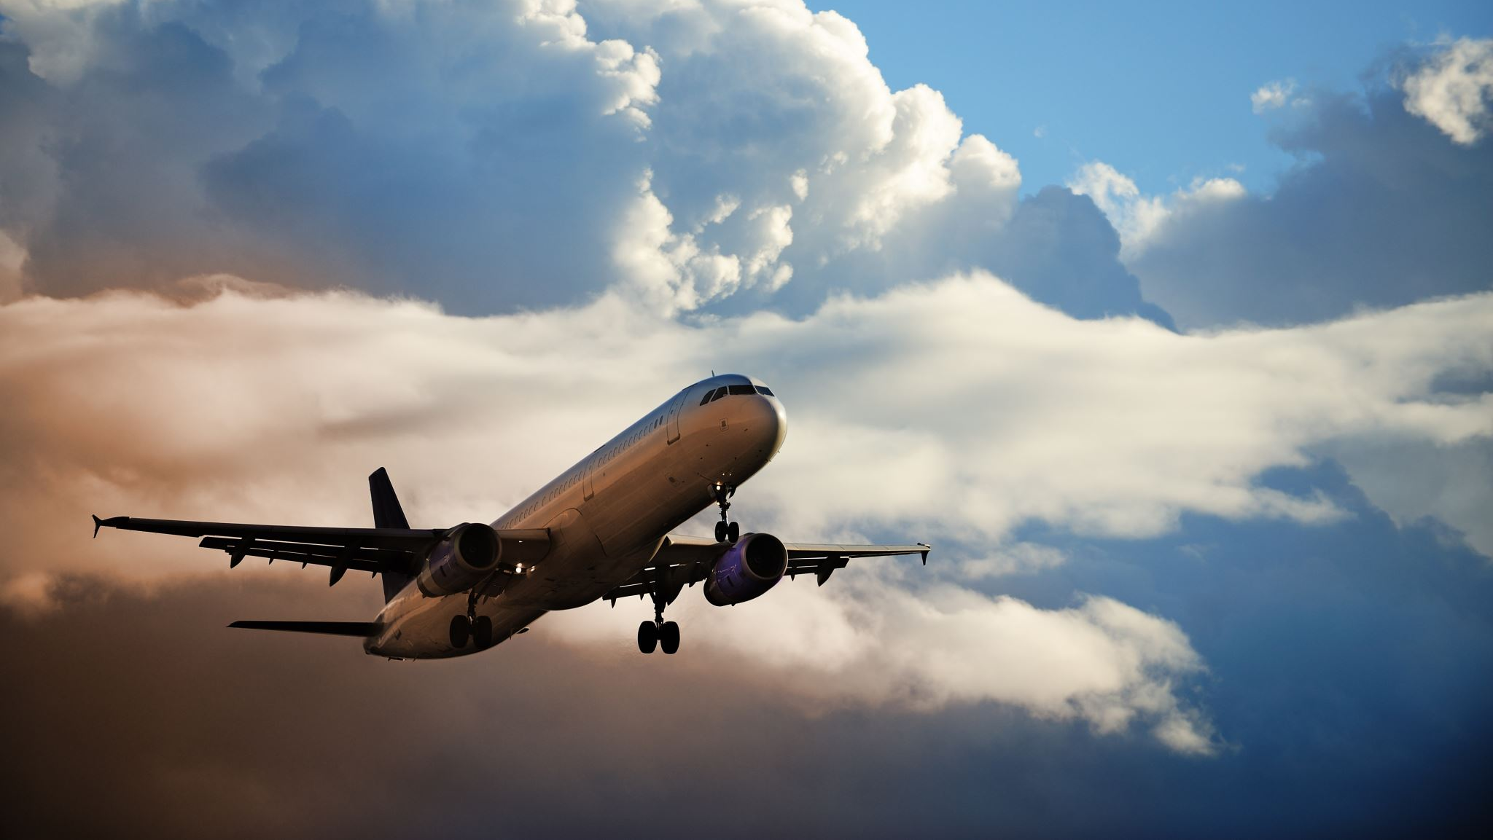
Airline Customer Satisfaction
Angela Diaz
Micro-Project #2
https://github.com/angelaorduno/Airline-Customer-Satisfaction
May 22, 2024

Slide 2

Problem Statement
This project will use Logistic Regression to predict Customer Satisfaction.

Slide 3
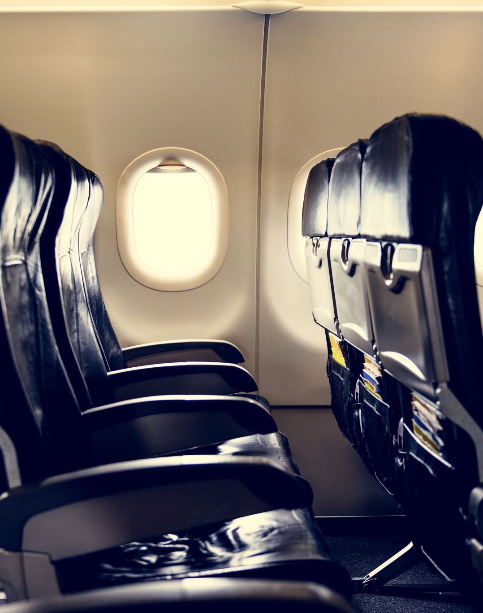
Hypothesis Formulation
Higher customer satisfaction is based on Cleanliness, Seat Comfort, Flight Distance and Age, Convenient Departure/Arrival, Inflight WiFi, Inflight Entertainment, Food & Drink, Leg room, and Online support.

Slide 4
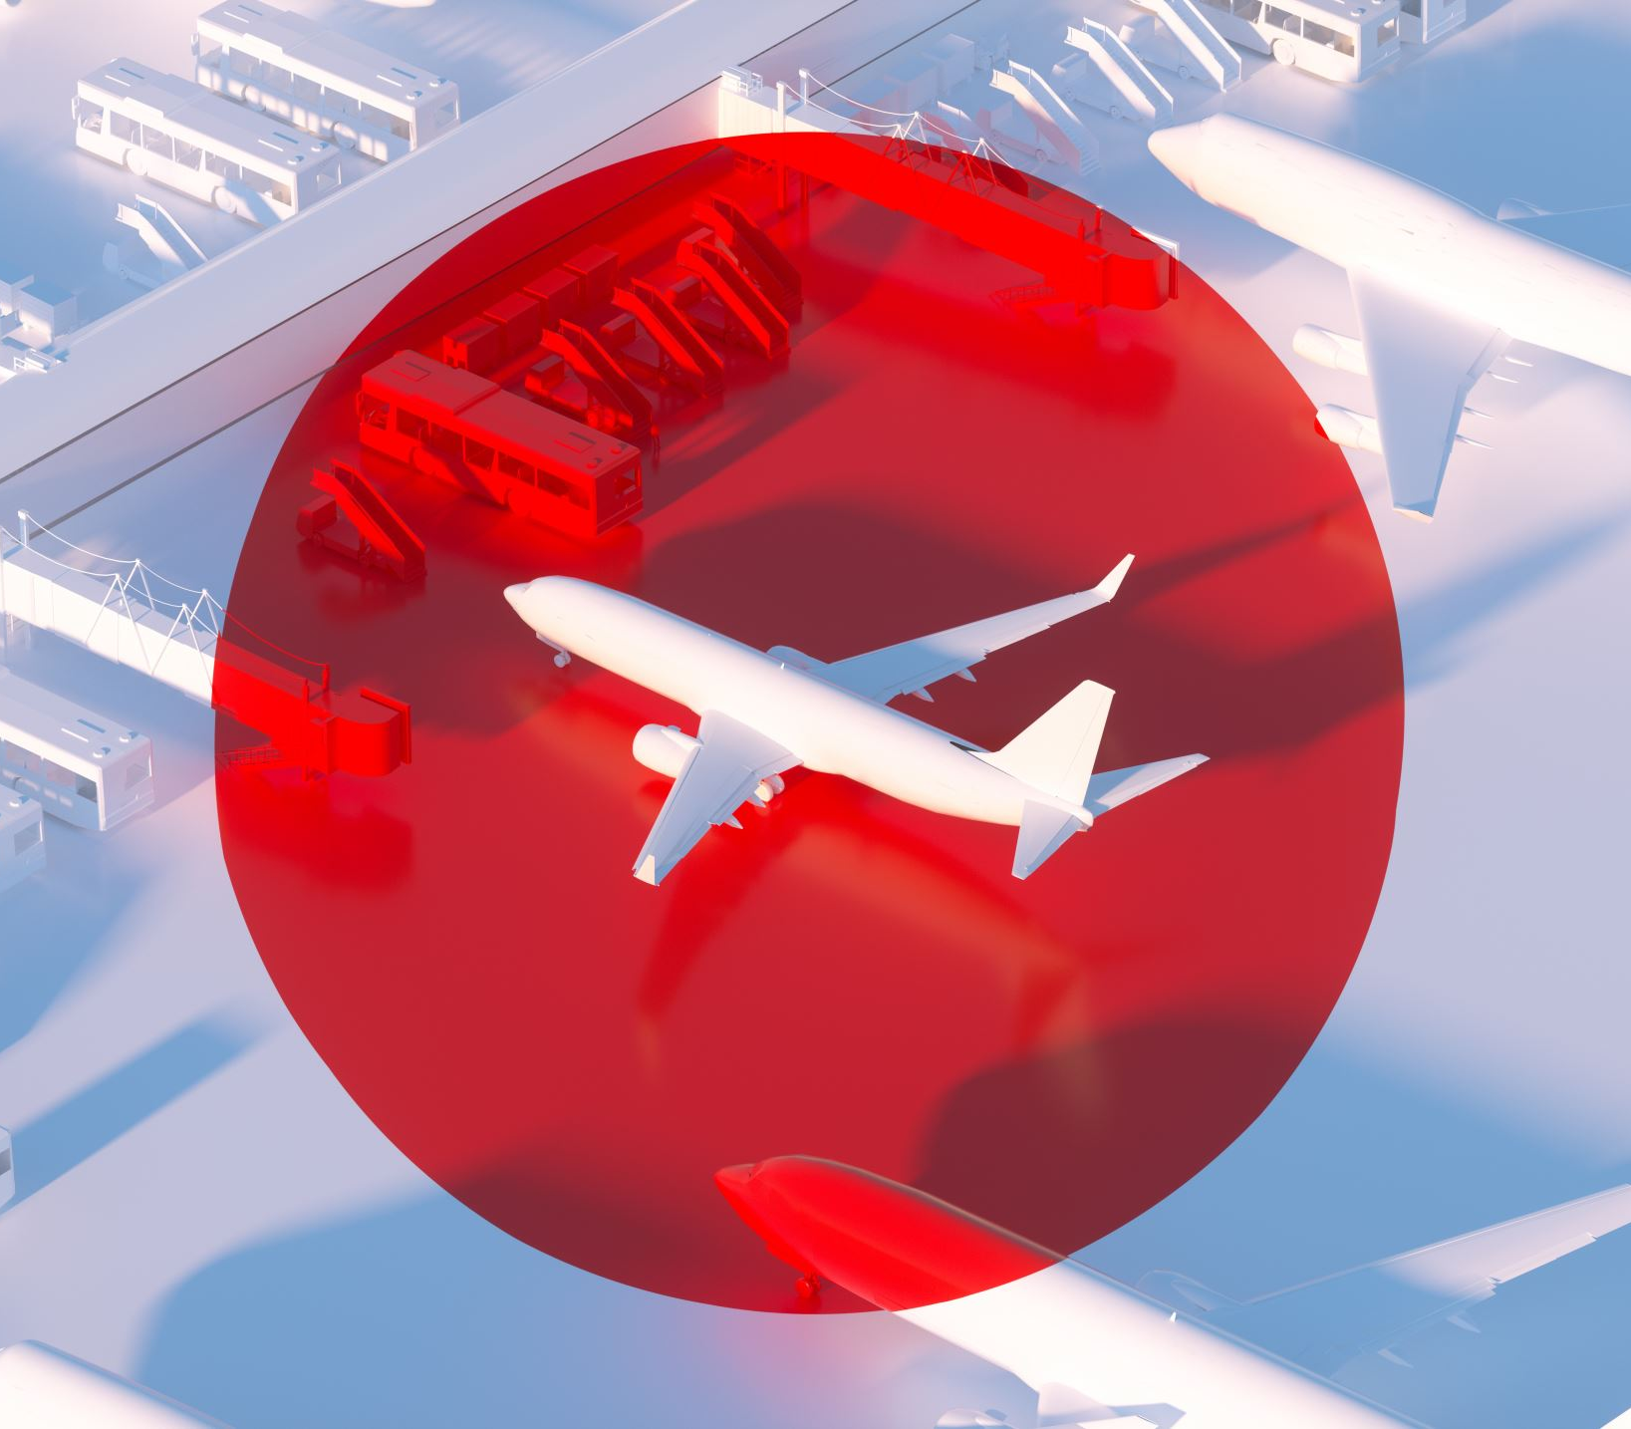
Acquire
The data is an airline dataset composed of 22 columns and 129,880 rows.
The purpose of the dataset is to be used in prediction models that can predict future customer satisfaction.
Customer satisfaction insights will aid the airline to tailor its services to best serve its customers.

Slide 5
Prepare
The shape of the data is 129,880 rows and 22 columns.
There are 18 integer variables. 4 were numeric and 12 were numeric categorical.
There are 4 object variables that were converted to category.
Because there was less than 1% of data missing, missing values were replaced with the mean values.
Located outliers via boxplots and removed some of them to standardize the data.

Slide 6
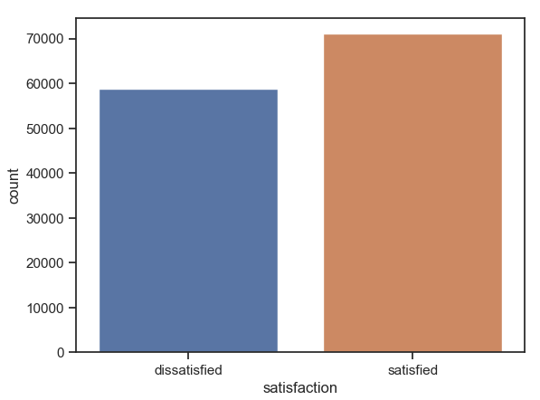
Analyze: Customer Satisfaction
Airline customers were mostly satisfied with their flights.
There are 70,000 satisfied customers.
There are a little under 60,000 dissatisfied customers.

Slide 7
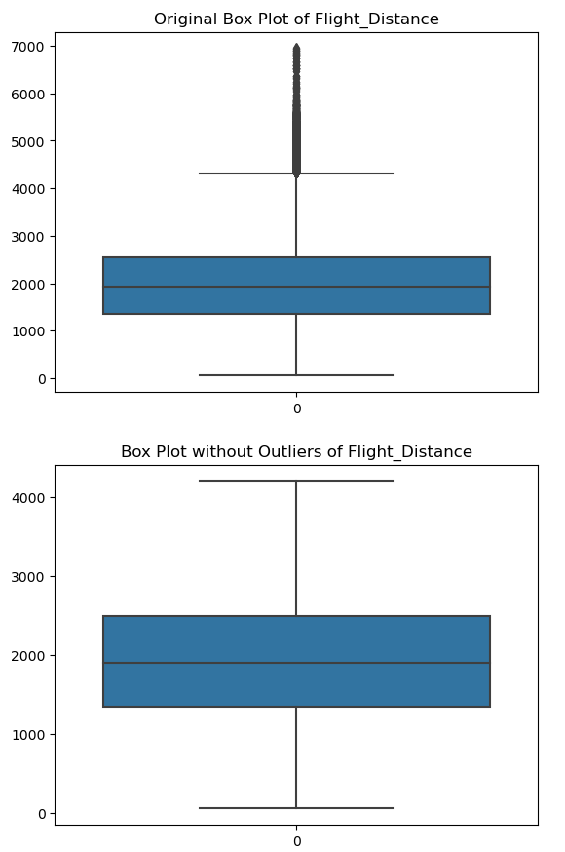
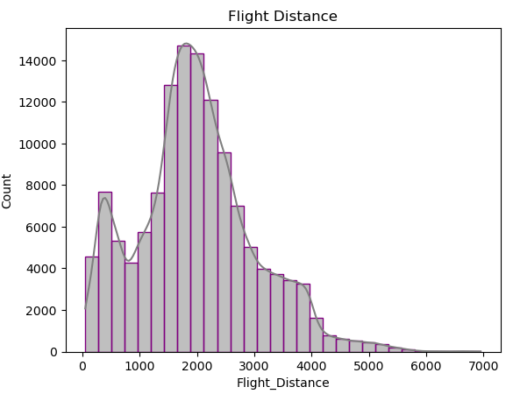
Analyze: Flight Distance
Flight Distance values range from 50 to 7000.
The distribution is normal with a right skew.
Flight Distance had 3011 outliers, which is less than 1%.
After removing outliers, the values of Flight Distance range from 50 to 4200.

Slide 8
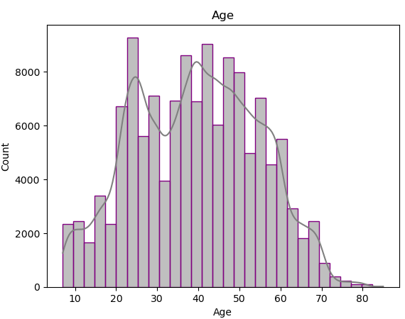
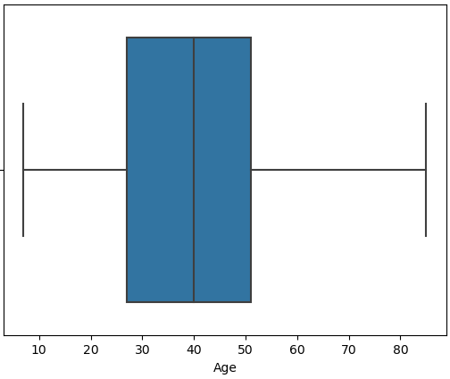
Analyze: Age
Customers age ranges from 10 years old to 80+ years old.
Age has a normal distribution.
Age does not have any outliers.
The most ages that travel are between 20 and 50 years old.

Slide 9
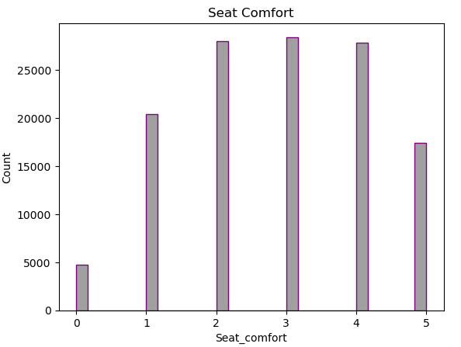
Analyze: Seat Comfort
Seat Comfort appears to be a categorical variable.
Seat Comfort is a rate from 0 to 5.
The highest score are 2 to 4.

Slide 10
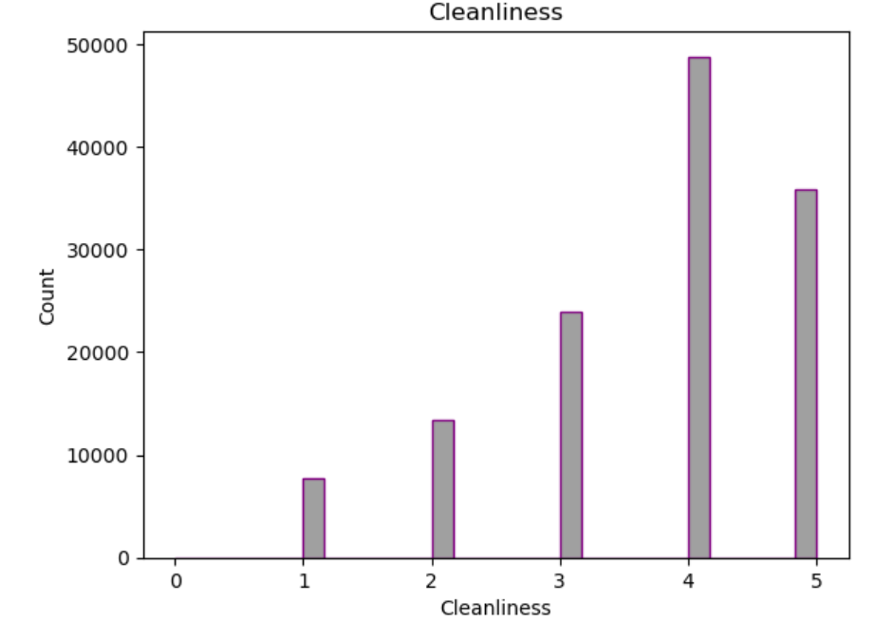
Analyze: Cleanliness
Cleanliness is a categorical variable.
Cleanliness appears to be a rating scale.
The rating 4 has the highest count of customers.

Slide 11
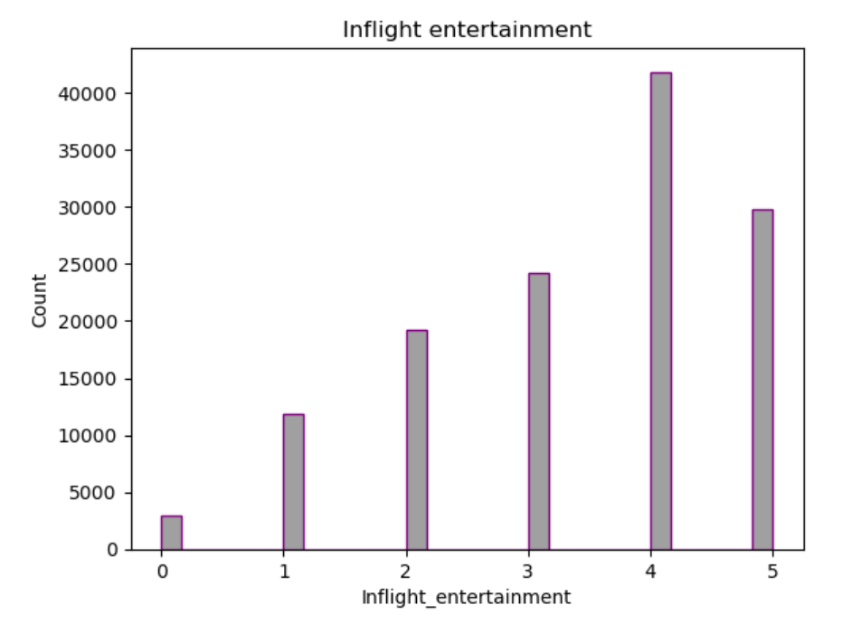
Analyze: Inflight entertainment
Inflight entertainment is a categorical variable.
Inflight Entertainment is a rating scale from 0 to 5.
The rating 4 has the highest count of customers.

Slide 12
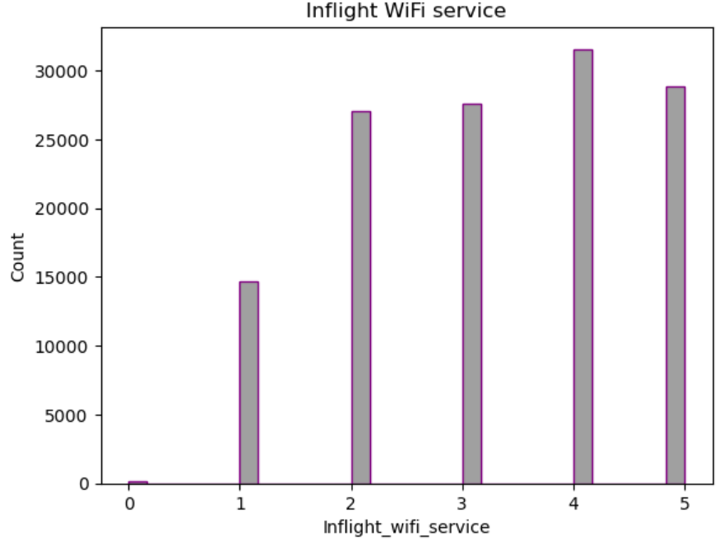
Analyze: Inflight WiFi service
Inflight WiFi service is a categorical variable.
Inflight WiFi service is a rating scale from 0 to 5.
The rating 4 has the highest count of customers.

Slide 13
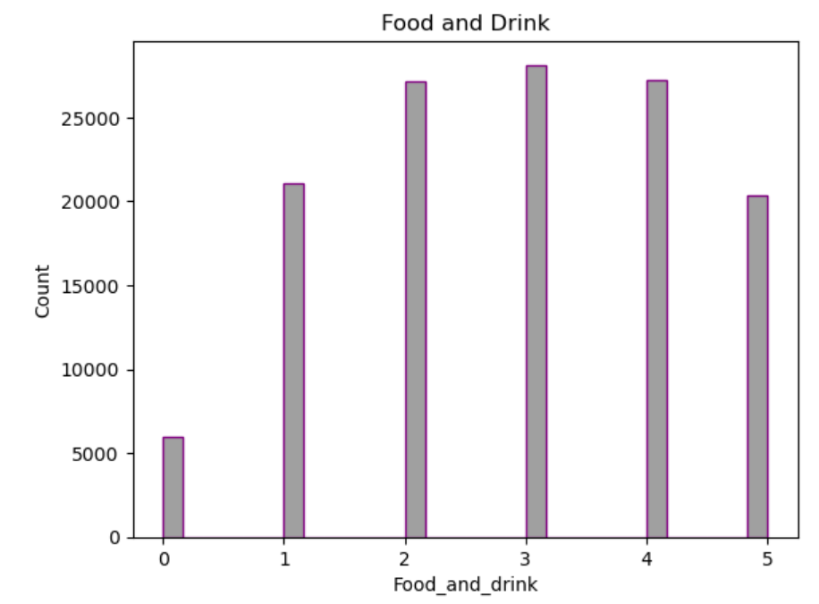
Analyze: Food and drink
Food and Drink is a categorical variable.
Food and Drink is a rating scale from 0 to 5.
The rating 3 has the highest count of customers.

Slide 14
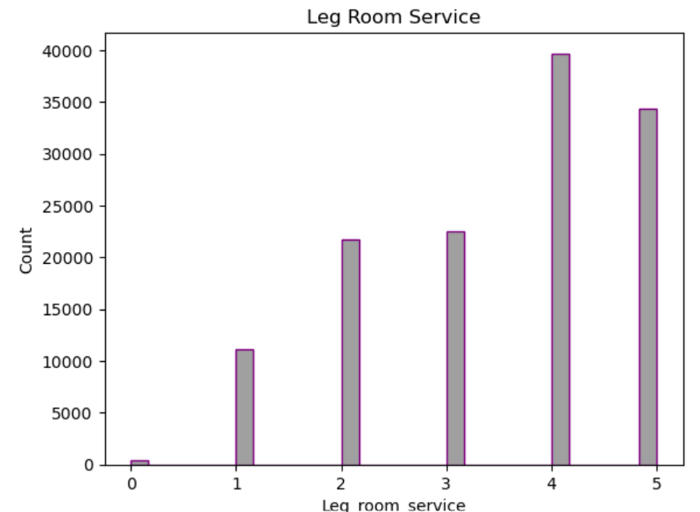
Analyze: Leg room service
Leg Room Service is a categorical variable.
Leg Room Service is a rating scale from 0 to 5.
The rating 4 has the highest count of customers.

Slide 15
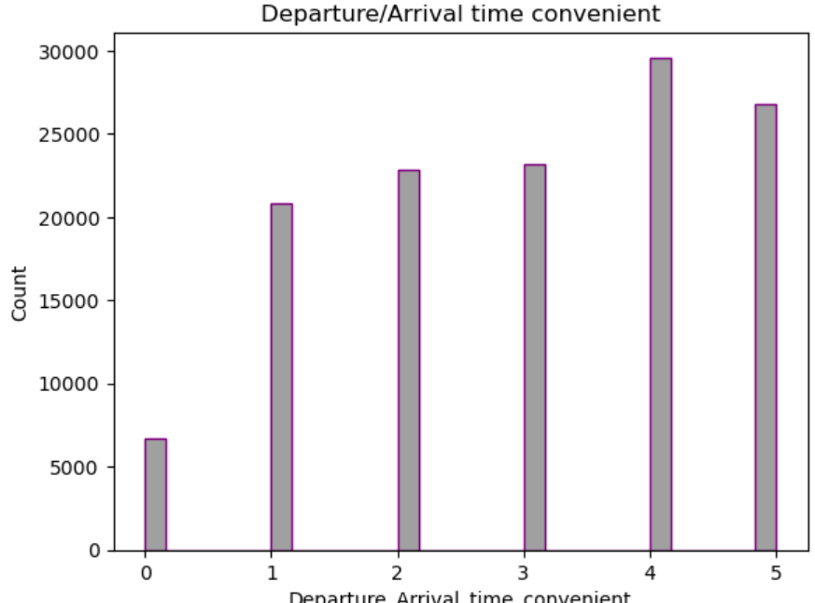
Analyze: Departure/Arrival time convenient
Departure/Arrival time convenient is a categorical variable.
The rating scale ranges from 0 to 5.
The rating 4 has the highest count of customers.

Slide 16
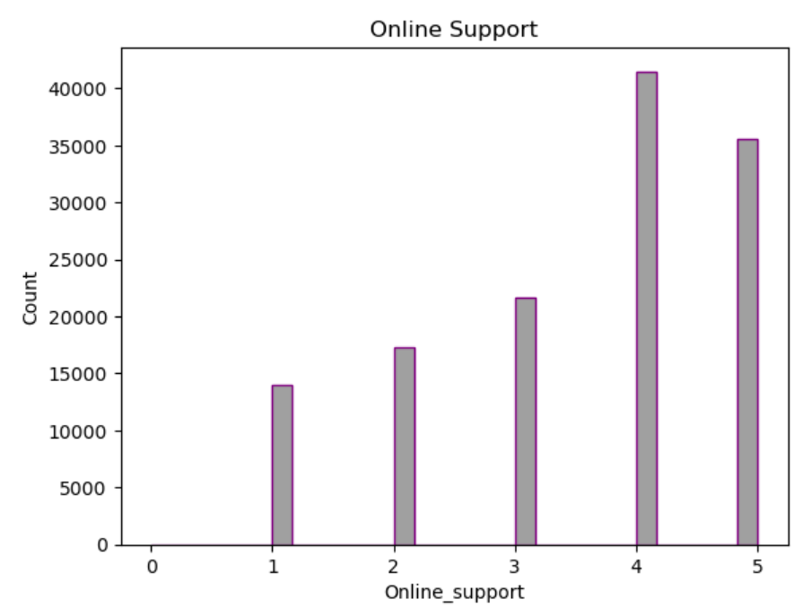
Analyze: Online support
Online Support is a categorical variable.
Online Support is a rating scale ranging from 0 to 5.
There are no customer ratings for Online Support.
The rating 4 is the highest customer rating.

Slide 17
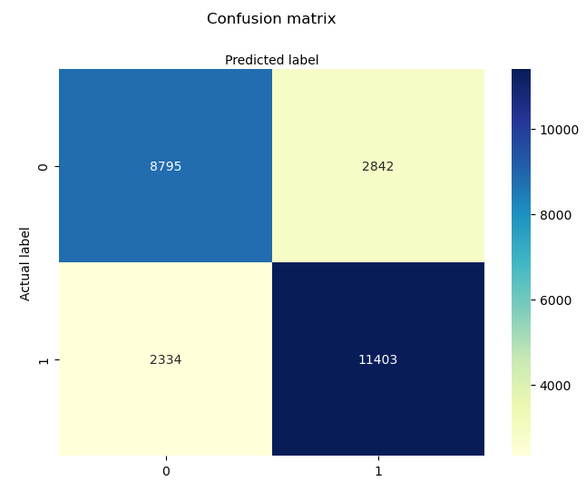
Analyze: Logistic Regression
There are 11,403 True Positive.
There are 2,334 False Negative.
There are 8,795 True Negative
There are 2,842 False Positive

Slide 18
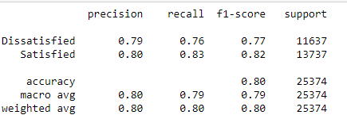
Report: Logistic Regression
The model scored an accuracy of .80
The Precision for Satisfied is .80.
The Recall for Satisfied is .83.
The F1-score for Satisfied is .82.

Slide 19

Act: Customer Satisfaction Model
The model where Customer Satisfaction is explained by Cleanliness, Seat Comfort, Flight Distance and Age, Convenient Departure/Arrival, Inflight WiFi, Inflight Entertainment, Food & Drink, Leg room, and Online support has an accuracy rate of 80%; making it a good model.

Slide 20
References
Huseyn, R. (2024, May 6). Airline customer satisfaction. Kaggle. https://www.kaggle.com/datasets/raminhuseyn/airline-customer-satisfaction

