Slide 1

Daily Website Visitors
Angela Diaz
Github:
ANA500 Deep Learning Project

Slide 2

Problem Statement
This project will use Recurrent Neural Networks to forecast daily website visitor traffic.

Slide 3

Hypothesis Formulation
The number of website visitors will have higher traffic on weekdays compared to weekends.

Slide 4

Acquire
The dataset is composed of the website visitor traffic on statforecasting.com for the duration of 5 years.
The data time frame ranges from September 14, 2014 to August 19, 2020.
The purpose of this dataset is to develop a forecast model for unique website visitors.
Website visit forecasting will aid businesses to tailor its services to best serve its customers.

Slide 5
Prepare
The shape of the data is 2,167 rows and 8 columns. There are zero missing values.
Page.Loads, Unique.Visits, and First.Time.Visits were converted to Float32. Date was converted to Datetime64.
There are two integer variables and the six object variables.
Commas were removed from Page.Loads, Unique.Visits, and First.Time.Visits values.

Slide 6
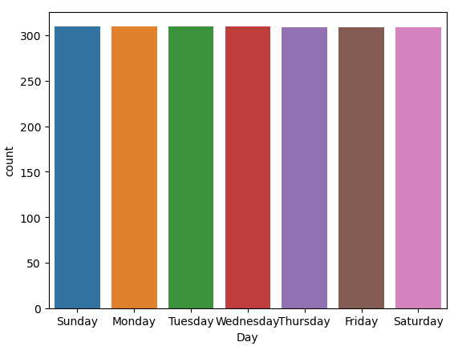
Analyze: Day
Day is a categorical variable.
Day holds values for all 7 days of the week; Sunday, Monday, Tuesday, Wednesday, Thursday, Friday and Saturday.
The count for each of the days is a little over 300 visitors each.
The counts for each day are evenly distributed.

Slide 7
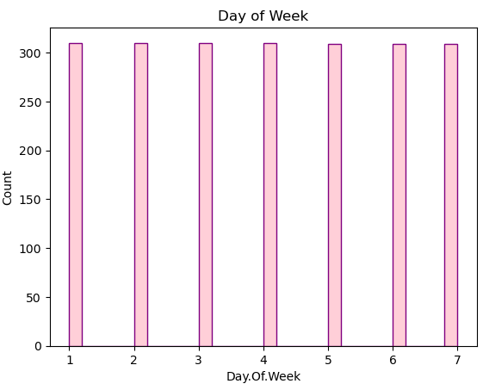
Analyze: Day.Of.Week
Day.Of.Week is an integer variable.
Day.Of.Week holds values for each numerical representation of the day of the week.
The week starts with Sunday which is represented as 1.
The histogram is an even distribution.

Slide 8
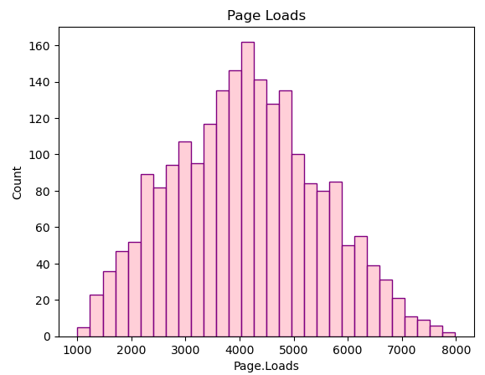
Analyze: Page.Loads
Page.Loads has a Normal Distribution.
The Values range from 1,002 to 7.984.
The highest count of visitors is 160 which correlates to about 4,000 page loads.

Slide 9
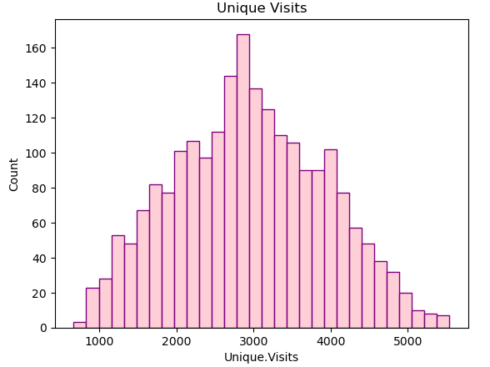
Analyze: Unique.Visits
Unique.Visits has a normal distribution.
The values range from 667 to 5,541.
The highest count of visitors is 160 which accounts for about 2,900 unique visits.

Slide 10
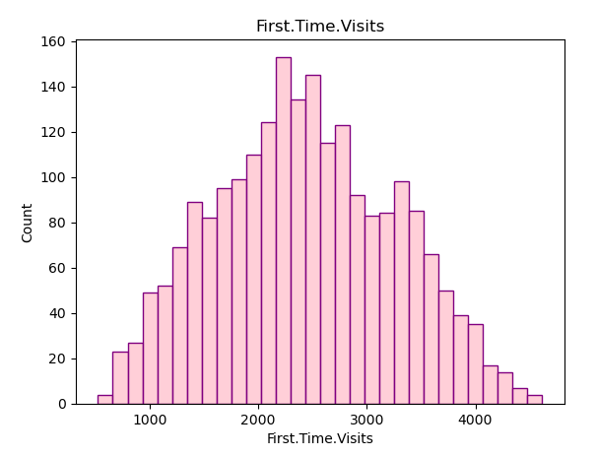
Analyze: First.Time.Visits
First.Time.Visits has a normal distribution.
The values range from 522 to 4,616.
The highest count is about 2,400 first time visitors.

Slide 11
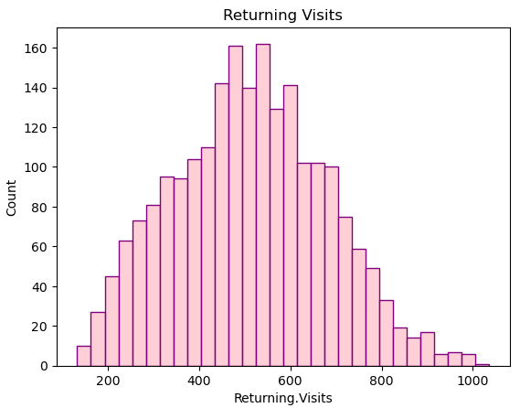
Analyze: Returning.Visits
Returning.Visits has a normal distribution.
The values range from 133 to 1,036.
The highest count of returning visits is 509.

Slide 12
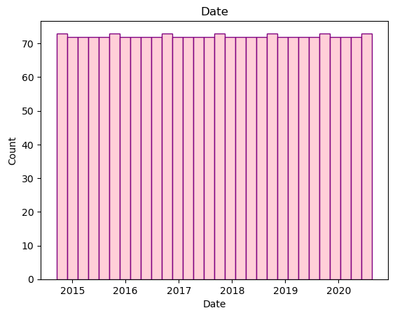
Analyze: Date
Date is a datetime variable.
The dates range from September 14, 2014 to August 19, 2020.
Date has an even distribution.

Slide 13
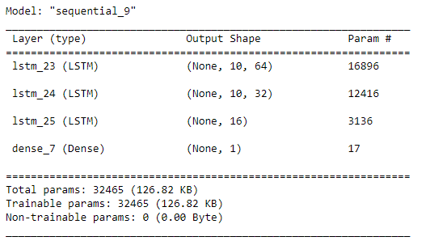
Analyze: RNN - LSTM
The Model has a total of 32,462 parameters
All of the parameters are also trainable.

Slide 14
Report: RNN - LSTM

Slide 15
Act: Daily Website Visitors

Slide 16
References:
Nau, B. (2020, August 20). Daily website visitors (time series regression). Kaggle. https://www.kaggle.com/datasets/bobnau/daily-website-visitors
Karthik BhojarajKarthik Bhojaraj 14511 gold badge11 silver badge66 bronze badges, cs95cs95 395k102102 gold badges727727 silver badges778778 bronze badges, Ameya MaratheAmeya Marathe 17111 silver badge33 bronze badges, sameer_nubiasameer_nubia 75588 silver badges1010 bronze badges, Gaurav Singh Rathore Gaurav Singh Rathore 1122 bronze badges, NabreezyNabreezy 4111 gold badge11 silver badge44 bronze badges, & codexaxorcodexaxor 9722 silver badges55 bronze badges. (1963, June 1). How can I fix “valueerror: Expected 2D array, got 1D array instead” in scikit-learn/python? Stack Overflow. https://stackoverflow.com/questions/46638641/how-can-i-fix-valueerror-expected-2d-array-got-1d-array-instead-in-scikit-le
Awan, A. A. (2022, March 16). Recurrent neural network tutorial (RNN). DataCamp. https://www.datacamp.com/tutorial/tutorial-for-recurrent-neural-network
Person. (2021, August 9). Failed to convert a NumPy array to a tensor. TensorFlow Forum. https://discuss.tensorflow.org/t/failed-to-convert-a-numpy-array-to-a-tensor/3595
LukasLukas 14111 gold badge11 silver badge44 bronze badges, & sameersameer 1. (1966, July 1). Valueerror: Input 0 of layer sequential is incompatible with the layer: Expected ndim=3, found ndim=4. full shape received: [none, 25, 25, 1]. Data Science Stack Exchange. https://datascience.stackexchange.com/questions/85608/valueerror-input-0-of-layer-sequential-is-incompatible-with-the-layer-expected

