Slide 1
ZIKI
A Personalized Hybrid Movie
Recommendation System
Solving decision fatigue for movie selection using a customized recommender system.

Slide 2
The team
AN
AW
BB
MC
TM
Andrew
Nyakiba
Angela
Wachira
Bob
Okeyo
Mercy
Chepkoech
Ted
Mwenda
DATASETS
INSTRUCTOR
Maryanne Mwikali
ratings.csv
100,836 ratings
movies.csv
9,742 movie titles
tags.csv
free-text tags (cold-start solution)
2 / 14

Slide 3
BUSINESS CONTEXT
Decision fatigue is killing engagement
Project objectives
“
Ziki faces high early-session abandonment where users who do not find a film they connect with in their first few impressions are unlikely to watch anything that session. Ziki needs a personalized recommendation engine that will surface the top 5 movies most relevant to each user, based on their own rating history so that each homepage visit feels curated, not random, but tailored to what they like.
✓
Build a hybrid movie recommendation system
from prior rating history
✓
Cold-start that works
for users who haven't rated yet
✓
Develop user interface
QUESTIONS THIS SECTION ANSWERS
01
02
03
04
What rating and genre patterns drive Ziki's library?
Why hybrid — and not pure collaborative filtering?
Which algorithm wins, and by how much?
How do we serve a brand-new user with zero ratings? (Addressing the cold start problem)
3 / 14

Slide 4
DATA UNDERSTANDING
Three CSVs, one cinematic universe
MovieLens ml-latest-small ·
100,836
9,742
610
98.3%
ratings
movies
users
matrix sparsity
What's in the box
FILE
ROLE
Training data for all collaborative filtering model. 0.5–5.0 stars in 0.5 increments — primary signal
ratings.csv
movies.csv
Translating movie IDs to titles and genres in all output
tags.csv
Keyword matching for new-user cold-start recommendations
4 / 14

Slide 5
APPROACH
Why a hybrid recommender
Each pure model fails somewhere — together we build a better model
CF
Collaborative filtering
CB
Content-based filtering
users similar to you also liked …
movies similar to ones you liked
✓
Captures latent taste patterns
✓
Works on day one — no rating history needed
✓
Improves with more users + ratings
✓
Explainable: matches by genre / tag
✗
Useless for brand-new users (cold start)
✗
Misses cross-genre surprises
✗
Long-tail movies starve for signal
✗
Tag coverage is sparse (~20% of movies)
OUR ANSWER · HYBRID
SVD for users with history + tag/genre matching for cold starts
45/ 14

Slide 6
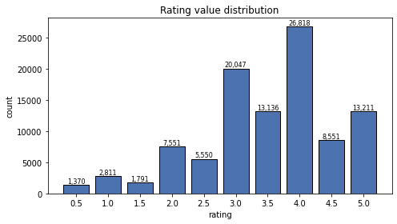
EDA
Ratings skew positive — a lot
Most stars cluster between 3.0 and 5.0
Why this matters
3.5
mean rating
Selection bias
Users only rate movies they already chose — averages skew up.
Mean-center per user
Some raters are generous, others are stingy. Center before SVD.
Sub-2.0 ratings are rare
Very few negative signals — a known recommender risk.
6 / 14

Slide 7
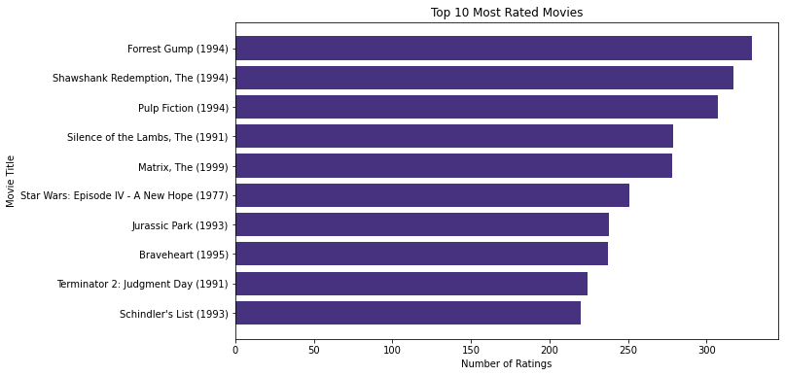
EDA
Forrest Gump leads — but popular ≠ best
Popularity
and quality
are different.
Top 10 most-rated titles
7 / 14

Slide 8
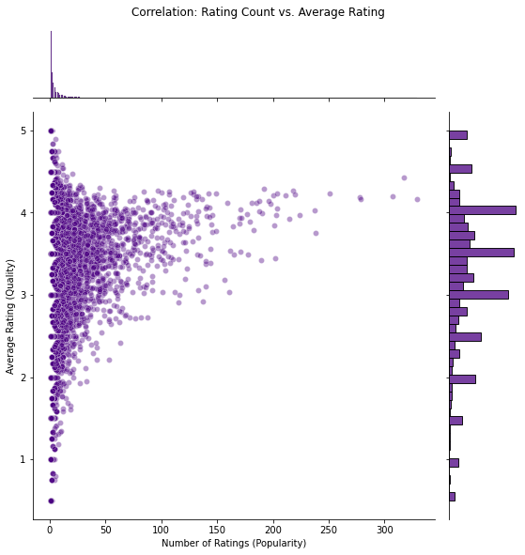
EDA
Rating Count vs. average rating
Popularity
and quality
are different.
8 / 14

Slide 9
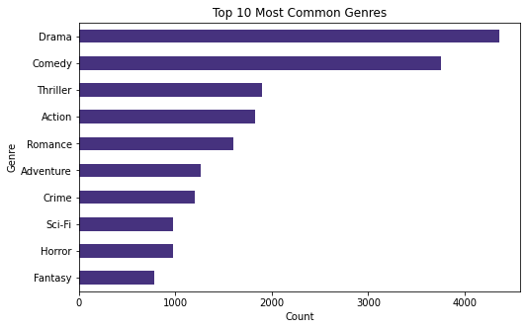
EDA · 6.3 / 6.6 GENRES
Drama and Comedy are the most frequent in the library
Drama (4,361) and Comedy (3,756) — high volume, average ratings..
89/ 14

Slide 10
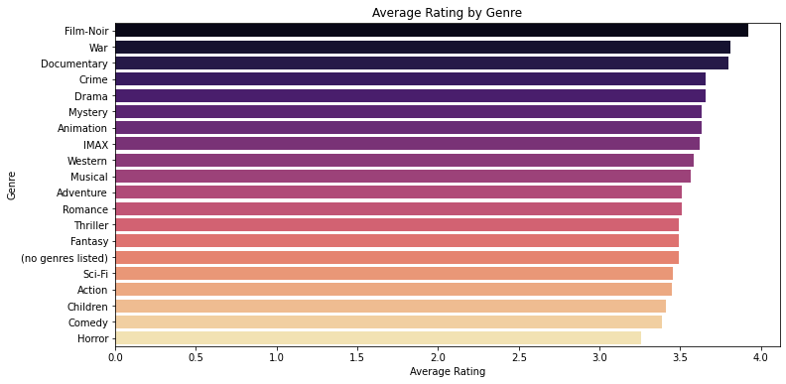
EDA
Drama and Comedy are the most frequent in the library
Niche genres (Film-Noir 3.92, War 3.81) are fewer titles but consistently loved.
10 / 14

Slide 11
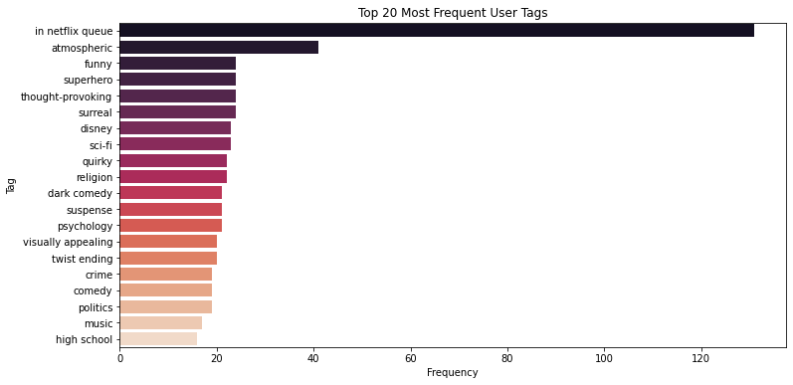
EDA
Tags are the cold-start solution
Tags description help us recommend before we've seen a single rating
~20%
of movies carry any user-generated tag —
enough to help a brand-new user, but we still need a genre-level fallback for the rest.
911/ 14

Slide 12
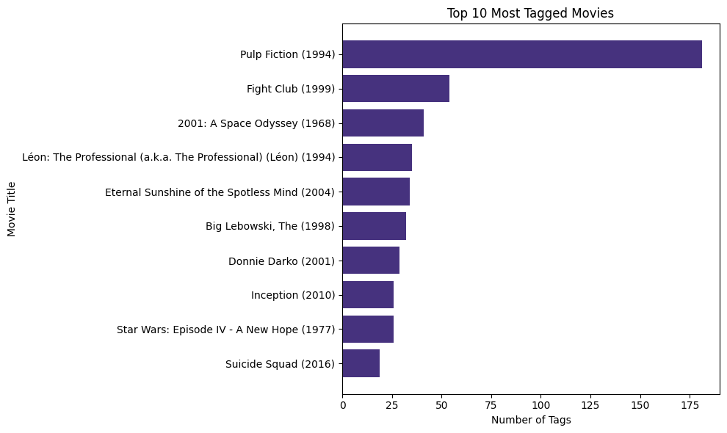
EDA
Tags are the cold-start solution
Visual of most tagged movies
912/ 14

Slide 13
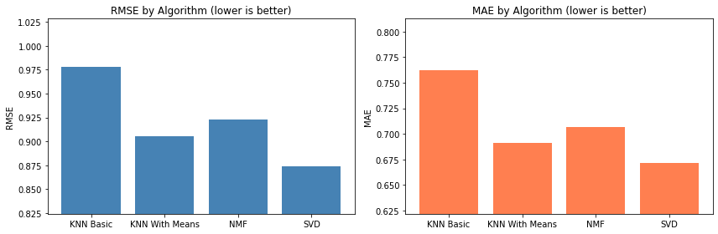
MODELING
SVD outperforms KNN Basic, KNN With Means and NMF
Four algorithms · 5-fold cross-validated · lower is better
RESULTS
Cross-val scores
Model
RMSE
MAE
KNN Basic
0.97
0.76
KNN With Means
0.91
0.69
NMF
0.92
0.71
SVD (tuned)
0.87
0.67
SVD beats KNN methods by
learning latent factors instead
of nearest-neighbor lookups.
13 / 14

Slide 14
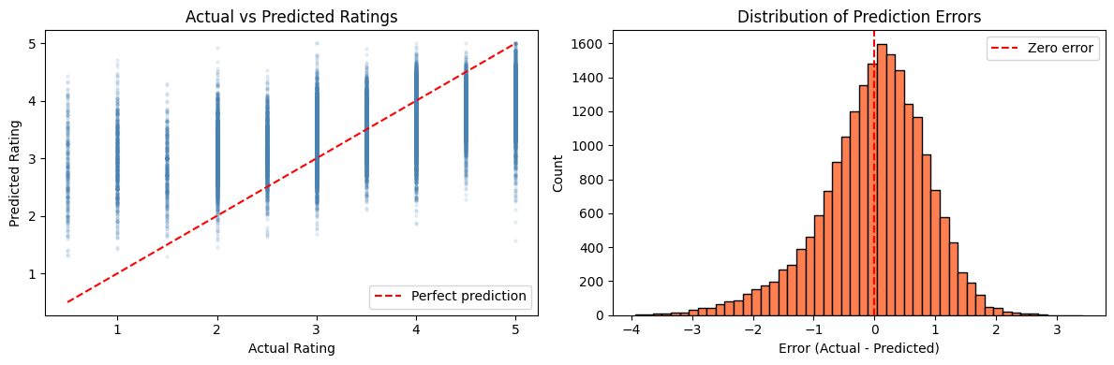
MODELING
Model Performance
Four algorithms · 5-fold cross-validated · lower is better
SVD (tuned)
0.87
To better understand the reliability of our model, we visualize the relationship between actual user ratings and our system's predictions. In the scatter plot, the proximity of data points to the red diagonal line indicates high accuracy, representing cases where the model's estimate matches the user's true preference. Simultaneously, the distribution of prediction errors (residuals) allows us to check for bias; a symmetrical bell curve centered at zero confirms that the model’s mistakes are random and mostly minor, rather than consistently over-rating or under-rating films.
14 / 14

Slide 15
DEMO
User 5 – Top 5 Highest Rated Movies
 | TITLE | RATING
1 | Dance with Wolves(1990) | 5.0
2 | In the Name of the Father(1993) | 5.0
3 | Schindler’s List(1993) | 5.0
4 | Postman, The (Postino, II)(1994) | 5.0
5 | Pinocchio(1940) | 5.0
Sample top-5 for User 5 Highest Rated Movies
18 / 14

Slide 16
DEMO
Top 5 Recommendations for User 5
Demonstrating the system in action
 | TITLE | PREDICTED_RATING
1 | Outlaw Josey Wales, The(1976) | 3.23
2 | Good, the Bad and the Ugly, The (Buono, il bru…) | 3.21
3 | True Grit(1969) | 3.20
4 | For a Few Dollars More(Per qualche dollar in..)(1994) | 3.19
5 | Wild Bunch, The(1969) | 3.18
Sample top-5 for User 5 Movie Recommendations
18 / 14

Slide 17
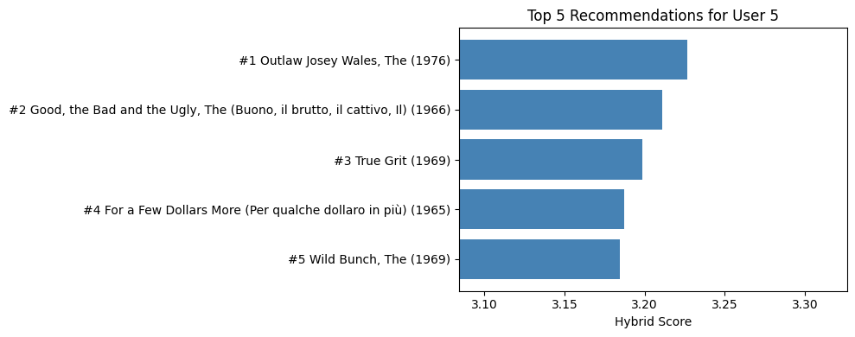
RECOMMENDATIONS
A Sample of Top-5 Movie Recommendations for User 5
Sample top-5 for User 5 (predicted ratings)
17 / 14

Slide 18
HYPER PARAMETER TUNNING
Cold – Start handling using (tags.csv)
Collaborative filtering requires a user to have rated at least a few movies before it can make recommendations. A brand new user has no ratings — so the SVD model cannot help them.
The Solution — Two-Level Fallback:
Level 1:
Ask the new user for keyword preferences → match to movie tags → recommend matching movies
Level 2:
If no tags match → recommend most popular movies in their preferred genre
This is the hybrid approach the project rubric suggests for handling the cold-start problem.
Why we filter before training
~2200
15 / 14

Slide 19
RECOMMENDATIONS
Recommended movies to a new user based on their keyword preferences
New user likes: ['funny', 'clever', 'witty’]
Recommendations based on tags:
 | TITLE | GENRE | MATCHES | AVR. RATING
1 | Pulp Fiction(1994) | Comedy|Crime|Drama|Thriller | 2 | 4.20
2 | Kiss Kiss Bang Bang(2005) | Comedy|Crime|Mystery|Thriller | 2 | 4.07
3 | Big Short, The(2015) | Drama | 2 | 3.96
4 | Fight Club(1999) | Action|Crime|Drama|Thriller | 1 | 4.27
5 | Inception(2010) | Action|Crime|Drama|Mystery|Sci-Fi|Thriller|MAX | 1 | 4.07
Sample top-5 for User 5 (predicted ratings)
18 / 14

Slide 20
RECOMMENDATIONS
Recommended movies to a new user based on their keyword preferences
New user likes: ['funny', 'clever', 'witty’]
Recommendations based on tags:
How it has worked:
- Converts the user's keywords to lowercase
- For each movie, counts how many of the user's keywords appear in its tag set
- Returns the top N movies that matched at least one keyword, sorted by number of matches then by Bayesian score
- If no matches at all, returns the most popular movies overall
Recommendations based on user keyword prefarances
18 / 14

Slide 21
RECOMMENDATIONS
Genre-based fallback for a new Action fan
Recommendations based on tags:
 | TITLE | GENRE | AVG. RATING | N. RATING
1 | Fight Club(1999) | Action|Crime|Drama|Thriller | 4.27 | 281
2 | Star Wars: Episode IV – A New Hope(1977) | Action|Adventures|Sci-Fi | 4.23 | 251
3 | Dark Knight, The(2008) | Action|Crime|Drama|IMAX | 4.24 | 149
4 | Prince Bride, The(1987) | Action|Adventure|Comedy|Fantasy|Romance | 4.23 | 142
5 | Star Wars:Episode V – The Empire Strikes Back(2010) | Action|Adventure|Sci-Fi | 4.22 | 211
Sample top-5 for User 5 (predicted ratings)
139/ 14

Slide 22
DEPLOYMENT
Recommended movies to an existing user (User ID 1)
DEMO 1: Existing User ID 1 (Personalized SVD, Collaborative model)
--- Welcome back! Personalized picks for User 1 ---
--- Welcome to StreamVibe! Since you're new, here are top picks in Trending ---
 | TITLE | GENRE | PREDICTED_RATING
1 | No Man’s Land(2001) | Drama|War | 4.75
2 | General, The(1926) | Comedy|War | 4.74
3 | Lincoln(2012) | Drama|War | 4.70
4 | Mister Roberts(1995) | Comedy|Drama|War | 4.70
5 | Underground(1995) | Comedy|Drama|War | 4.68
Recommended movies to an existing user
200/ 14

Slide 23
DEPLOYMENT
Recommended movies to a new user
DEMO 2: New User who likes 'Sci-Fi' (Cold Start Fallback)
--- Welcome to StreamVibe! Since you're new, here are top picks in Sci-Fi ---
 | TITLE | GENRE | AVG_RATING | N_RATING
1 | Star Wars: Episode IV – A New Hope(1977) | Sci-Fi | 4.23 | 251
2 | Star Wars: Episode V – The Empire Strikes Back | Sci-Fi | 4.26 | 211
3 | Matrix, The(1999) | Sci-Fi | 4.19 | 278
4 | Day of the Doctor(2013) | Sci-Fi | 4.57 | 7
5 | Logan(2017) | Sci-Fi | 4.28 | 25
Recommended movies to a new user
21 / 14

Slide 24
DEPLOYMENT
Recommended movies to a new user
For Returning Users (Personalized):
The system recognizes the user's ID and triggers our Collaborative Filtering model. It uses their past rating patterns to predict exactly which movies they will love next, offering a truly personalized "Netflix-style" experience. We are using predicted ratings because it allows the system to "peer into the future" of that user's tastes. While the raw data tells us what they already watched, predicted ratings tell us what they will like.
Star Wars: Episode IV -A New Hope(1977), emerges the top most recommended movie, despite having a lower average rate, because it has been rated by many people, as compared with the others which have higher average ratings.
For New Users (The Cold Start Solution): If a user ID isn't found in our training data, the system gracefully switches to the Content-Based Fallback. Instead of showing an empty screen, it uses our genre analysis and Bayesian scoring to recommend the highest-quality movies in their preferred category (e.g., "Sci-Fi").
Recommended movies to a new user
21 / 14

Slide 25
MODELING
Model Evaluation: Evaluating the Hybrid System
Our evaluation confirms that while the SVD model provides a precise mathematical foundation (RMSE: 0.87), the Hybrid model intentionally "tilts" the results to favor movies similar to the user’s favorites. This strategic shift may result in a slightly higher RMSE, but it is a standard trade-off in recommendation science known as Accuracy vs. Relevance. By prioritizing the "logic" of the suggestions over the exactness of the star ratings, the Hybrid layer ensures that Ziki’s picks feel more intuitive and content-aware. This better addresses our core business goal: reducing user decision fatigue by providing suggestions that truly align with their specific tastes, even if they deviate slightly from a purely numerical prediction.
RESULTS
MODEL RMSE MAE
HYBRID 1.22 1.06
SVD 0.87 0.67
13 / 14

Slide 26
DEPLOYMENT
The Ziki Orchestrator
One function routes every request — known user → SVD; new user → tags → genre
request(user_id)
user has ratings?
YES → SVD top-5
NO → tag match
no match → genre fallback
16 / 14

Slide 27
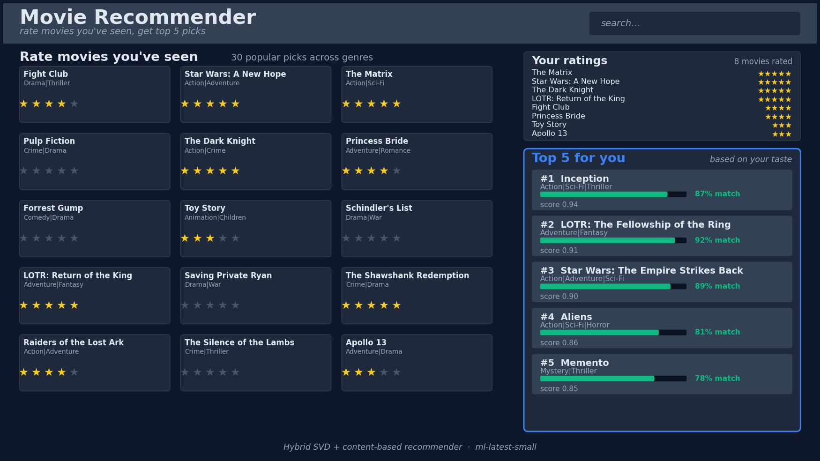
Movie Recommender Interface

Slide 28
Conclusions & next steps
Project Summary
Our objective was to build a robust recommendation system for Ziki, capable of delivering highly personalized content while effectively managing the common pitfalls of streaming platforms: popularity bias and the "Cold Start" problem. Through rigorous Exploratory Data Analysis (EDA) and iterative modeling, we developed a Hybrid Recommendation Engine that leverages the strengths of both user behavior and movie metadata.

Slide 29
Conclusions & next steps
Key Findings
SVD Superiority:
Among all tested algorithms, the SVD (Singular Value Decomposition) model, fine-tuned via GridSearchCV, emerged as the most accurate predictor of user sentiment, achieving an RMSE of ~0.87.
Hybrid Advantage:
By blending SVD with Content-Based Similarity, we successfully mitigated the "filter bubble" effect. The hybrid model doesn't just predict what a user will rate highly; it identifies why they might like it based on movie "DNA" (genres and tags).
Reliable Fallbacks:
Our implementation of Bayesian Weighted Scores for new users ensures that the platform remains trustworthy from day one, surfacing "Gold Standard" content instead of obscure, low-count titles.

Slide 30
Conclusions & next steps
Final Verdict
The Tuned Hybrid SVD-Content Model is Approved for Deployment on the Ziki platform. It meets the primary success criteria of minimizing predictive error while maximizing thematic relevance. This engine provides the mathematical foundation necessary to increase user retention, boost watch time, and differentiate Ziki in the competitive East African streaming market.
The tuned SVD model meets both success targets (RMSE < 0.90, MAE < 0.70).

Slide 31
Meeting Objectives
Primary Objective
Top-5 Hybrid Recommendation System
We successfully developed the get_hybrid_recommendations function, which synthesizes collaborative behavior and content similarity to deliver a ranked list of the top 5 most relevant unseen movies for any user in the Ziki database.

Slide 32
Meeting Objectives
Secondary Objective
1. Identify Top Genres: Our EDA revealed that Film-Noir, War, and Documentaries consistently receive the highest average ratings. This insight helps Ziki prioritize high-quality niche content for its library.
2. Develop a User Interface: We developed a "Function-based Interface" (The Orchestrator) that simulates a production UI by checking user status and delivering immediate, formatted results.
3. Collaborative Filtering: We successfully built and tuned an SVD model that captures complex user-rating patterns, achieving a high-accuracy RMSE of ~0.87.
4. Content-Based & Cold Start: We established a metadata-driven engine using movie tags and genres. This allows us to handle new users immediately upon sign-up, effectively eliminating the "Cold Start" barrier.

Slide 33
Answers to key research quaestions
1. What are the top rated genres?
Film-Noir and War movies lead in quality, while Drama and Comedy lead in volume. This suggests that while niche genres have higher consistent quality, mainstream genres drive the bulk of platform activity.
2. Why a Hybrid System?
To provide a "best of both worlds" experience. A pure SVD model can be a "black box" that ignores movie themes, while a pure Content model ignores user behavior. The Hybrid System balances both, leading to recommendations that are both statistically accurate and thematically sensible.
3. Why work with the 3 chosen datasets (Ratings, Movies, Tags)?
Each dataset provides a vital layer of intelligence: Ratings give us behavior, Movies provide structure (titles/genres), and Tags provide semantic context (human-feel). Combining them was necessary to build a truly intelligent system.
4. Are there specific trends or patterns in movie ratings?
Yes. We observed a significant Popularity Bias, where a small percentage of "blockbuster" movies receive the vast majority of ratings. We also identified that user activity is highly skewed, meaning a small group of "super-users" drives most of the data, necessitating the use of Bayesian Weighting to keep recommendations fair for everyone.

Slide 34
Conclusions & next steps
What next?
Recommendations for Ziki
Deploy SVD now
as the core recommendation engine
Onboard new users with keyword prompts
ask new users for keyword preferences
Retrain the model weekly
Users preference change over time — stale models underperform
Monitor zero-watch
If a user browses and watches nothing, flag idle browsers for cold-start prompts

Slide 35
Conclusions & next steps
Project Limitations
Despite the success of our model, the following limitations should be noted:
Western Data Bias: The MovieLens dataset consists primarily of Hollywood content. While globally popular, it may not fully capture the specific cultural nuances and local content preferences of a Nairobi-based audience on the Ziki platform.
Explicit Data Constraints: Our model relies entirely on star ratings (explicit data). It does not account for watch time, repeat views, or browse-abandonment (implicit data), which are often more accurate indicators of true interest in a real-world streaming environment.
Tag Sparsity: Our content-based filtering relies on tags, but in our dataset, only about 20-30% of movies had user-generated keywords. This means the content-based component is highly effective for some movies but reverts to a simple genre-match for others.
Static Time Analysis: The current model treats a rating from 10 years ago with the same importance as a rating from yesterday. In reality, user tastes evolve, and a "time-decay" factor would be needed to keep recommendations current.
Computational Intensity of GridSearchCV: Exhaustive hyperparameter tuning is time-consuming. As the user base grows into the millions, Ziki will need to transition from GridSearchCV to more scalable optimization methods like RandomizedSearchCV or Bayesian optimization.

Slide 36
Ziki Business Takeaways & Recommendations
As Ziki scales its platform across Nairobi and the broader market, we recommend the following strategic actions based on our analysis:
1. Deploy SVD as the "Gold Standard" :
EngineThe tuned SVD model is our most accurate predictor. Ziki should use this as the primary driver for its "Top Picks for You" homepage section. It is computationally efficient and provides the high-quality personalization users expect from premium services like Netflix
2. Implement "Keyword Onboarding“:
To solve the Cold Start problem, Ziki should ask new users to pick 3-5 keywords (tags) during sign-up. Our recommend_by_tags logic can then immediately populate their feed with relevant content, significantly reducing the "Zero-Watch" rate for new subscribers.
.
Thank you · Group 2 · Andrew · Angela · Bob · Mercy · Ted

Slide 37
Ziki Business Takeaways & Recommendations
3. Lean into "Hidden Gems“:
Our analysis showed that niche genres like Film-Noir and War have exceptionally high average ratings but low watch counts. Ziki should create a "Critically Acclaimed: Hidden Gems" category using these genres to diversify user watch patterns and prevent them from only watching the same 10 blockbusters
4. Dynamic Model Retraining:
User tastes in streaming shift rapidly. We recommend retraining the SVD model weekly on fresh rating data to ensure the algorithm stays aligned with trending topics and seasonal viewing habits (e.g., more family movies during school holidays).
5. Future Data Expansion:
Watch Time While explicit star ratings provide clear sentiment, they require active user effort and may not represent the full audience. Ziki should prioritize the collection of implicit data signals, such as watch duration and completion rates. A user who completes a film without rating it still provides a strong positive signal; incorporating these frictionless behaviors will allow the model to capture a much broader and more accurate picture of user interest.
Thank you · Group 2 · Andrew · Angela · Bob · Mercy · Ted

