Slide 1
Virtual Room Reservation Assistant
By ： Group 21
李柏賢 B10815007
羅翡幸 B10815009
葉小婷 B10815011
范恩琪 B10815013
施佳妘 B10815014

Slide 2
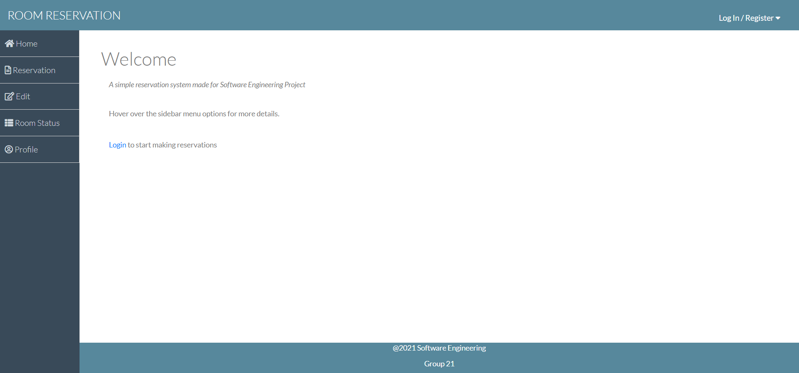


Home Page
Home Page when logged out
Notes:
This is the homepage for the reservation room
Register first if you don’t have the account
Then login

Slide 3
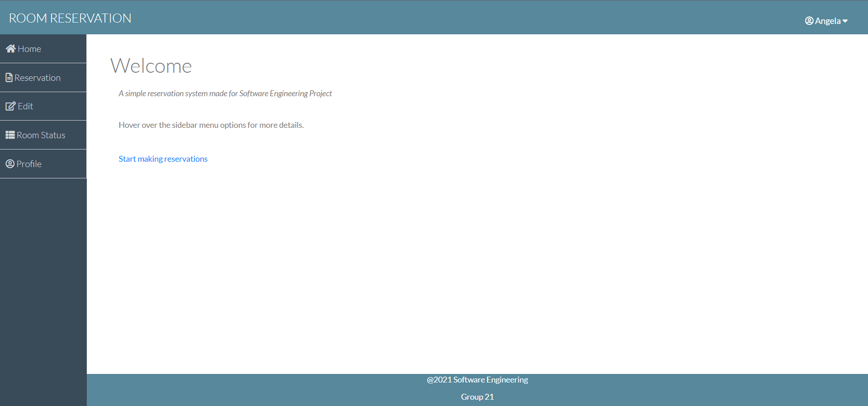
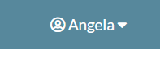

Home Page
Home Page when logged in
Notes:
This is the page after login and you can see your login name in the top right
And then of course you can start booking a room

Slide 4
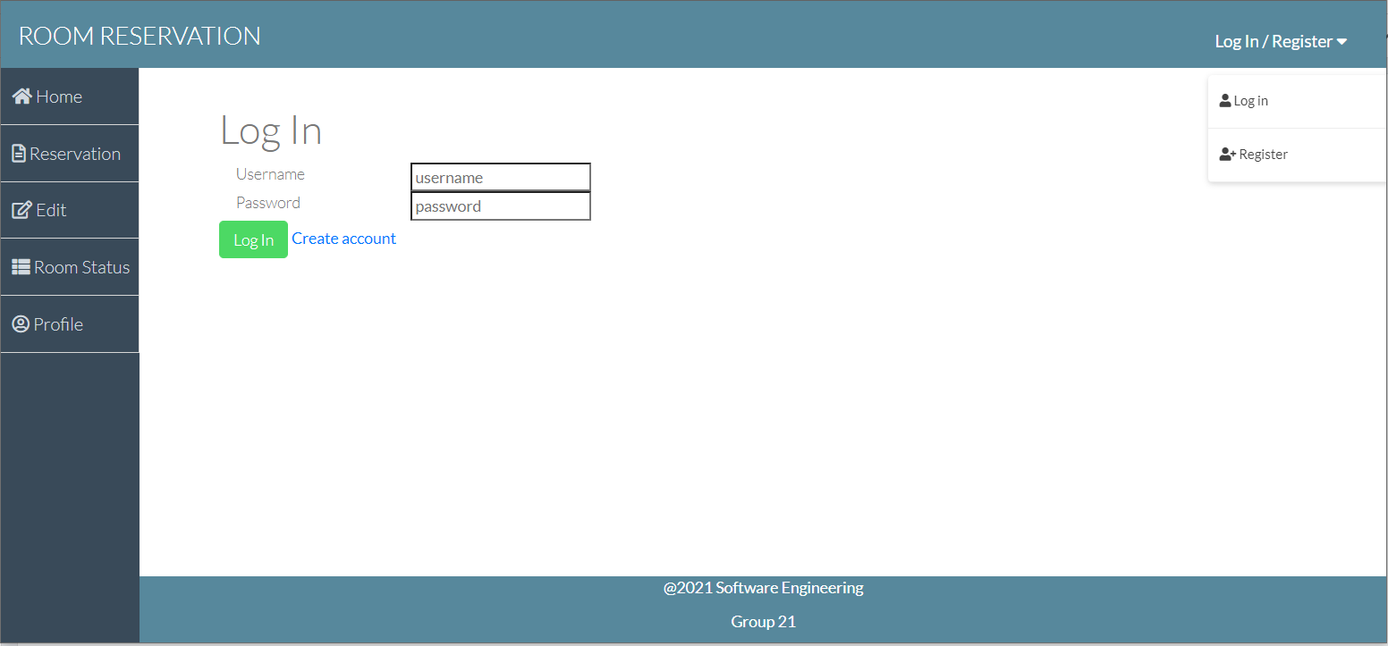
Login Page
Used for user Login
User can alternatively create/register account page if account hasn’t been made
After logged in:
‘Login/Register’ will be replace with ‘Logout’
User redirected to Home page

Slide 5
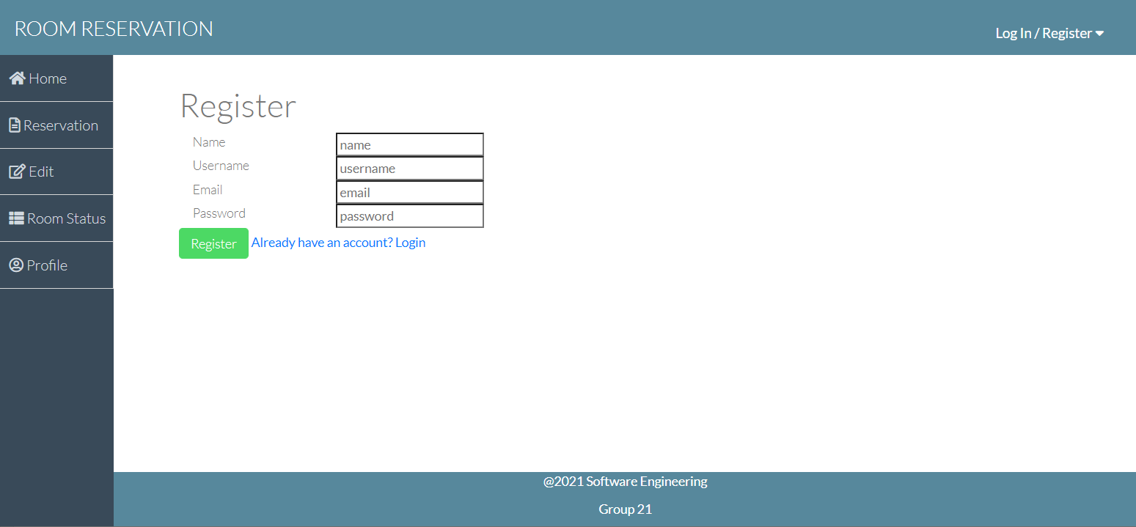
Registration Page
Used for creating or register new account
User can access login page from here if account exists

Slide 6
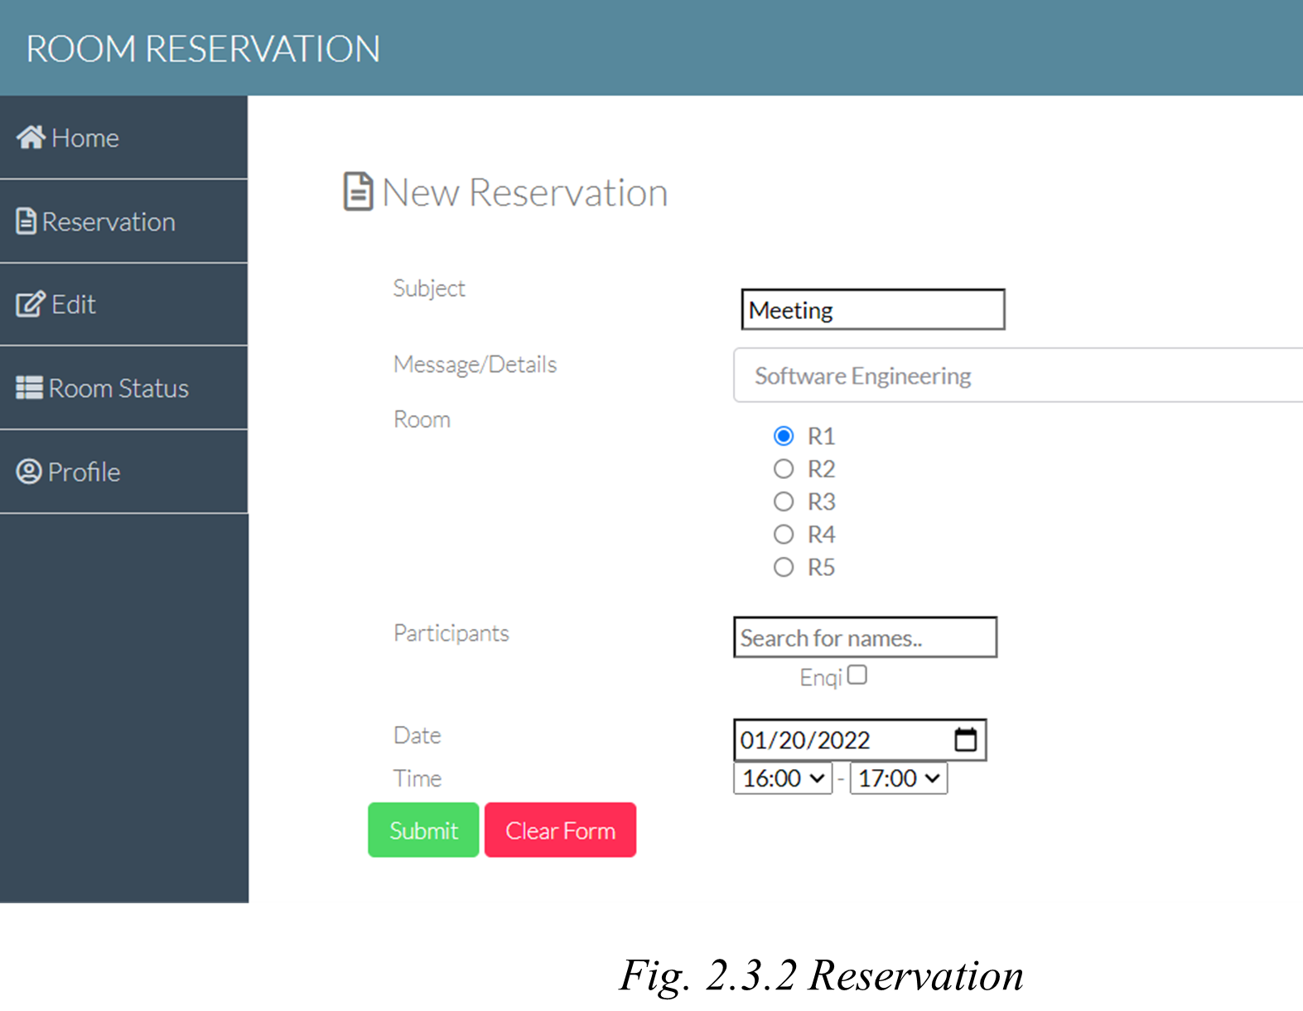
Reservation Page
Used for reserve rooms
Default values:
Subject: “Meeting”
Date: Today’s date
Time: 1 hour after current time
Room selection is a mandatory.
Message/Details & Participants are optional (participants can be added later)
Notes:
Subject of the reservation can be changed according to the purpose of the reservation room
You also can add any additional requirement to the message and details box
There are 5 room that you can book
Participants can be search by name but for those who haven’t register an account yet cannot be invited to the meeting
Then set the date and time of the meeting
If any participant have another meeting that need to attend and you also choose the same time for the meeting the system will warning you. For example, another participant have an appointment in jan 22 at 1 to 3 o’clock and you make an appointment at 2 to 4 o’clock, resulting the system warning that one of your participant have another meeting to attend

Slide 7
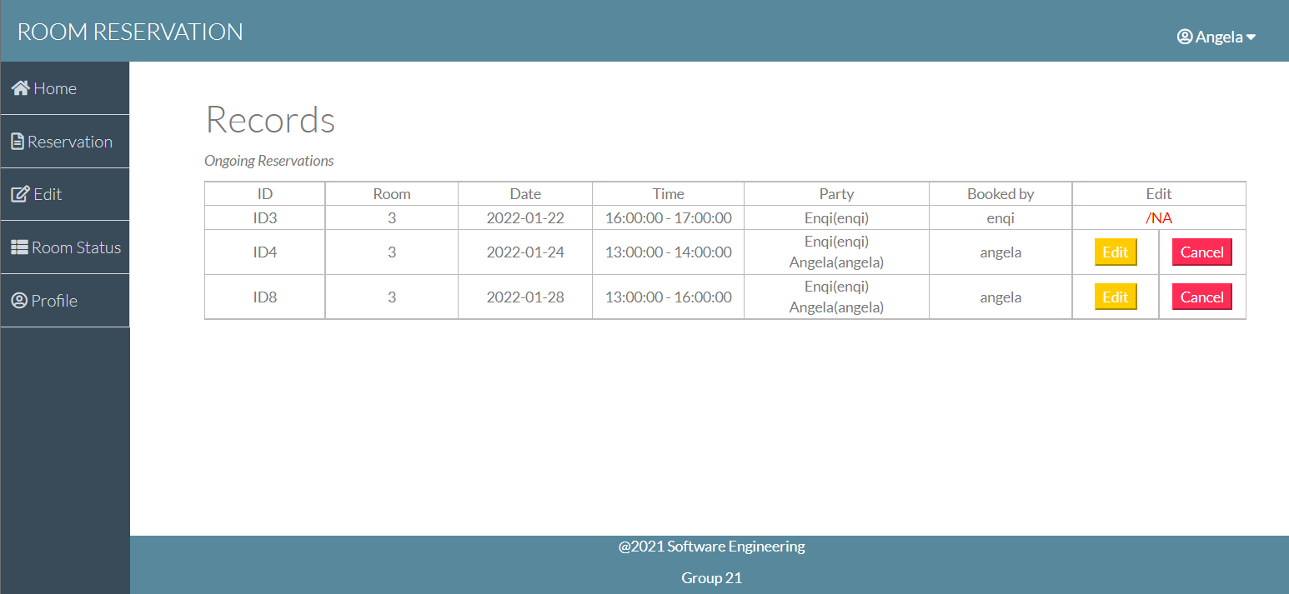
Edit Page
Used for reservation editing or canceling
All Ongoing reservation will be displayed
Notes:
This page show all the reservation that are already being reserve
And if there are any change of the reservation it also can be edit in this page

Slide 8
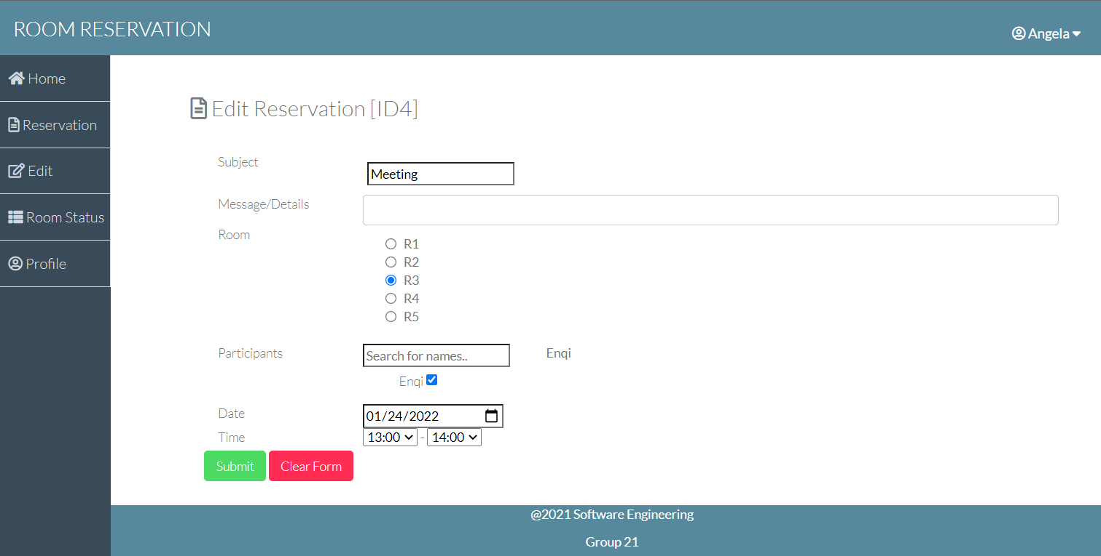
Edit Page (Reservation Editing)
Used for editing Upcoming reservations
All form inputs will be pre-populated with reservation’s current record
Notes:
In this page you can edit if there is any new participant that wanted to be add
Or there are any participants that have something important to deal with

Slide 9
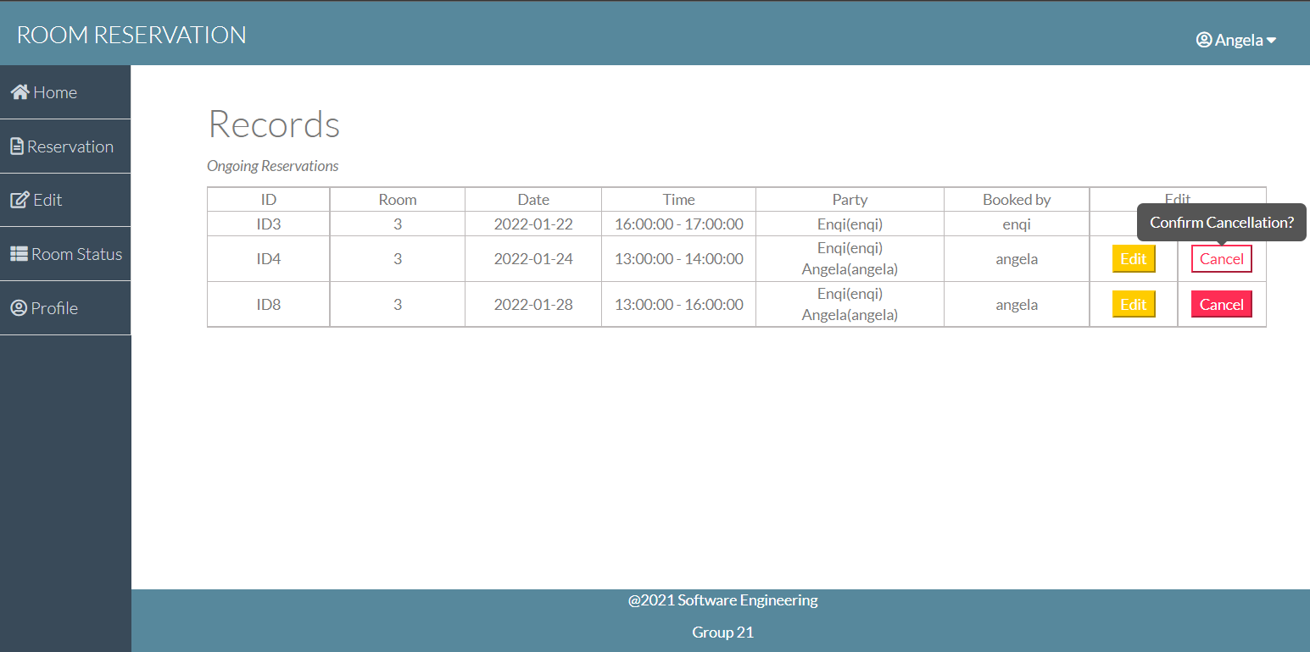
Edit Page (Cancelation)
Cancel button will trigger confirmation popup before cancelling

Slide 10
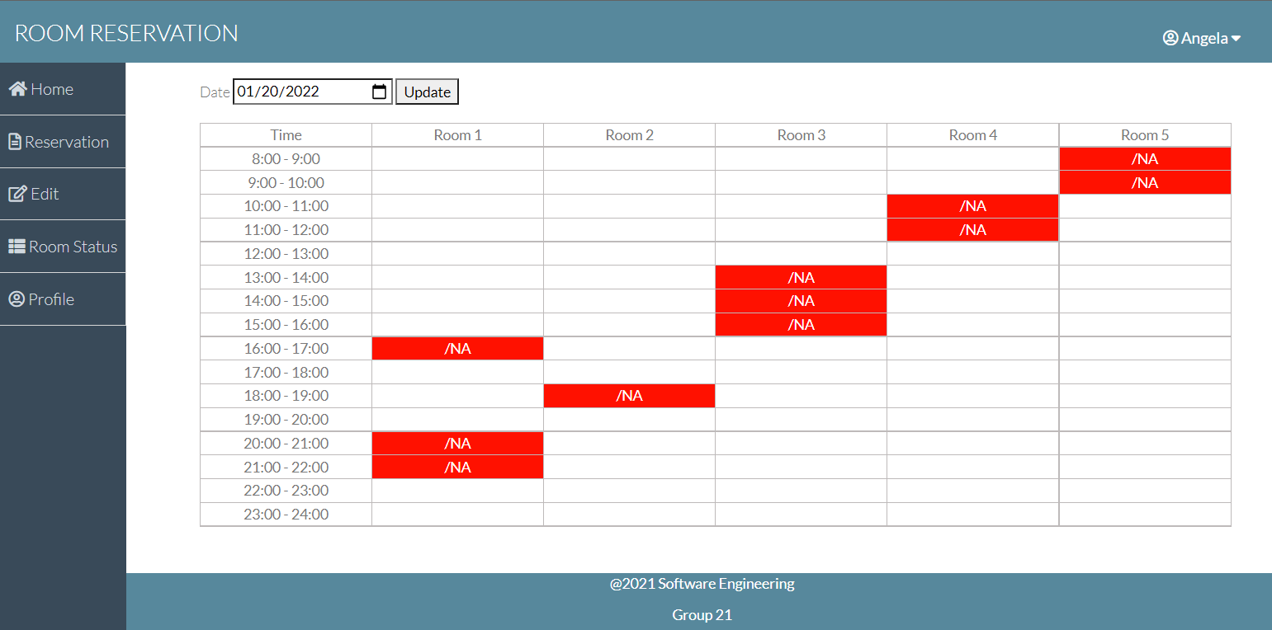
Room Status
Used for checking room reservation status
Shows the timetable of each room’s availability for the selected date

Slide 11
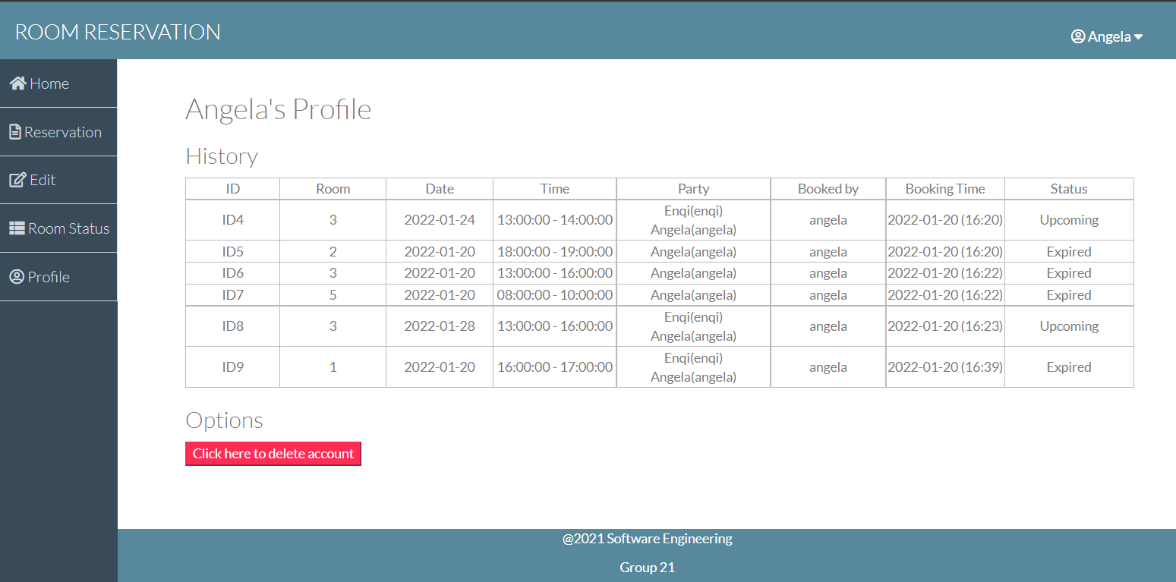
Profile
Used to check the user’s profile, all reservation history is visible (ongoing, upcoming, expired)
Button option to delete account

Slide 12
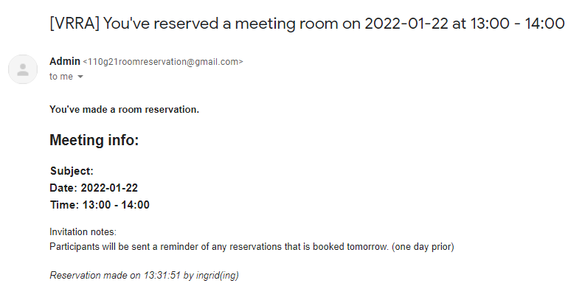
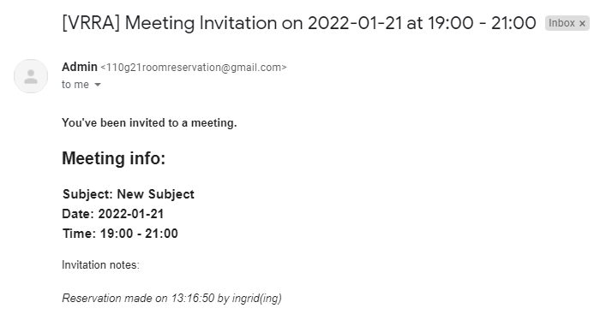
Email Screenshots
Reservation Booking email sent to Host
Reservation Invitation email sent to Participant

Slide 13
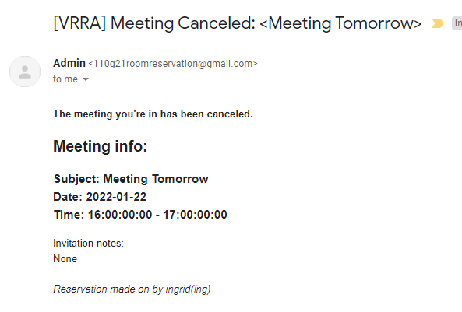
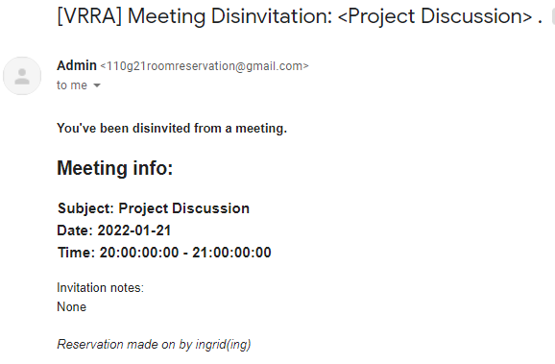
Email Screenshots
Reservation Cancelation email
Email sent to disinvited participants

