Slide 1

Requirements Gathering for Biometric Students Attendance Mobile Application
Group 13
Requirements Gathering For Biometric Students Attendance Mobile Application
Task 2
GROUP 13
Dr Valery
Dr Valerie

Slide 2
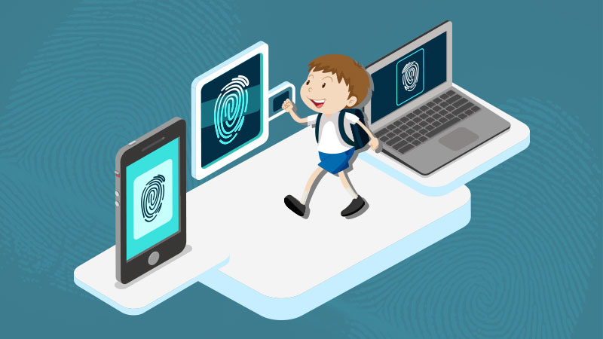
TABLE OF CONTENTS
INTRODUCTION
STAKEHOLDER IDENTIFICATION
REQUIREMENT GATHERINH TECHNIQUES
REQUIREMENT CONSTRAINTS

Slide 3
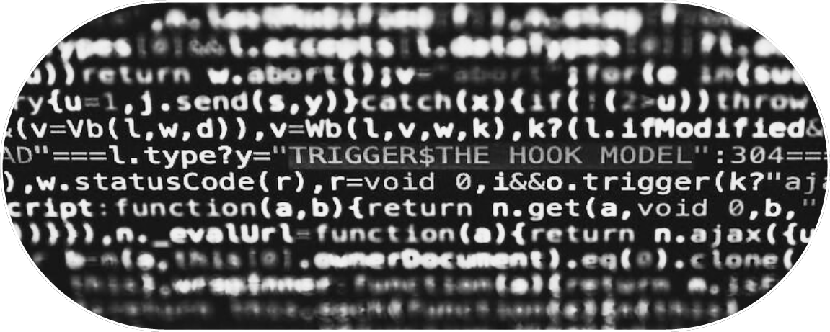
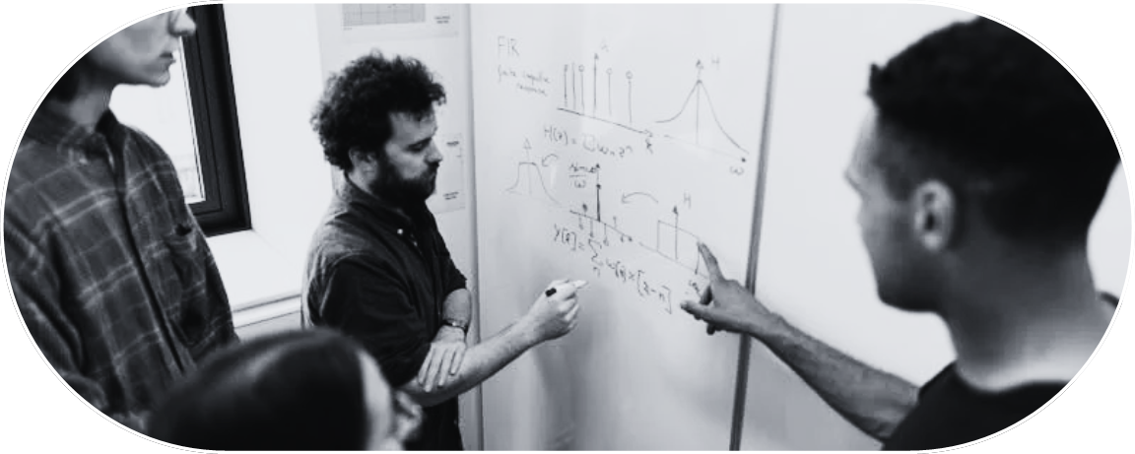
INTRODUCTION
PROJECT SCOPE
Scope Statement
The objective of our biometric student attendance mobile application is to streamline the process of tracking student attendance in our educational institutional.
Deliverable
It has been by many lecturers that one of the measure reason why students in the University of Buea fail their courses is because of very poor class attendance.

Slide 4
What do we understand by Requirement gathering??
Requirement gathering is the process of collecting, documenting, and analyzing the needs, expectations, and specifications of stakeholders for a particular project or system. It is a crucial phase in the software development lifecycle and serves as the foundation for designing and implementing a solution that meets the desired objectives and requirements. In this document we are going to outlines the needs and users wants in this our system.

Slide 5
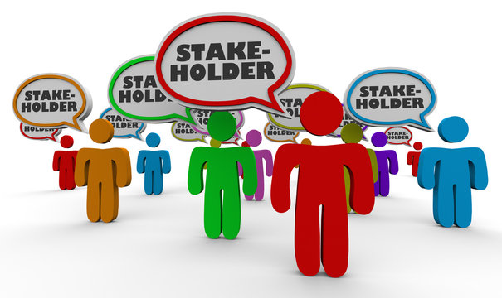
Stakeholder Identification
What do we understand by Stakeholder????
Identification of key stakeholders involved in the project their roles and responsibility
Student
Instructors
Administrative Staff

Slide 6
Stakeholder Identification
Important of involving stakeholders in the requirement gathering process
Understanding their need
Building Support
Validating Assumption

Slide 7


Requirement gathering techniques
Interviews
One to one interviews where conducted with key stakeholders of our platform such as Students, Instructors and Administrative staff.
Online Surveys
Google sheets forms where written so as to ease the work of send to other stakeholders.

Slide 8
Requirement gathering techniques
Document Analysis
Document analysis is a research method used to examine and interpret written or recorded information to gain insights and understanding about a particular topic .
Brainstorming
Here we tried to generate a large number of ideas, solutions between us the team developers.

Slide 9
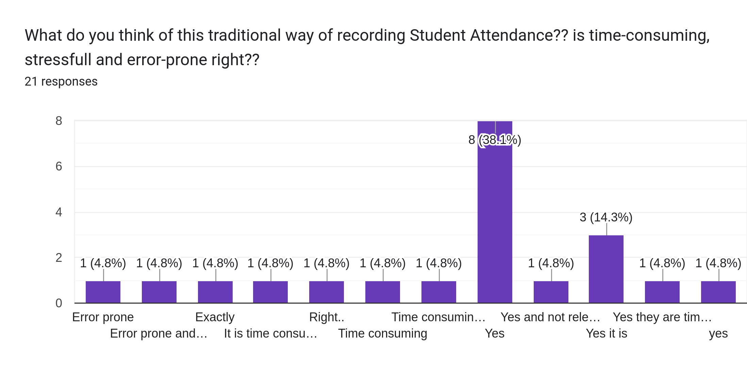
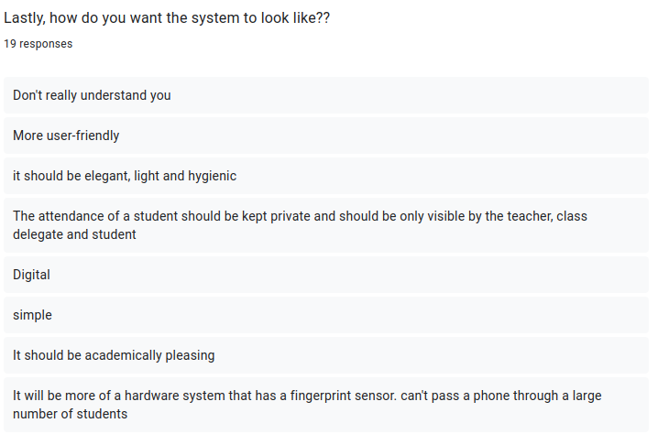
Requirement Gathering Results
Data Assessment
After the online survey was done using Google forms, the following results were gotten from the responses of the students.

Slide 10
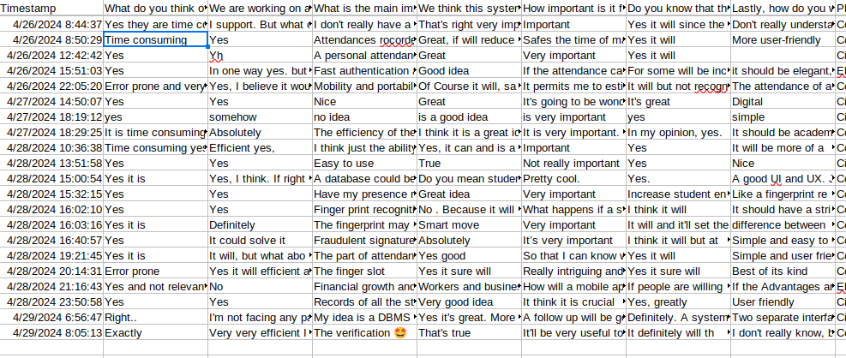
Data Visualization
The data obtained from google forms were exported to an excel sheet for better visualization of students’ responses for the extractions of relevant requirements

Slide 11
COTEGORIES THE VARIOUS REQUIREMENTS GOTTEN FROM DIFFERENT REQUIREMENT GATHERING TECHNIQUES WE USED
Requirements gotten from Document Analysis
Compatibility
Real-time Attendance tracking
Recording
Biometric Authentication
Scalability

Slide 12

COTEGORIES THE VARIOUS REQUIREMENTS GOTTEN FROM DIFFERENT REQUIREMENT GATHERING TECHNIQUES WE USED
Requirements gotten from Brainstorming
Attendance Exception
Attendance Backup
Notification

Slide 13
COTEGORIES THE VARIOUS REQUIREMENTS GOTTEN FROM DIFFERENT REQUIREMENT GATHERING TECHNIQUES WE USED
Attendance Report
Attendance percentage notification
Portability
Easy to use
Performance
security
Weekly reviews
Efficiency
Requirements gotten from Online Survey

Slide 14
COTEGORIES THE VARIOUS REQUIREMENTS GOTTEN FROM DIFFERENT REQUIREMENT GATHERING TECHNIQUES WE USED
Requirements gotten from interviews
Instructors
Attendance Session Taking
Time frame
Registration and login Process
Generate Attendance Records
Security

Slide 15

COTEGORIES THE VARIOUS REQUIREMENTS GOTTEN FROM DIFFERENT REQUIREMENT GATHERING TECHNIQUES WE USED
Requirements gotten from interviews
Administrative Staff
This is what they have to said

Slide 16
Dr Nguti
Vice Dean
“Passing the tablet round the class or putting it at the wall is not that flexible at all. If the device that is used to record student attendance using their finger print is passed round the class is not a flexible option to used. because student may broke or damage the tablet/device, may mistakenly throw the tablet down and it can get missing/stolen. He said that he guarantee that a week will not passed that two or more tablet/device is not damage and the school will need an army of maintenance staffs to handle those damage device and also the school will need to buy tablet almost every week. Which will be so costly on the administration sites.”

Slide 17
DEAN
FET
“Firstly he was really marvelous when we told him about this project that we are building and he said if we successfully build such a great project, he is going to support us, for it to be implemented there at the faculty and if successfully implemented there at the faculty and really performing great, he will showcase this project to the VC on how it can be implemented in our institution levels. He also said something similar to what Dr Nguti said, looking on cost site if it will be costly for the faculty let look on other option that will be less costly for the faculty.”

Slide 18
COTEGORIES THE VARIOUS REQUIREMENTS GOTTEN FROM DIFFERENT REQUIREMENT GATHERING TECHNIQUES WE USED
Requirements gotten from interviews
Administrative Staff
The system should be a client Server Application. When the lecturer wants to record students’ attendance through the platform, the lecturer will just initiate the attendance taking, the student will login from their client application installed on their device and they will double authenticate themselves with their fingerprint data to ensure they are the one login in, after doing that, they will connect to the server of the lecturer machine/device using the lecturer hotspot and they will probe to mark their attendance using their fingerprint on their client application. And the data will be sent to the server application, which processes it, marks attendance, and stores information in a database.
Client Server Application

Slide 19
COTEGORIES THE VARIOUS REQUIREMENTS GOTTEN FROM DIFFERENT REQUIREMENT GATHERING TECHNIQUES WE USED
Requirements gotten from interviews
Administrative Staff
Fingerprint Enrollment
The student should be able to enroll their fingerprint data through the client application and be securely stored in the server database.
Attendance Summary
The system should be able to generate the summary of the percentage of lectures that an individual student have attended and also for the course as well the percentage of students that have attended that particular course.

Slide 20
COTEGORIES THE VARIOUS REQUIREMENTS GOTTEN FROM DIFFERENT REQUIREMENT GATHERING TECHNIQUES WE USED
The system should be integrated with the school management database or simple Go-student database
Integration
Account Registration
Student should be able to registered themselves into the platform using their name, matriculation number, intuitional email, department, level and password
Monitoring
The system should be also be used to monitor lecturers if they are frequently coming to class

Slide 21
COTEGORIES THE VARIOUS REQUIREMENTS GOTTEN FROM DIFFERENT REQUIREMENT GATHERING TECHNIQUES WE USED
Requirements gotten from interviews
Students
Interface Customization
Attendance Report
Attendance percentage Notification
Usability

Slide 22

Requirement Constraint and Limitation
Constraints
Budget
Time frame
Regulatory Compliance

Slide 23

Requirement Constraint and Limitation
Limitation
Accessibility
Environmental Factors
Unavailability of some of our stakeholder

Slide 24
Conclusion
Overall, requirement gathering is the most essential step of project development and involving the stakeholders in the requirement process promotes collaboration, reduces risks, enhances understanding and increases the chances of the project success.

Slide 25
THANK YOU

