Slide 1
Econophysics: How have tools developed by physicists revealed about Economics
Angela Zu
10/02/2026
For Second year’s talk, St Catherine’s College, Oxford

Slide 2
Questions
How is wealth distributed?
What Distributions Reveal About Economic Dynamics?
Why is the Markov assumptions invalid in stock market?
How to apply dimensional analysis outside of physics?
Motto: “Use models as instruments for intuition rather than as axiomatic certificates of truth”

Slide 3
Guess: How is the shape of distribution of wealth be like?

Slide 4
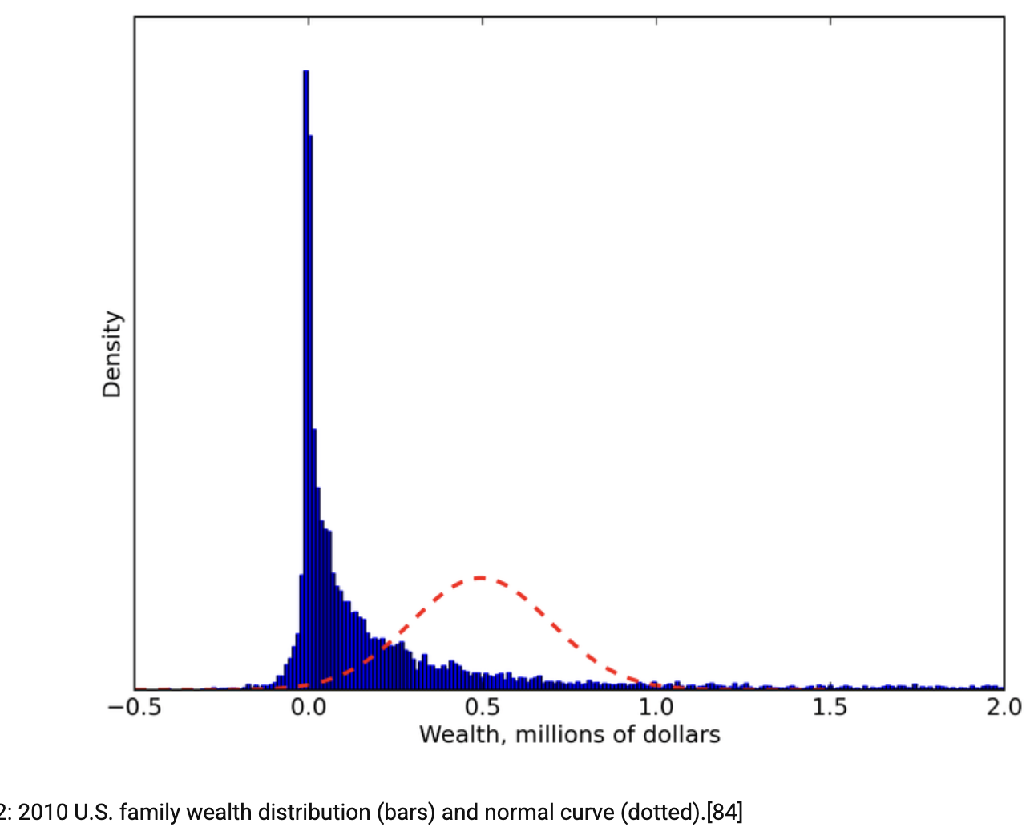
Wealth Distribution: Why This Shape?
- Skewed to the left
- More extreme cases on both tails (billionaires& poverty)

Slide 5

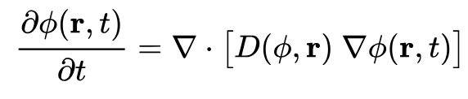
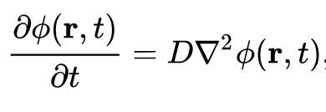
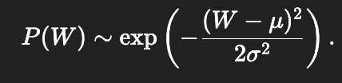
Brownian Motion generates Gaussian Distribution
Additive Random Processes
W(t+1)=W(t)+ξ(t)
Assume that Initial function is Delta function:
, which is normal distribution
Additive Random Process FAILS!

Slide 6
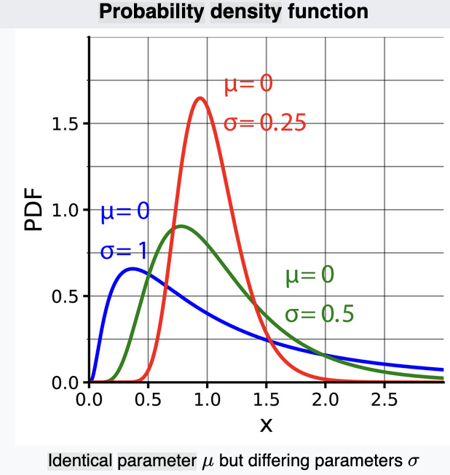


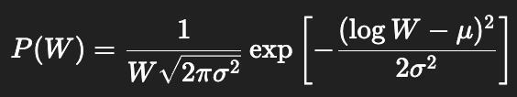
Multiplicative Random Processes and Log-Normal Distributions
a multiplicative stochastic process
Log-normal is better than Gaussian, but it is still not enough, for it’s unsatisfactory behavioral at both tails and 0.

Slide 7
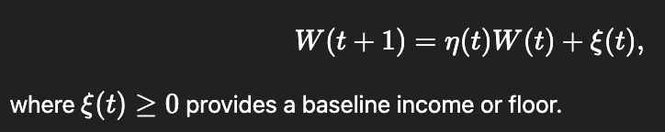

Include Boundary Conditions
Lower bounds: wealth cannot fall below zero.
Additive income: wages, subsidies, or transfers.
Random resets or shocks.
Dissipation mechanisms, such as taxation or consumption.
1. An addictive term prevent wealth from dropping to zero
2. the stationary distribution of
𝑊 develops a Pareto tail (for billionaires)
That’s why we introduce Kesten Process:

Slide 8
Other complexities provoked by policies
......

Slide 9
Conclusion
Body: log-normal
Right tail: Perato
Left tail: Non of the distribution fits well.
Why?

Slide 10
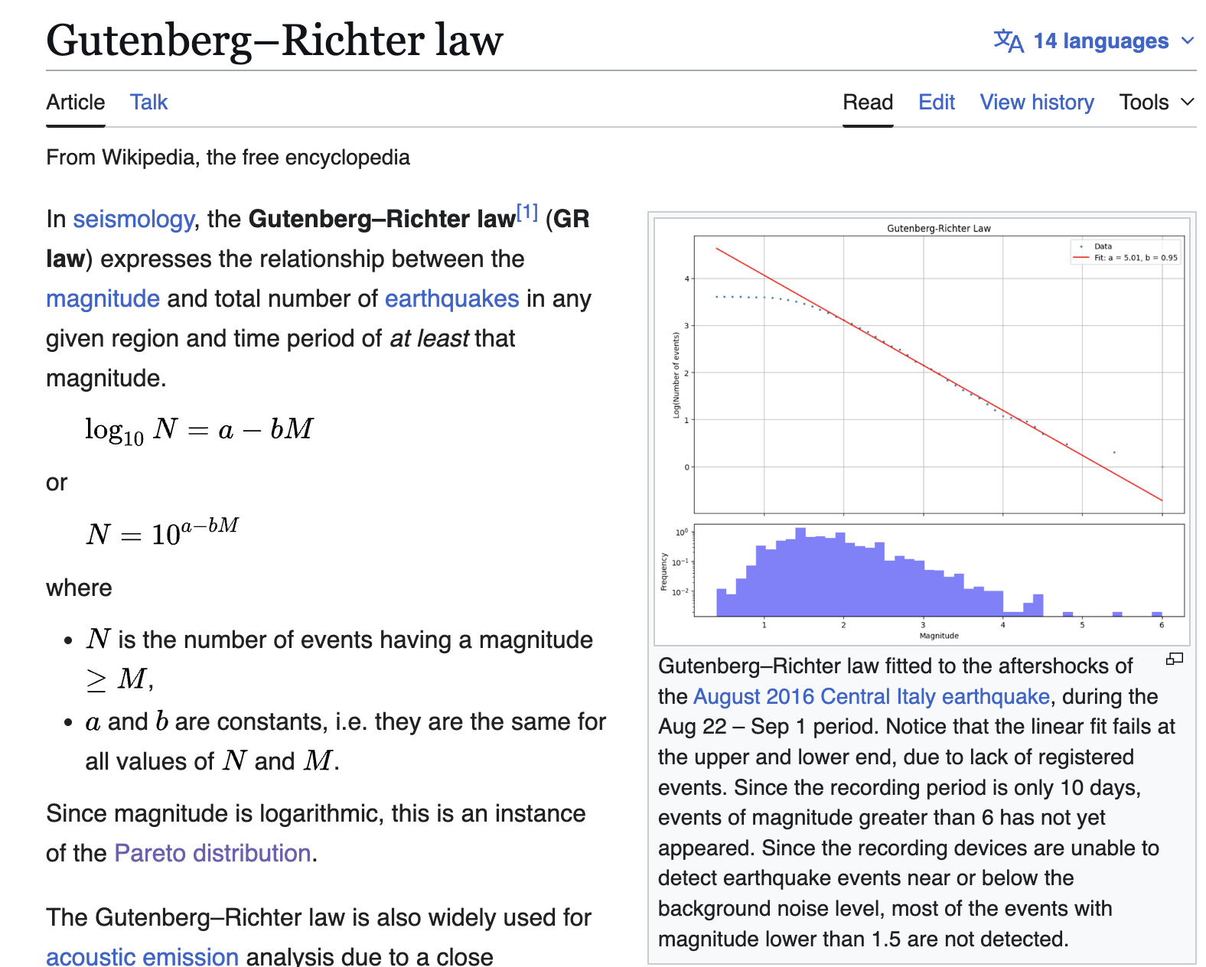

Slide 11
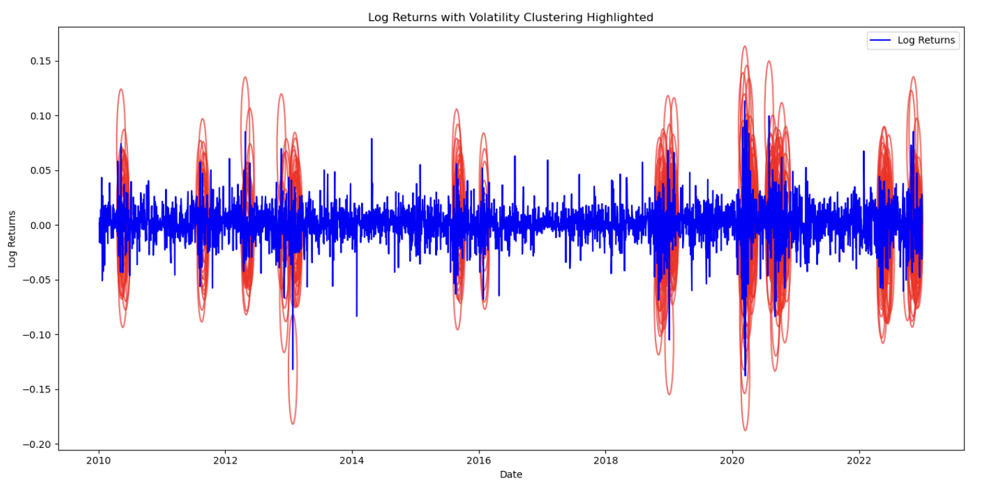
Volatility Clustering
Until now, we preassumed Markov Assumption: “The evolution of a system in the future only depends on its present state, not the past.”

Slide 12


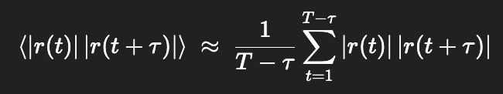

Volatility Clustering: Mathematics
“Return” don’t have momentum:
But “the magnitude of return” (volatility) have momentum
Note: If X and Y are independent,

Slide 13
Why?
Volatility might have something to do with the intrisic property of the stock market: e.g. leverage
......

Slide 14
Dimensional Analysis
Tool: The Vaschy-Bukingham π-theorem
If a physical equation involves n physical variables and m non-linearly dependent fundamental units, then there exists an equivalent equation involving n − m dimensionless variables constructed from the original variables.
We will use this tool to guess the ideal market law!

Slide 15
An example in physics: The ideal gas law
(p, V, T)
pV has the dimension of energy.
RT is thermal energy.
Therefore, PV /RT = cst (or a dimensionless function)

Slide 16
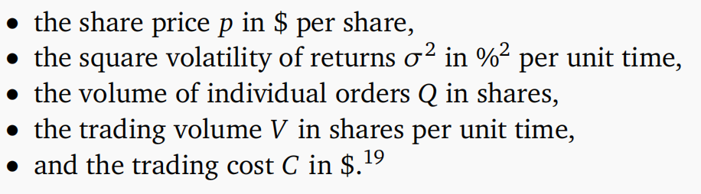

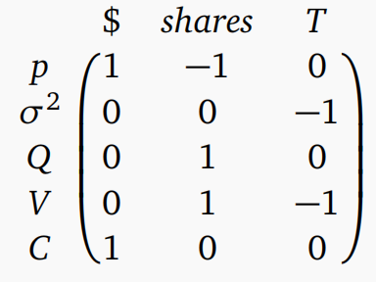
An example in finance: The ideal market law
Assume
How many dimensionless variables is required?
rank = 3,
Therefore, 5-3=2 dimensionless variables are expected.

Slide 17
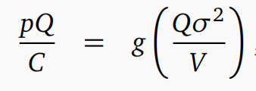

An example in finance: The ideal market law
Bearing in mind that we need 2 dimensionless variables, we choose:
“......should keep p × σ constant”
This suggests that g(x) ∼x ^−1/2, finally leading to the so-called 3/2 law:
where we introduced the trading activity or exchanged risk W := pVσ and the trading rate N = V/Q

Slide 18
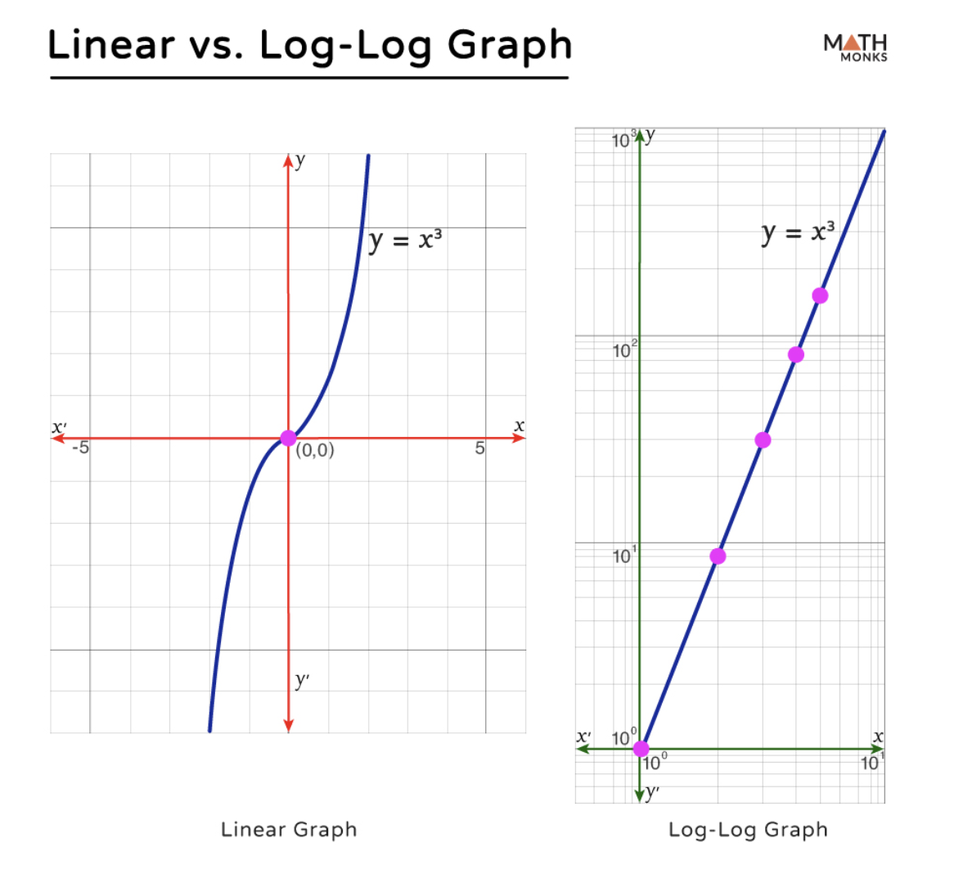
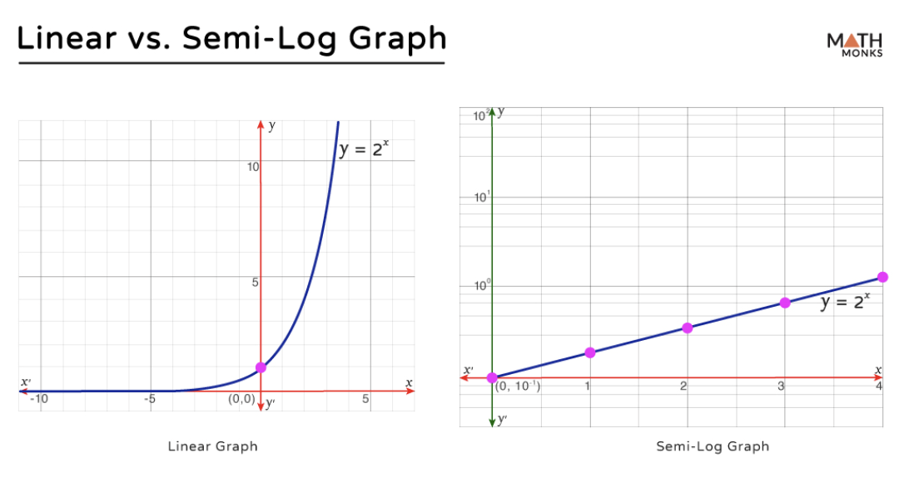
Bonus: log-log plot and semi-log plot

Slide 19
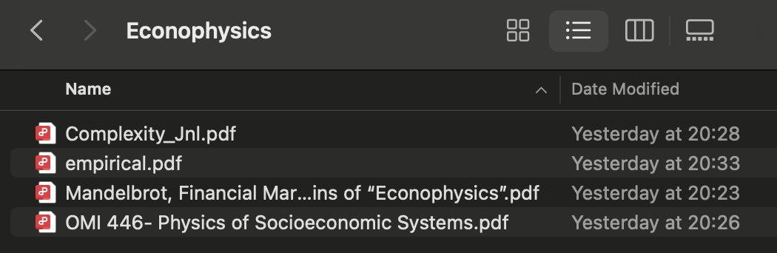
References

Slide 20
Questions
How is wealth distributed?
How to use macroscopic distributions to reveal microscopic mechanism?
Why is the Markov assumptions invalid in stock market?
How to apply dimensional analysis outside of physics?

