Slide 1







Applied Data Science Capstone: An Analysis of SpaceX through Data Science
Angel Barra Muñoz
February 22, 2023

Slide 2



OUTLINE
Executive Summary
Introduction
Methodology
Results
Visualization – Charts
Dashboard
Discussion
Findings & Implications
Conclusion
Appendix

Slide 3

EXECUTIVE SUMMARY
Collecting the Data
Trough API
Trough Web Scraping
Data Wrangling
Exploratory Data Analysis (EDA)
SQL
Visualization
Interactive Visual Analytics and Dashboard
Folium
Plotly
Model predictions
Logistic Regression
Support Vector Machine (SVM)
Decision Tree
K-Nearest Neighbor

Slide 4

INTRODUCTION
SpaceX is a space transportation and aerospace manufacturer founded in 2002 by Elon Musk.
Rockets from the Falcon 9 family have been launched 309 times over 14 years, with 91 launches occurring in 2023 alone. The machine learning approach for studying the influence of different variables is essential to predict if a landing will be successful. A significant factor in SpaceX's ability to offer launches at the "reduced" cost of 62 million USD is the reusability of the Falcon 9 rockets.

Slide 5
METHODOLOGY
Data Collection
Using Python the data is collected trough the API from SpaceX and Web Scraping from Wikipedia
Data Wrangling
Processing the data to find patters and determine what is the label for the supervised model
Evaluation Data Analysis
EDA with SQL to study the failures and successes of the landing
EDA with visualization to study the different inference of the variables of the data frame in the determination of the failure or success of a landing
Interactive Analysis
See the geographic position of the launchpad and the inference of the ambient in the success of a launch.
With Plotly see in a interactive way the success rate of every launchpad and the relation between the payload mass and the success of the mission.
Model Application to the Data.
Determinate the best Hyperparameter for a variety of method, these are Logistic Regression, SVM, Decision Tree and KNN
Determinate which of the 4 methods have the best performance.

Slide 6
Data Collection
SpaceX API
We request data rom the SpaceX API, which is provided in JSON format. This data is then converted into a dataframe for analysis. Since the dataset includes information on both Falcon 9 and Falcon Heavy launches, we apply a filter to isolate only the data pertaining to Falcon 9. Following the filtration process, we export the refined dataframe to a CSV file for further use.
Link: https://github.com/angelbarram/Applied-Data-Science-Capstone/blob/main/Week_1_API.ipynb
Web Scraping
We retrieve Falcon 0 launch data from its Wikipedia page using the specified URL. A BeautifulSoup object is then instantiated to parse the HTML content. Utilizing this object, we extract the columna names and variable identifiers from the HTML headers to strucsture our datset appropriately.
Link: https://github.com/angelbarram/Applied-Data-Science-Capstone/blob/main/Week_1_WebScraping.ipynb

Slide 7
Data Wrangling
During the data wrangling pase, we leveraged pandas to refine the previously obtained dataframe, thereby streamlining subsequent analyses. Our efforts focused on calculating the number of launches for each site in conjuction with the corresponding orbit type at the time of launch. Additionally, we analyzed the mission outcomes to assign a ‘landing outcome’ label, categorizing each evento as either a success or a failure.
Link:
https://github.com/angelbarram/Applied-Data-Science-Capstone/blob/main/Week_2_Data_Wrangling.ipynb

Slide 8
Exploratory Data Visualization with SQL
Using the %sql magic command, we execute queries to better understand the structure and contents of the database
Displaying the names of the launch sites.
Displaying the records where launch sites begin with the string ‘CCA’
Displaying the total payload mass carried by boosters launched by NASA (CRS)
Displaying the total average payload mass carried by booster versión F9 1.1
Listing the date when the first successful landing outcome in ground pad was achieved
Listing the names of the boosters which have success in drone ship and have payload mass greater than 4000 but les than 6000 kg
Listing the total number of successful and failure mission outcomes
Listing the names of the booster_versions which have carried the maximum payload mass
Listing the failed landing_outcomes in drone ship , their booster versions, and launch sites names for in year 2015.
Rank the count of landing outcomes or success between the date 2010-06-04 and 2017-03-20, in descending order.
Link:
https://github.com/angelbarram/Applied-Data-Science-Capstone/blob/main/Week_2_EDA_SQL.ipynb

Slide 9
Exploratory Data Visualization with Data Visualization
We conduct an analysis of the relationships between various variables. Shortly, we will present these variables and the corresponding visualizations that illustrate their interconnections.
The relations are:
Flight Number vs Pay Load Mass (kg)
Flight Number vs Launch Site
Launch Site vs Pay Load Mass (kg)
Orbit vs Successful rate
Flight Number vs Orbit
Pay Load Mass (kg) vs Orbit
Year vs Successful rate
Link: https://github.com/angelbarram/Applied-Data-Science-Capstone/blob/main/Wek_2_EDA_DV.ipynb

Slide 10
Data Visualization
With Folium
Our work with Folium involved plotting the launch sites on a map and annotating each sie with markers that signify the success or failure of launches conducted there.
We also calculate the distances from the launch site to the nearest cities, highways, and railways to assess proximity and accesibility.
Link:
https://github.com/angelbarram/Applied-Data-Science-Capstone/blob/main/Week_3_Folium.ipynb
With Plotly Dash
We utilized Plotly to develop and interactive web interface that displays the success rates of every launch site collectively. Users have the ability to filter and view the specific number of successful and failed launches at each site.
Addiotionally, users can adjust a slider to see how the payload mass affects the success rate of landings.
Link:
https://github.com/angelbarram/Applied-Data-Science-Capstone/blob/main/Week_3_Plotly_Dash.ipynb

Slide 11
Predictive Analysis (Classification)
Our predictive analysis utilized four distinct methods to ensure a comprehensive approach:
Logistic Regression
SVM
Decision Tree
KNN
We optimized each method by searching for the best hyperparameters using GridSearchCV.
Link:
https://github.com/angelbarram/Applied-Data-Science-Capstone/blob/main/Week_4_Model_Prediction.ipynb

Slide 12

Results (EDA with SQL)
Display the names of the unique launch sites in the space mission

Slide 13
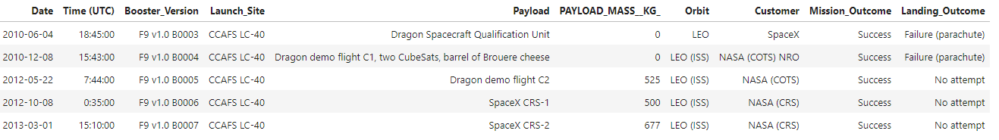
Results (EDA with SQL)
Display 5 records where launch sites begin with the string ‘CCA’

Slide 14



Results (EDA with SQL)
Display the total payload mass carried by booster launched by NASA (CRS)
Display average payload mass carried by booster versión F9 1.1
List the date when the first successful landing outcome in ground pad was achieved.

Slide 15
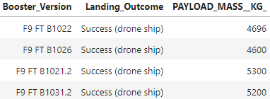
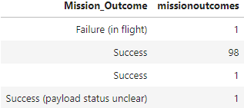
Results (EDA with SQL)
List the names of the boosters which have success in drone shop and have payload mass greater than 4000 but les than 6000
List the total number of successful and failure mission outcomes

Slide 16
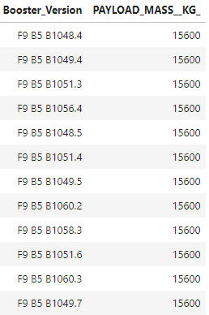
List the names of the booster_versions which have carried the maximum payload mass. Use a subquery

Slide 17

Results (EDA with SQL)
List the records which will display the month names, failure landing_outcomes in drone ship, booster versions, launch_site for the months in year 2015

Slide 18
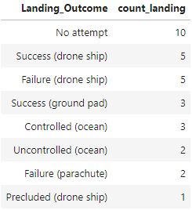
Results (EDA with SQL)
Rank the count of landing outcomes (such as Failure (drone ship) or Success (ground pad)) between the date 2010-06-04 and 2017-03-20, in descending order.

Slide 19
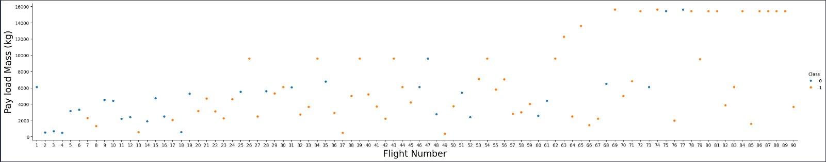
Results (Data Visualization)
Flight Number vs Payload Mass (kg)
CCAFS LC-40 has the lowest success rate which is 60% while the highest is KSC LC 39

Slide 20
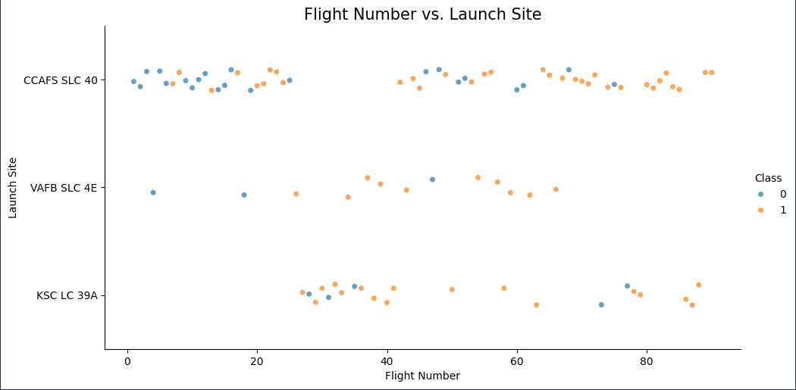
Results (Data Visualization)
Flight Number vs Launch Site
Same as the previous graph, we can see that KSC LC 39A has the highest rate of success and between Flight Number 40 and 70 has only successful landings

Slide 21
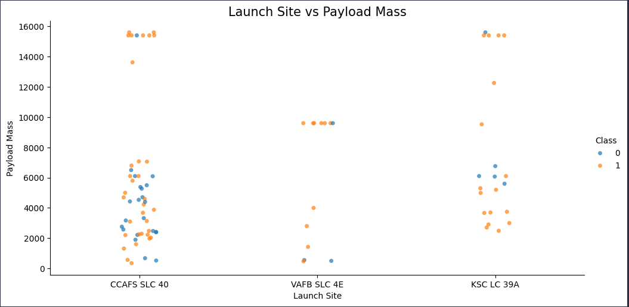
Results (Data Visualization)
Launch Site vs Pay Load Mass (kg)
We can see in the graph that at higher mass the succesfull rate for CCAFS SLC 40 and KSC LC 39A are higher than lower masses while VAFB SLC 4E have a great succesfull rate at any mass.

Slide 22
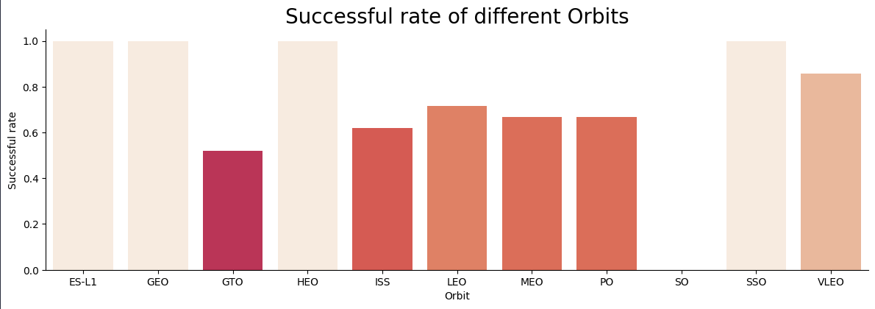
Results (Data Visualization)
Successful rate of different Orbits
The orbits ES-L1, GEO, HEO and SSO has the highest succes rate.

Slide 23
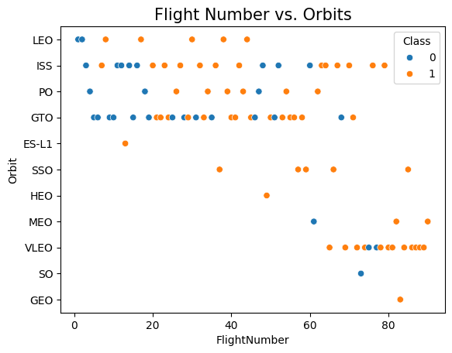
Results (Data Visualization)
Flight Number vs. Orbits
This graph servers as an addiotional illustration, similar to the previous one. It reveals that the success rates for GEO, HEO and ES-L1 are not reliable because there’s just one sample on each orbit, so we can’t say that orbit always will end in a successful landing.
In this case we can see that VLEO has a great successful rate.

Slide 24
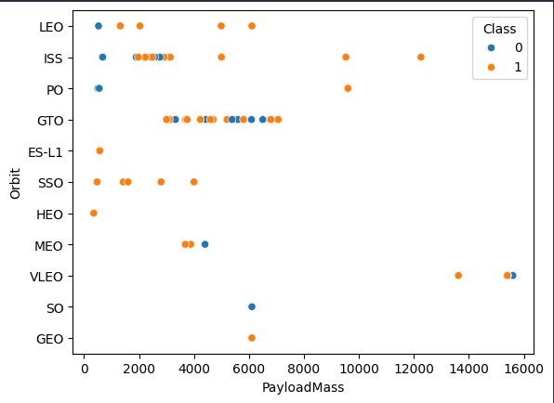
Results (Data Visualization)
Flight Number vs. Orbits
The analysis of the graph indicates that SSO continues to be a viable orbit with consistent succes. On the other hand, VLEO shows a 66% success rate with only three simples, suggesting a need for more data toa ssess reliability fully.
For missions to the ISS mass consideration, the success rate appears favorable, similarly to launches to GTO.

Slide 25
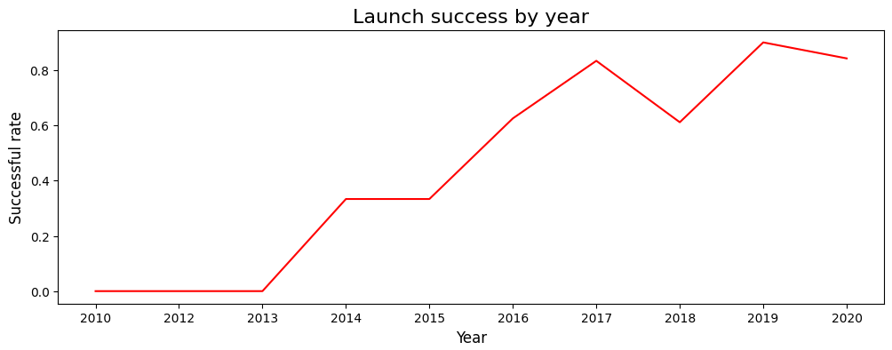
Results (Data Visualization)
Launch success per year
The graph suggests a year-over-year increase in the success rate of launches, corroborated by the high volume of 91 launches in the previous year, 2023.

Slide 26
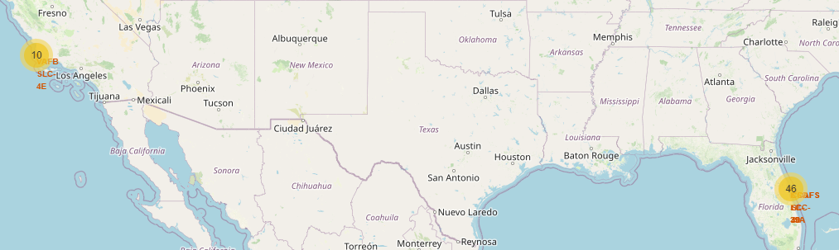
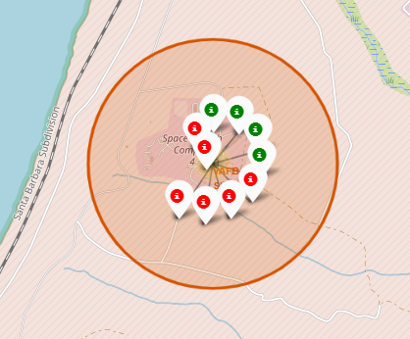
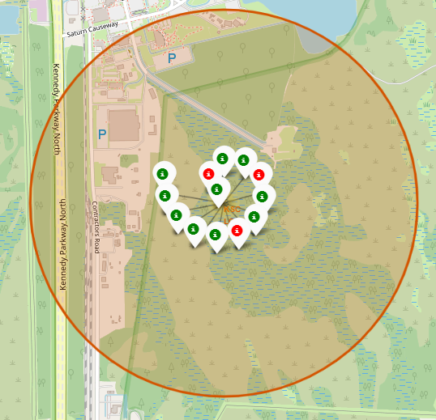
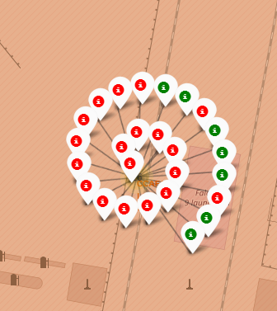
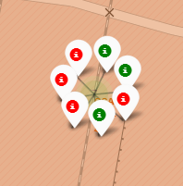
Results with Folium
VAFB SLC-4E RSC LC-39A CCAFS LC-40 CCAFS SLC-40

Slide 27
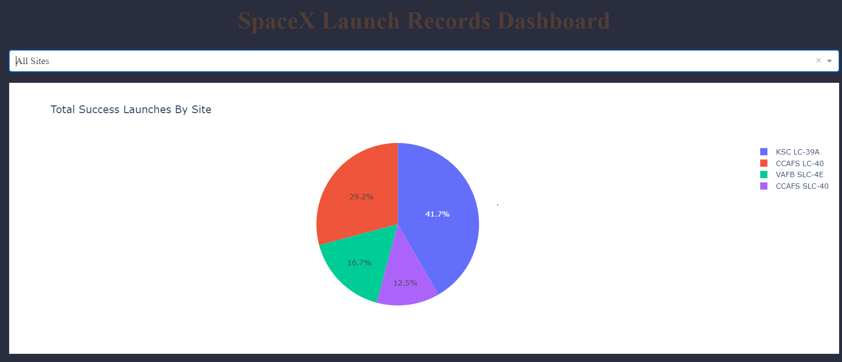
Results with Plotly Dash
Launch success rate

Slide 28
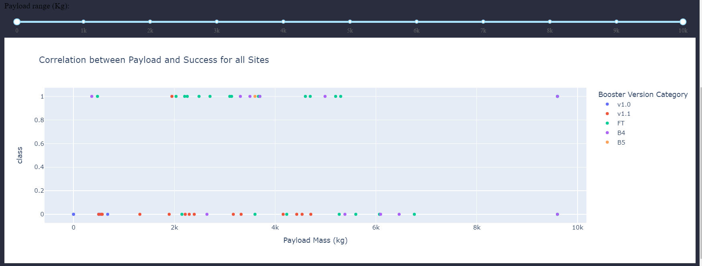
Results with Plotly Dash
Payload vs the success of a landing

Slide 29
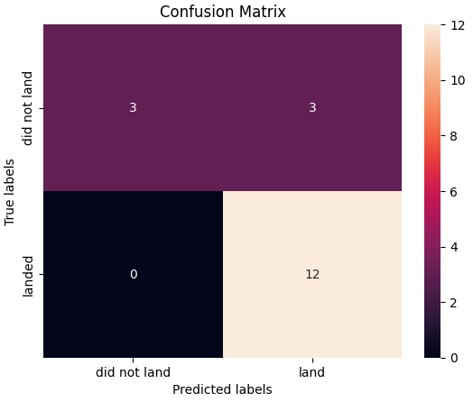
Results (Predictive Models)
Logistic Regression:
Hyperparameters:
C: 0.01, penalty: 12, solver:’lbfgs’
Accuracy: 83.3%
SVM:
Hyperparameters:
C: 1.0, gamma: 0.03162277660168379, kernel: sigmoid
Accuracy: 83.3%

Slide 30
Results (Predictive Models)
Decision Tree:
Hyperparameters:
criterion: gini, max_depth: 6, max_features: ’sqrt’, min_simples_leaf: 4, min_simples_split: 2, splitter: random
Accuracy: 83.3%
KNN:
Hyperparameters:
algoritm: auto, n_neighbors: 10, p: 1
Accuracy: 83.3%

Slide 31
Conclusion
The landing pads are strategically placed close to the sea and at a distance from urban áreas and major roads, presumably the risk of civilian casualities in the evento of an incident. A higher payload mass appears to correlate with a reduces risk of launch failure. Specially, the ISS and SSO trajectories demonstrate the highest success rates when considering payload mass. Regarding predictive modeling, all four models tested exhibit comparable accuracy, making each a viable choice for forecasting outcomes for SpaceX’s Falcon 9 launches.

Slide 32

APPENDIX
Include any relevant additional charts, or tables that you may have created during the analysis phase.

