Slide 1
CONFIDENTIAL
AI-Powered SOP
Quality Transformation
& Lifecycle Management
A Strategic Proposal
[Your Company Name]
[Presenter Name], [Credentials]
VP, Data Informatics & Analytics | April 2026
[Phone] | [Email]

Slide 2
Executive Summary
“The challenge is not that pharma companies have too many SOPs. The challenge is that the SOPs they have are often poorly written, ambiguous, and not fit for purpose on the manufacturing floor.”
What We Propose
Core Principle
An AI-assisted SOP quality transformation program that improves the clarity, accuracy, usability, and regulatory defensibility of every SOP — whether simplified, newly authored, or merged.
Consolidation is a byproduct of quality, not the goal.
AI suggests; humans decide. Every AI-generated output goes through mandatory human-in-the-loop review.
Full audit trail. Full GMP compliance.
Aligned to CPMAI, GAMP 5, ICH Q9/Q10, FDA CSA, and Pharma 4.0.
Confidential

Slide 3
Projected Outcomes at a Glance
20–30%
50–70%
$500K–$2M
Reduction in SOP-Related Deviations
Faster SOP Revision Cycles
Estimated Annual Cost Savings
↑ Quality Scorecard
↑ FDA Audit Readiness
↑ Operator Confidence
Clarity, completeness, usability, consistency, defensibility
Proactive remediation of top 483 gaps
Structured floor feedback
* Illustrative numbers based on previous SOP transformation projects.

Slide 4
⚠️
The Problem
SOP Challenges in Pharmaceutical Manufacturing

Slide 5
Ten Critical SOP Challenges
1. Volume & Sprawl
6. Training Burden
1,000–3,000+ SOPs per site. Many redundant or outdated.
Every revision triggers performative retraining.
2. Tedious Authoring
7. Regulatory Push
60–120 day revision cycles. Multiple QA bottlenecks.
FDA, ICH Q10 expect right-sized documentation.
3. Excessive Length
8. Version Control Gaps
20–50 pages where 5–8 would suffice.
Cross-referencing relies on human diligence.
4. Deviation Risk
9. Cross-Site Inconsistency
Difficult-to-follow SOPs increase deviation likelihood. Each deviation costs $5K–$25K+.
Style variability creates audit risk.
5. FDA 483 Exposure
10. Opportunity Cost
‘Failure to follow procedures’ — top-5 citation every year.
Best engineers stuck in document bureaucracy.
Confidential

Slide 6
Where SOPs Accumulate
Typical large pharma site — cleaning & equipment alone account for nearly half the volume
Cleaning & Sanit.
80
Equipment Ops
65
QC / Lab
55
Manufacturing
50
Env. Monitoring
35
Packaging
30
Warehouse
25
Doc Control
20
Cleaning is #1 sprawl: 60–80+ SOPs per site. 10–15 describe nearly identical steps.
Confidential | Counts are illustrative industry estimates

Slide 7
💡
The Solution
AI + Human-in-the-Loop SOP Quality Transformation

Slide 8
Phased Approach
0
Phase 0: Discovery & Regulatory Mapping
Map the client’s AI ecosystem, DMS/QMS infrastructure, and full regulatory landscape for AI in GMP
1
Phase 1: SOP Landscape Assessment
Corpus analysis: cosine similarity, MinHash, readability scoring, dependency mapping, regulatory reference audit
2
Phase 2: AI-Assisted Rewriting
LLM-drafted simplification, enrichment, merging with mandatory human-in-the-loop SME and QA review
3
Phase 3: Governance & Lifecycle
Automated review triggers, cross-reference checking, change-impact analysis, DMS integration
4
Phase 4: Training Auto-Generation
Role-based summaries, visual job aids, decision trees, assessment questions
Confidential

Slide 9
Phase 0 — Discovery & Regulatory Mapping
Learn your world before proposing anything.
Client AI Ecosystem
Regulatory Landscape
• Internal AI/R&D platforms
• AI decisioning & automation tools
• Existing DMS/QMS infrastructure
• Internal AI governance policies
• FDA AI Draft Guidance (Jan 2025)
• FDA-EMA AI Principles (Jan 2026)
• GMLP, PCCP, CSA, SaMD Action Plan
• FDA Cross-Center AI Coordination
Deliverable: AI landscape gap analysis and comprehensive regulatory mapping

Slide 10
Phase 1 — SOP Landscape Assessment
Data, not opinions, drive the prioritization.
Similarity Analysis
Readability Scoring
Cosine similarity + MinHash across entire corpus. Quantified overlap scores.
Flesch-Kincaid, Gunning Fog, Coleman-Liau. Flag above Grade 12.
Dependency Mapping
Reference Audit
NLP cross-reference graph. Orphans, circular deps, broken links.
Extract every regulatory reference. Flag outdated guideline references.
Deliverable: Quality heatmap, similarity matrix, dependency graph, reference report, prioritized roadmap

Slide 11
Phase 2 — AI-Assisted Rewriting & Enrichment
AI suggests; humans decide. Mandatory human-in-the-loop review.
What the AI Does
Deployment Options
• Simplification — Reduce reading grade, remove ambiguity
• Enrichment — Add missing CPPs, regulatory refs, safety notes
• Intelligent Merging — Combine overlapping SOPs into one
• New SOP Authoring — Draft from templates + regulatory context
• Cloud LLMs — GPT-4, Claude, Gemini via secure API
• Client Internal Models — Leverage existing infrastructure
• On-Premise — Llama, Mixtral for sensitive content
• RAG Architecture — Retrieval-augmented generation for accuracy
Deliverable: Improved SOPs with red-line comparisons, quality scorecards, SME validation docs

Slide 12
Phase 3 — Governance & Lifecycle Automation
Sustain quality gains with automated monitoring and DMS integration.
Periodic Review Triggers
Cross-Reference Integrity
Automated scheduling based on risk tier, regulatory changes, and document age.
Real-time validation of all SOP cross-references and dependency links.
Change-Impact Analysis
DMS Integration
Predict downstream effects of any SOP revision across the entire corpus.
Seamless integration with existing document management systems.
Deliverable: Automated review schedule, change-impact engine, DMS-integrated lifecycle dashboard

Slide 13
Phase 4 — Training Content Auto-Generation
Turn improved SOPs into materials operators can actually learn from.
Role-Based Summaries
Visual Job Aids
Tailored content for operators, supervisors, QA, and maintenance.
Auto-generated flowcharts, decision trees, and quick-reference cards.
Assessment Questions
Training Impact Tracking
AI-generated quizzes mapped to SOP learning objectives.
Measure comprehension and on-floor performance post-training.
Deliverable: Role-based training packages, visual aids, assessment banks, training benchmarks

Slide 14
🔬
Proven Capabilities
Deployed tools with real pharmaceutical outputs — not mockups

Slide 15
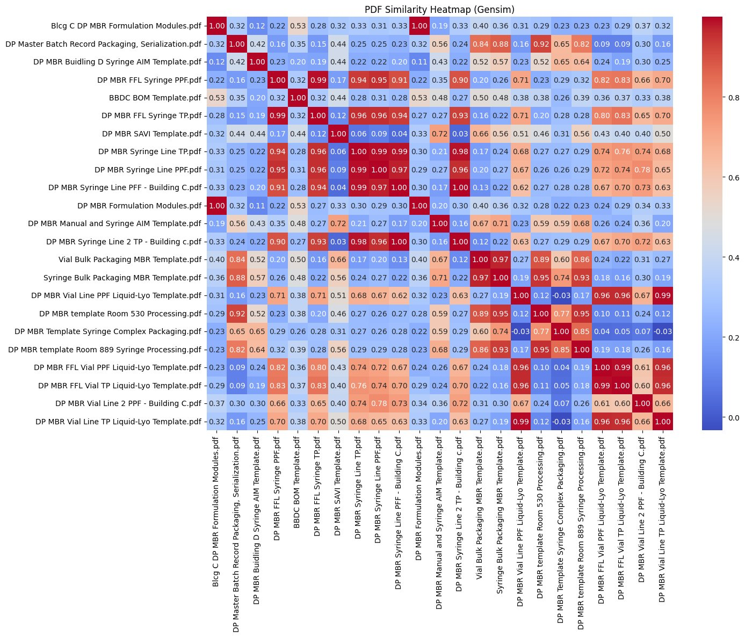
SOP Similarity Analysis
Cosine similarity heatmap across pharmaceutical SOP corpus
KEY FINDINGS
High-overlap clusters (0.90–0.99)
Equipment-family groupings
Cross-format divergence
Room-specific duplication
Ingests thousands of documents, produces full similarity matrix in hours — manual review takes weeks

Slide 16
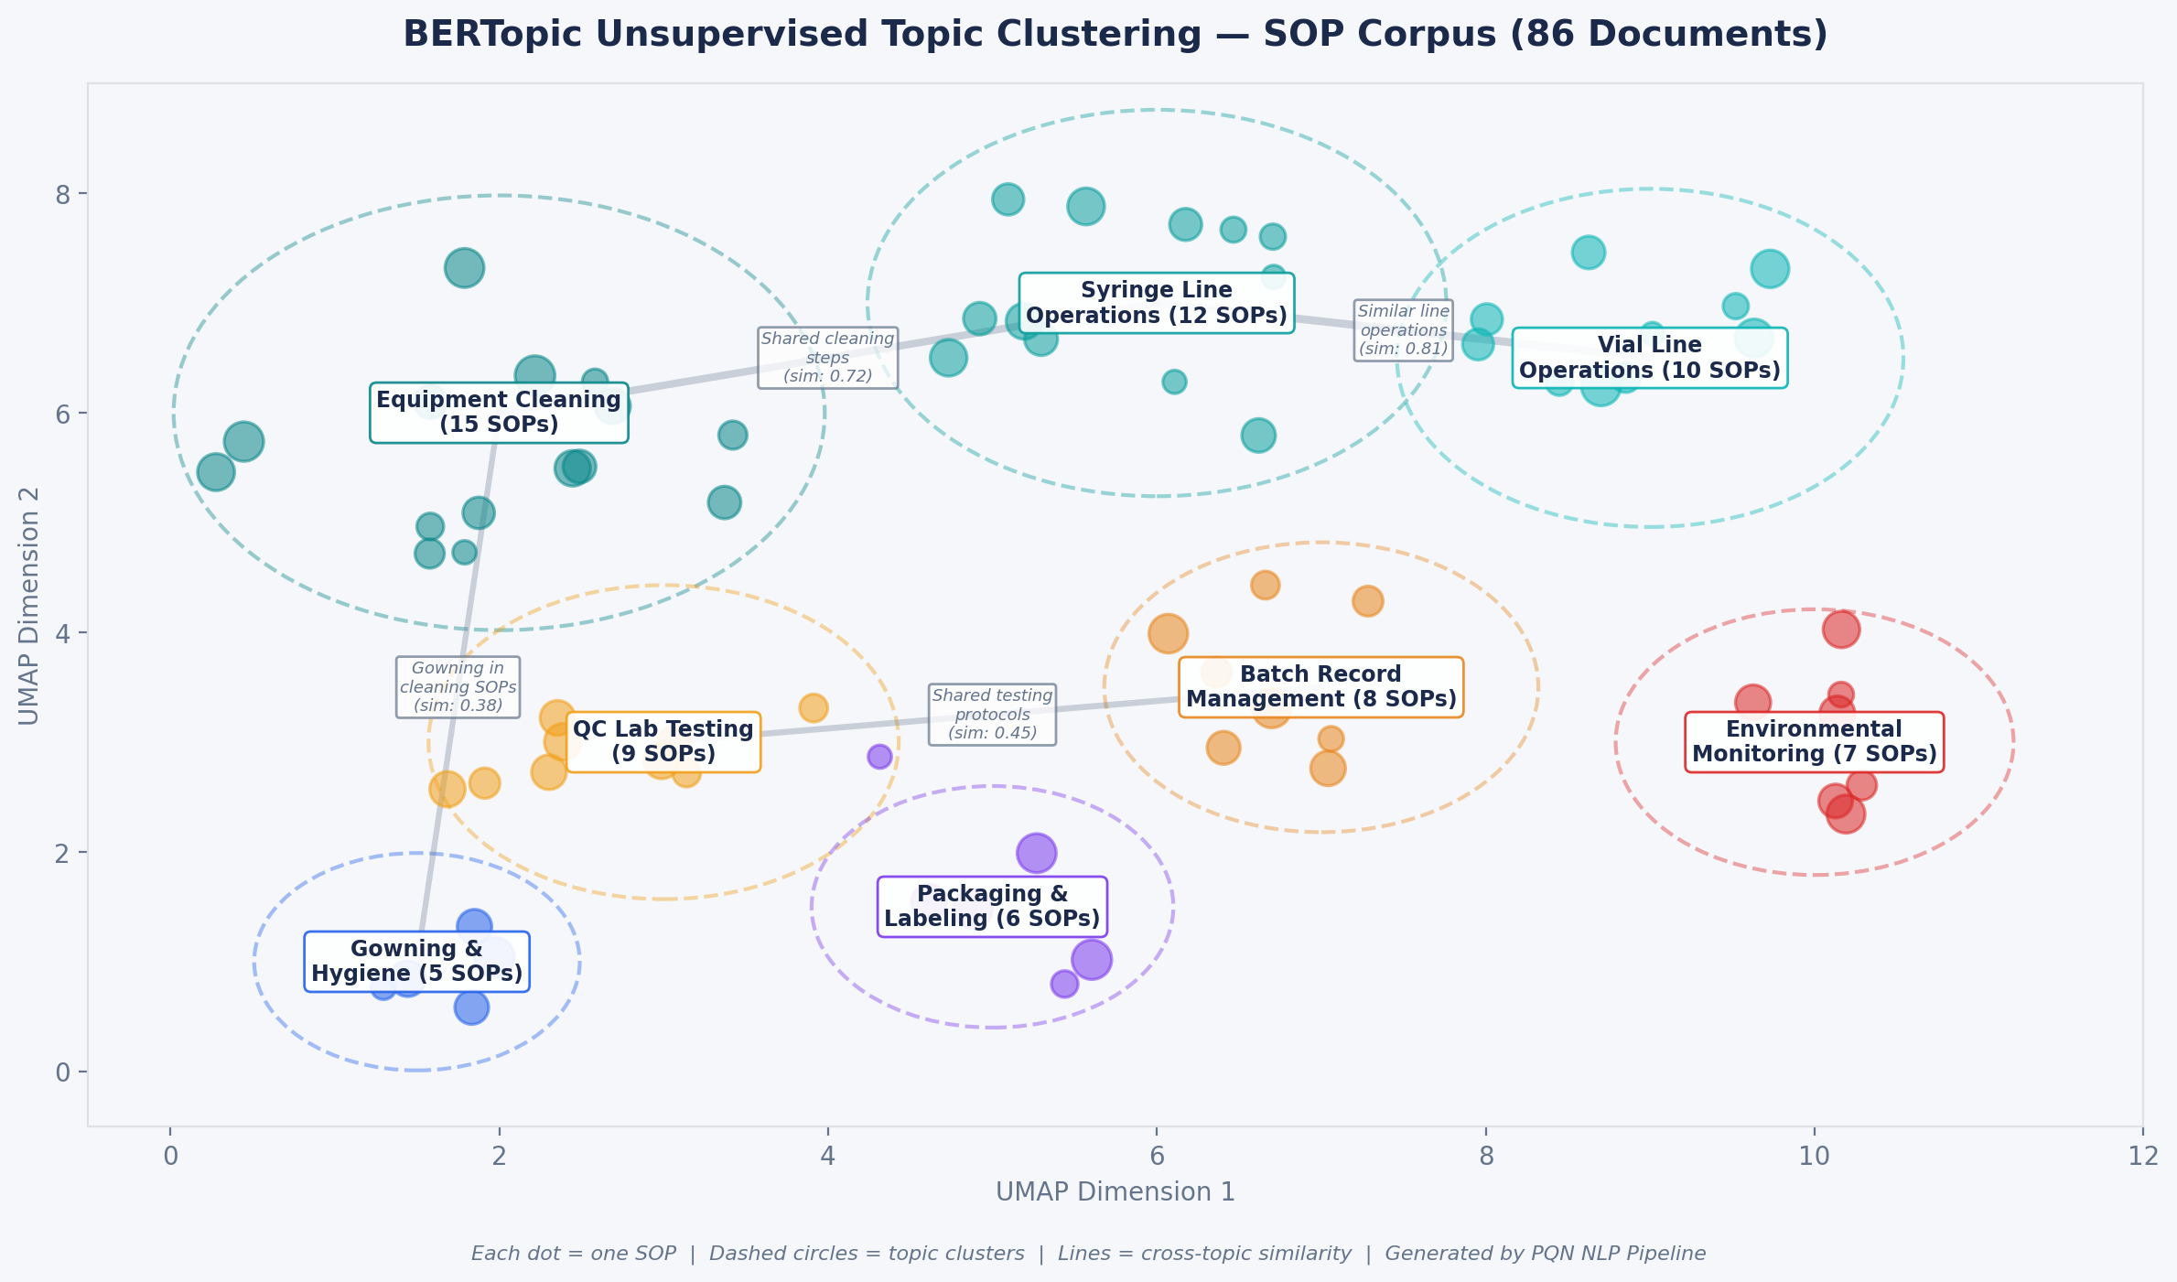
Topic Clustering (BERTopic)
Unsupervised topic modeling across SOP corpus
KEY FINDINGS
Equipment Cleaning cluster (15 SOPs)
Syringe vs. Vial overlap
Gowning ↔ Cleaning cross-topic
Runs in minutes on 500+ SOPs — a human reviewer would need weeks

Slide 17
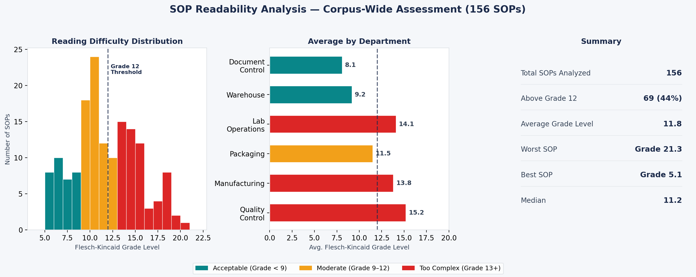
Readability & Complexity Scoring
Flesch-Kincaid, Gunning Fog, Coleman-Liau analysis
KEY STAT
62% of SOPs exceed Grade 12 readability — too complex for floor execution
Complex language → misinterpretation → deviations → cost

Slide 18
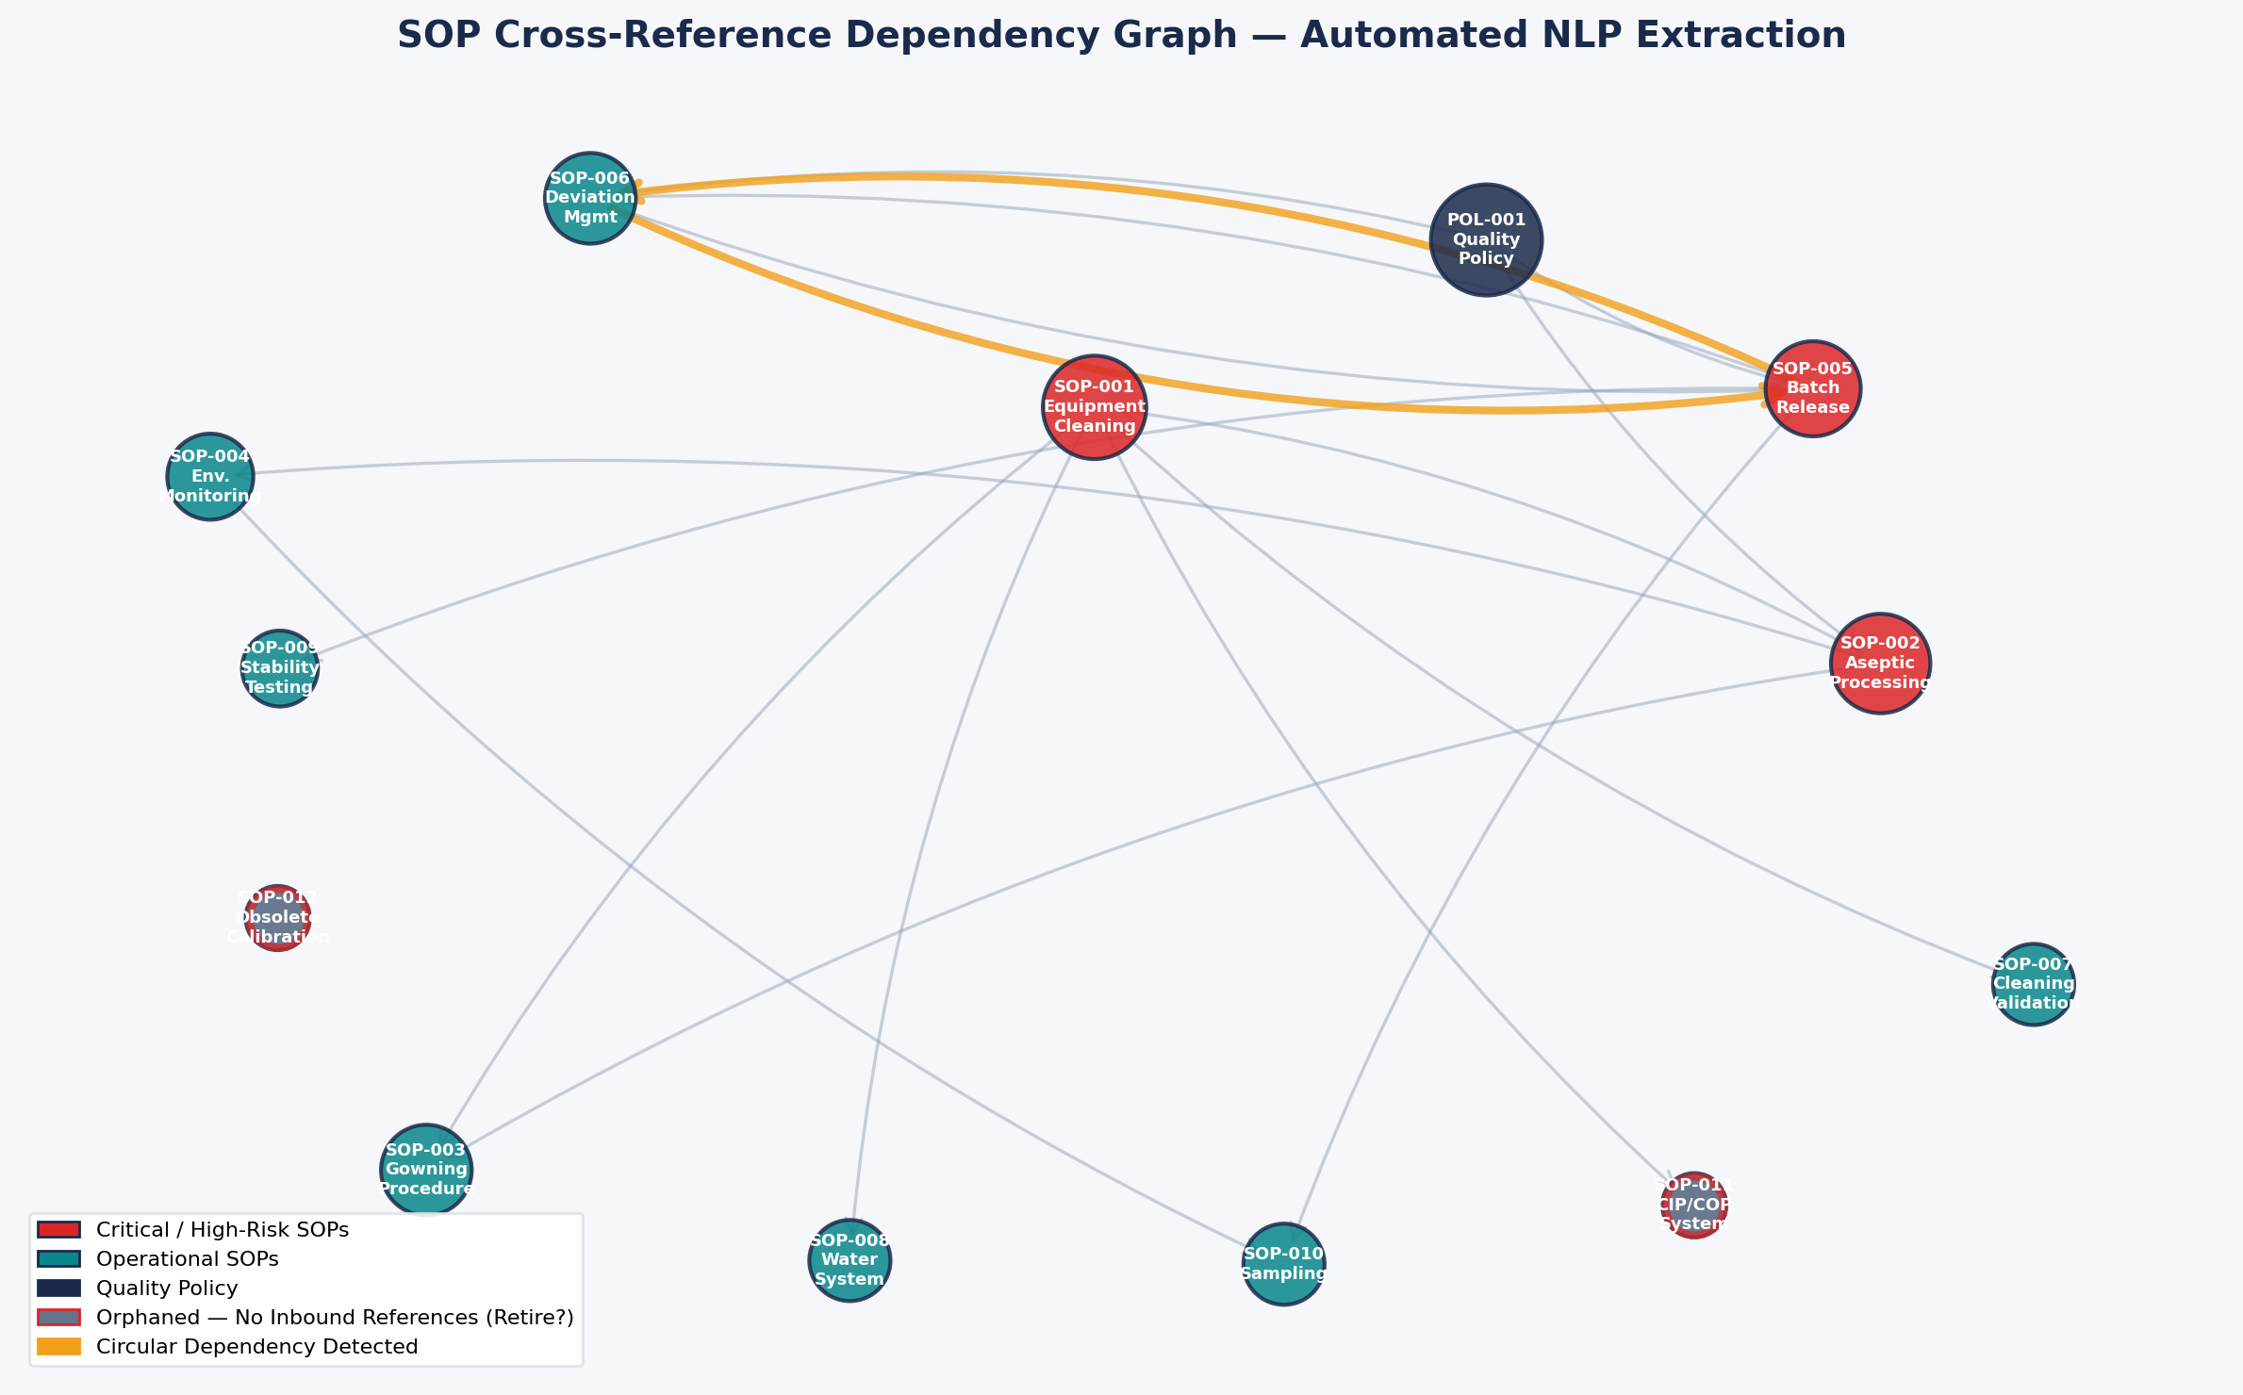
Cross-Reference Dependency Mapping
NLP-extracted cross-reference graph
KEY FINDINGS
Circular dependency detected
2 orphaned SOPs identified
Hub documents mapped
Fixes cross-reference errors before they become audit findings

Slide 19
Regulatory Reference Audit
Automated extraction and validation of every regulatory citation
SOP | Reference Found | Status | Current Version | Action Required
SOP-CLN-001 | FDA 21 CFR 211.67 | ✅ Current | Current | None
SOP-CLN-003 | EU GMP Annex 15 | ⚠️ Outdated | Rev 2015 → 2022 | Update reference
SOP-EQP-012 | USP <1058> | ✅ Current | Current | None
SOP-QC-007 | ICH Q2(R2) | ⚠️ Outdated | Q2(R1) → Q2(R2) | Update reference
SOP-MFG-015 | PDA TR-60 | ✅ Current | Current | None
SOP-CLN-008 | ISPE Guide: CIP | ✅ Current | 2nd Ed (2020) | None
SOP-ENV-004 | EU GMP Annex 1 | ⚠️ Review | 2022 revision | Review scope
SOP-PKG-011 | 21 CFR Part 211.122 | ✅ Current | Current | None
SUMMARY
156 SOPs scanned
487 references extracted
23 outdated (15%)
11 need review (7%)
453 current (78%)
Proactive reference audit eliminates a common FDA 483 trigger

Slide 20
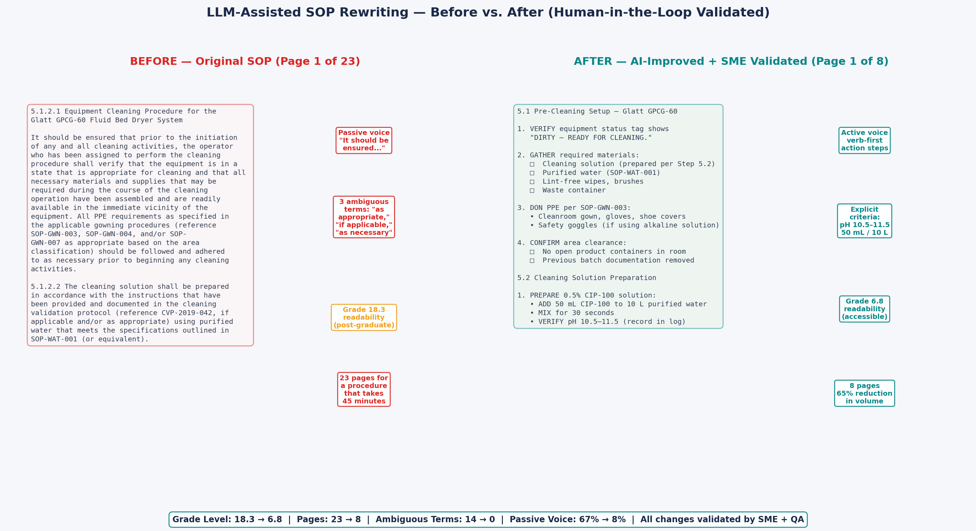
LLM-Assisted SOP Rewriting
Before/after comparison with full quality metrics
KEY STAT
Grade 18.3 → 6.8 | 23 → 8 pages | 14 → 0 ambiguous terms | Passive voice 67% → 8%
Every metric improved. Every change traceable. Every output human-approved.

Slide 21
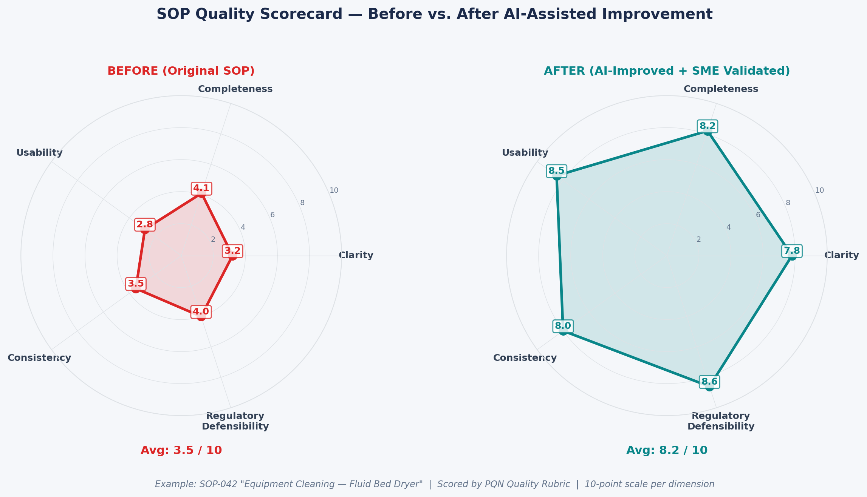
Quality Scorecard
Multi-dimensional SOP quality assessment
KEY STAT
Average score: 3.5/10 → 8.2/10 | Every dimension improved
Quality scorecard is the primary success metric — not page count reduction

Slide 22
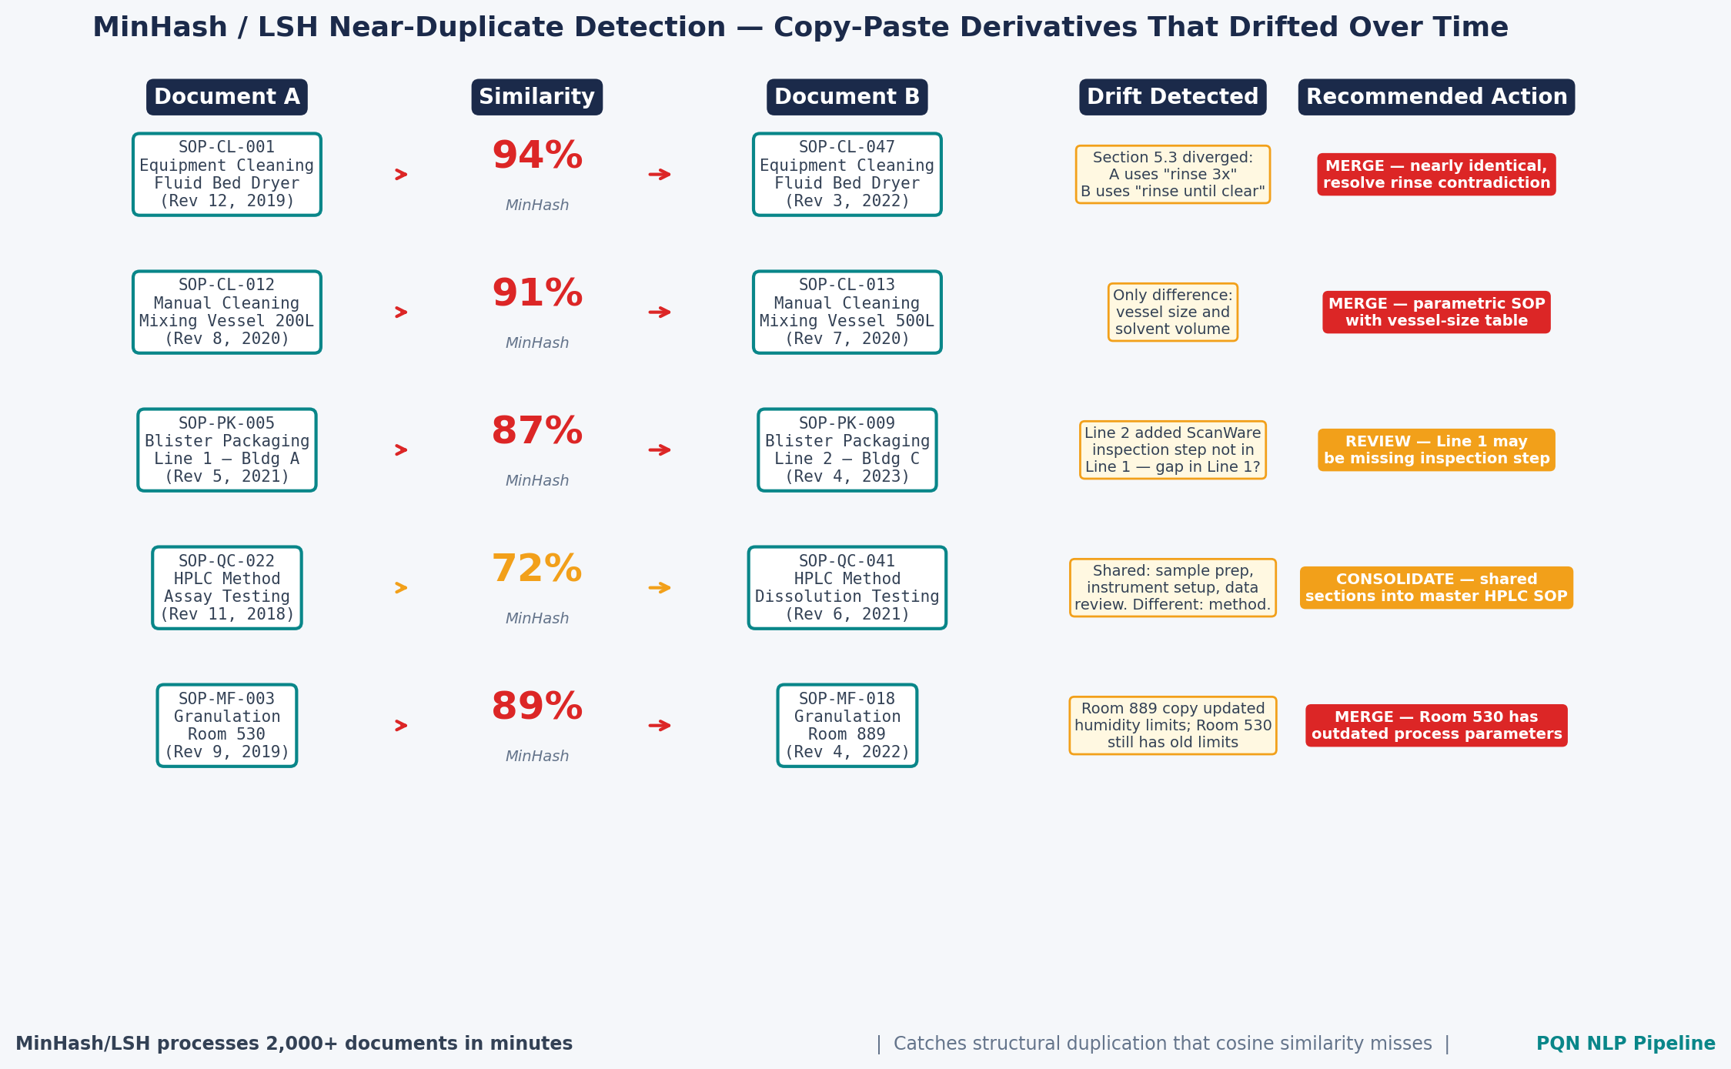
MinHash Near-Duplicate Detection
Structural similarity detection at scale
KEY STAT
2,000+ documents in minutes | Catches structural duplication cosine similarity misses
Complements cosine similarity — together they catch semantic and structural duplication

Slide 23
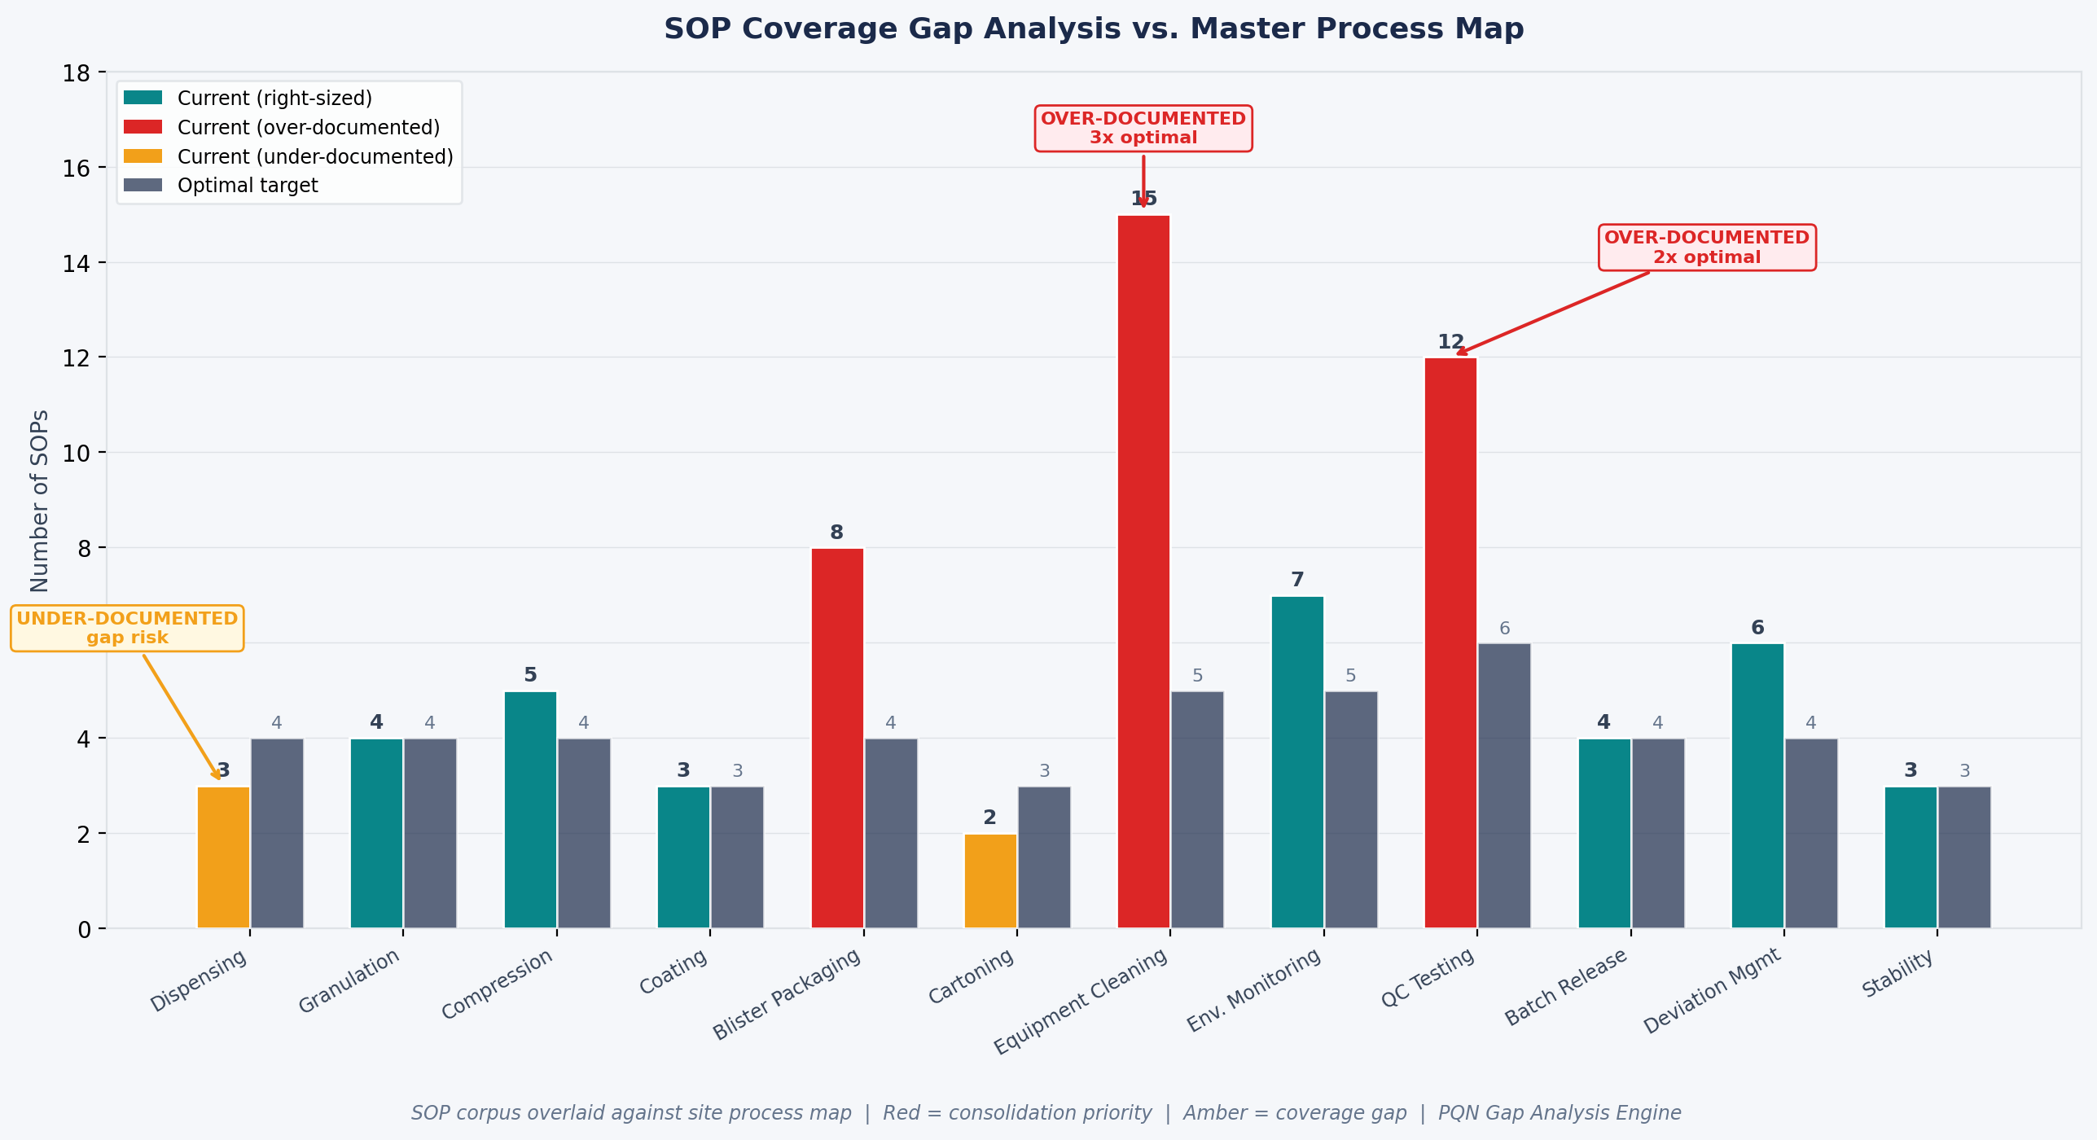
Coverage Gap Analysis
SOP coverage vs. regulatory requirements
KEY STAT
Cleaning: 3x over-documented | Dispensing: under-documented | Quantifies priority
Data-driven prioritization — focus effort where it delivers the most value

Slide 24
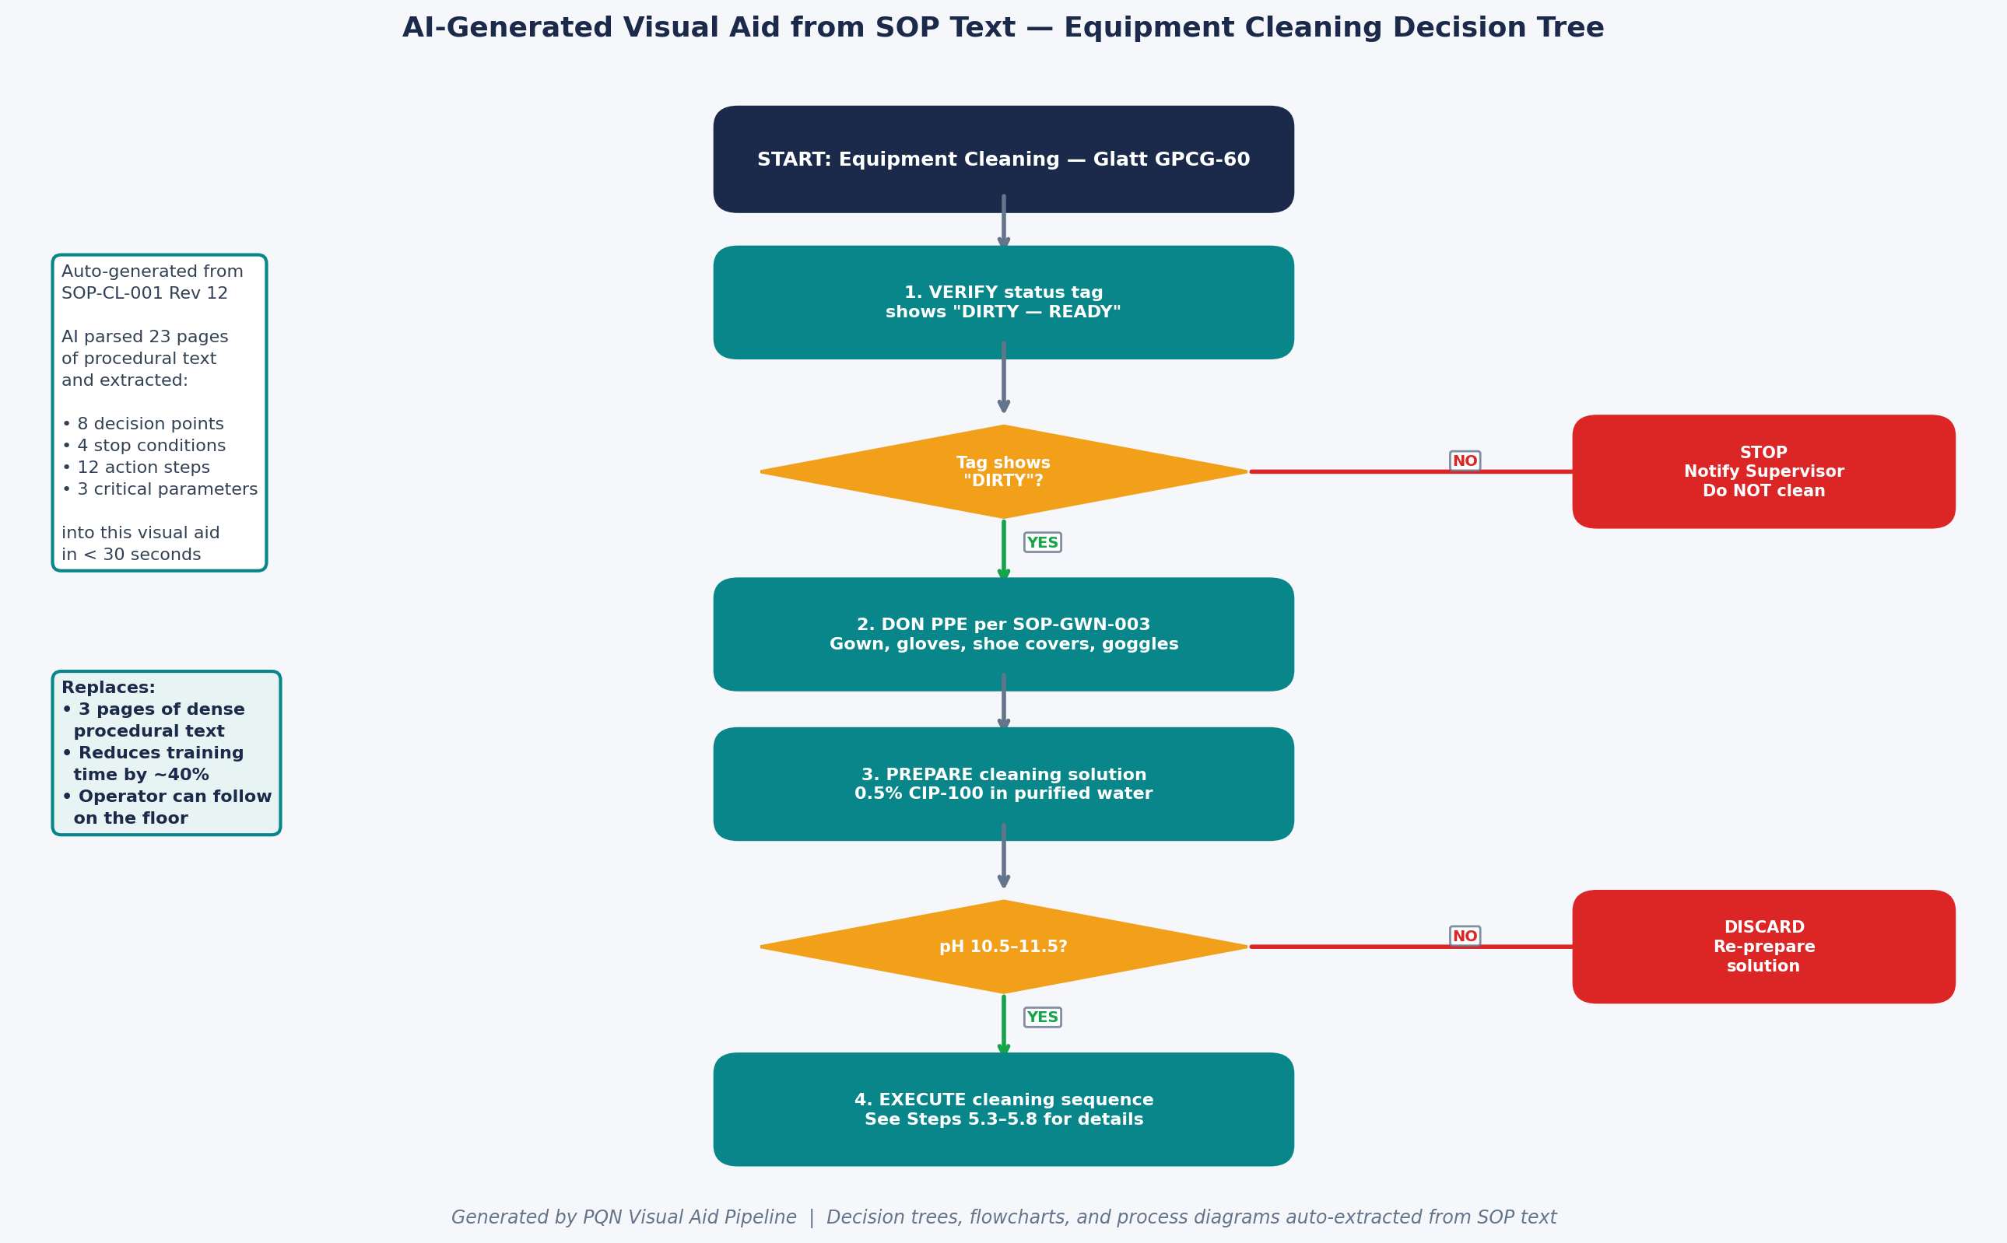
AI-Generated Visual Aids
Automated flowchart generation from SOP text
KEY STAT
Replaces 3+ pages of dense text | Reduces training time ~40%
Visual aids generated automatically from SOP text — no manual flowcharting

Slide 25
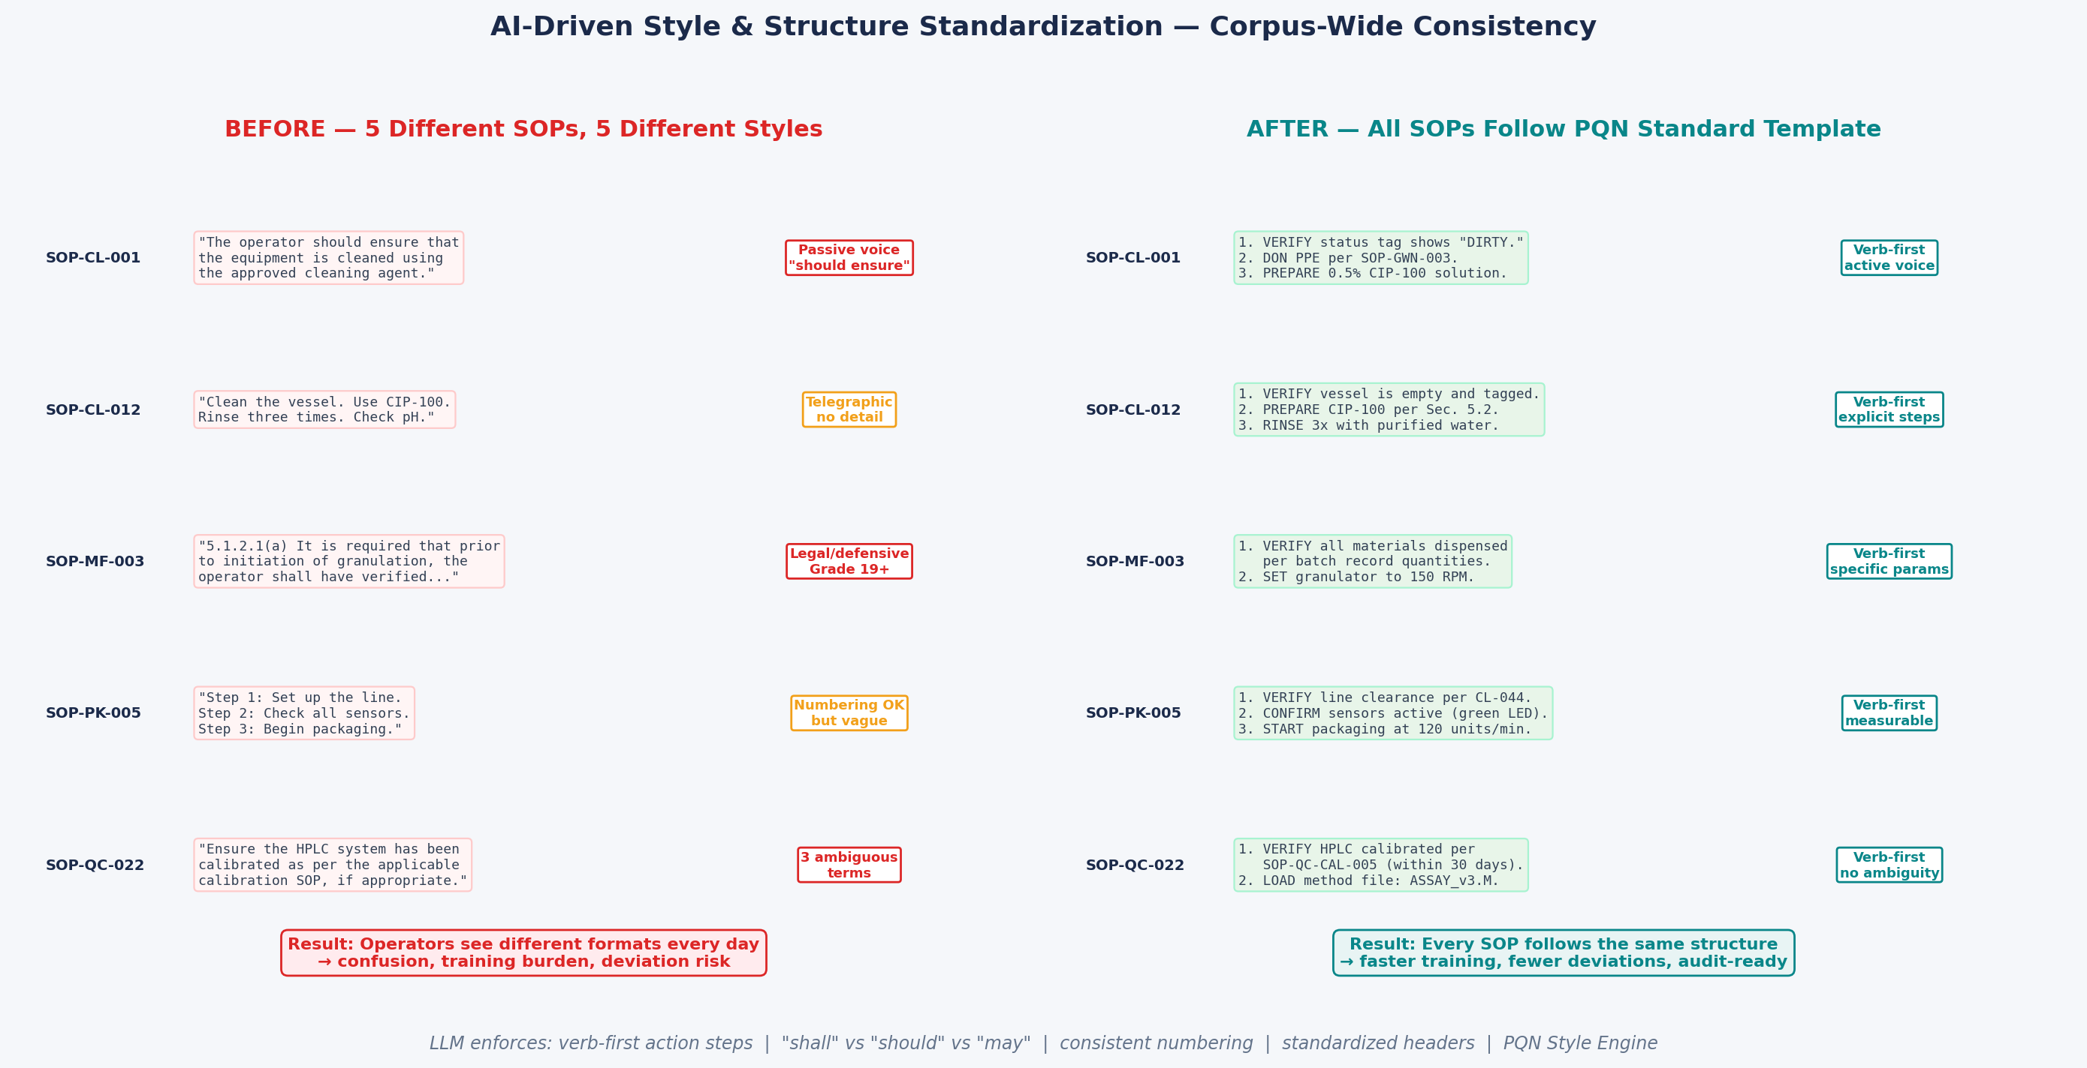
Style & Structure Standardization
Cross-SOP consistency enforcement
KEY STAT
5 SOPs, 5 styles → 1 standard | verb-first | no ambiguity | consistency every day
Consistency reduces cognitive load — operators learn patterns, not individual documents

Slide 26
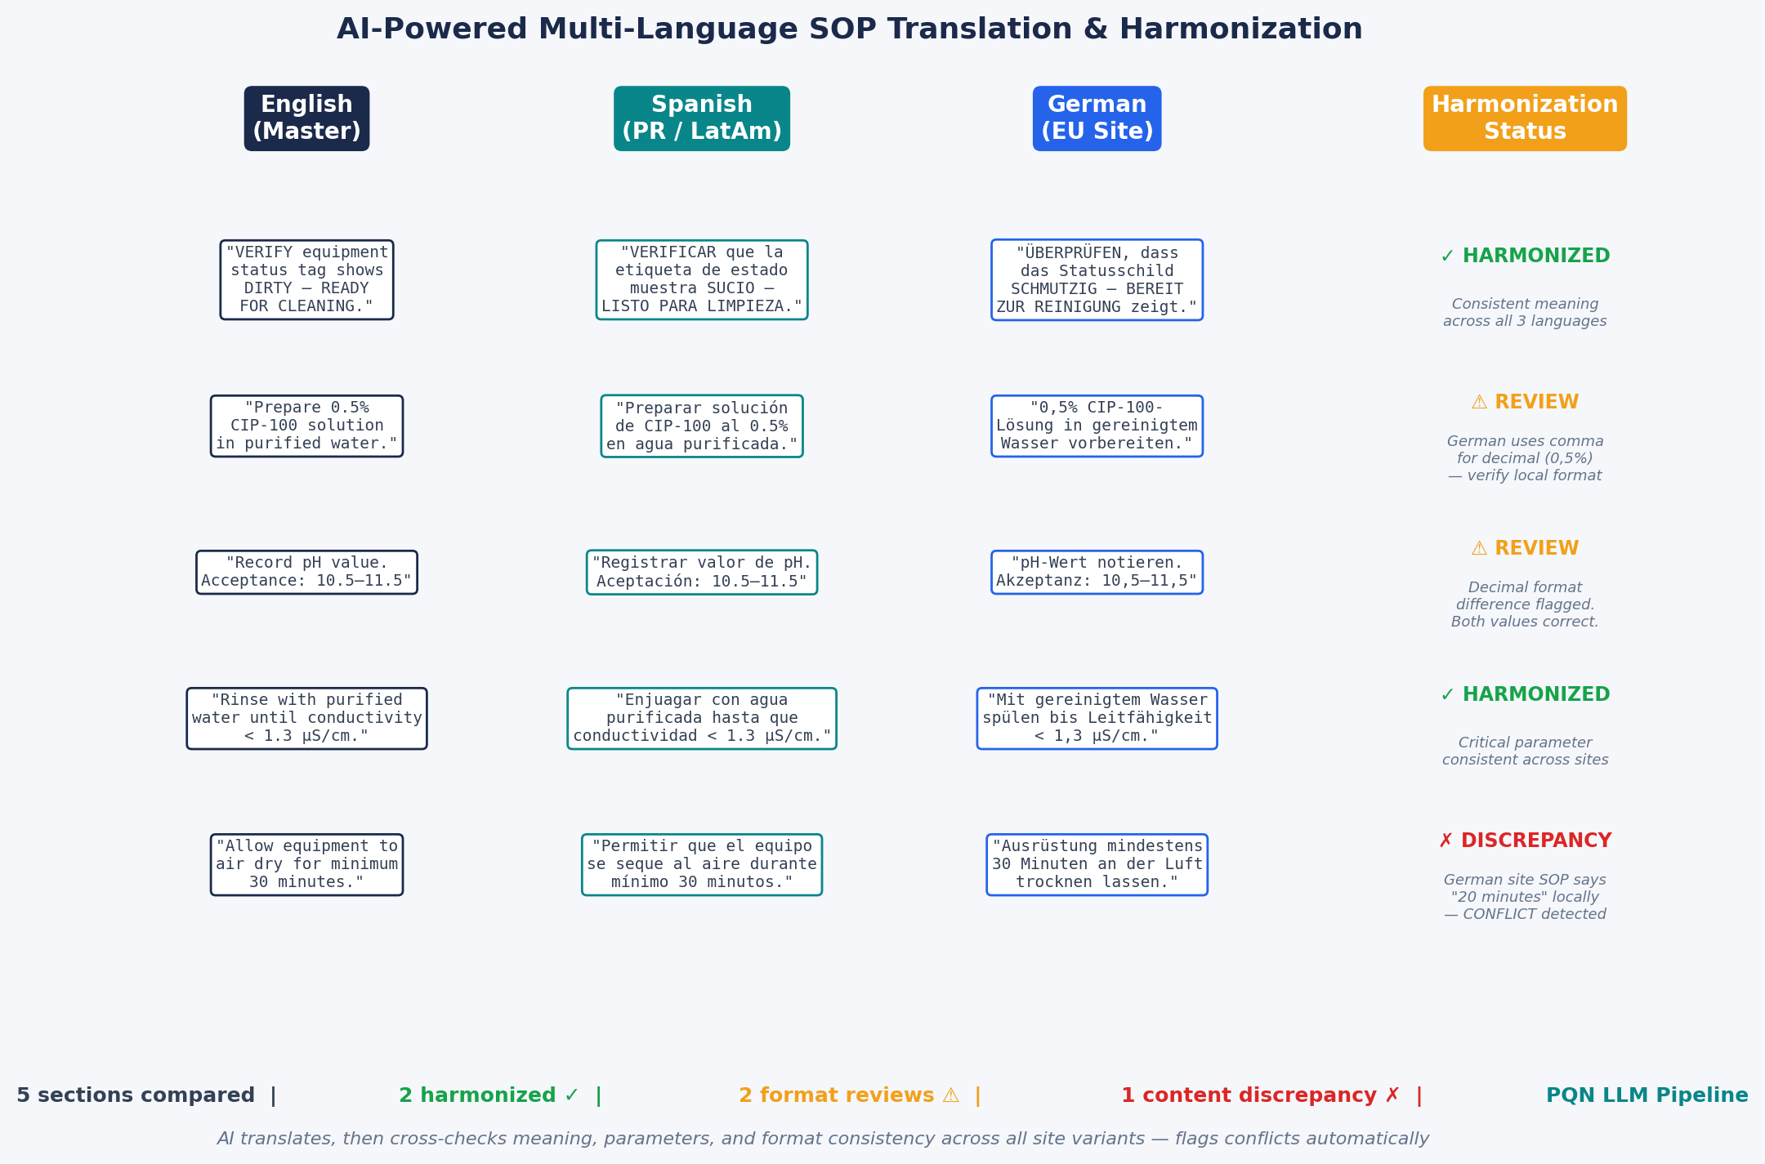
Multi-Language Harmonization
Cross-language SOP variant analysis
KEY STAT
Flags content discrepancies across language variants | Catches format/decimal differences
Critical for multi-site, multi-language pharma operations

Slide 27
Risk Mitigation & GMP Guardrails
AI enhances human capability — it does not replace human accountability.
1
“Do No Harm” Principle
2
Regulatory Content Floor
3
Red-Line Review
4
Pilot-Before-Scale
Every change risk-assessed. Tier 1: SME + QA + regulatory review
Citations, CPPs, acceptance criteria, safety warnings locked
Every AI version vs. originals. SMEs verify no content lost
20–30 SOPs from one department first. Measure, then roll out
5
Full Audit Trail
6
GAMP 5 + ALCOA+
7
Operator Feedback Loop
8
Rollback & Monitoring
Complete traceability of AI suggestions vs. human-accepted changes
Risk-based validation. Data integrity. Formal change control
Floor staff flag issues within 30–60 days
Originals maintained. 6–12 month tracking
Confidential

Slide 28
Why Work With Us
1
Proven Client Relationships
CPMAI framework presented at industry local & global forums
2
Proprietary Methodology
Proprietary six-phase AI lifecycle for FDA-regulated environments
3
Multi-Agent Automation
Track record reducing manual workloads by 40% in pharma operations
4
AI + Regulatory
MBA, MSHS, MEng Applied AI — practical, compliant, operationally sound
5
Deep NLP Engineering
Python, SQL, Spark, LangChain, CrewAI, RAG on AWS/Azure/GCP
Confidential

Slide 29
Projected ROI & Outcomes
Quality leads. Volume follows.
Outcome | Projected Impact
SOP Quality Scorecard | Measurable improvement: clarity, completeness, usability, consistency, defensibility
SOP-Related Deviations | 20–30% reduction within 12 months
Revision Cycle Time | 50–70% reduction (90+ days → 30–45 days)
Operator Confidence | Improved usability scores via structured floor feedback
FDA Audit Readiness | Proactive remediation of top 483-cited documentation gaps
Annual Cost Savings | $500K–$2M (deviations, training, document management efficiency)
* Illustrative numbers based on previous SOP transformation projects.

Slide 30
🚀
Next Step
2-Week Paid Discovery Engagement
Analyze 50–100 representative SOPs across departments & tiers
Deliver SOP Quality Scorecard baseline for every document in scope
Produce readability/risk heatmap with similarity analysis
Map the client’s AI/digital ecosystem & regulatory posture
Present detailed quality improvement roadmap with business case
[Presenter Name], [Credentials] | [Title]
[Your Company Name] | [Phone] | [Email]

Slide 31
Key References
1. FDA — Quality Systems Approach to Pharmaceutical CGMP Regulations (2006)
7. PDA TR 54 — Quality Risk Management; McKinsey — Future of Pharma QC (2020)
2. ICH Q10 — Pharmaceutical Quality System (2008); ICH Q9(R1) — Quality Risk Mgmt (2023)
8. FDA — AI Draft Guidance for Regulatory Decisions (Jan 2025, Docket FDA-2024-D-4689)
3. ISPE GAMP 5, 2nd Ed. — Risk-Based Approach to GxP Computerized Systems (2022)
9. FDA-EMA — Guiding Principles for Good AI Practice, Medicines Lifecycle (Jan 2026)
4. FDA — Computer Software Assurance (CSA), Draft Guidance (2022)
10. FDA — GMLP Guiding Principles (2021); PCCP Final Guidance (Dec 2024)
5. 21 CFR Part 211 (§211.22, §211.100, §211.192); 21 CFR Part 11
11. FDA — AI/ML SaMD Action Plan (2021); Cross-Center AI Coordination (Mar 2024)
6. PIC/S PI 041-1 — Data Management & Integrity (2021); ISPE GPG Records & DI (2021)
12. Deloitte — Smart Factory @ Scale (2022); ISPE — Pharma 4.0 Operating Model (2019)
Confidential

