Slide 1
CVE Data Warehouse
OLAP analysis of software vulnerabilities, 2020–2026
Integrating NIST NVD, FIRST EPSS, CISA KEV and MITRE CWE into two star schemas
Alessia Angele – 2003000
Data Management · Sapienza University of Rome

Slide 2
Contents
1
Project idea & questions
5
Logical schema
2
Data sources
6
OLAP queries & results
3
ETL pipeline
7
Conclusions
4
Dimensional Fact Models
CVE Data Warehouse · Alessia Angele · 2

Slide 3
Project idea
CVSS says how bad a vulnerability could be. It does not say whether anyone will exploit it.
The warehouse joins what is disclosed (NVD), what is predicted to be exploited (EPSS) and what is confirmed exploited (CISA KEV), so that these can be compared across time, vendors and weakness types.
How fast is the volume of vulnerabilities growing?
Q1
Which weakness families are exploited most, relative to how common they are?
Q2
Two business processes → two fact tables
1. a CVE is published in NVD
2. a CVE is added to the CISA KEV catalog
Does CVSS severity agree with predicted exploitation?
Q5
Which vendors produce vulnerabilities that end up exploited, and how quickly?
Q4 · Q6 · Q7
CVE Data Warehouse · Alessia Angele · 3

Slide 4
Data sources
Five files from four providers, integrated by the ETL (snapshot of 2 May 2026)
Source | Provider | File | Rows read | Used for
NVD CVE records | NIST | nvd_cve_records.csv | 201,542 | CVE, dates, CVSS, severity, attack vector
NVD weaknesses | NIST | nvd_cve_weaknesses.csv | 260,862 | CVE → CWE
NVD CPE matches | NIST | nvd_cve_cpe_matches.csv | 1,550,739 | CVE → vendor / product
EPSS scores | FIRST | first_epss_current.csv | 329,934 | probability of exploitation in 30 days
KEV catalog | CISA | cisa_kev_catalog.csv | 1,585 | confirmed exploitation, due date, ransomware
CWE catalog (view 1000) | MITRE | cwe_1000.csv | 944 | CWE names and CWE → pillar hierarchy
The Kaggle mirror (afr1ste/nvd-cve-cvss-kev-vulnerabilities-2020-2026) also ships a pre-joined table: it is used only to cross-check our joins, never as input.
CVE Data Warehouse · Alessia Angele · 4

Slide 5
ETL pipeline
etl.py: pandas + psycopg2, idempotent (drops and rebuilds the warehouse), writes etl_report.json
EXTRACT
CLEAN
INTEGRATE
BUILD
LOAD & CHECK
Read 6 CSVs, only needed columns, column names checked
Validate IDs, parse dates, NaN / ±∞ → NULL, range checks
Join sources on CVE id, reconcile vendor names, pick primary CWE / product
5 dimensions with surrogate keys + Unknown member, 2 fact tables
Constraints, FKs, indexes; post-load checks in SQL
2,324
31,987
622 / 644
0
rows in dim_date (was 201,542: one per CVE)
products in dim_product (was: KEV vendors only)
CWEs enriched with MITRE name and pillar
IEEE 754 NaN values reaching PostgreSQL
CVE Data Warehouse · Alessia Angele · 5

Slide 6
ETL: what the transformations actually do
All counts from etl_report.json on the real data
Numeric cleaning
Time grain fixed
Primary CWE and product
CVSS, EPSS and percentile are parsed with range checks (0–10, 0–1). Empty cells, 'NaN' and ±Infinity become NULL in pandas, so AVG and ORDER BY work without SQL workarounds.
8,974 CVEs without CVSS → NULL.
Timestamps are truncated to the calendar day. dim_date is a full calendar (Jan 2020 – May 2026) with a smart key YYYYMMDD and month / quarter / year levels.
KEV dates use the same dimension.
62,418 CVEs have several CWEs: the Primary one from NVD is kept. CPE strings are parsed (cpe:2.3:part:vendor:product); 445,848 non-vulnerable platform rows dropped; the most frequent vulnerable product is kept.
Entity resolution: CISA vendor → NVD vendor
Hierarchy from MITRE
258 vendor names in KEV: 149 identical to NVD, 62 remapped by majority vote over shared CVEs, 47 kept as in CISA.
d_link → dlink · check_point → checkpoint · android → google · barracuda_networks → barracuda
The ChildOf relations of CWE view 1000 are walked up to the root, giving the level cwe → pillar used for Roll-Up / Drill-Down (Q2).
NVD placeholders (NVD-CWE-noinfo, NVD-CWE-Other) are labelled as not classified.
CVE Data Warehouse · Alessia Angele · 6

Slide 7
ETL: validation
Our joins reproduce the reference counts exactly
194,478
1,039
0
3 / 3
CVEs with an EPSS score (reference: 194,478)
CVEs of 2020–2026 found in KEV (reference: 1,039)
disagreements with the pre-joined KEV flag
post-load SQL checks passed
Post-load check (SQL, run by etl.py) | Result
dim_date rows = distinct dates + Unknown member | OK
fact_vulnerability.is_in_kev = KEV rows inside the NVD snapshot | OK
no NaN in any numeric measure | OK
Known limits, stated
40,398 CVEs (20%) have no CPE → product = Unknown.
546 KEV entries are CVEs older than 2020: kept in the KEV fact, flagged in_nvd_snapshot = false.
EPSS is a current score, not historical.
CVE Data Warehouse · Alessia Angele · 7

Slide 8
DFM 1: vulnerability disclosure
Grain: one CVE published in NVD · teal = dimensions shared with DFM 2
vendor
product
product_type
cve_id (degenerate)
VULNERABILITY
year
quarter
month
date
cwe
cvss_score (AVG)
epss_score (AVG)
epss_percentile (AVG)
affected_products (SUM)
is_in_kev (COUNT IF)
count (COUNT)
pillar
day_of_week
abstraction
severity
exploit_type
attack_vector
primary_class
attack_complexity
CVE Data Warehouse · Alessia Angele · 8
Notes:
Hierarchies: date->month->quarter->year, product->vendor, cwe->pillar. cve_id is a degenerate dimension (identifier without its own table). Measures are additive except the averages of scores.

Slide 9
DFM 2: confirmed exploitation (KEV)
Grain: one CVE added to the CISA KEV catalog · the date dimension plays three roles
vendor
product
product_type
cve_id (degenerate)
KEV ADDITION
date_added
year
days_to_kev (AVG, MEDIAN)
remediation_days (AVG)
is_ransomware (COUNT IF)
count (COUNT)
quarter
month
cwe
due_date
pillar
date
published
in_nvd_snapshot
Conformed dimensions date, product and cwe are identical in both facts: this is what makes the Drill-Across (Q6) possible.
CVE Data Warehouse · Alessia Angele · 9

Slide 10
Logical schema: fact constellation in PostgreSQL 16
Two star schemas sharing three dimension tables
dim_date
dim_severity
fact_vulnerability
date_key PK (YYYYMMDD)
full_date
month, quarter, year
fact_kev_addition
severity_key PK
severity_level
attack_vector
attack_complexity
cve_id PK
published_date_key FK
product_key FK
cwe_key FK
severity_key FK
exploit_type_key FK
cvss_score
epss_score
epss_percentile
affected_products
is_in_kev
cve_id PK
date_added_key FK
due_date_key FK
published_date_key FK
product_key FK
cwe_key FK
is_ransomware
in_nvd_snapshot
days_to_kev
remediation_days
dim_product
product_key PK
vendor, product
product_type
dim_exploit_type
exploit_type_key PK
has_rce, has_xss
has_sqli, has_bof
primary_class
dim_cwe
cwe_key PK
cwe_id, cwe_name
pillar_id, pillar_name
Every dimension has an 'Unknown' member (key −1): facts never have NULL foreign keys and no row is lost in the joins.
CVE Data Warehouse · Alessia Angele · 10

Slide 11
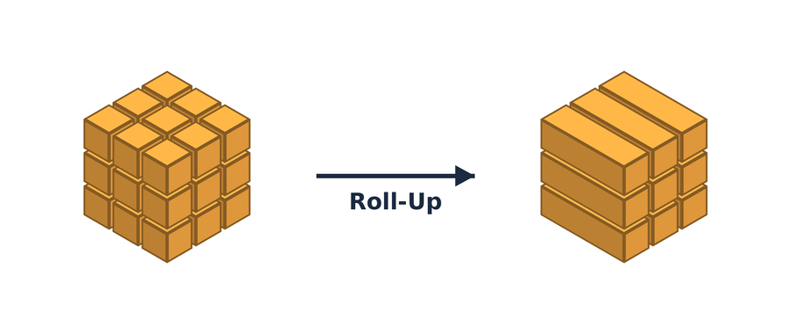
Q1 · Growth of disclosed vulnerabilities
ROLL-UP
“Number of CVEs per year and severity, rolled up from quarters to years.”
SELECT d.year, d.quarter,
COUNT(*) AS cve_count,
COUNT(*) FILTER (WHERE s.severity_level='CRITICAL')
AS critical,
... -- high, medium, low
ROUND(AVG(f.cvss_score),2) AS avg_cvss
FROM fact_vulnerability f
JOIN dim_date d
ON d.date_key = f.published_date_key
JOIN dim_severity s
ON s.severity_key = f.severity_key
WHERE d.date_key <> -1
GROUP BY ROLLUP (d.year, d.quarter)
ORDER BY d.year, d.quarter;
-- ROLLUP returns quarters, yearly
-- subtotals and the grand total
14,377 CVEs in 2020 → 49,549 in 2025 (×3.4). Critical ones grow less: from 14.0% to 8.1% of the total, and the average CVSS falls from 7.11 to 6.63.
CVE Data Warehouse · Alessia Angele · 11
Notes:
ROLLUP(year, quarter) produces three aggregation levels in one query: (year, quarter), (year) and the grand total. 2026 covers only January to April 28.

Slide 12
Q2a · Weakness families that get exploited
ROLL-UP
“For each CWE pillar: how many CVEs, how many in KEV, what share is exploited?”
SELECT c.pillar_name,
COUNT(*) AS cve_count,
COUNT(*) FILTER (WHERE f.is_in_kev) AS in_kev,
ROUND(100.0 * COUNT(*) FILTER
(WHERE f.is_in_kev) / COUNT(*), 3)
AS exploitation_rate_pct,
ROUND(AVG(f.epss_score), 4) AS avg_epss
FROM fact_vulnerability f
JOIN dim_cwe c ON c.cwe_key = f.cwe_key
WHERE c.pillar_id IS NOT NULL
GROUP BY c.pillar_name -- cwe -> pillar
ORDER BY in_kev DESC;
Memory-lifetime weaknesses and injection weaknesses have similar volumes (63k vs 57k CVEs), but memory ones are exploited twice as often: 0.70% vs 0.36%.
CVE Data Warehouse · Alessia Angele · 12

Slide 13

Q2b · Inside the most exploited family
DRILL-DOWN
“Open the pillar ‘Resource lifetime’ into its CWEs: most frequent vs most exploited.”
SELECT c.cwe_id, c.cwe_name,
COUNT(*) AS cve_count,
COUNT(*) FILTER (WHERE f.is_in_kev) AS in_kev,
RANK() OVER (ORDER BY COUNT(*) DESC)
AS rank_by_frequency,
RANK() OVER (ORDER BY COUNT(*)
FILTER (WHERE f.is_in_kev) DESC)
AS rank_by_exploitation
FROM fact_vulnerability f
JOIN dim_cwe c ON c.cwe_key = f.cwe_key
WHERE c.pillar_name = <top pillar of Q2a>
GROUP BY c.cwe_id, c.cwe_name -- pillar -> cwe
ORDER BY in_kev DESC LIMIT 15;
CWE | Weakness | CVEs | In KEV | Rank freq. | Rank expl.
CWE-787 | Out-of-bounds write | 9,754 | 98 | 1 | 1
CWE-416 | Use after free | 4,511 | 65 | 4 | 2
CWE-502 | Deserialization | 2,013 | 46 | 8 | 4
CWE-843 | Type confusion | 469 | 27 | 29 | 5
CWE-125 | Out-of-bounds read | 5,372 | 12 | 2 | 9
Frequency is a poor guide: type confusion is only #29 by volume but #5 by exploitation (5.8% of its CVEs are in KEV), while out-of-bounds read is #2 by volume and #9 by exploitation.
CVE Data Warehouse · Alessia Angele · 13

Slide 14

Q3 · Attack classes in 2025
SLICE
“Fix year = 2025: how do attack classes compare in severity and predicted exploitation?”
SELECT e.primary_class AS exploit_class,
COUNT(*) AS cve_count,
COUNT(*) FILTER (WHERE s.severity_level
IN ('CRITICAL','HIGH')) AS critical_or_high,
ROUND(AVG(f.cvss_score), 2) AS avg_cvss,
ROUND(AVG(f.epss_score), 4) AS avg_epss
FROM fact_vulnerability f
JOIN dim_date d
ON d.date_key = f.published_date_key
JOIN dim_exploit_type e
ON e.exploit_type_key = f.exploit_type_key
JOIN dim_severity s
ON s.severity_key = f.severity_key
WHERE d.year = 2025 -- the slice
GROUP BY e.primary_class
ORDER BY avg_epss DESC;
In 2025 remote code execution has an average EPSS 4× higher than any other class; XSS is the most harmless despite 7,147 CVEs.
CVE Data Warehouse · Alessia Angele · 14

Slide 15

Q4 · Riskiest vendors for severe remote flaws
DICE
“Severity CRITICAL/HIGH, network vector, 2022–2025, applications only: which vendors?”
SELECT p.vendor,
COUNT(*) AS cve_count,
COUNT(*) FILTER (WHERE f.is_in_kev) AS in_kev,
COUNT(*) FILTER
(WHERE f.epss_percentile >= 0.95) AS epss_top5pct
FROM fact_vulnerability f
JOIN dim_date d ON d.date_key = f.published_date_key
JOIN dim_severity s ON s.severity_key = f.severity_key
JOIN dim_product p ON p.product_key = f.product_key
WHERE s.severity_level IN ('CRITICAL','HIGH')
AND s.attack_vector = 'NETWORK'
AND d.year BETWEEN 2022 AND 2025
AND p.product_type = 'application'
GROUP BY p.vendor
HAVING COUNT(*) >= 10
ORDER BY epss_top5pct DESC LIMIT 15;
Ivanti has 76 of its 218 severe remote CVEs (35%) in the EPSS top 5%, against 13% for Apache and 7% for Microsoft: volume alone hides the riskiest vendor.
CVE Data Warehouse · Alessia Angele · 15

Slide 16
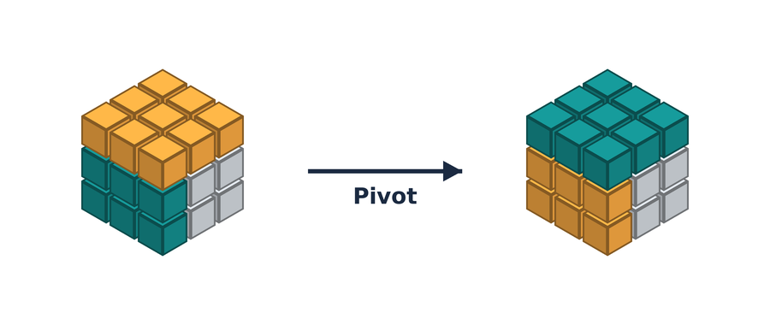
Q5 · Does CVSS agree with EPSS?
PIVOT
“Count CVEs by CVSS band (rows) and EPSS band rotated into columns.”
WITH banded AS (
SELECT CASE
WHEN cvss_score >= 9 THEN 'Critical'
WHEN cvss_score >= 7 THEN 'High'
WHEN cvss_score >= 4 THEN 'Medium'
ELSE 'Low' END AS cvss_band,
epss_score
FROM fact_vulnerability
WHERE cvss_score IS NOT NULL
AND epss_score IS NOT NULL)
SELECT cvss_band,
COUNT(*) FILTER (WHERE epss_score < 0.01)
AS "EPSS <1%",
... -- 1-10%, 10-50%
COUNT(*) FILTER (WHERE epss_score >= 0.5)
AS "EPSS >=50%"
FROM banded GROUP BY cvss_band;
CVSS \ EPSS | < 1% | 1–10% | 10–50% | ≥ 50%
Critical | 15,844 | 4,843 | 1,383 | 1,353
High | 60,023 | 8,894 | 2,089 | 1,059
Medium | 86,895 | 4,288 | 1,001 | 337
Low | 4,419 | 114 | 24 | 1
False alarms: 68% of CVSS-critical CVEs (15,844) have EPSS below 1%. Hidden dangers: 337 ‘medium’ CVEs have EPSS ≥ 50%. Patching by CVSS alone misprioritises.
CVE Data Warehouse · Alessia Angele · 16

Slide 17
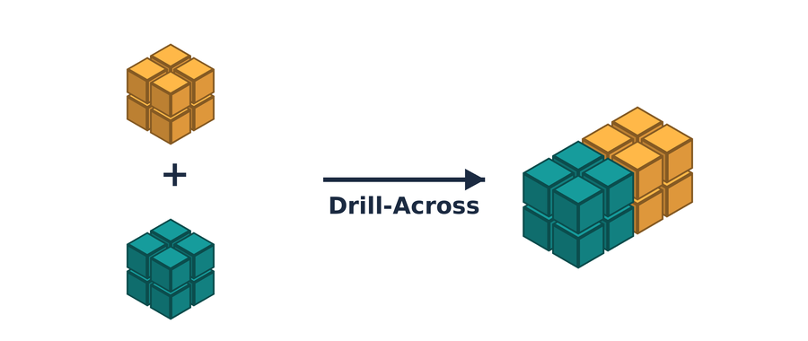
Q6 · Disclosed vs exploited, per vendor and year
DRILL-ACROSS
“For each vendor and year: CVEs published (cube 1) and CVEs added to KEV (cube 2).”
WITH published AS ( -- cube 1
SELECT p.vendor, d.year, COUNT(*) AS cve_published
FROM fact_vulnerability f
JOIN dim_product p USING (product_key)
JOIN dim_date d ON d.date_key = f.published_date_key
GROUP BY p.vendor, d.year),
exploited AS ( -- cube 2
SELECT p.vendor, d.year, COUNT(*) AS cve_added_to_kev
FROM fact_kev_addition k
JOIN dim_product p USING (product_key)
JOIN dim_date d ON d.date_key = k.date_added_key
GROUP BY p.vendor, d.year)
SELECT vendor, year, cve_published, cve_added_to_kev,
ROUND(1000.0 * cve_added_to_kev
/ NULLIF(cve_published, 0), 1) AS kev_per_1000
FROM published FULL OUTER JOIN exploited
USING (vendor, year) -- conformed dimensions
WHERE year BETWEEN 2021 AND 2025;
KEV per 1,000 published | 2021 | 2022 | 2023 | 2024 | 2025
microsoft | 95 | 176 | 27 | 32 | 31
cisco | 19 | 158 | 27 | 19 | 48
ivanti | 346 | 71 | 40 | 63 | 68
vmware | 105 | 122 | 29 | 116 | 300
apple | 42 | 67 | 44 | 12 | 14
google | 27 | 15 | 6 | 23 | 16
The 2021–22 peaks are the KEV back-fill (catalog created Nov 2021). From 2023 Microsoft stabilises around 30 per 1,000, while Ivanti (62–68) and VMware stay much higher.
CVE Data Warehouse · Alessia Angele · 17
Notes:
Each fact is aggregated separately to the common grain (vendor, year) through the conformed dimensions, then the two results are joined. Joining the two fact tables directly would multiply rows. The full query also counts ransomware-related entries and keeps the 10 vendors most present in KEV.

Slide 18
Q7 · How fast are vulnerabilities exploited?
ROLL-UP
“On the KEV cube, roll up products to vendors: median days from publication to KEV.”
SELECT p.vendor,
COUNT(*) AS kev_entries,
COUNT(*) FILTER
(WHERE k.days_to_kev < 0) AS zero_day,
PERCENTILE_CONT(0.5) WITHIN GROUP
(ORDER BY k.days_to_kev)
FILTER (WHERE k.days_to_kev >= 0)
AS median_days_to_kev,
ROUND(100.0 * COUNT(*) FILTER
(WHERE k.is_ransomware) / COUNT(*), 1)
AS ransomware_pct
FROM fact_kev_addition k
JOIN dim_product p ON p.product_key = k.product_key
WHERE k.in_nvd_snapshot
GROUP BY p.vendor -- product -> vendor
HAVING COUNT(*) >= 5
ORDER BY median_days_to_kev LIMIT 15;
Network appliances are exploited fastest: Fortinet in a median of 1 day, Palo Alto 8, Citrix 15.5. 61 CVEs entered KEV before NVD publication (zero-days), 16 each for Google and Apple.
CVE Data Warehouse · Alessia Angele · 18

Slide 19
Conclusions
Severity ≠ risk
Vendors differ in kind
Two cubes, one view
68% of critical CVEs are almost never exploited (Q5); rare weaknesses like type confusion are exploited far above their volume (Q2b).
Ivanti and VMware are exploited at 2–10× Microsoft's rate per published CVE (Q6); network appliances are exploited within days (Q7).
Conformed dimensions let the two business processes (disclosure and exploitation) be analysed together with a Drill-Across.
Limitations
20% of CVEs have no CPE, so their product is Unknown
EPSS is a single current snapshot, not a history over time
KEV lists confirmed exploitation only: absence from KEV does not mean “not exploited”
Attack classes come from keyword matching on descriptions (heuristic)
CVE Data Warehouse · Alessia Angele · 19

Slide 20
Thank you for your attention
Code: etl.py · queries.sql · export_results.py

