Slide 1

Design and Control of the Lift Subsystem of a Two-Wheeled Forklift Robot
f
Content
I. Introduction
II. Conceptual mechanical design
III. Modeling
IV. Control
V. Results
VI. Conclusions and Future work
Sergio Esteban Quintero Benavides
Keio University
Faculty of Science and Technology
School of Integrated Design Engineering
Murakami Laboratory
2nd year – Master’s degree
2025/04/19
SUM Sergio Esteban Quintero Benavides
1

Slide 2



I. Introduction
In modern industrial environments, humans and robots work together.
f
  Labor shortage in industrialized countries.
  High-risk tasks executed by robots.
[A]
Mobile robots should have a small footprint for safety and space optimization reasons.
[B]
2025/04/19
SUM Sergio Esteban Quintero Benavides
2

Slide 3
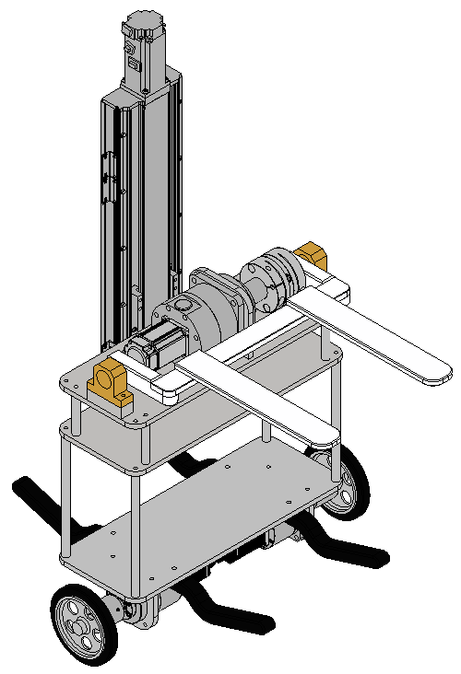

I. Introduction
Two-Wheeled Forklift Robot:
  Aimed for load movement in warehouses.
  Self-balanced mobile robot.
  Small footprint.
[C]
2025/04/19
SUM Sergio Esteban Quintero Benavides
3

Slide 4
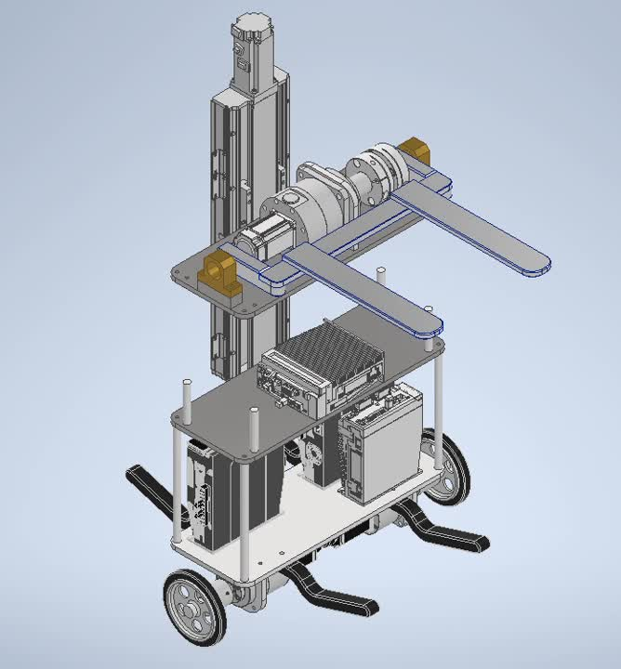
II. Conceptual mechanical design
2025/04/19
SUM Sergio Esteban Quintero Benavides
4

Slide 5
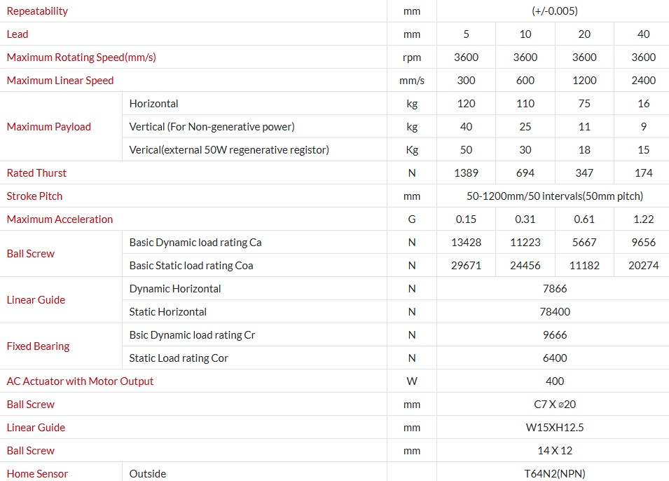
II. Conceptual mechanical design
Ball screw linear actuator ETH2-17-L5-350-BC-M40B-E5N5L
2025/04/19
SUM Sergio Esteban Quintero Benavides
5

Slide 6
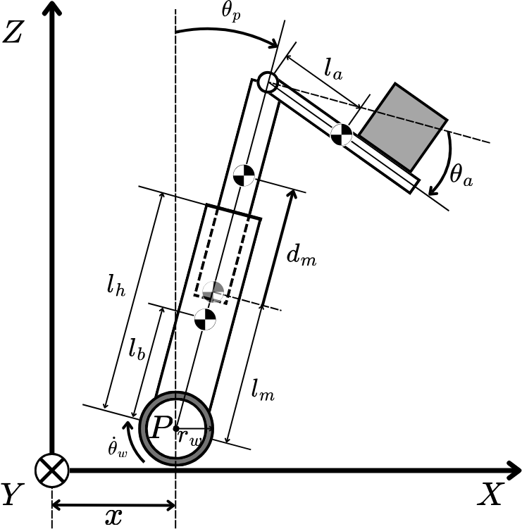
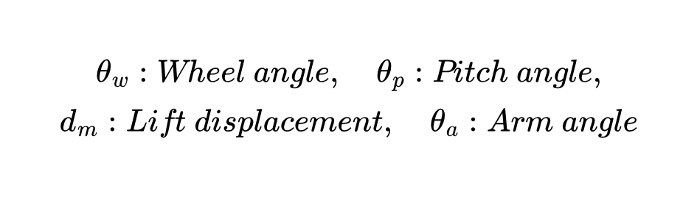
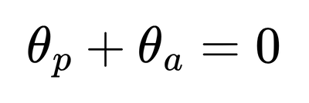
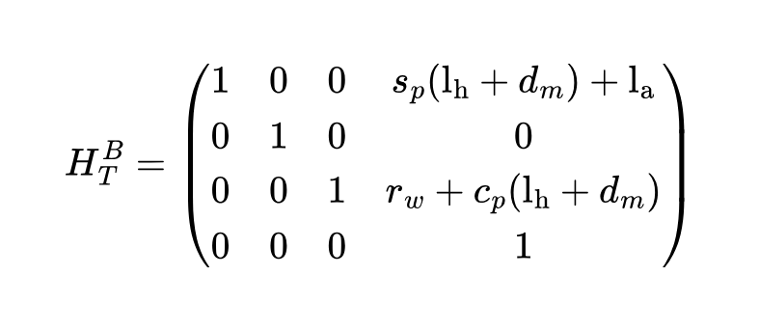
III. Modeling
Kinematics:
2025/04/19
SUM Sergio Esteban Quintero Benavides
6

Slide 7
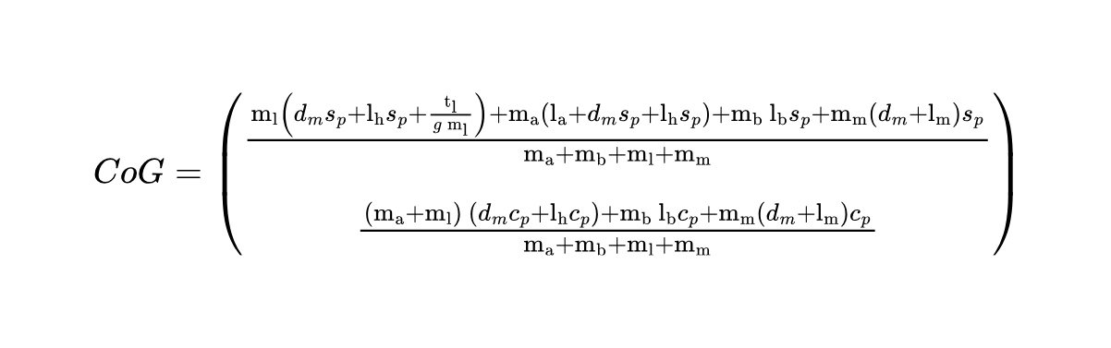
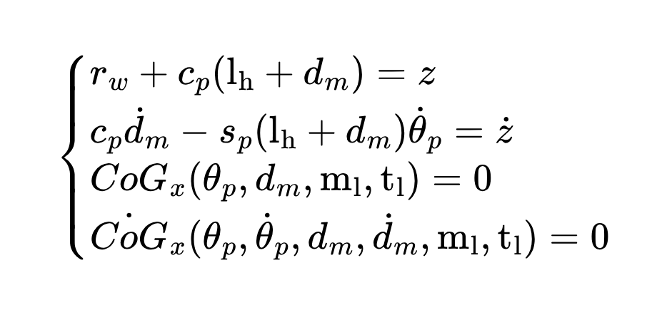
III. Modeling
Kinematics:
2025/04/19
SUM Sergio Esteban Quintero Benavides
7

Slide 8
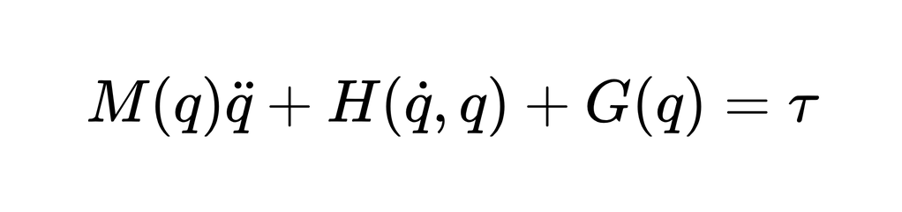
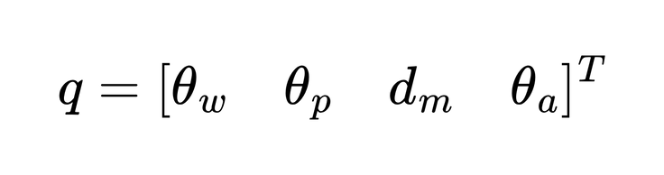
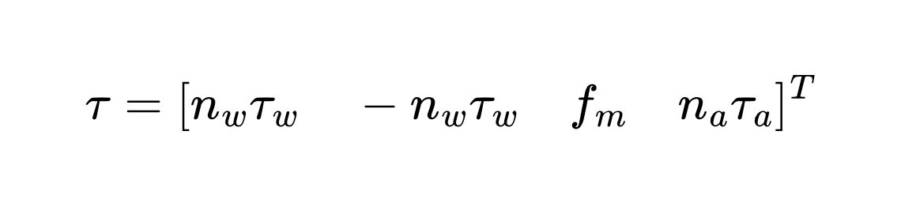
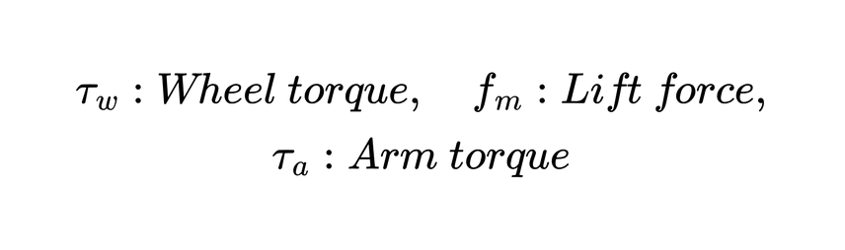
III. Modeling
Dynamics:
Generalized coordinates:
2025/04/19
SUM Sergio Esteban Quintero Benavides
8

Slide 9
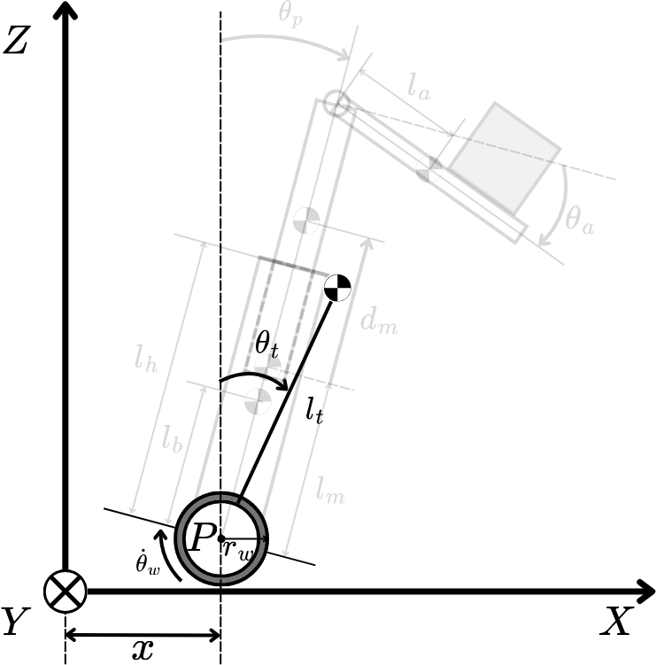
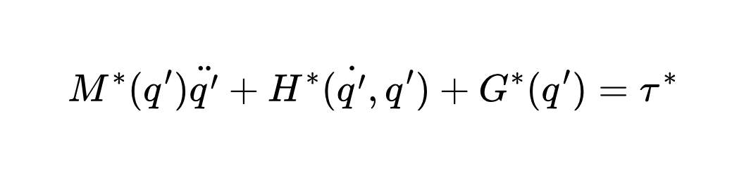
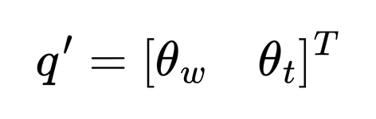
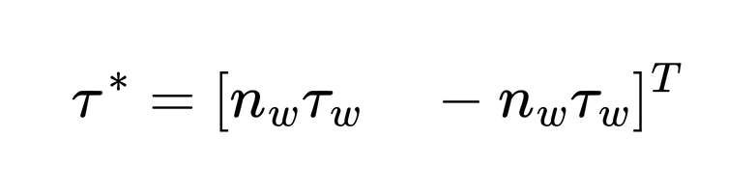
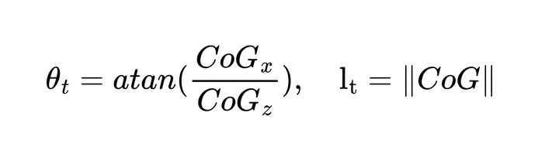
III. Modeling
Simplified dynamics:
Generalized coordinates:
2025/04/19
SUM Sergio Esteban Quintero Benavides
9

Slide 10
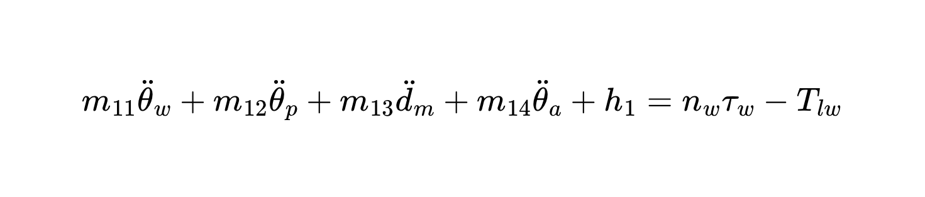
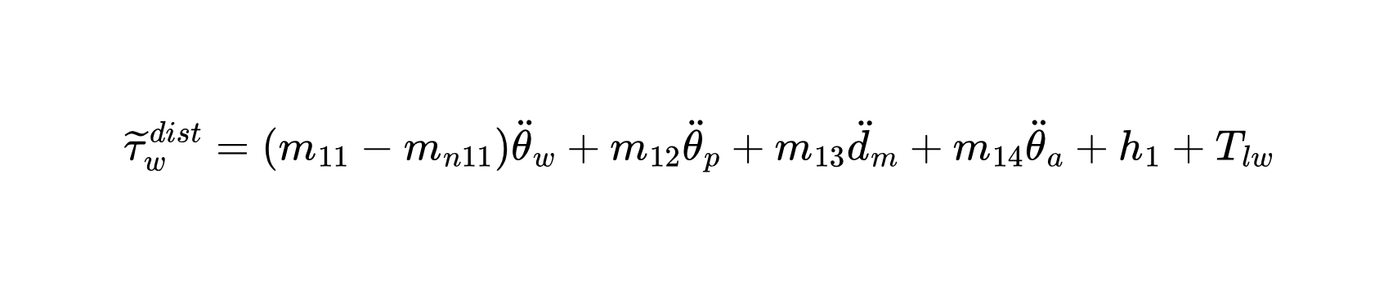
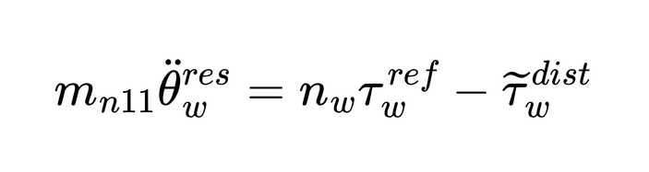
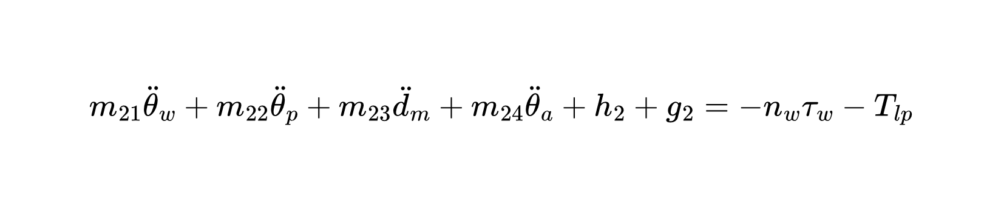
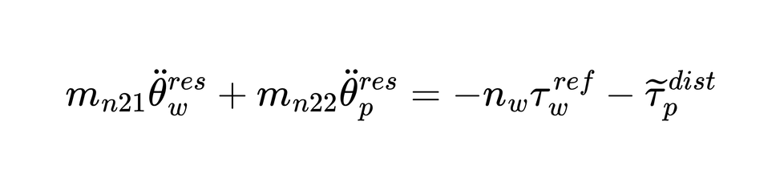
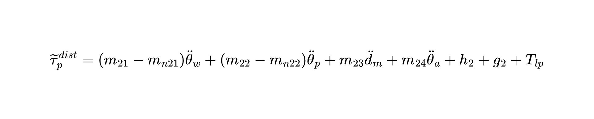
IV. Control
Synthesized Pitch Angle Disturbance Observer (SPADO):
2025/04/19
SUM Sergio Esteban Quintero Benavides
10

Slide 11
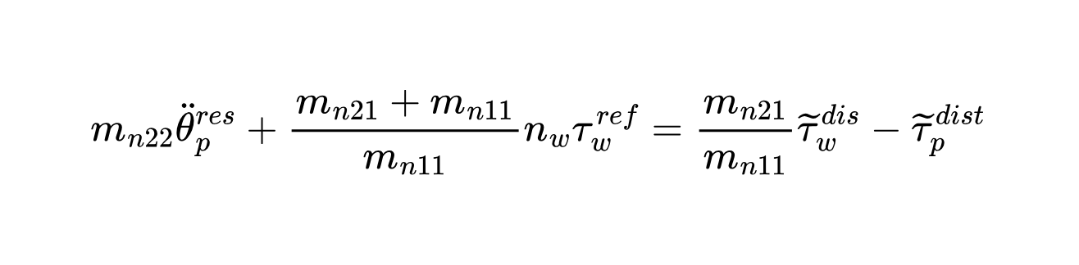
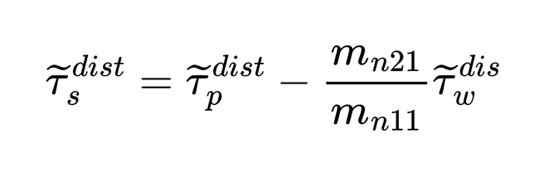
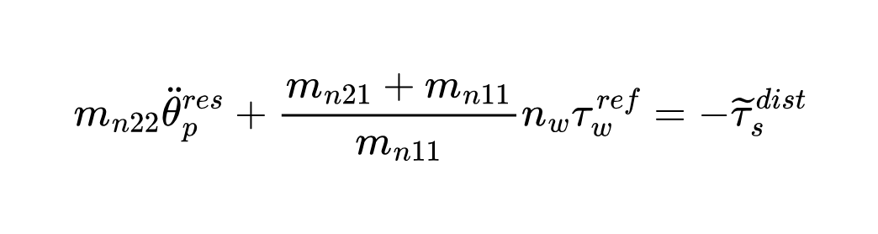
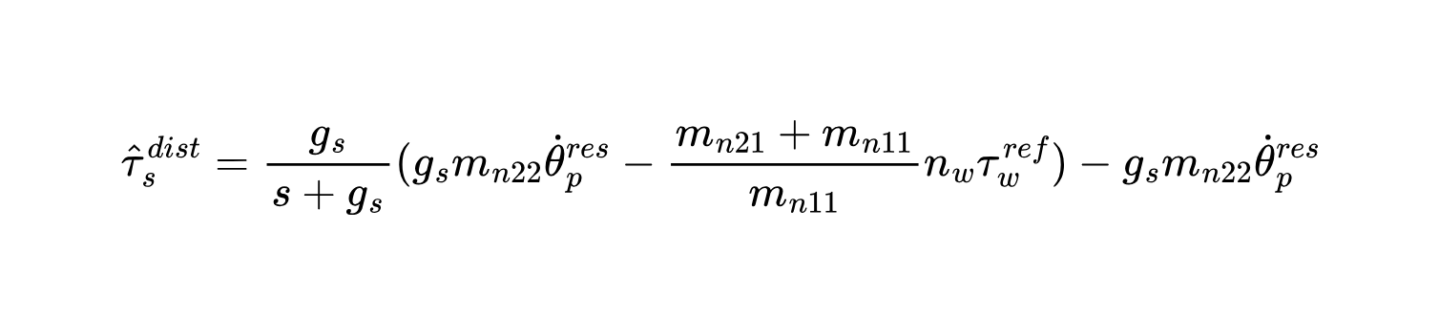
IV. Control
SPADO:
Pseudo differentiation
2025/04/19
SUM Sergio Esteban Quintero Benavides
11

Slide 12
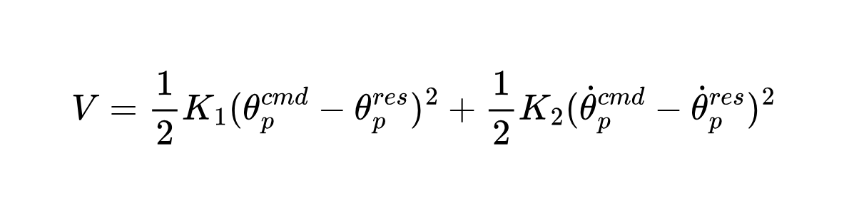
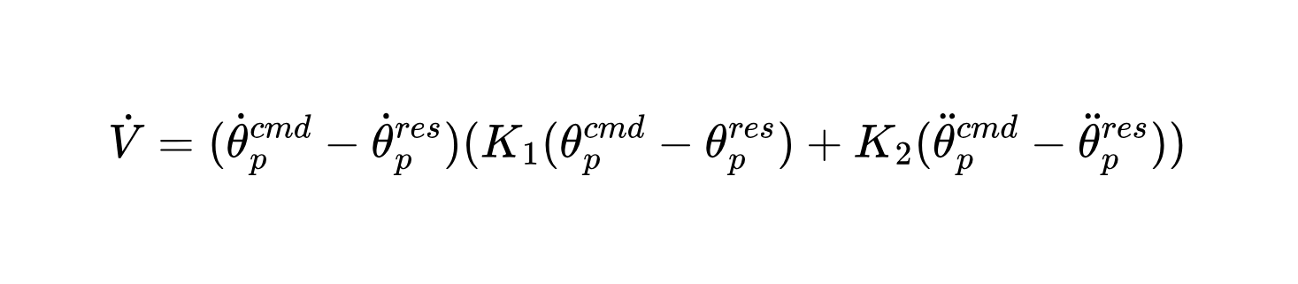
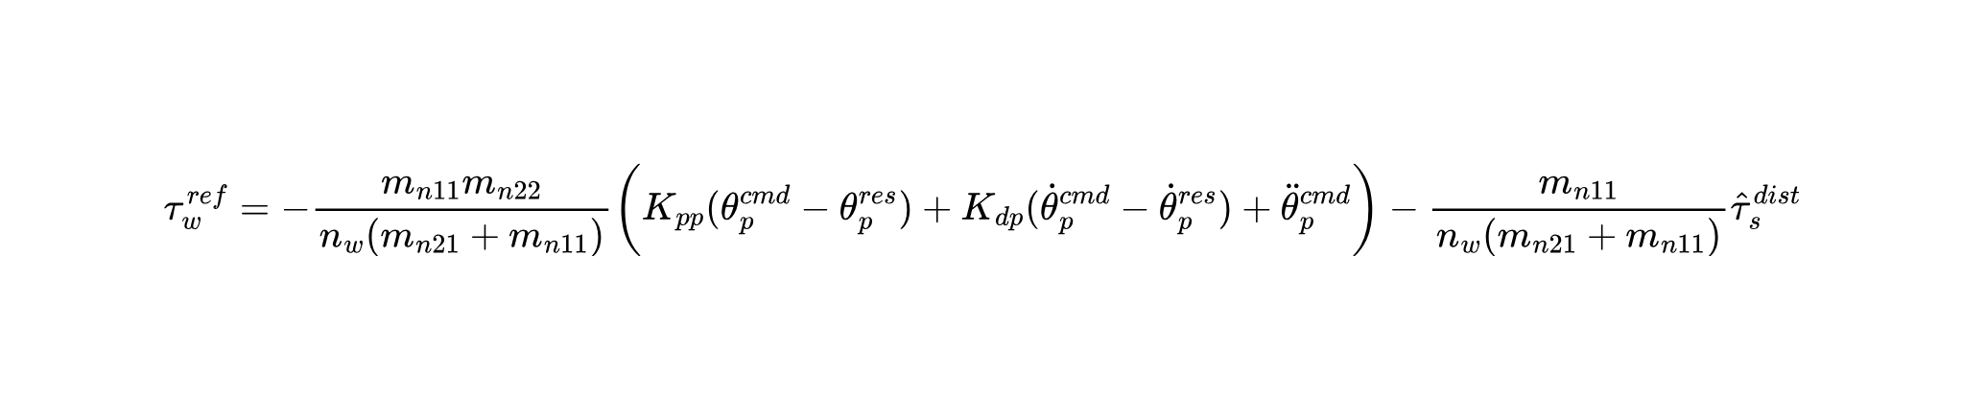
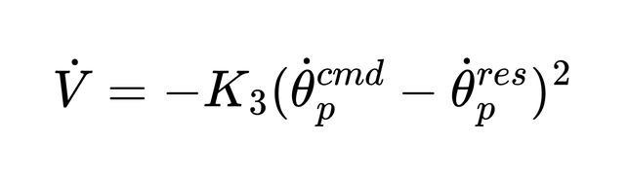
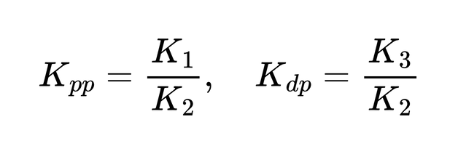
IV. Control
PD controller pitch angle:
2025/04/19
SUM Sergio Esteban Quintero Benavides
12

Slide 13
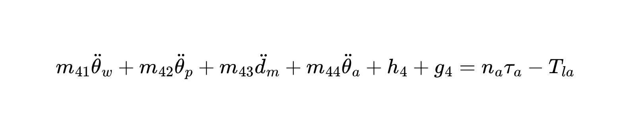
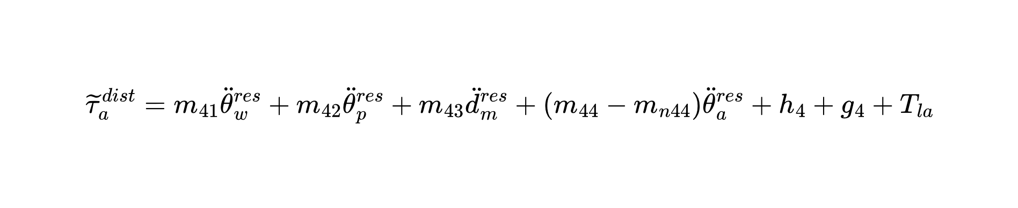
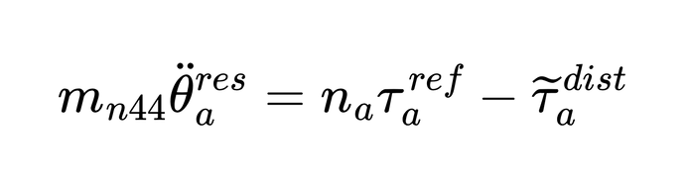
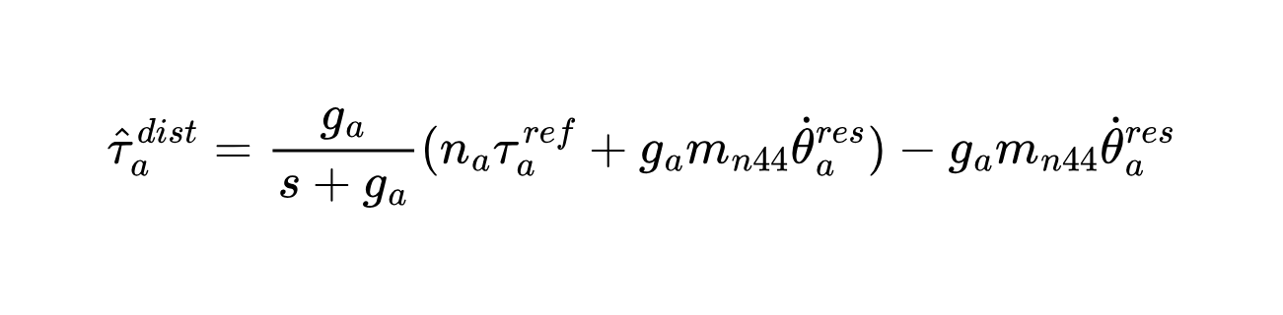
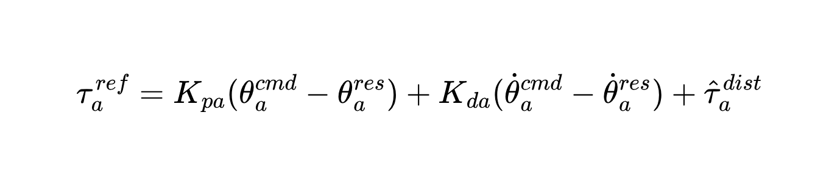
IV. Control
Fork Disturbance Observer (FDOB):
Pseudo differentiation
PD controller fork angle:
2025/04/19
SUM Sergio Esteban Quintero Benavides
13

Slide 14
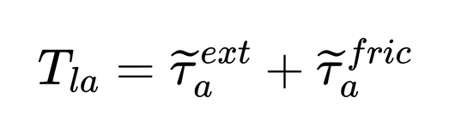
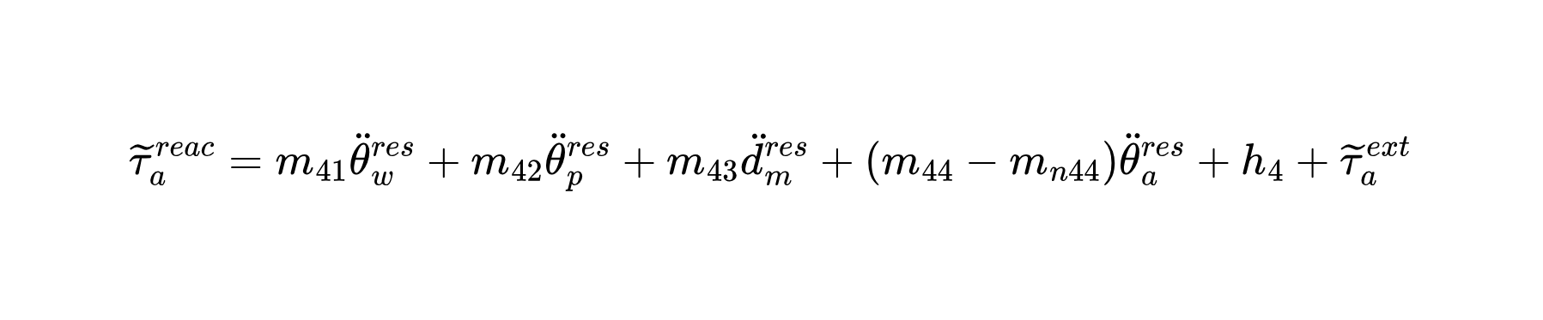
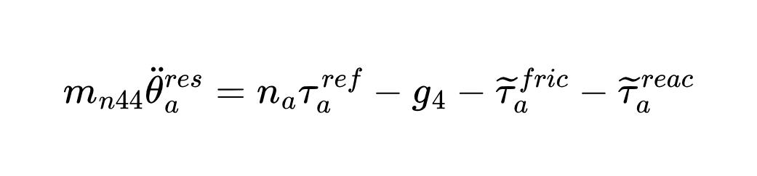
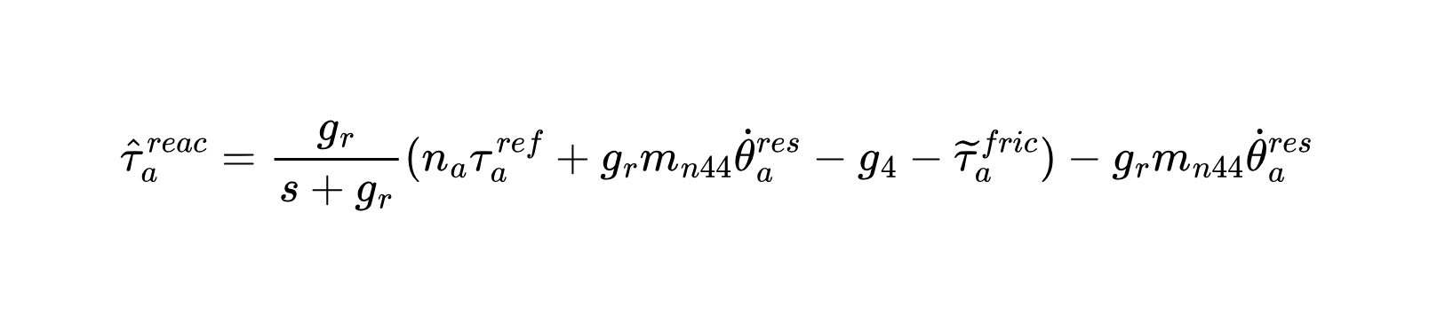
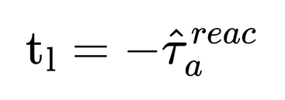
IV. Control
Fork Reaction Torque Observer (FRTOB):
Pseudo differentiation
2025/04/19
SUM Sergio Esteban Quintero Benavides
14

Slide 15
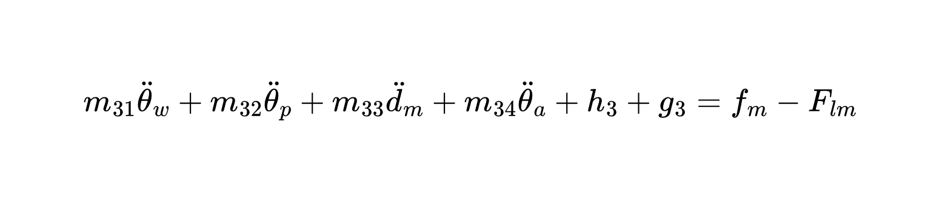
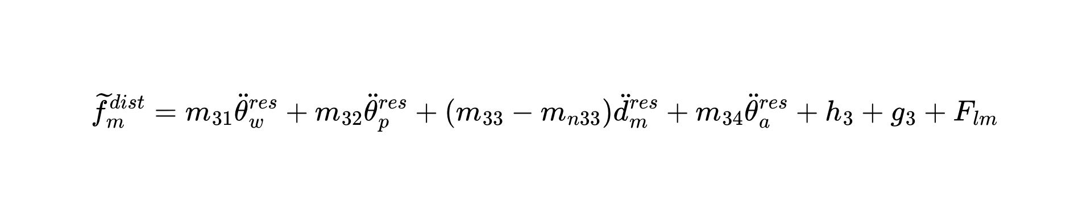
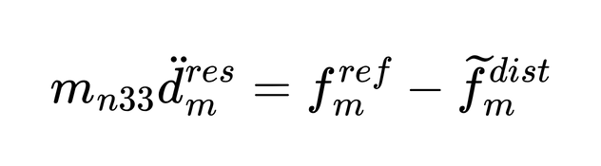
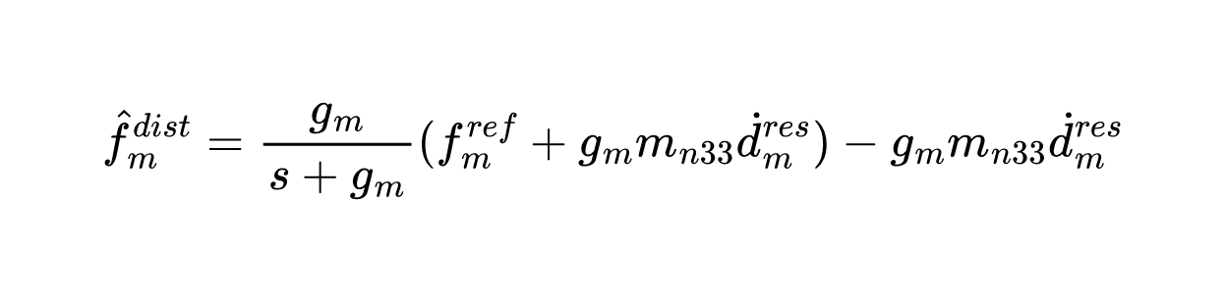
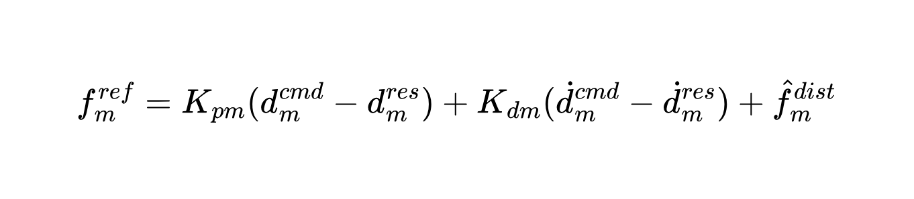
IV. Control
Lift Disturbance Observer (LDOB):
Pseudo differentiation
PD controller lift displacement:
2025/04/19
SUM Sergio Esteban Quintero Benavides
15

Slide 16
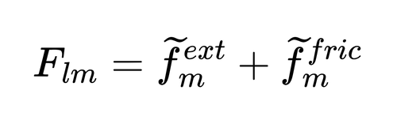
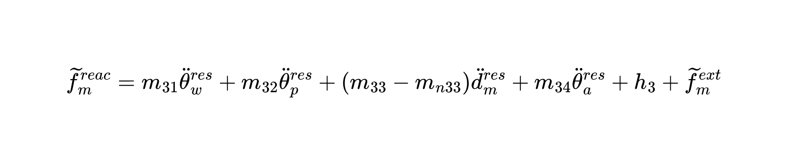



IV. Control
Lift Reaction Force Observer (LRFOB):
Pseudo differentiation
2025/04/19
SUM Sergio Esteban Quintero Benavides
16

Slide 17


IV. Control
Wheel Position Control:
Total pitch command:
2025/04/19
SUM Sergio Esteban Quintero Benavides
17

Slide 18


V. Results
2025/04/19
SUM Sergio Esteban Quintero Benavides
18

Slide 19

V. Simulation
2025/04/19
SUM Sergio Esteban Quintero Benavides
19

Slide 20

V. Simulation
Horizontal displacement of the robot
2025/04/19
SUM Sergio Esteban Quintero Benavides
20

Slide 21

V. Simulation
Position error of the robot
2025/04/19
SUM Sergio Esteban Quintero Benavides
21

Slide 22

V. Simulation
Horizontal velocity of the robot
2025/04/19
SUM Sergio Esteban Quintero Benavides
22

Slide 23

V. Simulation
Vertical position of the fork
2025/04/19
SUM Sergio Esteban Quintero Benavides
23

Slide 24

V. Simulation
Estimated external torque over the fork
2025/04/19
SUM Sergio Esteban Quintero Benavides
24

Slide 25

V. Simulation
Estimated mass of the external load
2025/04/19
SUM Sergio Esteban Quintero Benavides
25

Slide 26
VI. Conclusions and Future work
  The proposed motion planning and control strategies are capable of generating trajectories that the TWFR is capable of executing with an admissible position error.
  The implementation of adaptive IK and ID solutions that depend on the estimation of physical properties of the external load provides great flexibility in industrial environments where it is not possible to control the variables of the load that will be manipulated.
  The next steps for this work are the detailed mechanical design and construction of the lift subsystem. With the complete TWFR, the mathematical modeling and control parameters must be adapted to match the real system to test physically the presented motion planning and control algorithms.
2025/04/19
SUM Sergio Esteban Quintero Benavides
26

Slide 27
References
[1] H. Kanazawa, K. Ishizaki, Y. Miyata, M. Nawa, N. Kato, and T. Murakami, "Model-Based Pitch Angle Compensation for Center of Gravity Variation in Underactuated System with an Arm," in Proceedings of the 2023 IEEE 32nd International Symposium on Industrial Electronics (ISIE), 2023, pp. 1-6.
[2] H. Yajima, K. Ishizaki, Y. Miyata, M. Nawa, N. Kato, and T. Murakami, "Posture Stabilization Control Compensating Variation of Body Center of Gravity in Underactuated System," in Proceedings of the 2023 IEEE International Conference on Mechatronics (ICM), 2023, pp. 1-6.
[3] J. Ito and T. Murakami, "Underactuated Control for Two-Wheeled Mobile Robot with an Arm Using Torque Constraint Conditions and Disturbance Observer," in Proceedings of the 2023 IEEE 32nd International Symposium on Industrial Electronics (ISIE), 2023, pp. 1-6.
[4] Mezawa, M. (2022). Virtual Suspension Control in Two-Wheeled Transport Robot (Master's thesis, Keio University).
[A] https://www.flaticon.com/free-icons/comparison
[B] https://www.flaticon.com/free-icons/standard
[C] https://www.flaticon.com/free-icons/storage
2025/04/19
SUM Sergio Esteban Quintero Benavides
27

Slide 28
Thank you!
2025/04/19
SUM Sergio Esteban Quintero Benavides
28

