Slide 1

Energy Consumption Predictions
Angeles Olvera, MDS
Data Science Capstone Project 2, May 24,2025

Slide 2
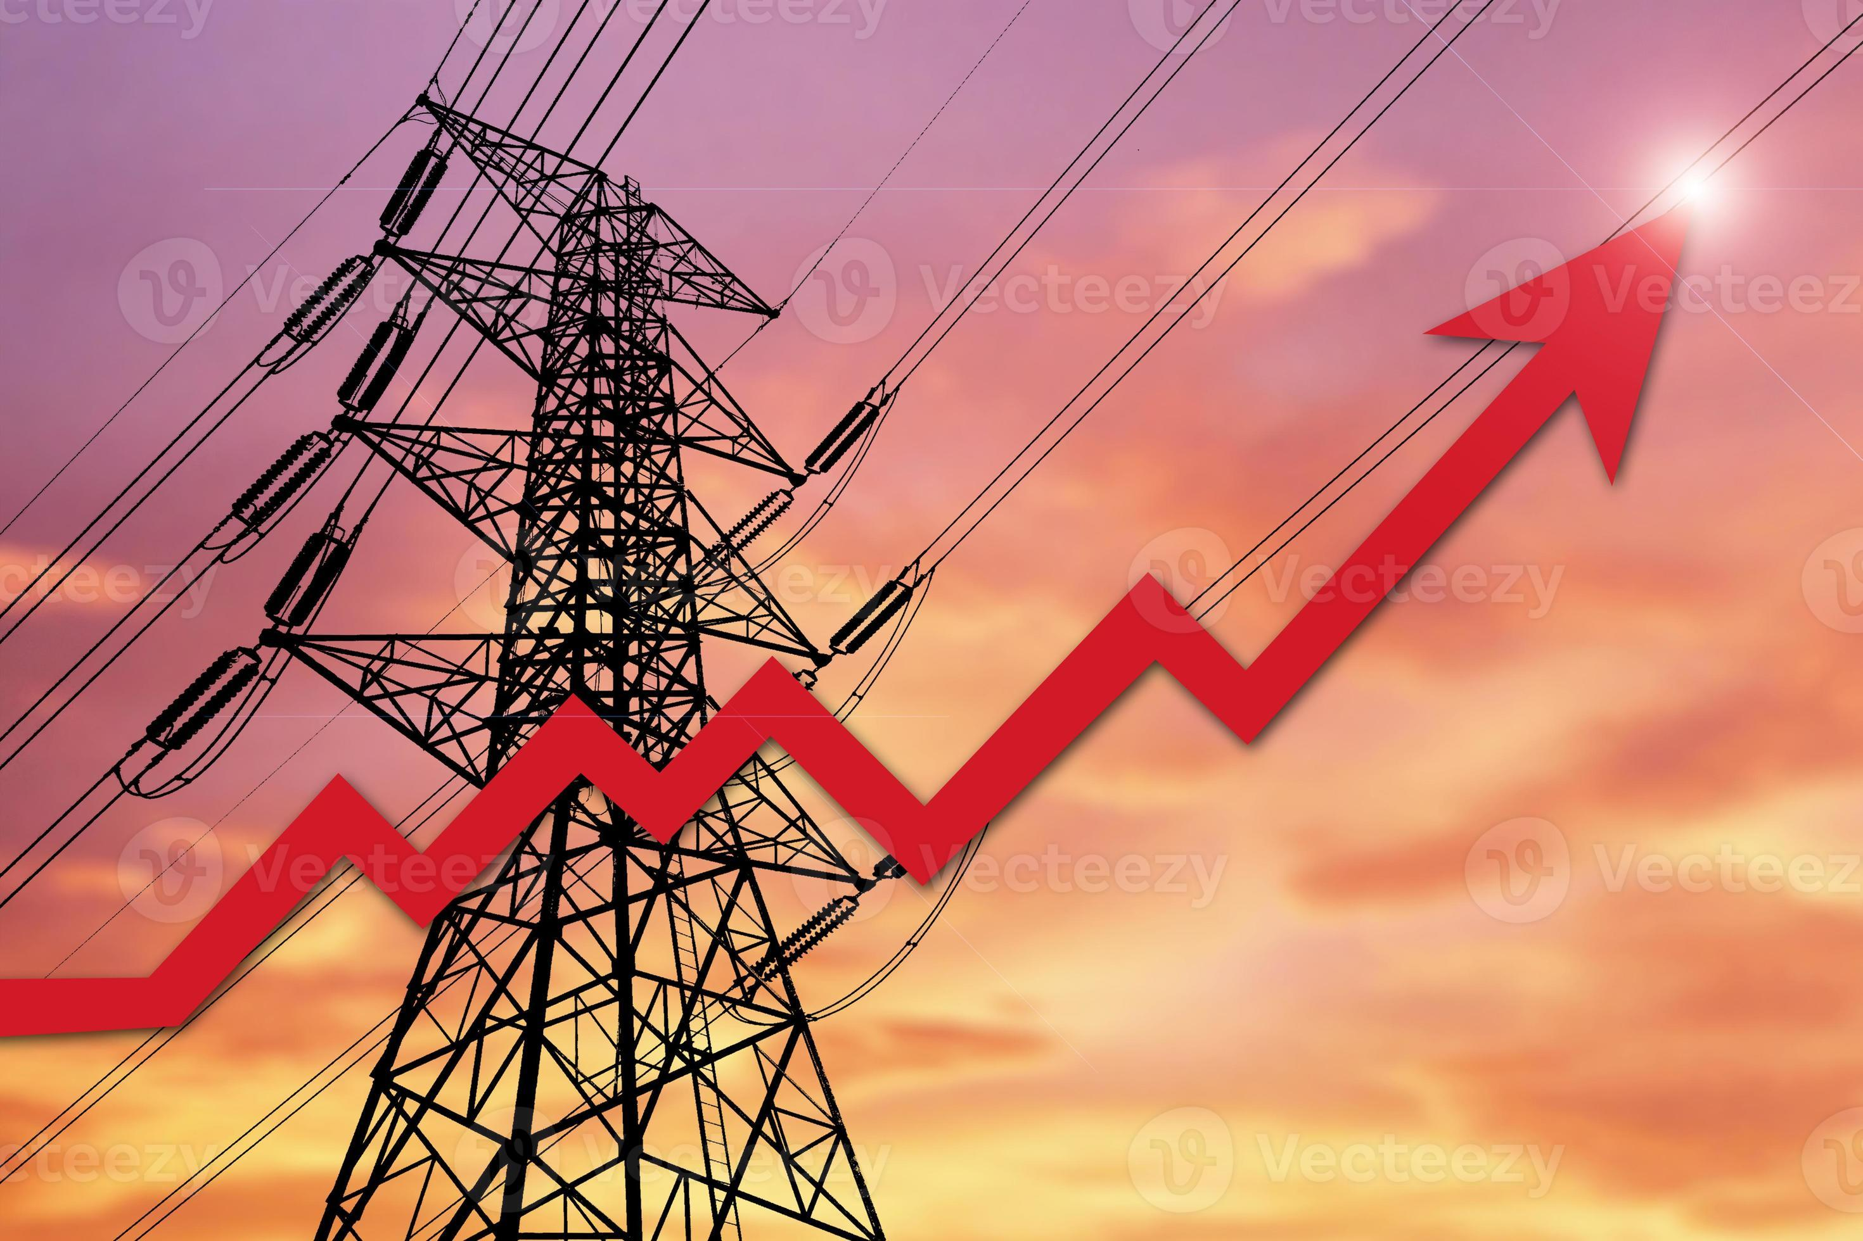

The Problem
GreenWatts Energy an energy solutions provider needs to optimize operational efficiency and meet growing energy demands.
What influences energy consumption?
When is energy consumption the highest and the lowest?

Slide 3
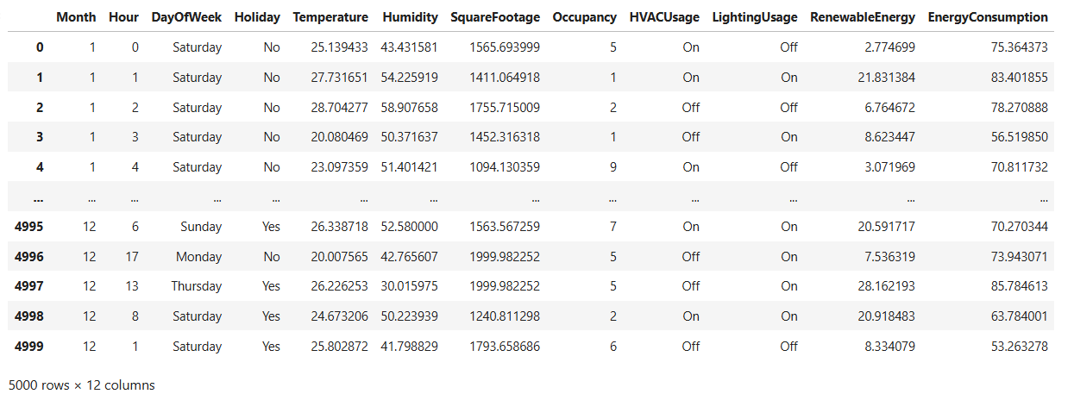
Data Wrangling
Data from Kaggle.com
Energy consumption prediction
5000 rows & 12 columns
4000 rows are synthetic data, and 1000 rows are real data.
Data Types : int64, object and float64
No missing data and no duplicates.
Outliers will not be removed as they play a big role on energy predictions.

Slide 4
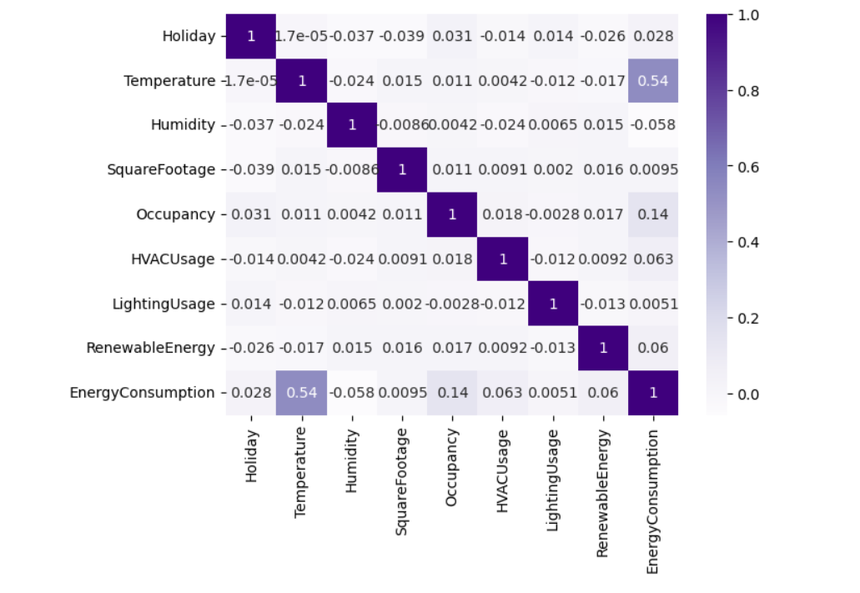
What influences energy consumption?
Correlation analysis shows that the variable with the highest correlation to energy consumption is Temperature.
- Hypothesis testing also revealed that this correlation does not occur by chance and the correlation between both variables is real.

Slide 5
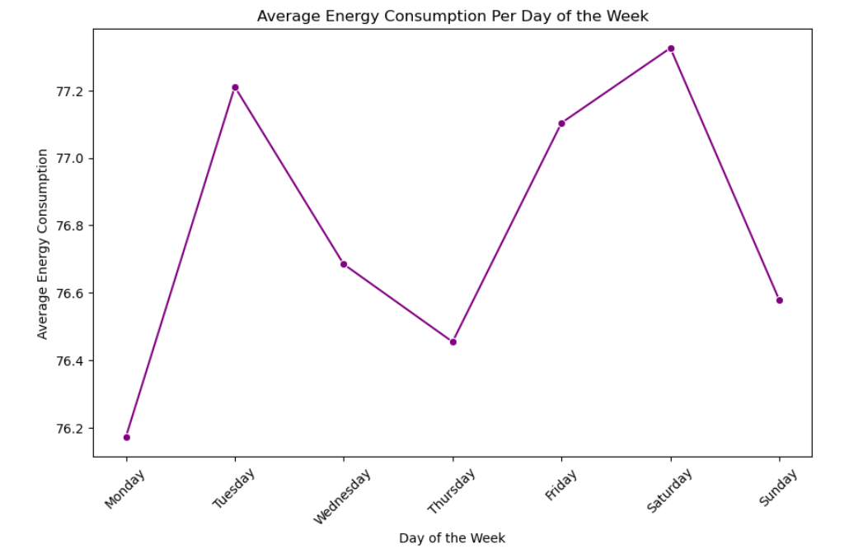
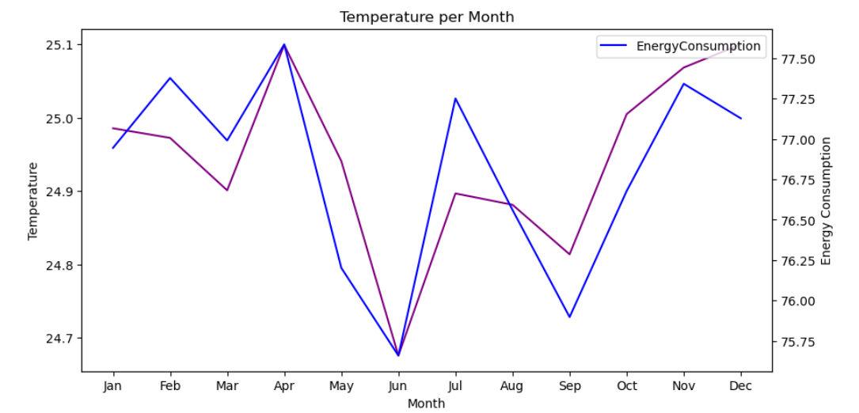
When is energy consumption the highest and the lowest?
Energy Consumption Trends by Day:
Highest consumption: Tuesdays and Saturdays
Lowest consumption: Mondays and Thursdays
Energy Consumption Trends by Month:
Highest consumption: April and November
Lowest consumption: June and September
Temperature & Energy Consumption Relationship:
The temperature variable followed the same trend as energy consumption.
This supports the hypothesis: higher temperatures lead to increased energy consumption, while lower temperatures decrease consumption.

Slide 6
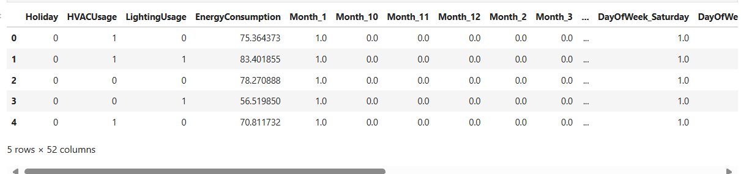
Data Pre-processing
Feature transformation with One-Hot Encoding
Scaled data with StandardScaler()
Split the data with train_test_split()

Slide 7
Model & Model Evaluation with Cross Validation
Linear Regression {'Cross-Validated RMSE': 7.649073347969607, 'Cross-Validated MAE': 6.109298336476741, 'Cross-Validated R2-SCORE': 0.3160332814094657, 'Cross-Validated MAPE': 8.152251830124545} | Random Forest Regressor {'Cross-Validated RMSE': 7.662464749499648, 'Cross-Validated MAE': 6.123869157025366, 'Cross-Validated R2-SCORE': 0.31328641714836175, 'Cross-Validated MAPE': 8.169134536114072} | Support Vector Regressor {'Cross-Validated RMSE': 7.662316518822432, 'Cross-Validated MAE': 6.1279417938770875, 'Cross-Validated R2-SCORE': 0.3136910166781213, 'Cross-Validated MAPE': 8.194621999628904} | XGBoost Regressor {'Cross-Validated RMSE': 7.876765633358914, 'Cross-Validated MAE': 6.296055331004747, 'Cross-Validated R2-SCORE': 0.27451448056390654, 'Cross-Validated MAPE': 8.390630579555472}

Slide 8
Model Evaluation
The following metrics were used for assessment:
RMSE (Root Mean Square Error)
MAE (Mean Absolute Error)
R² Score
MAPE (Mean Absolute Percentage Error)
Cross-validation was used to evaluate each model, with five iterations per model.
The technique partitioned the dataset into batches to test how well each model performed on unseen data.
After testing, the evaluation metrics were averaged to generate a final score per model.
Linear regression was the best-performing model, as it had:
The lowest RMSE, MAE, and MAPE, indicating minimal prediction errors.
The highest R² score, signifying strong predictive accuracy.

Slide 9

Model Optimization
Each model has its own hyperparameters, and each was optimized using RandomizedSearchCV .
RandomizedSearchCV provided the best parameters and best evaluation metric scored they computed.
Linear Regression n_jobs = -1 | Random Forest Regressor n_estimators = 800 min_samples_split = 10 min_samples_leaf = 10 max_samples = 0.75, max_depth = 10} | Support Vector Regressor kernel = rbf gamma = auto 'epsilon = 0.05 C = 8.0 | XGBoost Regressor random_state = 50 n_estimators = 100 max_depth = 40 learning_rate = 0.01

Slide 10
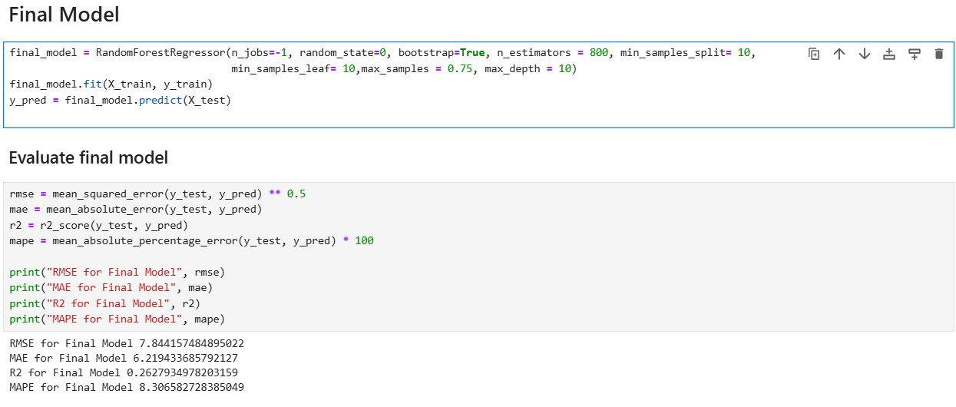
Final Model - Random Forest Regressor
Test results closely align with the scores from the training data .
Low RMSE & MAE confirm the model maintains a stable error rate, even with unseen data (test data).
MAPE below 10% indicates that predictions deviate from actual values by less than 10%, proving reliability.

Slide 11
Recommendations
Improved forecasting – Predict energy consumption trends accurately.
Operational efficiency – Prevent outages and optimize production.
Strategic planning – Allocate resources effectively and reduce costs.

