Slide 1
School of Information Technology
Project Management: Integration

Slide 2
Learning Objectives
Describe an overall framework for project integration management
Describe project plan development
Use guidelines and templates to
    develop plans
    perform stakeholder analysis
Explain project plan execution, its relationship to project planning and factors related to success

Slide 3
Learning Objectives
Describe the process of monitoring and controlling project work
Describe integrated change control
Plan for and manage changes in projects
Use a change control system
Describe the use of software to aid project integration management

Slide 4
Managing Project: Integration
Project managers must coordinate all of the other knowledge areas throughout a project’s life cycle
Many new project managers have trouble looking at the “big picture” and want to focus on too many details

Slide 5
Project Integration Management Processes
Develop the project charter:
  working with stakeholders to create the document that formally authorizes a project
  - the charter
Develop the project management plan:
  coordinating all planning efforts to create a consistent, coherent document - the project management plan
Direct and manage project execution:
  carrying out the project management plan by performing the activities included in it

Slide 6
Project Integration Management Processes
Monitor and control the project work:
  overseeing project work to meet the performance objectives of the project
Perform integrated change control:
  coordinating changes that affect the project’s deliverables and organizational process assets
Close the project or phase:
  finalizing all project activities to formally close the project or phase

Slide 7
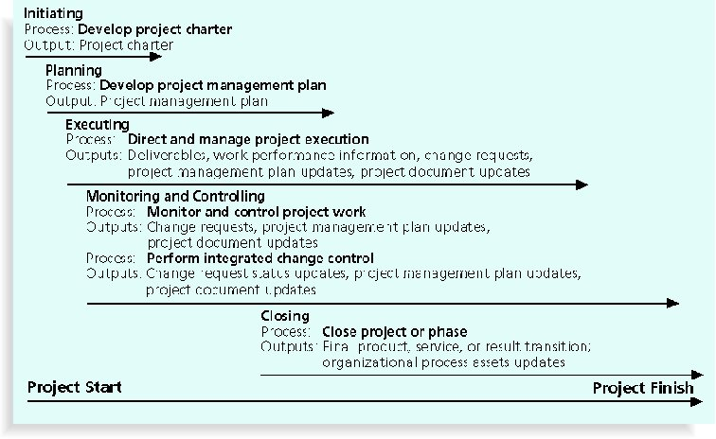
Project Integration Management Summary

Slide 8
Strategic Planning and Project Selection
Strategic planning involves determining long-term objectives, predicting future trends, and projecting the need for new products and services
Organizations often perform a SWOT analysis
  Analyzing Strengths, Weaknesses, Opportunities, and Threats
As part of strategic planning, organizations:
  Identify potential projects
  Use realistic methods to select which projects to work on
  Formalize project initiation by issuing a project charter

Slide 9
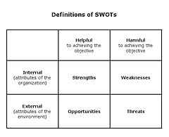
Identifying Projects
  Use organisational strategic planning to identify projects. A SWOT analysis may help identify appropriate projects
Notes:
The technique is credited to Albert Humphrey, who led a research project at Stanford University in the 1960s and 1970s using data from the Fortune 500 companies.
Strengths: attributes of the organization that are helpful to achieving the objective.
Weaknesses: attributes of the organization that are harmful to achieving the objective.
Opportunities: external conditions that are helpful to achieving the objective.
Threats: external conditions that are harmful to achieving the objective.

Slide 10
Methods for Selecting Projects
There are usually more projects than
available time and resources to
implement them
Methods for selecting projects include:
  Focusing on broad organizational needs
  Categorizing information technology projects
  Performing net present value or other financial analyses
  Using a weighted scoring model

Slide 11
Focusing on Broad Organizational Needs
It is often difficult to provide strong justification for many IT projects, but everyone agrees they have a high value
Three important criteria for projects:
  There is a need for the project
  There are funds available
  There’s a strong will to make the project succeed

Slide 12
Categorizing IT Projects
Other categorizations are:
  How long it will take to do and when it is needed
  What is the overall priority of the project
  Does the project address:
    A problem
    An opportunity, or
    A directive
Financial matters are often an important
consideration in selecting projects

Slide 13
Financial Analysis of Projects
Three primary methods for determining the projected financial value of projects are:
  Net present value (NPV) analysis
    expected net monetary gain or loss from a project by discounting all expected future cash inflows and outflows to the present point in time
  Return on investment (ROI)
    calculated by subtracting the project costs from the benefits and then dividing by the costs
  Payback analysis
    the amount of time it will take to recoup, in the form of net cash inflows, the total dollars invested in a project

Slide 14
Weighted Scoring Model
A weighted scoring model is a tool that provides a systematic process for selecting projects based on many criteria
  Identify criteria important to the project selection process
  Assign percentages (i.e. weights) to each criterion so they add up to 100%
  Assign scores to each criterion for each project
  Multiply the scores by the weights and get the total weighted scores
The higher the weighted score, the better

Slide 15
Project Charter
After deciding what project to work on, the rest of the organization must be informed
A project charter is a document that formally recognizes the existence of a project and provides direction on the project’s objectives and management
Key project stakeholders should sign a project charter to acknowledge agreement on the need and intent of the project; a signed charter is a key output of project integration management

Slide 16
Project Charter
Should include:
  Title and date of authorisation
  Manager contact details
  Summary schedule
  Summary budget
  Brief description of objectives
  Planned approach
  Roles / responsibilities
  Sign-off
  Comments

Slide 17
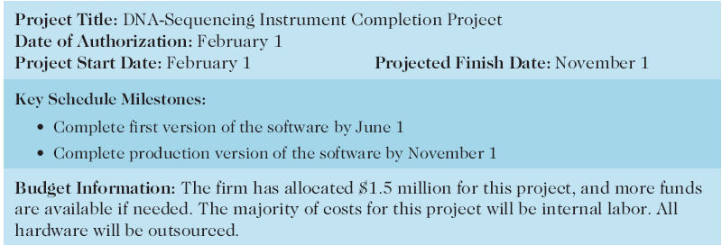
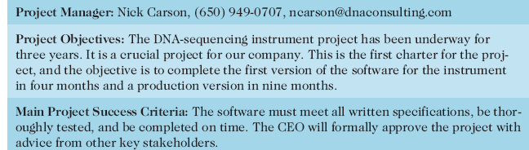
Project Charter:
DNA-Sequencing Instrument Completion Project

Slide 18
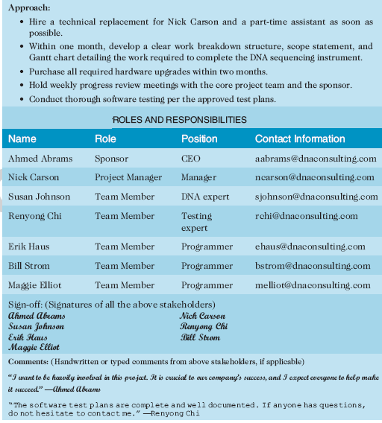
Project Charter: Example

Slide 19
Project Management Plans
A project management plan is a document used to coordinate all project planning documents, management processes, and to help guide a project’s execution and control (i.e. product development)
Plans created in the other knowledge areas are subsidiary parts of the overall project management plan

Slide 20
Common Elements of a
Project Management Plan
  Introduction or overview of the project
  Description of how the project is organized
  Management and technical processes used on the project
  Work to be done, schedule, and budget information
  A template of a project management plan is available on LMS. It is recommended that this template be used for your projects

Slide 21
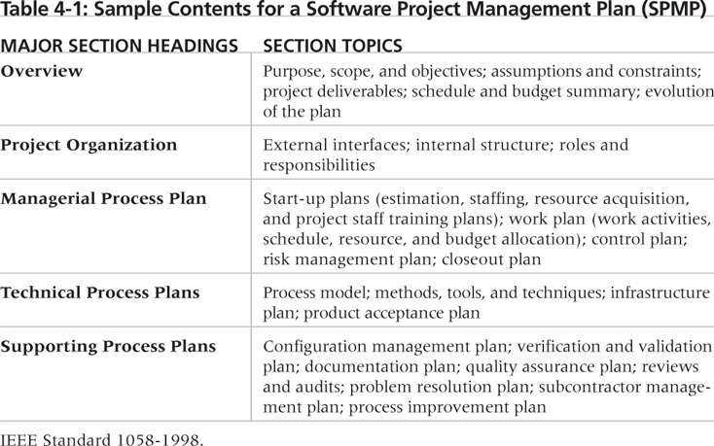
Sample Contents for a Software
Project Management Plan (SPMP)

Slide 22
Project Execution:
Manage the Project
Project execution involves managing and performing the work described in the project management plan
This includes management processes and product development
The majority of time and money is usually spent on execution

Slide 23
Project Execution:
Planning
Project planning and execution are intertwined and inseparable activities
Those who will do the work should help to plan the work
Project managers must solicit input from the team to develop realistic plans

Slide 24
Project Execution:
Providing Leadership and a Supportive Culture
Project managers must lead by example to demonstrate the importance of creating and then following good project plans
Organizational culture can help project execution by:
  Providing guidelines and templates
  Tracking performance based on the plans

Slide 25
Project Execution:
Important Skills
General management skills like leadership, communication, and political skills
Product, business, and application area skills and knowledge
Use of specialized tools and techniques

Slide 26
Project Execution:
Tools and Techniques
Expert judgment:
  Experts can help project managers and their teams make many decisions related to project execution
Project management information systems:
  There are hundreds of project management software products available on the market today, and many organizations are moving toward powerful enterprise project management systems that are accessible via the Internet

Slide 27
Monitoring and Controlling Project Work
Monitoring project work includes collecting, measuring, and disseminating performance information:
  Involves assessing measurements and analyzing trends to determine what process improvements can be made
The project team should continuously monitor project performance to assess the overall health of the project and identify areas that require special attention

Slide 28
Monitoring and Controlling Project Work
Monitoring also involves managing changes that are inevitable on most projects, so it’s important to develop and follow a process to monitor and control changes
A baseline is the approved project management plan plus approved changes

Slide 29
Integrated Change Control
Three main objectives are:
  Influencing the factors that create changes to ensure that changes are beneficial
  Determining that a change has occurred
  Managing actual changes as they occur
Often only the last factor is controlled!

Slide 30
Managing change
  View project management as a process of constant communication and negotiation
  Plan for change
  Establish a formal change control system
  Define procedures for making timely decisions on smaller changes
  Use written and oral performance reports to help identify and manage change
  Use project management and other software to help manage and communicate change

Slide 31
Change Control on
IT Projects
Former view:
  the project team should strive to do exactly what was planned on time and within budget
Problem:
  stakeholders rarely agreed on the up-front project scope, and time and cost; estimates inaccurate
Modern view:
  project management is a process of constant communication and negotiation
Solution:
  changes are often beneficial, and the project team should plan for them

Slide 32
Change Control System
A formal, documented process that describes when and how official project documents and work may be changed
Describes who is authorized to make changes and how to make them

Slide 33
Change Control Board (CCB)
A group of people who are formally responsible for approving or rejecting changes on a project
CCBs provide guidelines for preparing change requests, evaluating change requests, and managing the implementation of approved changes
Includes stakeholders from the entire organization

Slide 34
Making Timely Changes
Some CCBs only meet occasionally, so it may take too long for changes to occur
Some organizations have policies in place for time-sensitive changes
  “48-hour policy” allows project team members to make decisions; then they have 48 hours to reverse the decision pending senior management approval

Slide 35
Closure
To close a project, you must finalize all activities and transfer the completed or cancelled work to the appropriate people
Main outputs include:
  Administrative closure procedures
  Contract closure procedures
  Final products, services, or results
  Organizational process asset updates

Slide 36
Software for PIM
Several types of software can be used to assist in project integration management:
  Word processing software creates documents
  Presentation software creates presentations
  Spreadsheets or databases perform tracking
  Communication software such as e-mail and Web authoring tools facilitate communications
  Project management software can pull everything together and show detailed and summarized information

Slide 37
Summary
Project integration management involves coordinating all of the other knowledge areas throughout a project’s life cycle
Main processes include:
  Develop project charter
  Develop project management plan
  Direct and manage project execution
  Monitor and control project work
  Perform integrated change control
  Close the project or phase

