Slide 1
SQL for Tidyverse Pros
Colby Lewis V
Mailman-Biostatistics
February 8th, 2022

Slide 2


Agenda
I’d like to have a conversation about two guiding questions:
Part 1: How should we separate SQL and tools like the tidyverse/pandas in our minds?
Part 2: What resources are available to facilitate using these tools together?
SQL
SQL
≠
SQL

Slide 3
Ethos
SQL
SQL
≠
Part 1: How should we separate SQL and tools like the tidyverse/pandas in our minds?
Modern statistical curricula have mandatory courses built on R-tidyverse and Python-pandas
When available, SQL course are optional and believed to be for “more technical folks”

Slide 4
Ethos
SQL
SQL
≠
Let’s pretend your datascience Ⅰ course did teach SQL!
The next few slides are my reimagining of how today’s students could be introduced to SQL in the context of their tidyverse education
Quick acknowledgement to Ani Adhikari’s Data 8 and Debra D’Angelo’s BIOSTATS 8180 for some of the following resources and ideas in the talk

Slide 5
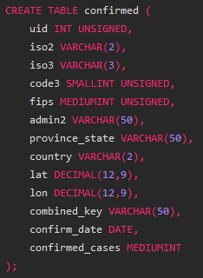
Introduction to SQL:
SQL
SQL
≠
SQL is a declarative programming language:
You never tell SQL how something should be achieved, instead, you define in very literal detail what you want to be produced

Slide 6
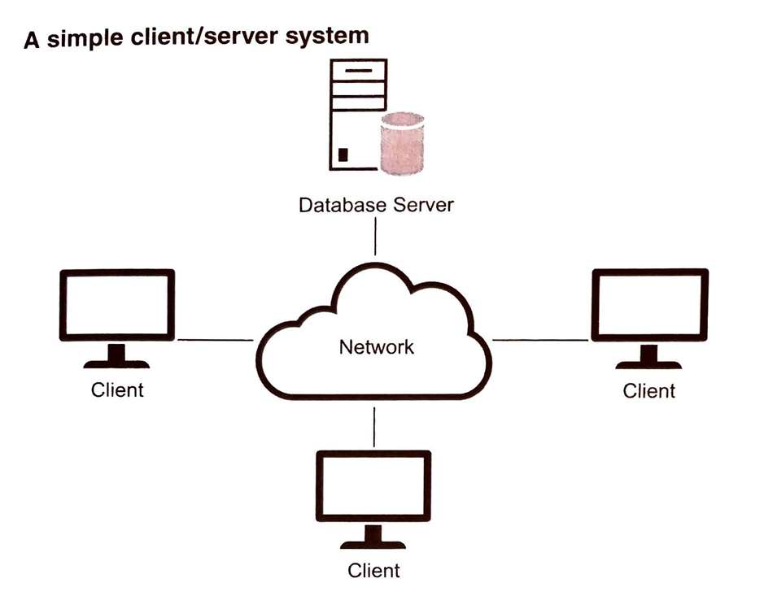
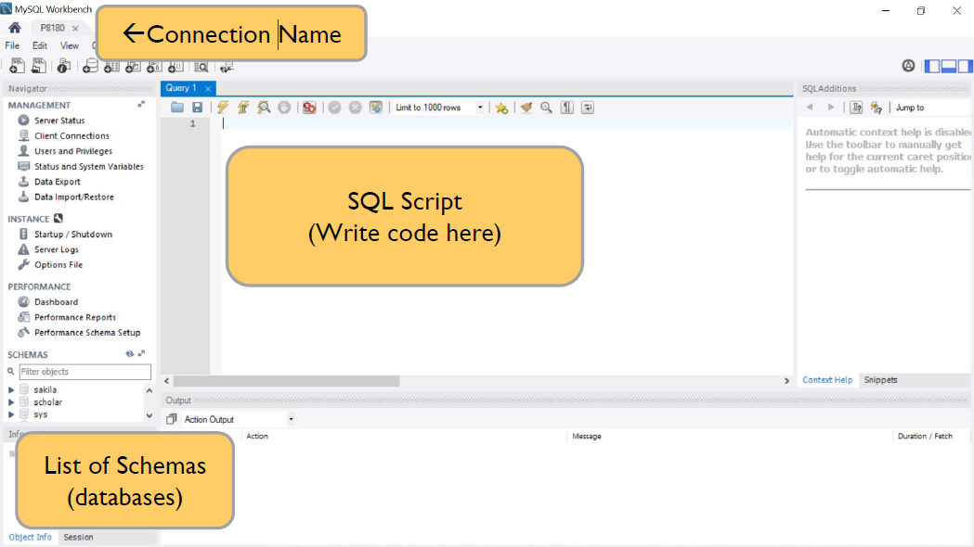
Introduction to SQL:
SQL
SQL
≠
SQL is a declarative programming language:
Indeed, SQL is so abstracted that there is no one “.sql” filetype or one SQL terminal

Slide 7


SQL Scripts:
SQL
SQL
≠
Most SQL environments have simple file-types for performing basic manipulations on a set of tables. I’ll refer to these as SQL scripts
Looks simple right? This query appears to be performing the table operations of filtering and selecting

Slide 8
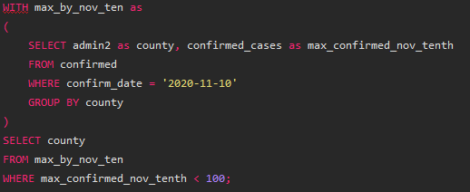
SQL Scripts:
SQL
SQL
≠
Here’s the full query along with the question we are trying to solve: List the names of counties reporting less than 100 confirmed cases as of 11/10/20

Slide 9

SQL is Different:
SQL
SQL
≠
When we compare side by side, things are much more different than they first seemed

Slide 10
SQL is Different:
SQL
SQL
≠
There are many differences between these languages, and today I’d like to communicate a key few. First up is so called “order of operations”

Slide 11
SQL is Different:
SQL
SQL
≠
What do you notice about the order of the functions on the left vs on the right?

Slide 12
SQL is Different:
SQL
SQL
≠
SQL can cause headaches fast for tidyverse pros if you forget about the “backwards” order of operations that go into writing a query.
4th
3rd*
1st
2nd
7th
5th
6th

Slide 13
SQL Cheat Sheet:
SQL
SQL
≠
What is evaluate first in a written out query?
FROM and JOINS
WHERE
GROUP BY
HAVING
WINDOW functions <“down column” operation applied to ungrouped rows>
SELECT <and aggregating functions like DISTINCT(), COUNT()>
UNION
ORDER BY
LIMIT

Slide 14
SQL Cheat Sheet:
SQL
SQL
≠
What is the dplyr equivalent
FROM and JOINS <- select(), left_join(), …
WHERE <- filter()
GROUP BY <- group_by()
HAVING <- filter()
WINDOW functions custom vector work then add new col…
SELECT <- select() AND summarise() AND rename()
UNION <- bind_rows()
ORDER BY <- arrange()
LIMIT <- slice(), head(), …

Slide 15

SQL is Different:
SQL
SQL
≠
GROUP BY + SELECT functionality
Remember, the group_by() and summarise() operations are separated in space.
If your query has a GROUP BY clause, then each column name referenced in the select, besides that group column(s), must have an aggregate function applied to it

Slide 16

SQL is Different:
SQL
SQL
≠
GROUP BY + SELECT functionality
While it first feels clunky, there are tons of very useful aggregation functions which let you skip manual labor in dplyr
COUNT(DISTINCT col_name) basically sneaks in a group over a column entirely within the SELECT statement.
There are many more shortcuts! Google for them!

Slide 17
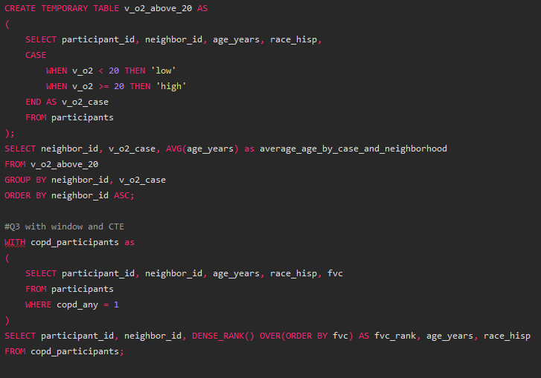
SQL is Different:
SQL
SQL
≠
Final Topic, building queries in multiple stages
TEMPORARY TABLE
like instantiating a new variable, uses a <;>
WITH
immediately followed by another select statement, no <;>

Slide 18
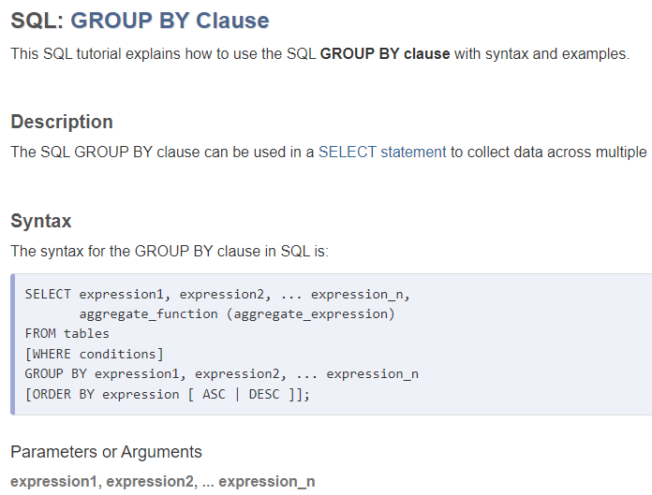
SQL all Purpose Wiki:
SQL
SQL
≠
This talk has been light on details of how to write queries, but Professor D’Angelo found the best documentation out there for SQL:
https://www.techonthenet.com/sql/index.php

Slide 19
Agenda
I’d like to have a conversation about two guiding questions:
Part 1: How should we separate SQL and tools like the tidyverse/pandas in our minds? ☑
Part 2: What resources are available to facilitate using these tools together?
SQL
SQL
≠
SQL

Slide 20
Adding SQL to a Workflow
SQL
If SQL is so different from tidyverse tools for table manipulation why use it?
Necessity (legacy data)
Speed
Simplicity
For complex databases spanning many tables and many devices/servers, it is the lesser evil
…discuss!

Slide 21
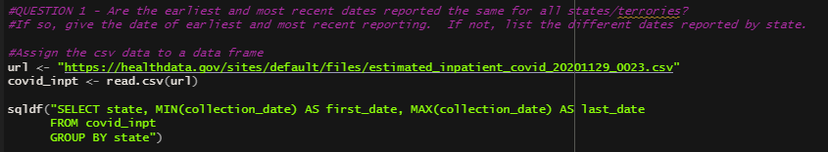
Adding SQL to a Workflow
SQL
What is the best way to practice SQL for Mailman students?
Given that you’ve all got countless homeworks and research .Rmd lying around on your computer, I recommend trying to reproduce your old work with the R-library sqldf
https://cran.r-project.org/web/packages/sqldf/index.html

Slide 22
Adding SQL to a Workflow
SQL
What is the best way to practice SQL for Mailman students?
Simply write a SQL query as a string which references variables in the R environment!
From googling, this is not a full fast/memory efficient SQL backend, so it is only for practice

Slide 23
Adding SQL to a Workflow
SQL
Next Steps
Free SQL backends are available for installation on your local machine.
SQLite is default included in the mac terminal (but is not fast)
MySQL is the lightest weight free “real” SQL option
Other options include PostgreSQL, MSSQL, and Oracle
Take our own Professor D’Angelo or Professor An’s P8180! You’ll complete 20+ assignments and get tech support on the MySQL install

Slide 24
Agenda
I’d like to have a conversation about two guiding questions:
Part 1: How should we separate SQL and tools like the tidyverse/pandas in our minds? ☑
Part 2: What resources are available to facilitate using these tools together? ☑
SQL
SQL
≠
SQL

Slide 25
Thank You
SQL
SQL
≠
SQL

