Slide 1
Structural Loading on Appendages
Understanding Lift, Bending, and Torsion in Natural Flyers

Slide 2
Motivation
- Understand how nature handles aerodynamic forces
- Design better flying machines
- Predict and prevent structural failures

Slide 3
Propulsive Appendages in Nature
- Fish fins, bird wings, insect wings
- Provide thrust and control
- Need to balance strength and flexibility

Slide 4
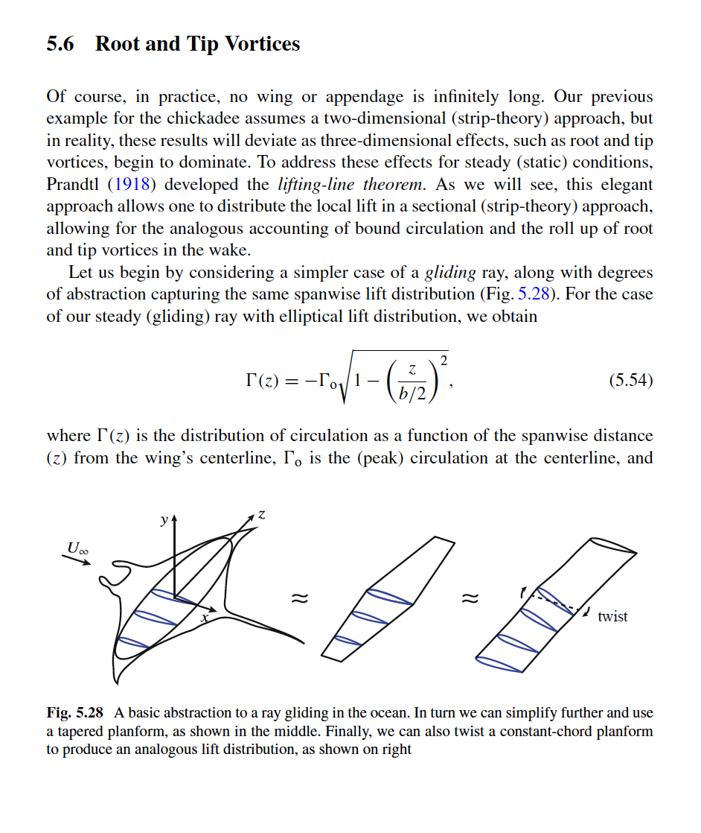
Example: Gliding Ray and Lift Distribution

Slide 5
3D Effects: Root and Tip Vortices
- Real wings aren't infinite
- Vortices form at tips and roots
- Lift changes along the span

Slide 6
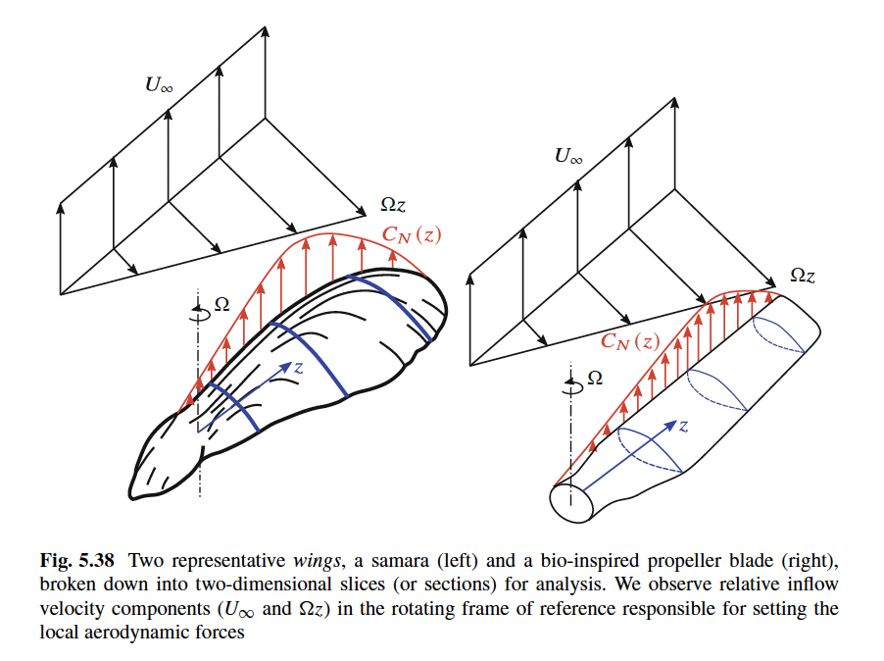
Bio-Inspired Propulsion

Slide 7
Modeling Structural Forces
- Wings split into 2D slices
- Forces: lift, drag, normal, axial
- Moments: bending (flap/edge) and torsion

Slide 8
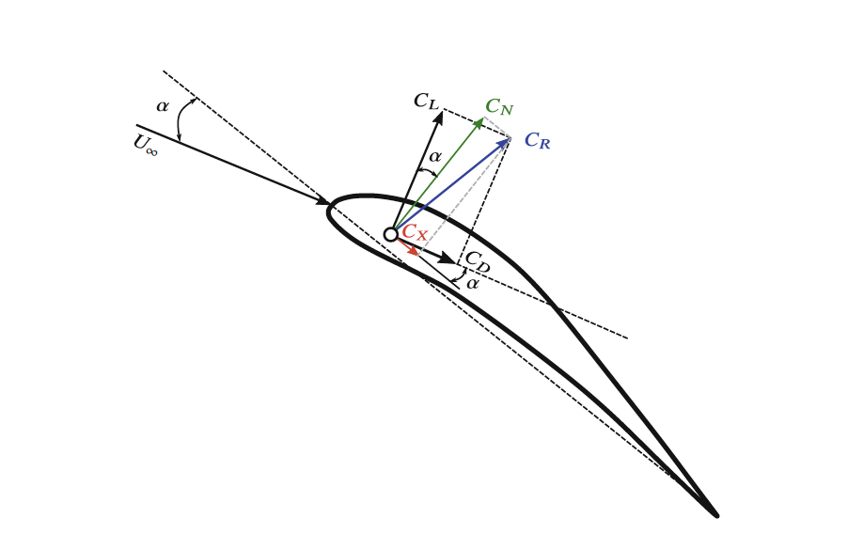
Force Components on a Section

Slide 9
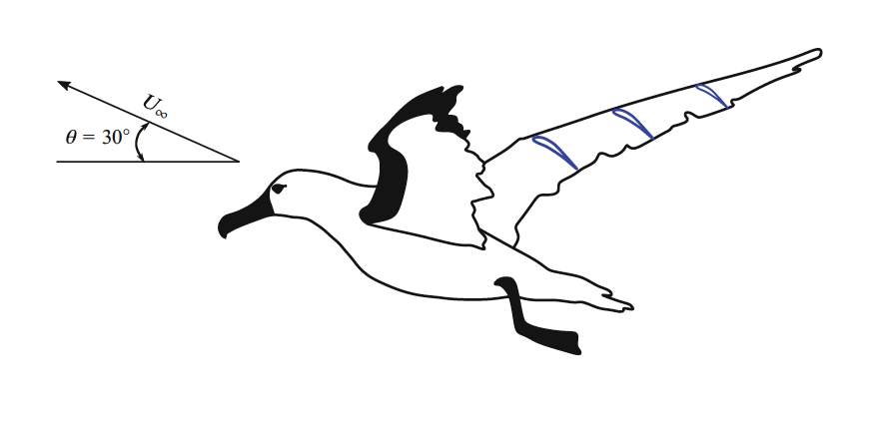
Albatross Takeoff Scenario

Slide 10
Takeoff Modeling Example
- Use geometry and airspeed
- Apply known coefficients (C_L, C_D)
- Compute flapwise, edgewise, and torsional moments

