Slide 1
Tunable LSM Tree
Jack Dent, CS 265 Final Project

Slide 2


Design
Buffer:
std::set, implemented as binary tree
reads and writes
Run: contains
Bloom filter, where the bitset has size r * n
Fence pointers for every page
File in secondary storage containing entries in sorted order
Level: contains f runs

Slide 3
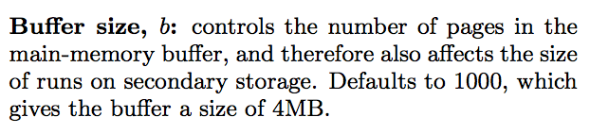
Parameters

Slide 4
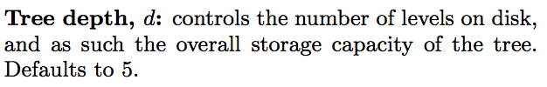
Parameters

Slide 5
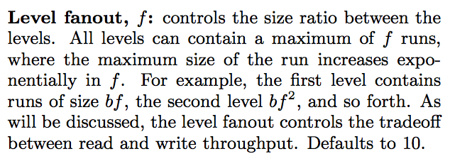
Parameters

Slide 6
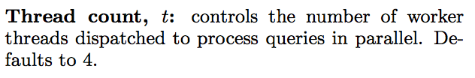
Parameters

Slide 7
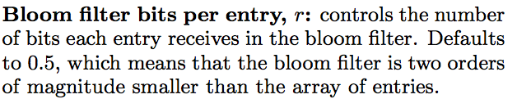
Parameters

Slide 8
Put queries

Slide 9
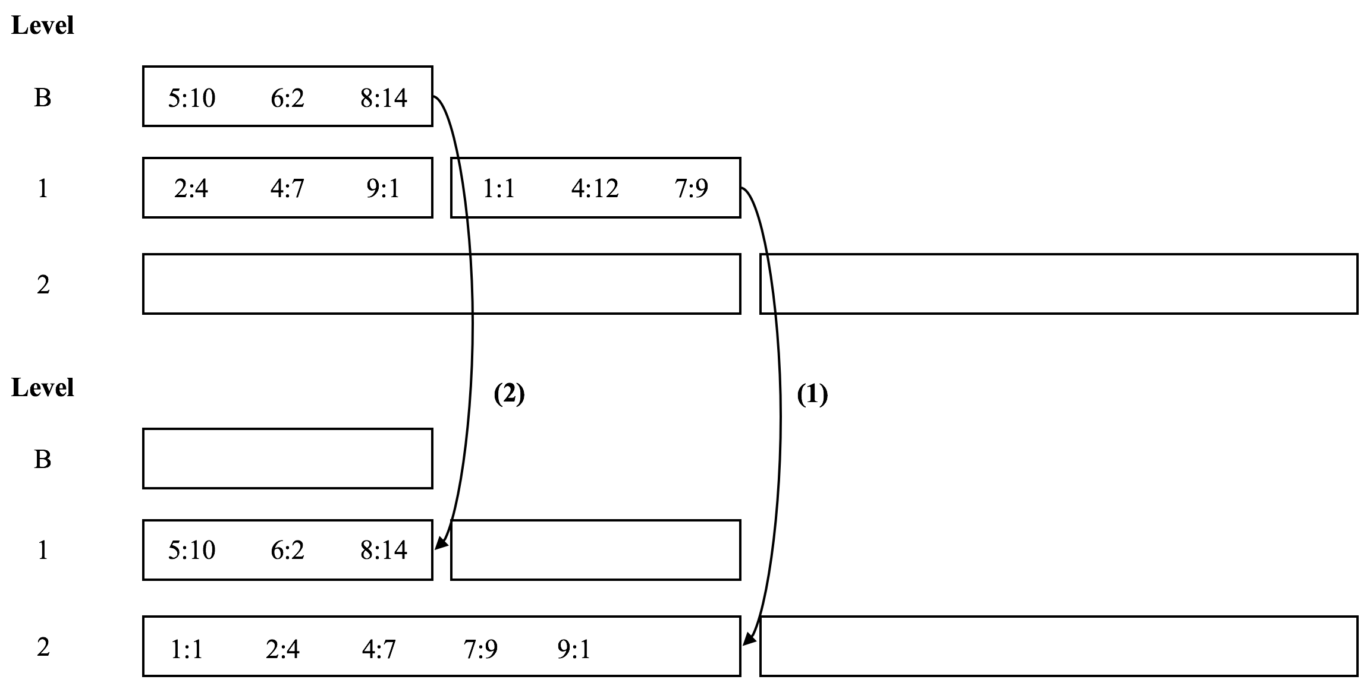
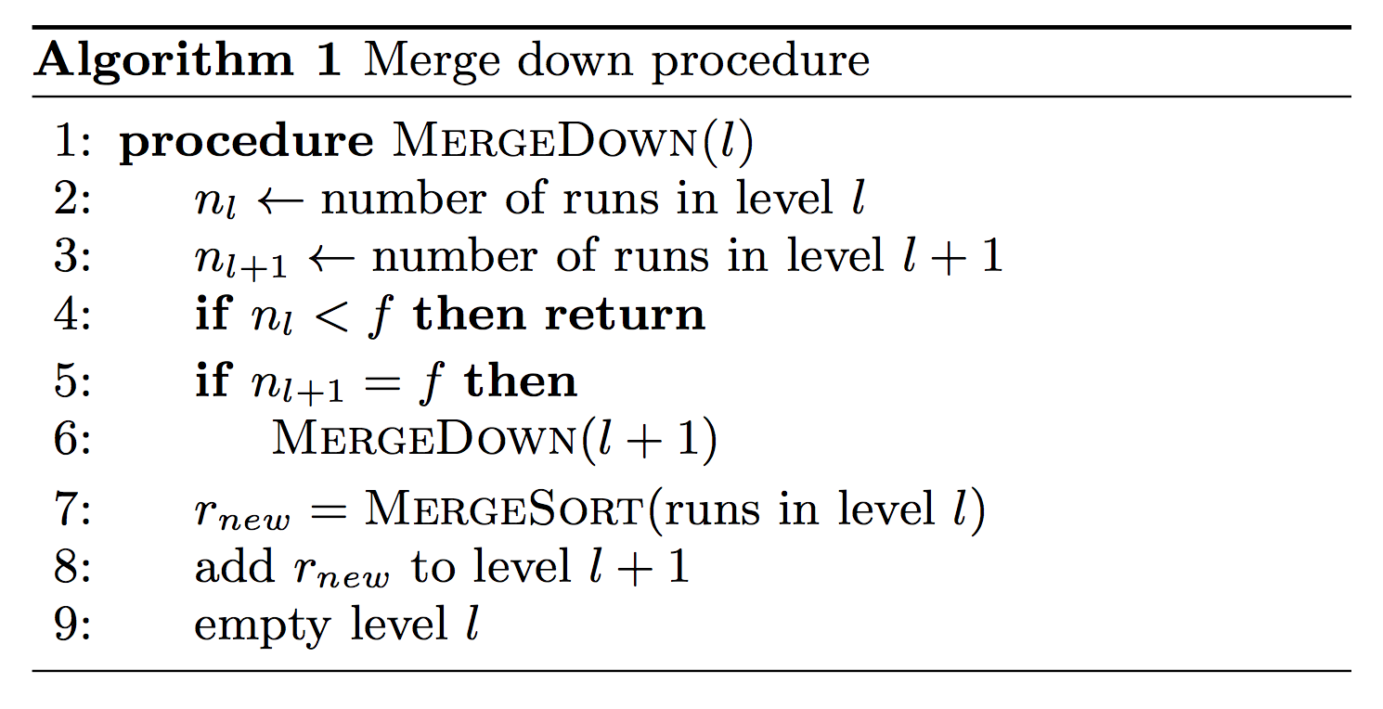
Tiered merge policy

Slide 10




Number of merge operations per entry:
Cost of merging single entry:
Write complexity:
For f=n/b, complexity is O(1/b * (1+mu))

Slide 11
Get queries

Slide 12



Cost of searching single run:
O(1)
Cost of searching entire level:
Cost of searching entire tree:
Point query complexity:
For f=n/b, complexity is O(n/b * phi)

Slide 13


Slide 14
Range queries

Slide 15



Cost of searching single run:
Cost of searching entire level:
Cost of searching entire tree:
For 𝞓=n/b, complexity is O(d * f); compare with GET query:

Slide 16
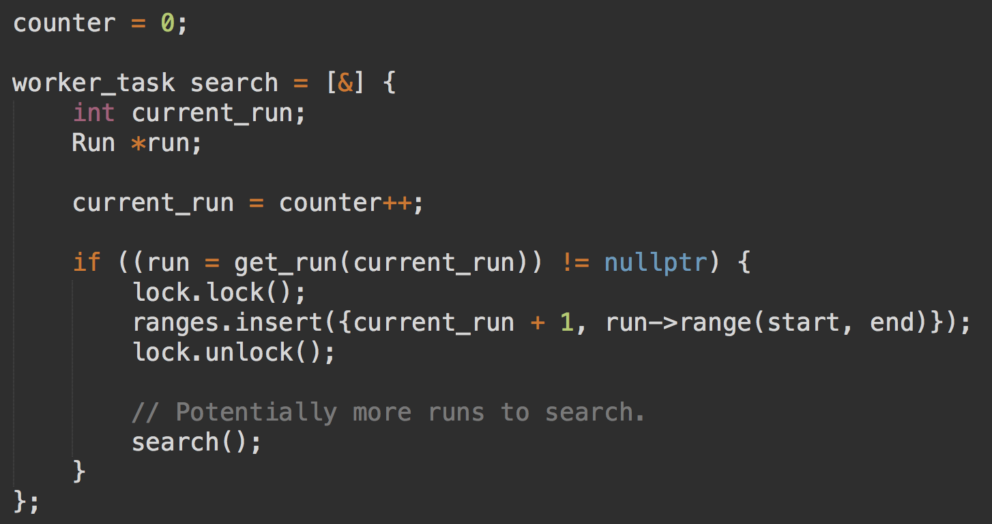

Slide 17
Optimizations
Thread pool
Condition variables to synchronize tasks
mmap
Especially performant when performing random IO for fence pointers with higher page spacing

Slide 18
Experimental results

Slide 19
Test infrastructure
Processor:
2.8 GHz Intel Core I7 processors 16 GB
RAM:
1600 MHZ DDR3 random access memory
Secondary storage:
500 GB SSD, flash storage

Slide 20
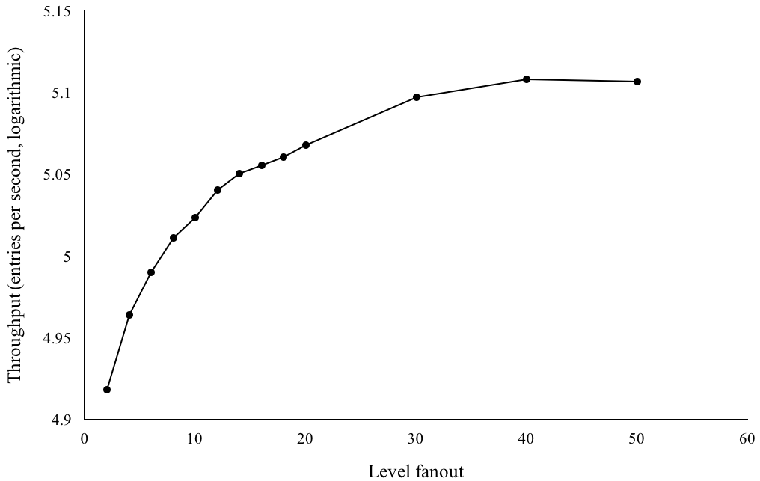
Level fanout, effect on write throughput

Slide 21
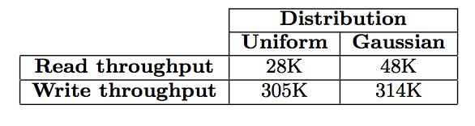
Throughput
Workload size: 100,000,000 queries
Surprising finding: buffer is a bottleneck

Slide 22
Future work

Slide 23
Implement skip list!
Have another go at integrating Facebook’s folly/wangle libraries for thread management
Aghhh...
Experiment more with fence pointer variable page spacing
MonkeyDB-esque bloom filter sizing
Background merge daemon (parallel for PUT queries)

