Slide 1
Final Project – IMDb Reviews (Sentiment Analysis)
Angelica, Aneesh, bryan, Donald, soraiya

Slide 2




What tools did we use?

Slide 3
Our steps
Our approach to the sentiment analysis:
Clean and transform data
Tokenize words, remove stop words and punctuation
Create a bag of words
Build our model
Check its accuracy!
Visualize

Slide 4
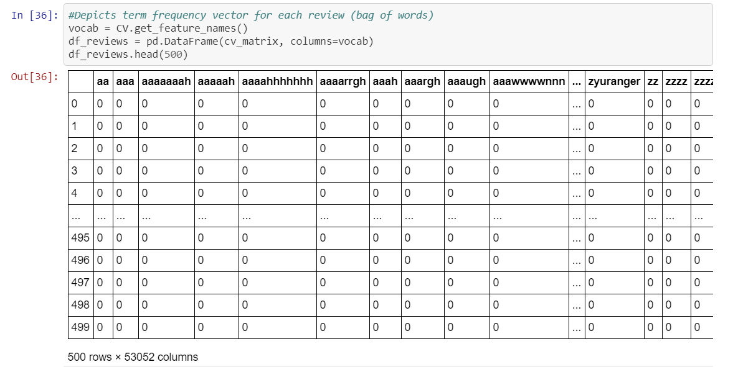
Results – ML Algorithm
We tried, and ended up using, one model:
Bag of Words model; Score: 0.998

Slide 5
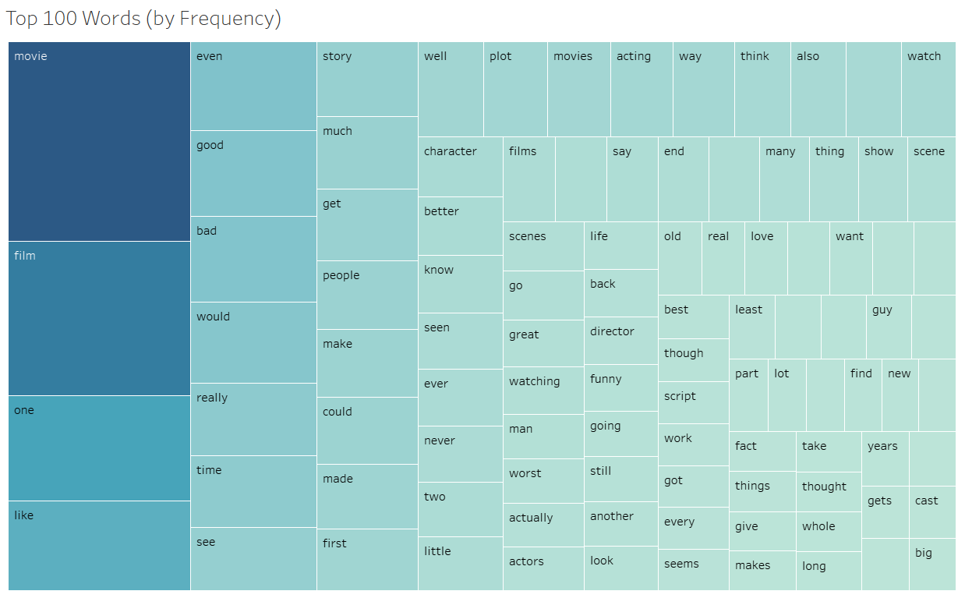

Slide 6
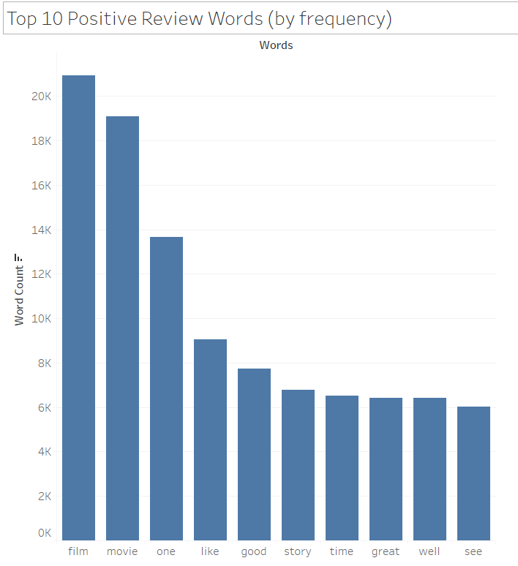
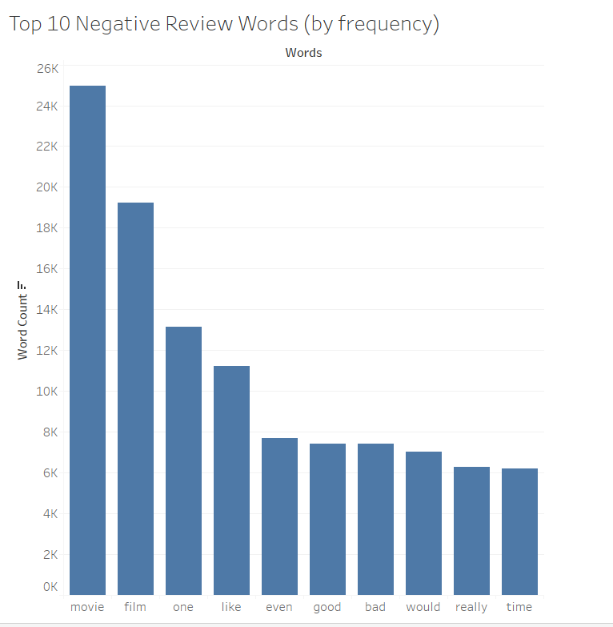

Slide 7
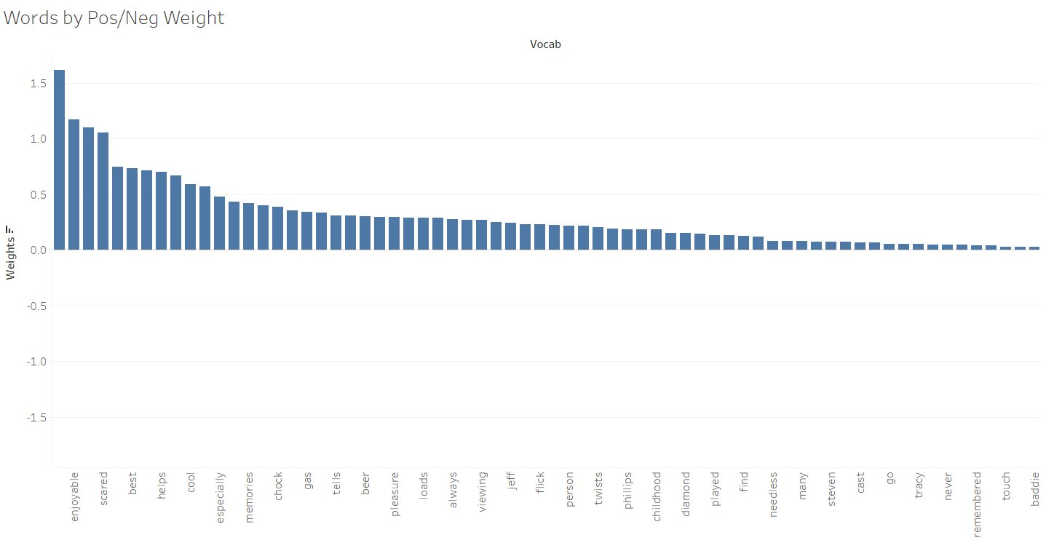

Slide 8
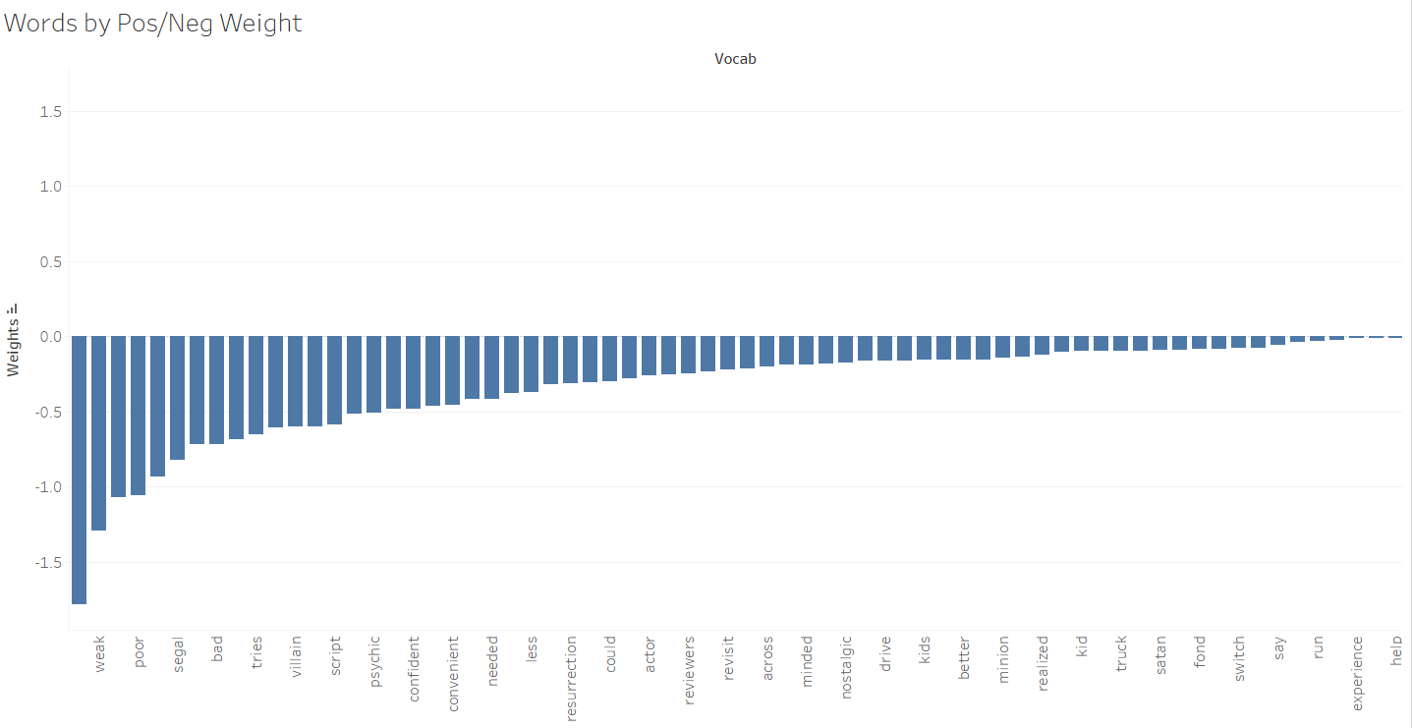

Slide 9
Example
“childhood memory tells scary movie touch go whether revisit anyway remembered scary scene involving homeless person cool villain played jeff kober first power good movie sad say chock full cop clich poor script holes truck could drive along countless convenient twists help story run along lou diamond phillips confident bad ass cop sends baddie serial killer kober gas chamber find minion satan power resurrection along power possessing every weak minded person comes across mix poorly realized psychic helps case ahhh trash enjoyable especially fond memories scared kid scene homeless person still pretty good kind logic forget every scenario thrown good measure end cross steven segal action flick demonic flick earth thought good idea cast lou diamond phillips lead needless say convincing tries best never problem guy many reviewers seem tracy griffith psychic less said better kober pretty good killer always liked actor first power may doctor ordered hard day work brain switch needed beer likely enhance viewing experience definitely loads next time give movie spin good flick somewhat guilty pleasure nostalgic fans easily scared kids see around buddy boy”

Slide 10
Example (cont.)
Model correctly predicts a negative review!
Probability of a positive review is 7.3%

Slide 11
Questions?

