Slide 1



Medicare Project
View in Power BI

Slide 2
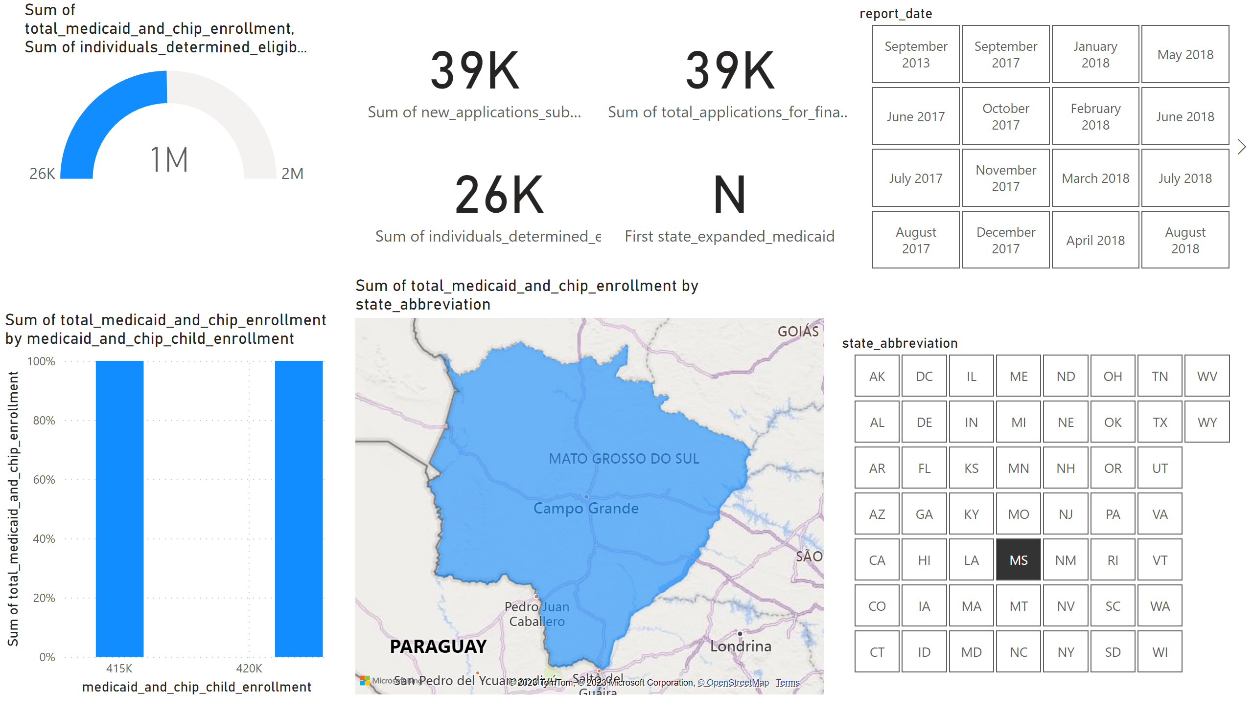
Page 1
Notes:
hundredPercentStackedColumnChart
No alt text provided
filledMap
No alt text provided
gauge
No alt text provided
card
No alt text provided
card
No alt text provided
slicer
No alt text provided
slicer
No alt text provided
card
No alt text provided
card
No alt text provided

