Slide 1
Building an Expert System to Guide Diagnosis and Management of Rhinosinusitis
BMIN 5200-001 202430 Foundations Of Artificial Intelligence In Health – Prof. Romano
Final project - MBMI Student Antonia Angeli Gazola
December 12th, 2024

Slide 2
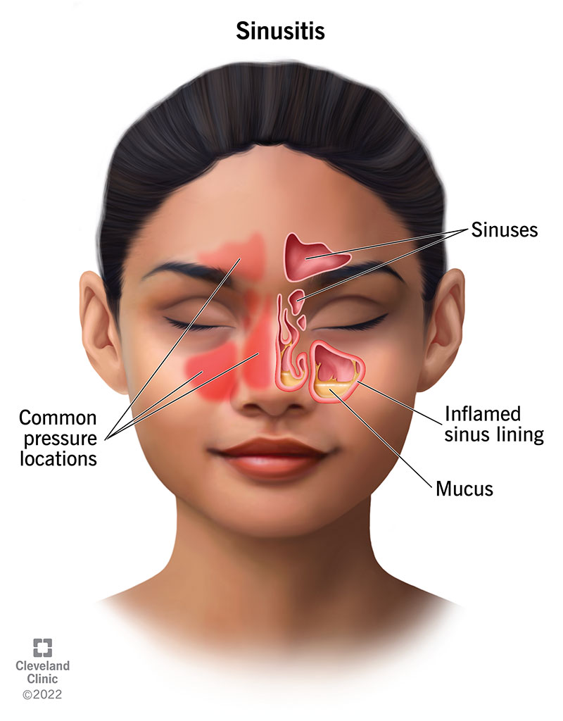
Background – rhinosinusitis definition
Rhinosinusitis is an inflammation of the mucus membranes, classified based on symptoms (guidelines differ).
Management will be defined based on:
matching symptoms criteria,
duration of presentation (acute, subacute, chronic),
bacterial infection vs viral,
presence of complications,
need for hospitalization.

Slide 3
Background – rhinosinusitis epidemiology
Usually favorable,
Affects ~1 in 7 U.S. adults annually (~3 million visits/year),
~90% of viral upper respiratory infections are accompanied by viral sinusitis,
~85% of cases resolve without antibiotics in 7-15 days,
Only 0.5-2% progress to bacterial acute rhinosinusitis,
Most common pathogens: S. pneumoniae, H. influenzae, M. catarrhalis, S. aureus.

Slide 4
Background – challenges of antibiotics for rhinosinusitis
Most cases are viral and resolve without antibiotics,
Antibiotics are prescribed in 84-91% of acute rhinosinusitis cases (overprescription),
Increased antibiotic resistance.
Discrepancy related to:
patient expectations for antibiotic therapy,
differences in guidelines,
inconsistent adherence to guidelines,
limited time for diagnosis in primary care/urgent care.
Number-needed-to-treat | Number-needed-to-harm | Adverse effects
Every 7-18, one benefits | Every 8-12, one has side effects | Antibiotics: 27% vs. Placebo: 15%

Slide 5
Background – Using AI to help with the challenges
Can guide clinical reasoning,
Provide standardized option to use in clinical practice, based on evidence-based guidelines,
Aid in reducing uncertainty in time-limited or doubtful cases,
Aid in reducing antibiotic overuse and resistance,
Existing AI Tools:
RHINA CDSS: direct diagnosis/treatment suggestions (Charles University in Prague),
U-Net Segmentation: focused on chronic odontogenic rhinosinusitis with computed vision methods (Kharkiv National Medical University in Ukraine).
This project aims to provide a detailed expert system to guide diagnosis/management of rhinosinusitis.

Slide 6
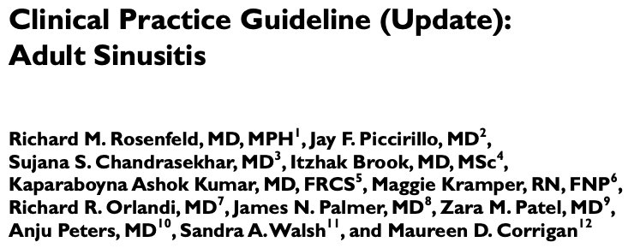
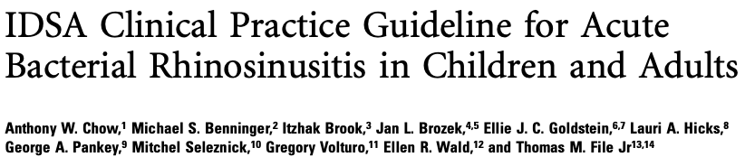
Methods and materials
Expert system: developed with CLIPS.py in a Jupyter Notebook
Guidelines used: mainly IDSA and AAO-HNS
Flow diagrams of the expert system steps were created with draw.io
Github repository with the work: github.com/angeligazola/5200_Final_Project_Antonia
Report: written with LaTeX via Overleaf, using Mendeley for references

Slide 7
Design
Added expert system overview and flow diagrams exemplifying tool functionality;
Imported clips and clips_util;
Created a clips.py environment to execute system;
Used logging to ensure that strings are captured in the output;
Created templates and inference rules, using propositional logic with boolean operators (and, or, not) and conditional statements (if then);
System inputs facts from clinical provider and makes inferences with forward chaining rule-based reasoning methods;
System gathers more input data as needed or reaches conclusions.

Slide 8
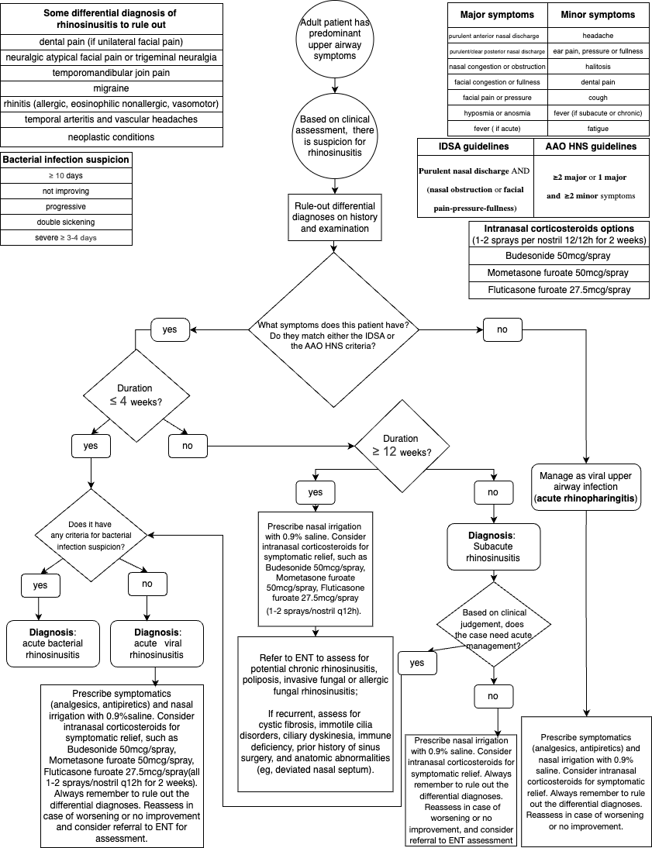
Design

Slide 9
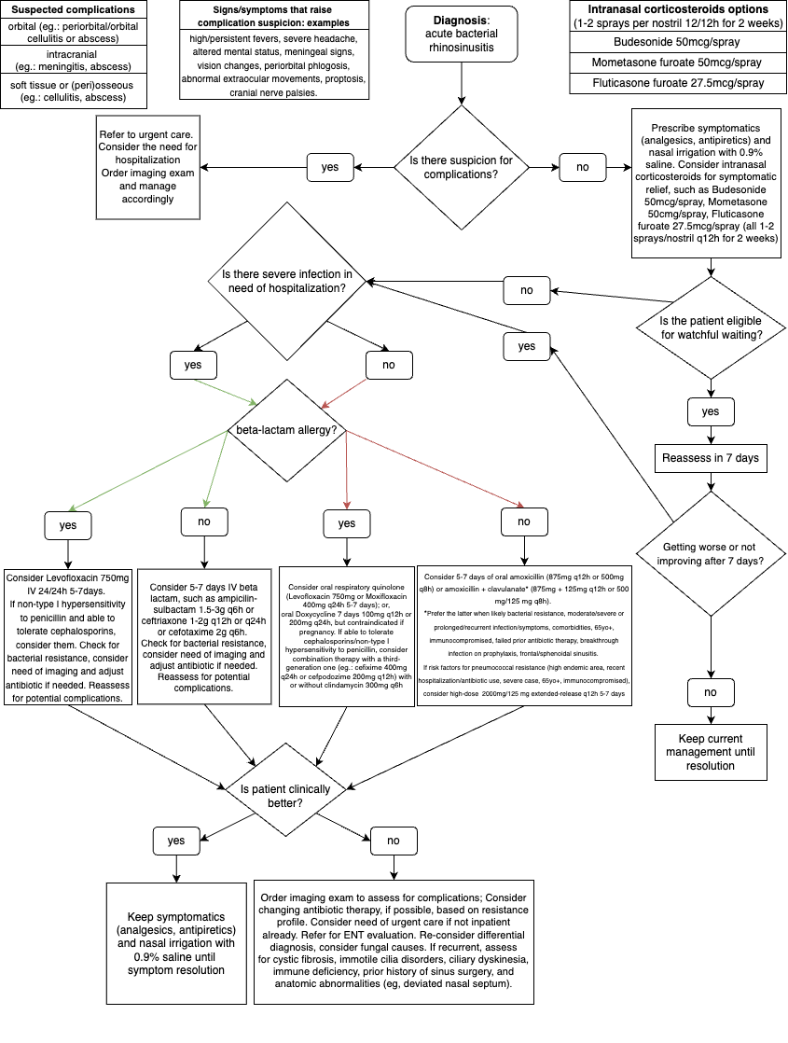
Design

Slide 10
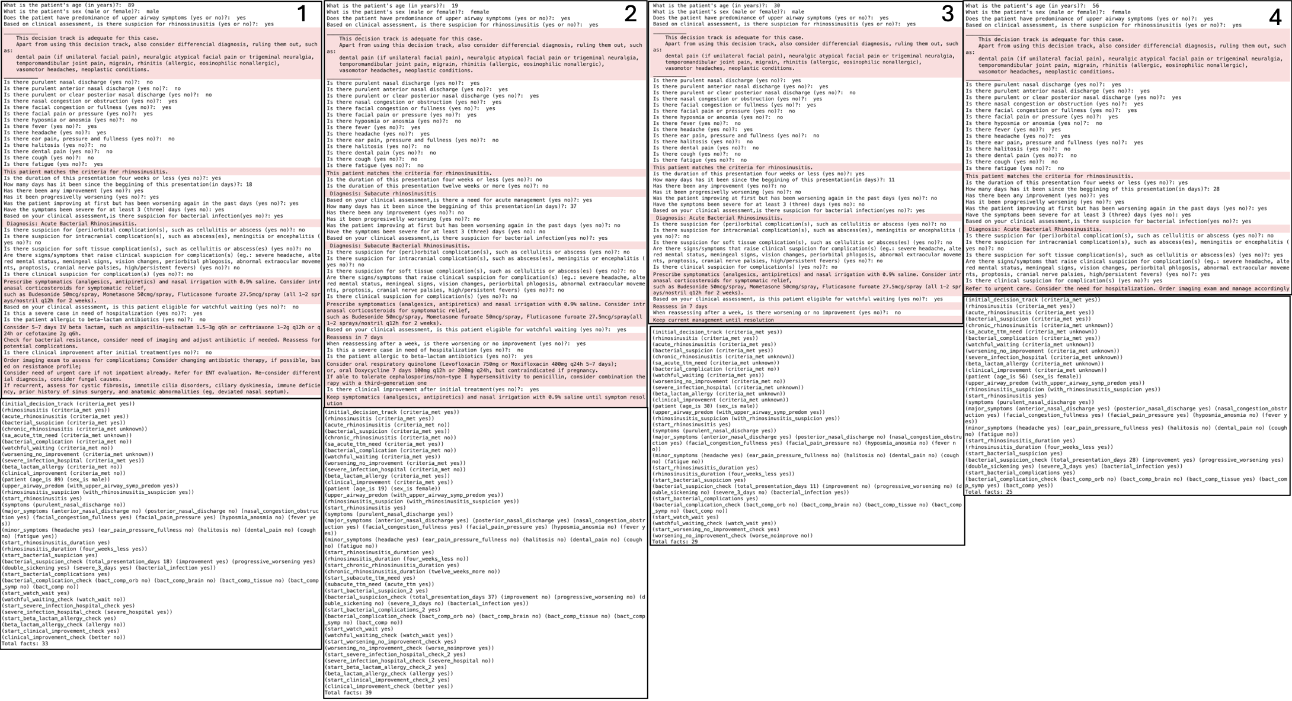
Demonstration
Notes:
1- case of non-complicated inpatient acute bacterial RS, without beta-lactam allergy and no clinical improvement after first treatment;
2- case of non-complicated outpatient subacute bacterial RS with beta-lactam allergy, that worsened or failed to improve after a week of watchful-waiting, requiring further management with antibiotics and achieving clinical improvement after that;
3- case of non-complicated outpatient acute bacterial RS with clinical improvement after a week of watchful-waiting;
4- case of complicated acute bacterial RS.

Slide 11
Discussion and conclusion
This expert system:
Supports adherence to guidelines, ensuring accurate initial assessments;
Helps to reduce unnecessary antibiotic prescriptions, combating resistance;
Leads to reduced healthcare costs;
Is good for time-limited settings;
Is an assisting tool not a replacement for clinical providers;
Trust-building through refinement and usability improvements.
Future plans:
Include comorbidities and pregnancy status for personalized recommendations;
Incorporate other diagnoses;
Improve user experience, integrate with existing platforms, add session-saving features;
Important to regularly update the knowledge base to align with the latest guidelines.
This expert system is a prototype that with refinement has potential to be integrated into clinical practice to guide clinical reasoning

Slide 12
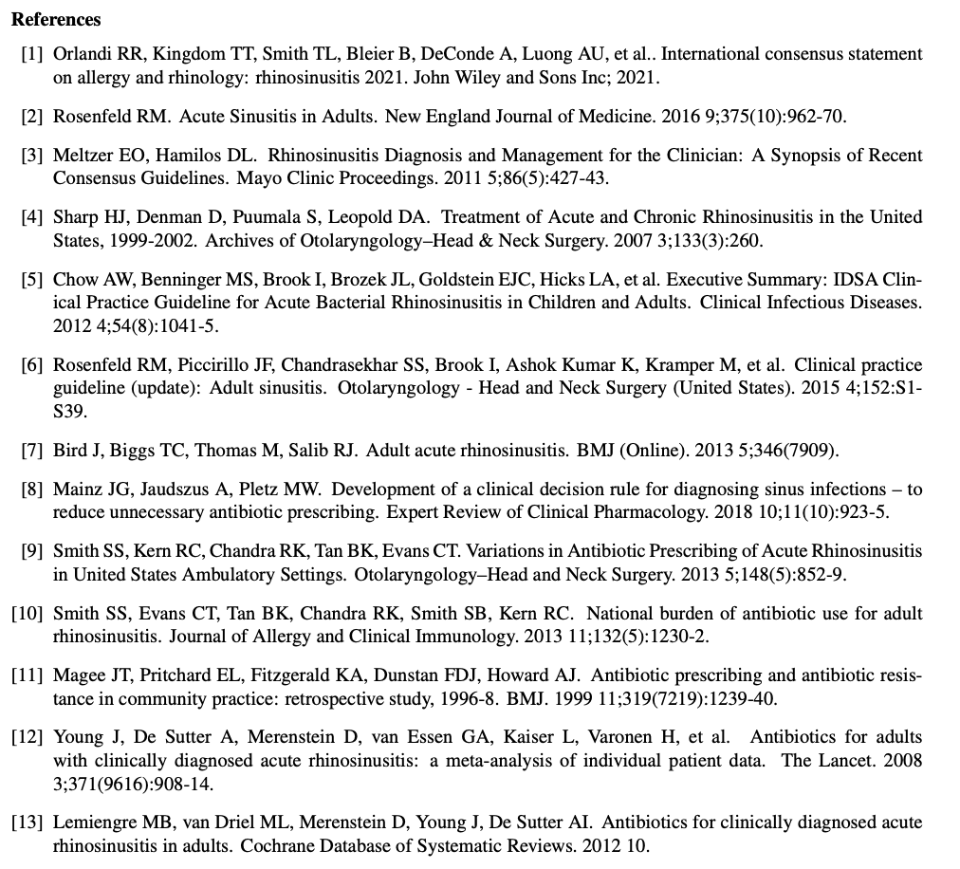
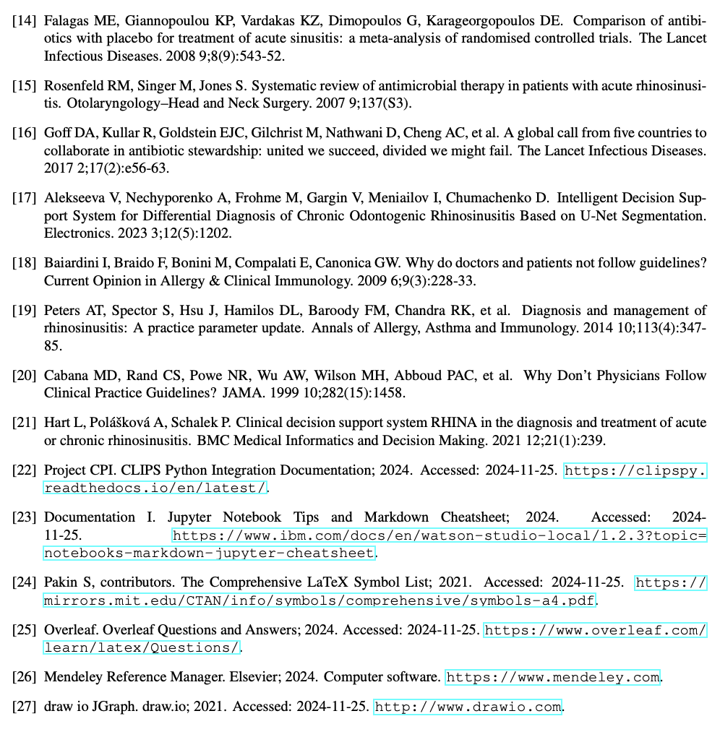
References

Slide 13
Questions?

Slide 14
Building an Expert System to Guide Diagnosis and Management of Rhinosinusitis
BMIN 5200-001 202430 Foundations Of Artificial Intelligence In Health – Prof. Romano
Final project - MBMI Student Antonia Angeli Gazola
December 13th, 2024

