Slide 1
Exploring the Association Between BMI and Early-Onset Colorectal Cancer
Master of Biomedical Informatics - Perelman School of Medicine - University of Pennsylvania
5030-401 202430 Data Science For Biomedical Informatics
MBMI Student: Antonia Angeli Gazola
December 3rd, 2024

Slide 2
Introduction
Declining/stable average-onset vs. increasing early-onset colorectal cancer rates (unclear reasons);
Obesity is a recognized risk factor for colorectal cancer, with limited understanding of its impact on early-onset cases;
Emerging studies suggest a potential link between higher BMI and earlier colorectal cancer onset.
Could a higher BMI be associated with early-onset colorectal cancer?
This project’s aim is to explore the association between BMI and early-onset colorectal cancer from the chosen dataset, by investigating the relationship between BMI and age at diagnosis and potential associations with other demographic and clinical factors.
Advisors: Dr. Weissman and Nicholas Bishop
Integrating epidemiology, data science, biostatistics, and oncology.

Slide 3
Methods
Analyzing the MSK Colorectal Cancer Dataset (JNCI 2021) via cBioPortal with 1,516 colorectal cancer cases
Kept most of the code in methods with explanations; printed and explained the findings in the results.
The analysis is structured in three main sections:
Descriptive statistics: added packages, data loading, cleaning and summarization to understand data distribution and variables relationships;
Linear regression analysis: model the relationship between age at diagnosis and BMI, including interactions with other predictors to try to find associations and test the hypothesis;
Logistic regression analysis: examine the likelihood of early-onset cases based on BMI and age groups to complement the descriptive statistics and linear regression models with a more complex approach that might provide additional insights or significance.

Slide 4
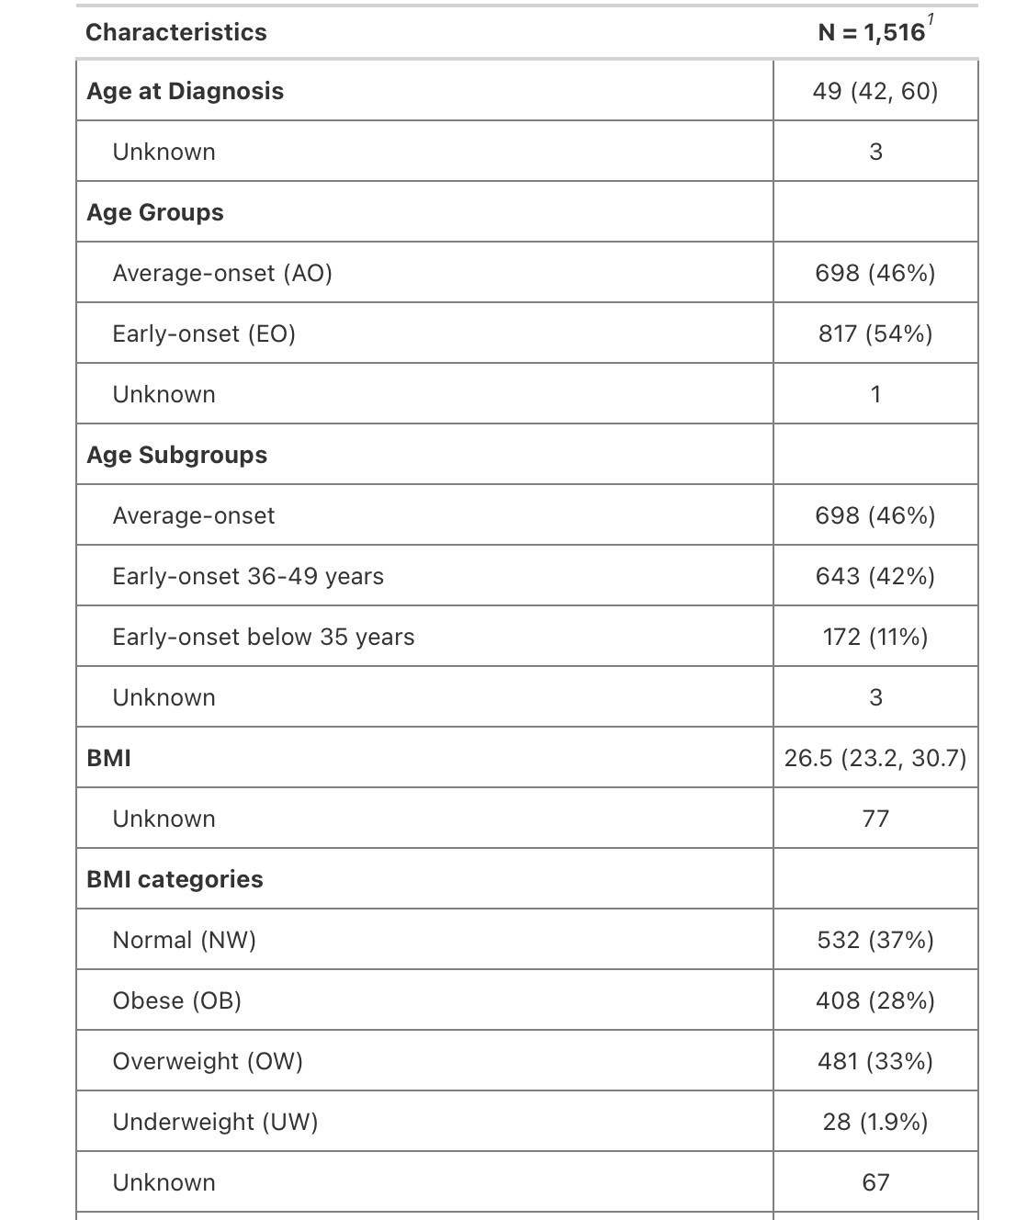
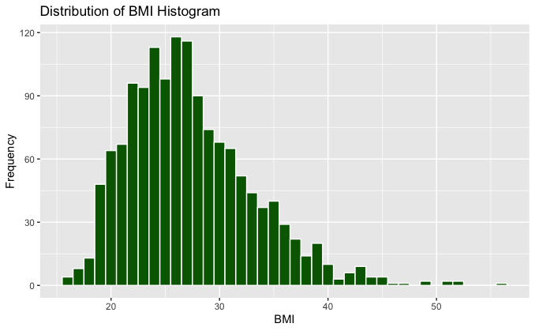
Results – descriptive statistics
general summary of the entire dataset + histogram

Slide 5
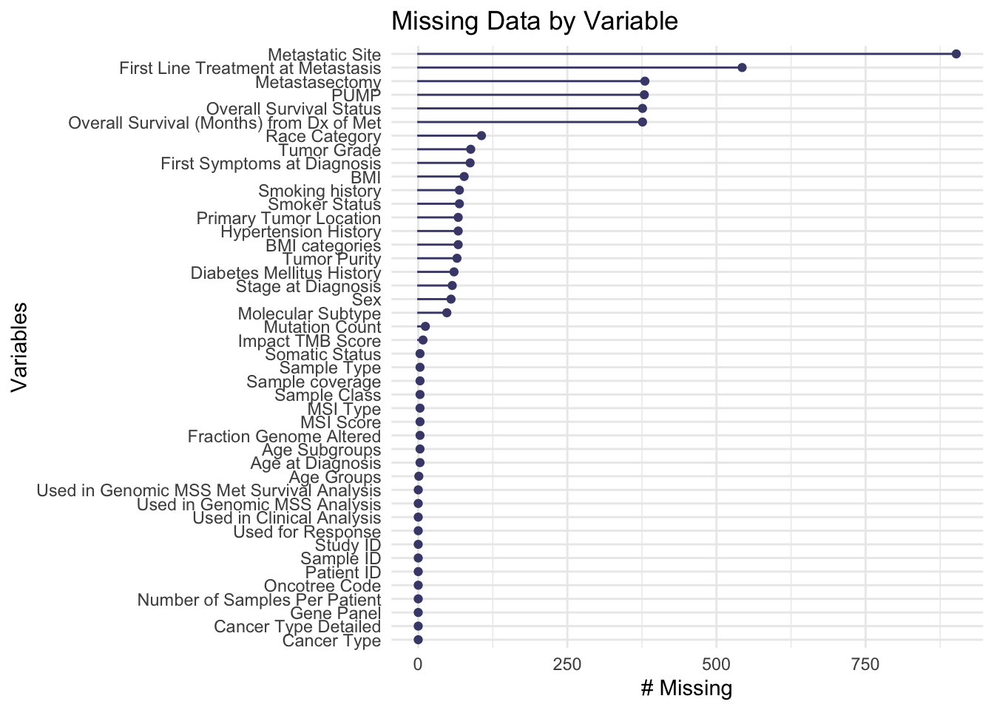
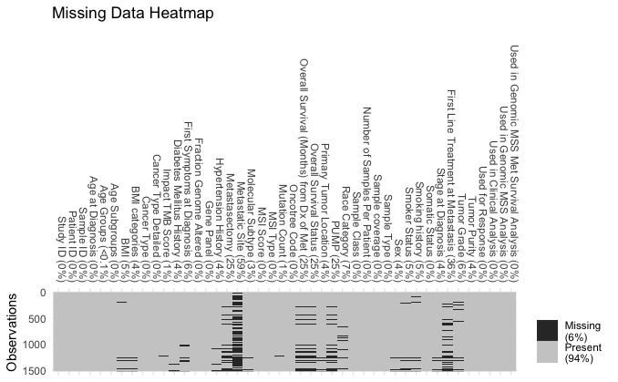
Results – descriptive statistics
exploring missing data with plots
Visualization of missing data in dataset
Heat map for visualization of missing data in dataset

Slide 6
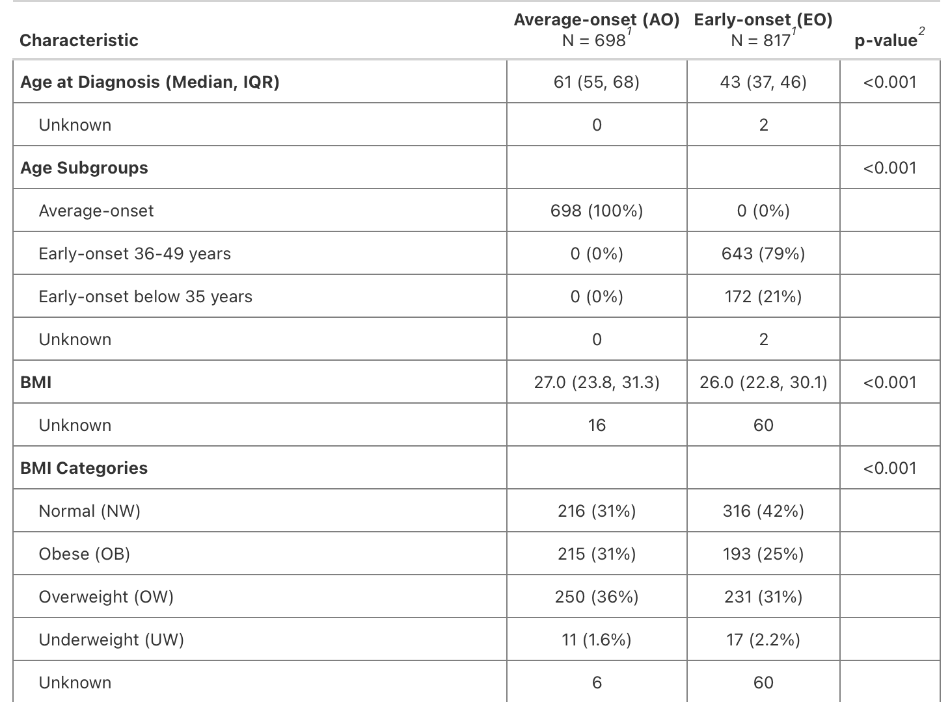
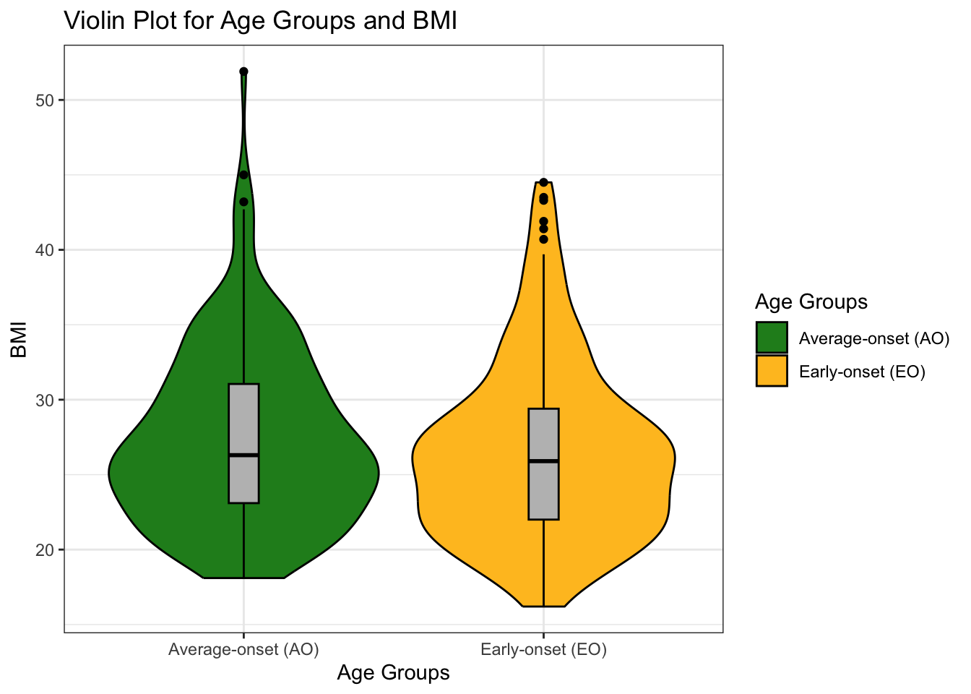
Results – descriptive statistics
summarizing data by age groups + violin plot

Slide 7
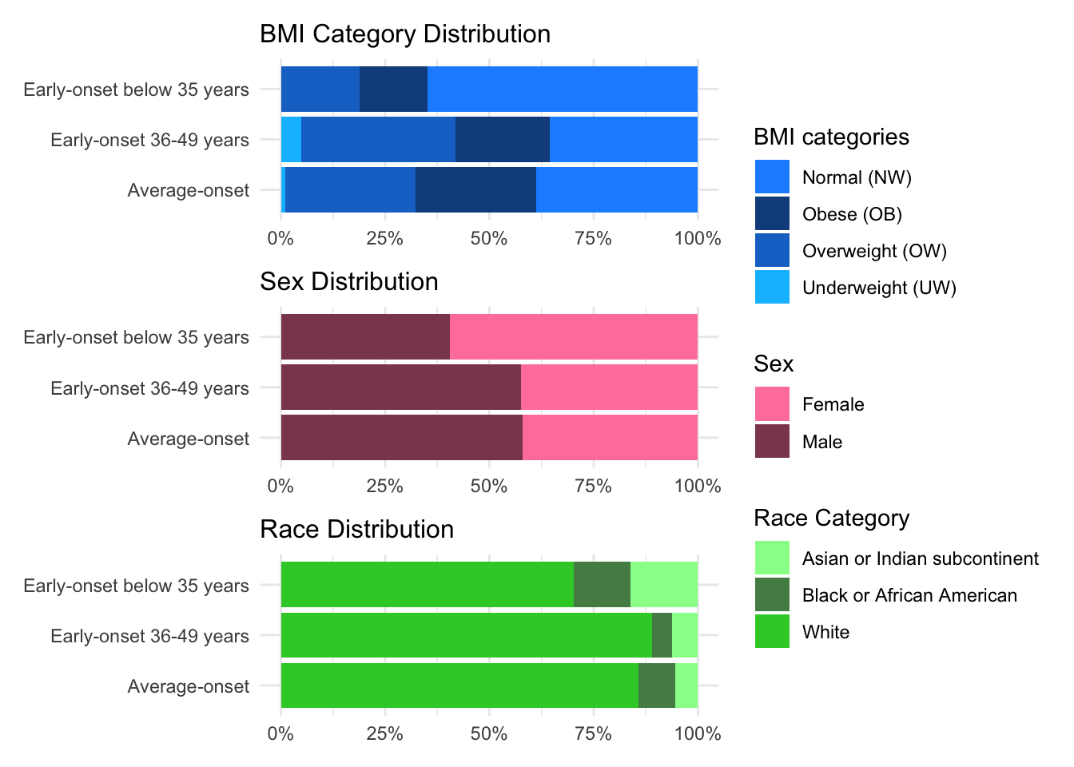
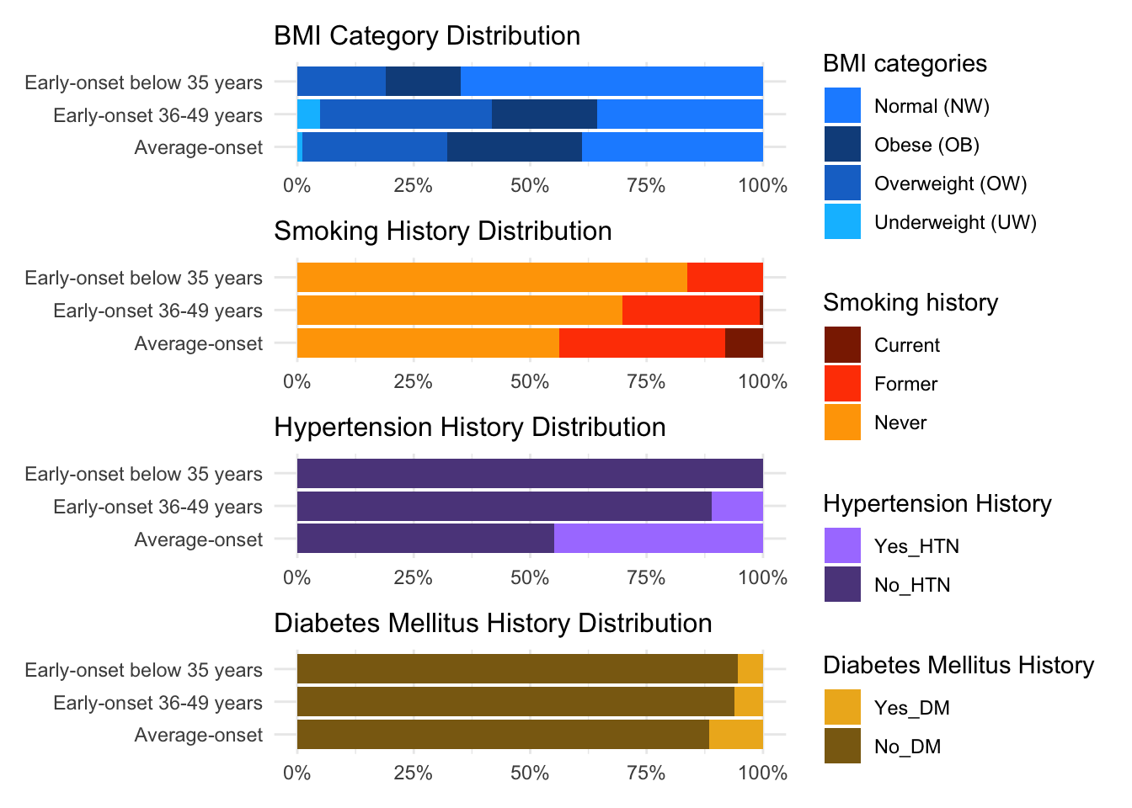
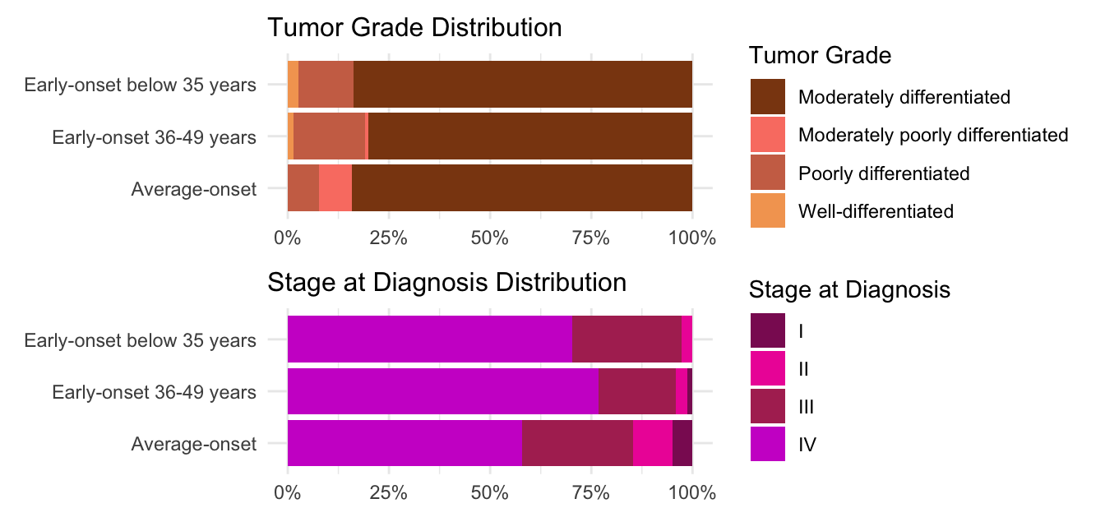
Results – descriptive statistics
bar plots: variables distributions based on age subgroup

Slide 8
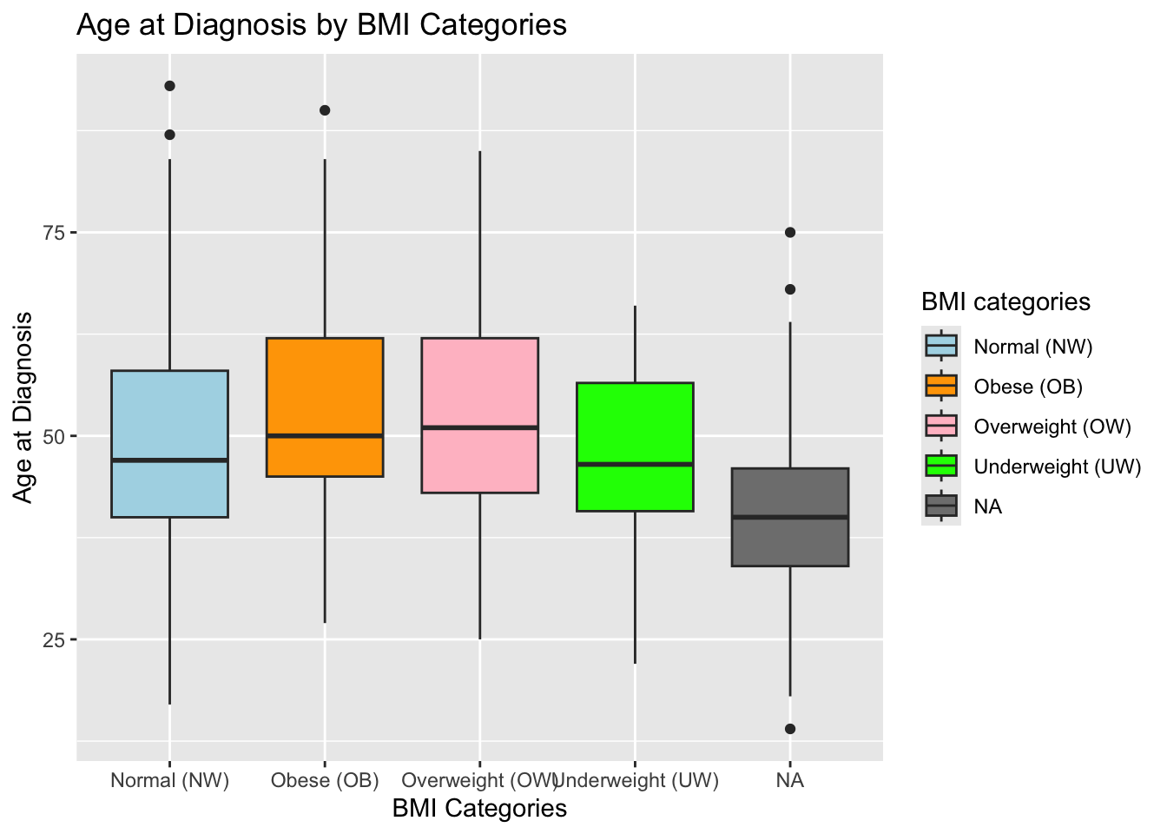
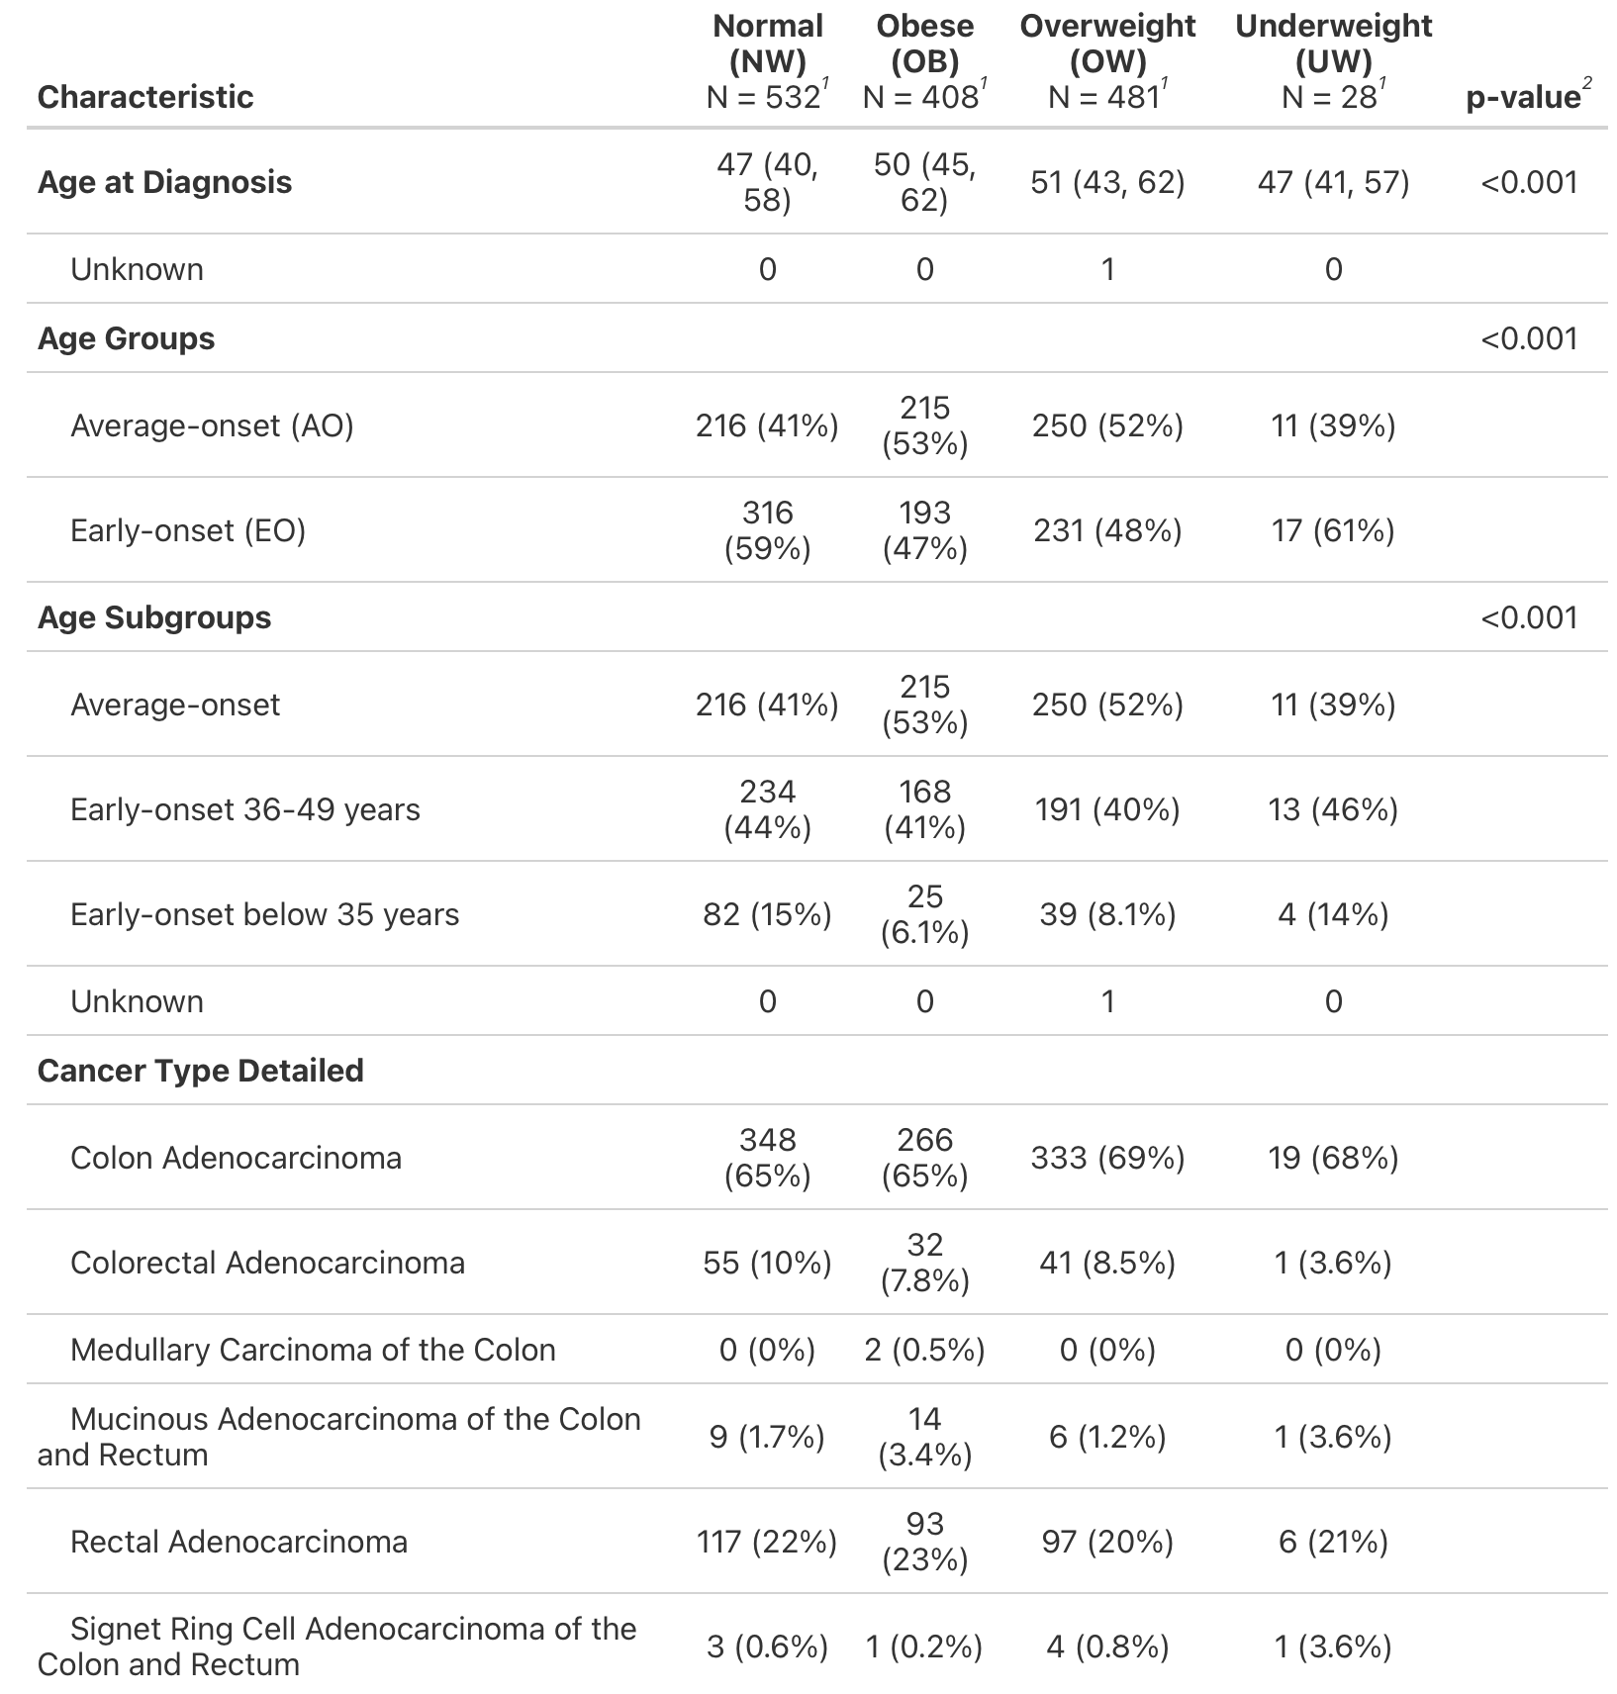
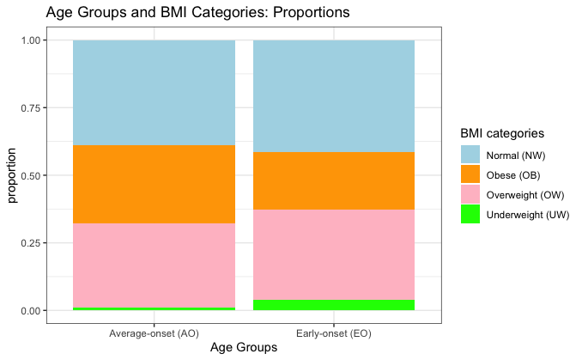
Results – descriptive statistics
summary table per BMI categories + box/bar plots

Slide 9
Results – descriptive statistics take-away
Early-onset cases:
lower BMI, fewer comorbidities,
more aggressive and poorly differentiated tumors,
more rectal cases,
shorter overall survival post-metastasis (EO 23 months vs. AO 40 months);
Normal/underweight cases had higher likelihood of younger diagnosis (EO);
Overweight/obese individuals were predominantly diagnosed later (AO);
BMI significantly associated with clinical characteristics and age of onset.

Slide 10
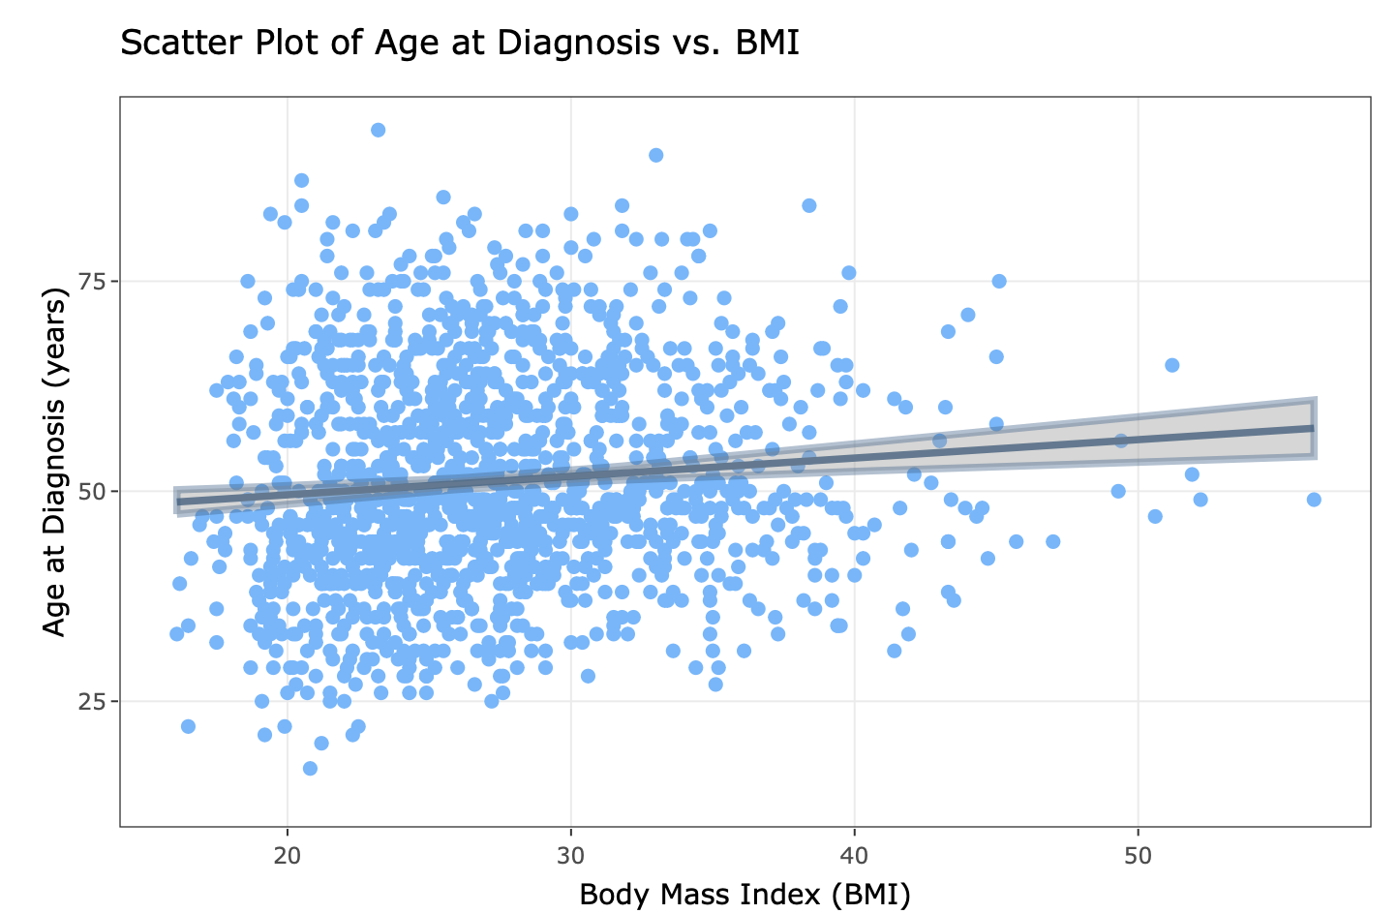
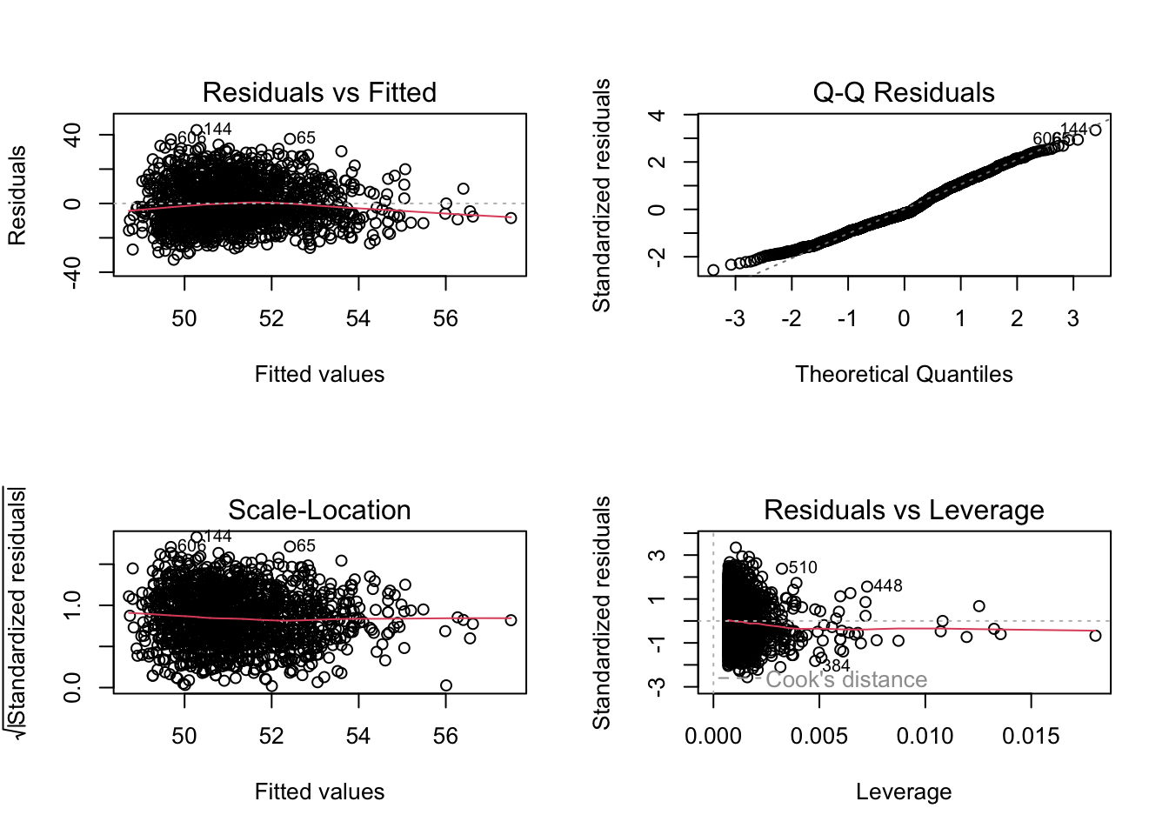
Results – simple linear regression model of age at diagnosis and BMI
Summary of the linear regression model with coefficients, confidence intervals, Pearson and Spearman correlations;
Model fit, selection, performance metrics, diagnostic plots for model assessment;
Interactive scatter plot with fitted regression line of linear relationship between age at diagnosis and BMI.

Slide 11
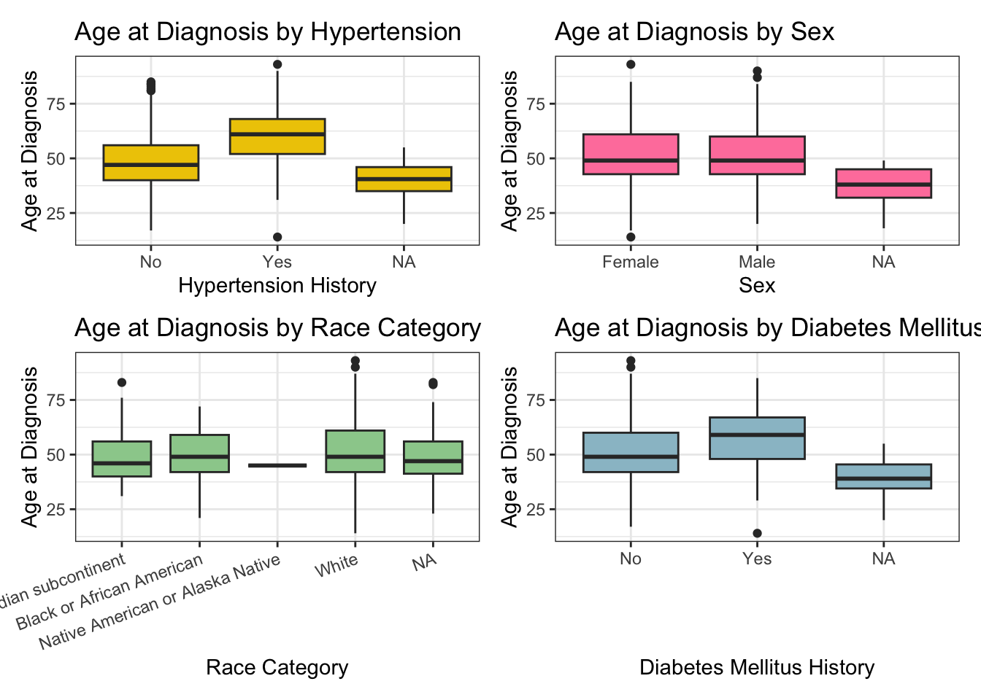
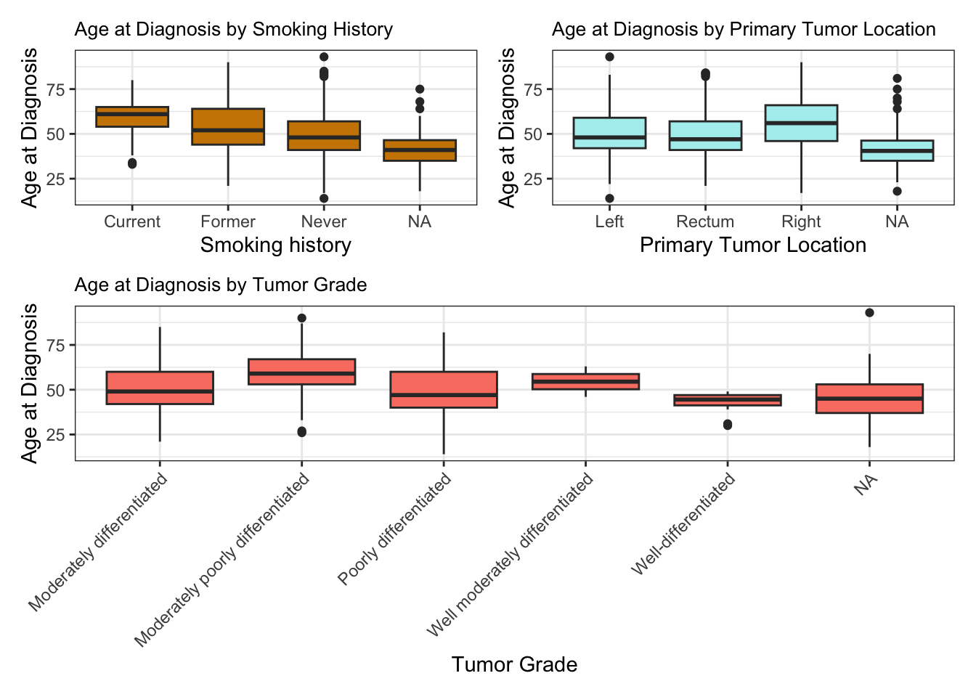
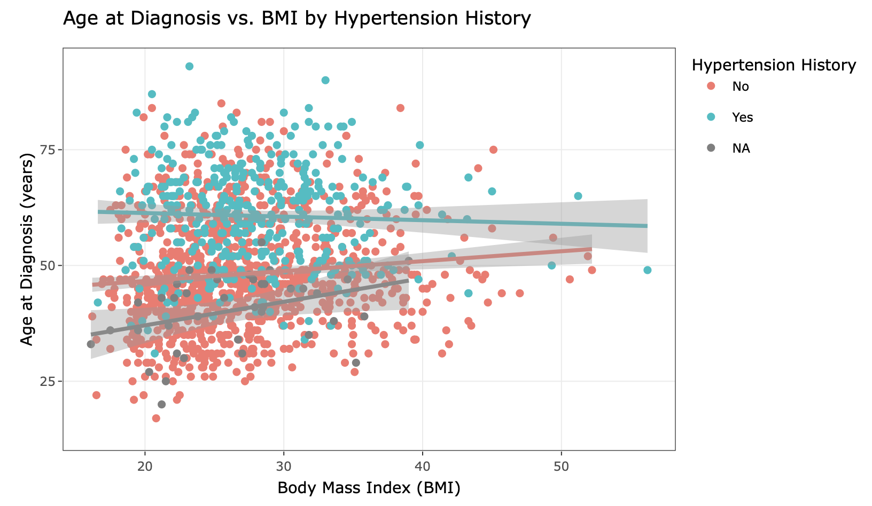
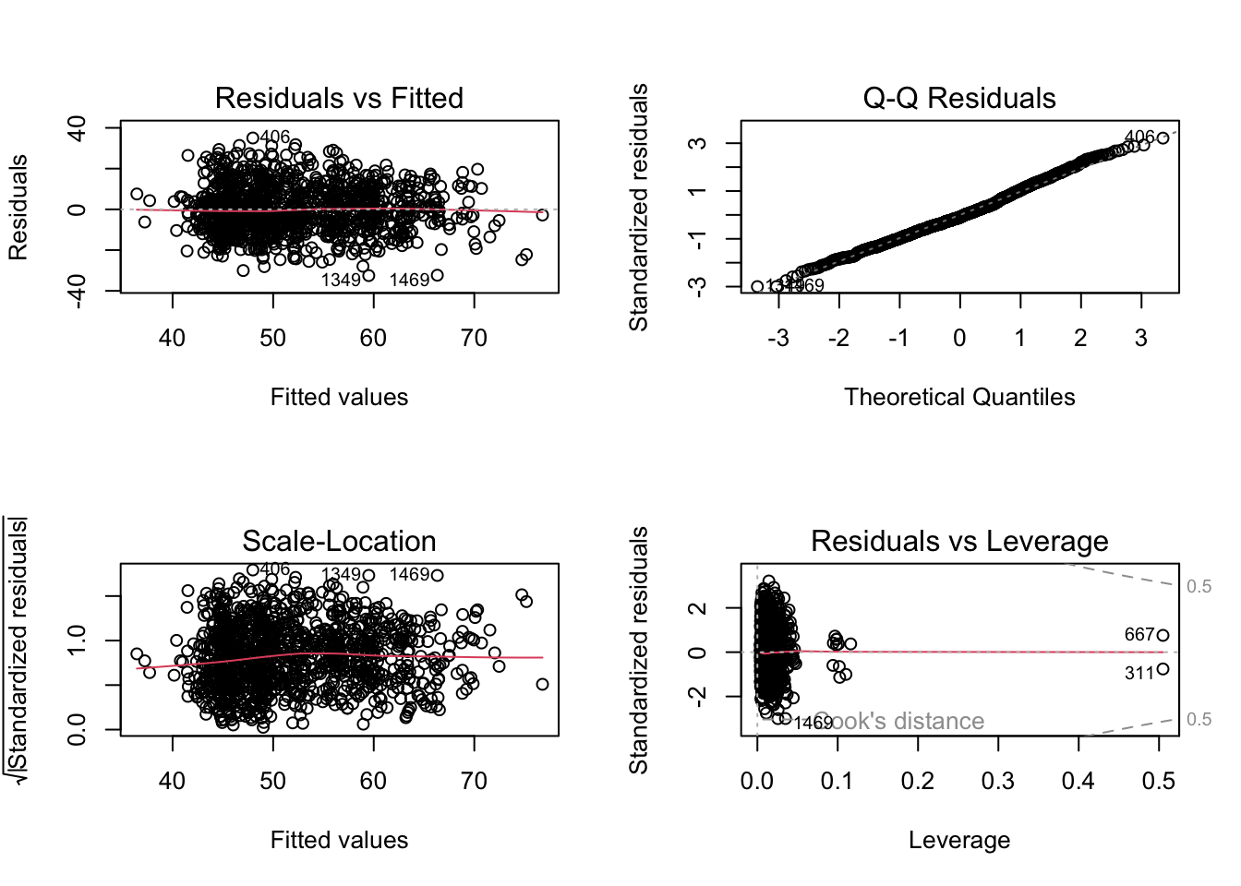
Results – multivariate linear regression models checking for predictors and interaction terms
Summary of the multivariate models with coefficients, confidence intervals and multicollinearity check using VIF;
Model fit, selection, performance metrics, diagnostic plots for model assessment;
Comparing models with ANOVA;
Box plots of age at diagnosis according to variables;
Interactive scatter plot of age at diagnosis vs. BMI by hypertension history.

Slide 12
Results – linear regression analysis take-away
The findings show a weak statistically significant association between BMI and age at diagnosis.
Hypertension history had strongest association; Diabetes and tumor grade and location had smaller influence.
Expanded multivariate model explains 27.92% of variation in diagnosis age (R² = 27.92%), an increase from simple model, which highlights influence of comorbidities and tumor characteristics and suggests additional factors contribute to variation.

Slide 13
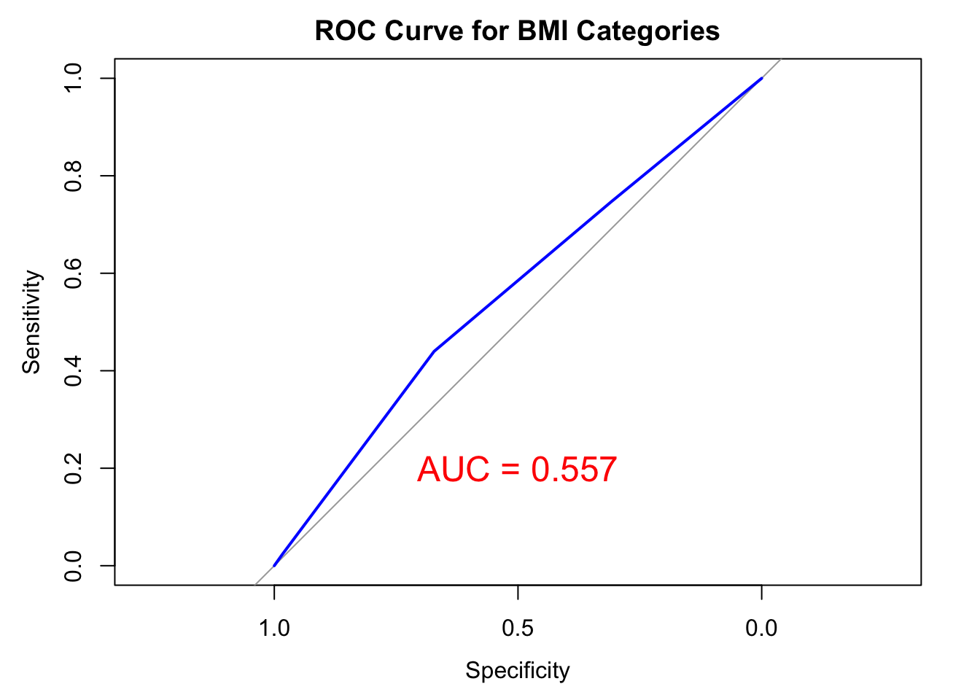
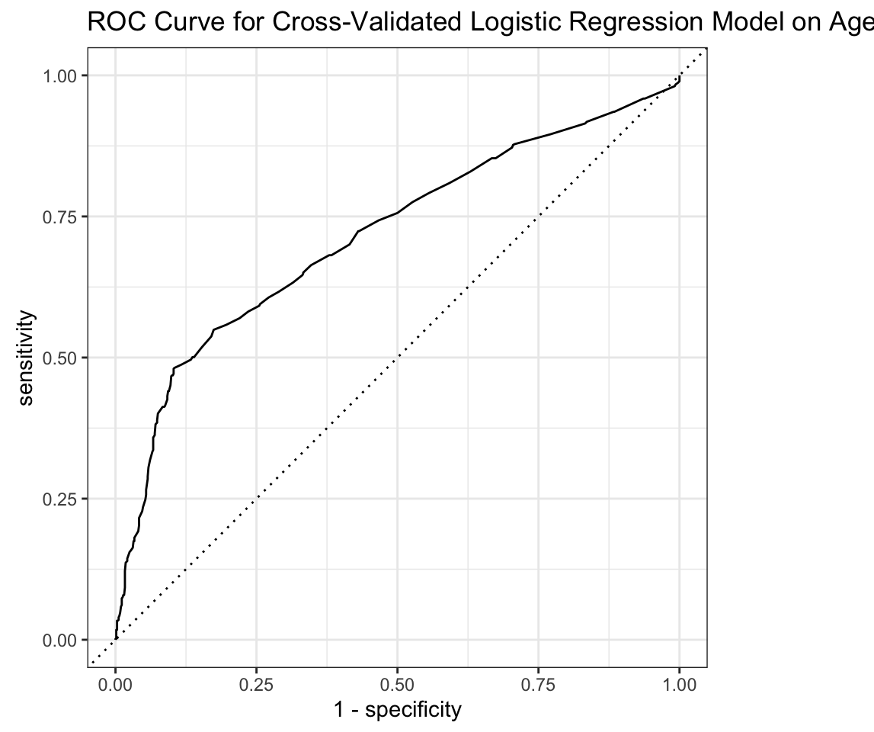
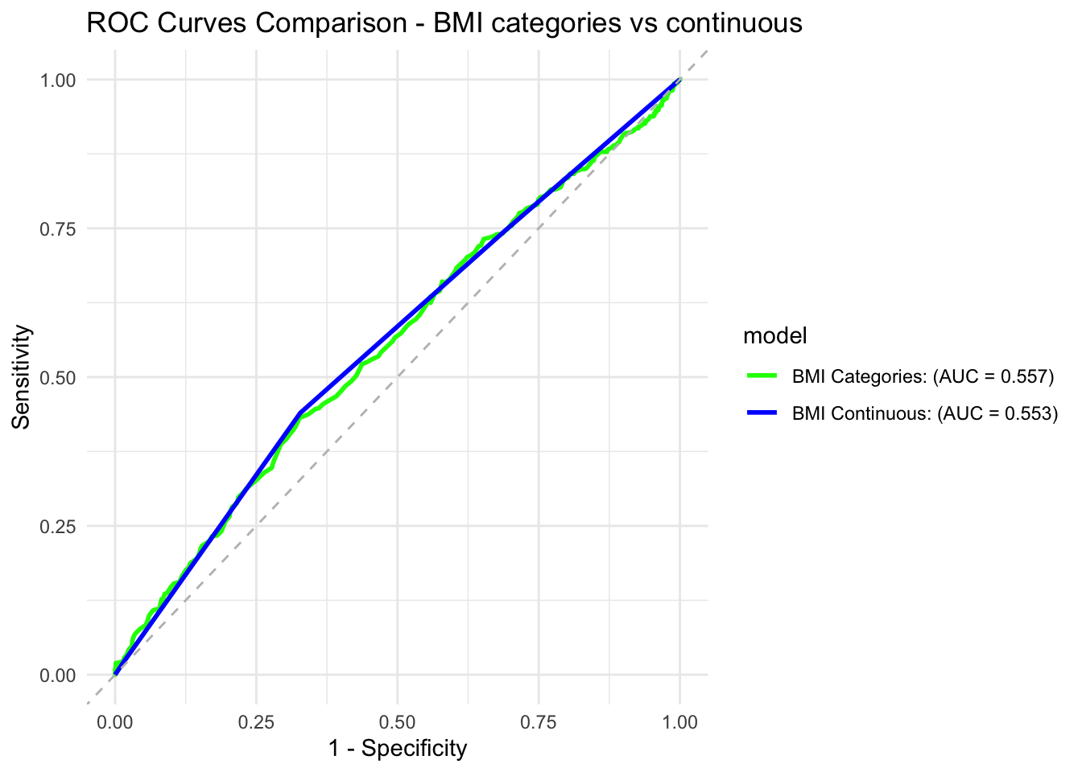
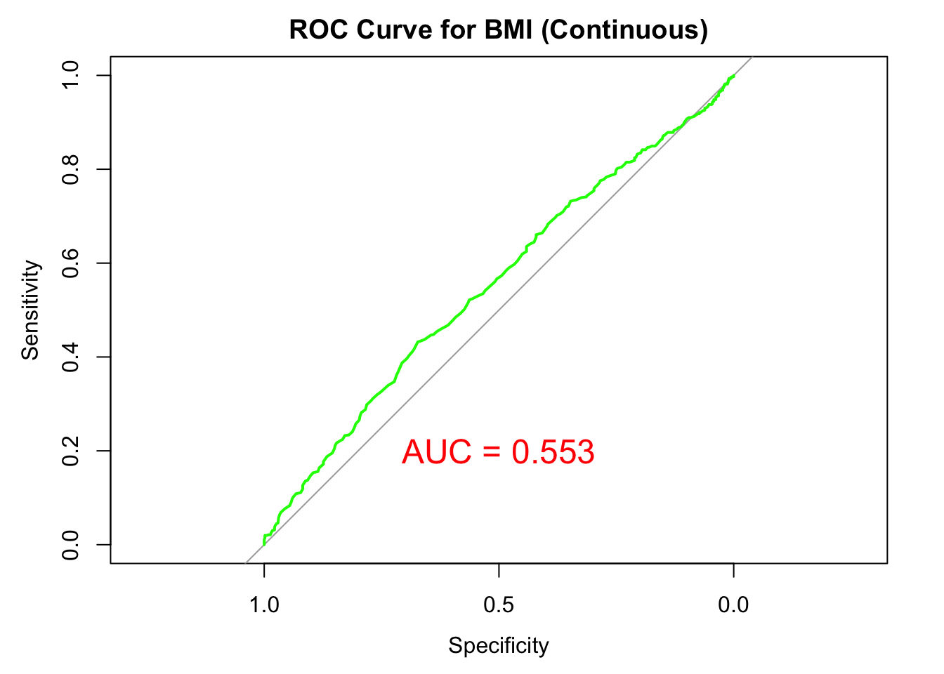
Results – Logistic Regression Analyses
Models on age groups and BMI (categorical and continuous) and adding interaction terms;
Compared interaction models (AIC, BIC) and checked best one for collinearity (VIF);
Model on age subgroups and BMI categories (multinominal);
Presented odds ratios and confidence intervals, AUC/ROC curves and precision, recall, and F1 for cross-validated models.

Slide 14
Results – logistic regression analysis take-away
BMI and age at diagnosis continued to have a significant but modest association in the logistic analysis.
Higher BMI linked to later onset;
BMI had limited predictive power: low AUC (< 0.56 in simple model) with multicollinearity issues in complex models;
Smoking history, hypertension, and tumor characteristics had greater predictive value;
First interaction model tested (glm1) had better fit than simple model, showing the effect of other variables.

Slide 15
Discussion, limitations and conclusion
Findings contrast with initial hypothesis that higher BMI correlates with earlier onset;
Linear Regression showed weak positive relationship between BMI and later age of diagnosis;
Logistic regression agrees with findings, showing lower likelihood of early-age diagnosis when higher BMI
This highlights complexity of this relationship and multifactorial interplay, challenging simplistic view of high BMI accelerating colorectal cancer onset;
Limitations: small sample size, missing variables, demographic representation limitation, observational study (no causality assessment);
Future ideas: larger study, more detailed studies, with more variables, needed to fully understand BMI’s role in colorectal cancer onset.
Final project repo: https://github.com/angeligazola/BMIN503_Final_Project

Slide 16
References
Cercek, Andrea, Walid K Chatila, Rona Yaeger, Henry Walch, Gustavo Dos Santos Fernandes, Asha Krishnan, Lerie Palmaira, et al. 2021. “A Comprehensive Comparison of Early-Onset and Average-Onset Colorectal Cancers.” JNCI: Journal of the National Cancer Institute 113 (November): 1683–92. https://doi.org/10.1093/jnci/djab124.
Gu, Wan-Jie, Jun-Peng Pei, Jun Lyu, Naohiko Akimoto, Koichiro Haruki, Shuji Ogino, and Chun-Dong Zhang. 2022. “The Burden of Early-Onset Colorectal Cancer and Its Risk Factors from 1990 to 2019: A Systematic Analysis for the Global Burden of Disease Study 2019.” Cancers 14 (July): 3502. https://doi.org/10.3390/cancers14143502.
Laiyemo, Adeyinka O., and Paul F. Pinsky. 2022. “Understanding Early-Onset Colorectal Cancer: The Role of Obesity.” Gastroenterology 162 (April): 1026–27. https://doi.org/10.1053/j.gastro.2022.01.041.
Lazarova, Darina, and Michael Bordonaro. 2021. “Multifactorial Causation of Early Onset Colorectal Cancer.” Journal of Cancer 12: 6825–34. https://doi.org/10.7150/jca.63676.
Li, Hengjing, Daniel Boakye, Xuechen Chen, Michael Hoffmeister, and Hermann Brenner. 2021. “Association of Body Mass Index with Risk of Early-Onset Colorectal Cancer: Systematic Review and Meta-Analysis.” American Journal of Gastroenterology 116 (November): 2173–83. https://doi.org/10.14309/ajg.0000000000001393.
Li, Hengjing, Daniel Boakye, Xuechen Chen, Lina Jansen, Jenny Chang-Claude, Michael Hoffmeister, and Hermann Brenner. 2022. “Associations of Body Mass Index at Different Ages with Early-Onset Colorectal Cancer.” Gastroenterology 162 (April): 1088–1097.e3. https://doi.org/10.1053/j.gastro.2021.12.239.
Low, Eric E., Joshua Demb, Lin Liu, Ashley Earles, Ranier Bustamante, Christina D. Williams, Dawn Provenzale, et al. 2020. “Risk Factors for Early-Onset Colorectal Cancer.” Gastroenterology 159 (August): 492–501.e7. https://doi.org/10.1053/j.gastro.2020.01.004.
Siegel, Rebecca L., Nikita Sandeep Wagle, Andrea Cercek, Robert A. Smith, and Ahmedin Jemal. 2023. “Colorectal Cancer Statistics, 2023.” CA: A Cancer Journal for Clinicians 73 (May): 233–54. https://doi.org/10.3322/caac.21772.

