Slide 1
CodeClan Gym App
By Angelina blyth

Slide 2
Aims
A local gym has asked you to build a piece of software to help them to manage memberships, and register members for classes
Manage Membership
Manage Classes
Register Users for Classes
View all customers assigned to a class

Slide 3
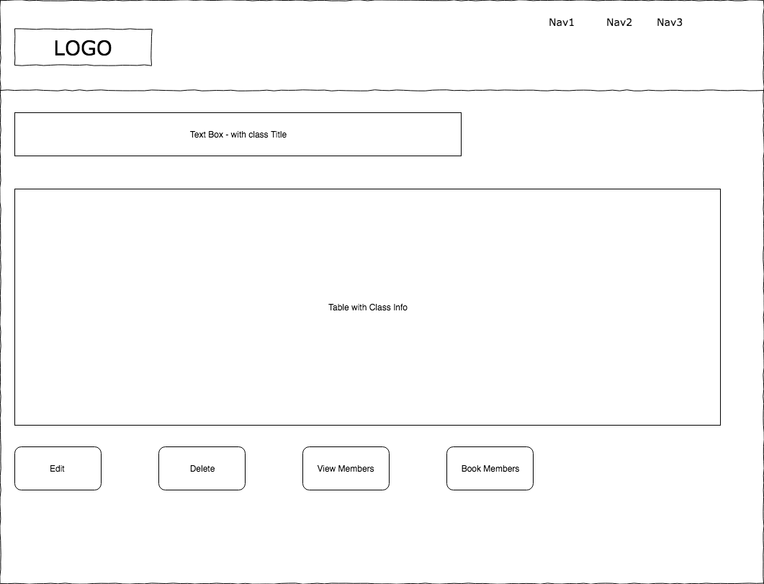
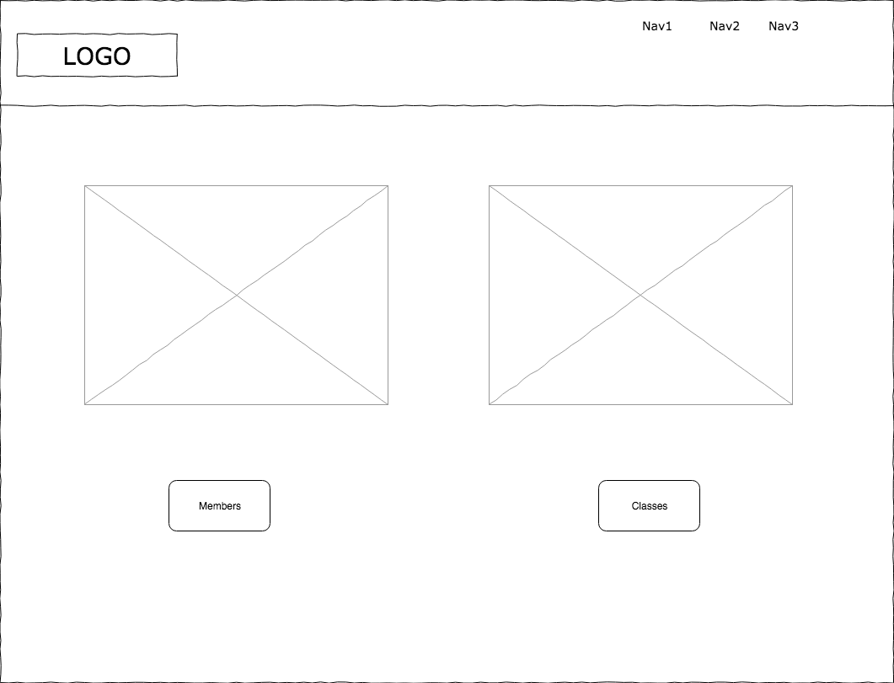
Planning - Wireframes
Notes:
Two wireframes. One on the left shows what the page will look like when you click to view all the classes available.
Right shows how the admin dashboard will look like, two pictures with buttons that will take you two view all members or all classes.

Slide 4
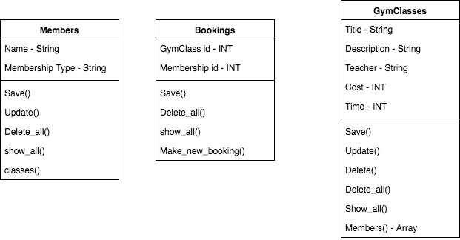
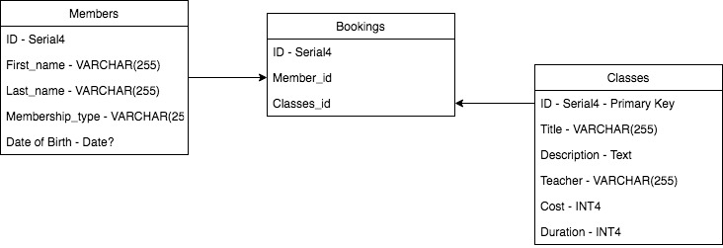
Planning - Diagrams
Notes:
Diagram on left is classes. Diagram on right in the sql.

Slide 5
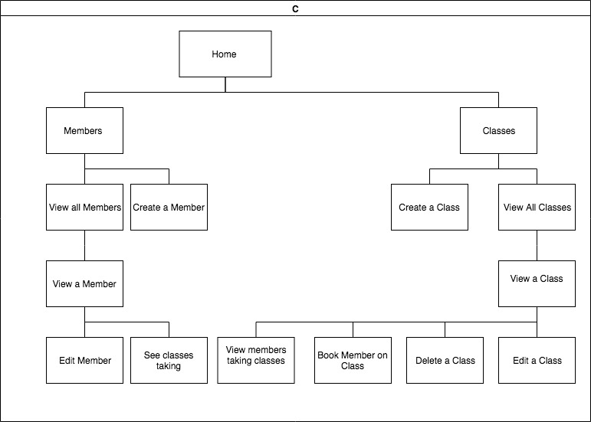

Slide 6
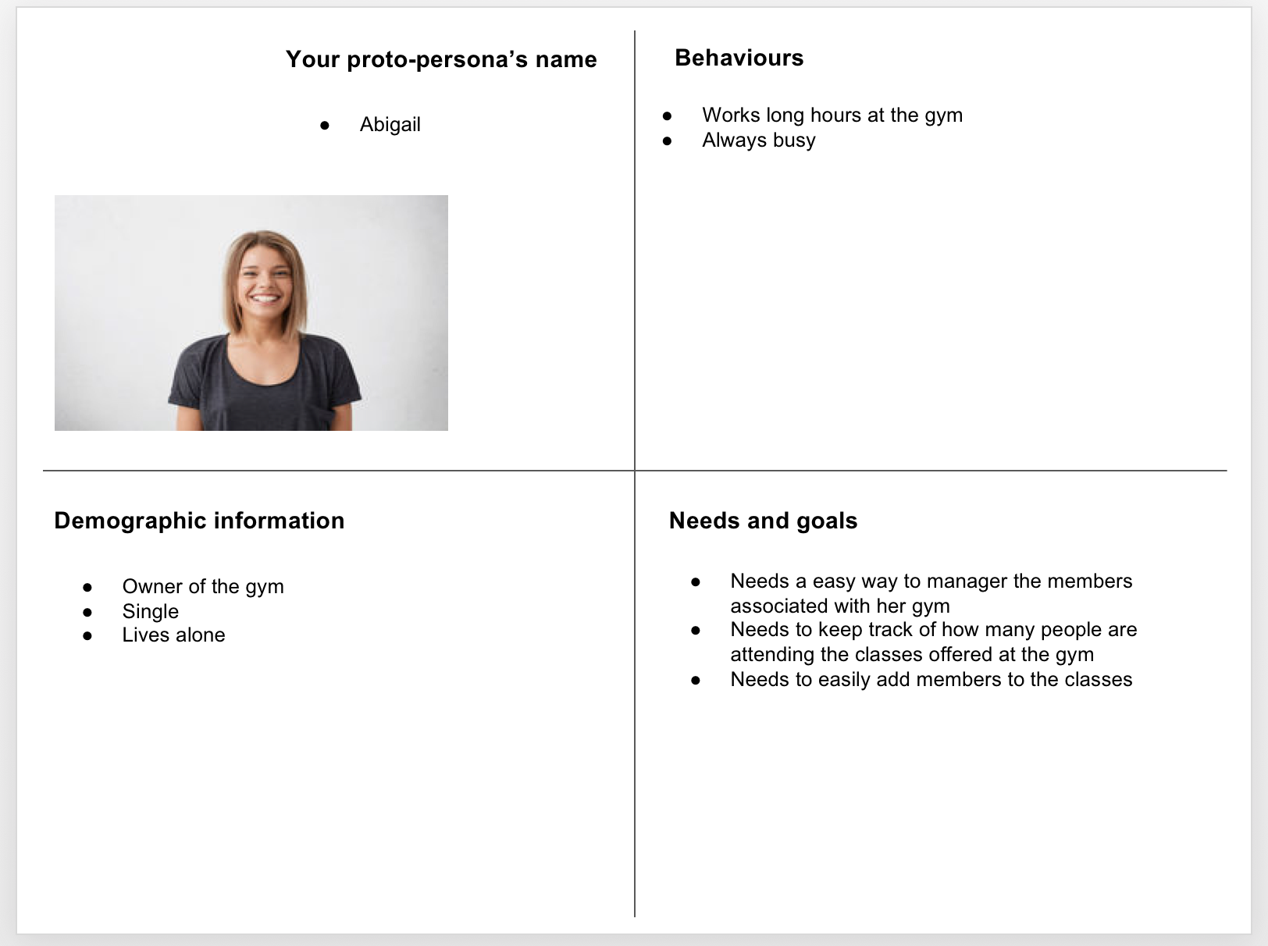
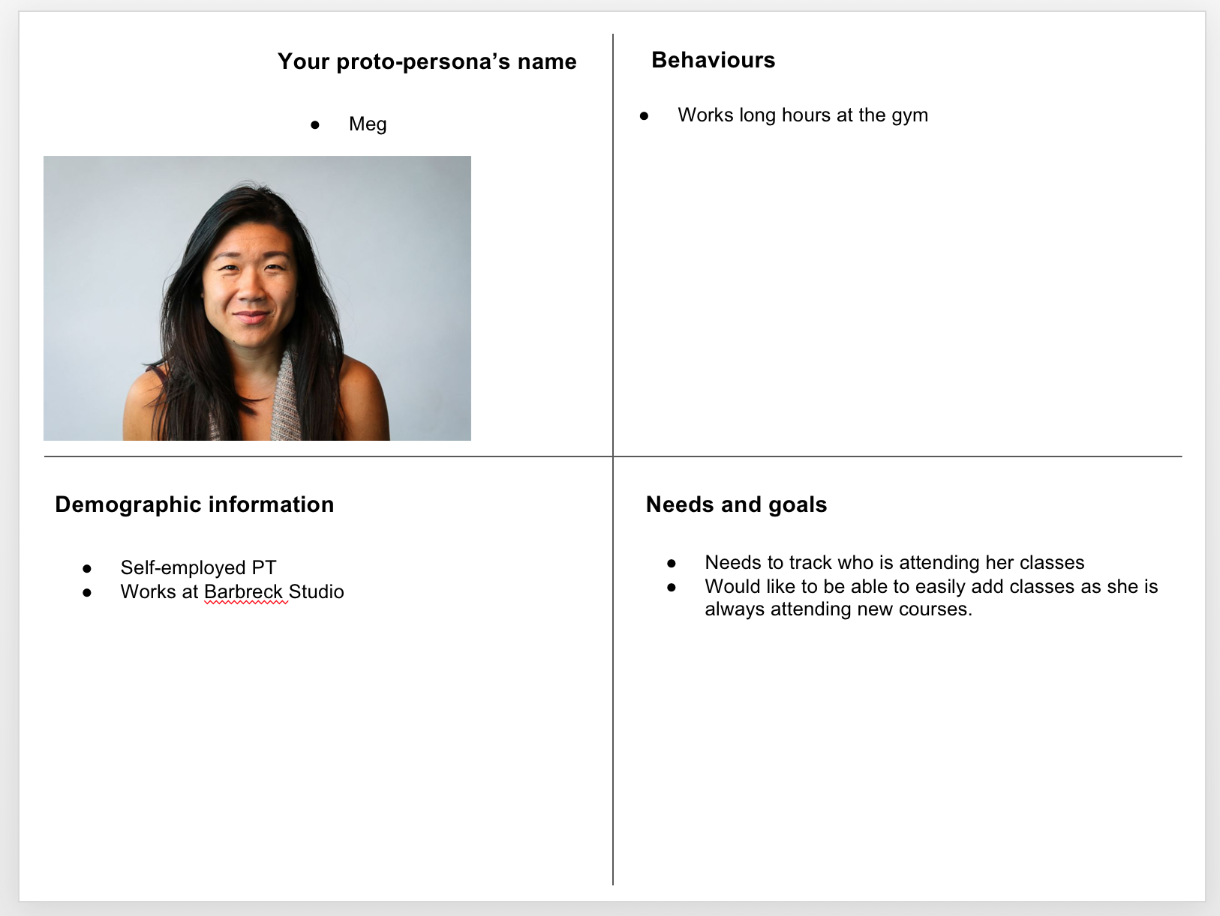
Planning

Slide 7
Planning – User needs
As a... | I want to... | So that...
Gym Manager | manage the list of members | I am storing up-to-date information about members
Gym Manager | manage the list of classes | I have up to date inforamtion about what classes are available
Gym Manager | be able to add members to classes | I can book their place
Gym Manager | view all members assigned to a class | I can see which classes are going to be busy
PT | be able to add new classes to the gym | I can offer clients the latest fun ways to work out
PT | be able to see my class times | I can offer clients personal training outwith classes
Gym Manager | add premium membership | can offer clients deals on classes
PT | be able to limit the number of clients able to attend certain classes | I that it is more intimate and I can give people better quality classes

Slide 8
Planning – User Journey
 | Step 1 | Step 2 | Step 3 | Step 4 | Goal
User action(s) | Abi has brought up the dashboard. She can click on the link to 'Classes' that is at the top of the screen, or the image. | Abi selects the classes her client is wanting to attend. | Abi then selects a button marked 'Add Member" | Abi selects the name of the client and clicks the button to book them onto the system. | Abi's client has been sucsessfully added to the class they wish to attend.
System response | Page navigatates to the classes page. List of classes is displayed | Page navigates to the individual class page. | Page navigates to the booking page for that class. It displays a drop down with all members of the gym. | A new entry in the bookings table is created, page redirects to a page asking if there are any more clients to add to the class.
Potential problems |  | Class might not appear as it might be a new class, if the case, Abi would need to first add the class in. | Lift might get too long, perhaps make it searchable? | There might be multiple users needing added to the class, perhaps multi select clients? Also user might already be added to the class, need to get a way to not be able to select clients already assigned to class.
Notes:
Persona's name Abigail Johnston Journey goal Book member on class

Slide 9
DEMO

Slide 10
What I would change
I would make the front end more responsive
Plan for mobile first
Easier navigation
Use space on website better

Slide 11
What I Learned?
To read the entire error message
That I know more that I thought I did
If something not working and you know it should, restart everything!
Take time to plan – referred to this a lot when making the views

Slide 12
Questions?

