Slide 1



Carmark Angelina ramola and Nathan Cmeyla

Slide 2
Problem and Business objective
Problem Statement: CarMark currently relies on scattered spreadsheets and manual notes to track customer information, making it difficult to analyze trends, personalize outreach, and integrate data into modern analytics tools
Business Objective:
CarMark is a local automotive dealership looking to optimize car sales by building a centralized relational database that organizes customer information to support personalized sales and marketing strategies
Key Goals:
Collect customer information in a database that including lifestyle traits, vehicle ownership history, purchasing behavior, financial information, etc.
Segment customers into categories; all segment categories tracked through propensity scores
Assign financial tiers to each customer via analytical model
Enable analytics for predicting purchase intent and improving marketing effectiveness

Slide 3
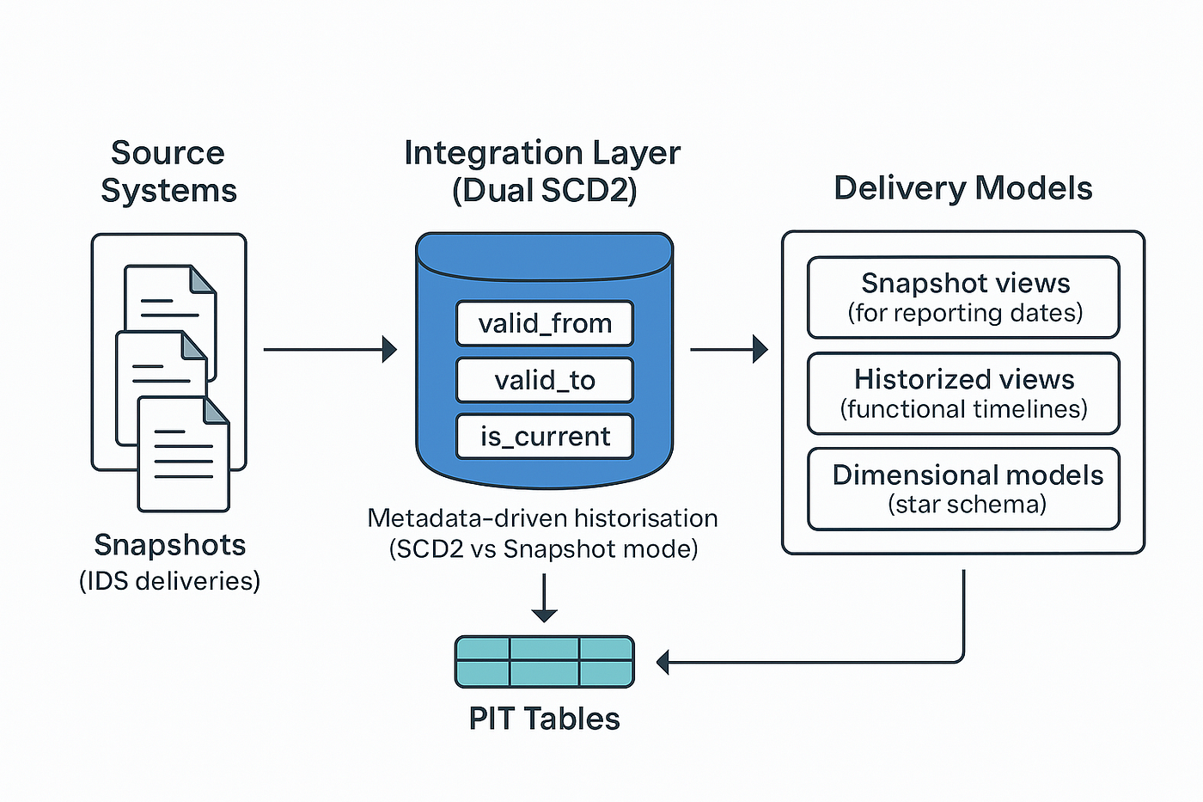
Key refinements since midterm
Effective-Dated Historical Tables
SCD2 implemented
Static 'Age' field -> Dynamic 'DOB'
Detailed financial qualifications/limits
No overwriting, fill history preserved
Financial Analytical Model

Slide 4
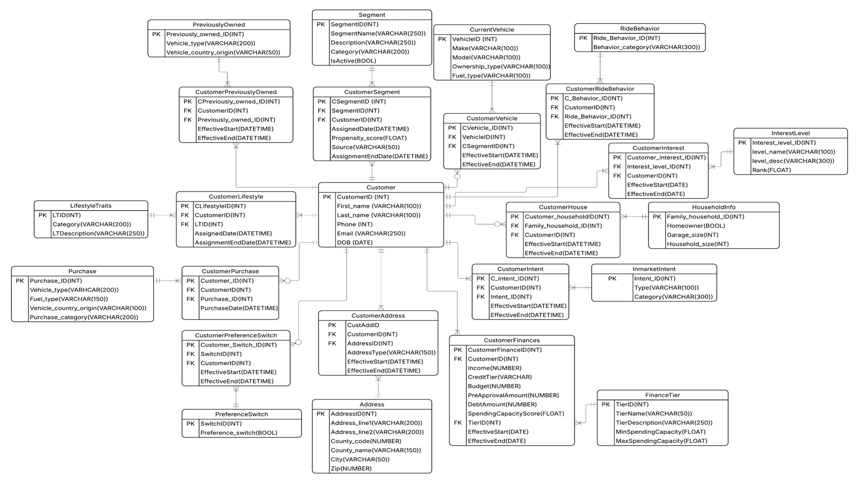

Slide 5
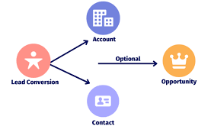
Lead Lifecycle
1. New Lead Creation
Lead enters via online form or in-person visit
Initial consultation captures customer profile, lifestyle traits, interests, and intent
Data stored using effective-dated (SCD2) structures for long-term history
2. Analytical Scoring and Targeted Outreach
Segmentation Propensity Model: assigns likelihood of belonging to each of the behavioral segments
Financial Tier Model: computes spending capacity and assigns Tier 1–5
Snowflake enables fast joins between models to inform personalized engagement strategies
3. Lead Conversion
Purchase triggers creation of CustomerPurchase, CustomerVehicle, and PreferenceSwitch records
Any updates to finances, interests, or behaviors create new SCD2 rows without overwriting prior values
4. Re-Entry as Future Lead
Customers re-enter the funnel as life events or financial situations change
Full historical tracking supports ongoing retention, remarketing, and future model updates

Slide 6
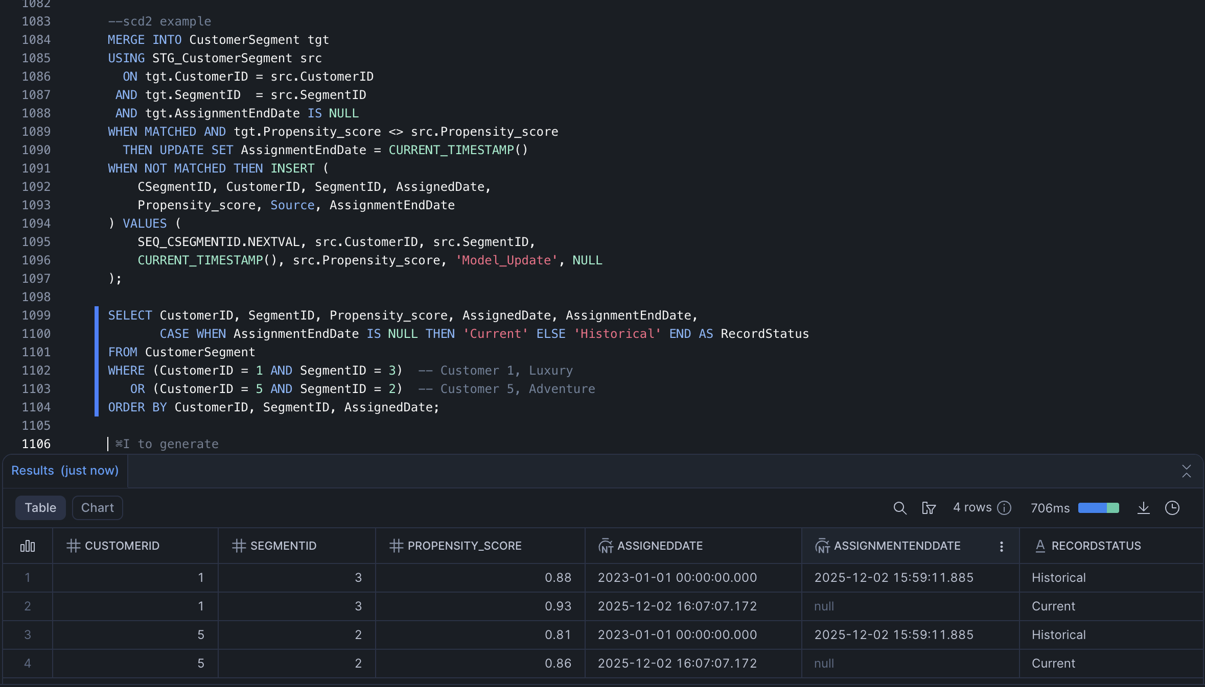
SCD2 Merge example for updating customer Propensity scores

Slide 7
Financial analytical Model
CarMark uses an analytical model to assess customer affordability
The model takes raw customer financial data and assigns them weights to calculate SpendingCapacityScore
SpendingCapacityScore is then separated into 5 different tiers (premium, strong, moderate, limited, and restricted)
The model formula:
SCI_raw =
(Income × 0.0004)
+ (Budget × 0.01)
+ (PreApprovalAmount × 0.0003)
– (DebtAmount × 0.0005)
+ CreditTierOffset

Slide 8
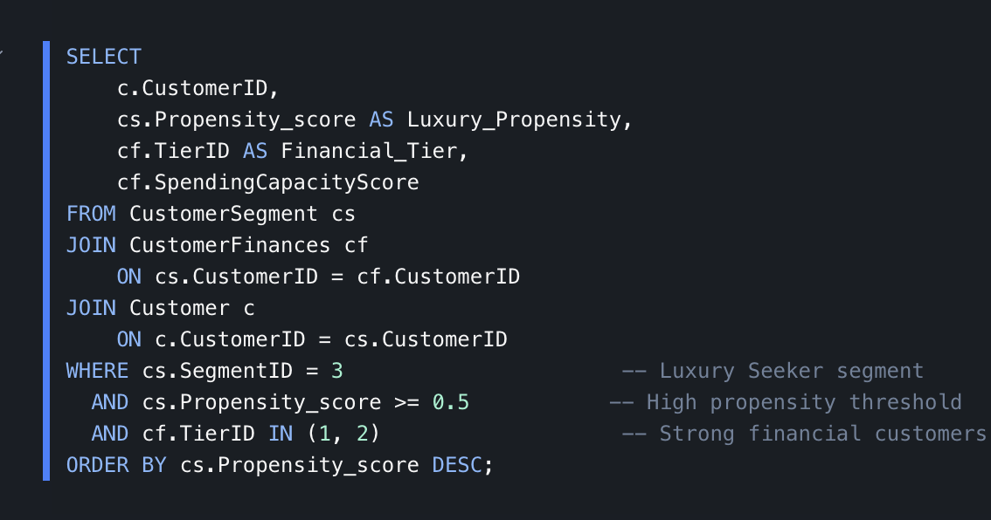
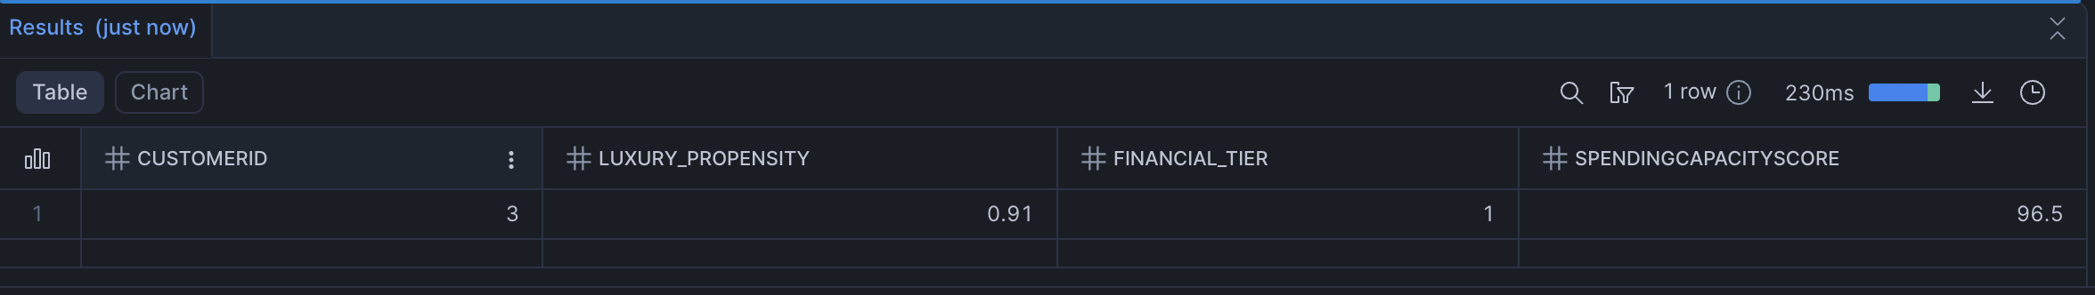
Example Query

Slide 9

Conclusion
CarMark now has a scalable Snowflake data model with full history tracking, analytical models, and customer intelligence features to optimize sales and marketing campaigns and enhance company profitability.

