Slide 1
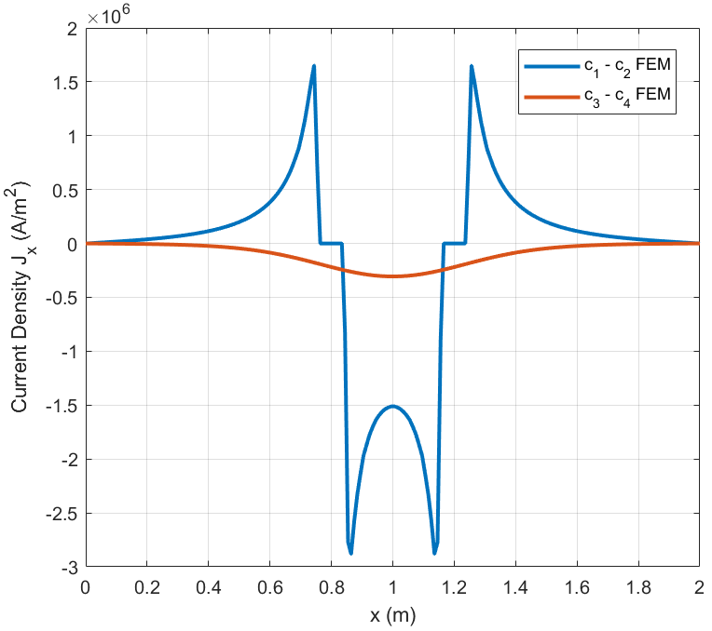
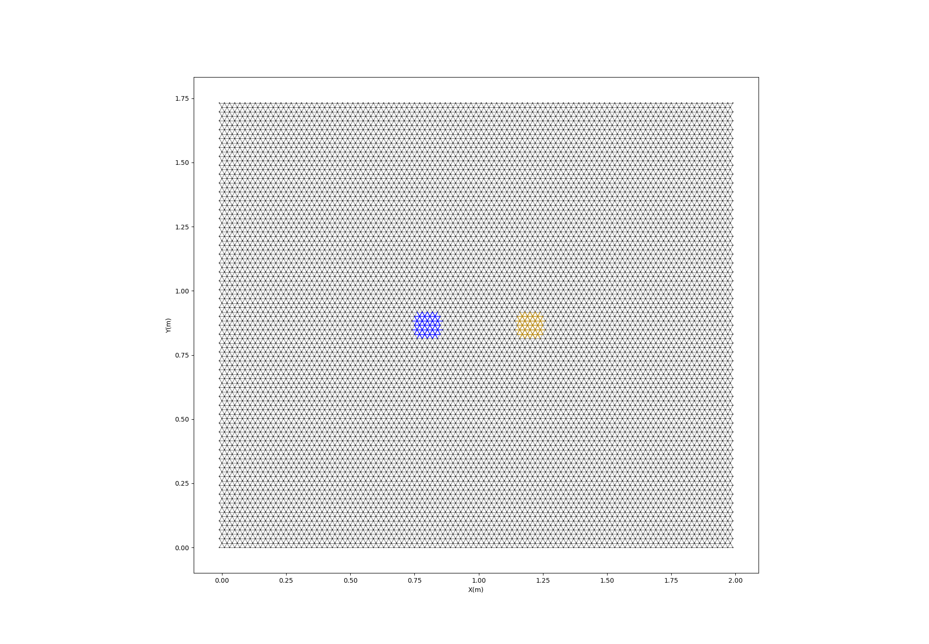
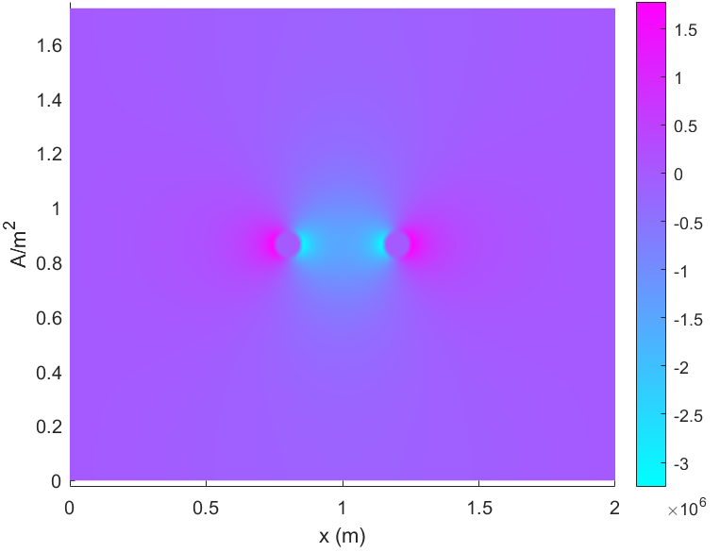







Negative electrode(-5V)
Figure 2
a
Positive electrode(+5V)
c
L
$$c_{1}$$
$$c_{2}$$
W
$$\frac{W}{4}$$
$$l_{e}$$
$$c_{3}$$
$$c_{4}$$
$$\frac{W}{4}$$
b
$${2l}_{p}^{0}$$
$${2l}_{p}^{0}$$
Characteristic size of the mesh
d
$${2l}_{p}^{0}$$

