Slide 1
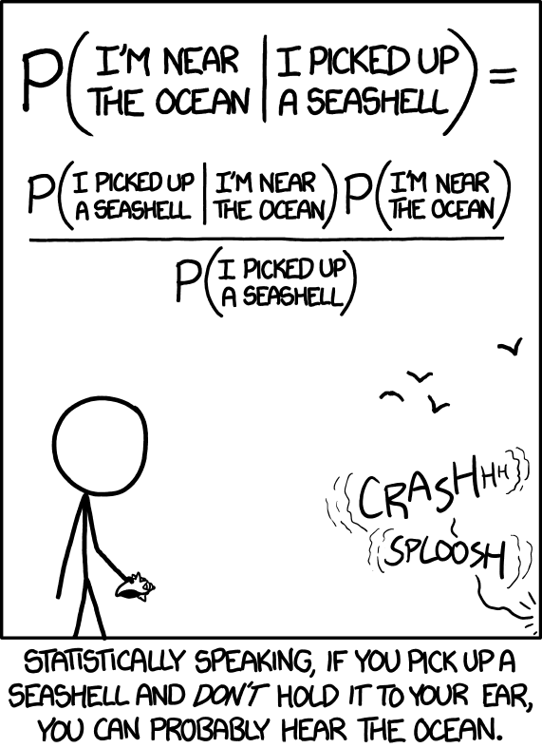
Introduction to Bayesian analyses for developmental researchers
SRCD 2021 Professional Developmental Session
Introduce yourself in the chat!
Where are you calling in from? (geography or institution)
Are you a graduate student? Postdoc? Professor? Alternative Researcher? ...
Do you have any familiar with {regression modeling, Bayesian modeling, both}?
Why did you choose to come today?
https://xkcd.com/1236/

Slide 2
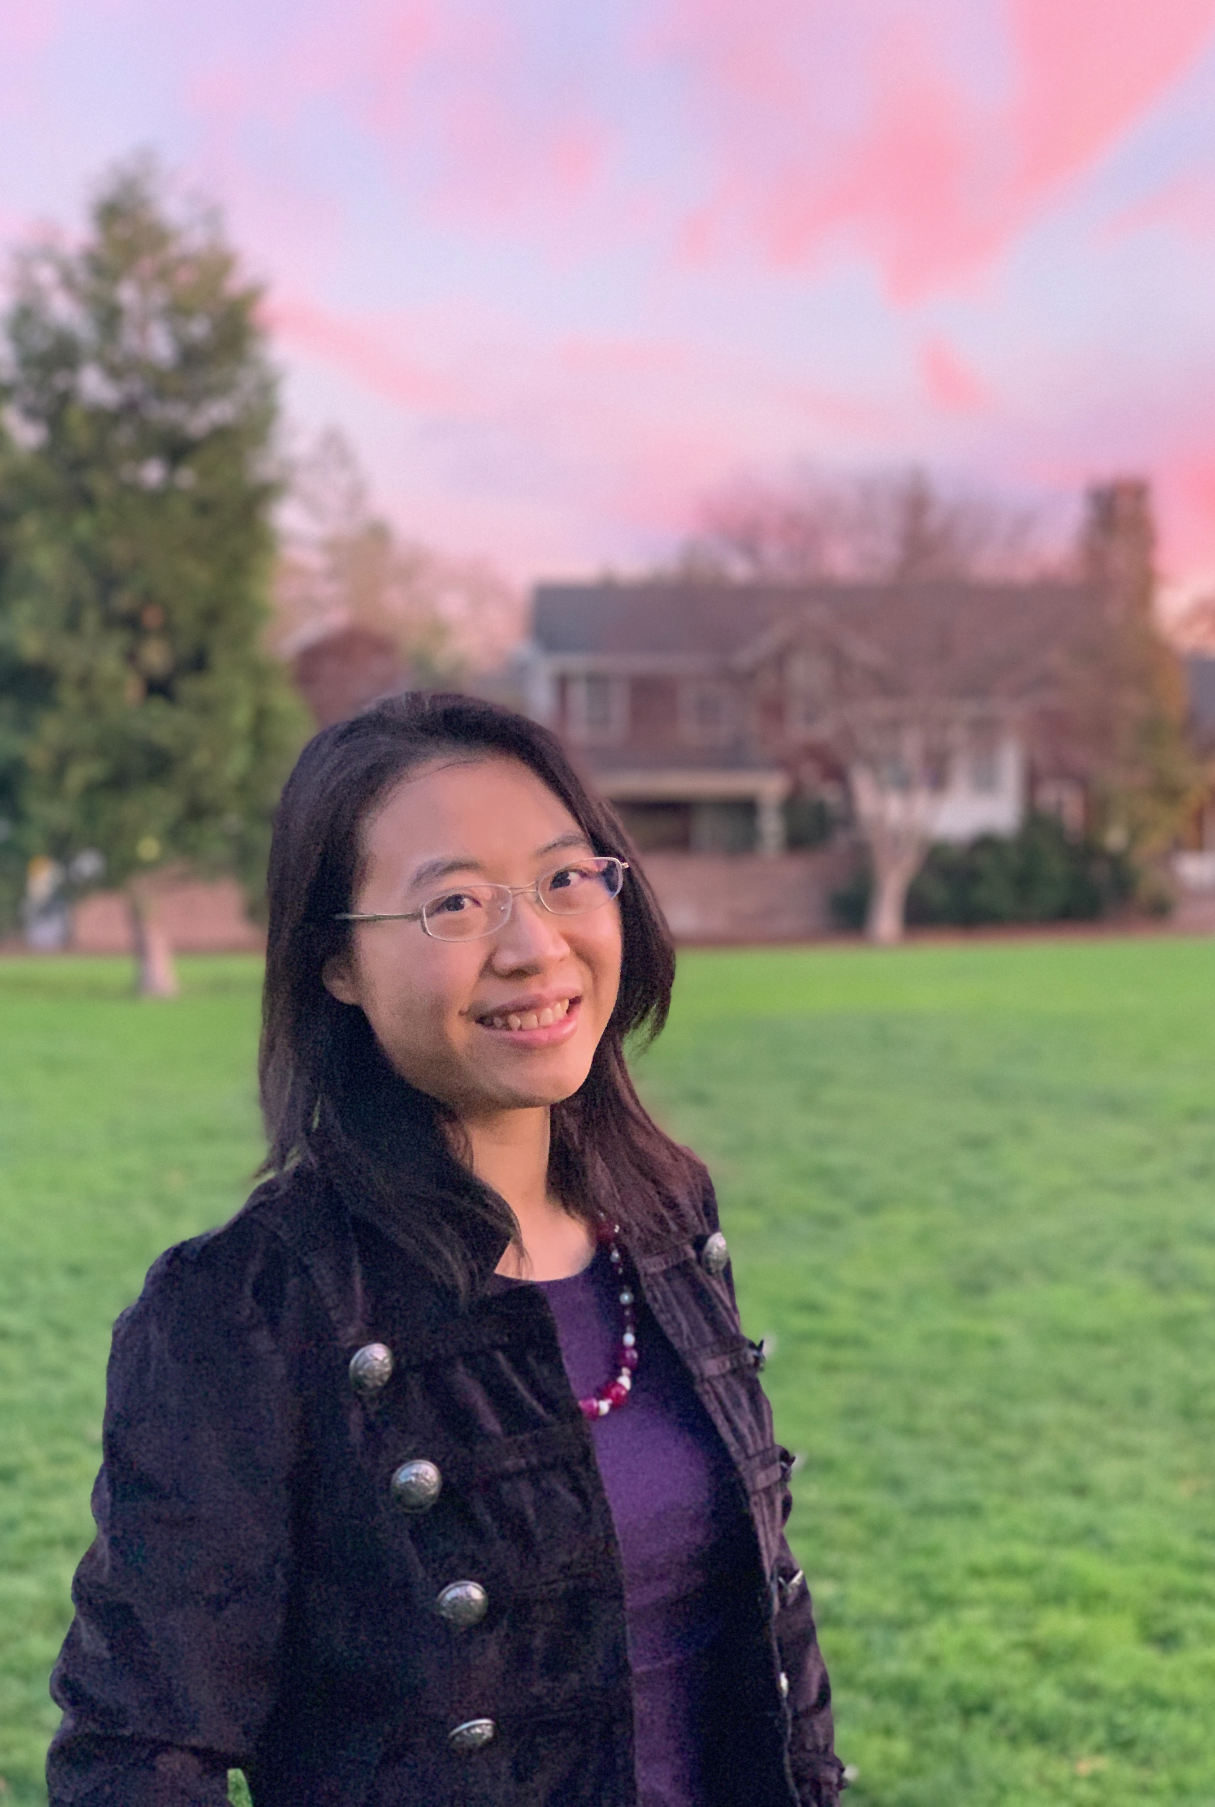
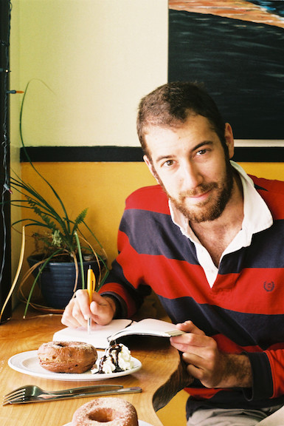
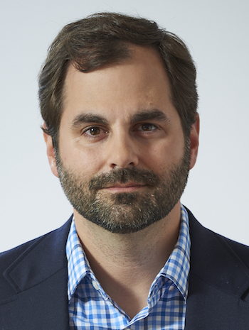
Meet the organizers
Angeline Sin Mei Tsui
Michael Henry (“MH”) Tessler
Michael C. Frank

Slide 3
Outline of the workshop
A total of 4 sessions:
Introduction to Bayesian inference
Bayes factors for testing hypotheses
Bayesian mixed effects model
Implication for planning developmental studies
We will use R, RMarkdown, tidyverse R package, BayesFactor, lme4, and brms
All materials can be assessed: https://github.com/angelinetsui/srcd2021_bayesian

Slide 4

Introduction: We want to know about you
Who are you? Are you:
Undergraduate and graduate students
Postdoctoral researchers
Professors
Others
Why are you here?
Why do you want to learn Bayesian statistics?
This Photo by Unknown Author is licensed under CC BY-SA

