Slide 1
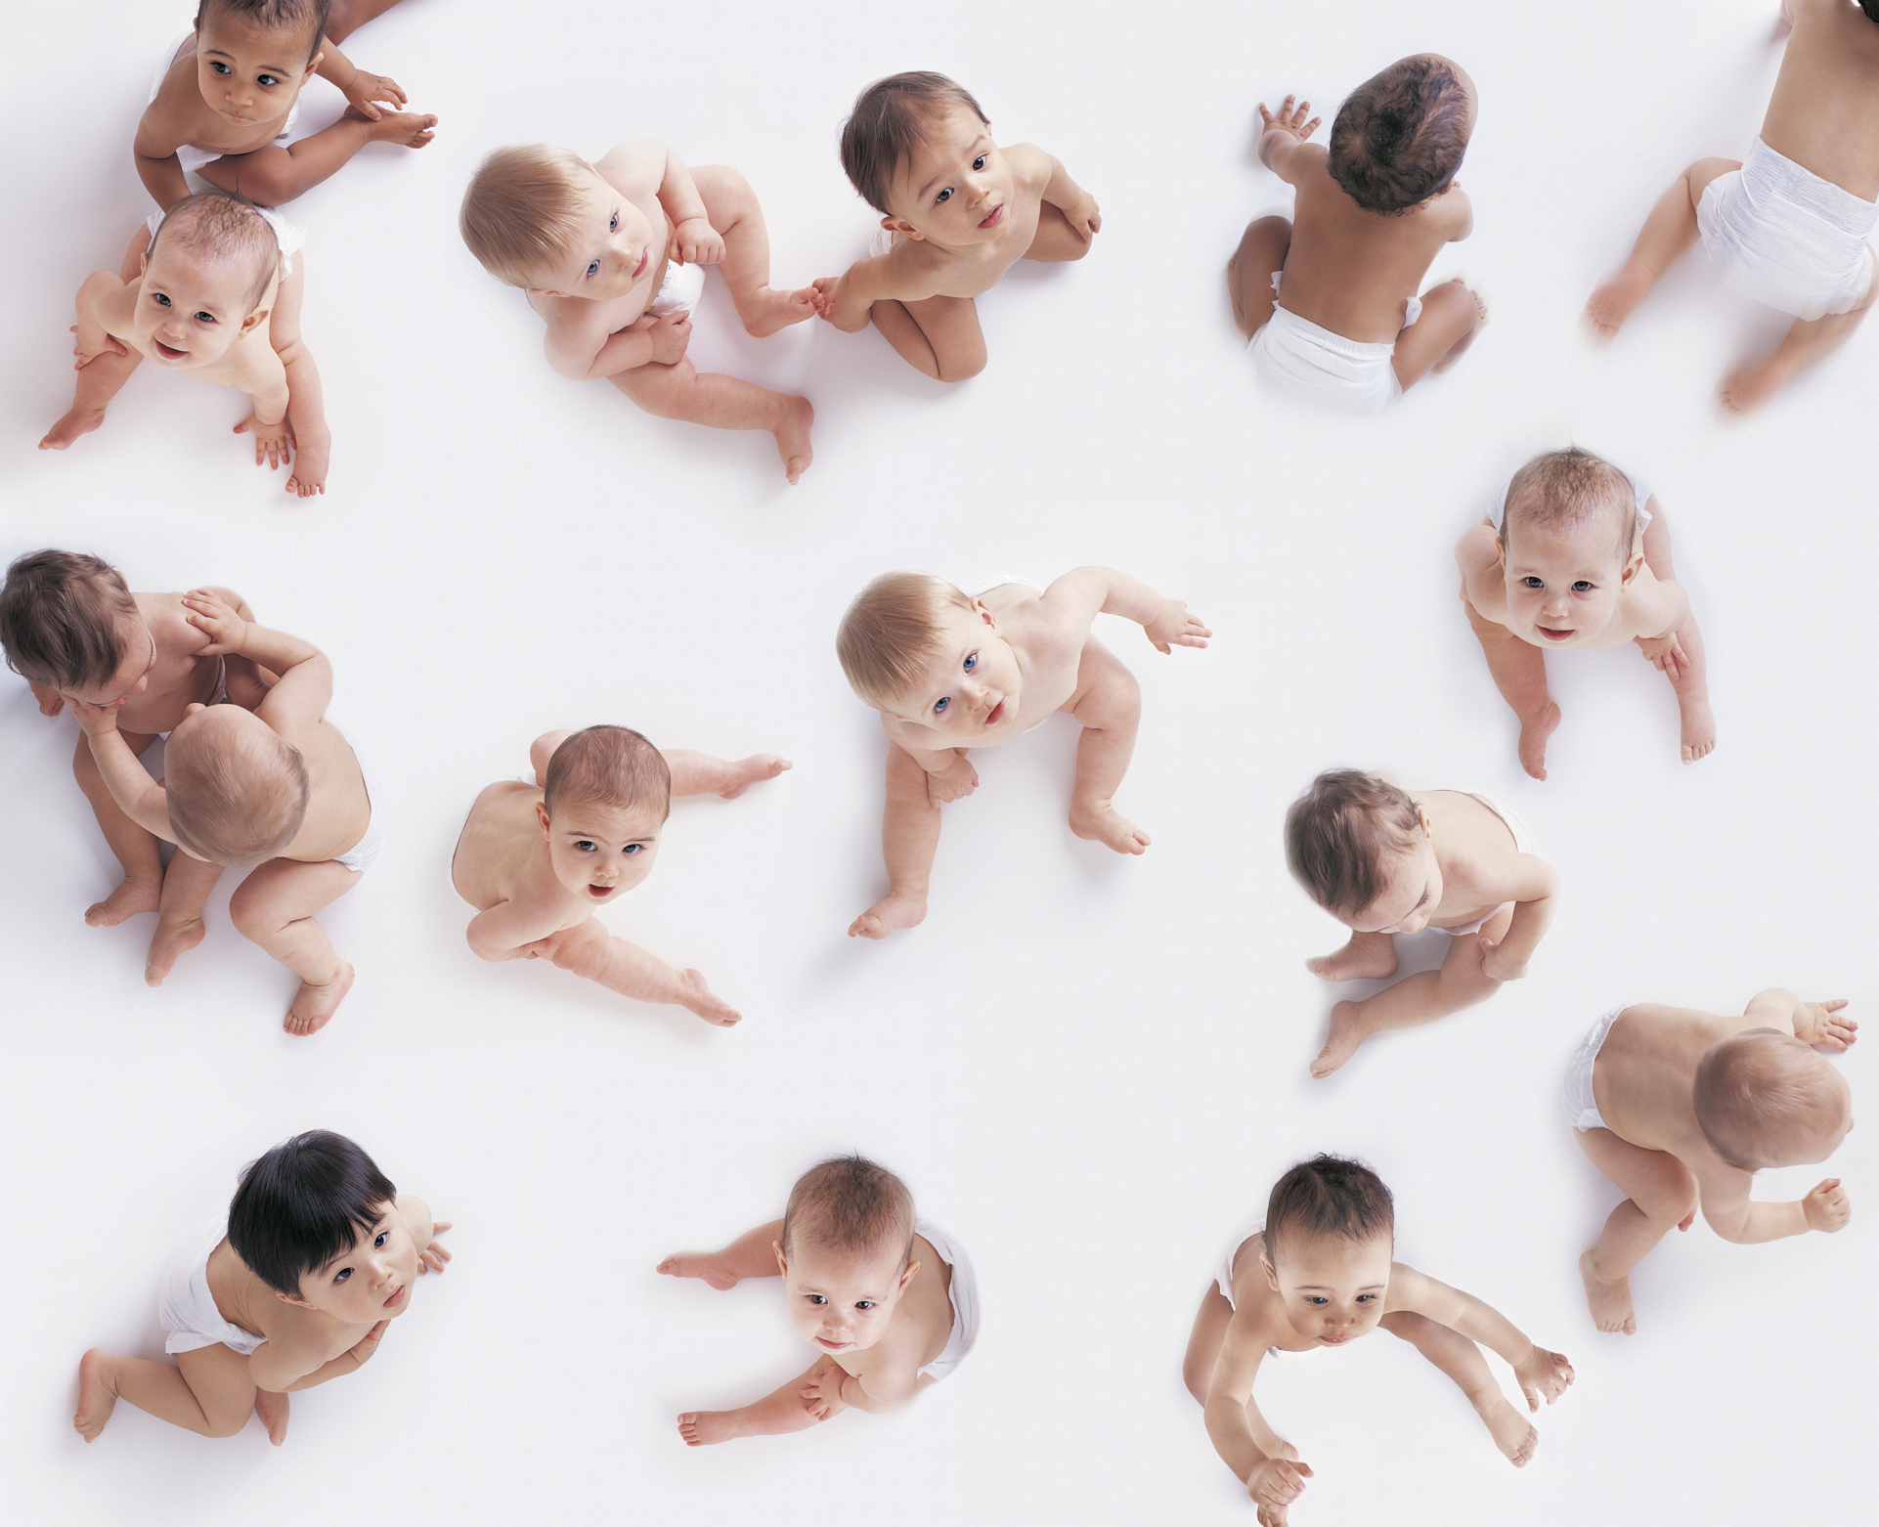
ManyBabies 1: Infant-Directed Speech Preferences
An initiative for reproducibility and best practices in developmental research

Slide 2
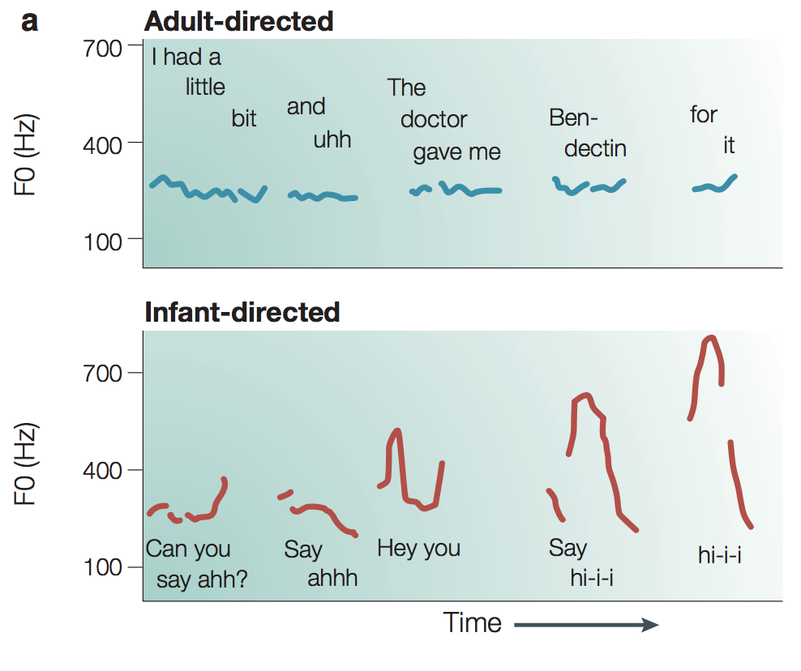
Infant-directed speech
Kuhl (2004) - originally Fernald & Kuhl (1987)

Slide 3
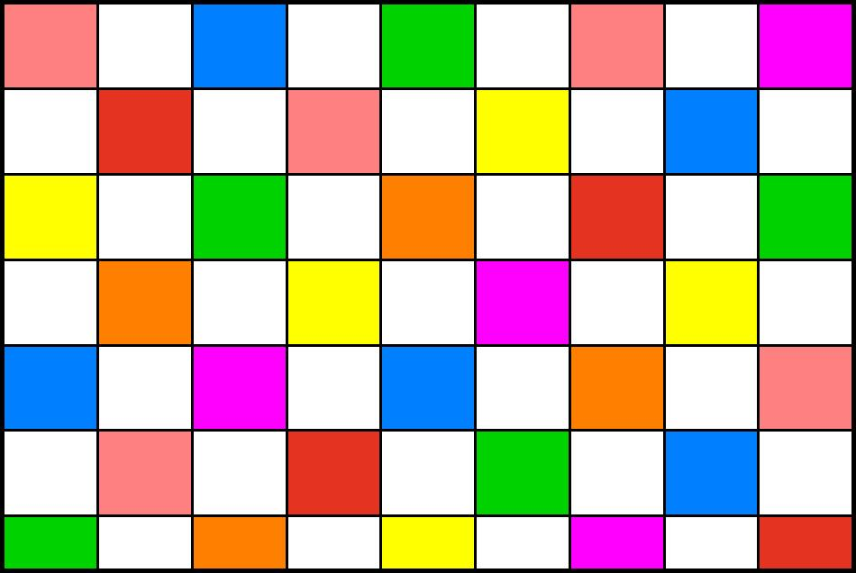
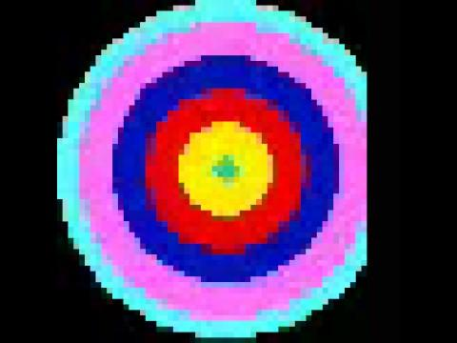
Design
Modeled on Cooper & Aslin (1990)
DV: Looking time to checkerboard
IDS vs. ADS played in pairs of trials within subjects
16 test trials (8 pairs)
North American English stimuli
Visual fixation stimulus
Attention-getter

Slide 4
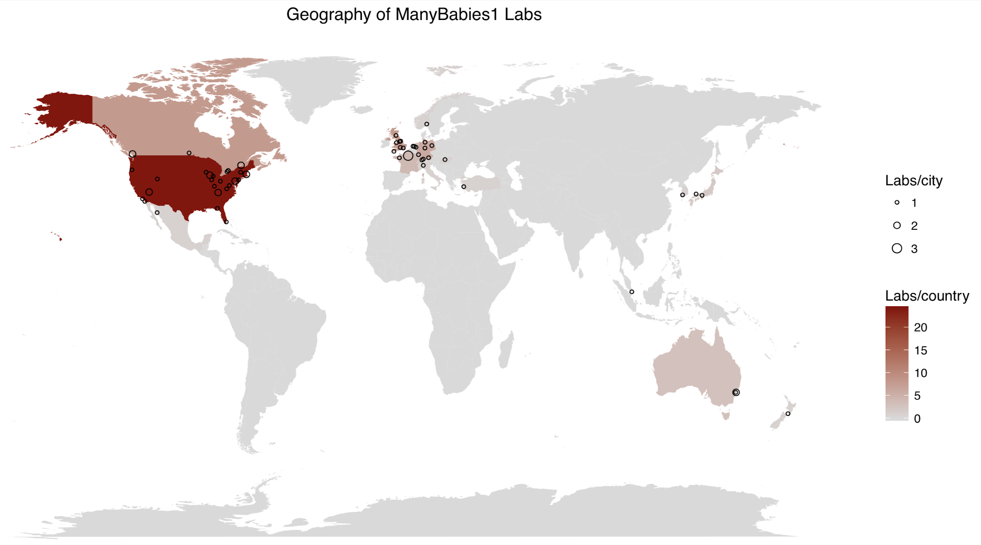
Sample in MB1
67 labs, 17 countries, 4 continents
Initial sample: 2754 babies
Exclusions
5.88% language status (not monolinguals)
2.39% preterm
0.08% atypical
3.18% session errors
10.61% trial errors
16.13% for no usable trials
0.47% excluded labs
Final sample: 2329 babies (85%)

Slide 5
MB1 dataset
https://github.com/manybabies/mb1-analysis-public
Let us focus on the trial dataset
Each row represents an infant’s looking time on a particular trial

