Slide 1
Project: TA Report System
IE04 Phase 1 Presentation
2022/11/09
Team: Sauce Katsudon

Slide 2
Our Vision
Goal: A system that is simple and easy to use.
What we want to do:
Simplify the process of submitting the report
Staff can check and manage the reports easily
TA/SA can input their working time easily and will be able to keep track of the total working hours
Lecturers can see all the TA/SA of the course they’re teaching (progress of each TA/SA)

Slide 3
Demo

Slide 4
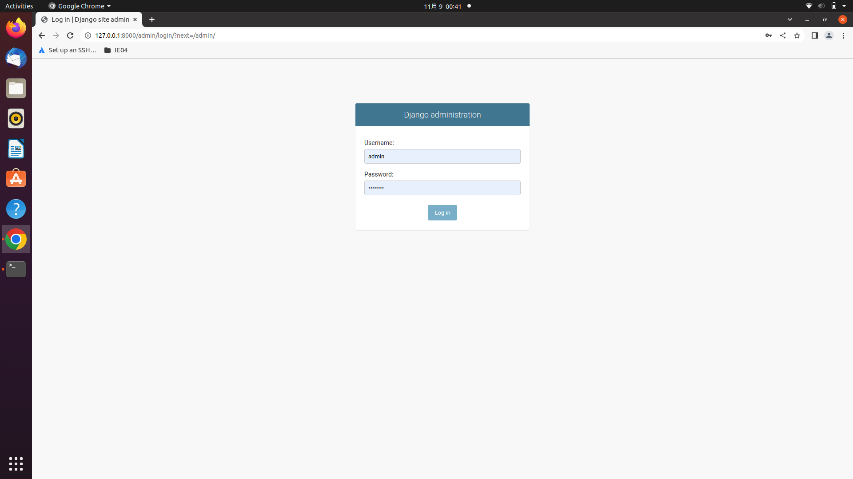

Slide 5
