Slide 1
TA/SA Report System
Integrated Exercise for Software II
Team Sauce Katsudon
s1282003, Angelita Gozaly
s1280179, Ide Tomohito
2023/2/1
Integrated Exercise for Software II
‹#›

Slide 2
Contents 内容
The Product 成果物について
The Process 開発の過程・手順
Learnings from the Activity わたしたちの学び
2019/1/30
Integrated Exercise for Software II
‹#›

Slide 3
Product

Slide 4
Product
Separate interface for staff, lecturer, and student
Staff | Lecturer | Student
Login & logout Create account Assign to course | Login See list of courses | Login See list of courses
 | See student’s report | Create new report Add working hours See list of activity

Slide 5
User stories
Users can login to the website
Staff can create accounts for student and lecturer
Staff can assign each student and lecturer to the courses
Staff can edit all data in the database from the admin page
Student can see the list of courses
Student can open report calendar page when clicking the report
Lecturer can see the list of courses
Student can open report calendar page when clicking student’s report

Slide 6
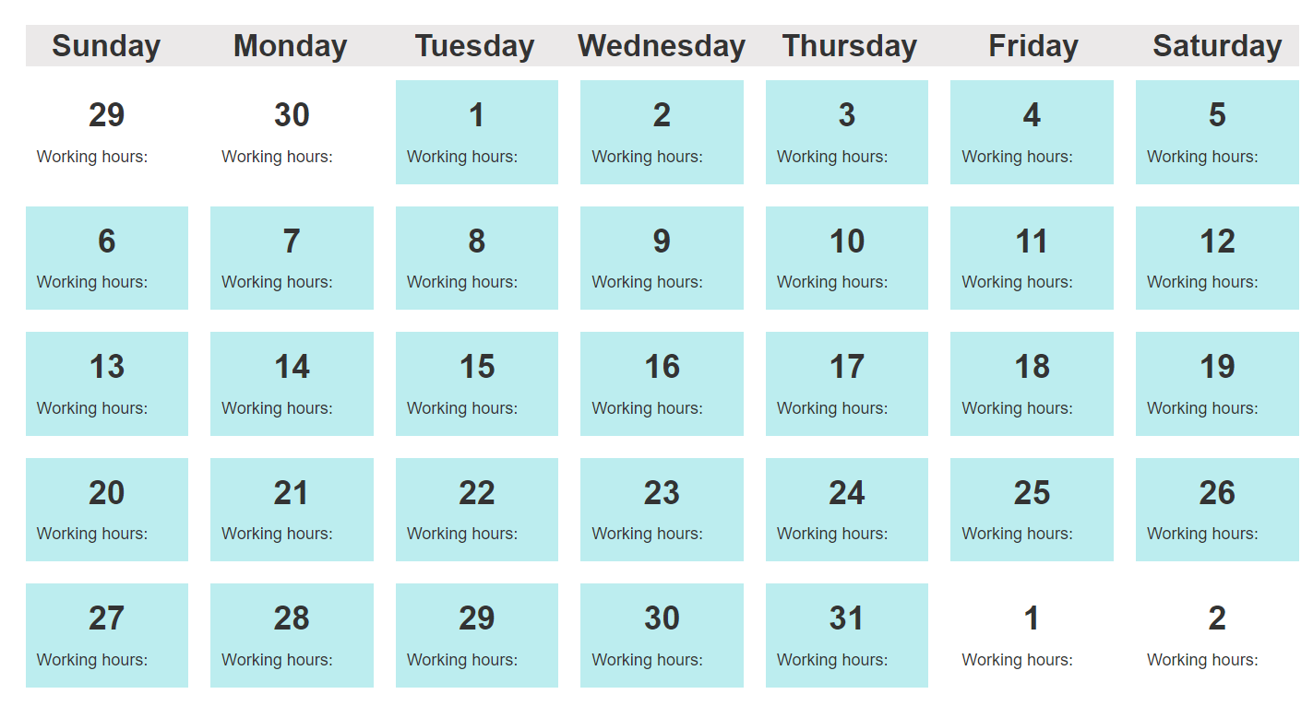
Creativity
Calendar format

Slide 7
Process

Slide 8
Development environment
Django
Easy to learn
Has built in functionalities such as customizable admin
interface
MySQL
Required
Webflow
Easy to use for designing UI
Support code export
Prior experience

Slide 9
Development process
Analysis
Design
Implementation
Analyze the RFP and specify all the requirements
Separate the work into phases
Divide the work between members
Describe all the requirements in the form of user-stories and use-case diagrams
Design the database and user interfaces
Implement the interface
based on prior design
Develop backend system using Django

Slide 10
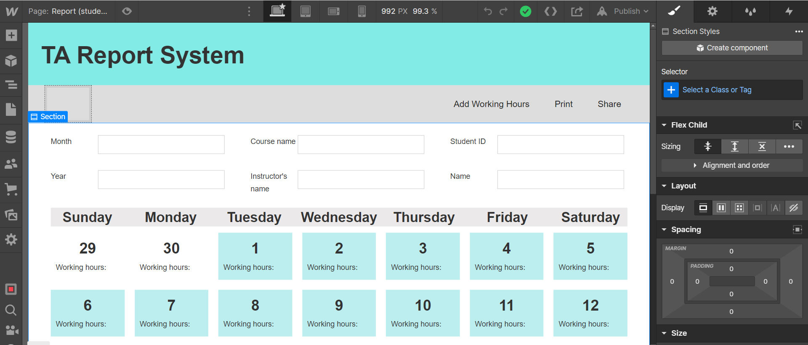
Creativity in Development Process
Using Webflow to design UI and export the code

Slide 11
Contributions
Member | Analysis （hours） | Design （hours） | Coding （hours） | Test （hours） | Total （hours） | LOC* | Work Efficiency
Angelita | 25 | 22.5 | 27 | 2 | 76.5 | 379 | 4.95
Tomohito | 11 | 4 | 4 | 2 | 24 | 10* | 0.42
Total | 36 | 26.5 | 31 | 4 | 100.5 | 389 | 4.43
*not including UI code
2019/1/30
Integrated Exercise for Software II
‹#›

Slide 12
Learning

Slide 13
Angelita
Project management: development process
Analyze requirements, design, implementation
The importance of documentation
New skills
Know about system architecture, learned new programming
language and framework (Django), seeing from both user
and developer’s POV
Version control using GitHub
Working in team
Difficulty of predicting what we can do

Slide 14
Tomohito
learned about Django
how link in django
how to see html file
ask question what I problem

