Slide 1
BANKBOT a chatbot application
-Madhura Bandhe (501766)
-Vinanti Bhoeer (501767)
-Saingel Isaac (501775)
-Uroosa Mukri (501778)

Slide 2
-Chatterbot module
  It is a machine-learning based conversational dialog engine build in Python which makes it possible to generate responses based on collections of known conversations.
-Flask
  It is an API of Python that allows us to build up web-applications.
  -html
  -css

Slide 3
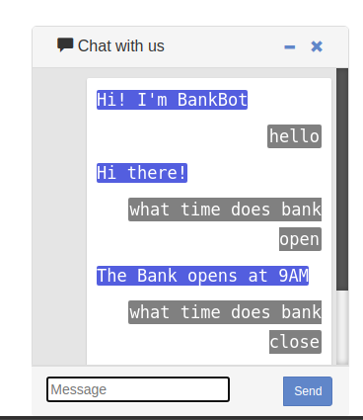
  Incorporated basic datasets and trained them
  -BankBot answers basic operational questions and FAQs

