Slide 1
VISITOUR: A Smart Tourist Guide using Augmented Reality

Slide 2
PROJECT DESCRIPTION
Using VISITOUR as a case study, a mobile application designed to guide tourists within Panaad Park and Stadium. The course demonstrates how digital innovations can enhance visit experiences, promote local culture, and improve tourism services in Panaad. Researchers will explore how AR can provide interactive guides, historical overlays, and real-time navigation for tourists visiting Panaad's landmarks, pavilions, sports facilities, and cultural exhibits. The course falls under the category of ICT for Tourism Development and covers mobile app design, digital mapping, multimedia integration, and user experience enhancement. It equips participants with the knowledge and skills to create smart, engaging, and user-friendly tourism platforms. What makes this course unique is its focus on enriching cultural tourism through immersive technologies, promoting local heritage, and applying smart solutions tailored to the Panaad Park and Stadium environment.

Slide 3
OBJECTIVE
1.Design and develop a mobile application with the following technical features:
1.1. Augmented Reality (AR) Integration for image tracking.
1.2. Multimedia incorporating audio narrations, videos, and digital images.
1.3 Multi-Language Support for the users
1.4 Real-Time Information Updates on event schedules, exhibit details, and festival highlights.
1.5 QR Code-Based Access System
1.6 Interactive Map of Pana-ad Park and Stadium
2. Test the functionality of the above the aforementioned; (IT expert)
3. Evaluate the usability using ISO / CSUQ.

Slide 4
SCOPE AND LIMITATION
The development of VISITOUR focuses on the integration of augmented reality (AR) technology into a mobile application that serves as an interactive tourist guide for Pana-ad. The system includes features such as QR code-based access to download the app, real-time historical and cultural information, AR basedmultimedia for user interaction, and a responsive map for easy navigation. It is designed to be compatible with Android ensuring a user-friendly and improved experience for festival-goers. The primary objective is to enhance visitor engagement through innovative digital tourism solutions while maintaining system efficiency and accessibility.
The system is limited to only inside the Pana-ad Park and Stadium and not extend outside. It requires internet access or mobile data for real-time updates and multimedia content loading. The system also does not support offline navigation. Additionally, the application is only compatible for Android devices.

Slide 5
RESEARCH DESIGN AND RESPONDENST
This study employed a developmental research design. The developmental research design refers to the systematic process of designing, developing, and evaluating a system or product (Richey & Klein, 2019). This method was used to document and evaluate the entire process of developing VISITOUR, from its conceptualization and design to its implementation and testing.
Respondent | Frequency | Percent
Visitors | 1 | 1%
Admin | 99 | 99%
Total | 100 | 100%

Slide 6
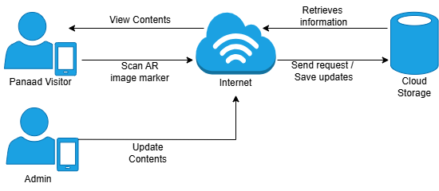
OPERATIONAL FRAMEWORK

Slide 7
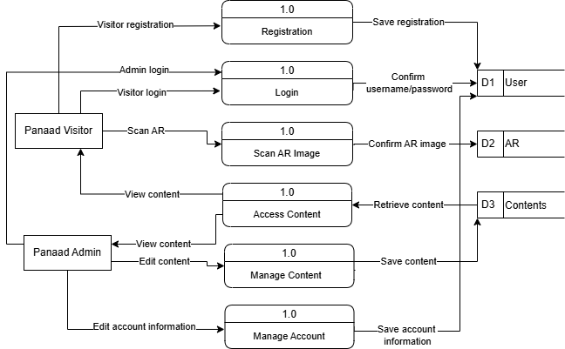
DATA FLOW DIAGRAM

