Slide 1
Thread
執行緒是作業系統能夠進行運算排程的最小單位。

Slide 2
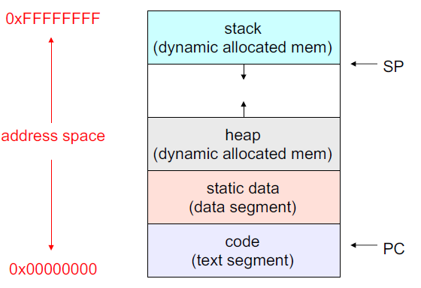
What’s in a process?
A process at least consists of
An address space, containing
The code for the running program
The data for the running program
The process, which defines the address space and general process attributes
Process/ address spaces are just containers in which threads execute
Thread state, consisting of
The program counter (PC), including the next instruction
The stack pointer register (implying the stack it points to)
Other general purpose register values
The thread which defines a sequential execution stream within a process

Slide 3
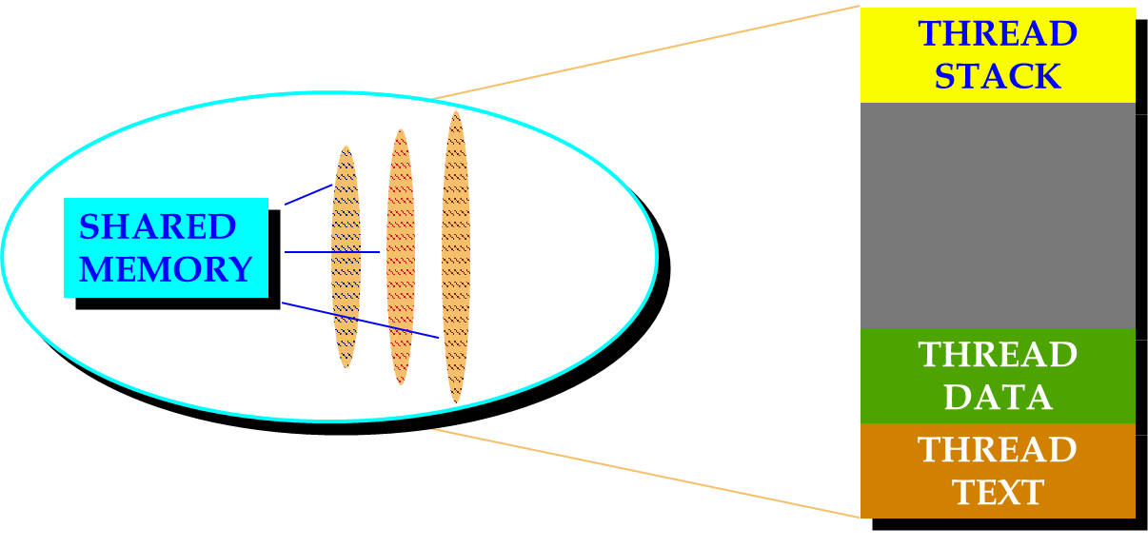
Thread

Slide 4
Thread
Traditional processes have a single thread of control
An abstract data type representing an independent flow of control within a process
A thread is a basic unit of CPU utilization, consisting of a program counter, a stack, and a set of registers, and a thread ID
Could be applied to a process has multiple tasks to perform independently of the others.
If a process has multiple threads of control, it can perform more than one task at a time.
Threads are a way for a program to split itself into two or more simultaneously running tasks.

Slide 5
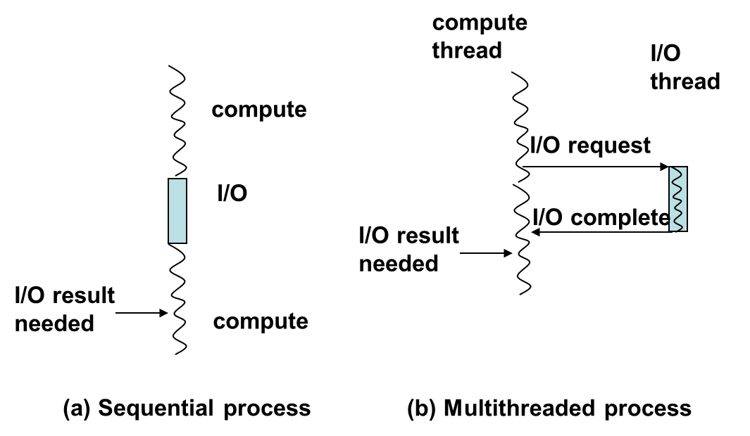
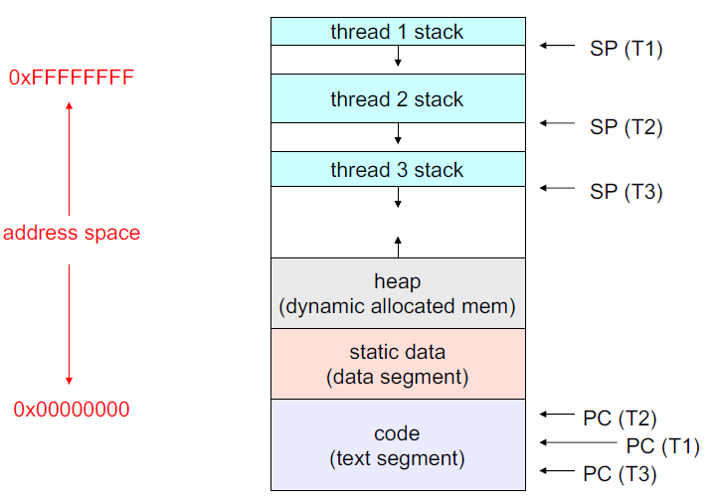
Thread
Better, more abstract, more modular way of solving a problem
Separate computation from I/O

Slide 6
Thread
Thread (light weight process)
A flow of control through an address space
Each address space can have multiple concurrent control flows
Each thread has access to entire address space
Potentially parallel execution, minimal state (low overheads)
May need synchronization to control access to shared variables

Slide 7
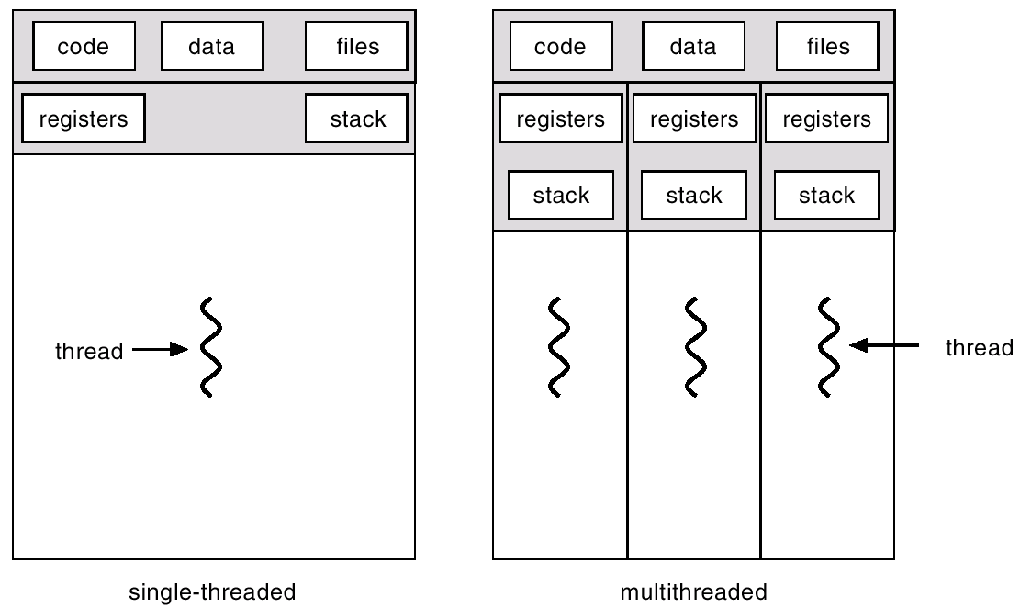
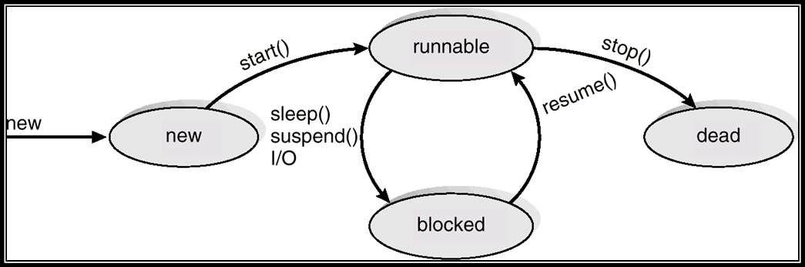
Thread
When a new thread is created, it shares its code section, data section and operating system resources like open files with other threads. But it is allocated its own stack, register set and a program counter.

Slide 8
Why thread
Threads can share common data, they do not use inter-process communication.
Threads can take advantage of multiprocessors.
Threads do not need new address space, global data, program code or operating system resources.
Context switching are fast when working with threads. The reason is that we only have to save and/or restore PC, SP and registers.
For example, they require space to store, the PC, the SP, and the general-purpose registers, but they do not require space to share memory information, Information about open files of I/O devices in use, etc. With so little context, it is much faster to switch between threads. OS uses the context switching technical to schedule the threads so they appear to execute in parallel.

Slide 9
Application benefits of threads
Consider an application that consists of several independent parts that do not need to run in sequence
Each part can be implemented as a thread
Whenever one thread is blocked waiting for an I/O, execution could possibly switch to another thread of the same application (instead of switching to another process)

Slide 10
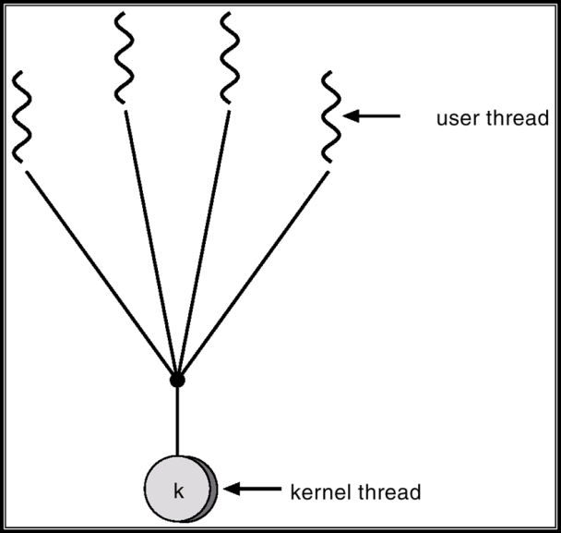
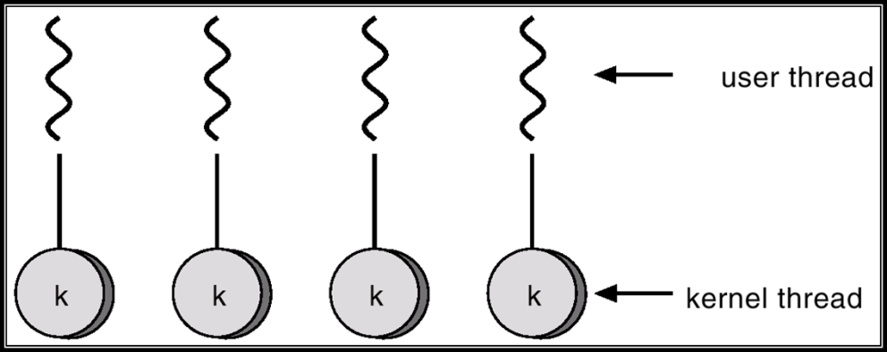
Why not thread
If the kernel is single threaded, a system call of one thread will block the whole process and CPU may be idle during the blocking period.
An extensive sharing among threads there is a potential problem of security. It is quite possible that one thread over writes the stack of another thread (or damaged shared data)

Slide 11
Cannot benefit from threads
Any sequential process that cannot be divided into parallel task will not benefit from thread, as they would block until the previous one completes.

Slide 12
Why Multithreading
Better, more abstract, more modular way of solving a problem
Separate computation from I/O
Take advantage of multiprocessors

Slide 13
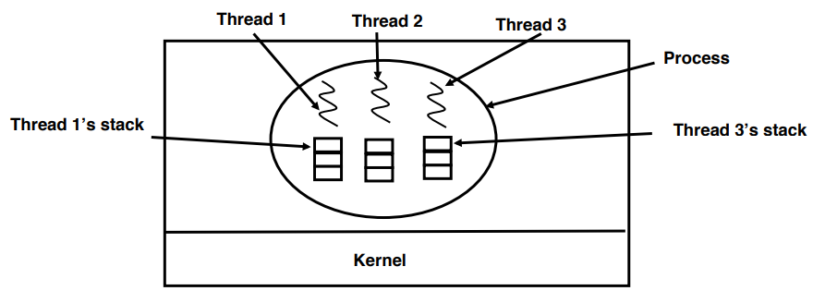
Multithreading
Multiple threads running in parallel in one process is analogous to having multiple processes running in parallel in one computer.
Multiple threads within a process will share
The address space
Open files
Other resources

Slide 14
Multithreading
Multithreading
It extends the idea of multitasking into applications.
We can subdivide specific operations within a single application into individual threads. The OS divides processing time not only among different applications, but also among each thread within an application.
Each of the threads can run in parallel.

Slide 15
Multithreading
Dynamically create threads
Communicate among threads
Synchronize activities of threads
Terminate threads

Slide 16
Benefits of Multithreading
Responsiveness
Multithreading an interactive application may allow a program to continue running even if part of it is blocked or performing a lengthy operation.
Resource Sharing
Sharing the address space and other resources may result in high degree of cooperation
Economy
Creating / managing processes is much more time consuming than managing threads.
Scalability
A single threaded process can only run on one CPU, no matter how many may be available, whereas the execution of a multi-threaded application may be split amongst available processors.
Better Utilization of Multiprocessor Architectures

Slide 17
Benefits of Multithreading
Benefits
More efficient CPU use
Better system reliability
Improved performance on multiprocessor computers
Example
A long round-trip work in a single thread with synchronous call may block or prevent any other task within the application from executing until the operation completes.
Improve:
The above synchronous call runs on one thread, other parts of the program that do not depend on this call runs on different threads.

Slide 18
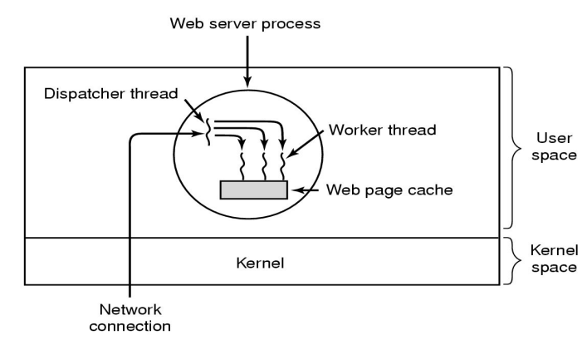
Benefits of Multithreading
Ex: In a word processor,
A background thread may check spelling and grammar
A foreground thread processes user input ( keystrokes )
A third thread loads images from the hard drive
A fourth does periodic automatic backups of the file being edited
A multithreaded web server

Slide 19
Process/thread separation
Concurrency (multithreading) is useful for:
handling concurrent events (e.g., web servers and clients)
building parallel programs (e.g., matrix multiply, ray tracing)
improving program structure (the Java argument)
Multithreading is useful even on a uniprocessor
even though only one thread can run at a time
Supporting multithreading – that is, separating the concept
of a process (address space, files, etc.) from that of a minimal thread of control (execution state), is a big win
– creating concurrency does not require creating new processes
– “faster / better / cheaper”

Slide 20
User-level Threads
User-level threads implement in user-level libraries, rather than via systems calls, so thread switching does not need to call operating system and to cause interrupt to the kernel.
It implies that create a thread, switch between threads and synchronization between threads can all be done without intervention of the kernel.
Each thread is represented simply by a PC, registers, stack and a small control block, all stored in the user process address space.

Slide 21
Kernel-level threads
Instead of thread table in each process, the kernel has a thread table that keeps track of all threads in the system.
Because kernel has full knowledge of all threads, Scheduler may decide to give more time to a process having large number of threads than process having small number of threads.
The kernel-level threads are slow and inefficient. For instance, threads operations are hundreds of times slower than that of user-level threads.
Since kernel must manage and schedule threads as well as processes. It require a full thread control block (TCB) for each thread to maintain information about threads. As a result there is significant overhead and increased in kernel complexity.

Slide 22
Kernel-level threads
OS now manages threads and processes / address spaces
all thread operations are implemented in the kernel
OS schedules all of the threads in a system
• if one thread in a process blocks (e.g., on I/O), the OS knows about
it, and can run other threads from that process
• possible to overlap I/O and computation inside a process
• Kernel threads are cheaper than processes
– less state to allocate and initialize
• But, they’re still pretty expensive for fine-grained use
– orders of magnitude more expensive than a procedure call
– thread operations are all system calls
• context switch
• argument checks
– must maintain kernel state for each thread

Slide 23
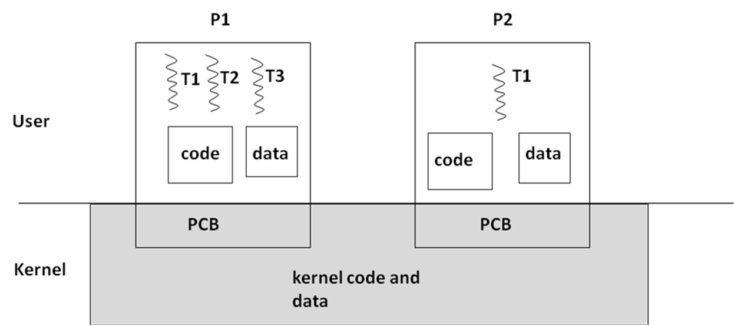
OS Support for Threads

Slide 24
Context Switching among threads compared to among processes
Action of kernel to context switch among threads
The threads share a lot of resources with other peer threads belonging to the same process. So a context switch among threads for the same process is easy. It involves switch of register set, the program counter and the stack. It is relatively easy for the kernel to accomplished this task.
Action of kernel to context switch among process
Context switches among processes are expensive. Before a process can be switched its process control block (PCB) must be saved by the operating system. The PCB consists of the following information:
The process state.
The program counter, PC.
The values of the different registers.
The CPU scheduling information for the process.
Memory management information regarding the process.
Possible accounting information for this process.
I/O status information of the process.
When the PCB of the currently executing process is saved the operating system loads the PCB of the next process that has to be run on CPU. This is a heavy task and it takes a lot of time.

Slide 25
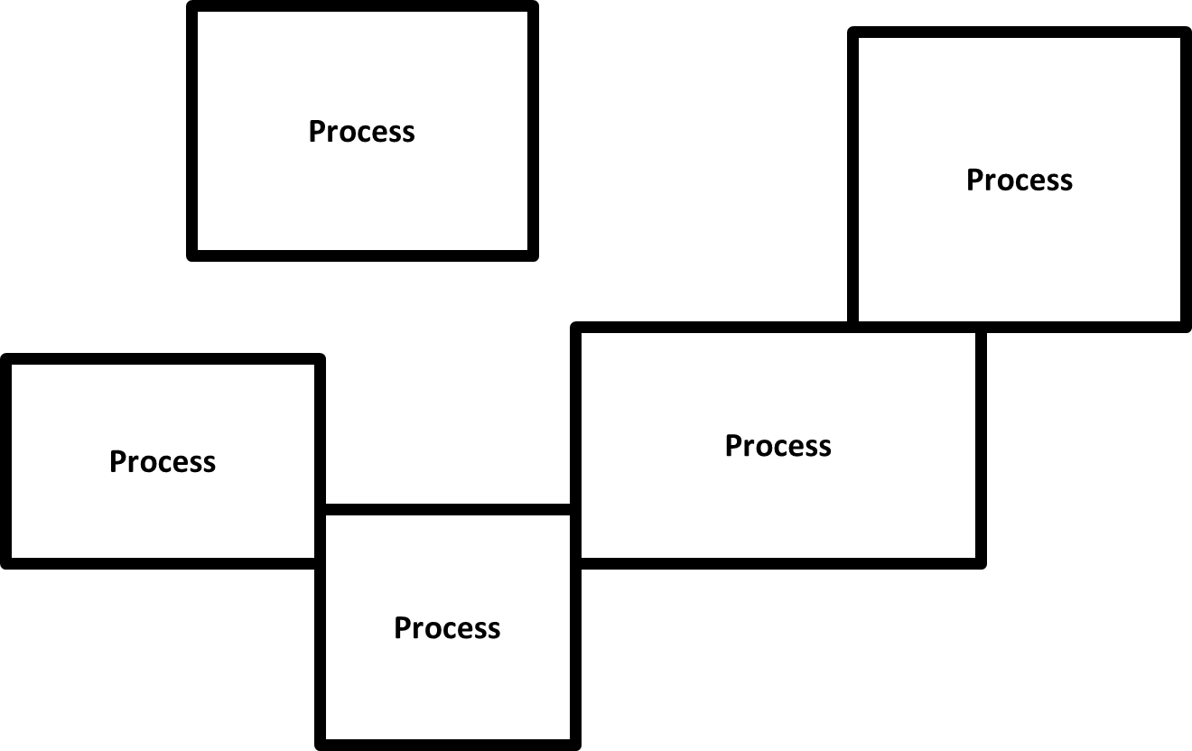
Processes
Processes are protected

Slide 26
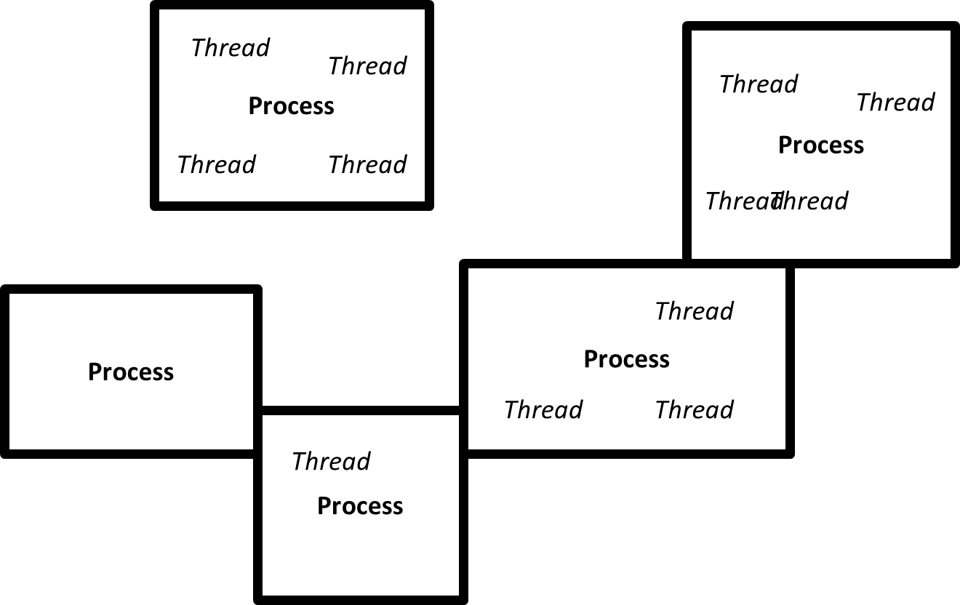
Multithreading
Multiple threads can exist in a single process space

Slide 27
Thread Creating
A thread executes some portion of a program
Just like a program it has an entry point or a point where it begins execution
When a thread is created this entry point is defined usually as the address of some function

Slide 28
Thread Terminating
Thread automatically terminates when it exits the top-level procedure that it started in.

Slide 29

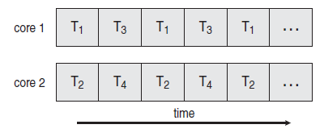
Thread: Concurrency vs. Parallelism
Threads are about concurrency and parallelism
Concurrent execution on single-core system
Parallelism on a multi-core system

Slide 30
Threads
Threads are about concurrency and parallelism
One way to get concurrency and parallelism is to use
multiple processes
The programs (code) of distinct processes are isolated from each other
Threads are another way to get concurrency and parallelism
Thread share a process – same address space, same OS resources
Threads have private stack, CPU state – are schedulable

Slide 31
Communication
Threads are concurrent executions sharing an address space (and some OS resources)
Address spaces provide isolation
Hence, communicating between processes is expensive
Must go through the OS to move data from one address space to another
Because threads are in the same address space, communication is simple/cheap
Just update a shared variable

Slide 32
Where do threads come from
Natural answer: the OS is responsible for creating/managing threads
For example, the kernel call to create a new thread would
allocate an execution stack within the process address space
create and initialize a Thread Control Block
stack pointer, program counter, register values
stick it on the ready queue
We call these kernel threads
There is a “thread name space”
Thread id’s (TID’s)
TID’s are integers

Slide 33
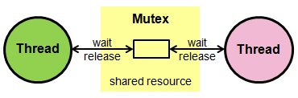
Locks
The basic premise is that a lock protects access to some kind of shared resource. If you own a lock then you can access the protected shared resource. If you do not own the lock then you cannot access the shared resource.
For example, if you have a lockable object XYZ you may:
acquire the lock on XYZ,
take the lock on XYZ,
lock XYZ,
take ownership of XYZ,
or some similar term specific to the type of XYZ

Slide 34
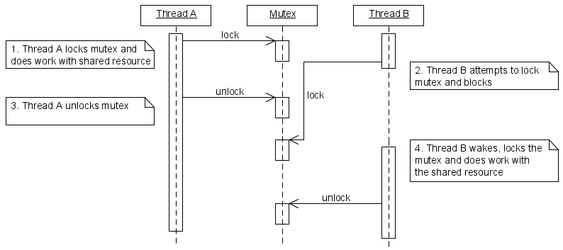
Locks

Slide 35
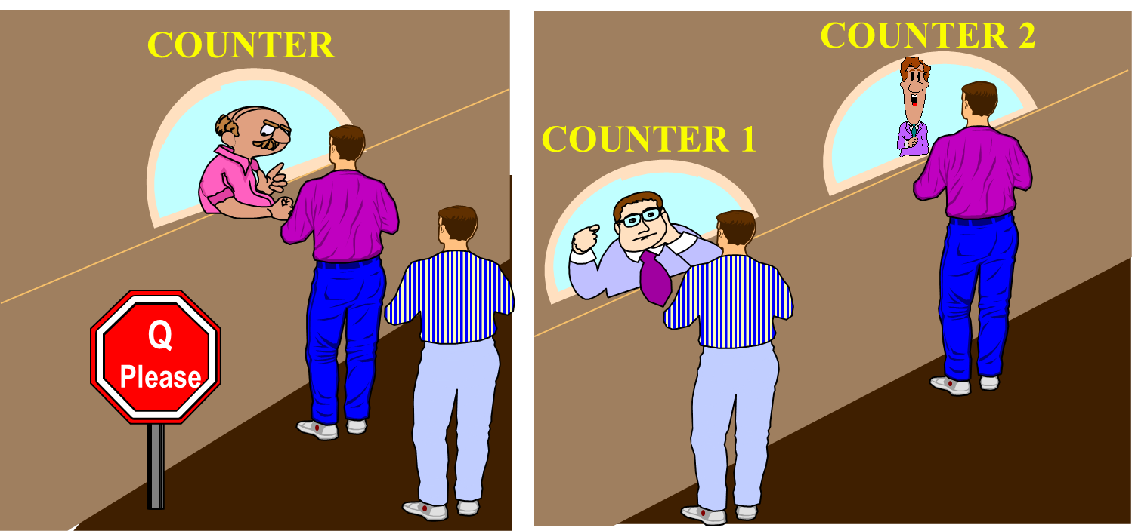
Locks
The concept of a lock also implies some kind of exclusion
sometimes you might be unable to take ownership of a lock, and the operation to do so will either fail, or block.
For example if a lockable object only allows 3 owners then a 4th attempt to acquire the lock will block. When one of the first 3 owners releases the lock then that 4th attempt to acquire the lock will succeed.

Slide 36
Ownership
The specific thread owns the lock, through the use of that specific object, within this particular scope

Slide 37
Thread synchronization
Most of threaded programs have threads that interact with one another
Interaction in the form of sharing access to variables
Multiple concurrent reads (ok)
Multiple concurrent writes (not ok, outcome non-deterministic)
One write, multiple reads (not ok, outcome non-deterministic)
Needs to make sure that the outcome is deterministic
Synchronization: allowing concurrent accesses to variables, removing non-deterministic outcome by enforcing the order of thread execution

Slide 38
Thread synchronization
Typical types of synchronizations
Mutual exclusion (mutex in pthread):
Thread 1:
insert A to tree
Thread 2:
insert B to tree
Thread 1:
lock(tree)
insert A to tree
unlock(tree)
Thread 2:
lock(tree)
insert A to tree
unlock(tree)

Slide 39
Thread synchronization
Signal (ordering the execution of threads, condition variable)
Thread 1: Thread 2: Thread 3:
for (i=0; i<25; i++) for (i=25; i<50; i++) for (i=50; i<75;i++)
a(i+1) = a(i)+1 a(i+1) = a(i) +1; a(i+1) = a(i)+1;
Thread 1: Thread 2: Thread 3:
for (i=0; i<25; i++)
a(i+1) = a(i)+1
signal a(25) ready
wait for a(25) ready
for(i=25;i<50;i++)
a(i+1) = a(i)+1
signal a(50) ready
wait for a(50) ready
……

Slide 40
A pthread example
int counter = 0;
void *thread_producer(void *arg)
{
int val;
/* produce a product */
counter++;
return NULL;
}
Could there be any problem in this code?

Slide 41
An example
int counter = 0;
void *thread_producer(void *arg)
{
int val;
/* produce a product */
counter++; /* this may not be atomic */
return NULL;
}
Most constructs in the high level language are not atomic!!
Need to make them atomic explicitly in a threaded program. Solution: mutex

Slide 42
Mutex variables
Mutex = abbreviation for “mutual exclusion”
Primary means of implementing thread synchronization and protecting shared data with multiple concurrent writes
A mutex variable acts like a lock
Multple threads can try to lock a mutex, only one will be successful; other threads will be blocked until the owning thread unlock that mutex

Slide 43
Mutex variables
A typical sequence in the use of a mutex is as follows:
Create and initialize a mutex variable
Several threads attempt to lock the mutex
Only one succeeds and that thread owns the mutex
The owner thread performs some set of actions
The owner unlocks the mutex
Another thread acquires the mutex and repeats the process
Finally the mutex is destroyed

Slide 44
Mutex operations
Creation:
pthread_mutex_t my = PTHREAD_MUTEX_INITIALIZER
Destroying:
pthread_mutex_destroy(pthread_mutex_t *mutex);
Locking and unlocking mutexes
pthread_mutex_lock(pthread_mutex_t *mutex);
pthread_mutex_trylock(pthread_mutex_t *mutex);
pthread_mutex_unlock(pthread_mutex_t *mutex);

Slide 45
Mutex example
int counter = 0;
ptread_mutex_t mutex = PTHREAD_MUTEX_INITIALIZER;
void *thread_func(void *arg)
{
int val;
/* protected by mutex */
Pthread_mutex_lock( &mutex );
val = counter;
counter = val + 1;
Pthread_mutex_unlock( &mutex );
return NULL;
}
How about
Making mutex a local variable?

Slide 46
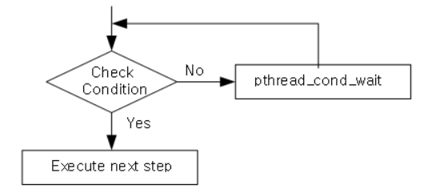
Condition Variable
Waiting and signaling on condition variables
Routines
pthread_cond_wait(condition, mutex)
Blocks the thread until the specific condition is signalled.
Should be called with mutex locked
Automatically release the mutex lock while it waits
When return (condition is signaled), mutex is locked again
pthread_cond_signal(condition)
Wake up a thread waiting on the condition variable
The thread is chosen non-deterministically
Called after mutex is locked, and must unlock mutex after
pthread_cond_broadcast(condition)
Used when multiple threads blocked in the condition

Slide 47
Condition Variable – for signaling
Think of Producer – consumer problem
Producers and consumers run in separate threads.
Producer produces data and consumer consumes data.
Producer has to inform the consumer when data is available
Consumer has to inform producer when buffer space is available

Slide 48
/* Globals */
int data_avail = 0;
pthread_mutex_t data_mutex = PTHREAD_MUTEX_INITIALIZER;
void *producer(void *)
{
Pthread_mutex_lock(&data_mutex);
Produce data
Insert data into queue;
data_avail=1;
Pthread_mutex_unlock(&data_mutex);
}

Slide 49
void *consumer(void *)
{
while( !data_avail );
/* do nothing – keep looping!!*/
Pthread_mutex_lock(&data_mutex);
Extract data from queue;
if (queue is empty)
data_avail = 0;
Pthread_mutex_unlock(&data_mutex);
consume_data();
}

Slide 50
int data_avail = 0;
pthread_mutex_t data_mutex = PTHREAD_MUTEX_INITIALIZER;
pthread_cont_t data_cond = PTHREAD_COND_INITIALIZER;
void *producer(void *)
{
Pthread_mutex_lock(&data_mutex);
Produce data
Insert data into queue;
data_avail = 1;
Pthread_cond_signal(&data_cond);
Pthread_mutex_unlock(&data_mutex);
}

Slide 51
void *consumer(void *)
{
Pthread_mutex_lock(&data_mutex);
while( !data_avail ) {
/* sleep on condition variable*/
Pthread_cond_wait(&data_cond, &data_mutex);
}
/* woken up */
Extract data from queue;
if (queue is empty)
data_avail = 0;
Pthread_mutex_unlock(&data_mutex);
consume_data();
}

Slide 52
Semaphores
Semaphores are a kind of generalized lock
First defined by Dijkstra in late 60s
Main synchronization primitive used in original UNIX
Definition: a Semaphore has a non-negative integer value and supports the following two operations:
P(): an atomic operation that waits for semaphore to become positive, then decrements it by 1等待信號量變為正數的原子操作，然後將其減1
Think of this as the wait() operation可以將其視為wait（）操作
V(): an atomic operation that increments the semaphore by 1, waking up a waiting P, if any它將信號量遞增1
This of this as the signal() operation

Slide 53
Semaphores Like Integers Except
Semaphores are like integers, except
No negative values
Only operations allowed are P and V – can’t read or write value, except to set it initially
Operations must be atomic
Two P’s together can’t decrement value below zero
Similarly, thread going to sleep in P won’t miss wakeup from V – even if they both happen at same time
Semaphore from railway analogy
Here is a semaphore initialized to 2 for resource control:
Value=2
Value=1
Value=0
Value=1
Value=0
Value=2

