Slide 1
Irrlicht
Software rendering introduction
Chen Liang

Slide 2
What is Irrlicht
The Irrlicht Engine is an open source high performance realtime 3D engine written in C++. It is completely cross-platform, using D3D, OpenGL and its own software renderers, and has all of the state-of-the-art features.
http://irrlicht.sourceforge.net/
open source
cross-platform using C++
multi driver support
feature set & easy to use

Slide 3
What we are gonna cover today?
Software rendering modules
Irrlicht made an abstraction about the lower level rendering implementation, it supports:
1 Open GL
2 DirectX
3 Reference implementation(S)
4 Burning Video(S)
(S) Means software rendering
Reference implementation
Burning Video

Slide 4
Traditional rendering pipeline
Model space-> World space -> Camera space -> Projection space->Screen space

Slide 5
What is space?
Space uses coordinate system to describe geometry attributes of an object, the values in a coordinate means the length in the corresponding axis.
So it’s a dot product with the axis normal.
In 3d space, we can use 3 mutually perpendicular axis to describe a space.

Slide 6
Model space-> World space
World space is the stage.
Irrlicht uses SceneObject to manage objects in the scene, the system is kind of like how flash manages the display objects.
So you can use like scale, translate & rotate to put an object in the scene.

Slide 7
World space -> Camera space
What are the 3 axis for the camera space?
1 look at
2 up
3 3rd axis
lookat = target – position
up = whatever you like
3rd = lookat x up
up = 3rd x lookat
What about the translates?

Slide 8
Camera space->Projection space
It’s perspective projection actually, simulating how human eyes see the world, things that are farther away look smaller.
aspect ratio = width / height (ar for short)
yp = y*d / z
xp = x*d / (ar * z)
d = 1 / tan(viewAngle/2)
x ->[-1, 1]
y->[-1, 1]
what about z?
z is used for sorting definitely useful and we can limit z -> [-1, 1] or [0, 1]
we can make the clipping easier.
| d/ar 0 0 0|
| 0 d 0 0|
| 0 0 A B|
| 0 0 1 0|
that means z is saved in the w,
f(z) = A + B/z, put zNear & zFar in to solve the A & B, you get your projection matrix.

Slide 9
Projection space->Screen space
now the x & y coordinates are both within [-1, 1], the transform will be
widthHalf = width / 2
heightHalf = height / 2
xFinal = x*widthHalf + widthHalf + xOffset
yFinal = -y*heightHalf + heightHalf + yOffset
x & y offset means you can translate the render result in your screen

Slide 10
Tips
matrix is not a must in software rendering but only rendering fast enough is useful, you can save operations without using matrix, but you lose hardware acceleration.

Slide 12
Superior Text
Soft Shadow
Text in PowerPoint 2007 has learned new tricks. There are handy features like strikethrough and advanced features like character spacing control. And you’ll look your best with soft shadows and the ability to put “WordArt” styles right onto your slide text.
Effects
Kerning
Character Spacing
Styled Underline
Strikethrough

Slide 13
The Power of OfficeArt Graphics
Make a statement with great looking graphics. PowerPoint makes it easy to produce visuals that used to require multiple applications to accomplish. Easily apply soft shadows, reflections, glows, bevels, 3D and more!
Soft Shadow
Reflection
Bevel
3D

Slide 14
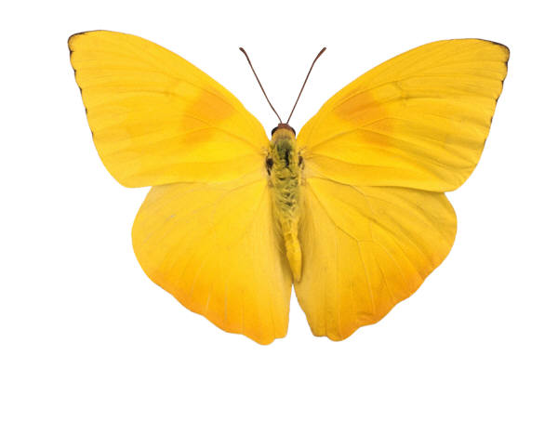

Picture This…
You can do a lot more with pictures in PowerPoint 2007. Easily recolor pictures or change the shape of their frame. And all of OfficeArt’s effects can be applied to a picture – even 3D!

Slide 15
SmartArt

Slide 16
Visualize It!
Business Process
Operate
Support
Optimize
Change
SmartArt turns your bullet points into graphics in a single click. You can even change your graphic layout to find just the right way to express your idea.

Slide 17
Business Process
Operate
Support
Optimize
Change

Slide 18
Business Process
Operate
Support
Optimize
Change

Slide 19
Themes & Quick Styles

Slide 20
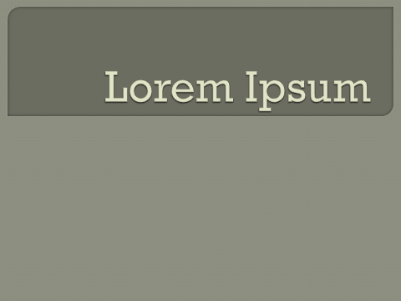
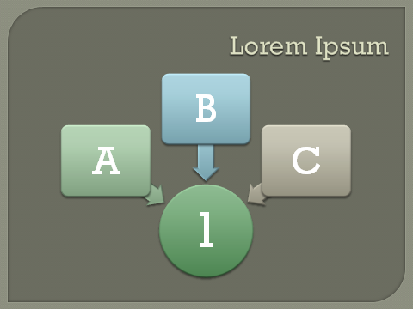
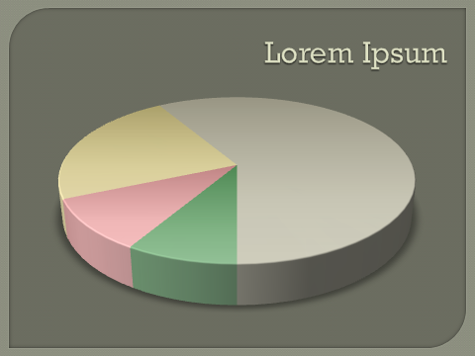
Get Coordinated with Themes!
Office Themes give you effortless coordination of the colors, fonts and graphic effects applied to your presentation. Everything you insert into your presentation will be automatically styled to match.

Slide 21
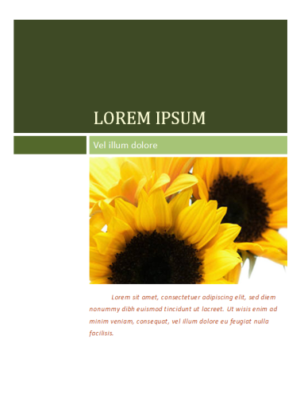
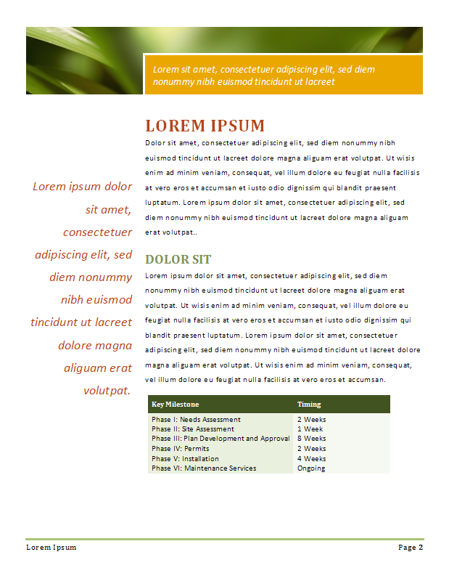
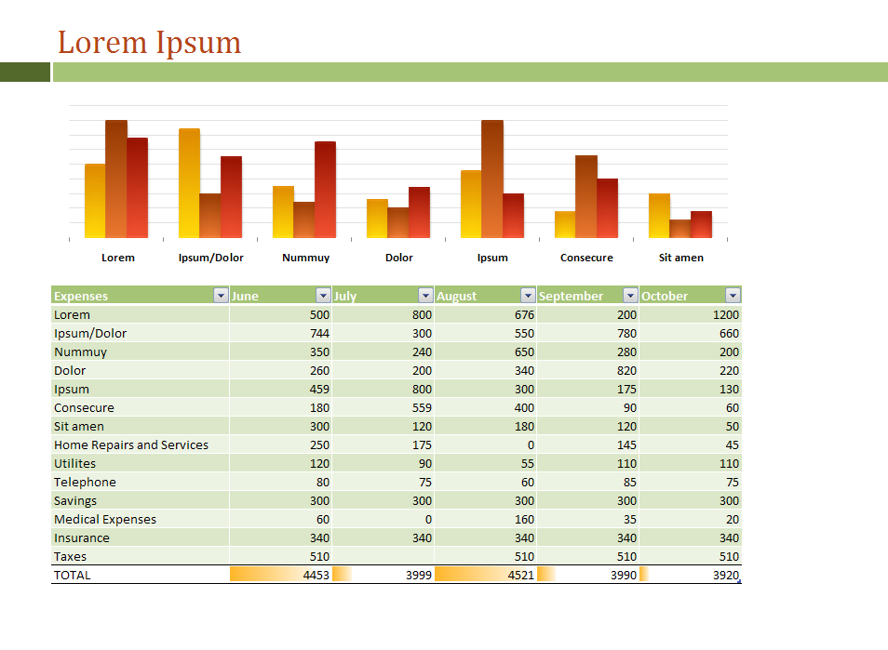
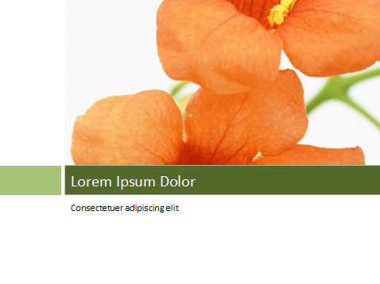
Word and Excel, too!
PowerPoint now shares a common set of “Office Themes” with Word and Excel so you can create documents and spreadsheets that match your presentation for a “branded” look.

Slide 22
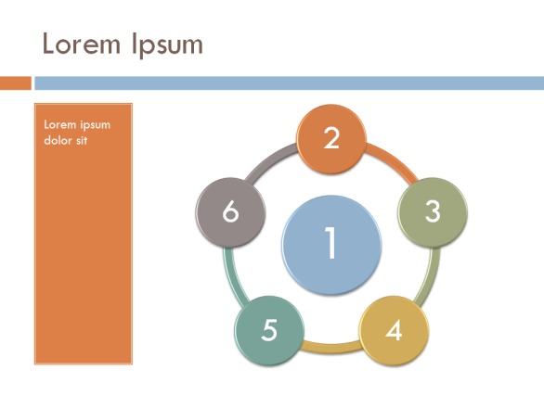
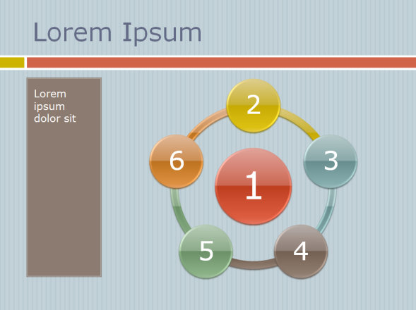
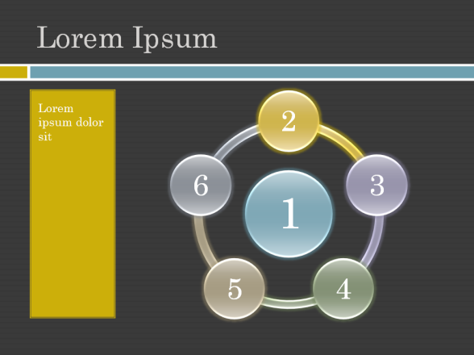
Mix It Up!
Office Themes are infinitely customizable. You can mix and match the colors, fonts and effects from different themes.

Slide 23
Quick Styles
1
2
3
4
5
There is a spectrum of designer styles for every chart, diagram, table or picture you add to your presentation. In a single click you can go from understated to wow or anywhere in between.
1 | 2 | 3
1 | 2 | 3
1 | 2 | 3
1
2
3
4
5
1 | 2 | 3
1 | 2 | 3
1 | 2 | 3
1
2
3
4
5
1 | 2 | 3
1 | 2 | 3
1 | 2 | 3

Slide 24
New Layouts

Slide 25
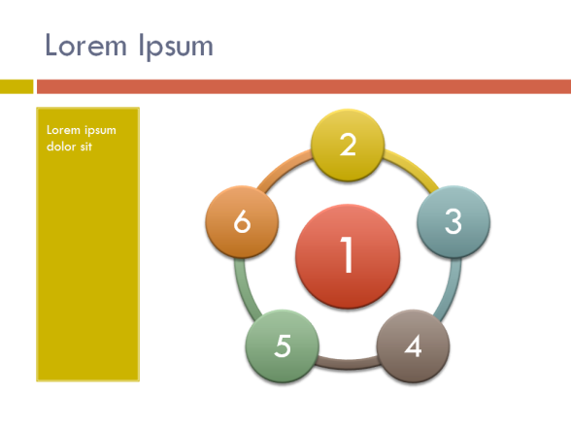
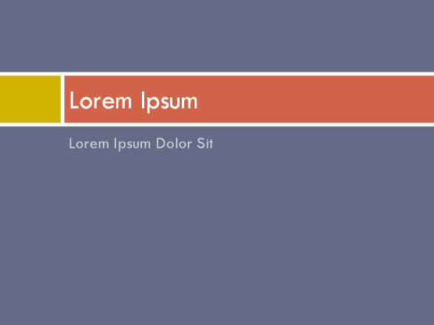
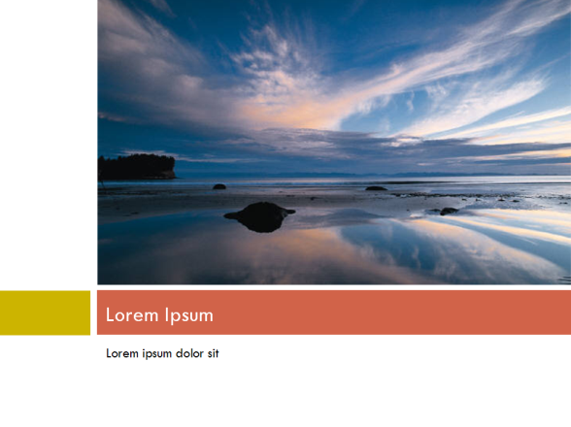
Slide Perfect!
PowerPoint has new layouts that give you more ways to present your words, images and media.
Everything you add into the layout placeholders is arranged perfectly for you.

Slide 26
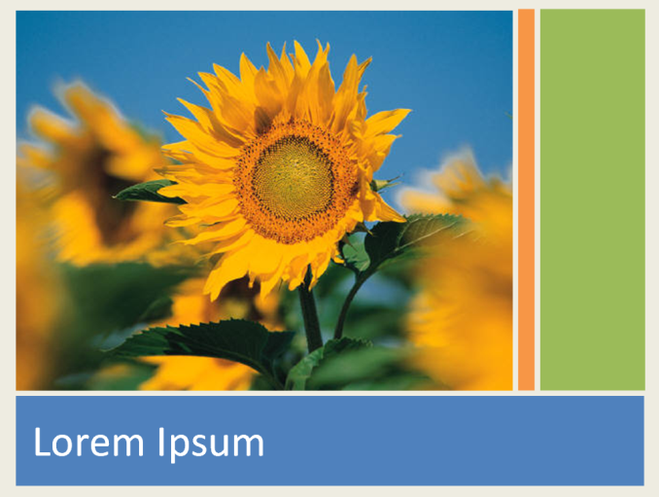
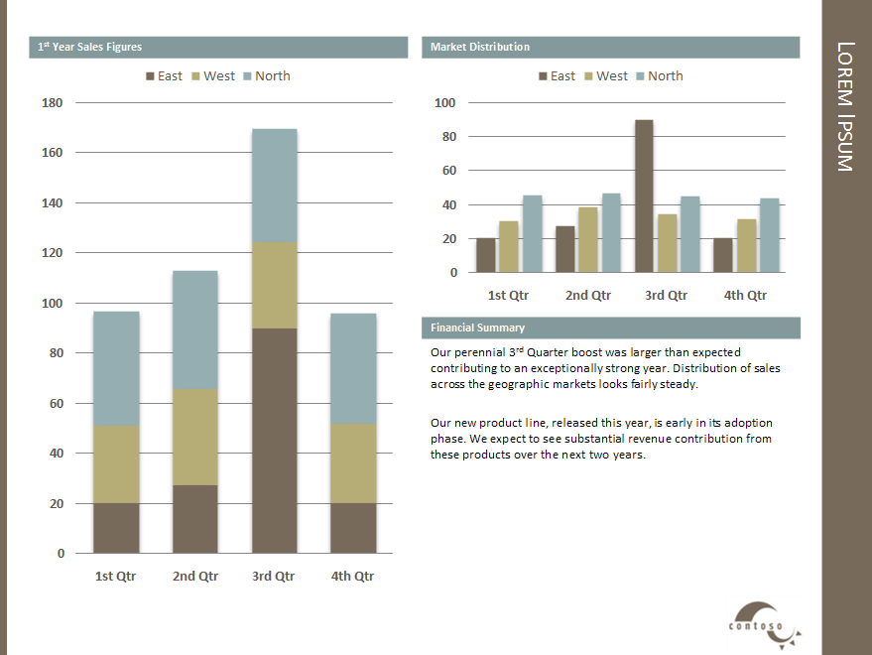
Arrange it Your Way
With custom layouts you design your own slide arrangements. You can create new kinds of documents with PowerPoint. Easily create everything from business pitchbooks to family photo albums.

