Slide 1

"ITghurls"

Slide 2

Introduction to BOOOM - paniiiittt

Slide 3
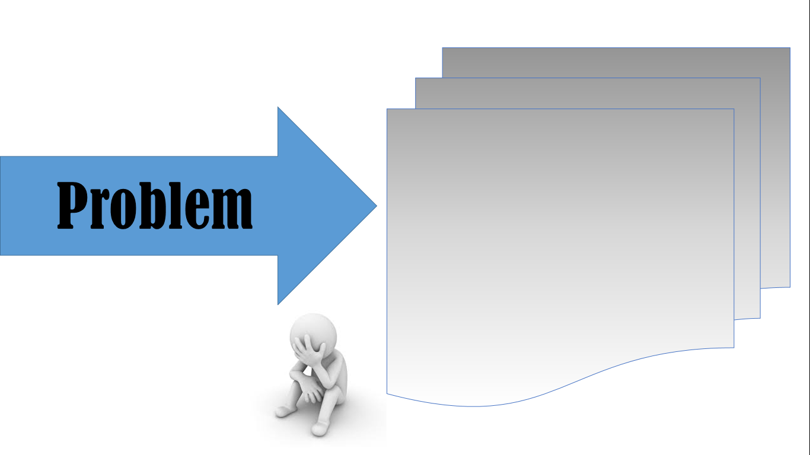
- LABLAB -

Slide 4

"BOOOM" BOOOM - paniiiittt

Slide 5

Benefits :
Features :
- khjadsjhk
- akjdhk

