Slide 1

"Pitchitup"

Slide 2

Introduction to kasjhdkahas

Slide 3
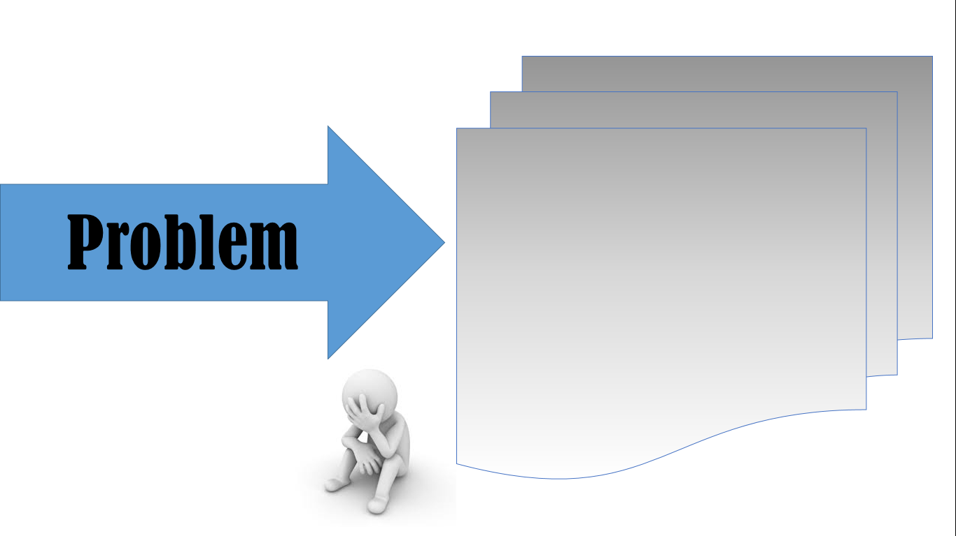
- kashdkas -

Slide 4

"Kasjhdkahas" Kasjhdkahas

Slide 5

Benefits :
Features :
- asdkh
- askdjh

