Slide 1

"ITghurls"

Slide 2

Introduction to money - bacbascijkbcijn

Slide 3
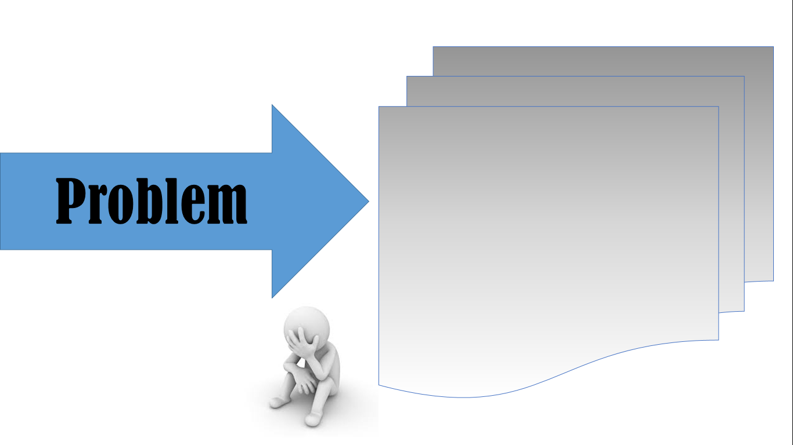
- i need money.. loads of them. -

Slide 4

"Money" Money - bacbascijkbcijn

Slide 5

Benefits :
Features :
- test
- test

