Slide 1

"Pitchitup"

Slide 2

Introduction to Pitchitup - platform as-a-service for startup pitch deck

Slide 3

What is the Problem ?
- Failed to do pitch deck -

Slide 4

Our Solution
"Pitchitup" Pitchitup - platform as-a-service for startup pitch deck

Slide 5

Benefits :
Features :
- simple
- download

Slide 6

The Market
Channels :
- pitchitup.com

Slide 7

- generate pitch deck

Slide 8
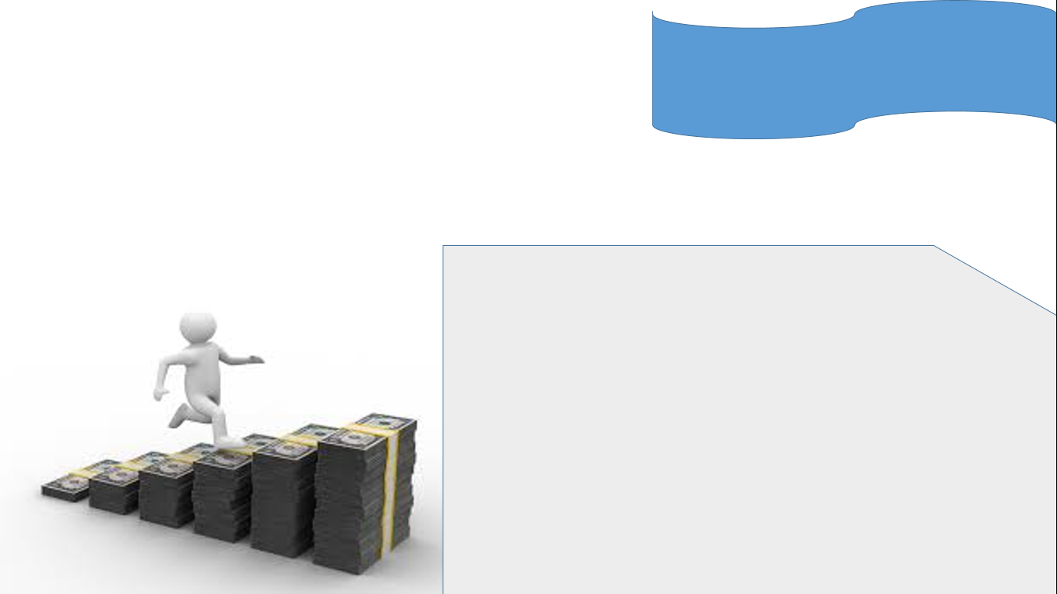
How to make money ?
Revenue Streams :
- premium

Slide 9

Competitors Analysist:
- slidebean

