Slide 1

"Pitchitup"

Slide 2

Introduction to Pitchitup - platform as-a-service for startup pitch deck

Slide 3
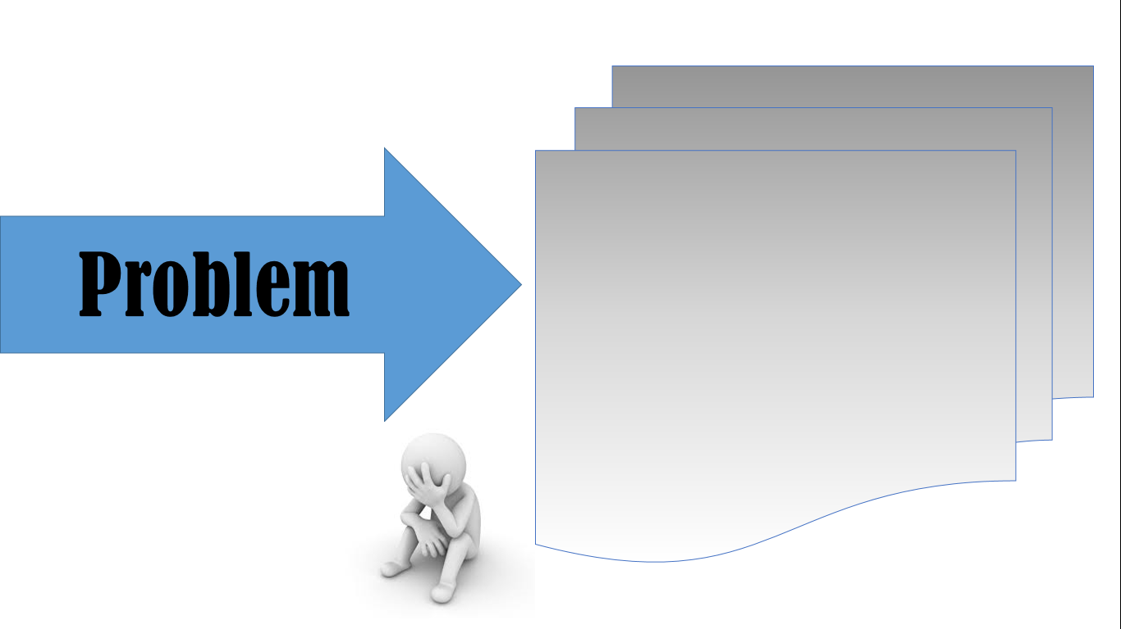
- Failed to do pitch deck -

Slide 4
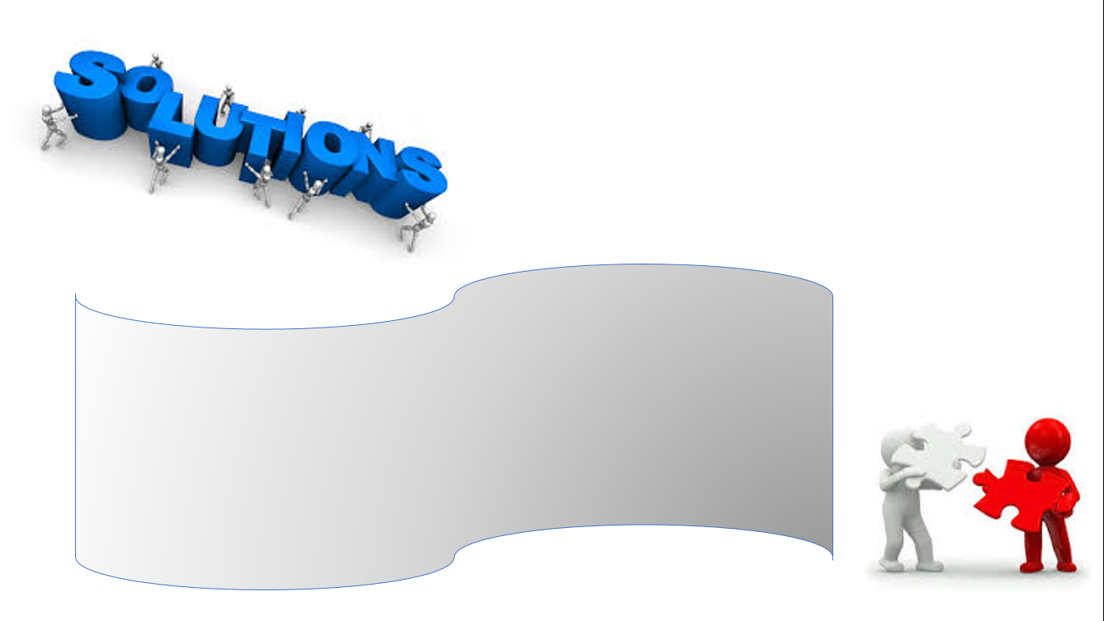
"Pitchitup" Pitchitup - platform as-a-service for startup pitch deck

Slide 5

Benefits :
Features :
- simple
- download

