Slide 1

"Pitchitup"

Slide 2

Introduction to

Slide 3
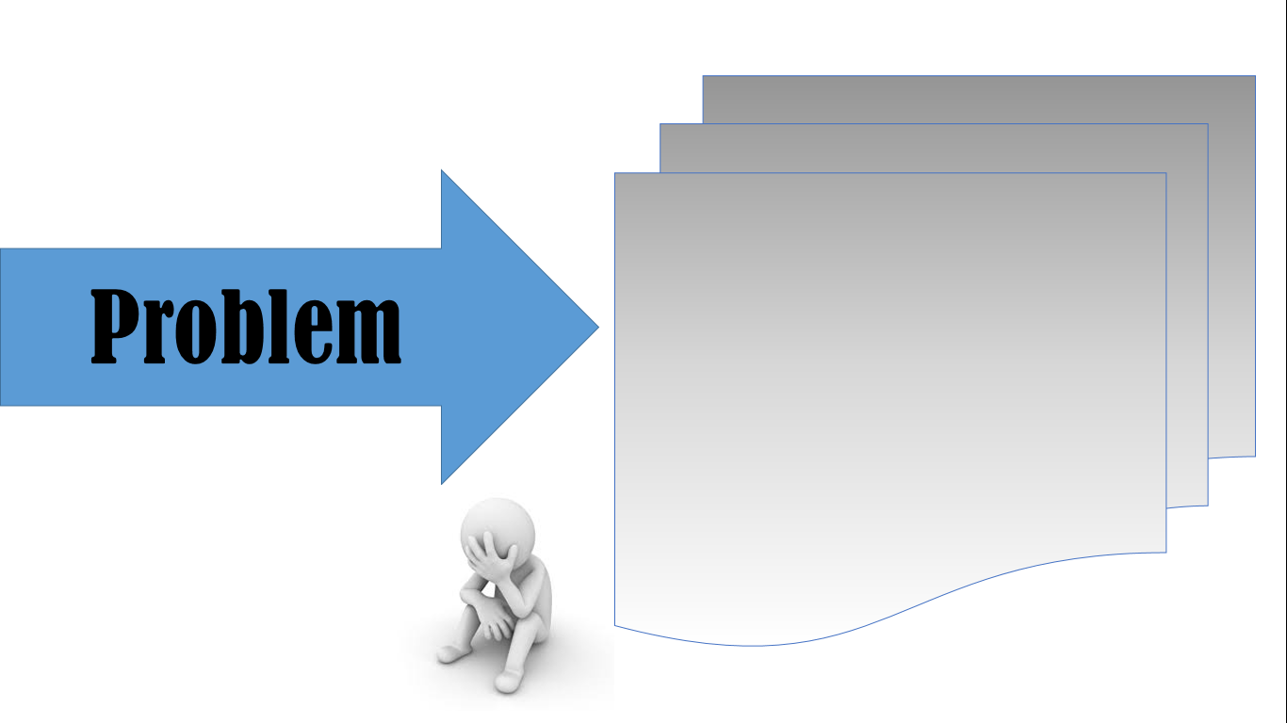
- asdkh -

Slide 4

""

Slide 5

Benefits :
Features :
- asdkj
- asd,kj

