Slide 1
MULTI-FACTOR Authentication by asynchronous token and sMS

Slide 2
Need of mfa
Reduce security breach
Increase levels of security
Combines authentication by knowledge and ownership

Slide 3
How mfa is achieved
Identification with user credentials
SMS with challenge question to user’s mobile phone, using Twilio helper library
Mobile application as the asynchronous token to generate response key

Slide 4
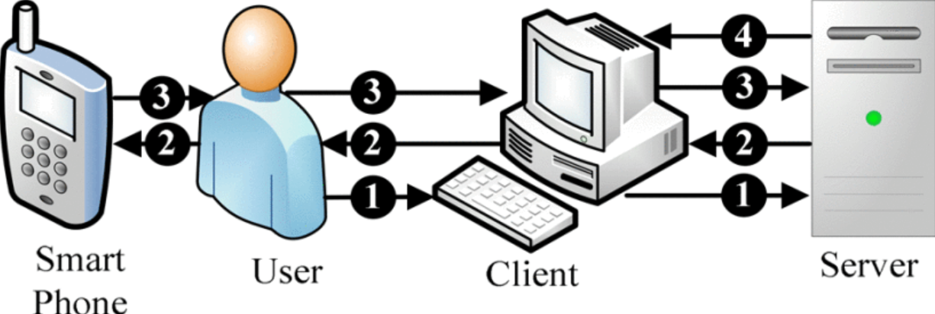
Mfa framework
Identification with user credentials.
SMS with challenge question to user’s registered number.
Mobile application acts as the asynchronous token to generate response key

Slide 5
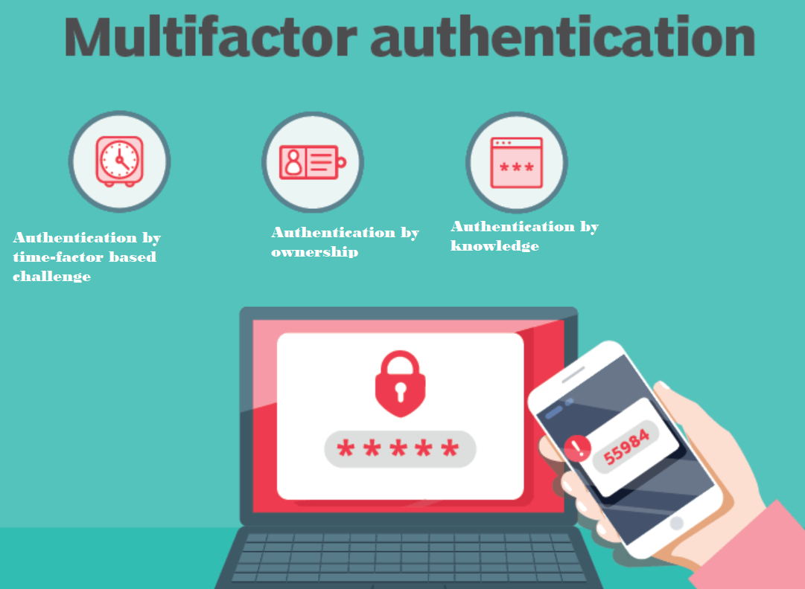
MFA Technologies
Authentication by time factor-based challenge
Authentication by ownership
Authentication by knowledge

Slide 6
Identification with user credentials
Users with valid credentials alone, passes the first step of authentication.
Credentials are :
User-name
Password

Slide 7
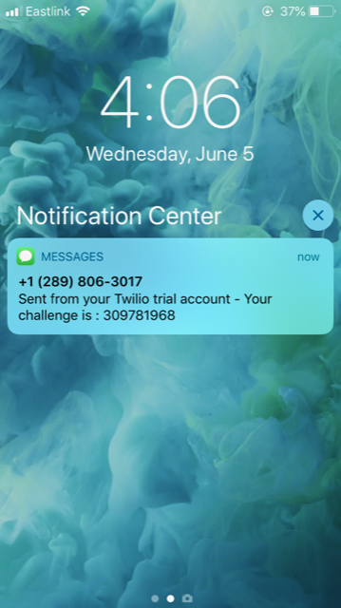
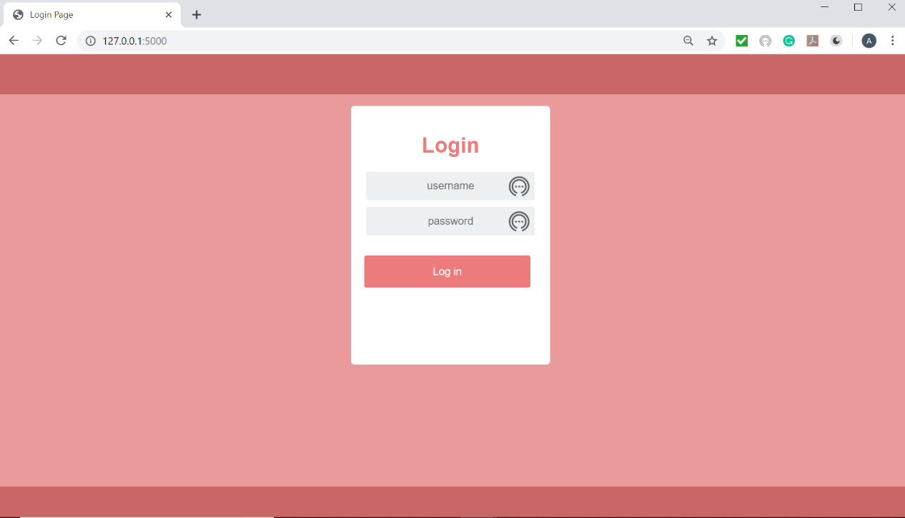
Login page and SMS received on user mobile
SMS contains time factor-based challenge question

Slide 8
Challenge question
Challenge question generation :
Encrypt the combination of time factor and random number
Key of encryption – base64 encoded value of user pin
Hash the value of encrypted combination

Slide 9
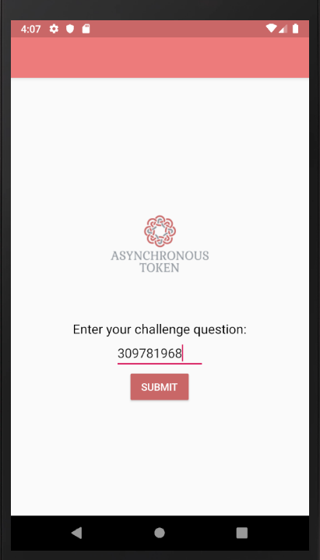
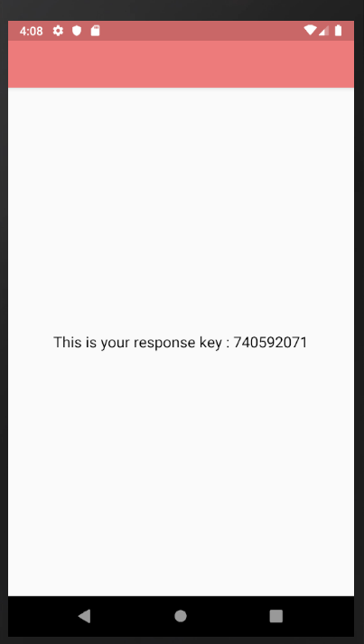
Asynchronous soft token
Input : Challenge question
Output : Response key

Slide 10

Response key
Hashed value of the challenge question
hashCode() method in Java is used to generate the value

Slide 11
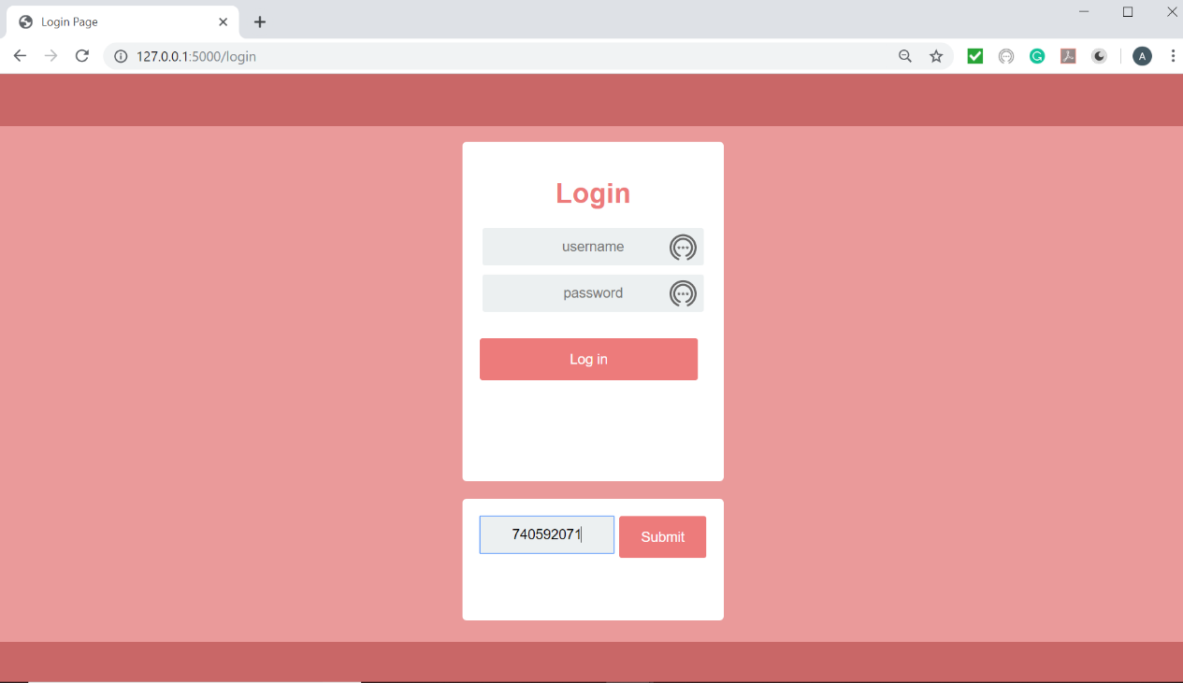
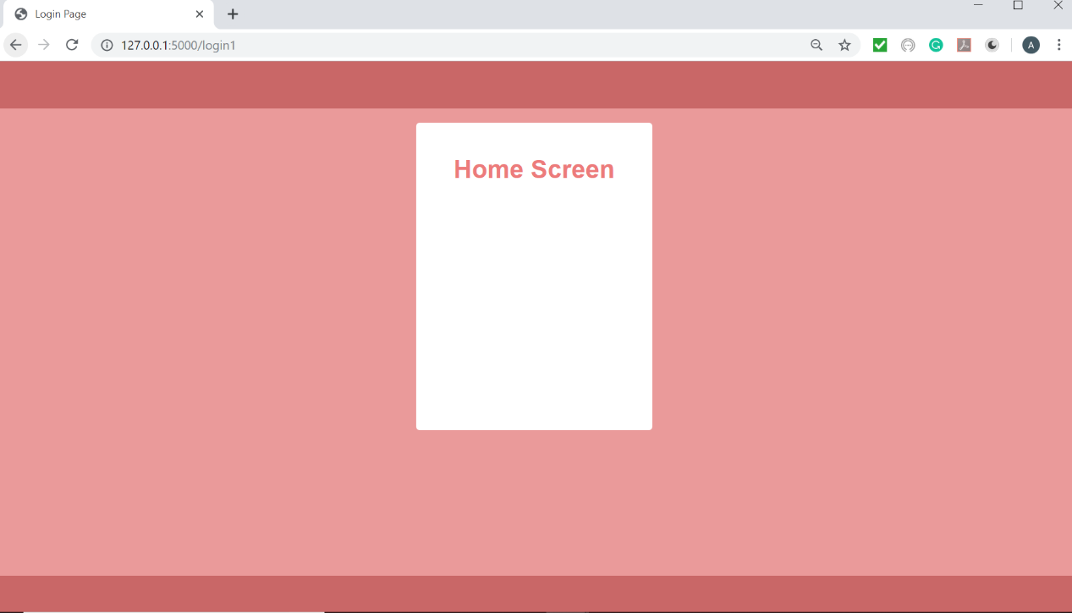
home page
User enters the response key
User is taken to home page

Slide 12

conclusion
Authentication by possession
Authentication by ownership
Out of band method to send SMS provides separate communication channel
Increased levels of security

