Slide 1
TeamCity
Distributed Build Management and Continuous Integration Server
Angel Núñez Salazar

Slide 2

Motivación
BUILDING SOFTWARE
Can be a risky business

Slide 3

Continuous Integration

Slide 4
Integración Continua Reduce Riesgos
Encontrar errores muy tarde.
Ejecución constante de pruebas automatizadas.
Baja cohesión del equipo. Integra el trabajo del equipo de manera constante.
Demora en comenzar alguien nuevo. A solo un click.
Falta de visibilidad. Reportes y Métricas.
No tener software “deployable”. Compila y despliega el código en cualquier plataforma.

Slide 5
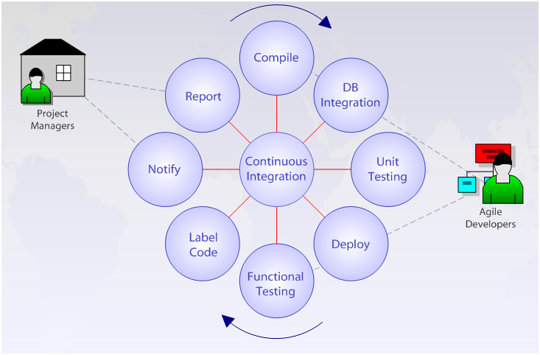
Continuous Integration
Notes:
A software development practice where members of a team integrate their work frequently, usually each person integrates at least daily – leading to multiple integrations per day. Each integration is verified by an automated build to detect integration errors as quickly as possible.
El proceso de integración continua se hace efectivo cuando el build es generado con éxito. En el caso que el build no sea generado debido a problemas, la prioridad del equipo pasa a la corrección de los defectos. Normalmente el error en un build ocurre cuando este no compila o no pasa las pruebas básicas automatizadas.
El proceso de integración continua funciona de la siguiente manera:
Los desarrolladores del equipo hacen modificaciones en el código fuente, compilan y ejecutan las pruebas unitarias automatizadas y hacen el check-in (o commit) del código en la línea activa del desarrollo en la herramienta de control de versiones.
La herramienta de integración continua de acuerdo a ciertos períodos de tiempo (se recomienda colocar períodos cortos menores a cuatro horas) verifica si nuevo código se ha colocado en la línea activa del software de control de versiones.
Si es así, la herramienta de integración continua extrae todo el código fuente y compila en el servidor isolado que tiene por objetivo generar builds limpios.
Si compila, la herramienta de integración continua ejecuta otras tareas que pueden ser definidas por la herramienta de build como: compilar y ejecutar pruebas unitarias, pruebas de aceptación, generar información de las pruebas, de la cobertura y de análisis estático de código.
La herramienta de Integración Continua actualiza los datos de la página Web del proyecto con todos los resultados de la ejecución del build y con todos los fuentes alterados y con los datos de que se hizo en cada iteración.
La herramienta envía mensajes (por email, page, MSN, etc) para el equipo informando el resultado del proceso de build durante la integración continua.
Why Continuous Integration?
The benefit of continuous integration, according to Martin Fowler, is reduced risk. Reduced risk is accomplished through a quick feedback cycle. The longer you defer integration, the more difficult integration becomes. If you integrate automated testing into your integration cycle, you can further reduce your risk.
Why is CI Important?
This is one of the most frequently asked questions, and here are a few points to note about this powerful technique:
Building software often greatly increases the likelihood that you will spot defects early, when they still are relatively manageable.
Extends defect visibility.
CI ensures that you have production ready software at every change.
CI also ensures that you have reduced the risk of integration issues by building software at every change.
CI server can also be configured to run continuous inspection which can assist the development team in finding potential bugs, bad programming practice, automatically check coding standards, and also provide valuable feedback on the quality of code being written
Now that we have a basic understanding of CI, why CI is important for us, and the tools required to run a successful CI process, in a series of upcoming articles we will see how to setup CI, how to maintain code quality, continuously run code inspections, generate documentations, provide feedbacks to the teams and so on. Stay tuned….

Slide 6
Tres Pilares de Integración Continua
Code Repository
CI Server
Automated Build Script
Notes:
While CI is actually a process, the term Continuous Integration often is associated with three important tools in particular. As shown in the screen above the three pillars of CI are:
Version Control Repository:
Version control repositories also known as SCM (source code management) play a crucial role in any software development environment. They also play a very important role for a successful CI process. The SCM is a central place for the team to store every needed artifact for the project. It is mandatory for the teams to put everything needed for a successful build into this repository. This includes the build scripts, property files, database scripts, all the libraries required to build the software and so on.
The CI Server:
For CI to function properly, we also need to have an automated process that monitors a version control repository and runs a build when any changes are detected. There are several CI servers available, both open source and commercial. Most of them are similar in their basic configuration and monitor a particular version control repository and run builds when any changes are detected.
Some of the most commonly used open source CI servers are; Cruise Control, Continuum, and Hudson. Hudson is particularly interesting because of its ease of configuration and compelling plug-ins, which makes integration with test and static analysis tools much easier.
Automated Build:
The process of CI is about building software often, which is accomplished through the use of a build. A sturdy build strategy is by far the most important aspect of a successful CI process. In the absence of a solid build that does more than compile your code, CI withers. With automated builds, teams can reliably perform (in an automated fashion) otherwise manual tasks like compilation, testing, and even more interesting things like software inspection and deployment.
Now that we have seen the important tools in our CI process, let’s see how a typical CI scenario looks like for a developer:
CI server is configured to poll the version control repository continuously for changes.
Developer commits code to the repository.
CI server detects this change, and retrieves the latest code from the repository.
This causes the CI server to invoke the build script with the given targets and options.
If configured, CI Server will send out an e-mail to the specified recipients when a certain important event occurs.
The CI server continues to poll for changes.

Slide 7
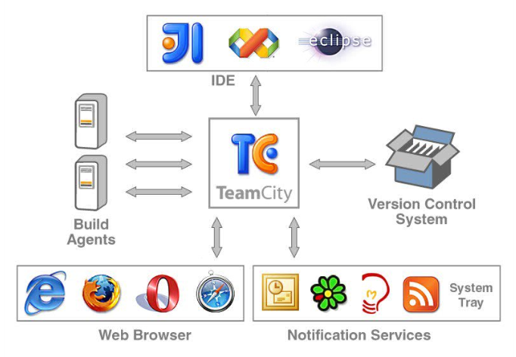
TeamCity
Notes:
Más que un servidor de integración continua.
Control de Calidad
Cooperación del Equipo
Integración con varios IDEs
Java, .NET, Ruby
Software build and automation manag

Slide 8
Why TeamCity ?
Rápida Configuración
“From now on anyone who considers themselves to be a serious professional must refuse to write another line of XML. When asked, say NO”
Robert C. Martin (Uncle Bob)

Slide 9
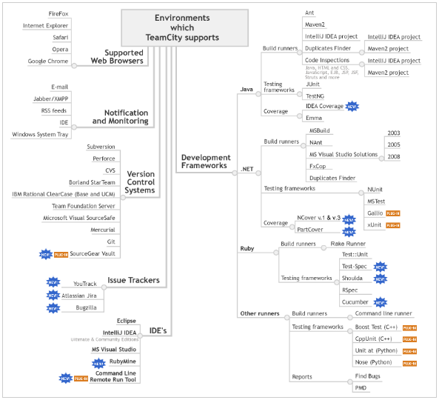
Why TeamCity ?
Integración “out of the box”

Slide 10
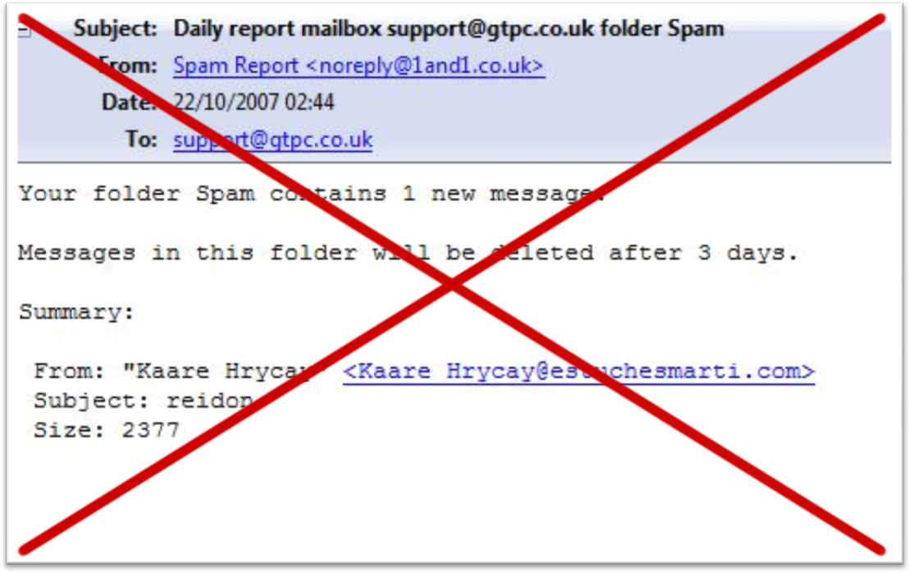
Why TeamCity ?
Notificaciones Rápidas y Claras

Slide 11
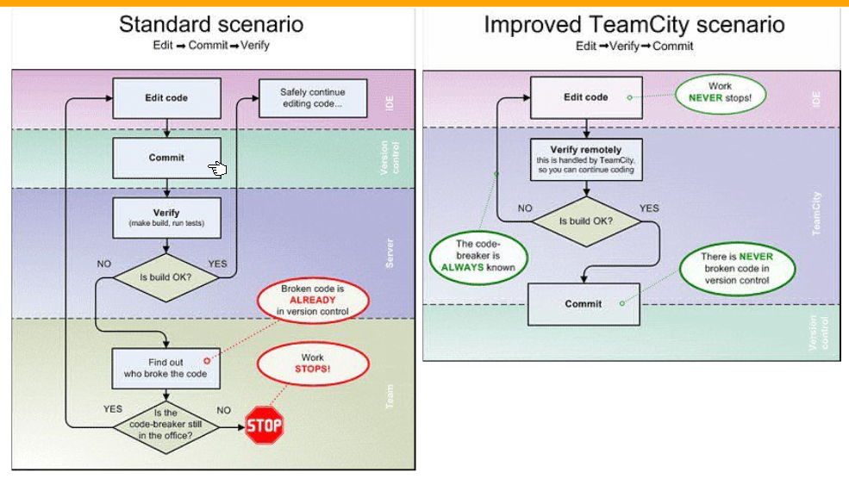
Why TeamCity ?
Pre – Tested Commit

Slide 12

Conclusión
TeamCity nos permite aprovechar de todos los beneficios de la “Integración Continua” sin convertir a la tecnología en un impedimento

