Slide 1

Toy model V1
Simplified model
1 product variant
WP3 - Task 3.1 (PMI)
Automata Learning Results

Slide 2
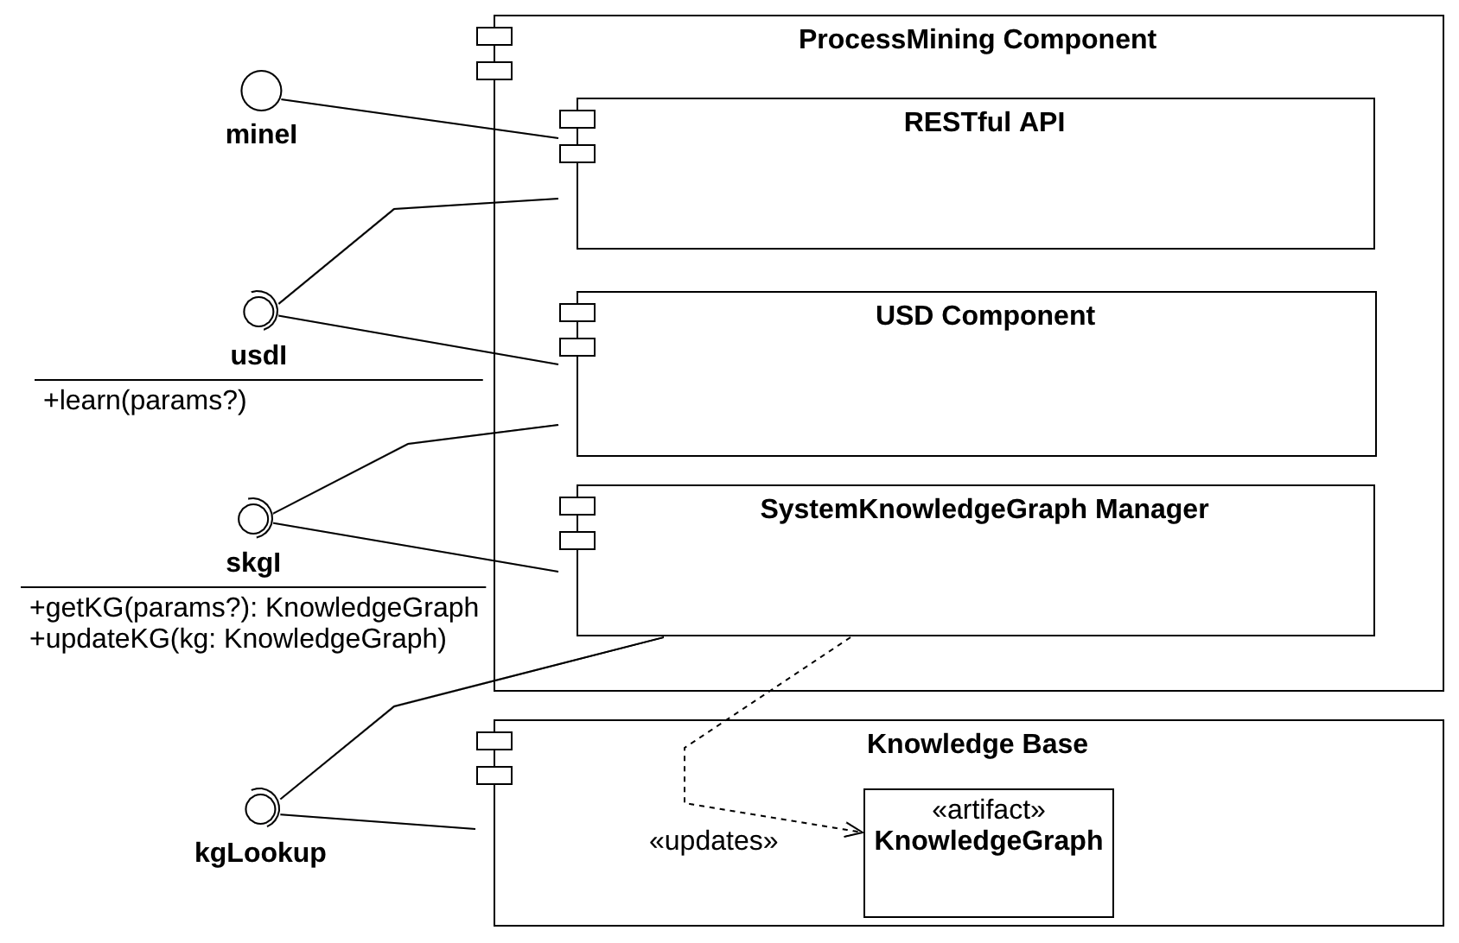
Proposed Architecture:

Slide 3
Proposed Architecture:
Pizza V1: Local
Pizza V2: Local/TTS
Pizza V3: Local/TTS
Croma: Local
(https://neo4j.ttsnetwork.net:7473/)

Slide 4
Proposed Architecture:
Draft (agnostic to the specific use case and
the system discovery technique):
https://github.com/LesLivia/ekg_extractor

Slide 5
Proposed Architecture:
Module for automata learning:
https://github.com/LesLivia/lsha/tree/develop

Slide 6
Proposed Architecture:
TODO

Slide 7
Pizza Line V1

Slide 8
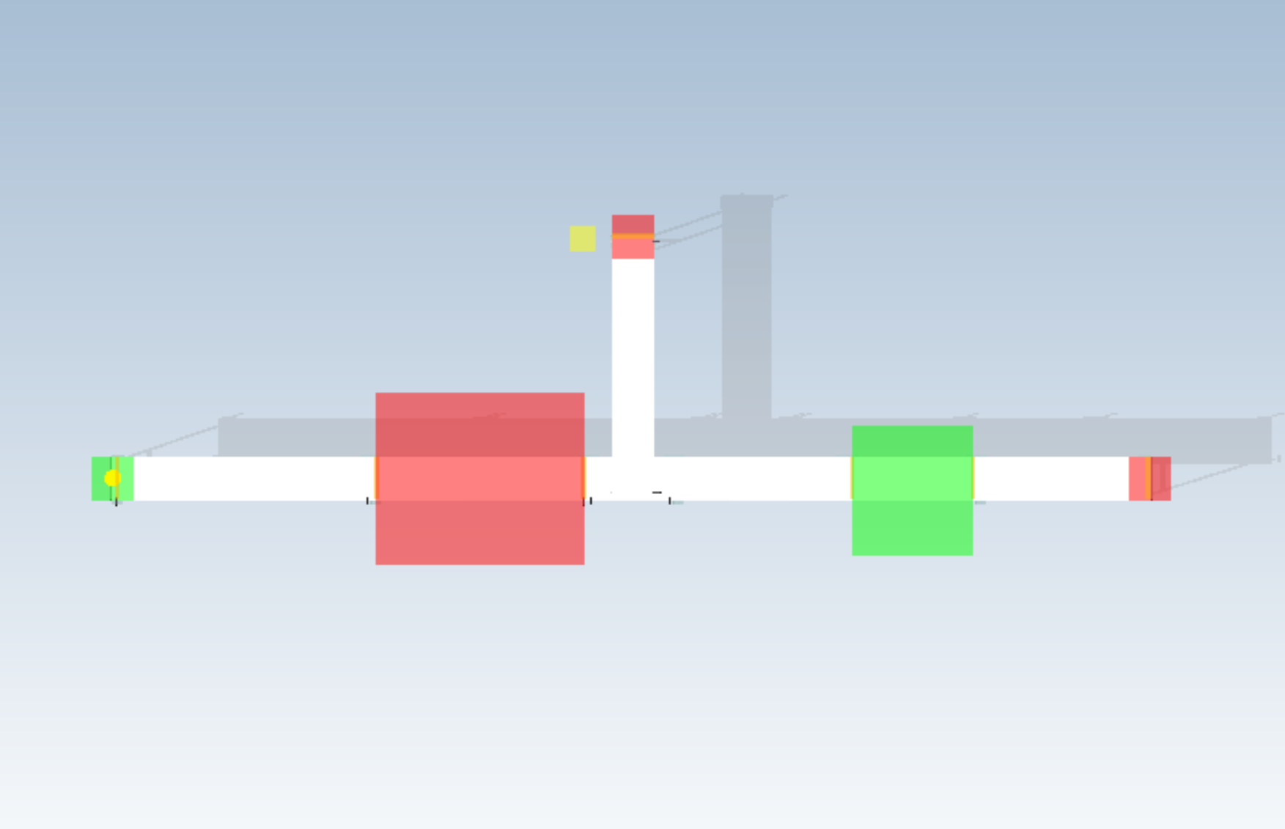
Position of sensors
S7
S1
S2
S3
S4
S5
S6

Slide 9
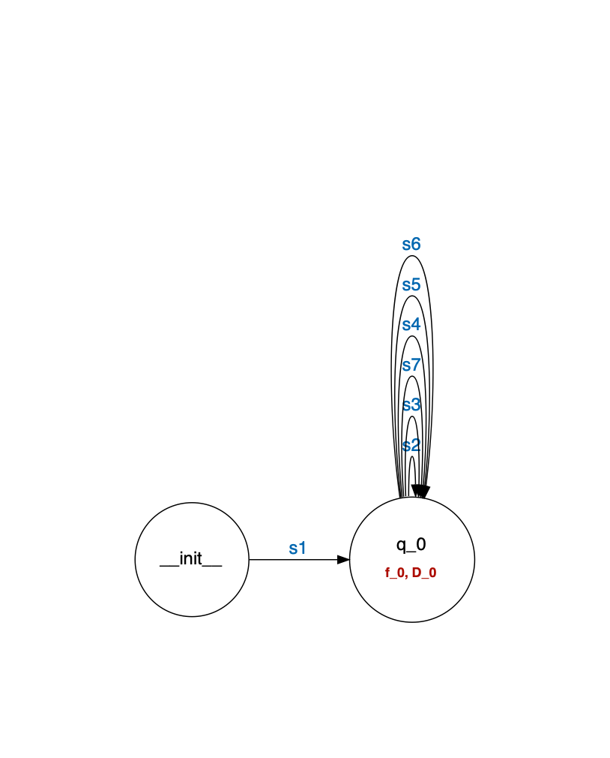
INPUT: EKG events grouped by entity ID and ordered by timestamp
PM TECHNIQUE: L*_SHA, mi query de-activated, events correspond to sensor activations grouped by item (i.e., traces are s1-s2-s3-s7 and s1-s2-s3-s4-s5-s6)
-> no distinction on state
OUTPUT:

Slide 10
INPUT: EKG events grouped by entity ID and ordered by timestamp
PM TECHNIQUE: L*_SHA, mi query de-activated, events correspond to sensor activations grouped by item (i.e., traces are s1-s2-s3-s7 and s1-s2-s3-s4-s5-s6)
-> fictitious signal with latest sensor activation

Slide 11
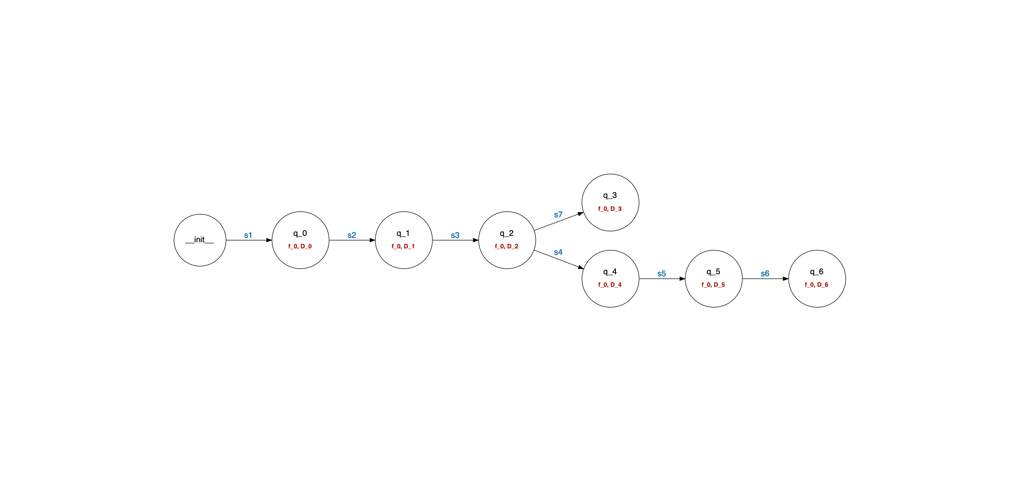
INPUT: EKG events grouped by entity ID and ordered by timestamp
PM TECHNIQUE: L*_SHA, mi query de-activated, events correspond to sensor activations grouped by item (i.e., traces are s1-s2-s3-s7 and s1-s2-s3-s4-s5-s6)
OUTPUT:

Slide 12
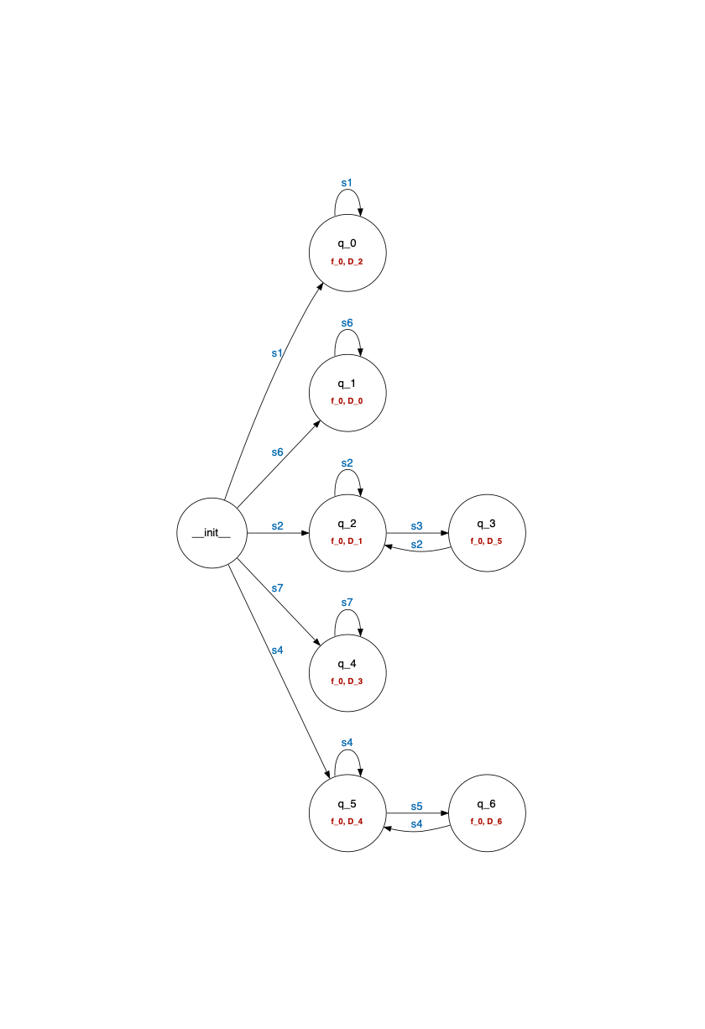
INPUT: EKG events grouped by entity ID and ordered by timestamp
PM TECHNIQUE: L*_SHA, mi query de-activated, events correspond to sensor activations grouped by resource (i.e., traces are s1-s1-…, s2-s3-s2-…)
OUTPUT:
Last sensor activation is S3
Last sensor activation is S2

Slide 13
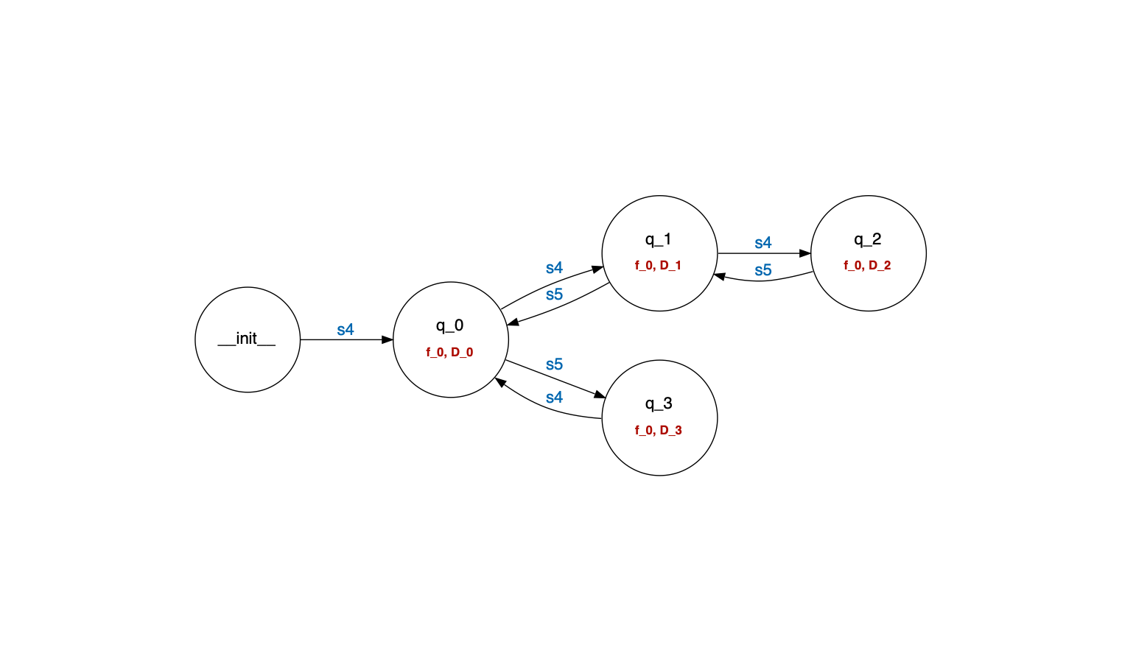
INPUT: EKG events grouped by entity ID and ordered by timestamp
PM TECHNIQUE: L*_SHA, mi query de-activated, events correspond to sensor activations, for single resource, fictitious signal is no. of items (i.e., traces are s1-s1-…, s2-s3-s2-…)
OUTPUT:
2 items
3 items
1 item
0 items

Slide 14
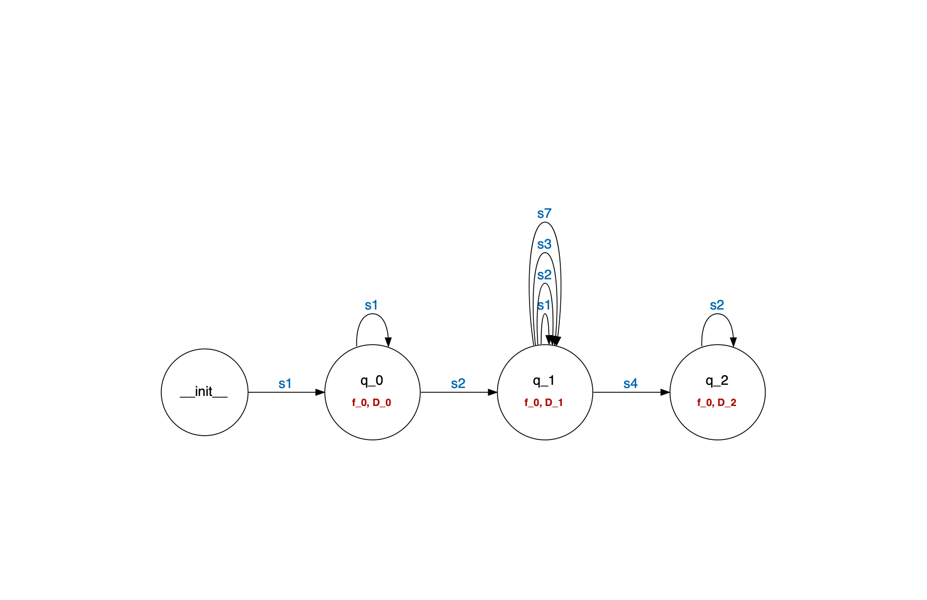
INPUT: EKG events grouped by entity ID and ordered by timestamp
PM TECHNIQUE: L*_SHA, mi query de-activated, events correspond to sensor activations grouped by state vector (i.e., traces are s1-s1-s2-s1-s2-…)
OUTPUT:

Slide 15
INPUT: EKG events grouped by entity ID and ordered by timestamp
PM TECHNIQUE: L*_SHA, mi query de-activated, events correspond to sensor activations grouped by state vector (i.e., traces are s1-s1-s2-s1-s2-…)
OUTPUT:
Idle machines
Busy machines
M1 busy, M2 idle

Slide 16
Pizza Line V2

Slide 17
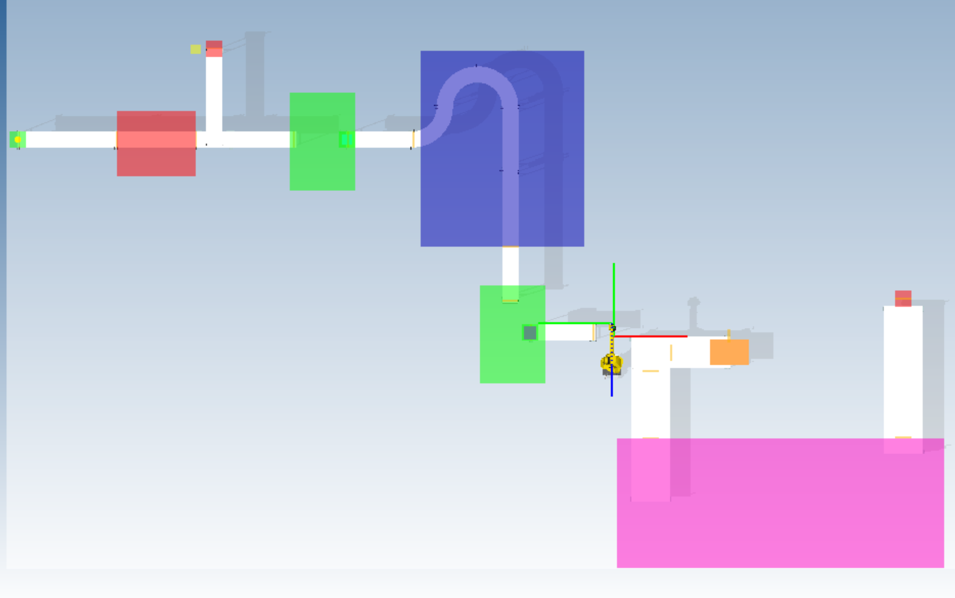
S16
S1
S2
S6
S4
S3
S5
S7
S8
S15
S9
S11
S10
S12
S13
S14
S14
Position of sensors

Slide 18
INPUT: EKG events grouped by entity tree (i.e., pizza to pallet) and ordered by timestamp
PM TECHNIQUE: L*_SHA, mi query de-activated, events correspond to sensor activations grouped by items (i.e., traces are s1-s2-s3-s7 and s1-s2-s3-s4-s5-s6)
-> fictitious signal with latest sensor activation

Slide 19
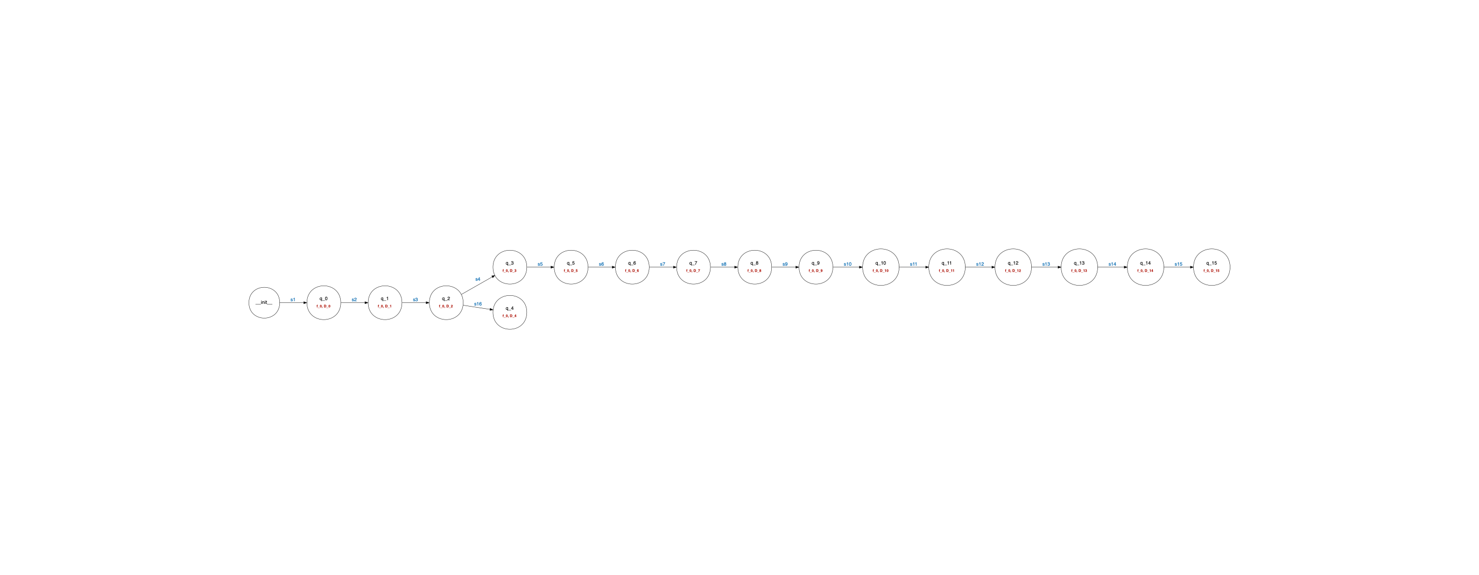
INPUT: EKG events grouped by entity tree (i.e., pizza to pallet) and ordered by timestamp
PM TECHNIQUE: L*_SHA, mi query de-activated, events correspond to sensor activations grouped by items (i.e., traces are s1-s2-s3-s7 and s1-s2-s3-s4-s5-s6)
OUTPUT:

Slide 20
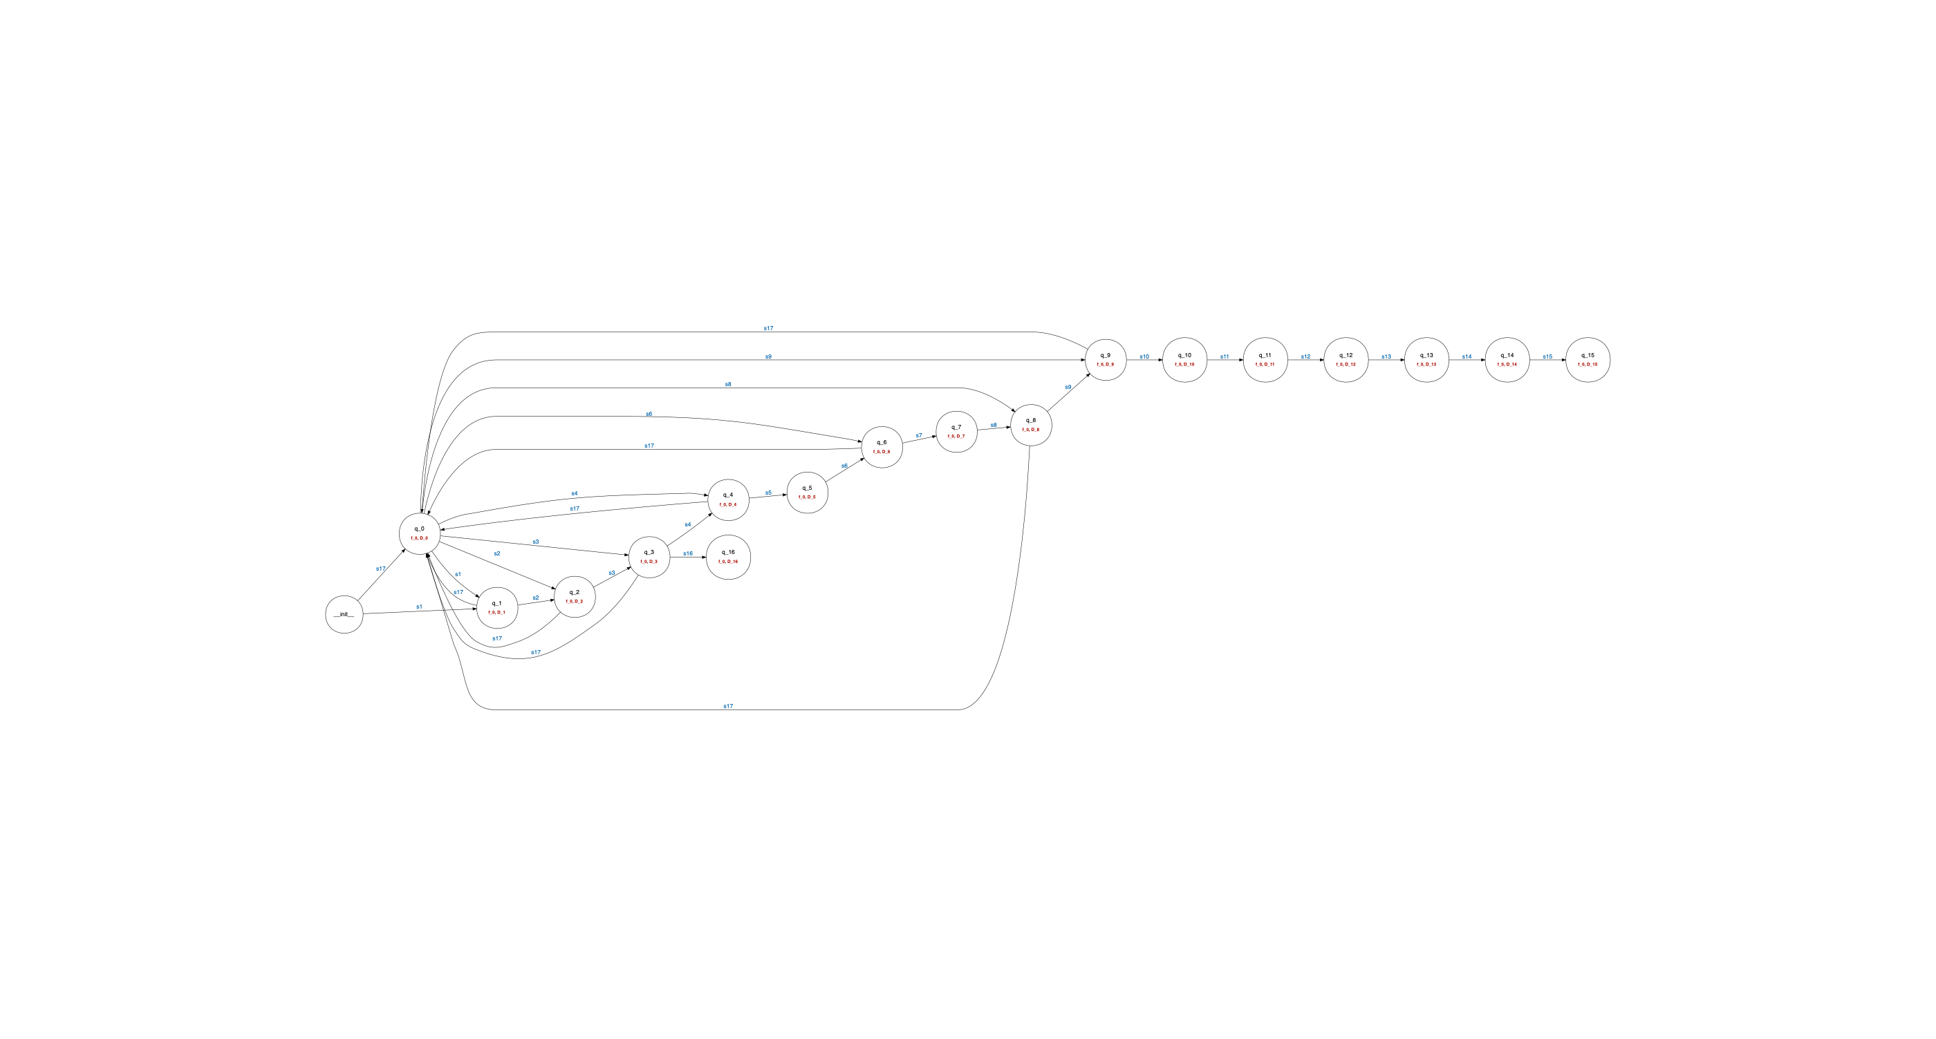
INPUT: EKG events grouped by entity tree (i.e., pizza to pallet) and ordered by timestamp
PM TECHNIQUE: L*_SHA, mi query de-activated, events correspond to sensor activations grouped by items (i.e., traces are s1-s2-s3-s7 and s1-s2-s3-s4-s5-s6)
OUTPUT (after addition of S17):

Slide 21
INPUT: EKG events grouped by entity tree (i.e., pizza to pallet) and ordered by timestamp
PM TECHNIQUE: L*_SHA, mi query de-activated, events correspond to sensor activations grouped by resources (i.e., traces are s1-s1-…, s2-s3-…)

Slide 22
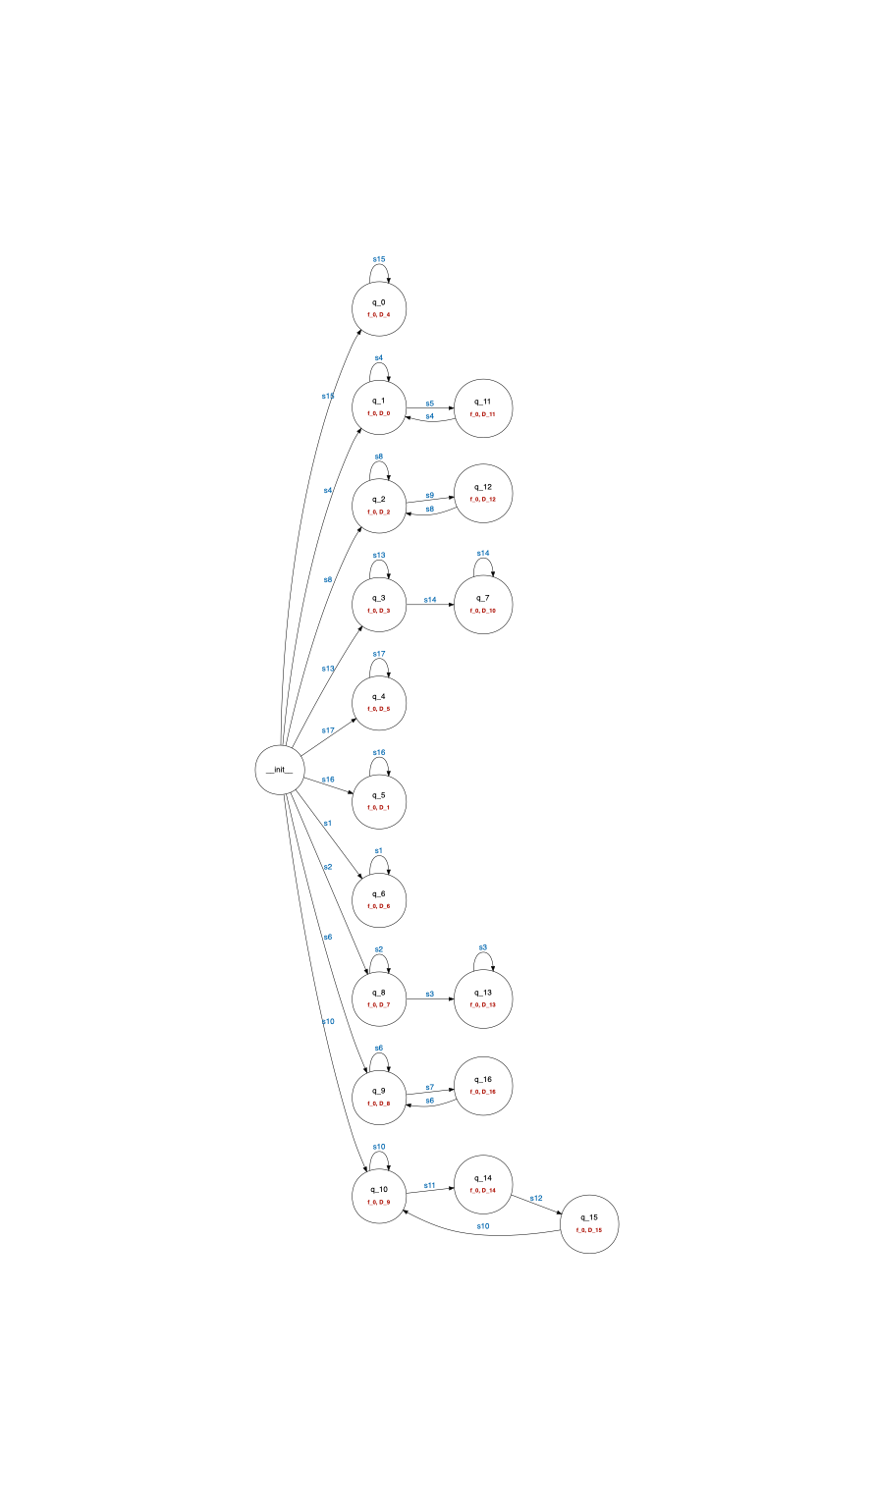
OUTPUT:

Slide 23
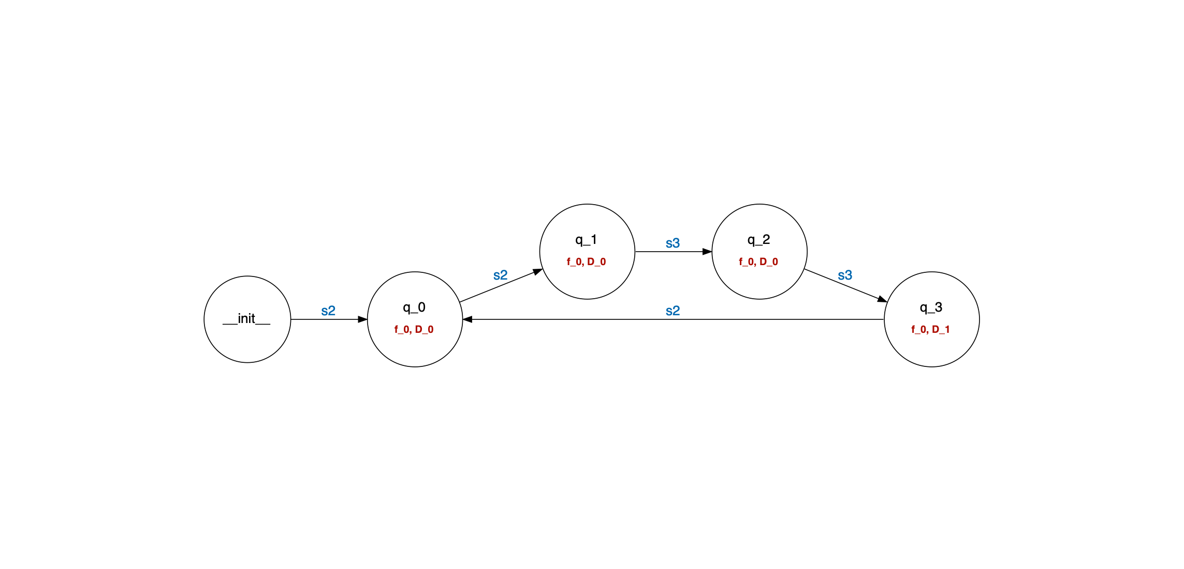
INPUT: EKG events grouped by entity ID and ordered by timestamp
PM TECHNIQUE: L*_SHA, mi query de-activated, events correspond to sensor activations, for single resource, fictitious signal is state vector (i.e., traces are s1-s1-…, s2-s3-s2-…)
OUTPUT:
2 items
1 item
1 item
0 items

Slide 24
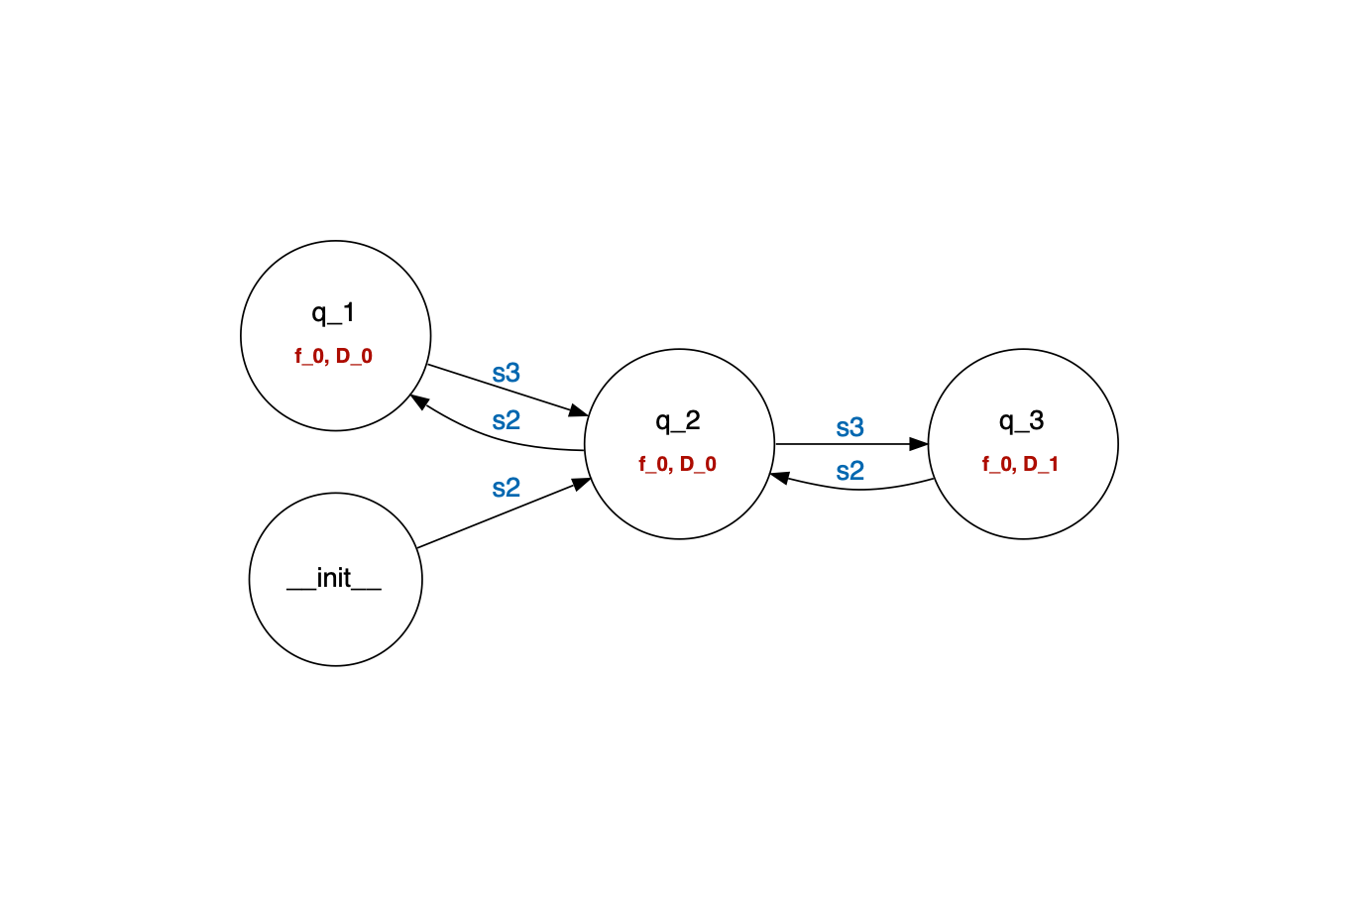
INPUT: EKG events grouped by entity ID and ordered by timestamp
PM TECHNIQUE: L*_SHA, mi query de-activated, events correspond to sensor activations, for single resource, fictitious signal is state vector (i.e., traces are s1-s1-…, s2-s3-s2-…)
OUTPUT (higher time bound, merges q_0 and q_2):
2 items
1 item
0 items

Slide 25
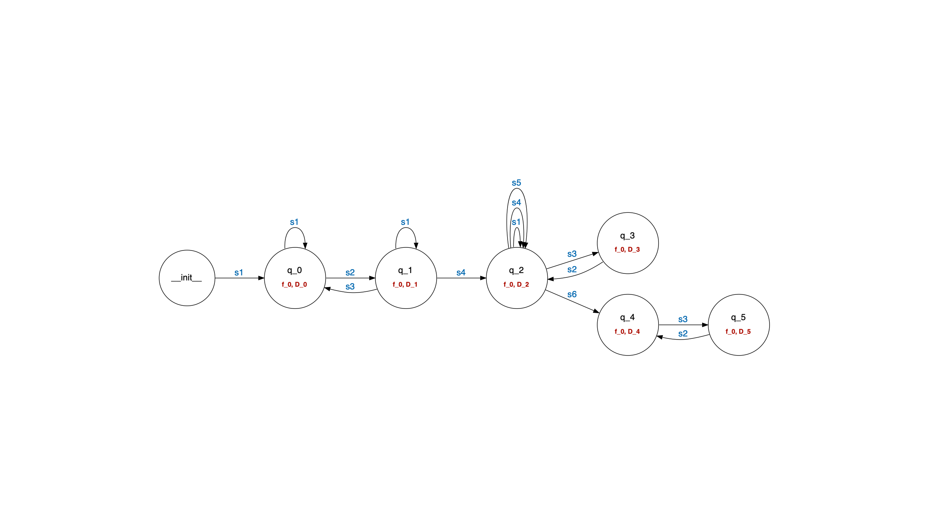
INPUT: EKG events grouped by entity tree (i.e., pizza to pallet) and ordered by timestamp
PM TECHNIQUE: L*_SHA, mi query de-activated, events correspond to sensor activations grouped by state vector (i.e., traces are s1-s1-s2-s1-…)
OUTPUT:
Idle machines
M1 busy
M2 busy
M2, M3 busy
M1, M2 busy
M1, M2, M3 busy

Slide 26
Pizza Line V3

Slide 27
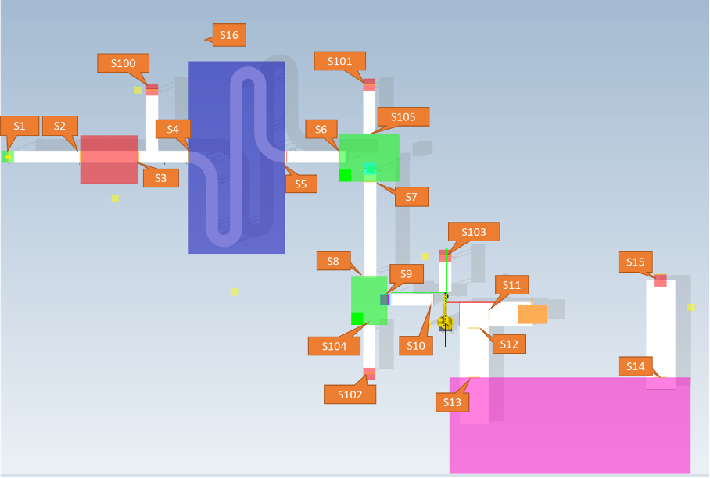

Slide 28
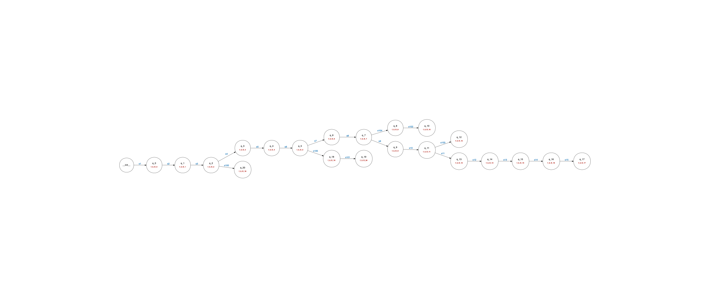
INPUT: EKG events grouped by entity tree (i.e., pizza to pallet) and ordered by timestamp
PM TECHNIQUE: L*_SHA, mi query de-activated, events correspond to sensor activations grouped by items
OUTPUT:

Slide 29
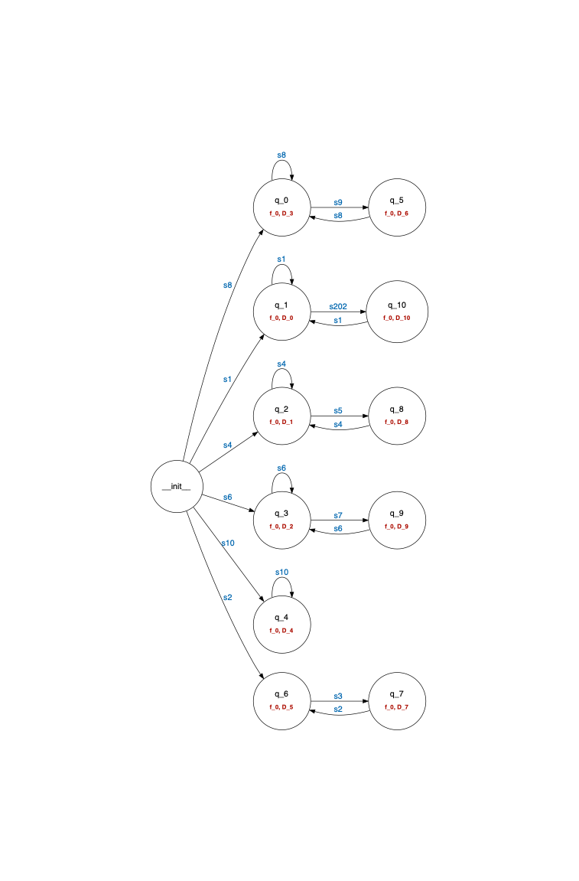
INPUT: EKG events grouped by entity tree (i.e., pizza to pallet) and ordered by timestamp
PM TECHNIQUE: L*_SHA, mi query de-activated, events correspond to sensor activations grouped by resources
OUTPUT:

Slide 30
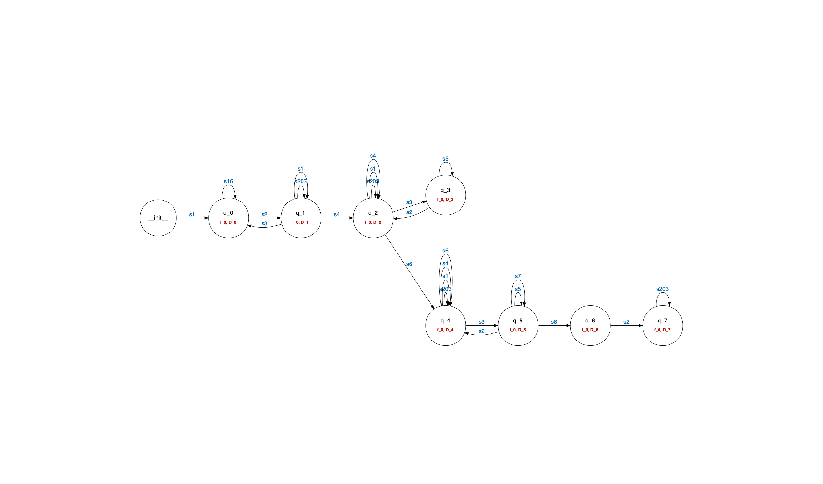
INPUT: EKG events grouped by entity tree (i.e., pizza to pallet) and ordered by timestamp
PM TECHNIQUE: L*_SHA, mi query de-activated, events correspond to sensor activations grouped by state vector
OUTPUT:
Busy pack station
Busy pack station, freezer, box station
Idle machines
Busy oven
Busy oven,
Pack station
Busy oven, pack station, freezer
Busy pack station, freezer
Busy oven, pack station, freezer, box station

Slide 31
Croma

Slide 32
INPUT: EKG events grouped by entity (i.e., kits) and ordered by timestamp
PM TECHNIQUE: L*_SHA, mi query de-activated, events correspond to sensor activations grouped by items (i.e., traces are s1-s2-s3-s7 and s1-s2-s3-s4-s5-s6)
Events Symbols:
"Entrada Material Sucio": 'S1',
"Cargado en carro L+D": 'S2',
"Carga L+D iniciada": 'S3',
"Carga L+D liberada": 'S4',
"Montaje": 'S5',
"Producción montada": 'S6',
"Composición de cargas": 'S7',
"Carga de esterilizador liberada": 'S8',
"Carga de esterilizadorliberada": 'S9'

Slide 33
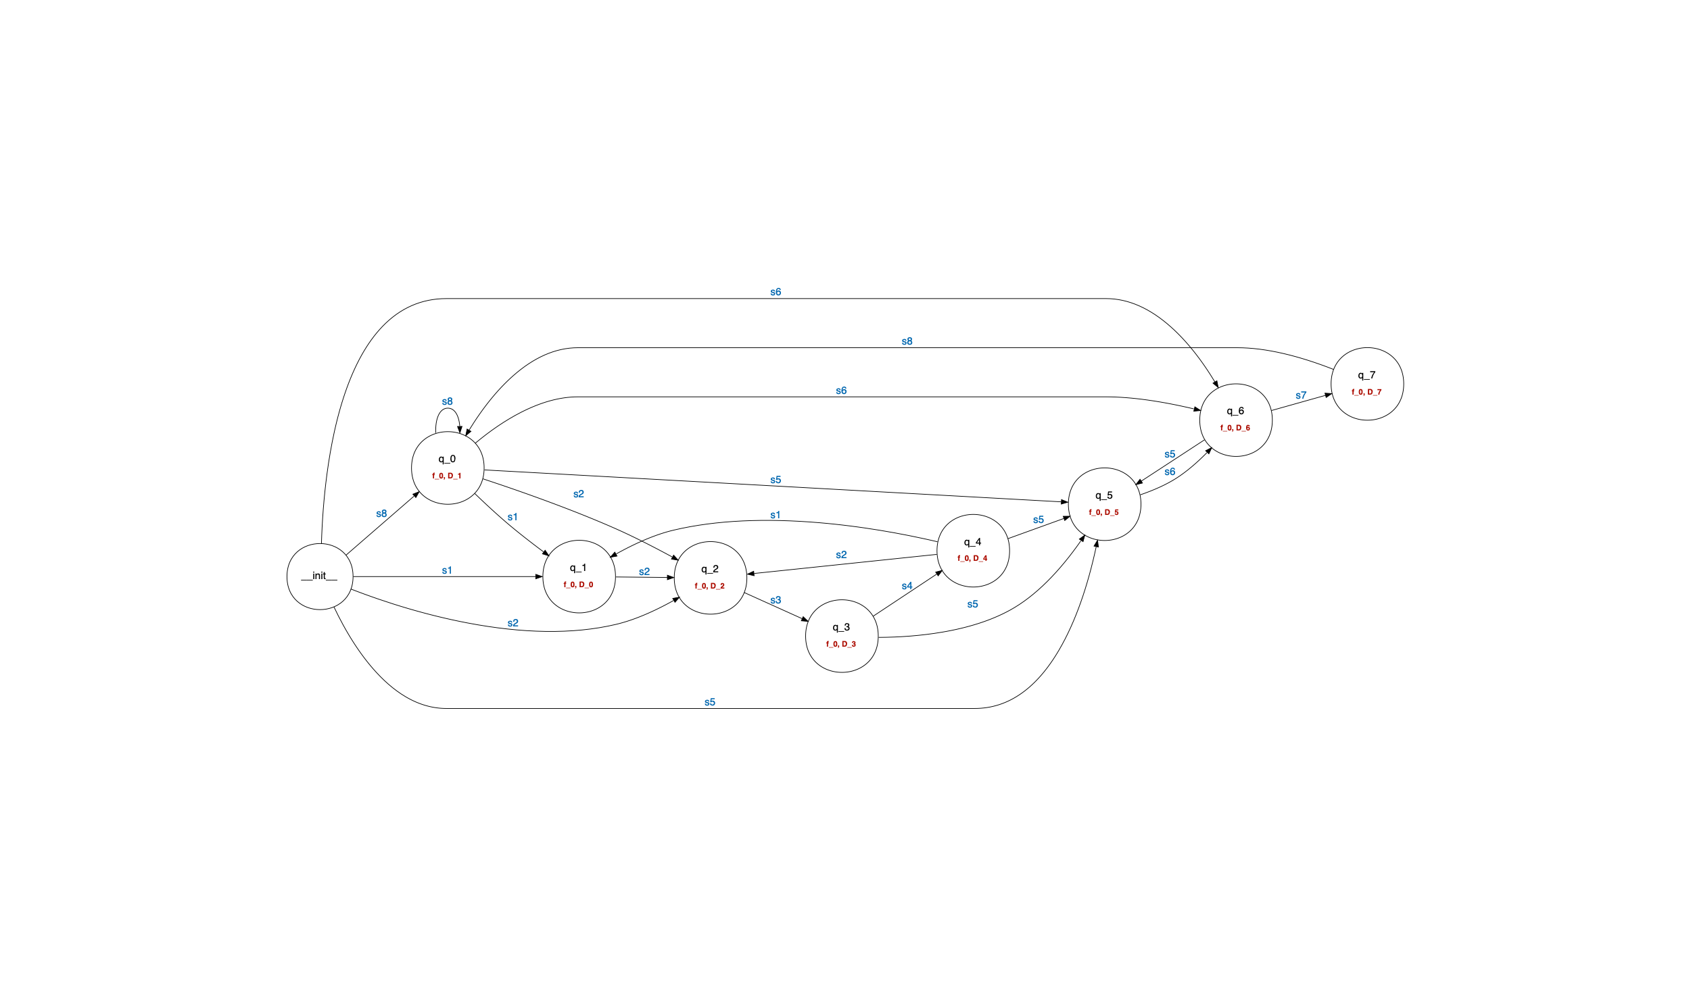
INPUT: EKG events grouped by entity (i.e., kits) and ordered by timestamp
PM TECHNIQUE: L*_SHA, mi query de-activated, events correspond to sensor activations grouped by items (i.e., traces are s1-s2-s3-s7 and s1-s2-s3-s4-s5-s6)
OUTPUT:

Slide 34
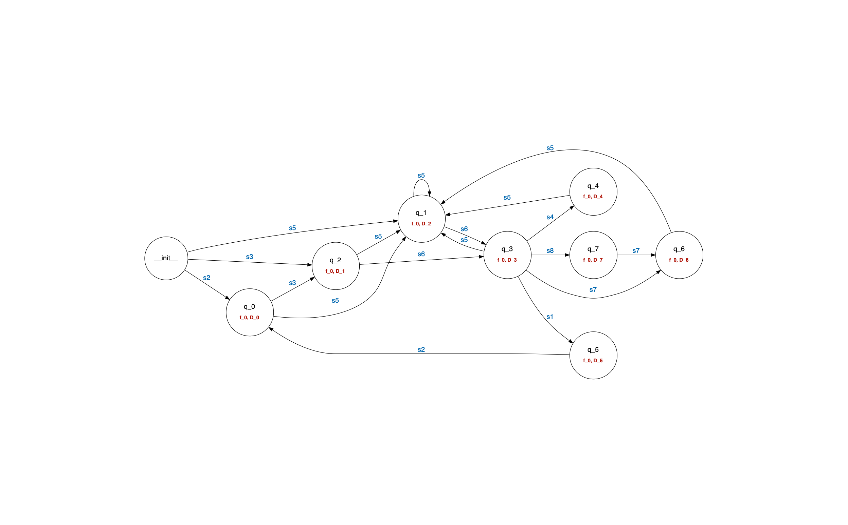
INPUT: EKG events grouped by entity (i.e., kits) and ordered by timestamp
PM TECHNIQUE: L*_SHA, mi query de-activated, events correspond to sensor activations grouped by resource (i.e., traces are s1-s2-s3-s7 and s1-s2-s3-s4-s5-s6)
OUTPUT:

Slide 35
Lego Plant

Slide 36
INPUT: EKG events grouped by entity (i.e., parts) and ordered by timestamp
PM TECHNIQUE: L*_SHA, mi query de-activated, events correspond to sensor activations grouped by items (i.e., traces are s1-s2-s3-s7 and s1-s2-s3-s4-s5-s6)
Events Symbols:
'_LOAD_1': 'S11', '_PROCESS_1': 'S12', '_UNLOAD_1': 'S13',
'_LOAD_2': 'S21', '_PROCESS_2': 'S22', '_UNLOAD_2': 'S23',
'_FAIL_1': 'S14', '_BLOCK_2': 'S24', '_LOAD_3': 'S31',
'_PROCESS_3': 'S32', '_LOAD_4': 'S41', '_UNLOAD_3': 'S33',
'_PROCESS_4': 'S42', '_LOAD_5': 'S51', '_PROCESS_5': 'S52',
'_UNLOAD_5': 'S53', '_UNLOAD_4': 'S43', '_FAIL_5': 'S54',
'_BLOCK_1': 'S15', '_BLOCK_5': 'S55', '_BLOCK_3': 'S34', '_BLOCK_4': 'S44'

Slide 37
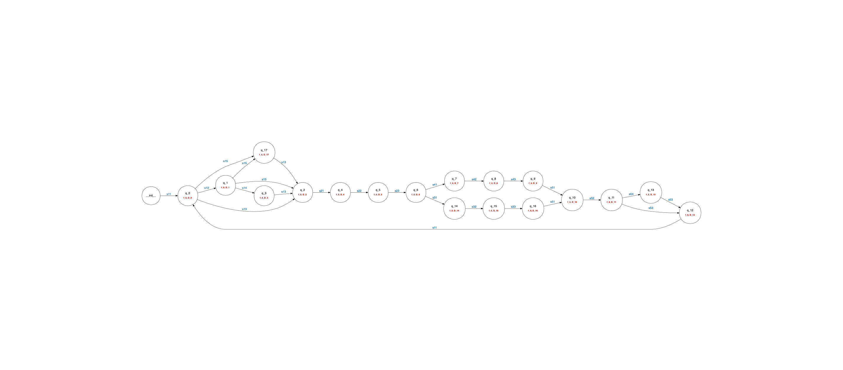
INPUT: EKG events grouped by entity (i.e., parts) and ordered by timestamp
PM TECHNIQUE: L*_SHA, mi query de-activated, events correspond to sensor activations grouped by items (i.e., traces are s1-s2-s3-s7 and s1-s2-s3-s4-s5-s6)
OUTPUT:

Slide 38
Possible Research
Directions

Slide 39
Extensions to L*_SHA (DEIB):
Learn time constraints (guards/invariants)
Learn probability weights (e.g., probability of arrival of a new pizza)
Composition of automata learned with different time windows
Potential extension to PTA with handling of rewards/costs
Relationship between process mining and automata learning (DMec + DEIB):
Are the two techniques equivalent? Is one better for one POV and one better with another? What are their limitations?
Can (or should) the two resulting models be combined into one? For example combining two POVs?
Automated generation of Digital Twins (PMI + ext.):
What is the desired set of features? Is there a preferred POV (or combination of POVs)?
Valuable features for for WP4?
What can (or should) we predict with a learned model? E.g., cost of an item, percentage of scrapped items?

