Slide 1

Parsing
Recommended Reading: Ch. 12-14th
Jurafsky & Martin 2nd edition
PI Disclosure: This set includes adapted material from Rada Mihalcea, Raymond Mooney and Dan Jurafsky

Slide 2
Today
Parsing with CFGs
Bottom-up, top-down
Ambiguity
CKY parsing
Early algorithm

Slide 3
Context-Free Grammars
Context-free grammars (CFGs)
Also known as
Phrase structure grammars
Backus-Naur form
G = (T, N, S, R)
Rules (R)
Terminals (T)
Non-terminals (N)
The Start symbol (S)

Slide 4
Context-Free Grammars
Terminals
We’ll take these to be words (for now)
Non-Terminals
The constituents in a language
Like noun phrase, verb phrase and sentence
Rules
Rules are equations that consist of a single non-terminal on the left and any number of terminals and non-terminals on the right.

Slide 5
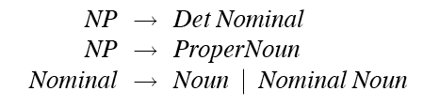
Some NP Rules
Here are some rules for our noun phrases
Together, these describe two kinds of NPs.
The third rule illustrates two things
An explicit disjunction
A recursive definition

Slide 6
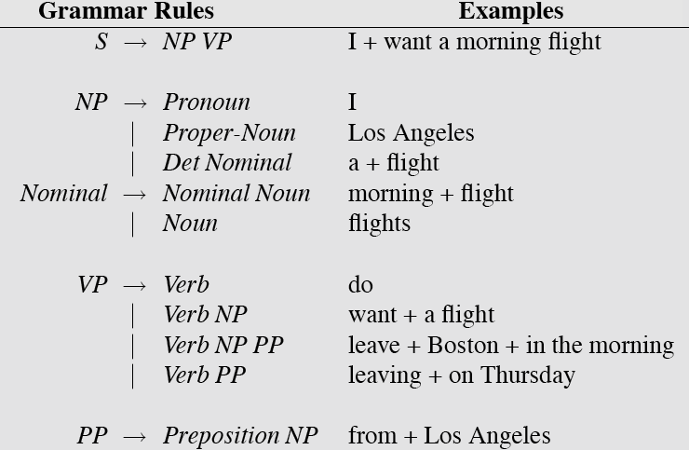
L0 Grammar

Slide 7
Generativity
As with FSAs (and FSTs), you can view these rules as either analysis or synthesis machines
Generate strings in the language
Reject strings not in the language
Impose structures (trees) on strings in the language

Slide 8
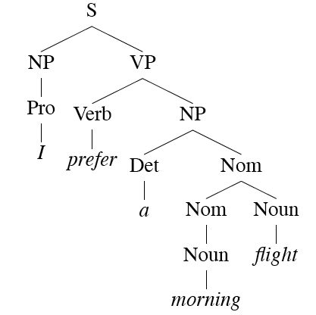
Derivations
A derivation is a sequence of rules applied to a string that accounts for that string
Covers all the elements in the string
Covers only the elements in the string

Slide 9
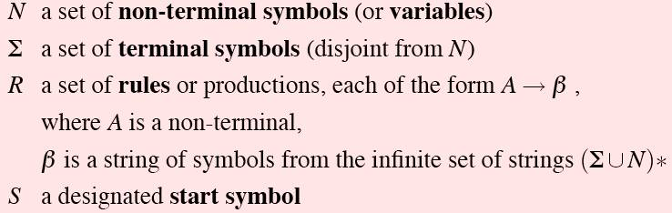
Definition
More formally, a CFG consists of

Slide 10
Parsing
Parsing is the process of taking a string and a grammar and returning a (multiple?) parse tree(s) for that string
It is completely analogous to running a finite-state transducer with a tape
It’s just more powerful

Slide 11
An English Grammar Fragment
Sentences
Noun phrases
Agreement
Verb phrases
Subcategorization

Slide 12
L0 Grammar

Slide 13
Sentence Types
Declaratives: A plane left.
S → NP VP
Imperatives: Leave!
S → VP
Yes-No Questions: Did the plane leave?
S → Aux NP VP
WH Questions: When did the plane leave?
S → WH-NP Aux NP VP

Slide 14
Notes on CFGs
CFGs appear to be just about what we need to account for a lot of basic syntactic structure in English.
But there are problems
There are simpler, more elegant, solutions that take us out of the CFG framework (beyond its formal power)

Slide 15
Treebanks
Treebanks are corpora in which each sentence has been paired with a parse tree (presumably the right one).
These are generally created
By first parsing the collection with an automatic parser
And then having human annotators correct each parse as necessary.
This generally requires detailed annotation guidelines that provide a POS tagset, a grammar and instructions for how to deal with particular grammatical constructions.

Slide 16
Treebanks
Starting off, building a treebank seems a lot slower and less useful than building a grammar
But a treebank gives us many things
Reusability of the labor
Frequencies and distributional information
A way to evaluate systems

Slide 17
Treebank Grammars
Treebanks implicitly define a grammar for the language covered in the treebank.
Simply take the local rules that make up the sub-trees in all the trees in the collection and you have a grammar.
Not complete, but if you have decent size corpus, you’ll have a grammar with decent coverage.

Slide 18
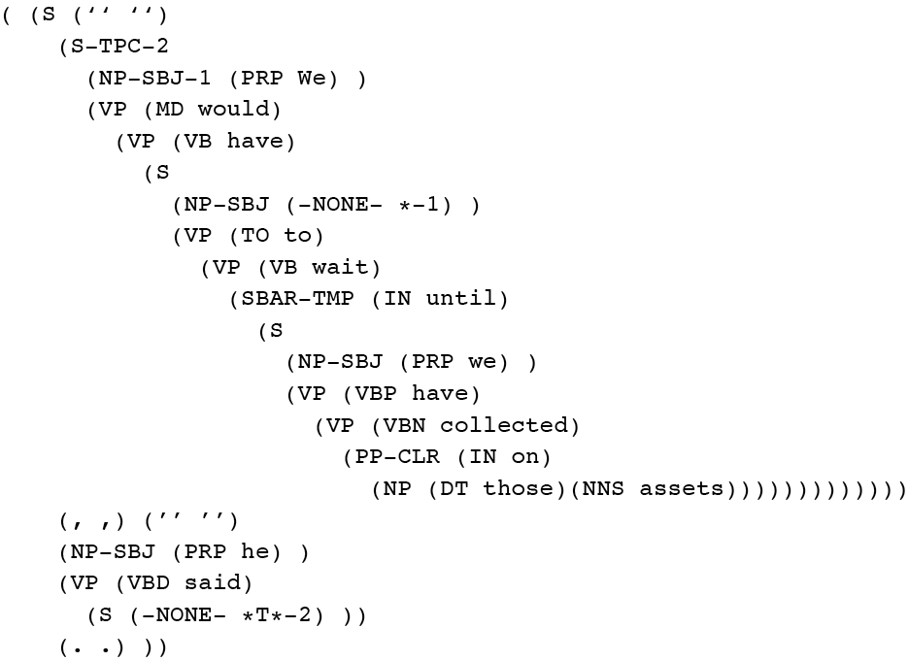
Penn Treebank
Penn TreeBank is a widely used treebank.
Most well known is the Wall Street Journal section of the Penn TreeBank.
1 M words from the 1987-1989 Wall Street Journal.

Slide 19


Treebank Grammars
Such grammars tend to be very flat due to the fact that they tend to avoid recursion.
For example, the Penn Treebank has 4500 different rules for VPs. Among them...

Slide 20
Parsing with CFGs
Parsing with CFGs refers to the task of assigning proper trees to input strings
Proper: a tree that covers all and only the elements of the input and has an S at the top
It doesn’t actually mean that the system can select the correct tree from among all the possible trees

Slide 21
Parsing with CFGs
As with everything of interest, parsing involves a search
We’ll start with some basic methods:
Top down parsing
Bottom up parsing
Real algorithms:
Cocke-Kasami-Younger (CKY)
Earley parser

Slide 22
For Now
Assume…
You have all the words already in some buffer
The input isn’t POS tagged
We won’t worry about morphological analysis
All the words are known

Slide 23
Top-Down Search
Since we’re trying to find trees rooted with an S (Sentences), why not start with the rules that give us an S.
Then we can work our way down from there to the words.
As an example let’s parse the sentence:
Book that flight

Slide 24
Top Down Parsing
S
NP VP
Pronoun

Slide 25
Top Down Parsing
S
NP VP
Pronoun
X
book

Slide 26
Top Down Parsing
S
NP VP
ProperNoun

Slide 27
Top Down Parsing
S
NP VP
ProperNoun
X
book

Slide 28
Top Down Parsing
S
NP VP
Det Nominal

Slide 29
Top Down Parsing
S
NP VP
Det Nominal
X
book

Slide 30
Top Down Parsing
S
Aux NP VP

Slide 31
Top Down Parsing
S
Aux NP VP
X
book

Slide 32
Top Down Parsing
S
VP

Slide 33
Top Down Parsing
S
VP
Verb

Slide 34
Top Down Parsing
S
VP
Verb
book

Slide 35
Top Down Parsing
S
VP
Verb
X
book
that

Slide 36
Top Down Parsing
S
VP
Verb NP

Slide 37
Top Down Parsing
S
VP
Verb NP
book

Slide 38
Top Down Parsing
S
VP
Verb NP
book
Pronoun

Slide 39
Top Down Parsing
S
VP
Verb NP
book
Pronoun
X
that

Slide 40
Top Down Parsing
S
VP
Verb NP
book
ProperNoun

Slide 41
Top Down Parsing
S
VP
Verb NP
book
ProperNoun
X
that

Slide 42
Top Down Parsing
S
VP
Verb NP
book
Det Nominal

Slide 43
Top Down Parsing
S
VP
Verb NP
book
Det Nominal
that

Slide 44
Top Down Parsing
S
VP
Verb NP
book
Det Nominal
that
Noun

Slide 45
Top Down Parsing
S
VP
Verb NP
book
Det Nominal
that
Noun
flight

Slide 46
Bottom-Up Parsing
Of course, we also want trees that cover the input words. So we might also start with trees that link up with the words in the right way.
Then work your way up from there to larger and larger trees.

Slide 47
Bottom Up Parsing
book that flight

Slide 48
Bottom Up Parsing
Noun
book that flight

Slide 49
Bottom Up Parsing
Nominal
Noun
book that flight

Slide 50
Bottom Up Parsing
Nominal
Nominal Noun
Noun
book that flight

Slide 51
Bottom Up Parsing
Nominal
Nominal Noun
X
Noun
book that flight

Slide 52
Bottom Up Parsing
Nominal
Nominal PP
Noun
book that flight
Notes:
52

Slide 53
Bottom Up Parsing
Nominal
Nominal PP
Noun
Det
book that flight
Notes:
53

Slide 54
Bottom Up Parsing
Nominal
Nominal PP
NP
Noun
Det
Nominal
book that flight
Notes:
54

Slide 55
Bottom Up Parsing
Nominal
Nominal PP
NP
Noun
Det
Nominal
book that
Noun
flight
Notes:
55

Slide 56
Bottom Up Parsing
Nominal
Nominal PP
NP
Noun
Det
Nominal
book that
Noun
flight
Notes:
56

Slide 57
Bottom Up Parsing
Nominal
Nominal PP
S
NP
VP
Noun
Det
Nominal
book that
Noun
flight
Notes:
57

Slide 58
Bottom Up Parsing
Nominal
Nominal PP
S
NP
VP
Noun
Det
Nominal
X
book that
Noun
flight
Notes:
58

Slide 59
Bottom Up Parsing
Nominal
Nominal PP
X
NP
Noun
Det
Nominal
book that
Noun
flight
Notes:
59

Slide 60
Bottom Up Parsing
NP
Verb
Det
Nominal
book that
Noun
flight

Slide 61
Bottom Up Parsing
VP
NP
Verb
Det
Nominal
book that
Noun
flight

Slide 62
Bottom Up Parsing
S
VP
NP
Verb
Det
Nominal
book that
Noun
flight

Slide 63
Bottom Up Parsing
S
X
VP
NP
Verb
Det
Nominal
book that
Noun
flight
Notes:
63

Slide 64
Bottom Up Parsing
VP
VP
PP
NP
Verb
Det
Nominal
book that
Noun
flight

Slide 65
Bottom Up Parsing
VP
VP
PP
X
NP
Verb
Det
Nominal
book that
Noun
flight
Notes:
65

Slide 66
Bottom Up Parsing
VP
NP
NP
Verb
Det
Nominal
book that
Noun
flight

Slide 67
Bottom Up Parsing
VP
NP
Verb
Det
Nominal
book that
Noun
flight

Slide 68
Bottom Up Parsing
S
VP
NP
Verb
Det
Nominal
book that
Noun
flight

Slide 69
Top-Down and Bottom-Up
Top-down
Only searches for trees that can be answers (i.e. S’s)
But also suggests trees that are not consistent with any of the words
Bottom-up
Only forms trees consistent with the words
But suggests trees that make no sense globally

Slide 70
Control
Of course, in both cases we left out how to keep track of the search space and how to make choices
Which node to try to expand next
Which grammar rule to use to expand a node
One approach is called backtracking
Make a choice, if it works out then fine
If not then back up and make a different choice

Slide 71
Problems
Even with the best filtering, backtracking methods are doomed because of ambiguity
Attachment ambiguity
Coordination ambiguity

Slide 72
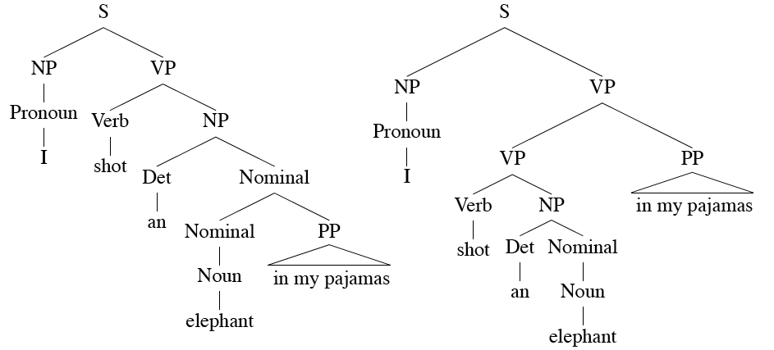
Ambiguity

Slide 73
Dynamic Programming
DP search methods fill tables with partial results and thereby
Avoid doing avoidable repeated work
Efficiently store ambiguous structures with shared sub-parts.
We’ll cover two approaches that roughly correspond to top-down and bottom-up approaches:
Cocke-Kasami-Younger (CKY)
Earley parser

Slide 74
CKY Parsing
First we’ll limit our grammar to epsilon-free, binary rules (more later)
Consider the rule A → BC
If there is an A somewhere in the input then there must be a B followed by a C in the input.
If the A spans from i to j in the input then there must be some k s.t. i<k<j
Ie. The B splits from the C someplace.

Slide 75
Problem
What if your grammar isn’t binary?
As in the case of the TreeBank grammar?
Convert it to binary… any arbitrary CFG can be rewritten into Chomsky-Normal Form automatically.
What does this mean?

Slide 76
Problem
More specifically, we want our rules to be of the form
A → B C
Or
A → w
That is, rules can expand to either 2 non-terminals or to a single terminal.

Slide 77
Binarization Intuition
Eliminate chains of unit productions.
Introduce new intermediate non-terminals into the grammar that distribute rules with length > 2 over several rules.
So… S → A B C turns into
S → X C and
X → A B
Where X is a symbol that doesn’t occur anywhere else in the the grammar.

Slide 78
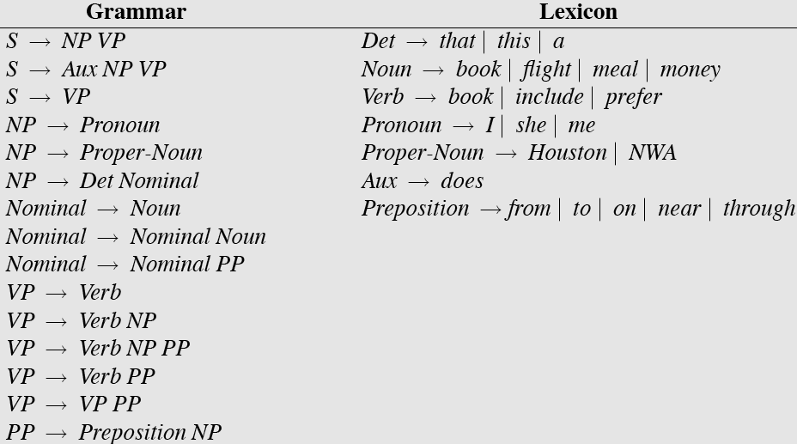
Sample L1 Grammar

Slide 79
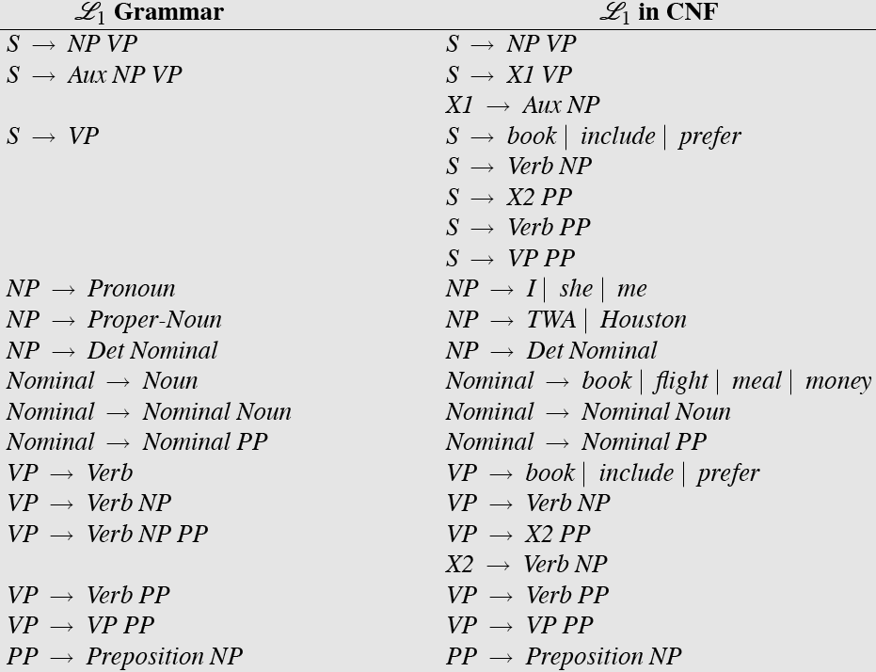
CNF Conversion

Slide 80
CKY Parsing: Intuition
Consider the rule D → w
Terminal (word) forms a constituent
Trivial to apply
Consider the rule A → B C
If there is an A somewhere in the input then there must be a B followed by a C in the input
First, precisely define span [ i, j ]
If A spans from i to j in the input then there must be some k such that i<k<j
Easy to apply: we just need to try different values for k
j

Slide 81
CKY Parsing: Table
Any constituent can conceivably span [i, j] for all 0≤i<j≤N, where N = length of input string
We need an N × N table to keep track of all spans…
But we only need half of the table
Semantics of table: cell [i, j] contains A iff A spans i to j in the input string
Of course, must be allowed by the grammar!

Slide 82
CKY Parsing: Table-Filling
So let’s fill this table…
And look at the cell [ 0, N ]: which means?
But how?

Slide 83
CKY Parsing: Table-Filling
In order for A to span [i, j ]:
A → B C is a rule in the grammar, and
There must be a B in [ i, k ] and a C in [ k, j ] for some i<k<j
Operationally:
To apply rule A → B C, look for a B in [i, k ] and a C in [k, j ]
In the table: look left in the row and down in the column

Slide 84
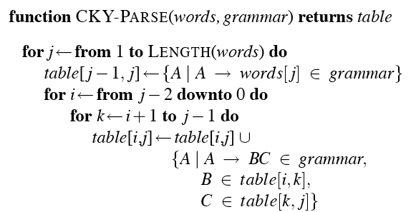
CKY Algorithm

Slide 85
Note
We arranged the loops to fill the table a column at a time, from left to right, bottom to top.
This assures us that whenever we’re filling a cell, the parts needed to fill it are already in the table (to the left and below)
It’s somewhat natural in that it processes the input left to right a word at a time
Known as online

Slide 86
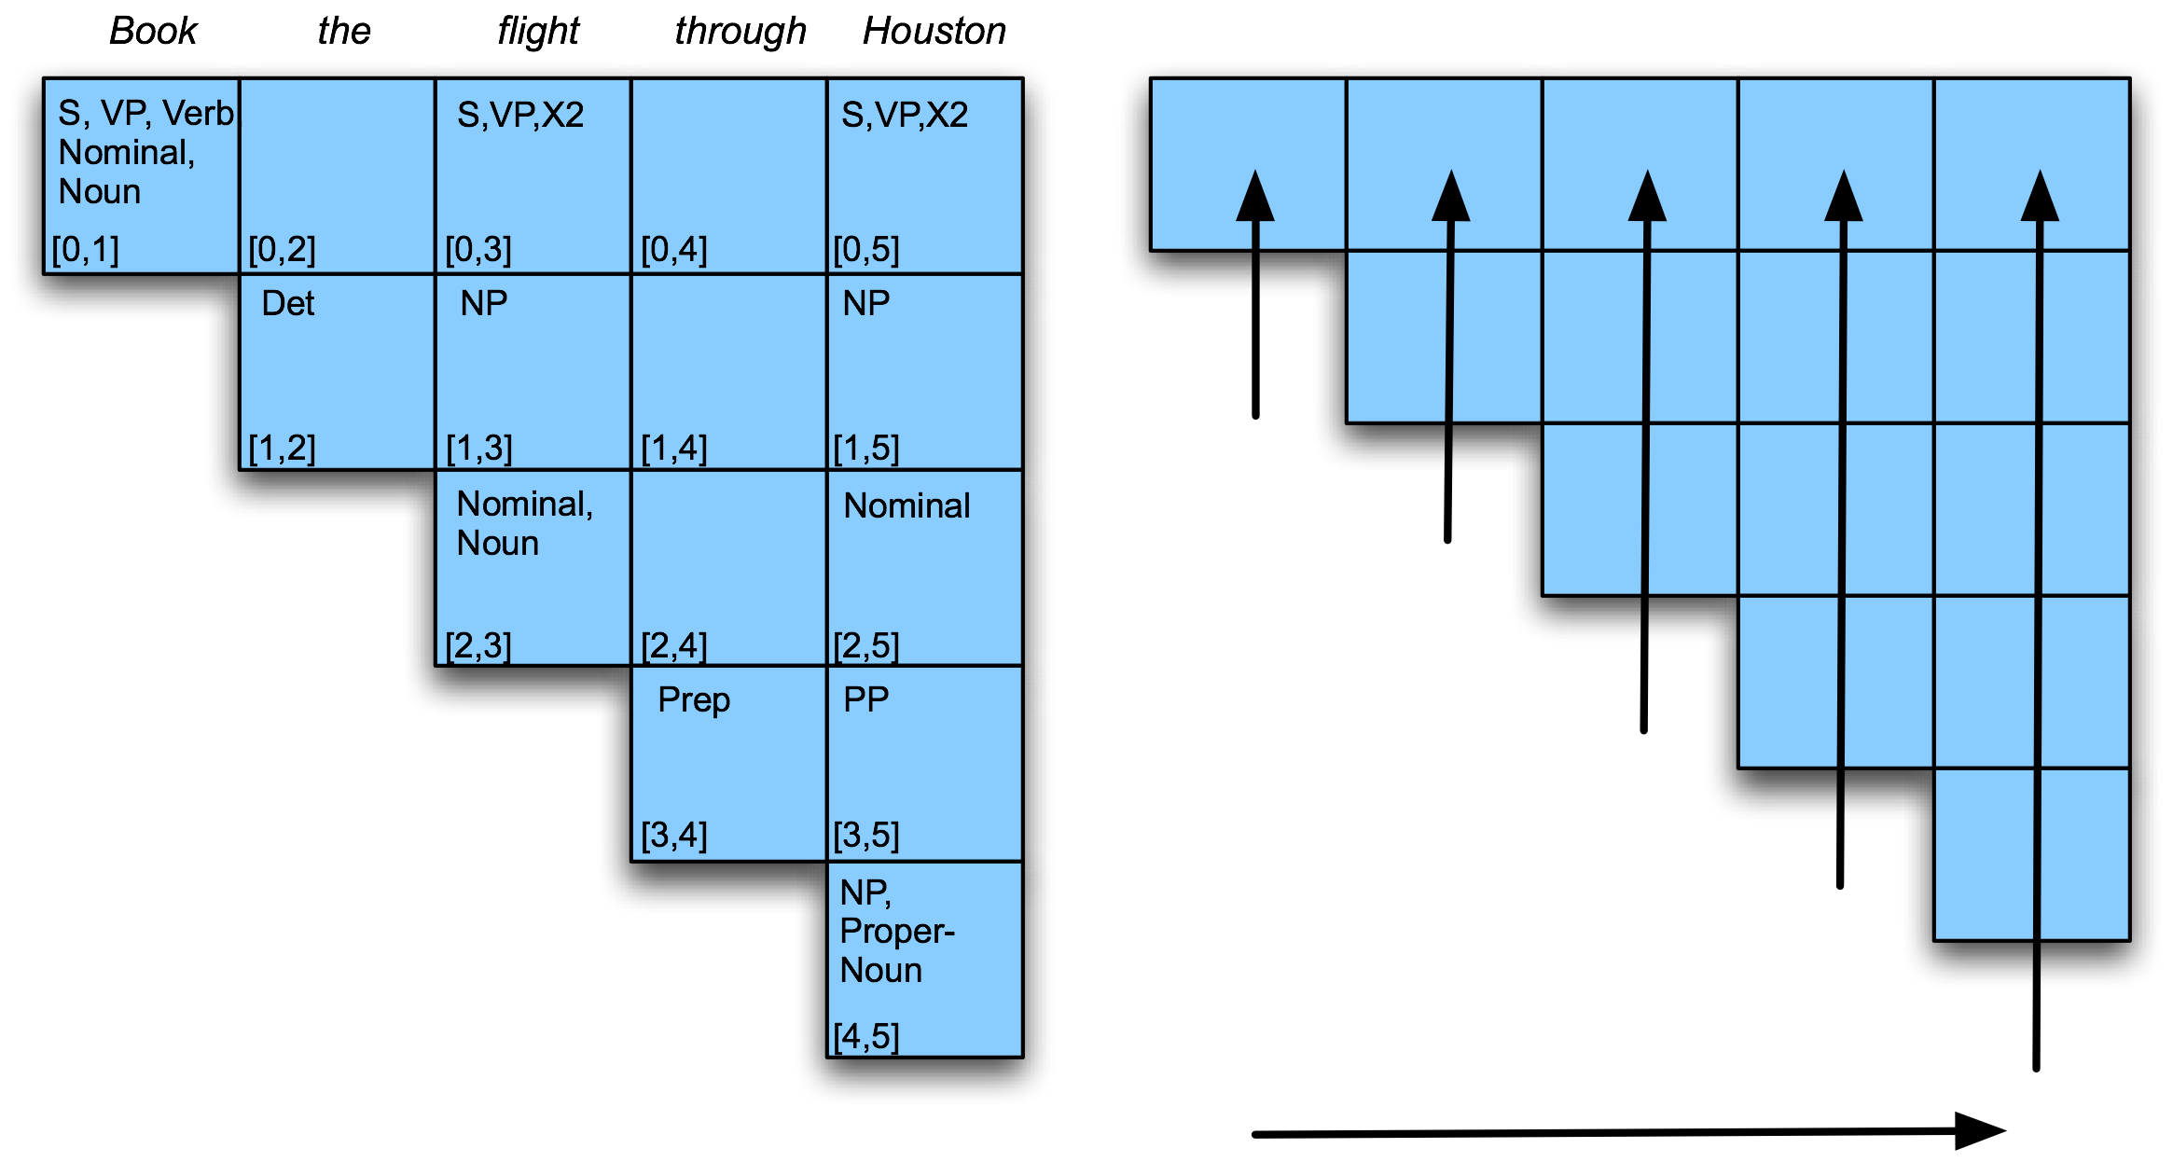
Example

Slide 87
CKY Parser Example

Slide 88
CKY Notes
Since it’s bottom up, CKY populates the table with a lot of phantom constituents.
To avoid this we can switch to a top-down control strategy
Or we can add some kind of filtering that blocks constituents where they can not happen in a final analysis.
Is there a parsing algorithm for arbitrary CFGs that combines dynamic programming and top-down control?

Slide 89
Earley Parsing
Allows arbitrary CFGs
Top-down control
Fills a table in a single sweep over the input
Table is length N+1; N is number of words
Table entries represent a set of states (s_{i}):
A grammar rule
Information about progress made in completing the sub-tree represented by the rule
Span of the sub-tree

Slide 90
States/Locations
S →  VP, [0,0]
NP → Det  Nominal, [1,2]
VP → V NP  , [0,3]
A VP is predicted at the start of the sentence
An NP is in progress; the Det goes from 1 to 2
A VP has been found starting at 0 and ending at 3

Slide 91
Earley
As with most dynamic programming approaches, the answer is found by looking in the table in the right place.
In this case, there should be an S state in the final column that spans from 0 to N and is complete. That is,
S → α  [0,N]
If that’s the case you’re done.

Slide 92
Earley
So sweep through the table from 0 to N…
New predicted states are created by starting top-down from S
New incomplete states are created by advancing existing states as new constituents are discovered
New complete states are created in the same way.

Slide 93
Earley
More specifically…
Predict all the states you can upfront
Read a word
Extend states based on matches
Generate new predictions
Go to step 2
When you’re out of words, look at the chart to see if you have a winner

Slide 94
Earley
Proceeds incrementally, left-to-right
Before it reads word 5, it has already built all hypotheses that are consistent with first 4 words
Reads word 5 & attaches it to immediately preceding hypotheses. Might yield new constituents that are then attached to hypotheses immediately preceding them …
E.g., attaching D to A → B C . D E gives A → B C D . E
Attaching E to that gives A → B C D E .
Now we have a complete A that we can attach to hypotheses immediately preceding the A, etc.

Slide 95
Earley
Three Main Operators:
Predictor: If state s_{i} has a non terminal to the right we add to s_{i} all alternatives to generate the non terminal
Scanner: when there is POS to the right of the dot in s_{i} then scanner will try to match it with an input word and if a successful match is found the new state will be added to s_{i}
Completer: if the dot is at the end of the production then the completer looks for all states looking for the non terminal that has been found and advances the position of the dot for those states.

Slide 96
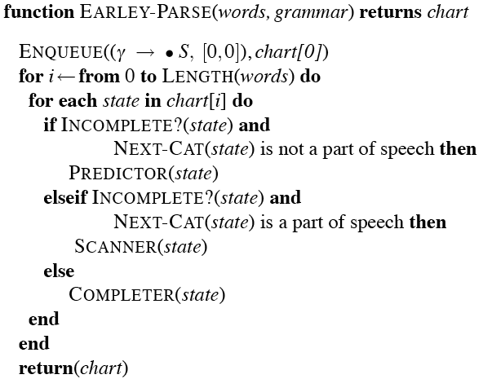
Core Earley Code

Slide 97
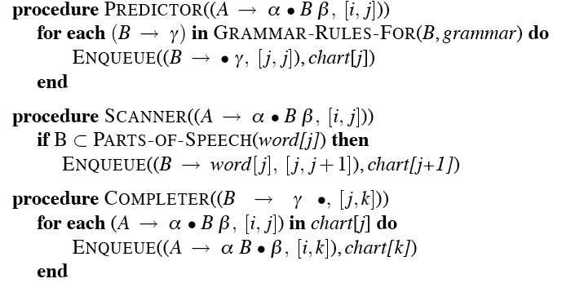
Earley Code

Slide 98
Example
Book that flight
We should find… an S from 0 to 3 that is a completed state…

Slide 99
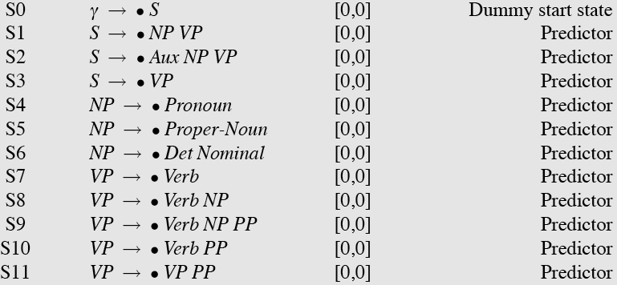
Chart[0]
₀Book ₁ the ₂ flight ₃
Note that given a grammar, these entries are the same for all inputs; they can be pre-loaded.

Slide 100
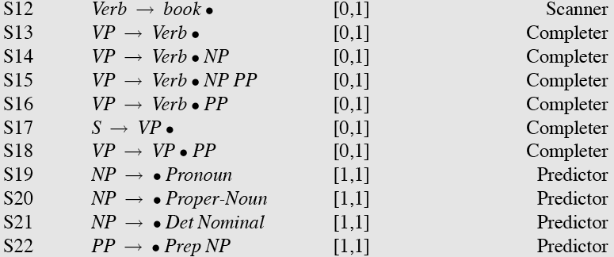
Chart[1]

Slide 101
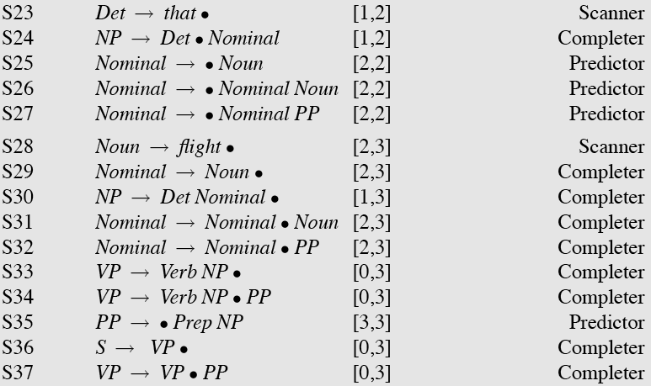
Charts[2] and [3]

Slide 102
Efficiency
For such a simple example, there seems to be a lot of useless stuff in there.
Why?
It’s predicting things that aren’t consistent with the input
That’s the flipside to the CKY problem.

Slide 103
Details
As with CKY that isn’t a parser until we add the backpointers so that each state knows where it came from.

Slide 104
Back to Ambiguity
Did we solve it?

Slide 105
Ambiguity
No…
Both CKY and Earley will result in multiple S structures for the [0,N] table entry.
They both efficiently store the sub-parts that are shared between multiple parses.
And they obviously avoid re-deriving those sub-parts.
But neither can tell us which one is right.

Slide 106
Ambiguity
In most cases, humans don’t notice incidental ambiguity (lexical or syntactic). It is resolved on the fly and never noticed.
We’ll try to model that with probabilities.

