Slide 1

Statistical Parsing
IP disclosure: Content borrowed from J&M 3rd edition and Raymond Mooney.

Slide 2
Statistical Parsing
Statistical parsing uses a probabilistic model of syntax in order to assign probabilities to each parse tree.
Provides principled approach to resolving syntactic ambiguity.
Allows supervised learning of parsers from tree-banks of parse trees provided by human linguists.
Also allows unsupervised learning of parsers from unannotated text, but the accuracy of such parsers has been limited.

Slide 3
Probabilistic Context Free Grammar (PCFG)
A PCFG is a CFG where each production has a probability subject to:
String generation is now probabilistic where production probabilities are used to non-deterministically select a production for rewriting a given non-terminal.

Slide 4
Simple PCFG for English
Grammar
Prob
Lexicon
S → NP VP
S → Aux NP VP
S → VP
NP → Pronoun
NP → Proper-Noun
NP → Det Nominal
Nominal → Noun
Nominal → Nominal Noun
Nominal → Nominal PP
VP → Verb
VP → Verb NP
VP → VP PP
PP → Prep NP
0.8
0.1
0.1
0.2
0.2
0.6
0.3
0.2
0.5
0.2
0.5
0.3
1.0
Det → the | a | that | this
0.6 0.2 0.1 0.1
Noun → book | flight | meal | money
0.1 0.5 0.2 0.2
Verb → book | include | prefer
0.5 0.2 0.3
Pronoun → I | he | she | me
0.5 0.1 0.1 0.3
Proper-Noun → Houston | NWA
0.8 0.2
Aux → does
1.0
Prep → from | to | on | near | through
0.25 0.25 0.1 0.2 0.2
+
1.0
+
1.0
+
1.0
+
1.0

Slide 5
Sentence Probability
Probability of derivation is the product of the probabilities of its productions.
P(D₁) = 0.1 x 0.5 x 0.5 x 0.6 x 0.6 x
0.5 x 0.3 x 1.0 x 0.2 x 0.2 x
0.5 x 0.8
⁼ 0.0000216
S
D₁
0.1
VP
0.5
Verb NP
0.6
0.5
book
Det Nominal
0.5
0.6
the
Nominal PP
1.0
0.3
Noun
Prep NP
0.2
0.5
0.2
flight
through
Proper-Noun
0.8
Houston

Slide 6
Syntactic Disambiguation
Resolve ambiguity by picking most probable parse tree.
S
D₂
P(D₂) = 0.1 x 0.3 x 0.5 x 0.6 x 0.5 x
0.6 x 0.3 x 1.0 x 0.5 x 0.2 x
0.2 x 0.8
⁼ 0.00001296
0.1
VP
0.3
VP
0.5
Verb NP
0.6
0.5
PP
book
Det Nominal
1.0
0.6
0.3
the
Noun
Prep NP
0.2
0.5
0.2
flight
through
Proper-Noun
0.8
Houston
6

Slide 7
Sentence Probability
Probability of a sentence is the sum of the probabilities of all of its derivations.
P(“book the flight through Houston”) =
P(D₁) + P(D₂) = 0.0000216 + 0.00001296
= 0.00003456

Slide 8
Three Useful PCFG Tasks
Observation likelihood: To classify and order sentences.
Most likely derivation: To determine the most likely parse tree for a sentence.
Maximum likelihood training: To train a PCFG to fit empirical training data.

Slide 9
PCFG: Most Likely Derivation
There is an analog to the Viterbi algorithm to efficiently determine the most probable derivation (parse tree) for a sentence.
Notes:
9

Slide 10
Probabilistic CKY
CKY can be modified for PCFG parsing by including in each cell a probability for each non-terminal.
Cell[i,j] must retain the most probable derivation of each constituent (non-terminal) covering words i +1 through j together with its associated probability.
When transforming the grammar to CNF, must set production probabilities to preserve the probability of derivations.

Slide 11
Probabilistic Grammar Conversion
Original Grammar
Chomsky Normal Form
S → NP VP
S → Aux NP VP
S → VP
NP → Pronoun
NP → Proper-Noun
NP → Det Nominal
Nominal → Noun
Nominal → Nominal Noun
Nominal → Nominal PP
VP → Verb
VP → Verb NP
VP → VP PP
PP → Prep NP
S → NP VP
S → X1 VP
X1 → Aux NP
S → book | include | prefer
0.01 0.004 0.006
S → Verb NP
S → VP PP
NP → I | he | she | me
0.1 0.02 0.02 0.06
NP → Houston | NWA
0.16 .04
NP → Det Nominal
Nominal → book | flight | meal | money
0.03 0.15 0.06 0.06
Nominal → Nominal Noun
Nominal → Nominal PP
VP → book | include | prefer
0.1 0.04 0.06
VP → Verb NP
VP → VP PP
PP → Prep NP
0.8
0.1
0.1
0.2
0.2
0.6
0.3
0.2
0.5
0.2
0.5
0.3
1.0
0.8
0.1
1.0
0.05
0.03
0.6
0.2
0.5
0.5
0.3
1.0
Notes:
11

Slide 12
Probabilistic Grammar Conversion
The lexical entries
Noun → book | flight | meal | money
0.1 0.5 0.3 0.1
Proper-Noun → Houston | NWA
0.8 0.2
Verb → book | include | prefer
0.5 0.2 0.3
Det → the | a
0.6 0.4
Notes:
12

Slide 13
Probabilistic CKY Example

Slide 14
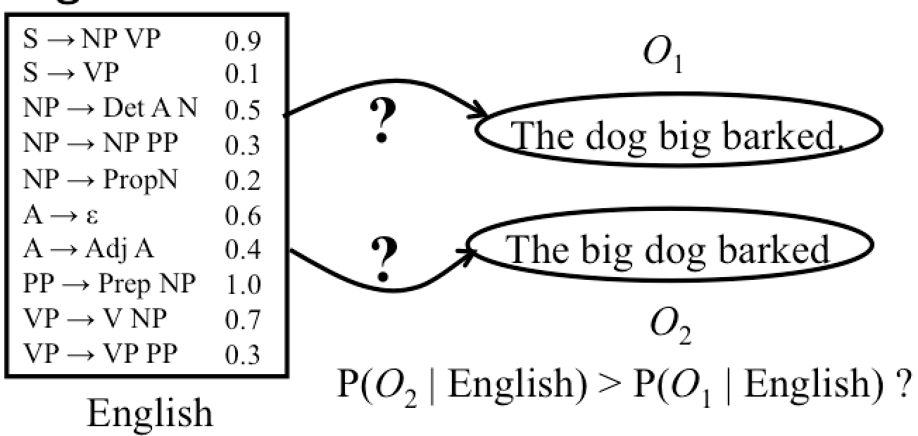
PCFG: Observation Likelihood
There is an analog to Forward algorithm for HMMs called the Inside algorithm for efficiently determining how likely a string is to be produced by a PCFG.
Can use a PCFG as a language model to choose between alternative sentences for speech recognition or machine translation.

Slide 15
Inside Algorithm
Use CKY probabilistic parsing algorithm but combine probabilities of multiple derivations of any constituent using addition instead of max.

Slide 16
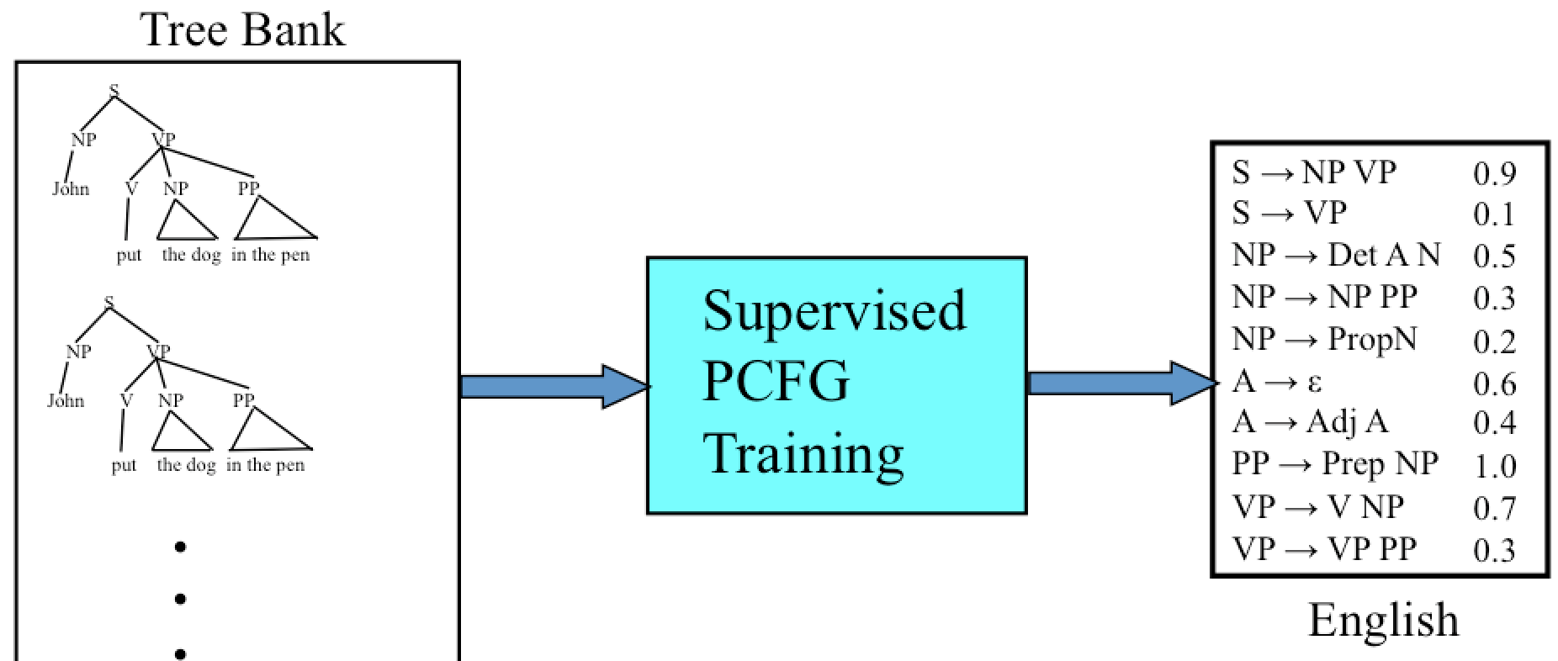
PCFG: Supervised Training
If parse trees are provided for training sentences, a grammar and its parameters can all be estimated directly from counts accumulated from the tree-bank (with appropriate smoothing).

Slide 17
Estimating Production Probabilities
Set of production rules can be taken directly from the set of rewrites in the treebank.
Parameters can be directly estimated from frequency counts in the treebank.

Slide 18
Vanilla PCFG Limitations
Lack ability to model relationships across the parse tree.
Only general structural disambiguation is possible (e.g. prefer to attach PPs to Nominals).
Consequently, vanilla PCFGs cannot resolve syntactic ambiguities that require semantics to resolve, e.g. ate with fork vs. meatballs.
In order to work well, PCFGs must be lexicalized (e.g. VP-ate).

Slide 19
Head Words
Syntactic phrases usually have a word in them that is most “central” to the phrase.
Linguists have defined the concept of a lexical head of a phrase.
Simple rules can identify the head of any phrase by percolating head words up the parse tree.
Head of a VP is the main verb
Head of an NP is the main noun
Head of a PP is the preposition
Head of a sentence is the head of its VP

Slide 20
Lexicalized Productions
Specialized productions can be generated by including the head word and its POS of each non-terminal as part of that non-terminal’s symbol.
S
liked-VBD
NP
John-NNP
VP
liked-VBD
NNP
VBD NP
dog-NN
Nominaldog-NN → Nominaldog-NN PPin-IN
John
liked
DT Nominal
dog-NN
the
Nominal PP
in-IN
dog-NN
NN
IN NP
pen-NN
dog
in
DT Nominal
pen-NN
the
NN
pen

Slide 21
Lexicalized Productions
S
put-VBD
NP
John-NNP
VP
put-VBD
VPput-VBD → VPput-VBD PPin-IN
NNP
VP PP
in-IN
put-VBD
John
VBD
NP
dog-NN
IN NP
pen-NN
put
DT Nominal
in
DT Nominal
pen-NN
dog-NN
the
the
NN
NN
dog
pen

Slide 22
Parameterizing Lexicalized Productions
Accurately estimating parameters on such a large number of very specialized productions could require enormous amounts of treebank data.
Need some way of estimating parameters for lexicalized productions that makes reasonable independence assumptions so that accurate probabilities for very specific rules can be learned.

Slide 23
Missed Context Dependence
Another problem with CFGs is that the production chosen to expand a non-terminal is independent of its context.
However, this independence is frequently violated for normal grammars.
NPs that are subjects are more likely to be pronouns than NPs that are objects.

Slide 24
Splitting Non-Terminals
To provide more contextual information, non-terminals can be split into multiple new non-terminals based on their parent in the parse tree using parent annotation.
A subject NP becomes NP^S since its parent node is an S.
An object NP becomes NP^VP since its parent node is a VP

Slide 25
Parent Annotation Example
S
NP
^S
VP
^S
VP^S → VBD^VP NP^VP
NNP
^NP
VBD NP
^VP
^VP
John
liked
DT Nominal
^NP
^NP
the
Nominal PP
^Nominal
^Nominal
NN
IN NP
^PP
^PP
^Nominal
dog
in
^NP
DT Nominal
^NP
the
NN
^Nominal
pen

Slide 26
Split and Merge
Non-terminal splitting greatly increases the size of the grammar and the number of parameters that need to be learned from limited training data.
Best approach is to only split non-terminals when it improves the accuracy of the grammar.
May also help to merge some non-terminals to remove some un-helpful distinctions and learn more accurate parameters for the merged productions.
Method: Heuristically search for a combination of splits and merges that produces a grammar that maximizes the likelihood of the training treebank.

Slide 27
Treebanks
English Penn Treebank: Standard corpus for testing syntactic parsing consists of 1.2 M words of text from the Wall Street Journal (WSJ).
Typical to train on about 40,000 parsed sentences and test on an additional standard disjoint test set of 2,416 sentences.
Chinese Penn Treebank: 100K words from the Xinhua news service.
Other corpora existing in many languages, see the Wikipedia article “Treebank”

Slide 28
First WSJ Sentence
( (S
(NP-SBJ
(NP (NNP Pierre) (NNP Vinken) )
(, ,)
(ADJP
(NP (CD 61) (NNS years) )
(JJ old) )
(, ,) )
(VP (MD will)
(VP (VB join)
(NP (DT the) (NN board) )
(PP-CLR (IN as)
(NP (DT a) (JJ nonexecutive) (NN director) ))
(NP-TMP (NNP Nov.) (CD 29) )))
(. .) ))

Slide 29
Parsing Evaluation Metrics
PARSEVAL metrics measure the fraction of the constituents that match between the computed and human parse trees. If P is the system’s parse tree and T is the human parse tree (the “gold standard”):
Recall = (# correct constituents in P) / (# constituents in T)
Precision = (# correct constituents in P) / (# constituents in P)
Labeled Precision and labeled recall require getting the non-terminal label on the constituent node correct to count as correct.
F₁ is the harmonic mean of precision and recall.

Slide 30
Computing Evaluation Metrics
Correct Tree T
Computed Tree P
S
S
VP
VP
Verb NP
VP
book
Det Nominal
Verb NP
the
Nominal PP
Det Nominal
PP
book
Noun
Prep NP
the
Noun
Prep NP
flight
through
Proper-Noun
flight
through
Proper-Noun
Houston
Houston
# Constituents: 12
# Constituents: 12
# Correct Constituents: 10
Recall = 10/12= 83.3%
Precision = 10/12=83.3%
F₁ = 83.3%

Slide 31
Treebank Results
Results of current state-of-the-art systems on the English Penn WSJ treebank are slightly greater than 90% labeled precision and recall.

Slide 32
Discriminative Parse Reranking
Motivation: Even when the top-ranked parse not correct, frequently the correct parse is one of those ranked highly by a statistical parser.
Use a discriminative classifier that is trained to select the best parse from the N-best parses produced by the original parser.
Reranker can exploit global features of the entire parse whereas a PCFG is restricted to making decisions based on local info.

Slide 33
2-Stage Reranking Approach
Adapt the PCFG parser to produce an N-best list of the most probable parses in addition to the most-likely one.
Extract from each of these parses, a set of global features that help determine if it is a good parse tree.
Train a discriminative classifier (e.g. logistic regression) using the best parse in each N-best list as positive and others as negative.

Slide 34
Parse Reranking
N-Best Parse Trees
PCFG Parser
sentence
Parse Tree
Feature Extractor
Best Parse Tree
Discriminative
Parse Tree
Classifier
Parse Tree Descriptions

Slide 35
Sample Parse Tree Features
Probability of the parse from the PCFG.
The number of parallel conjuncts.
“the bird in the tree and the squirrel on the ground”
“the bird and the squirrel in the tree”
The degree to which the parse tree is right branching.
English parses tend to be right branching (cf. parse of “Book the flight through Houston”)
Frequency of various tree fragments, i.e. specific combinations of 2 or 3 rules.

Slide 36
Evaluation of Reranking
Reranking is limited by oracle accuracy, i.e. the accuracy that results when an omniscient oracle picks the best parse from the N-best list.
Typical current oracle accuracy is around F₁=97%
Reranking can generally improve test accuracy of current PCFG models a percentage point or two.

Slide 37
Other Discriminative Parsing
There are also parsing models that move from generative PCFGs to a fully discriminative model, e.g. max margin parsing (Taskar et al., 2004).
There is also a recent model that efficiently reranks all of the parses in the complete (compactly-encoded) parse forest, avoiding the need to generate an N-best list (forest reranking, Huang, 2008).

Slide 38
Human Parsing
Computational parsers can be used to predict human reading time as measured by tracking the time taken to read each word in a sentence.
Psycholinguistic studies show that words that are more probable given the preceding lexical and syntactic context are read faster.
John put the dog in the pen with a lock.
John put the dog in the pen with a bone in the car.
John liked the dog in the pen with a bone.
Modeling these effects requires an incremental statistical parser that incorporates one word at a time into a continuously growing parse tree.

Slide 39
The

Slide 40
The horse

Slide 41
The horse raced

Slide 42
The horse raced past

Slide 43
The horse raced past the

Slide 44
The horse raced past the barn

Slide 45
The horse raced past the barn fell

Slide 46
Garden Path Sentences
People are confused by sentences that seem to have a particular syntactic structure but then suddenly violate this structure, so the listener is “lead down the garden path”.
vs. The horse raced past the barn broke his leg.
The complex houses married students.
The old man the sea.
While Anna dressed the baby spit up on the bed.
Incremental computational parsers can try to predict and explain the problems encountered parsing such sentences.
The
horse
raced
past
the
barn
fell

Slide 47
Center Embedding
Nested expressions are hard for humans to process beyond 1 or 2 levels of nesting.
The rat the cat chased died.
The rat the cat the dog bit chased died.
The rat the cat the dog the boy owned bit chased died.
Requires remembering and popping incomplete constituents from a stack and strains human short-term memory.
Equivalent “tail embedded” (tail recursive) versions are easier to understand since no stack is required.
The boy owned a dog that bit a cat that chased a rat that died.

Slide 48
Statistical Parsing Conclusions
Statistical models such as PCFGs allow for probabilistic resolution of ambiguities.
PCFGs can be easily learned from treebanks.
Lexicalization and non-terminal splitting are required to effectively resolve many ambiguities.
Current statistical parsers are quite accurate but not yet at the level of human-expert agreement.

Slide 49
Other Applications of PCFGs
Authorship attribution (Raghavan et al., 2010)
Modeling of language acquisition (Waterfall et al., 2010)

