Slide 1

Word classes and part of speech tagging
Reading: Ch. 5, Jurafsky & Martin (Ch. 9 3rd. Edition)
PI Disclosure: This set includes adapted material from Rada Mihalcea, Raymond Mooney and Dan Jurafsky

Slide 2
Outline
Review of coarse grammatical classes
Why part of speech tagging?
Tag sets and problem definition
Automatic approaches:
HMMs
MEMMs

Slide 3
The Categories: Part of Speech: Open and Closed Categories
Part of Speech - POS (pretty much stable set across languages)
Morphological “behavior” is typically consistent within a POS category
Open categories: (“open” to additions)
verb, noun, pronoun, adjective, numeral, adverb
subject to inflection (in general); subject to cross-category derivations
newly coined words always belong to open POS categories
potentially unlimited number of words
Closed categories:
preposition, conjunction, article, interjection, particle
not a base for derivation (possibly only by compounding)
finite and (very) small number of words

Slide 4
Definition
“The process of assigning a part-of-speech or other lexical class marker to each word in a corpus” (Jurafsky and Martin)
WORDS
TAGS
the
girl
kissed
the
boy
on
the
cheek
N
V
P
DET

Slide 5
An Example
WORD
LEMMA
TAG
the
girl
kissed
the
boy
on
the
cheek
the
girl
kiss
the
boy
on
the
cheek
+DET
+NOUN
+VPAST
+DET
+NOUN
+PREP
+DET
+NOUN
From: http://www.xrce.xerox.com/competencies/content-analysis/fsnlp/tagger.en.html

Slide 6
Why is POS Tagging Useful?
First step of a vast number of practical tasks
Speech synthesis
INsult inSULT
OBject obJECT
OVERflow overFLOW
DIScount disCOUNT
CONtent conTENT
Parsing
Need to know if a word is an N or V before you can parse
Information extraction
Finding names, relations, etc.
Machine Translation

Slide 7
Outline
Why part of speech tagging?
Tag sets and problem definition
Automatic approaches:
HMMs
MEMMs

Slide 8
POS Tagging: Choosing a Tagset
Could pick very coarse tagsets
N, V, Adj, Adv.
More commonly used set is finer grained, the “Penn TreeBank tagset”, 45 tags
PRP$, WRB, WP$, VBG
Even more fine-grained tagsets exist

Slide 9
English POS Tagsets
Original Brown corpus used a large set of 87 POS tags.
Most common in NLP today is the Penn Treebank set of 45 tags.
The C5 tagset used for the British National Corpus (BNC) has 61 tags.
Universal POS tagset includes ~12 tags.

Slide 10
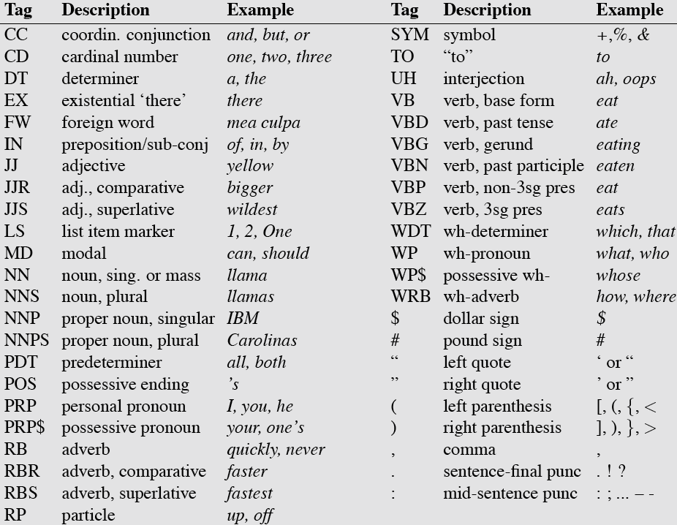
Penn TreeBank POS Tagset

Slide 11
Spanish POS Tagsets
EAGLES: 577 tags
IULA: 435 tags
TreeTagger Spanish: 77 tags

Slide 12
POS Tagging: Definition
The process of assigning a part-of-speech or other lexical class marker to each word in a corpus
Often applied to punctuation markers as well
Input: a string of words and a specified tagset
Output: a single best tag for each word

Slide 13
POS Tagging: The Problem
Words often have more than one word class:
This is a nice day = PRP
This day is nice = DT
You can go this far = RB
The back door = JJ
On my back = NN
Win the voters back = RB
Promised to back the bill = VB

Slide 14
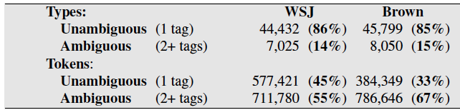
How Hard is POS Tagging? Measuring Ambiguity

Slide 15
Consistent Human Annotation is Crucial
Disambiguating POS tags requires deep knowledge of syntax
Development of clear heuristics in the form of tagging manuals
She told off/RP her friends
She told her friends off/RP
She stepped off/IN the train
*She stepped the train off/IN
See Manning (2011) for a more in depth discussion

Slide 16
Part-of-Speech Tagging
Manual Tagging
Automatic Tagging
Two flavors:
Rule-based taggers (EngCC ENGTWOL)
Stochastic taggers (HMM, Max Ent, CRF-based, Tree-based)
Hodge-podge:
Transformation–based tagger (Brill, 1995)

Slide 17
Manual Tagging
Agree on a Tagset after much discussion.
Chose a corpus, annotate it manually by two or more people.
Check on inter-annotator agreement.
Fix any problems with the Tagset (if still possible).

Slide 18
Outline
Why part of speech tagging?
Tag sets and problem definition
Automatic approaches:
HMMs

Slide 19
Classification Learning
Typical machine learning addresses the problem of classifying a feature-vector description into a fixed number of classes.
There are many standard learning methods for this task:
Decision Trees and Rule Learning
Naïve Bayes and Bayesian Networks
Logistic Regression / Maximum Entropy (MaxEnt)
Perceptron and Neural Networks
Support Vector Machines (SVMs)
Nearest-Neighbor / Instance-Based

Slide 20
Beyond Classification Learning
Standard classification problem assumes individual cases are disconnected and independent.
Many NLP problems do not satisfy this assumption (involve many connected decisions, ambiguity and dependence)

Slide 21
Sequence Labeling Problem
Many NLP problems can be viewed as sequence labeling.
Each token in a sequence is assigned a label.
Labels of tokens are dependent on the labels of other tokens in the sequence, particularly their neighbors (not i.i.d).

Slide 22
Sequence Labeling as Classification
Classify each token independently but use as input features, information about the surrounding tokens (sliding window).
John saw the saw and decided to take it to the table.
classifier
NNP

Slide 23
Sequence Labeling as Classification
Classify each token independently but use as input features, information about the surrounding tokens (sliding window).
John saw the saw and decided to take it to the table.
classifier
VBD

Slide 24
Sequence Labeling as Classification
Classify each token independently but use as input features, information about the surrounding tokens (sliding window).
John saw the saw and decided to take it to the table.
classifier
DT

Slide 25
Sequence Labeling as Classification
Classify each token independently but use as input features, information about the surrounding tokens (sliding window).
John saw the saw and decided to take it to the table.
classifier
NN

Slide 26
Sequence Labeling as Classification
Classify each token independently but use as input features, information about the surrounding tokens (sliding window).
John saw the saw and decided to take it to the table.
classifier
CC

Slide 27
Sequence Labeling as Classification
Classify each token independently but use as input features, information about the surrounding tokens (sliding window).
John saw the saw and decided to take it to the table.
classifier
VBD

Slide 28
Sequence Labeling as Classification
Classify each token independently but use as input features, information about the surrounding tokens (sliding window).
John saw the saw and decided to take it to the table.
classifier
TO

Slide 29
Problems with Sequence Labeling as Classification
Not easy to integrate information from category of tokens on both sides.
Difficult to propagate uncertainty between decisions and “collectively” determine the most likely joint assignment of categories to all of the tokens in a sequence.

Slide 30
Probabilistic Sequence Models
Probabilistic sequence models allow interdependent classifications and collectively determine the most likely global assignment.
Two standard models
Hidden Markov Model (HMM)
Conditional Random Field (CRF)

Slide 31
POS Tagging as Sequence Classification
We are given a sentence (an “observation” or “sequence of observations”)
Secretariat is expected to race tomorrow
What is the best sequence of tags that corresponds to this sequence of observations?
Probabilistic view:
Consider all possible sequences of tags
Out of this universe of sequences, choose the tag sequence that is most probable given the observation sequence of n words w₁…w_{n}.

Slide 32

Getting to HMMs
We want, out of all sequences of n tags t₁…t_{n} the single tag sequence such that P(t₁…t_{n}|w₁…w_{n}) is highest.
Hat ^ means “our estimate of the best one”
Argmax_{x} f(x) means “the x such that f(x) is maximized”

Slide 33
Hidden Markov Models

Slide 34
Outline
Introduction to Hidden Markov Models (HMMs)
Forward algorithm
Viterbi algorithm
Forward-Backward (Baum-Welch)

Slide 35
More Formally: Toward HMMs
Markov Models
A Weighted Finite-State Automaton (WFSA)
An FSA with probabilities on the arcs
The sum of the probabilities leaving any arc must sum to one
A Markov chain (or observable Markov Model)
a special case of a WFSA in which the input sequence uniquely determines which states the automaton will go through
Markov chains can’t represent inherently ambiguous problems
Useful for assigning probabilities to unambiguous sequences
Notes:
35

Slide 36
Markov Chain for Weather
Notes:
36

Slide 37
First-order Observable Markov Model
A set of states
Q = q₁, q₂…q_{N;} the state at time t is q_{t}
Current state only depends on previous state
Transition probability matrix A
Special initial probability vector π
Constraints:

Slide 38
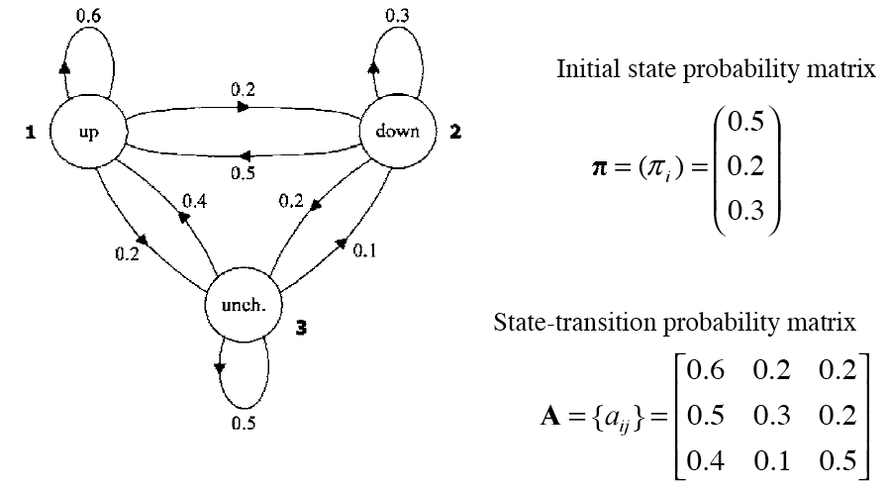
Markov Model for Dow Jones

Slide 39
Markov Model for Dow Jones
What is the probability of 5 consecutive up days?
Sequence is up-up-up-up-up
I.e., state sequence is 1-1-1-1-1
P(1,1,1,1,1) = ?

Slide 40
Markov Model for Dow Jones
P(1,1,1,1,1) =
π₁a₁₁a₁₁a₁₁a₁₁ = 0.5 x (0.6)⁴ = 0.0648

Slide 41
Hidden Markov Model
For Markov chains, the output symbols are the same as the states
See up one day: we’re in state up
But in many NLP tasks:
output symbols are words
hidden states are something else
So we need an extension!
A Hidden Markov Model is an extension of a Markov chain in which the input symbols are not the same as the states.
This means we don’t know which state we are in.
Notes:
41

Slide 42
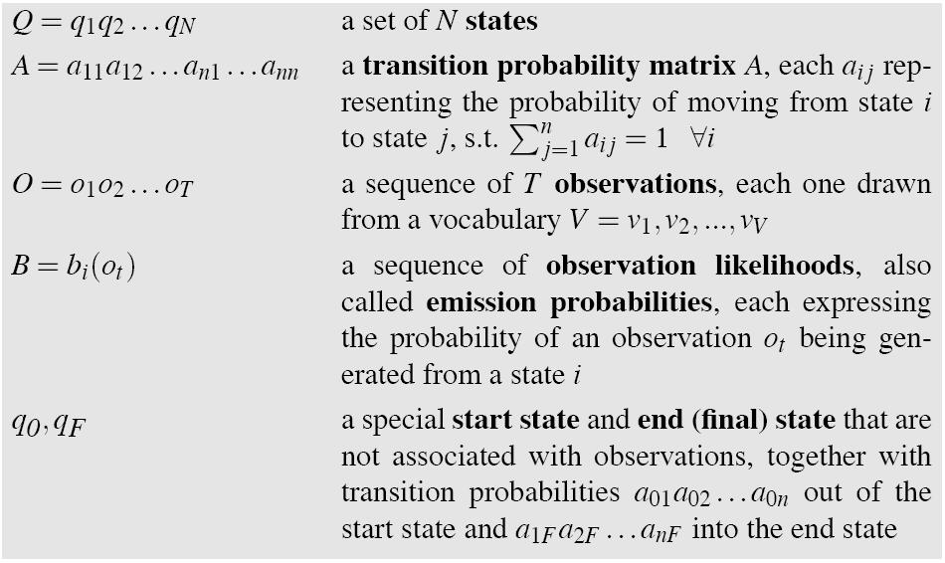
Hidden Markov Models
Notes:
42

Slide 43
Assumptions
Markov assumption:
Output-independence assumption

Slide 44
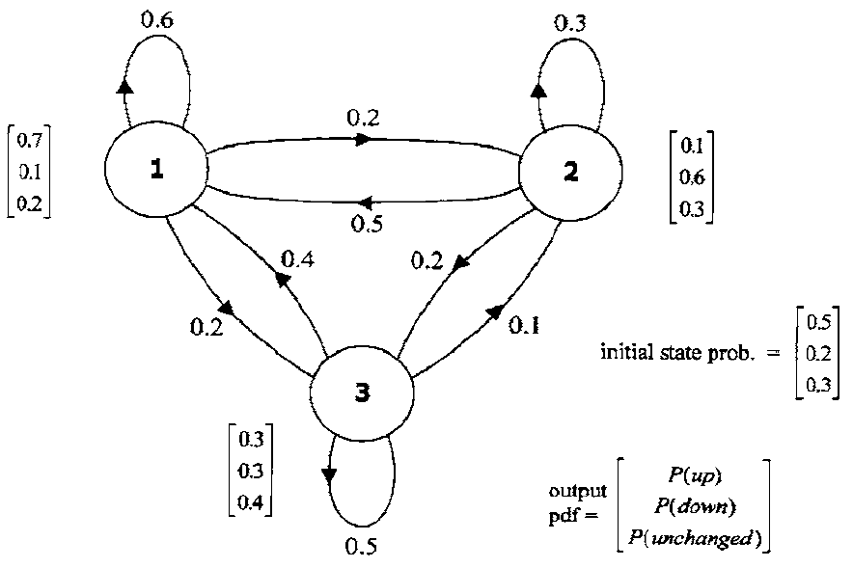
HMM for Dow Jones
From Huang et al.

Slide 45
HMMs for Weather and Ice-cream
Jason Eisner’s cute HMM in Excel, showing Viterbi and EM:
http://www.cs.jhu.edu/~jason/papers/#teaching
Idea:
You are climatologists in 3004
Want to know about Baltimore weather in 2004
Only data you have is Jason Eisner’s diary (how much ice cream he ate)
Observation:
Number of ice creams
Hidden State: Simplify to only 2 states
Weather is Hot or Cold that day.

Slide 46
The Three Basic Problems for HMMs
(From the classic formulation by Larry Rabiner after Jack Ferguson)
L. R. Rabiner. 1989. A tutorial on Hidden Markov Models and Selected Applications in Speech Recognition. Proc IEEE 77(2), 257-286. Also in Waibel and Lee volume.

Slide 47
The Three Basic Problems for HMMs
Problem 1 (Evaluation/Likelihood): Given the observation sequence O=(o₁o₂…o_{T}), and an HMM model Φ = (A,B), how do we efficiently compute P(O| Φ), the probability of the observation sequence, given Φ
Problem 2 (Decoding): Given the observation sequence O=(o₁o₂…o_{T}), and an HMM model Φ = (A,B), how do we choose a corresponding state sequence Q=(q₁q₂…q_{T}) that is optimal in some sense (i.e., best explains the observations)
Problem 3 (Learning): How do we adjust the model parameters Φ = (A,B) to maximize P(O| Φ )?
Notes:
47

Slide 48
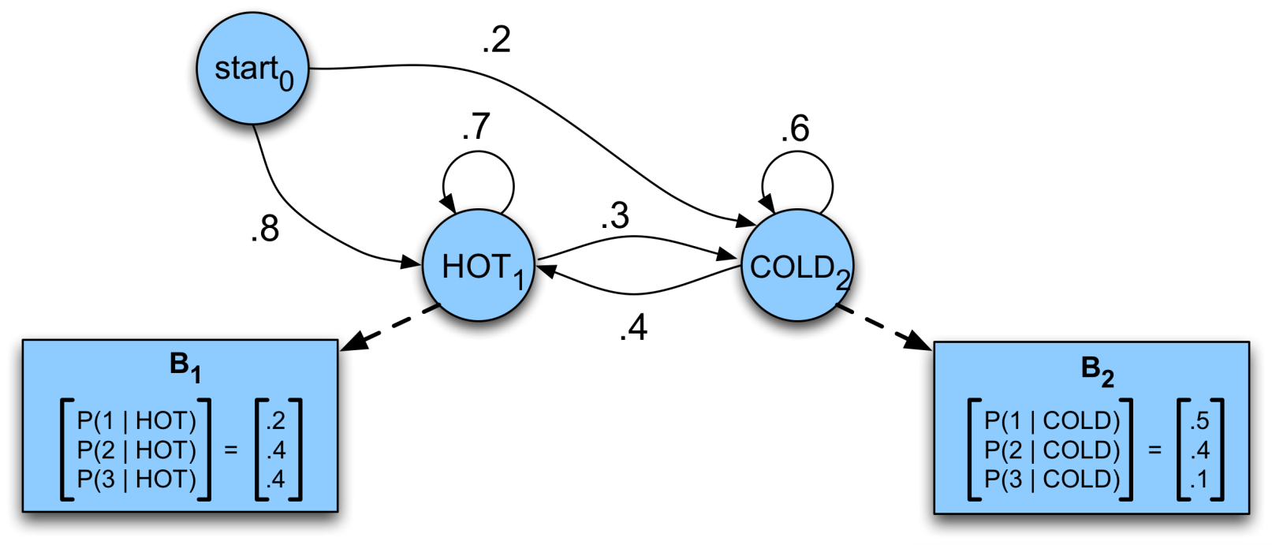
Problem 1: Computing the Observation Likelihood
Given the following HMM:
How likely is the sequence 3 1 3?

Slide 49
How to Compute Likelihood
For a Markov chain, we just follow the states 3 1 3 and multiply the probabilities
But for an HMM, we don’t know what the states are!
So let’s start with a simpler situation
Computing the observation likelihood for a given hidden state sequence
Suppose we knew the weather and wanted to predict how much ice cream Jason would eat
i.e. P( 3 1 3 | H H C)

Slide 50

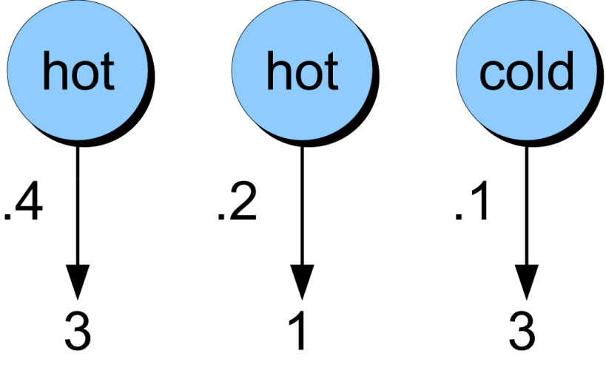
Computing Likelihood of 3 1 3 Given Hidden State Sequence

Slide 51
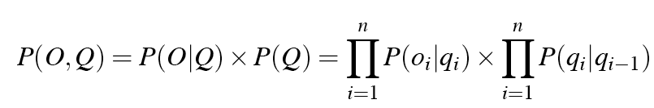
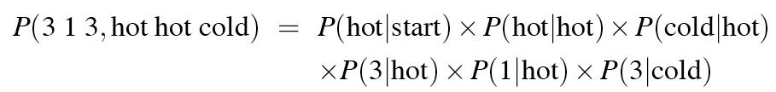
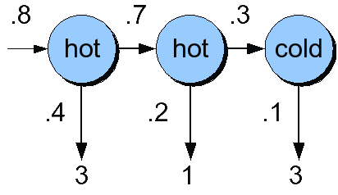
Computing Joint Probability of Observation and a Particular State Sequence

Slide 52

Computing Total Likelihood of 3 1 3
We would need to sum over
Hot hot cold
Hot hot hot
Hot cold hot
….
How many possible hidden state sequences are there for this sequence?
How about in general for an HMM with N hidden states and a sequence of T observations?

Slide 53
Computing Observation Likelihood P(O|Φ)
Why can’t we do an explicit sum over all paths?
Because it’s intractable, there are O(N^{T}) paths
What we do instead:
The Forward Algorithm. O(N²T)
A kind of dynamic programming algorithm
Uses a table to store intermediate values
Idea:
Compute the likelihood of the observation sequence by summing over all possible hidden state sequences

Slide 54
The Forward Algorithm
The goal of the forward algorithm is to compute
We’ll do this by recursion

Slide 55

The Forward Algorithm
Each cell of the forward algorithm trellis α_{t}(j)
Represents the probability of being in state j
After seeing the first t observations
Given the automaton
Each cell thus expresses the following probability

Slide 56
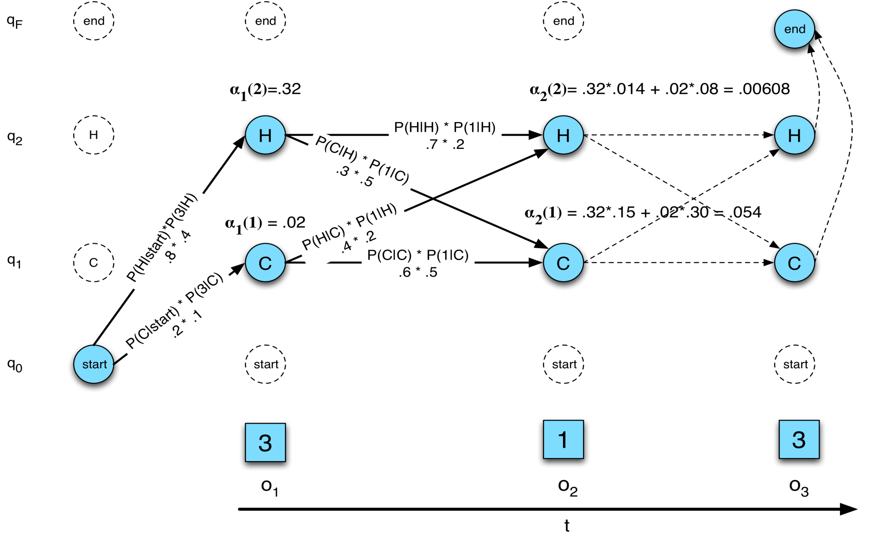
The Forward Trellis

Slide 57
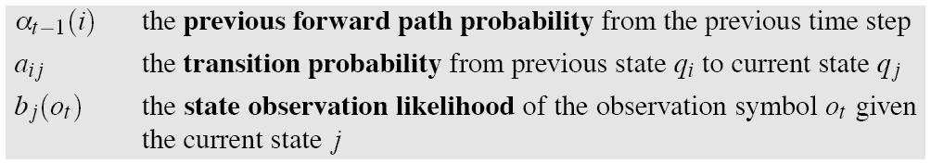
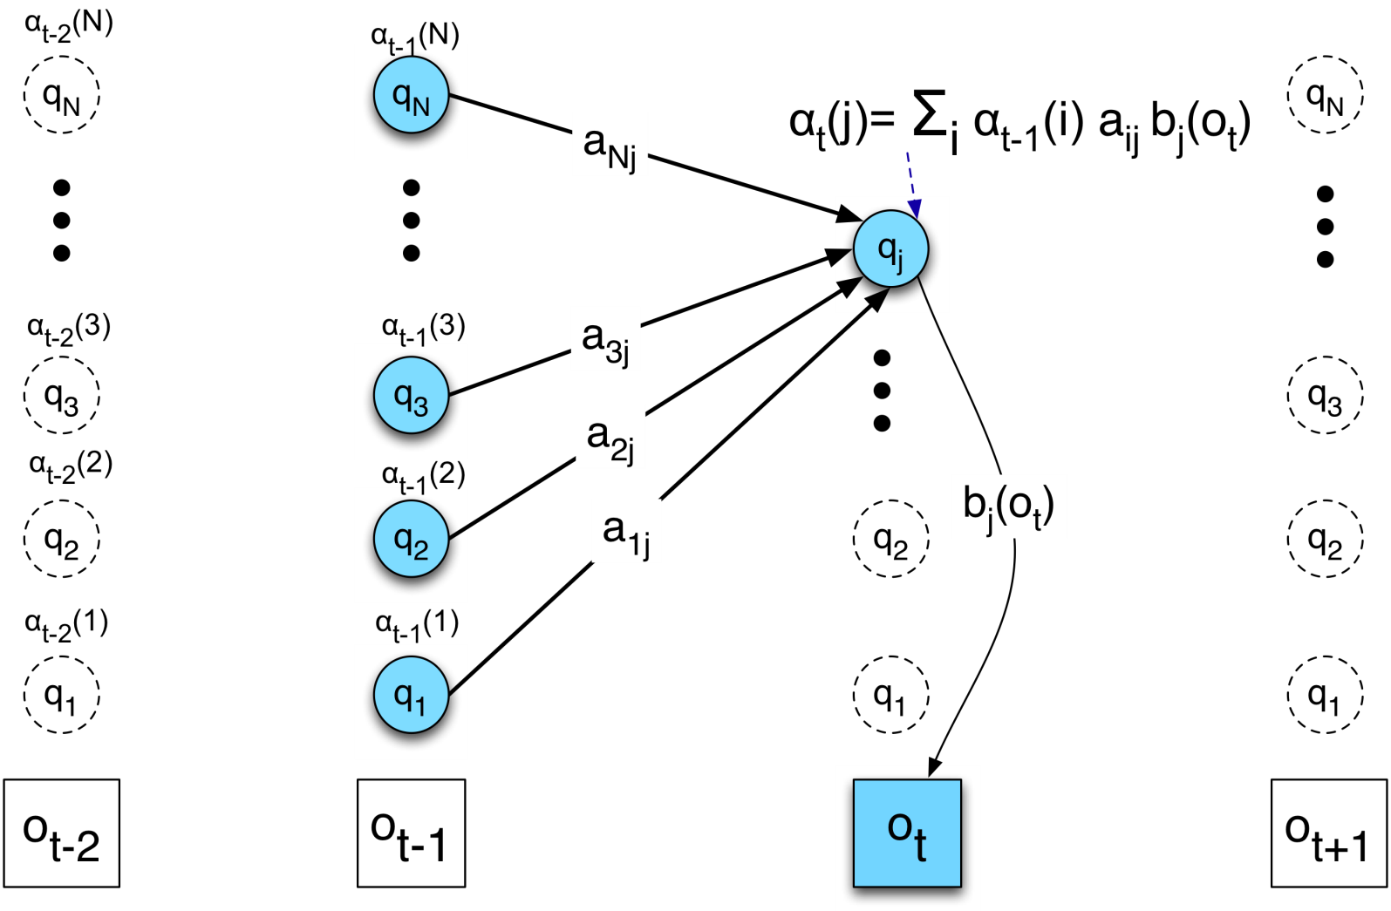
We update each cell

Slide 58
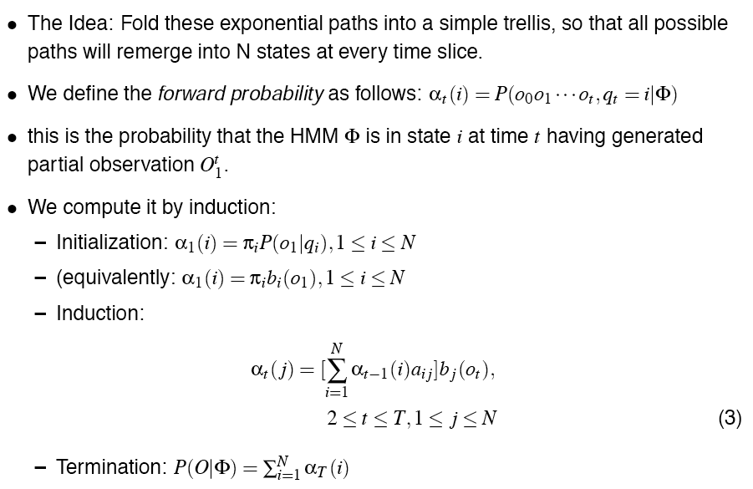
The Forward Algorithm

Slide 59
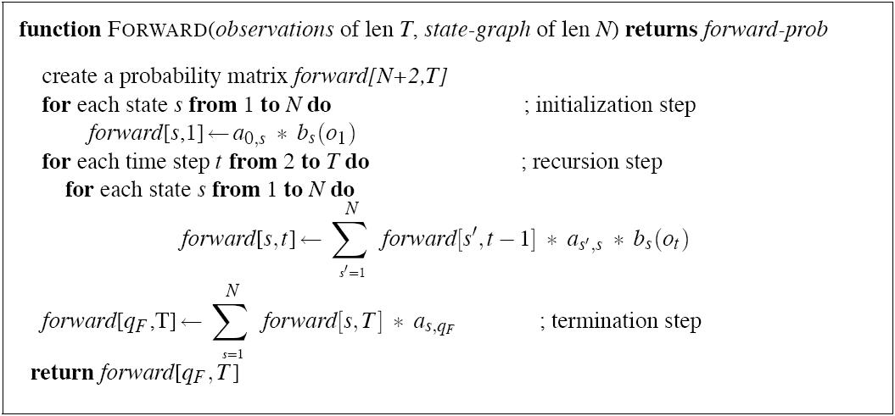
The Forward Algorithm

Slide 60
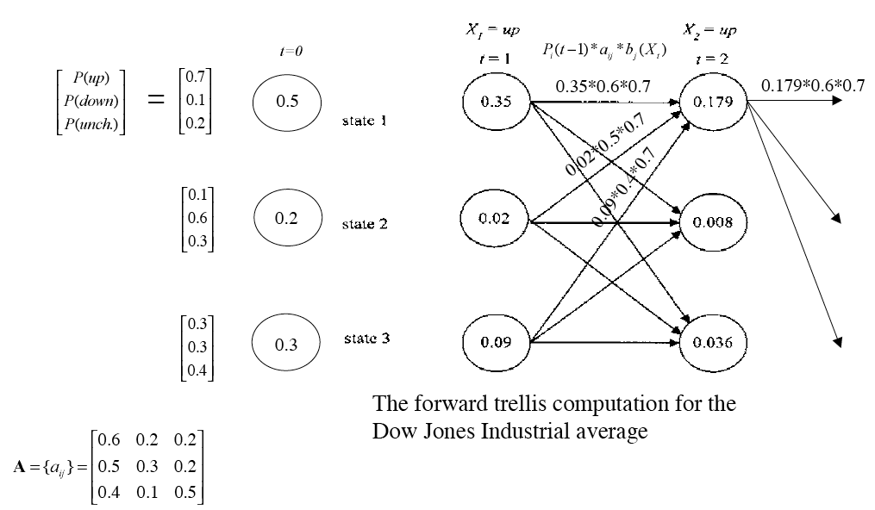
Forward Trellis for Dow Jones

Slide 61
The Three Basic Problems for HMMs
Problem 1 (Evaluation): Given the observation sequence O=(o₁o₂…o_{T}), and an HMM model Φ = (A,B), how do we efficiently compute P(O| Φ), the probability of the observation sequence, given the model
Problem 2 (Decoding): Given the observation sequence O=(o₁o₂…o_{T}), and an HMM model Φ = (A,B), how do we choose a corresponding state sequence Q=(q₁q₂…q_{T}) that is optimal in some sense (i.e., best explains the observations)
Problem 3 (Learning): How do we adjust the model parameters Φ = (A,B) to maximize P(O| Φ )?
Notes:
61

Slide 62
Decoding
Given an observation sequence
up up down
And an HMM
The task of the decoder
To find the best hidden state sequence
We can calculate P(O|path) for each path
Could find the best one
But we can’t do this, since again the number of paths is O(N^{T}). Instead:
Viterbi Decoding: dynamic programming, slight modification of the forward algorithm
Notes:
62

Slide 63


Viterbi intuition
We want to compute the joint probability of the observation sequence together with the best state sequence

Slide 64
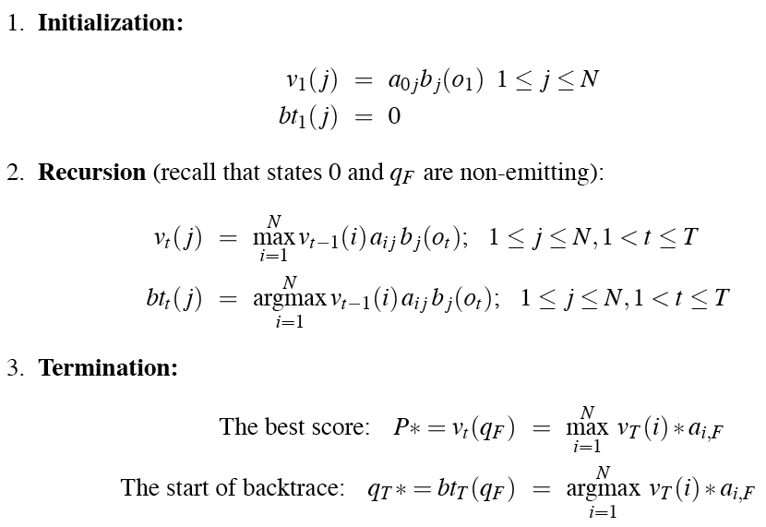
Viterbi Recursion

Slide 65
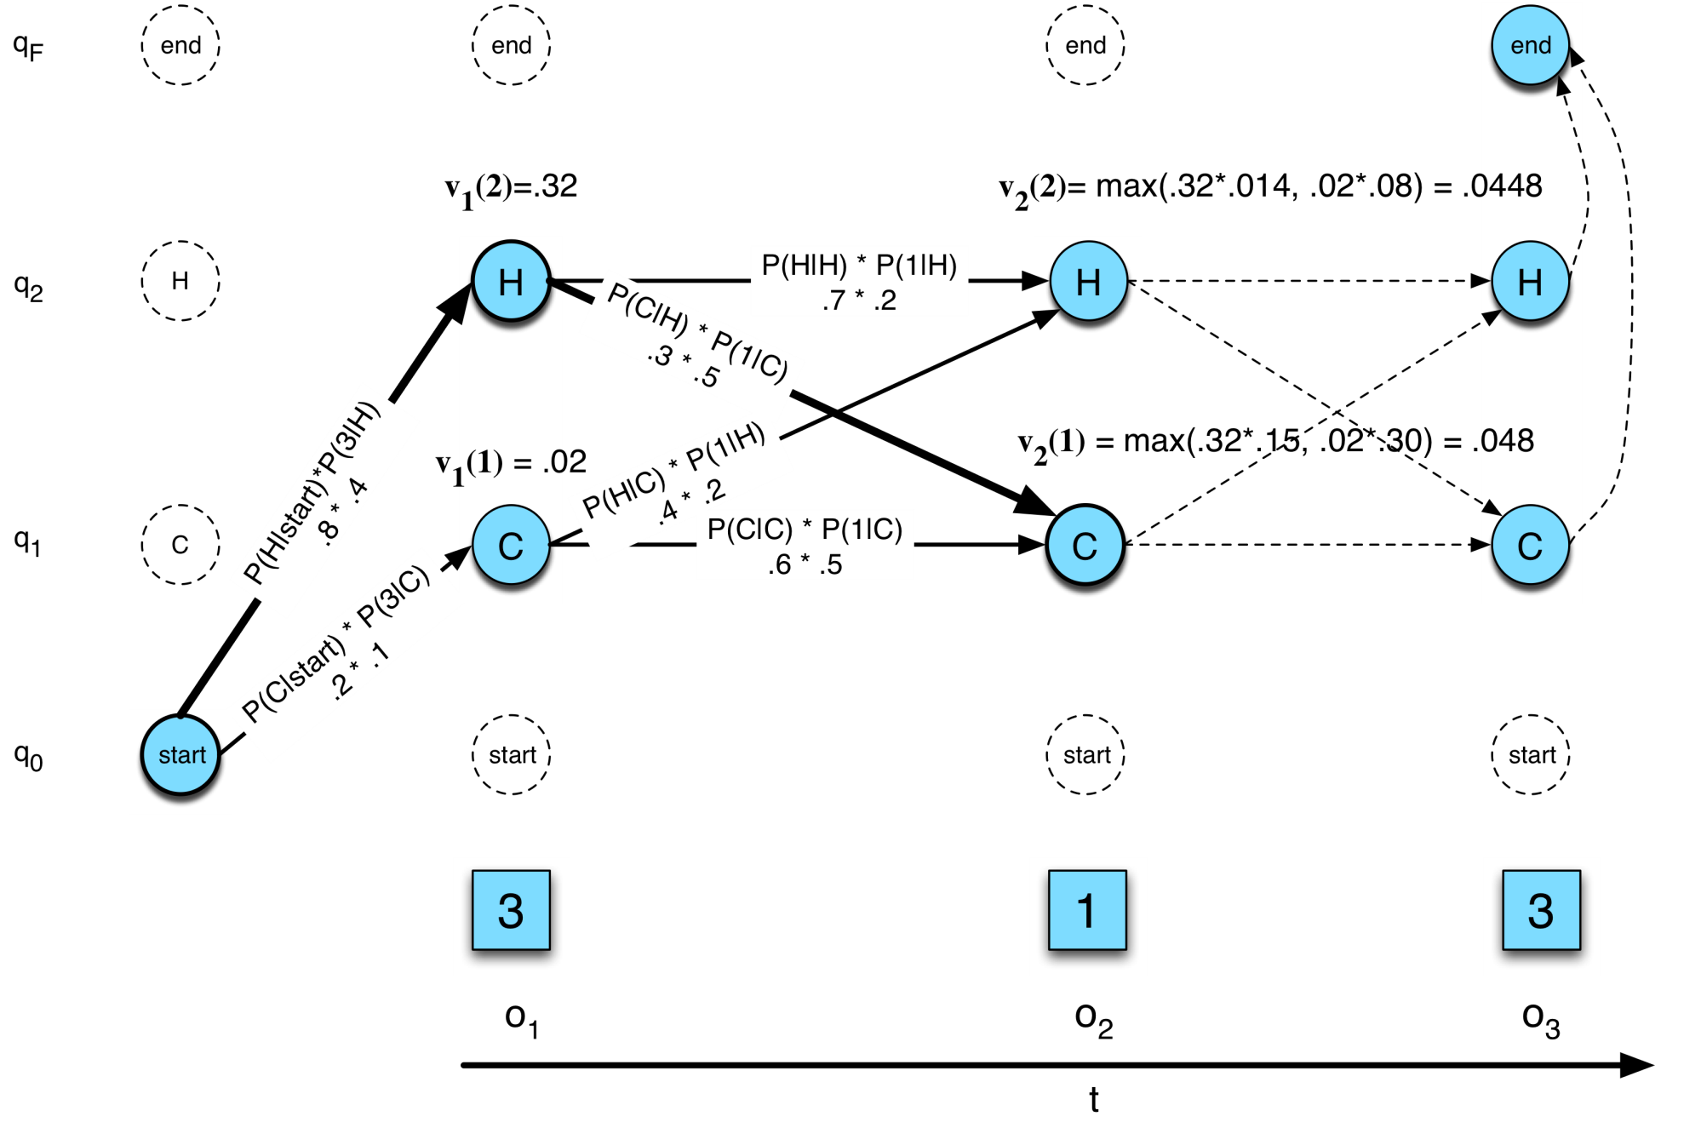
The Viterbi trellis

Slide 66
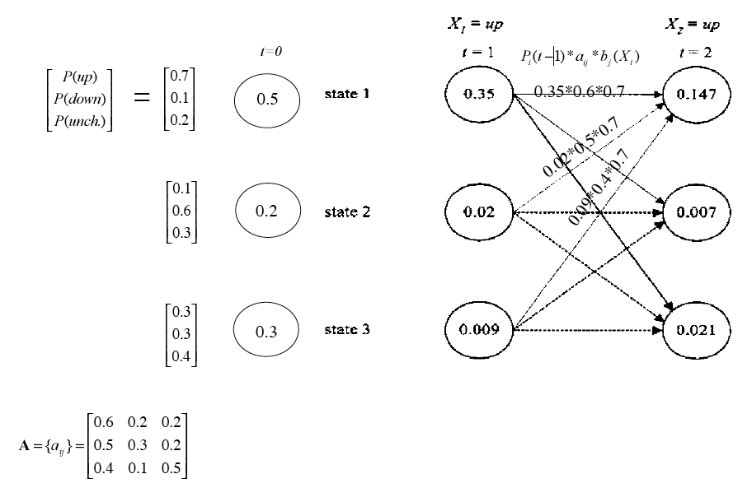
Viterbi for Dow Jones

Slide 67
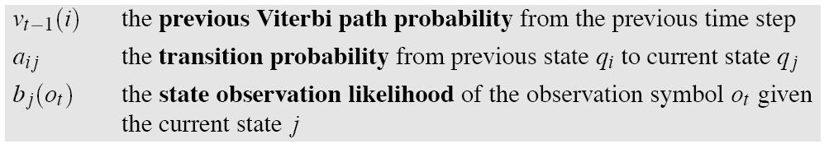
Viterbi Intuition
Process observation sequence left to right
Filling out the trellis
Each cell:
Notes:
67

Slide 68
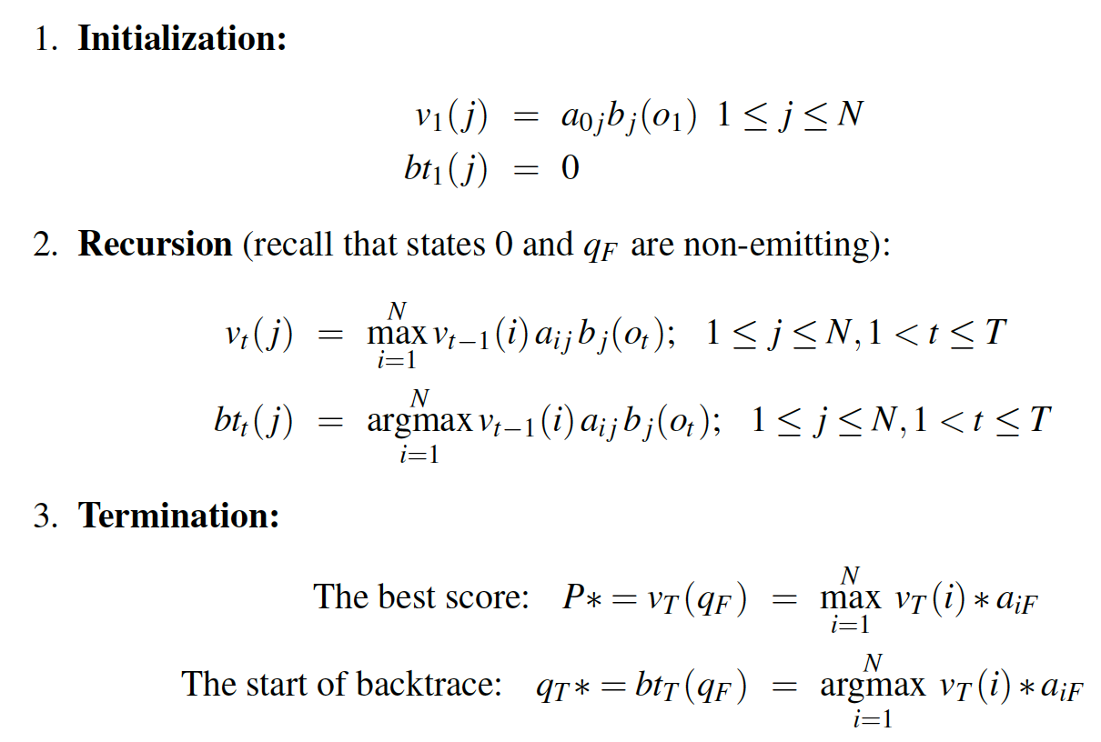
The Viterbi Algorithm

Slide 69
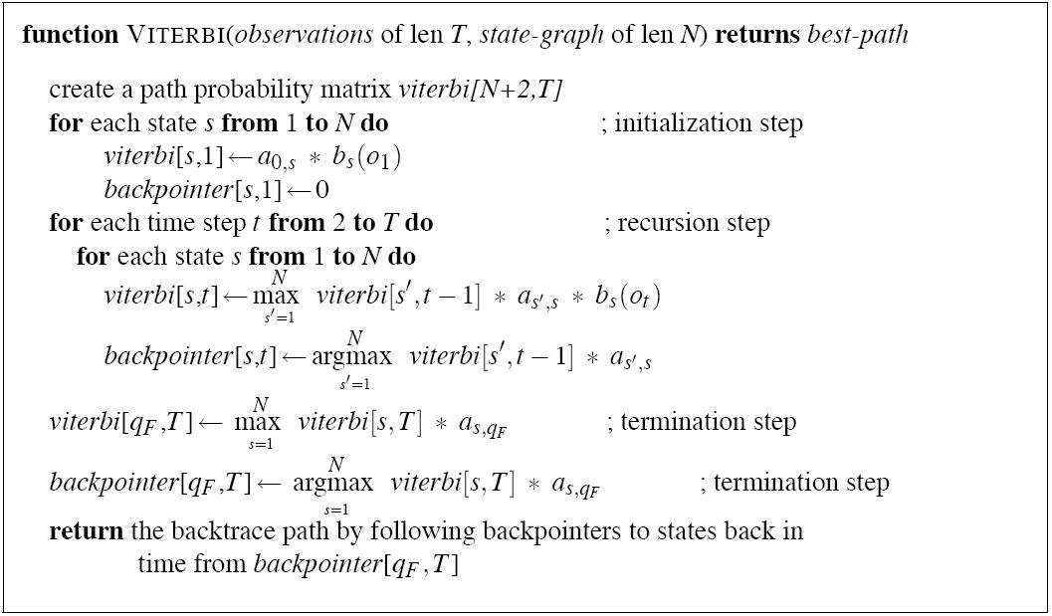
The Viterbi Algorithm

Slide 70
So Far…
Forward algorithm for evaluation
Viterbi algorithm for decoding
Next topic: the learning problem

Slide 71
The Learning Problem
Baum-Welch = Forward-Backward Algorithm (Baum 1972)
Is a special case of the EM or Expectation-Maximization algorithm (Dempster, Laird, Rubin)
The algorithm will let us train the transition probabilities A= {a_{ij}} and the emission probabilities B={b_{i}(o_{t})} of the HMM
Notes:
71

Slide 72
Starting out with Observable Markov Models
How to train?
Run the model on the observation sequence O.
Since it’s not hidden, we know which states we went through, hence which transitions and observations were used.
Given that information, training:
B = {b_{k}(o_{t})}: Since every state can only generate one observation symbol, observation likelihoods B are all 1.0
A = {a_{ij}}:

Slide 73
Extending Intuition to HMMs
For HMMs, cannot compute these counts directly from observed sequences
Baum-Welch (forward-backward) intuitions:
Iteratively estimate the counts
Start with an estimate for a_{ij} and b_{k}, iteratively improve the estimates
Get estimated probabilities by:
computing the forward probability for an observation
dividing that probability mass among all the different paths that contributed to this forward probability
Two related probabilities: the forward probability and the backward probability
Notes:
73

Slide 74
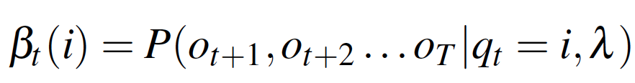
Backward Probability
β is the probability of seeing observations from time t+1 to the end, given that we’re in state i at time t, and given the automaton λ

Slide 75
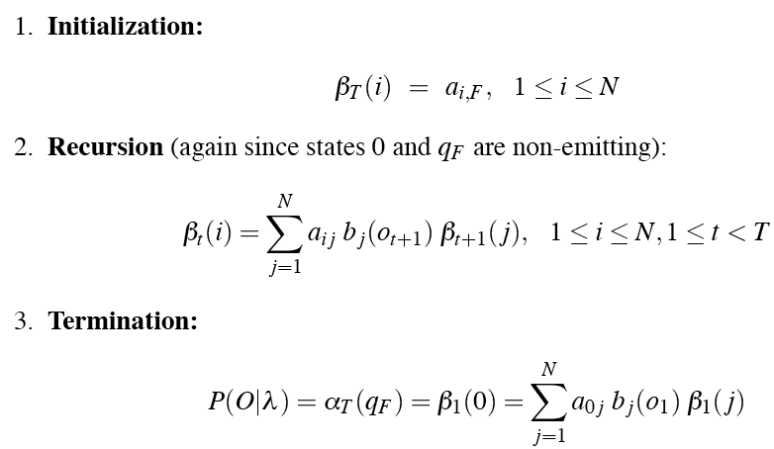
The Backward algorithm
We compute backward prob by induction:
Notes:
75

Slide 76
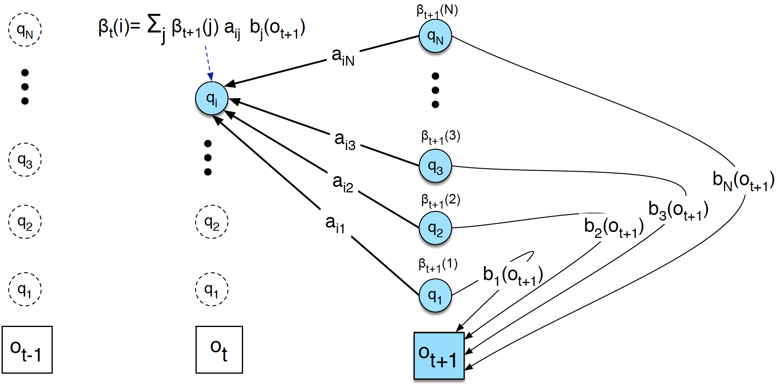
Inductive Step of the Backward Algorithm

Slide 77
Extending Intuition to HMMs
For HMMs, cannot compute these counts directly from observed sequences
Baum-Welch (forward-backward) intuitions:
Iteratively estimate the counts
Start with an estimate for a_{ij} and b_{k}, iteratively improve the estimates
Get estimated probabilities by:
computing the forward probability for an observation
dividing that probability mass among all the different paths that contributed to this forward probability
Two related probabilities: the forward probability and the backward probability
Notes:
77

Slide 78
Intuition for Re-estimation of a_{ij}
We will estimate via this intuition:
Numerator intuition:
Assume we had some estimate of probability that a given transition i→j was taken at time t in observation sequence.
If we knew this probability for each time t, we could sum over all t to get expected value (count) for i→j.

Slide 79
Re-estimation of a_{ij}
Let γ_{t} be the probability of being in state i at time t and state j at time t+1, given O_{1..T} and model Φ:
We can compute γ from not-quite-γ, which is:

Slide 80
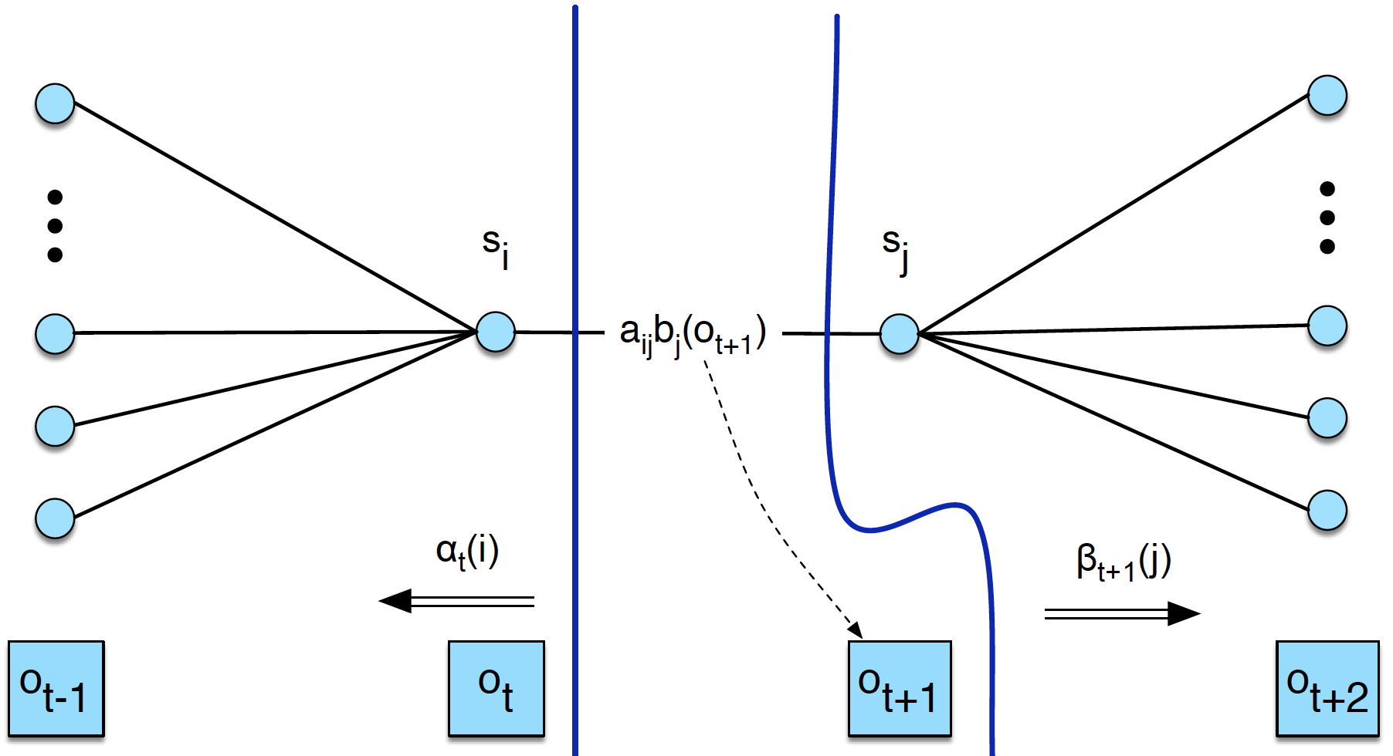
Computing not-quite-γ

Slide 81
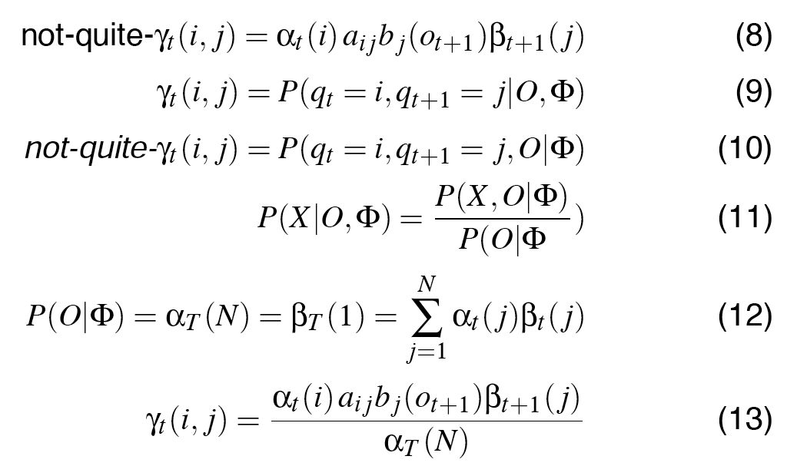
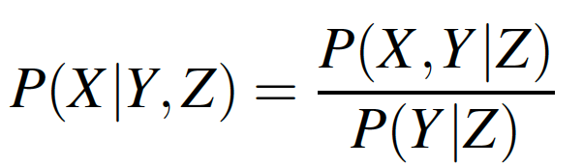
From not-quite-γ to γ

Slide 82
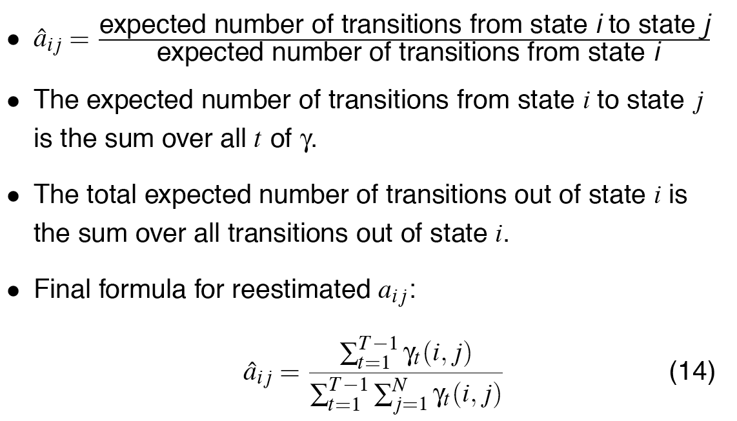
From γ to a_{ij}

Slide 83
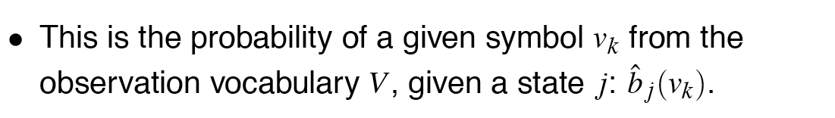
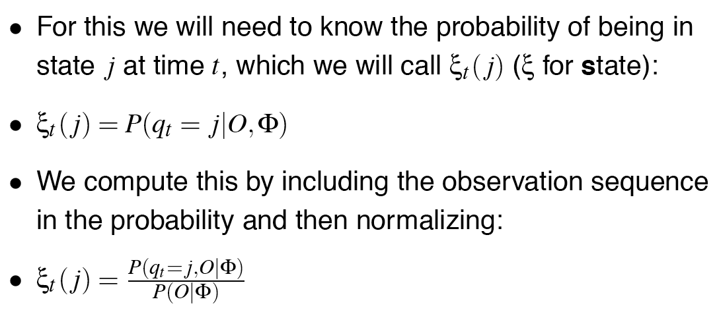
Re-estimating the Observation Likelihood b

Slide 84
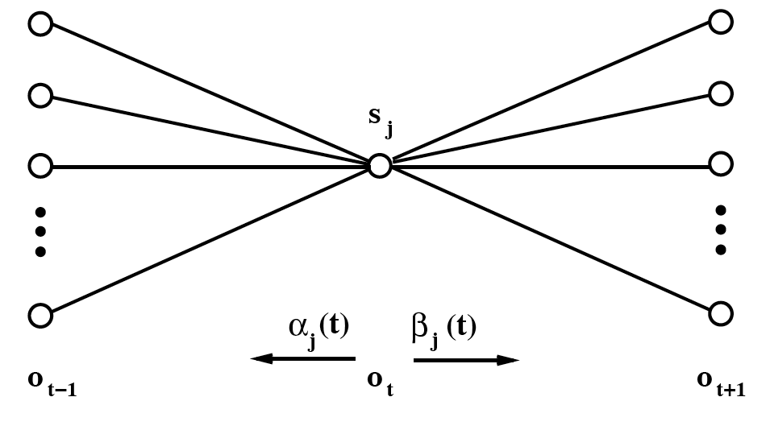
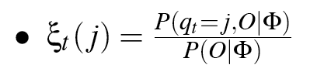
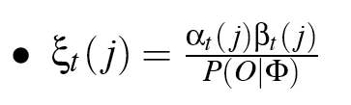
Computing ξ
Computation of ξ_{j}(t), the probability of being in state j at time t.

Slide 85
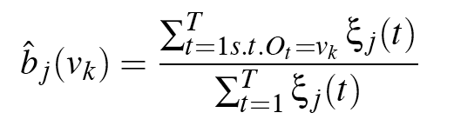
Reestimating the observation Likelihood b
For numerator, sum ξ_{j}(t) for all t in which o_{t} is symbol v_{k:}

Slide 86
Summary of A and B
The ratio between the expected number of transitions from state i to j
and the expected number of all transitions from state i
The ratio between the expected number of times the observation data emitted from state j is v_{k}, and the expected number of times any observation is emitted from state j

Slide 87
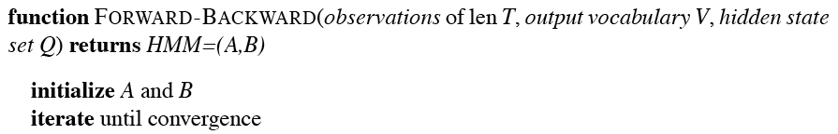
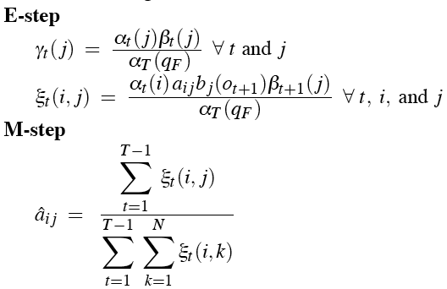
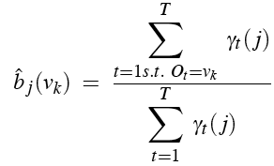

The Forward-Backward Algorithm

Slide 88
Summary: Forward-Backward Algorithm
Initialize Φ=(A,B,π)
Compute α, β, ξ
Estimate new Φ’=(A,B,π)
Replace Φ with Φ’
If not converged go to 2

Slide 89
Training of HMMs
How do we get initial estimates for a and b?
For a we assume that from any state all the possible following states are equiprobable
For b we can use a small hand-labelled training corpus

Slide 90
Summary
We learned the Baum-Welch algorithm for learning the A and B matrices of an individual HMM
It doesn’t require training data to be labeled at the state level; all you have to know is that an HMM covers a given sequence of observations, and you can learn the optimal A and B parameters for this data by an iterative process.

Slide 91
The Learning Problem: Caveats
Network structure of HMM is always created by hand
no algorithm for double-induction of optimal structure and probabilities has been able to beat simple hand-built structures.
Baum-Welch only guaranteed to find a local max, rather than global optimum

Slide 92
Now going back to POS tagging …

Slide 93
HMMs for POS tagging
We want, out of all sequences of n tags t₁…t_{n} the single tag sequence such that P(t₁…t_{n}|w₁…w_{n}) is highest.
Hat ^ means “our estimate of the best one”
Argmax_{x} f(x) means “the x such that f(x) is maximized”

Slide 94
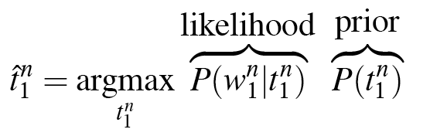
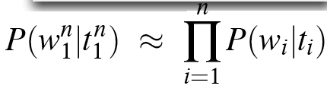
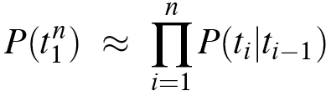
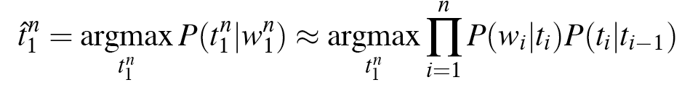
Likelihood and Prior
HMM Taggers choose tag sequence that maximizes this formula:
P(word|tag) × P(tag|previous n tags)

Slide 95
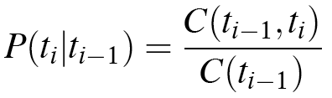
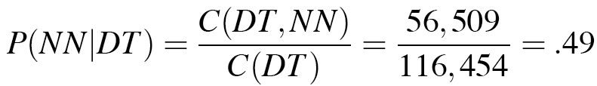
Two Kinds of Probabilities
Tag transition probabilities p(t_{i}|t_{i-1})
Determiners likely to precede adjs and nouns
That/DT flight/NN
The/DT yellow/JJ hat/NN
So we expect P(NN|DT) and P(JJ|DT) to be high
But P(DT|JJ) to be:
Compute P(NN|DT) by counting in a labeled corpus:

Slide 96
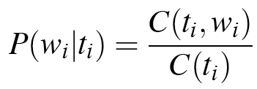
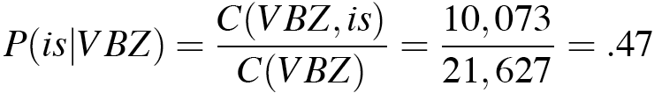
Two Kinds of Probabilities
Word likelihood probabilities p(w_{i}|t_{i})
VBZ (3sg Pres verb) likely to be “is”
Compute P(is|VBZ) by counting in a labeled corpus:

Slide 97
Example: The Verb “race”
Secretariat/NNP is/VBZ expected/VBN to/TO race/VB tomorrow/NR
People/NNS continue/VB to/TO inquire/VB the/DT reason/NN for/IN the/DT race/NN for/IN outer/JJ space/NN
How do we pick the right tag?

Slide 98
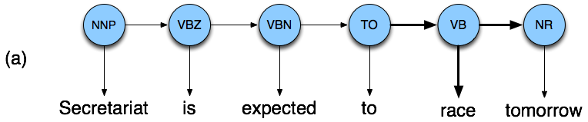

Disambiguating “race”

Slide 99
Example
P(NN|TO) = .00047
P(VB|TO) = .83
P(race|NN) = .00057
P(race|VB) = .00012
P(NR|VB) = .0027
P(NR|NN) = .0012
P(VB|TO)P(NR|VB)P(race|VB) = .00000027
P(NN|TO)P(NR|NN)P(race|NN)=.00000000032

Slide 100
Hidden Markov Models
What we’ve described with these two kinds of probabilities is a Hidden Markov Model (HMM)
MM vs HMM
Both use the same algorithms for tagging they differ on the training algorithms

Slide 101
Example animation

Slide 102
An Early Approach to Statistical POS Tagging
PARTS tagger (Church, 1988): Stores probability of tag given word instead of word given tag.
P(tag|word) × P(tag|previous n tags)
Compare to:
P(word|tag) × P(tag|previous n tags)
What is the main difference between PARTS tagger (Church) and the HMM tagger?

Slide 103
Supervised Parameter Estimation
Estimate state transition probabilities based on tag bigram and unigram statistics in the labeled data.
Estimate the observation probabilities based on tag/word co-occurrence statistics in the labeled data.
Use appropriate smoothing if training data is sparse.

Slide 104
Evaluating Taggers
Train on training set of labeled sequences.
Possibly tune parameters based on performance on a development set.
Measure accuracy on a disjoint test set.
Generally measure tagging accuracy, i.e. the percentage of tokens tagged correctly.
Accuracy of most modern POS taggers, including HMMs is 96−97% (for Penn tagset trained on about 800K words) . Most freq. baseline: ~92.4%
Generally matching human agreement level.

