Slide 1

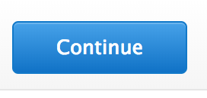


AWS SAP Sizer
Download template
SAP Workloads
General Workloads
Upload spreadsheet
Email address

Slide 2
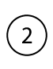
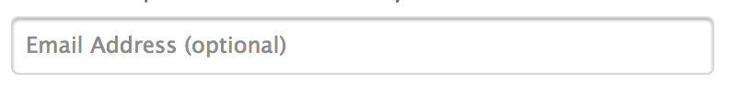
AWS SAP Sizer
Download template
Upload spreadsheet
Email address

Slide 3
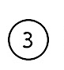
AWS SAP Sizer
Download template
Upload spreadsheet
Email address
Calculate

