Slide 1

Arrhythmia classification from ECG signals
Supervisors
Prof. Aris Anagnostopoulos
Prof. Ioannis Chatzigiannakis
Candidate
Angelo Catalani
1582230

Slide 2
Arrhythmia detection: motivation
Cardiovascular disease is the first cause of death worldwide
Arrhythmia is a dysfunction of regular heart rhythm
  Detection is crucial for clinical reasons
Accurate and low-cost diagnosis of arrhythmic heartbeats is highly desirable
  Project goal: Classify arrhythmias with state-of-the-art neural networks
Arrhythmia classification from ECG signals
Pagina <number>
Notes:
Cardiovascular diseases (CVDs) are the first cause of death worldwide: 18 million people died from CVDs in 2016, representing 31% of all global deaths ([29]).
This project is focused on the cardiovascular diseases related to complications with the electrical system that regulates the steady heartbeat and generates abnormal heartbeats called arrhythmias.
And low-cost diagnosis of arrhythmic heartbeats is highly desirable since it can detect early heart problems and prevent dangerous consequences.
We propose a series of algorithms able to automatically detect arrhythmias, with the aim for the future, to implement them on wearable devices.
It is worth to mention there are, several works have proposed a complete infrastructure to integrate that device in a fog-computing organization.

Slide 3
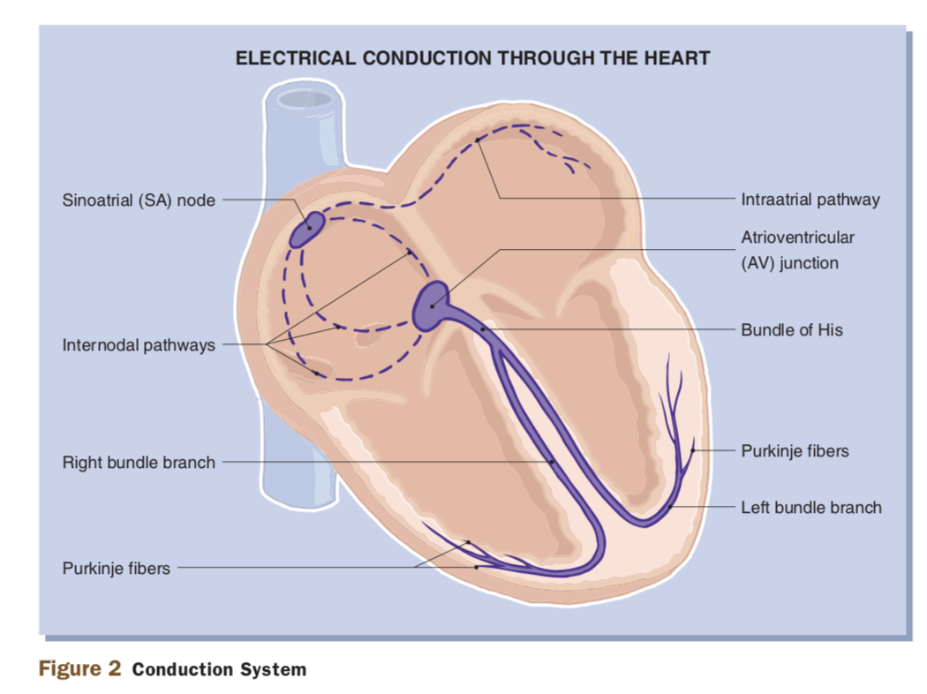
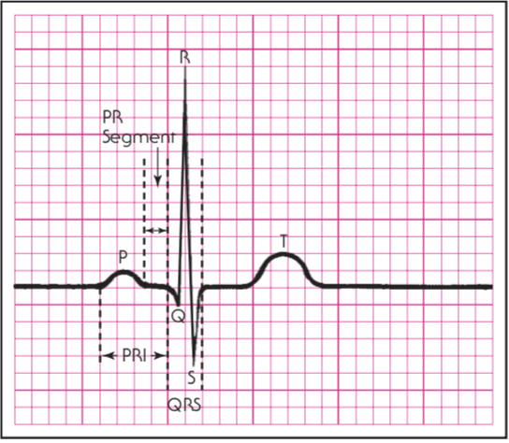
Electrical activity of heart
The ECG tracing is a recording of the electrical activity of the heart
Arrhythmia classification from ECG signals
Pagina <number>
Notes:
A standard tool to diagnose arrhythmias is the electrocardiogram (ECG): measurement of the heart’s electrical activity. Itgives a graphic display of the electrical activity in the heart so that it is possible to identify arrhythmias as recognizable patterns.
Since it is a non-invasive and painless test for the patients, it can be employed to collect massive volumes of data, and subsequently analyze them, to automatically detect arrhythmias.
Cardiologists use their knowledge and experience to carefully evaluate the ECG. However, this activity is time-consuming and prone to error: an automatic approach can support them during their decision.
Normally, the electrical activity originates in the Sino Atrial node travels to the ventricles by the Atrio-Ventricular node. After leaving it, the impulses go through the Bundle of His to reach the right and left bundle branches, located within the right and left ventricles. At the terminal ends of the bundle branches, small fibers distribute the electrical impulses to muscle cells to stimulate contraction.
The wave of depolarization originated in the SinoAtrial node stimulates the atria to contract as the wave advances. The depolarization wave passing through both atria produce a P wave on the ECG trace. When the depolarization wave enters the AV node, a short pause, named PR segment, is produced allowing the blood in the atria to enter the ventricles.
The QRS complex corresponds to the depolarization of both ventricles of the human heart and contraction of the large ventricular muscles. Hence, the QRS complex actually represents the beginning of ventricular contraction. The impulse is greater because the ventricles are bigger that the atrius.
In the end, T wave represents the end phase of ventricular repolarization. It is important to know that atria repolarize too, but this event is not significant enough to show up on the ECG trace.

Slide 4
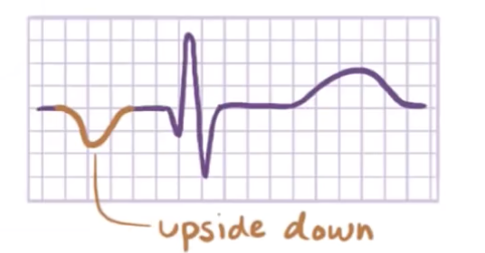
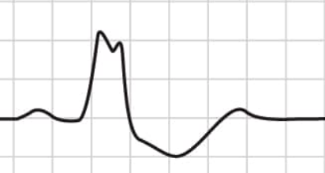
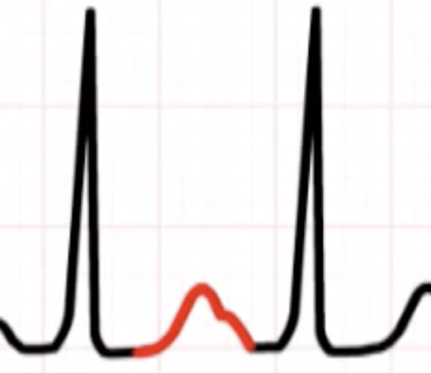
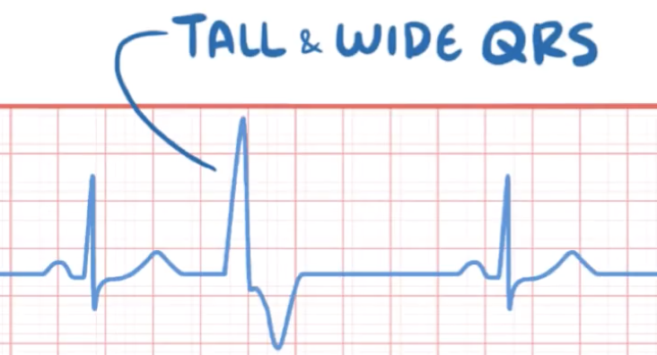
Types of arrhytmias
  Morphological arrhytmias
  Depends on the shape of a single beat
  Divided into 4 macro classes (AAMI standard) : N,S,V,F
N class
S class
V class
F class
Arrhythmia classification from ECG signals
Pagina <number>
Notes:
Arrhythmias can be classified into two macro-categories : rhythmic arrhythmias and morphological arrhythmias.
The first category consists of arrhythmias formed by a set of irregular heartbeats beat types.
while the second category consists of arrhythmias formed by a single irregular heartbeat
N-class: This class includes beats originating in the sinus node such as normal and bundle branch block
S-class: It includes supraventricular ectopic beats.
V-class: Ventricular ectopic beats form this class.
F-class: This class comprises beats that are generated by mutiple sources of depolarization
N-class happens when the beat regularly starts at SA node but can be blocked in the left or right bundle branch.
For example if it is a left bundle branch block, the right ventricles will contract first and then the polarization will happen right to left resulting in a broader QRS complex longer than 120ms
S-class happens when the beat is generated in the atrium in a different position than the SA node : for example if the stimulus is generated at the bottom of the atrium the electrical impulse goes bottom-up so that the ECG detects an upside downP wave
V-class happesn when the impulse originates in the ventricles and it shows up in the ECG as a tall and wide QRS
F-class happens when there are mutiple sorces of depolarization : for example in the picture the P wave is modified by an additional source of depolarization

Slide 5
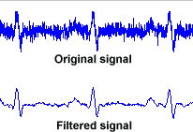
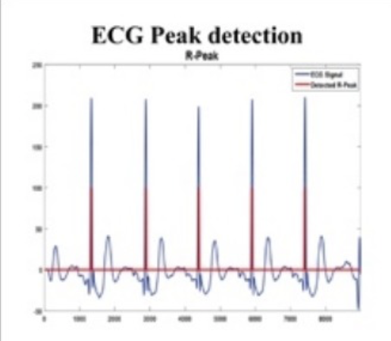
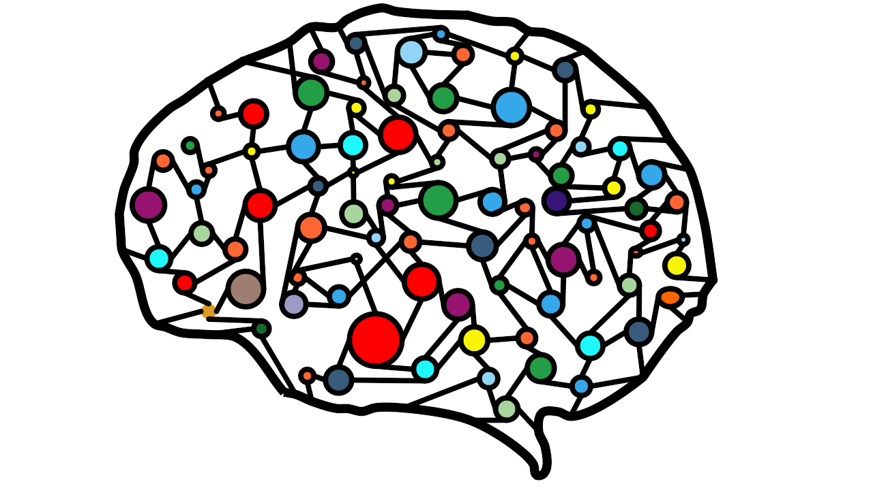
Arrhytmias detection system
Pre-processing
  Noise removal
  Data augmentation
Processing
  Beat Detection
  Feature Extraction
Arrhytmias classification
N,S,V,F
Arrhythmia classification from ECG signals
Pagina <number>
Notes:
The heartbeat classification system consists of three stages: a preprocessing stage, a processing stage, and a classification stage.
The preprocessing stage removes artifact signals from the ECG signal. These artifact signals include baseline wander, power line interference, and high-frequency noise. A widley adopted solution is the discrete wavelet transform
The processing stage consists of heartbeat detection and feature extraction modules. The heartbeat detection module attempts to locate all heartbeats. The feature extraction module forms a feature vecto of relevant featrues from each heartbeat.
The classification stage contains one or more classifier units which select one of the required classes in response to the input feature vector. The most difficult problem faced during automated ECG analysis is that there is a great variety of morphologies among the heartbeats belonging to one class, even for the same patient. Moreover, heartbeats belonging to different classes are morphologically similar to each other.

Slide 6
Arrhythmia classification
Given a set of beats from an ECG detect and classify arrhthmias
Previous approaches :
  Random Forest (Emanet, N et al CMPB 2009)
  SVM (Elhaj, F et al CMPB 2016)
  ResNet with CNNs (Kachuee, M. et al IEEE 2018)
Our best solutions:
  LSTM with Attention (Minh-Thang, Luong et al CoRR 2015)
  Neural ODE (Tian Qi, Chen et al CoRR 2018)
  Neural ODE with Attention
  Tranformer Based (Ashish ,Vaswani er al CoRR 2017)
Arrhythmia classification from ECG signals
Pagina <number>
Notes:
The first model we have replicated has a simple pre-processing and the classification is done with random forest.
Since the results were not good we opted for an approach with a complex pre-processing…
However the results were not satisfactory.
The rason of the failure is due to the fact the dataset is overbalanced anf fails to acquire any generalization power for under-represented classes.
Even if we perform data augmentation the new synthetic samples does not capture the relevant features of rare classes.
This is why we looked for a neural network approach and this one provided good results we have tried to improve.
In particular our models are based on the latest advacemet in neural networks.
The LSTM and Transformer have reached state-of-the-art results on difficult sequence prediction problems like text translation.
While the neural ode have been recelty awarded as best paper at NIPS is 2018
When we started working on this project, we considered the problem of arrhythmia detection as a simple classification task with only four classes. This is why at the beginning, we have approached it with elementary algorithms such as Random Forest.
Secondly, we realized the results were not good and we thought the problem was due to the noise in the signal and a more accurate feature selection, would have provided better accuracy. In fact, we experimented with Discrete Wavelet Transform since it was a popular choice in the literature. However, we did not get a satisfactory outcome and decided to move to more complex models while keeping the pre-processing step.
The reasons for this failure are due to the fact Random Forest applies the begging technique: it trains multiple decision trees on random partitions of the dataset and it computes the most probable outcome on the basis of each single decision tree’s output. In our case, we have an overbalancing problem so that without any form of data augmentation, the various decision’s trees will fail to learn the relevant features of rare classes. When we perform data augmentation, the synthetic samples fail to perfectly represent the low represented classes making weak classifiers for such labels. Even if we perform a pre-processing step to remove noise, the Random Forest can not generalize from synthetic samples.
At this point, we searched in the literature and the model described in [15] was exactly what we intended to implement: Support Vector Machine with a complex pre-processing. The results were slightly better than the first model but still, there was a lot to improve. The reasons for such low performance are probably the same as random forest since data augmentation is not able to create new authentic samples.
At this moment we realized the difficulties of the arrhythmia detection since it was challenging to implement an algorithm able to generalize the relevant features of each beat even for low represented class. We decided to use Neural Networks that are acknowledged to outperform the previous algorithms for complex tasks. The best model we found in the literature was [24] and it effectively provided acceptable results
We have taken into consideration THE LATEST ADVANCEMENT IN NEURAL NETWORKS: the LSTM and Transformer have reached state-of-the-art results on difficult sequence prediction problems like text translation. While the neural ode have been recelty awarded as best paper at NIPS is 2018

Slide 7
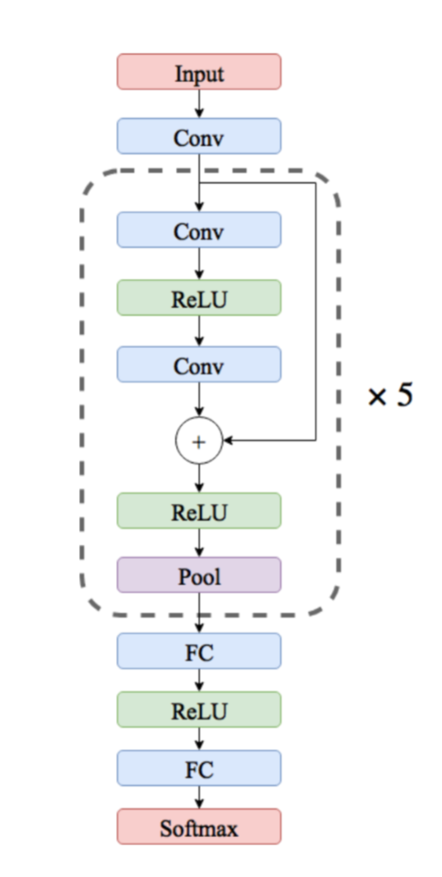
Model to beat : ResNet with CNNs
Simple pre-processing
  Resampling to 125 Hz
  Beat padded with zeros
1-D Convolutional Layers
  Skip connections
  32 kernels of size 5
  Max pooling of size 5 and stride 2
Fully Connected Layer of 32 neurons
Better results with ADASYN
Arrhythmia classification from ECG signals
Pagina <number>
Notes:
This is the best model we have found in the literature.
The input is a beat repersented as a sequence of 200 samples of 1 dimensional.
This deep neural network with convolutional layers , does not require a complex pre-processing because it has the ability to autonomous learn distinctive features through the various layers, from the most general to the most specific.
For example, we would expect the initial layers of that CNN to capture a beat as a simple smooth curve, and as we consider deeper layers, they capture more peculiarities such as the QRS complex, ST segment and so on.
It is easier to model a small variation to the input rather than a complete mepping
The convolutional layer is the building block of CNNs. It consists of a set of filters (or kernel), whose parameters are learned during the training.
each filter has a limited area called receptive field that is connected only to a small portion of the input to reduce the number of parameters. This technique as the name suggests is called parameter sharing and is based on the fact the same feature is present in multiple regions of the input
The point is that each layer operates at different pattern level detection: from more general to more specific patterns.

Slide 8
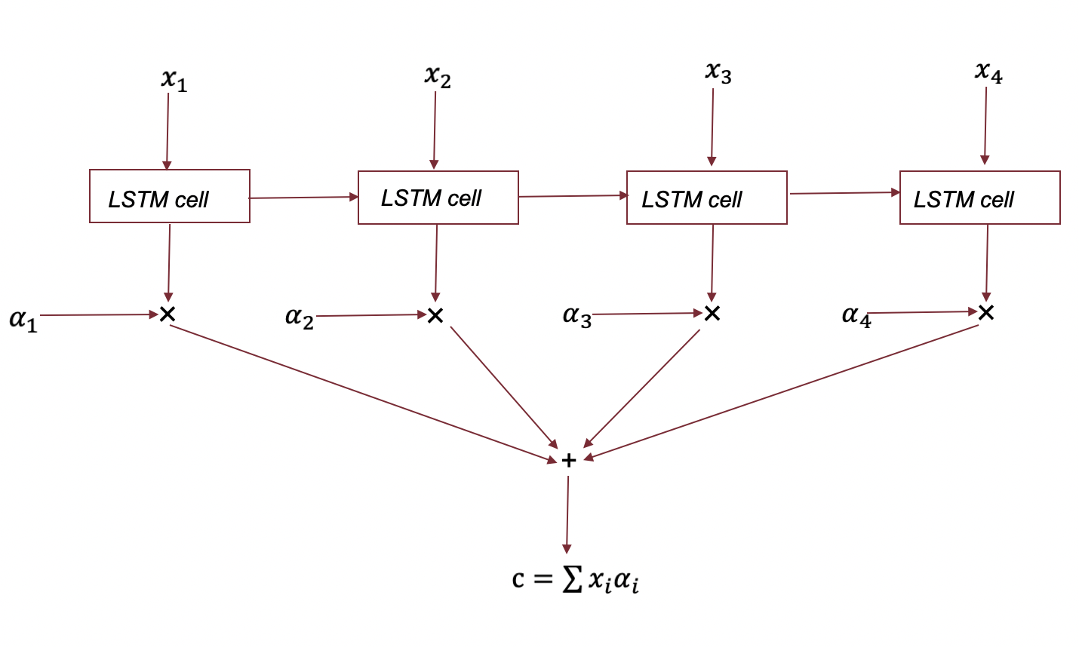
LSTM with Attention
  blabla
Arrhythmia classification from ECG signals
Pagina <number>
Notes:
This is the first model we have personally implemented taking into consideration the sequential nature of a beat
It is based on LSTM and Attention.
The LSTM allows to capture the spatial dependency inside a single beat in terms of PQRS complex.
The attention mechasim is used to explicitely give more importance to some portion of the input.
In particular the LSTM outputs a hidden state for each input, and the Attention mechanism computes a score that indicates how much that state is relevant for the final outcome.
The output is a contex vector computed as a weighted sum between all hidden stated and attention score
The second model born by the idea that the ECG signal could be considered as temporal time series with sequences made of single samples rather than multiple beats. The significance of this intuition was justified by the respectable outcome.
In the specific case of arrhythmia detection, it is required to capture the spatial dependency among samples, to detect features like the QRS complex, ST segment.
LSTM does not have the vanishing gradient problem so that it can models long term dependency
THE INPUT IS A SEQUENCE.
We added to the LSTM an attention mechanism following the trend in Natural Language Processing. Here we wanted to capture the fact that with respect to a particular arrhythmia, the model should pay more attention to some portion of the beat than others and in general, there are samples with low information content that must be ignored and others to give more weight. For example, we would expect samples in the QRS complex to have a higher attention weight than samples in the beat’s prologue. In the end, the best model we have implemented was LSTM with Luong’s Attention.
We compute a score for each hidden state and in the end for the whole sequence a single context vector is created that is the weighted sum of all the context vectors

Slide 9

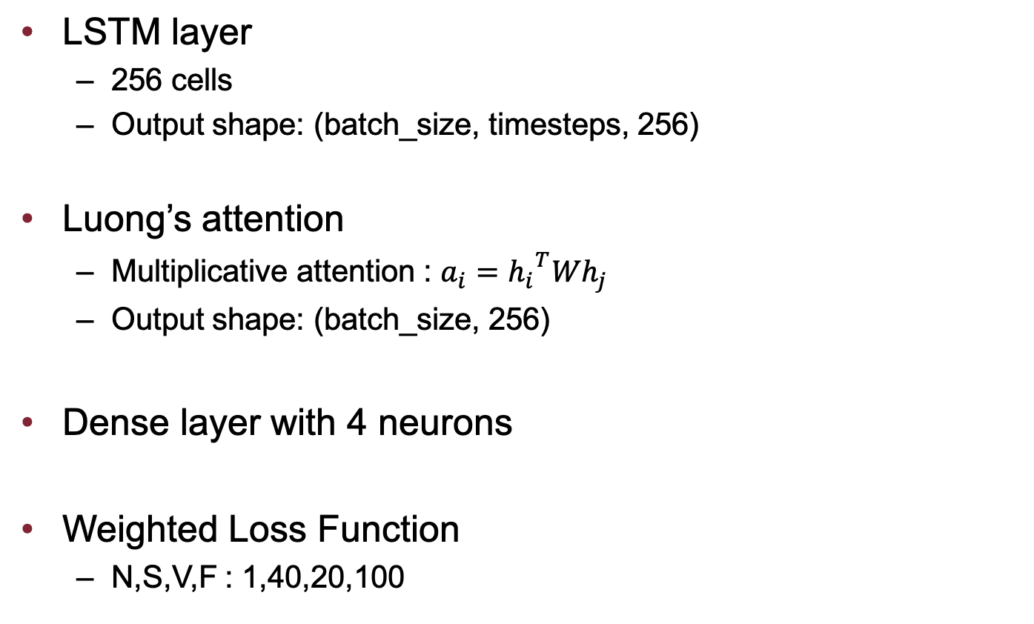




Our model: LSTM with Attention
Arrhythmia classification from ECG signals
Pagina <number>
Notes:
INPUT CONSISTS OF A SEQUENCE OF LENGTH 200 WITH 2 FEATURES
After we apply the LSTM, we turn the input into a sequence of lenght 200 with 256 features
Then when we apply the Luong’s attention the 200 vectors of size 256 are weigthed summed into a single vector of the same size
The attention score indicate the importance of a single hidden state wrt the last LSTM state for a given sequence: this is why it is a sort of self attention
We have used the luongs attention that is multiplicative and is optimized for GPU operations
There is also the additiva attention that tends to have similar results but is less optimized for vectorial operations

Slide 10











Our model: Neural ODE
First Block
  Residual structure
  2 Convolutional Layers + Pooling 32 kernels , padding=5 and stride=2
ODE Block
  2 Convolutional Layers
Last Block
  Pooling layer of size 10 and stride 5
  Flattening Layer
  2 Dense Layers with 32 and 4 neurons
Last Block with Attention
  LSTM with 128 cells
  Luong’ s attention
  Dense layer with 4 neurons
Arrhythmia classification from ECG signals
Pagina <number>
Notes:
In the ode block we define an initial value problem specifing a differential equation, an initial condition and an evaluation time.
The solution to it is the output of the block.
This approach has several benefits in terms of memory efficiency, adaptive computation and less parameters
The pooling is large enough to reduce the number of paramters without affecting the performance of the algorithm
In a second experiment We have added to this model an attention mechasim

Slide 11


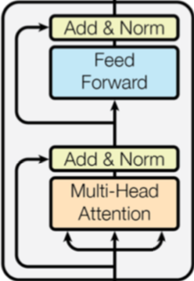




Our Model: Transfomer Based
First Block:
  CNN layer with 128 kernels of size 5
Transformer Encoder
  Fully Connected layers with 128 neurons
  4 heads
Last Block
  Fully Connected layer with 512 neurons
  Flatten layer
  2 dense: 256 and 4 neurons
Arrhythmia classification from ECG signals
Pagina <number>
Notes:
This model is based on the Transfomer.
Transformer ([36]) is a neural network architecture introduced in 2017 by Google research, for Natural Language Processing
The role of the first layer is to expand the dimension of the input: the transformer generally use an embedding but in our case we do not have a fixed dictionary
the encoder is made of 6 identical layers.
Each of them consists of two consecutive residual blocks where the first one is the self-attention layer, while the second one is a fully connected layer: they are both followed by a normalization layer.
This mechasim of attention can be used without Recurrent based models and in this way it can be parallelized

Slide 12
Evaluation
We compare our algorithms with the best previous approaches in detecting different types of arrhythmia
MIT BIH open source dataset :
  47 patient ECG recording of two channels each of 30 minutes sampled at 360 Hz
  Manually separated in beats (each R-peak is annotated)
  Manually annotated normal beats and arrhythmias (in 4 classes)
Performed various preprocessing (remove noise, data augmentation, etc.)
Arrhythmia classification from ECG signals
Pagina <number>

Slide 13
Unabalanced Dataset
The dataset is overbalanced
  N class is more than 80% of the whole data
Data Augmentation
  SMOTE
  ADASYN
Weighted Loss Function
Arrhythmia classification from ECG signals
Pagina <number>
Notes:
The dataset’s details will be discussed later: so far it is important to note it is overbalanced. In particular, the N class is more than 80% of the whole dataset. Models trained on imbalanced dataset do not acquire any generalization power: they are biased toward the most populated class and fail to detect the distinguishing features of the others. For example in our case, a model could reach a high accuracy during the train just by learning to always predict the same class.
Class imbalance is typical of biological dataset, where the interest is towards minor- ity samples that are linked to rare events ([21]). We have tried to solve this issue using the following methods: Smote, Adasyn and weighted loss function for neural networks.
Smote randmoly choose a new sample on the difference vector between rwo exisitng points.
Adasyn is an advanced version of Smote: the main difference is the first auto- matically detect the number of samples to generate: gi, with respect to the element.
In general, more samples will be created for samples whose neighbors belong to another class. The idea is that missing points should concentrate in the dataset space where a given element is under-represented.
A weighted loss function is used to give more weights and consequently importance to low represensent samples

Slide 14
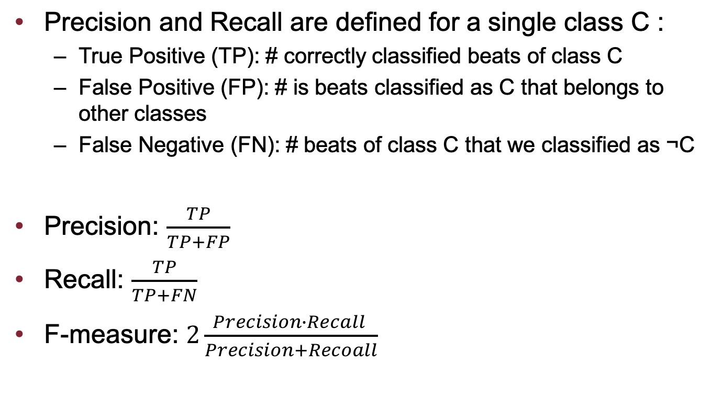
Performance criterion
Arrhythmia classification from ECG signals
Pagina <number>

Slide 15
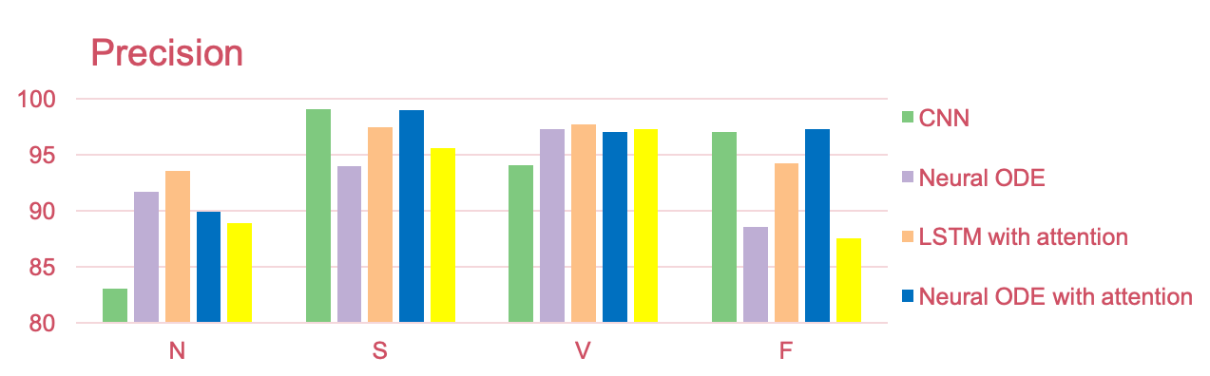
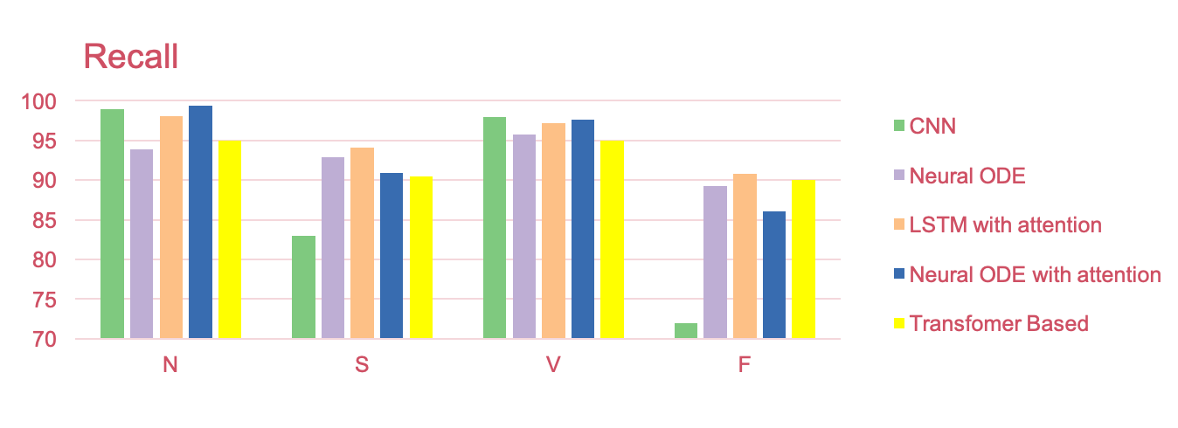
Results
Arrhythmia classification from ECG signals
Pagina <number>

Slide 16
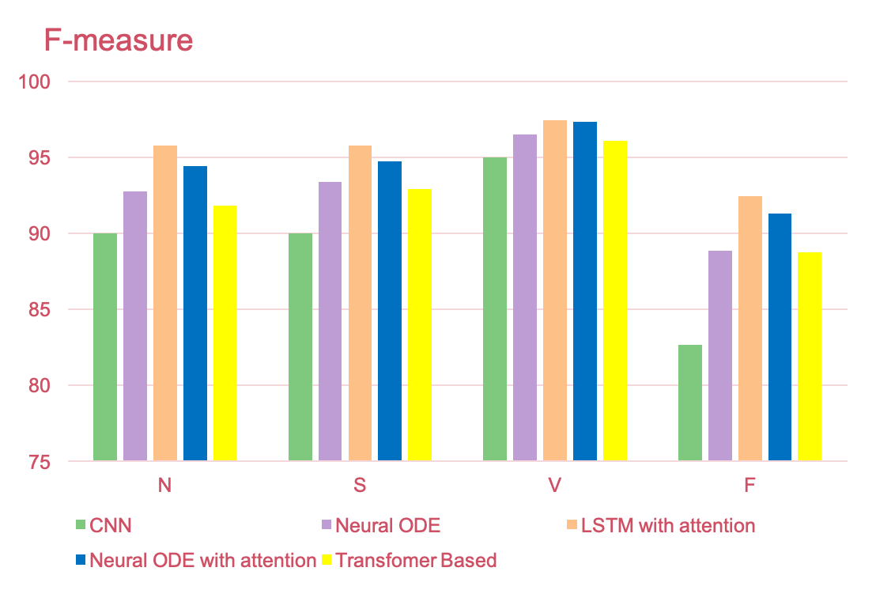
Results
Arrhythmia classification from ECG signals
Pagina <number>

Slide 17
Per Patient Dataset
Patient centric classifier
  Removed 3 patient from the data
  Global classifier: LSTM with Luong’s attention
Transfer learning
  Feature extraction + SVM
  Complete re-train
  Partial re-train: last 4 layers (best approach)
Arrhythmia classification from ECG signals
Pagina <number>
Notes:
Finally, we used a patient-centric approach. In particular, we wanted to imple- ment a model personalized for the end user, since our final goal was to implement an arrhythmia detection module on a wearable device. The approach we used was Transfer Learning and the outcome was good but there is a large margin of improvement. Initially, we used a pre-trained neural network as a feature extractor for the single and then SVM. The idea here is that the layers of a neural network learn features from the most general to the most specific, and in this way, the one before the last layer can be a good generalization.
As a second experiment, we first tuned all the model on a single patient and then only the last layers. Generally, the second technique is more popular because as we said before the initial layers of a neural network capture general features and only the final layers are focused on the peculiarities of the single patient. This is why also for our case, the latter approach tends to have a better score. However, for the evaluation we need to take into consideration some classes in the test data are low populated and statistically insignificant.
Better results can be obtained with more irregular beats for each patient, but this is not a good practice to solve the issue because in practice a user will experience for a long time regular beats, and the module still needs to find arrhythmias. In general, the confusion matrices in this case, show worse results than the previous situations with all the dataset. This means the general (lstm with luong’s att) model suffers from some sort of overfitting because it does not learn to generalize arrhythmias for completely new patients. However, the only solution to solve this issue is to acquire more data.

Slide 18
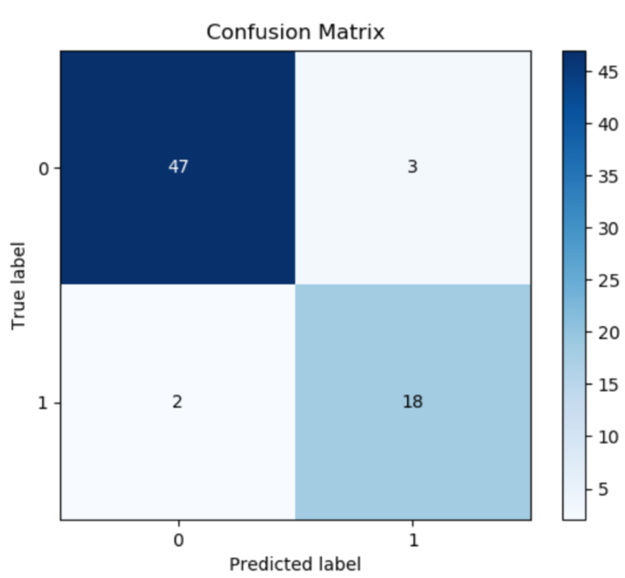
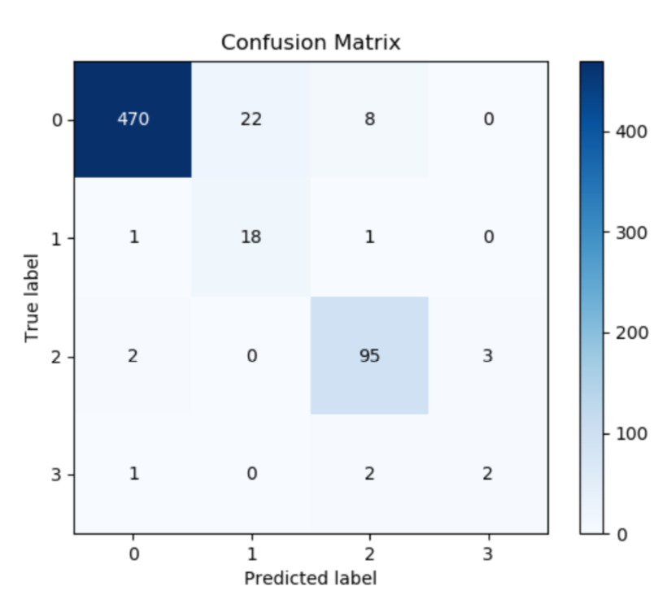
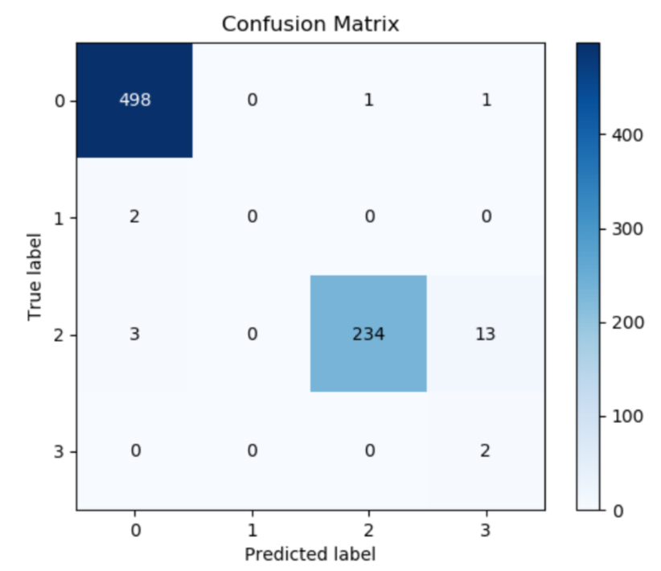
Results with Partial Retrain
Arrhythmia classification from ECG signals
Pagina <number>
Notes:
In this case the results are not as good as the previous experiments with all the dataset.
This means the global classifier is not able to generalize the discriminative features of new patients even after a fine tuning, and this is a symphthom of overfitting
In order to to solve this problem we should acquire more data so thtat the global classifier cuolb better understand the relevant features for low represnete classes

Slide 19
THANKS
Arrhythmia classification from ECG signals
Pagina <number>

